Slide 1
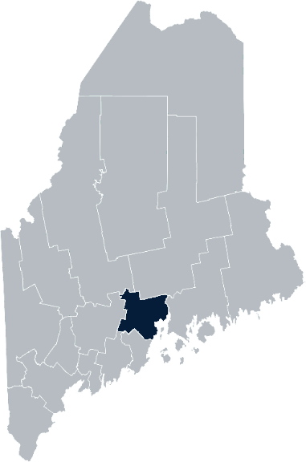
Maine Shared Community Health Needs Assessment Waldo County
2021
Notes:
Adrienne Gallant

Slide 2
The Maine Shared CHNA is a collaboration between the Maine Center for Disease Control and Prevention (Maine CDC), Central Maine Healthcare, Northern Light Health, MaineGeneral Health, and MaineHealth.
Notes:
Adrienne Gallant

Slide 3
Forum Agenda
Time | Activity | Speaker/Facilitator
3:30- 3:35 pm | Welcome | Adrienne Gallant, CHA Community Health Improvement
3:35- 3:40 pm | Overview of Zoom | Jo Morrissey, Maine Shared CHNA Program Manager
3:40 – 3:45 pm | Leadership Remarks | Kendra Emery, MD, Medical Director, CHA Community Health Improvement
3:45 – 3:55 pm | Review previous CHNA priorities and activities 2019-2021 | Drexell White, Public Health Liaison, Midcoast Public Health District Adrienne Gallant, CHA Community Health Improvement
3:55 – 4:15 pm | Presentation of key findings from the data | John Snow, Inc.
4:15 –4:40 pm | Break-out session – facilitated discussion on data and health priority identification | John Snow, Inc. & Local Facilitators
4:40 – 5:20 pm | Reconvene and Review | John Snow, Inc.
5:20 – 5:30 pm | Wrap up and next steps | Mark Fourre, MD, President, CEO, Pen Bay Medical Center and Waldo County General Hospital
Notes:
Adrienne Gallant
Introduce Jo Morrissey, Program Manager for the Maine Shared Community Health Needs Assessment to go over some housekeeping and background

Slide 4
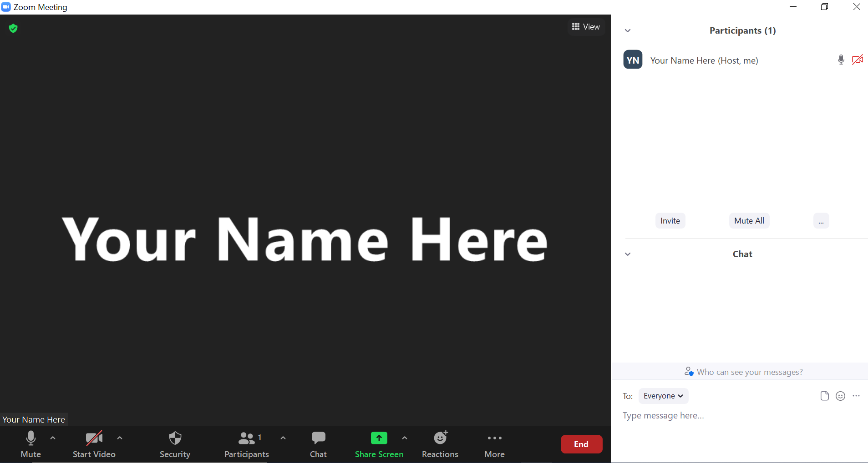
Share screen
Join Audio, Mute On/Off
Open/close participant list or chat
Turn Video On/Off
Reactions
Notes:
Jo

Slide 5
Matching Interests
Maine Shared
Community Health Needs Assessment
Images of PHAB and IRS from the internet
Notes:
Jo

Slide 6
The Evolution of an Idea…
2010 OneMaine | 2015 SHNAPP | 2018 Maine Shared CHNA | 2021 Maine Shared CHNA
Forums Surveys | 16 Forums 1639 Surveys | 22 Mainstream Forums (live) 2 Immigrant Forums 45 Interviews | 16+ Mainstream Forums (virtual) 10+ Community Sponsored Events 1500+ Oral Surveys
Notes:
Jo

Slide 7
Inputs and Outcomes
Ways to Provide Input
Data Collected
Outcomes
District & County Reports DUE APRIL 2022
4 Health Priorities by county
Related indicators
Gaps/barriers and resources/assets
Notable comparisons between attendee input and the data.
Description of those who provided input
Methodology
Mainstream county forums
Number of attendees
Where attendees live (not CSE)
List of data identified Forums and CSE only)
Discussion notes (Forums and CSE only)
Chat box comments (Forums and CSE only)
Health Priorities
Gaps and Resources
Community sponsored events
State Report DUE APRIL 2022
4 Health Priorities by Community Event and immigrant population.
Related indicators
Gaps/barriers and resources/assets,
Notable comparisons to mainstream population.
Description of those who provided input
Methodology
Oral Survey
Forums, Events and Surveys conducted Fall 2021
Notes:
Kendra Emery, MD, Medical Director, CHA Community Health Improvement will be providing leadership remarks
Jo or JSI
Community Sponsored Event Partners include
Disability Rights Maine (2 events: people who are deaf or hard of hearing and people with other disabilities)
Maine Primary Care Association (People who are served by Maine’s Federally Qualified Health Centers
Maine Council on Aging (Older Adults 65+
Consumer Right Council of Maine (people with a mental health diagnosis)
Formerly Incarcerated (Maine Prisoner Re-Entry Network)
Maine Youth Action Network and Friends (Raising the voices of Maine’s diverse youth)
Green Memorial A.M.E. Zion Church (Black/African American)
Health Equity Alliance (LGBTQ+ community)
Portland Recovery Center (for people with a substance use disorder or in recovery)
ADD HOUSING INSECURE IF NEED BE
ADD VETERAN IF NEED BE
Oral Survey Partners include:
City of Portland’s Minority Health Program
New Mainer’s Public Health Initiative
Maine Immigrant Access Network
Gateway Community Services
Maine Immigrant and Refugee Services
Maine Community Integration
Mano en Mano
We are piloting these additional outreach methods with support from
State of Maine’s Preventative Health and Health Services Block Grant
Maine Health Access Foundation
Introduce leader for leadership remarks

Slide 8
Leadership remarks
Notes:
Leadership remarks
Leader to introduce Drexell White, Public Health Liaison, Midcoast Public Health District
Adrienne Gallant, CHA Community Health Improvement
who will provide comments on recent health improvement efforts

Slide 9
Previous Health Improvement Efforts Waldo County: Highlights 2019-2021
Notes:
Jo to introduce Drexell White, Public Health Liaison, Midcoast Public Health District
Adrienne Gallant, CHA Community Health Improvement
who will provide comments on recent health improvement efforts

Slide 10
Pandemic Acknowledgement and Thanks
During this past CHNA cycle – COVID-19 became a public health focus for everyone.
This was and continues to be a focus of many of our partners’ outreach, planning, and every day activities.
COVID vaccination clinics held throughout both counties.
Notes:
Drexell and Adrienne
Number of COVID vaccination clinics and locations (CONTACT STEVE GARHARTT)
Number of vaccines delivered (include school vaccinations)
Acknowledge volunteers and employees that made clinics happen
Thank you. I’m Drexell White, the Maine CDC District Public Health Liaison for the Midcoast District. Welcome to everyone who took time to join us today and help us map out our Community Health Needs. I’d like to start with an acknowledgement of the times in which we live and the tremendous ongoing effort to keep Maine safe and healthy.
The vaccination numbers on the slide illustrate one part of the unprecedented effort undertaken by our healthcare, public health, and social services systems, as well as State, County and Local governments, non-governmental organizations, businesses and individuals throughout the State.
This has been an all-hands-on-deck effort affecting everyone. To all our thanks for your efforts and continued support..

Slide 11
Midcoast District Public Health Council
Midcoast Public Health District:
One of Nine (9) Public Health Districts in Maine
Includes Knox, Lincoln, Sagadahoc & Waldo Counties (73 Municipalities, including six island communities)
Midcoast Public Health Council (MPHC):
District Coordinating Council (DCC) for Public Health with Membership/ Representation from the District’s Four Counties, plus Brunswick & Harpswell
District Work 2019 -2021– Mental Health, Obesity, Elevated Lead Levels & Climate Change
Notes:
Drexell and Adrienne
The Midcoast Public Health District is one of 9 Public Health Districts in Maine; 8 geographic-based Districts and one population-based District serving the State’s indigenous tribes.
The Midcoast District has a public health unit that includes Public Health Nursing, District Epidemiology, Health Inspections, Drinking Water, and the District Liaison and Council Coordinator. In addition to its regular functions, the Public Health Unit has been focused on the support of the Covid 19 response.
Our District includes Waldo, Knox, Lincoln and Sagadahoc Counties encompassing 73 municipalities. One of the unique features of our District are the six island communities of Islesboro, Isle au Haut, North Haven, Vinalhaven and Monhegan.
Next Slide Please.

Slide 12
Midcoast Public Health Council Highlights
MPHC Committees:
Mental Health - Mental Health First Aid Training – 80 persons trained
Obesity – Promotion of low/no cost physical activity opportunities
Elevated Lead Levels – Collaborating with pediatric practices to increase screening
MPHC-sponsored panel discussions on:
Social Isolation, Aging, & Elder Abuse
Vaccine Hesitancy, and Vaccination Efforts in the District
Coping with Covid – Building Hope & Resiliency
Climate Change and its Public Health Implications
Notes:
Drexell and Adrienne
The Midcoast Public Health Council continued its work on mental health, obesity and elevated blood lead levels in children. Through funding made available through Maine CDC, the MPHC was able to conduct a series of Mental Health First Aid programs in the District, training 80 persons.
Our Obesity Committee sought out opportunities to promote low and no cost physical activity opportunities through local land trusts and conservancies.
And,, our lead committee collaborated with pediatric providers to create strategies to improve blood lead level screening in children.
The Midcoast Public Health Council meets five times per year, and continued to meet throughout the pandemic, offering a variety virtual panel discussions and presentations. Thanks to the MPHC Leadership, Council Members and Stakeholders for continuing to plan, meet and engage during these challenging times.
Thank you for this opportunity to provide Midcoast Public Health District and Council highlights, I’ll now turn it back to Adrienne Gallant.

Slide 13
Pen Bay Medical Center/Waldo County General Hospital CHNA 2019-2021 Priorities
Substance Use
Tobacco
Obesity & Diabetes
Food Insecurity
Notes:
Drexell and Adrienne
Before we delve into the next group of slides, I want to take a moment to mention that these upcoming slides are a snap shot of work done by the hospital and our community partner, the Knox County Community Health Coalition, with whom we collaborate on grant work to help move the needle on these health priorities. The work outlined here has been done between October 1, 2018 until September 2021. We fully recognize that we have many community partners who are also doing population health work in Knox County, many of which are here today. The
Onto our slides!
Next slide please

Slide 14
Substance Use
Education & Programs | Knox County Recovery Collaborative Waldo County Recovery Committee (WCRC) IMAT services at PBMC and WCGH Naloxone Quarterly online trainings 2,867 prescriptions written for PBMC 843 prescriptions written for WCGH Community Education—Knox County Community Health Coalition and WCRC Safe storage/disposal education workshops Medication take back Monthly prevention articles provided to schools Provided presentations to community and law enforcement on the importance of decreasing stigma Impairment detection trainings for local businesses, DHHS managers, CDS, others
Grant Work | HRSA Rural substance use disorder grant—PBMC Maine Prevention Services Grant—Knox County Community Health Coalition MeHAF grant—Knox County Community Health Coalition
Notes:
Drexell and Adrienne
As the years move forward, we continue to see the impact substance use has on individuals, families, and the community at large. Work by our hospitals and community partners continues to be done to increase access to treatment and/or provide education on the implications of substance use on the individual, families, and our community.
In 2018 a group of providers from multiple community organizations came together in Waldo County to form the Waldo County Recovery Committee. Knox County followed suit in 2019 forming the Knox County Recovery Collaborative. The purpose of the groups is to increase communication between organizations and help those struggling the many aspects of substance use.
Pen Bay Medical Center and Waldo County General Hospital continue to offer Integrated Medication Assisted Treatment to those dealing with opioid use disorder. Between Pen Bay and Waldo County General Hospital’s practices, psychiatric and health centers there are 20 IMAT providers.
Pen Bay received a federal planning grant in September of 2020 to look at the gaps in needs and resources for individuals with opioid use disorder. Through the grant, we were able to conduct a needs assessment and start developing a plan to addressing some of the gaps.
Over the past three years, Waldo County Recovery Committee and the Knox County Community Health Coalition provided a variety of community and provider focused trainings and partnered with law enforcement to support county wide county wide medication take back events.
Next slide please

Slide 15
Tobacco Use
Education & Programs | Referrals to Maine Tobacco Helpline from providers over 3 years 1,182 Knox County 1,129 Waldo County New tobacco policies 20 Knox County 20 Waldo County (2019-2021) Community education and trainings on: Vaping awareness and prevention Tobacco prevention and education QuitLink Sidekicks
Grant Work | Maine Prevention Services Grant Tobacco Prevention Coordinator—Knox County Community Health Coalition Tobacco Prevention Coordinator—Waldo County General Hospital
Notes:
Drexell and Adrienne
Tobacco use and tobacco prevention has been a focus across our counties. Work is done across sectors to develop policies, provide support for those that need or want to quit and educate people of all ages on the health risks of using tobacco and the need to become or remain tobacco free.
Over the past three years we’ve seen referrals from providers to the helpline increase each year.
Multiple trainings were provided to the community across both counties on vaping, tobacco prevention, the quitlink and the sidekicks program. Over 2500 people were reached with these trainings!
Next slide please

Slide 16
Obesity and Diabetes
Education & Programs | Let’s Go! 48 Knox County Sites 43 Waldo County Sites PBMC and WCGH Wellness 369 employees participated in 20 Works on Wellness programs Journey to Health classes 2,037 people registered for healthy eating and cooking, physical movement, and healthy mind and body classes 140 participants enrolled in fall prevention classes: Matter of Balance; Tai Chi for fall prevention and osteoporosis; Simple Fall Strategies National Diabetes Prevention Program
Grant Work | SNAP-Ed Nutrition education Grant SNAP-Ed Nutrition Educator—Waldo County General Hospital SNAP-Ed Nutrition Educator—Knox County Community Health Coalition Maine Prevention Services Grant (Let’s Go!)—PBMC and WCGH
Notes:
Drexell and Adrienne
As you can see here there are a number of programs in our county working on reducing the incidence and impact of obesity and diabetes. From Let’s Go! To SNAP-Ed to MaineHealth’s Diabetes Prevention program. There’s a large focus on helping our community eat healthy, move more and access fresh fruits and vegetables on a budget.
We’ve seen an increase in engagement from our LG! sites this year. With the interruption of COVID we were not sure if the program would rebound but sites were happy to re-engage to continue to provide healthy spaces for kids to learn. And with everything that schools have been going through they’ve been willing to work with our coordinator on revising their wellness policies (3 revised, 7 in the works).
Maine SNAP-Ed is a federally funded program that provides nutrition education services in settings like schools, food pantries, Head Starts, other child care settings, grocery stores and regional DHHS offices, and our SNAP-Ed coordinators have been working hard to get this information out to these organizations and sites.
908 nutrition education classes were provided by the SNAP Educators in both Knox and Waldo counties to youth of all ages as well as adults reaching almost 2500 participants.
SNAP-Ed in Waldo County collaborated with WIC, the Women, Infant and Children program, to create YouTube videos on how to make healthy meals.
SNAP-Ed in Knox County provided nutritional and menu guidance for the AIO weekend meal program.
The National Diabetes Prevention Program started being offered statewide October 2019. The program had to pivot quickly to a remote option in March of 2020. Since going remote we’ve seen an increase in participation in the program from both Knox and Waldo County residents (as well as across the state). The ability to participate in this program remotely has increased access to the program in a way that we didn’t anticipate.
Next slide please

Slide 17
Food Insecurity
Education & Programs | Rockland Farmer’s Market collaboration with SNAP $18,063 in SNAP sales $13,364 in Maine Harvest Bucks sales Provider practices provided emergency food bags to patients in need 195 bags distributed across both hospital systems Free veggies for patients at PBMC and WCGH Approx. 3,075 pounds of free veggies distributed at PBMC Approx. 2,326 pounds of free veggies distributed at WCGH Knox County Gleaners—Knox County SNAP-Ed
Notes:
Drexell and Adrienne
In Maine, people are living with food insecurity every day and Knox and Waldo counties are no different. Access to affordable fresh fruits and vegetables is a challenge for many of our residents. Over the past three years the hospitals and our community partners have been working to help those in need.
In the summer of 2019 PBMC partnered with the SNAP program and the Maine Federation of Farmer’s Markets to allow the use of SNAP benefits at the Rockland Farmer’s Market. As the summer progressed we saw an increase in the use of SNAP benefits. We also promoted the Harvest Bucks program: for every dollar spent, SNAP recipients would receive a dollar in harvest bucks that they could then use at the market to purchase fresh fruits and vegetables. The program was successful enough that the farmer’s market agreed to continue it for the following two summers (2020 and 2021). The program has continued to flourish!
Since December 2019, the hospital practices partnered with the Good Shepard Food Bank to distribute a total of 195 food bags to those identified as food insecure
Again in partnership with the Good Shepard Food Bank, under the Mainers Feeding Mainers initiative, PBMC and WCGH offered free veggies to patients. Between July and October of this year, both hospitals partnered with local farms to provide over 5,000 pounds of fresh vegetables to patients across both counties.
PBMC partnered with Maine Coast Heritage Farm for produce from Erickson Farm
WCGH partnered with Calyx Farm in Morrill
The SNAP-Ed coordinator for Knox County developed and expanded the Knox County Gleaners. Produce gleaned from farms was distributed among local food pantries, organizations and low-income senior residences. The coordinator also helped develop plans for a community kitchen where hands on classes can be taught and participants can gain cooking skills and understand how those skills can lead to a healthier life.
Now, I am happy to turn this back to JSI

Slide 18
How to Read the County Health Profiles and Health Equity Data Sheets
Notes:
JSI

Slide 19
How to Read County Health Profile
CHANGE shows statistically significant changes in the indicator over time, based on 95% confidence interval (see description on page 3).
ê | means the health issue or problem is getting better over time.
! | means the health issue or problem is getting worse over time.
○ | means the change was not statistically significant.
N/A | means there is not enough data to make a comparison.
BENCHMARK compares [COUNTY] data to state and national data, based on 95% confidence interval (see description on page 3).
ê | means [COUNTY] is doing significantly better than the state or national average.
! | means [COUNTY is doing significantly worse than the state or national average.
○ | means there is no statistically significant difference between the data points.
N/A | means there is not enough data to make a comparison.
ADDITIONAL SYMBOLS
* | means results may be statistically unreliable due to small numbers, use caution when interpreting.
— | means data is unavailable because of lack of data or suppressed data due to a small number of respondents.
EXAMPLE
Notes:
JSI or other facilitator
A star means that the health issue or problem is getting better over time or better in comparison to another place
A red exclamation point means that the health issue or problem is getting worse over time or worse in comparison to another place
A gray circle means that the dating hasn’t changed over time or isn’t much different in comparison to another place
N/A means that there was not enough data to be able to make a comparison
There are two additional symbols you might see:
A black dot means that you should use caution when interpreting the data – the results might be unreliable because of small numbers
A black dash means that data was unavailable, or that data was suppressed due to a small number of respondents
(Go to next slide and walk audience through an example)

Slide 20
How to Read County Health Profile
EXAMPLE
 | AROOSTOOK COUNTY |  |  | BENCHMARKS
INDICATOR | POINT 1 | POINT 2 | CHANGE | MAINE | +/- | U.S. | +/-
Individuals living in poverty | 2009-2011 15.6% | 2015-2019 16.1% | ¡ | 2015-2019 11.8% | ! | 2019 12.3% | N/A
Notes:
Here’s an example of how we’ve visualized the data in the County Health Profiles.
The charts in this presentation are all excerpts from the Data Health Profiles that were created by MaineHealth and the Maine CDC. They contain data pulled from publicly available sources that are designed to help people learn more about the health of their communities. Not all the data points are available for every measure, but we’ve included data wherever we can.
The green bars represent data from your community. The left most one represents a past data point, and the right bar represents the most recent data point available when the data was gathered. These are the same data points used in the Data Health Profiles.
The grey bars represent data for the state of Maine as a whole- on the left- and for the United States as a whole- on the right, when it is available.
We’ve also noted where differences in the data points are ‘statistically significant’. A difference between two measurements is significant when scientists can say, with a known degree of confidence, that the difference between them is large enough that the difference is most likely to be caused by an actual difference in the item being measured, and not caused by error associated taking the measurement. All of these tests are comparing the most recent data point for your community to other data points. A red exclamation mark indicates a difference that your community is significantly different in a less desirable direction compared to the data point with the symbol. A green star indicates that your community is significantly different in a more desirable direction. A grey circle indicates that there is no significant difference.
(keep in presentation – do not read for deaf/HOH event or people with disabilities). A difference between two measurements is significant when scientists can say, with a known degree of confidence, that the difference between them is large enough that the difference is most likely to be caused by an actual difference in the item being measured, and not caused by an error associated taking the measurement. All of these tests are comparing the most recent data point for your community to other data points.
For example, in this slide, we have two symbols. The grey circle next to the measurement for 2009-2011 Aroostook County means that there is no significantly different change in the rate of poverty in Aroostook County when comparing the data from 2009-2011 to the data from 2015-2019. The red exclamation mark next to the Maine data point says there is a significant difference between 2015-2019 Aroostook County and 2015-2019 Maine, and that it is less desirable that Aroostook County has a higher rate of individuals living in poverty. No comparison could be made to the data for the U.S. because the years of data collection were different.

Slide 21
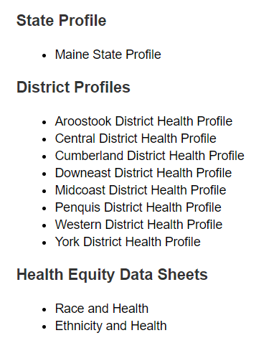
For More Data
www.mainechna.org
Notes:
The Maine Shared CHNA website contains health profiles for 3 of Maine’s largest cities, 16 counties, 5 public health districts, the state, as well as data provided by race, ethnicity, educational attainment, gender, sexual orientation, older adults, insurance status, income, and rurality.
IN addition, there is an interactive data portal where you can search by specific data points. All these breakdowns are then provided by data point.
REGARDING COVID-19 DATA
The Maine Shared CHNA data set does not include any data of COVID-19. This is largely due to the fact that there is a much more up-to-date and comprehensive Maine Data Dashboard continually being updated on the Maine CDC website.
Here you can find daily lab results, new case counts by date, trends, county breakdowns, data by race, and comparisons to other states and the nation.

Slide 22
Key Findings
Notes:
As we walk through the following data slides together, take notes. What surprises you? What stands out? What’s moving in the wrong direction?
Once the data presentation is over, you will be divided into breakout groups to discuss the data, share your top concerns, identify your top priorities, and share your knowledge about what’s working and what we need to work on to addres those top concerns.
Ready? Here we go.

Slide 23
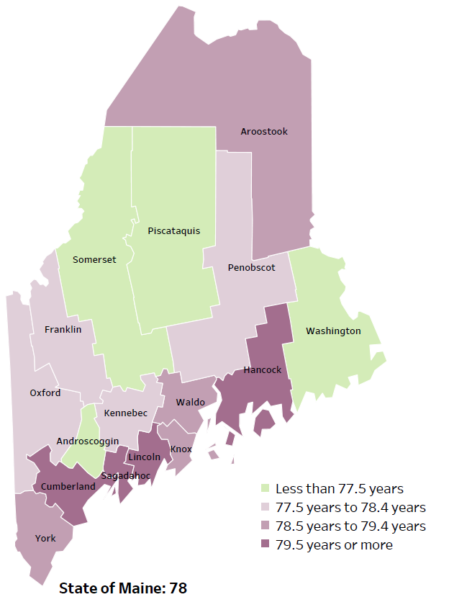
Demographics
Life Expectancy
2017-2019
National Center for Health Statistics,
CDC
RANK | MAINE | WALDO COUNTY
1 | Cancer | Cancer
2 | Heart Disease | Heart Disease
3 | Unintentional Injury | Chronic Lower Respiratory Disease
4 | Chronic Lower Respiratory Disease | Unintentional Injury
5 | Stroke | Diabetes
Notes:
The life expectancy in Waldo County is 78.6, which is the same as the state average of 78.7. Waldo Count’s life expectancy is the 7th oldest in the state, placing it in the middle of the counties. This is an indication that fewer people are dying at younger ages than residents in many other counties in Maine.
The table on the right side of the slides shows the five leading causes of death in Waldo County. Diabetes is a leading cause of death in Waldo County, which is not one of the leading causes in the state.
The leading cause of death is cancer, the same as the state leading cause of death. As we will see later in the presentation, Waldo has a high rate of coronary heart disease, heart failure and obesity, which is reflected as the leading cause of death.
Some highlights:
In Waldo County and Maine overall, the leading cause of death is Cancer followed by Heart Disease. The opposite is true in the U.S. overall- Heart Disease is the leading cause of death, and cancer is the 2nd leading cause. One of the reasons that this is true is because we have higher rates of risk factors for cancer, such as smoking/tobacco use. At the same time, there has been a lot of success implementing treatment of heart disease, resulting in folks with heart disease living longer.
The 3rd leading cause of death- Unintentional Injury- includes a number of accidental causes: Three of the most common causes are i) Deaths due to motor vehicle crashes, ii) deaths due to accidental falls, iii) deaths due to poisonings that either were unintentional, or the intent was undetermined. Some Firearm deaths may also be classified as unintentional. Suicides, some Firearm deaths and some Poisoning deaths are classified as intentional injury.

Slide 24
Demographics
Age distribution for Waldo County
AGE
WALDO COUNTY
POPULATION
39,539
STATE OF MAINE
POPULATION
1,362,359
Notes:
Waldo County has the 6th smallest population of any Maine County. The population is aging. There are fewer children and young adults and more adults over the age of 65, and fewer adults of the age where they might expect to have children.
Source: US Census Bureau, American Community Survey

Slide 25
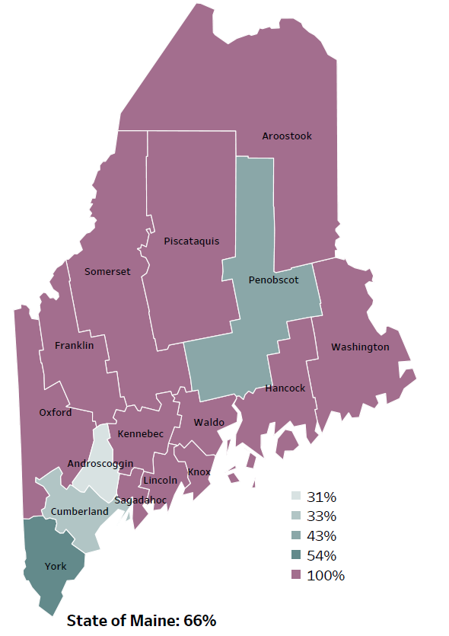
Demographics
Percentage of people living in
rural areas
2019
New England Round Table for Rural Health
Notes:
Waldo County is one of 12 counties with no population in a metro area. These data are based on the most recent Census estimates at the Zip-code level, and calculated use rural Urban Commuting Area codes. The categories were established by the New England Rural Health Association. This data is NOT comparable to 2010 US Census data on populations living in rural areas, as that data uses a different definition for rural.
Source: Data, Research and Vital Statistics town-level population file

Slide 26
Health Indicators
Notes:
Ambulatory care sensitive conditions are ones for which good outpatient care can potentially prevent the need for hospitalization or early intervention can prevent the progression or severity of the disease. A few examples of this type of condition are asthma, atrial fibrillation, gastroenteritis and pneumonia. As this chart shows the rate of Waldo County residents seeking treatment for an ambulatory-care condition is significantly higher than the overall state rate. This indicates people are going to the emergency department for conditions that could be treated with outpatient care or would benefit from early intervention.
We have calculated the rates so that they can be compared to other parts of the state that might have a population with a different mix of ages. Older people tend to have higher rates of many diseases and health conditions. It’s important to adjust for age so that we don’t accidentally mistake a place with older people for a place with an unusual number of disease-related deaths.
Data Source: Maine Health Data Organization Hospital Inpatient and Outpatient Databases
Read as needed - Definition: Rate per 10,000 people of emergency department discharges with a principal diagnosis of an ambulatory care-sensitive condition. ACSCs are conditions for which good outpatient care can potentially prevent the need for hospitalization, or for which early intervention can prevent complications or more severe disease.

Slide 27
Health Indicators
Notes:
The percentage of up-to-date breast cancer screenings in Waldo County is lower than the overall state rate. This difference is significant. Screenings are important for early cancer detection, cases that are more easily treated and have a higher survival rate.
Data Source: Behavioral Risk Factor Surveillance System
American Cancer Society -https://www.cancer.org/cancer/breast-cancer/screening-tests-and-early-detection/american-cancer-society-recommendations-for-the-early-detection-of-breast-cancer.html Definition: Percentage of females, ages 50 years and older, who had a mammogram within the past 2 years. Data collected in even numbered years.

Slide 28
Health Indicators
Notes:
Coronary heart disease deaths in Waldo County have decreased over time. As you can see, the rate remains higher than the state. This difference is significant. Coronary heart disease limits the blood flow in the heart due to plaque buildup in the arteries. High cholesterol can lead to coronary heart disease.
Data Source: Maine CDC Vital Records
CDC- https://www.cdc.gov/heartdisease/coronary_ad.htm
To be read as needed - Definition: Rate per 100,000 people of deaths with coronary heart disease as an underlying cause of death.
Age-adjusted definition: We have calculated the rates so that they can be compared to other parts of the state that might have a population with a different mix of ages. Older people tend to have higher rates of many diseases and health conditions. It’s important to adjust for age so that we don’t accidentally mistake a place with older people for a place with an unusual number of disease-related deaths.

Slide 29
Health Indicators
Notes:
Waldo County residents are significantly more likely to be hospitalized due to a heart attack when compared to the state.
Data Source: Maine Health Data Organization Hospital Inpatient Database
To be read as needed – Definition: Rate per 10,000 people of hospital discharges with a principal diagnosis of a heart attack.
Age Adjustment definition: We have calculated the rates so that they can be compared to other parts of the state that might have a population with a different mix of ages. Older people tend to have higher rates of many diseases and health conditions. It’s important to adjust for age so that we don’t accidentally mistake a place with older people for a place with an unusual number of disease-related deaths.

Slide 30
Health Indicators
Notes:
Similar to the previous slide, Waldo County residents are significantly more likely to be hospitalized due to a heart failure when compared to the state. The rate has decreased since 2016-2017, but not significantly. Heart failure is a long-term condition that prevents the heart from pumping sufficient blood throughout the body, while a heart attack occurs when blood flow is constricted in the heart.
Data Source: Maine Health Data Organization Hospital Inpatient Database
Cedars Sinai- https://www.cedars-sinai.org/blog/heart-attack-cardiac-arrest-and-heart-failure.html
Read as needed - Definition: Rate per 100,000 people of deaths with heart attack as an underlying cause of death.
Age Adjustment definition: We have calculated the rates so that they can be compared to other parts of the state that might have a population with a different mix of ages. Older people tend to have higher rates of many diseases and health conditions. It’s important to adjust for age so that we don’t accidentally mistake a place with older people for a place with an unusual number of disease-related deaths.

Slide 31
Health Indicators
Notes:
This chart shows the rate of hospitalization for pneumonia are higher in Waldo County when compared to the state. The difference is significant. The rate is improving within the county but is not a significant change.
Data Source: Maine Health Data Organization Hospital Inpatient Database
Definition: Rate per 10,000 people of hospital discharges with a principal diagnosis of pneumonia.
Age Adjustment definition: We have calculated the rates so that they can be compared to other parts of the state that might have a population with a different mix of ages. Older people tend to have higher rates of many diseases and health conditions. It’s important to adjust for age so that we don’t accidentally mistake a place with older people for a place with an unusual number of disease-related deaths.

Slide 32
Health Indicators
Notes:
Obesity rates are rising among 7th and 8th grade students in Waldo County. There has been a significant increase between 2017 and 2019. The rate is also higher than the state, but the difference is not significant.
Data Source: Maine Integrated Youth Health Survey Definition: Percentage of seventh- and eighth-grade students who were obese (i.e., at or above the 95th percentile for body mass index, by age and sex). Data collected in odd numbered years.

Slide 33
Health Indicators
Notes:
High school students in Waldo County are significantly more likely to drink one or more, soda or sports drinks per day when compared to the state overall. Data for this indicator is collected in odd numbered years.
Data Source: BRFSS
Read as needed - Definition: Percentage of high school students who drank at least one can, bottle, or glass of sugar-sweetened beverages per day during the past week. Data collected in odd numbered years.

Slide 34
Health Indicators
Notes:
The rate of births to 15-19 year-olds in Waldo County is significantly higher than the state rate. Teen birth is associated with myriad consequences to the both the mother and child, including lower educational attainment, medical complications, mental health issues and reduced earnings.
Data Source: Maine CDC Vital Records
World Health Organization- https://www.who.int/news-room/fact-sheets/detail/adolescent-pregnancy
Definition: Rate per 1,000 women, ages 15-19 years, who gave birth.

Slide 35
Health Indicators
Notes:
This chart shows that slightly less than three-quarters of mothers in Waldo County received more than 80% of expected prenatal visits. This is significantly lower than the state overall. Routine prenatal care reduces the risk of complications to both the mother and baby and provided nutritional and medical education.
Data Source: Maine CDC Vital Records
National Institute of Health - https://www.nichd.nih.gov/health/topics/pregnancy/conditioninfo/prenatal-care Definition: Percentage of new mothers who had more than 80% of the expected prenatal visits.

Slide 36
Health Indicators
Notes:
Women in Waldo County are significantly more likely to have smoked during pregnancy when compared to the state. The rate has improved slightly within the county, but the change is not significant. Nicotine exposure in utero can lead to preterm birth, low birth weight and increases the risk of birth defects and SIDS.
Data Source: Maine CDC Vital Records CDC - https://www.cdc.gov/tobacco/basic_information/health_effects/pregnancy/index.htm
Definition: Percentage of new mothers who smoked cigarettes at any time during pregnancy.

Slide 37
Health Indicators
Notes:
The rates of children screened for lead between 24 and 35 months within Waldo county increased between 2018 and 2019, but screening rates remain significantly lower than the state overall and are not significantly different from 2011. Lead testing is important given Maine’s older housing stock and the potential problems associated with childhood lead exposure.
Data Source: Maine CDC Childhood Lead Poisoning Prevention Unit
To be read as needed - Definition: Percentage of children, ages 24-35 months, who have had their blood tested for elevated blood lead levels.

Slide 38
Health Indicators
Notes:
This graph shows Waldo County residents 65 or older who have received the pneumococcal pneumonia vaccine. The County’s rate is significantly lower than the State’s. While Waldo County’s rate is lower than the U.S., the data for significance testing was not present.
Data Source: Behavioral Risk Factor Surveillance System
Read as needed - Definition: Percentage of adults, ages 65 and older, who have ever had a pneumonia vaccine.

Slide 39
Health Indicators
Notes:
The rate of fall related deaths within Waldo County have increased significantly since 2007-2011 and is now the same as the state rate.
Data Source: Maine CDC Vital Records
Read as needed - Definition: Rate per 100,000 people of deaths due to unintentional falls.
Age Adjustment definition: We have calculated the rates so that they can be compared to other parts of the state that might have a population with a different mix of ages. Older people tend to have higher rates of many diseases and health conditions. It’s important to adjust for age so that we don’t accidentally mistake a place with older people for a place with an unusual number of disease-related deaths.

Slide 40
Health Indicators
Notes:
Waldo County has a significantly higher rate of ER discharges due to an unintentional fall-related injury than the State overall. This measure has been age-adjusted, so it cannot be attributed to Waldo counties older residents.
Data Source: Maine Health Data Organization Hospital Inpatient and Outpatient Databases
To be read as needed - Definition: Rate per 10,000 people of emergency department discharges with a diagnoses of a fall-related injury.
Age Adjustment definition: We have calculated the rates so that they can be compared to other parts of the state that might have a population with a different mix of ages. Older people tend to have higher rates of many diseases and health conditions. It’s important to adjust for age so that we don’t accidentally mistake a place with older people for a place with an unusual number of disease-related deaths.

Slide 41
Health Indicators
Notes:
The rate of deaths due to motor vehicle accidents has increased within the county between 2007-2011 and 2015-2019. The rate is also higher than the overall state rate. This difference is significant.
Data Source: Maine CDC Vital Records Definition: Rate per 100,000 people of deaths due to unintentional motor vehicle crashes.
Age-adjusted definition: We have calculated the rates so that they can be compared to other parts of the state that might have a population with a different mix of ages. Older people tend to have higher rates of many diseases and health conditions. It’s important to adjust for age so that we don’t accidentally mistake a place with older people for a place with an unusual number of disease-related deaths.

Slide 42
Health Indicators
Notes:
This chart shows the rate of Traumatic brain injuries being treated in the emergency room. Waldo county has a significantly higher rate than the state. A TBI occurs when a sudden trauma, such as a car accident or sports injury, causes damage to the brain. Symptoms include confusion, dizziness, mood changes, impaired memory and headaches. This symptoms can be ongoing and persistent.
Data Source: Maine Health Data Organization Hospital Inpatient and Outpatient Databases
National Institute of Health - https://www.ninds.nih.gov/Disorders/All-Disorders/Traumatic-Brain-Injury-Information-Page
Definition: Rate per 10,000 people of emergency department discharges with a diagnoses of traumatic brain injury.
Age Adjustment definition: We have calculated the rates so that they can be compared to other parts of the state that might have a population with a different mix of ages. Older people tend to have higher rates of many diseases and health conditions. It’s important to adjust for age so that we don’t accidentally mistake a place with older people for a place with an unusual number of disease-related deaths.

Slide 43
Health Indicators
Notes:
This chart shows the percentage of adults who have been seen by a dentist for any reason within the past year. Those in Waldo county are less likely to be seen when compared to the state overall, but the difference is not significant. The difference between Waldo county and the US overall is significant.
Data Source: Behavioral Risk Factor Surveillance System Definition: Percentage of adults who visited the dentist or a dental clinic for any reason in the past 12 months. Data collected in even numbered years.

Slide 44
Health Indicators
Notes:
This measure shows the percentage of adults who have lost 6 or more teeth due to tooth decay or gum disease. As you can see, the percentage of adults in Waldo county who have dealt with tooth loss is higher than the overall state rate. This is a significant difference.
Data Source: Maine Health Data Organization Hospital Inpatient and Outpatient Databases
Read as needed - Definition: Percentage of adults who have lost six or more teeth due to tooth decay or gum disease. Data collected in even numbered years.

Slide 45
Health Indicators
Notes:
This slide shows the rate of infants who have been born addicted to or severely impacted by a substance. This data is collected from healthcare providers who report there is a reasonable cause to suspect the baby has been affected by an illegal substance or is demonstrating withdrawal symptoms. The line graph shows the trend from 2011-2017. These single year data are not as reliable as the most recent two year, but still show a clear increase. The two-year rate of drug-affected infants born in Aroostook County is significantly higher than the State overall. The data shows the average annual rate for the two years, and therefore can be compared to the single year data. There is a concern given the birth and health risk associated with drug exposure in utero.
Data Source: Maine CDC Vital Records
Read as needed - Definition: Rate per 1,000 births of infants for which a healthcare provider reported that there was reasonable cause to suspect the baby may be affected by illegal substance abuse or demonstrating withdrawal symptoms resulting from prenatal drug exposure or has a fetal alcohol spectrum disorder.

Slide 46
Health Indicators
Notes:
Marijuana use among adults within Waldo County has increased significantly over time. The percentage is also higher than the state, but the difference is not significant.
Data Source: Behavioral Risk Factor Surveillance System Definition: Percentage of adults who used marijuana during the past 30 days.

Slide 47
Health Indicators
Notes:
This graph shows a significant decline over time in reported binge drinking among high school students. Binge drinking is defined as consuming 5 or more alcoholic drinks on at least one day in the past 30 days. This chart is missing 2013 data (insufficient responses rate) and 2017 data, which we are still working to get.
The data in the profile may look different. We have realized that 2017 and 2019 data in the Profile use a different denominator – only including those HS students who report any drinking. So, for 2019, 44.3% of students who reported drinking at all in the last 30 days also reported binge drinking. This translates to 12.3% of ALL HS students who reported binge drinking. Waldo County HS students binge drink significantly more than all Maine HS students.
Data Source: Maine Integrated Youth Health Survey
To be read as needed - Definition: Percentage of high school students who had five or more alcoholic drinks on at least one day in the last 30 days. Data collected in odd numbered years.

Slide 48
Health Indicators
Notes:
Environmental tobacco smoke exposure among high school students has remained stable in Waldo County between 2017 & 2019. Environmental smoke exposure is defined as being in the same room as someone who was smoking cigarettes at least one day during the past seven days. Waldo County’s rate is significantly higher compared to the State’s rate of exposure.
Data Source: Maine Integrated Youth Health Survey Definition: Percentage of high school students who were in the same room with someone who was smoking cigarettes at least one day during the past seven days. Data collected in odd numbered years.

Slide 49
Health Indicators
Notes:
Environmental tobacco smoke exposure among middle school students has increased in Waldo County between 2017 & 2019. Similar to high school students, Waldo County’s rate of 7th and 8th grade students exposed to tobacco smoke is significantly higher than the State’s rate of exposure.
Data Source: Maine Integrated Youth Health Survey
To be read as needed - Definition: Percentage of high school students who were in the same room with someone who was smoking cigarettes at least one day during the past seven days. Data collected in odd numbered years.

Slide 50
Health Indicators
Notes:
This slide shows Waldo County high school students who reported of feeling sad and hopeless for two weeks or more during the past 12 months and caused them to stop doing some of their usual activities. Depression in adolescence is linked with increased risks for negative effects on growth and development, school performance, and peer/family relationships in later adolescence. The precent has increased in Waldo County between 2017 and 2019. Waldo County’s rate is significantly higher than the overall State.
Data Source: Maine Integrated Youth Health Survey
Adolescent Mental Health Data.pdf (ucsf.edu)
Definition: Percentage of high school students who felt so sad or hopeless almost every day for two weeks or more in a row during the past 12 months that they stopped doing some usual activities. Data collected in odd numbered years.

Slide 51
Breakout Discussions

Slide 52
Reconvene

Slide 53
Wrap up and Next Steps

Slide 54
Contact
Cathy Cole, Regional Director, Education, Lincoln Health, Pen Bay Medical Center and Waldo County General Hospital, Cathy.Cole@lchcare.org
Drexell White, District Liaison, Midcoast District, Maine CDC, Drexell.R.White@maine.gov
Jo Morrissey, MPH, Maine Shared CHNA, info@mainechna.org
www.mainechna.org

