Slide 1
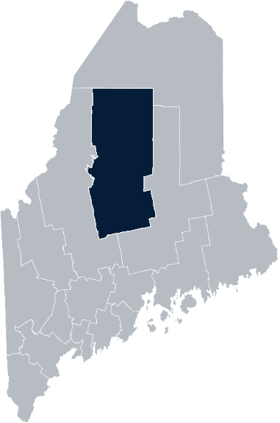
Maine Shared Community Health Needs Assessment Piscataquis County
2021

Slide 2
Welcome
Introductions
Overview of Tools
Purpose
Notes:
Local Planning Committee Member

Slide 3
The Maine Shared CHNA is a collaboration between the Maine Center for Disease Control and Prevention (Maine CDC), Central Maine Healthcare, Northern Light Health, MaineGeneral Health, and MaineHealth.
Notes:
Local Planning Committee Member

Slide 4
Thank you, forum sponsors
Bangor Public Health and Community Services | Northern Light Eastern Maine Medical Center
Health Access Network | Northern Light Mayo Hospital
Helping Hands with Heart | Northern Light Sebasticook Valley Hospital
Maine Center for Disease Control and Prevention | Penobscot Community Health Care
Millinocket Regional Hospital | Penobscot Valley Hospital
Northern Light Acadia Hospital | St. Joseph Healthcare & Hospital
Northern Light CA Dean Hospital | United Way of Eastern Maine
Notes:
Local Planning Committee Member

Slide 5
Forum agenda
Time | Activity | Piscataquis
1:00 – 1:05 pm | Welcome and introductions | Deidre Gilbert, Director of Pharmacy, Northern Light CA Dean Hospital
1:05 – 1:10 pm | Overview of Zoom tools and purpose of forum | Jo Morrissey, Maine Shared CHNA Program Manager
1:10 – 1:15 pm | Leadership remarks | Marie Vienneau, President, Northern Light CA Dean Hospital and Northern Light Mayo Hospital
1:15 – 1:20 pm | Review previous CHNA priorities and activities since last effort | Nicole Hammar, Manager, Community Health Improvement, Northern Light Health
1:20 – 1:45 pm | Presentation of key findings from the data | John Snow, Inc.
1:45 – 2:40 pm | Break-out session – facilitated discussion on data and health priority identification | John Snow, Inc. & Local Facilitator(s)
2:40 – 2:42 pm | Reconvene and Review | Jo Morrissey, Maine Shared CHNA Program Manager
2:43 – 3:00 pm | Wrap up and next steps | Hillary Starbird, Director, Community Outreach, Northern Light Mayo Hospital
Notes:
Local Planning Committee Member to go over agenda and then turn it over to Jo Morrissey to provide an overview of the Zoom tools available and the purpose of today’s forum

Slide 6
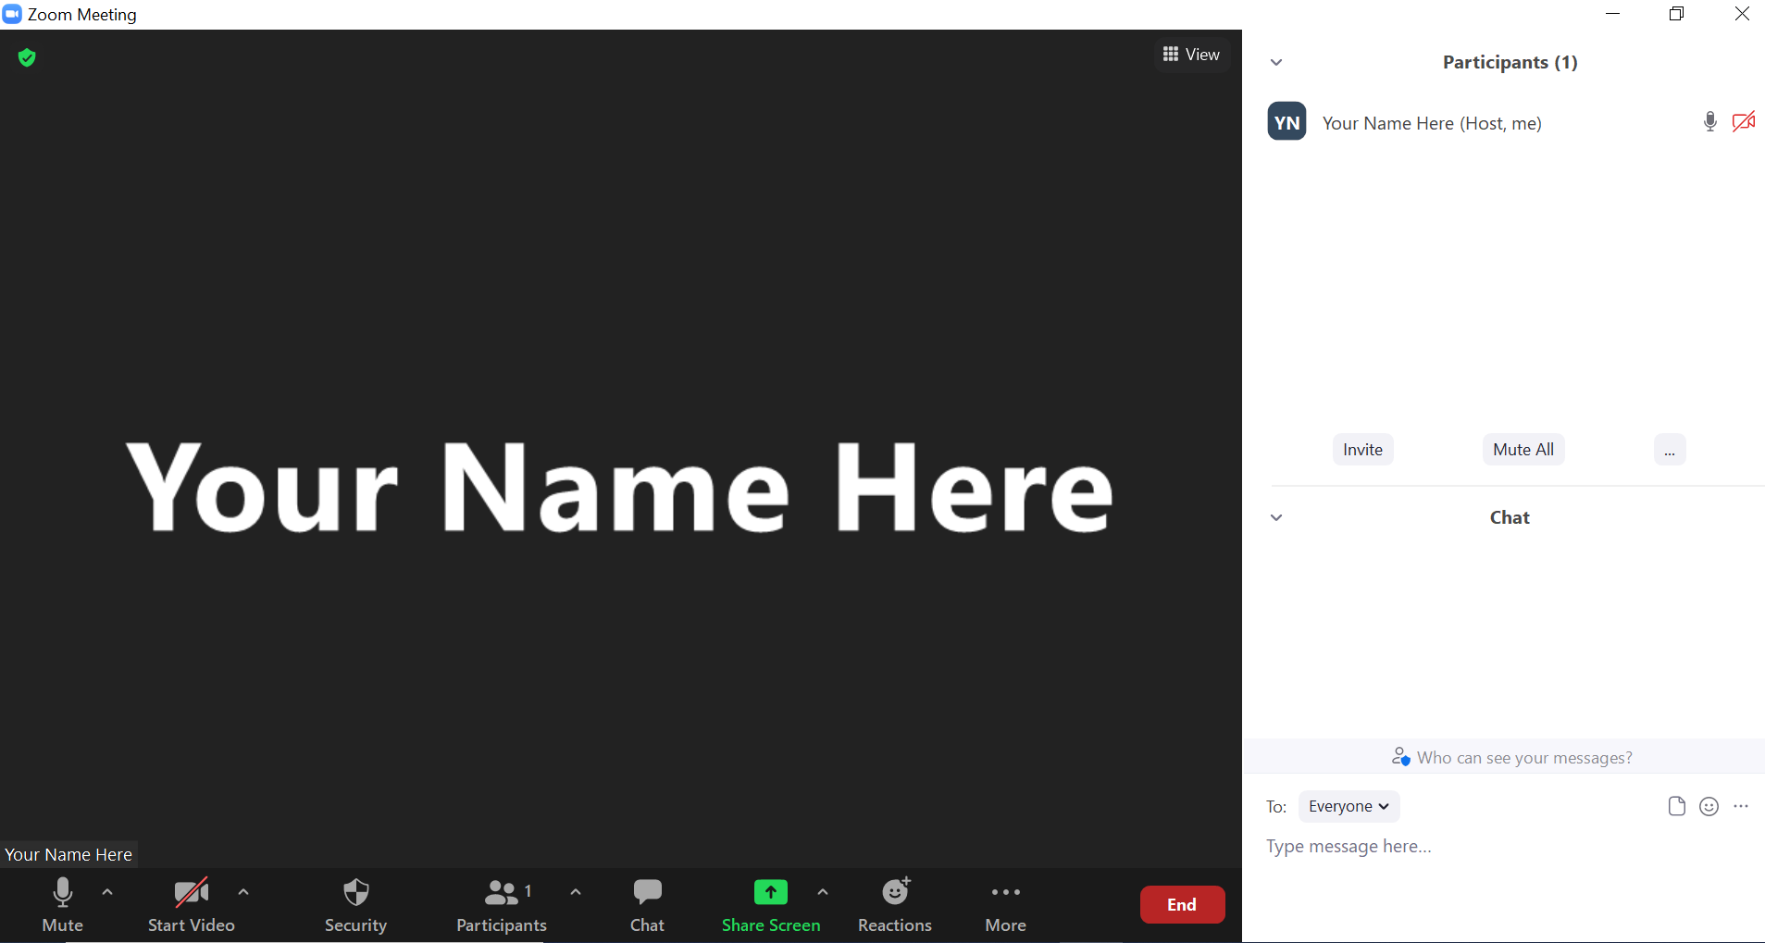
Share screen
Join Audio, Mute On/Off
Open/close participant list or chat
Turn Video On/Off
Reactions
Notes:
Jo or JSI

Slide 7
Matching Interests
Maine Shared
Community Health Needs Assessment
Images of PHAB and IRS from the internet
Notes:
Jo or JSI

Slide 8
The Evolution of an Idea…
2010 OneMaine | 2015 SHNAPP | 2018 Maine Shared CHNA | 2021 Maine Shared CHNA
Forums Surveys | 16 Forums 1639 Surveys | 22 Mainstream Forums (live) 2 Immigrant Forums 45 Interviews | 16+ Mainstream Forums (virtual) 10+ Community Sponsored Events 2000+ Oral Surveys
Notes:
Jo or JSI

Slide 9
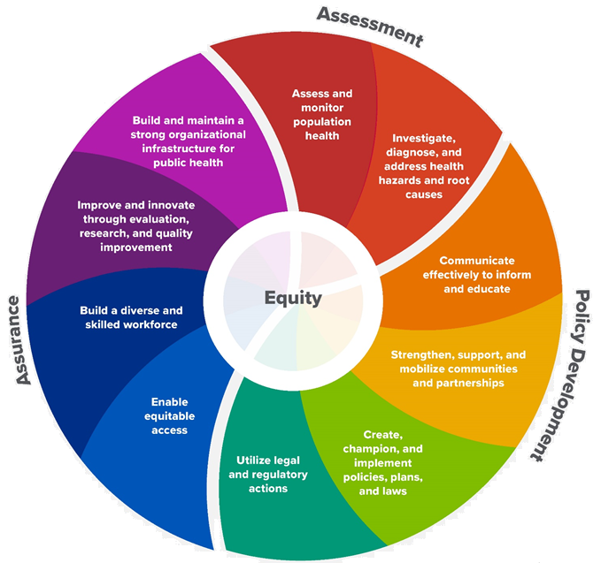
10 Essential Public Health Services
Notes:
Jo or JSI

Slide 10
Maine Shared CHNA Organizational Chart
Steering Committee
Program Manager
Vendor Support
Metrics Committee
Health Equity Community Engagement Committee
Data Analysis Teams
Local Planning Teams
Notes:
Jo or JSI

Slide 11
Inputs and Outcomes
Ways to Provide Input
Data Collected
Outcomes
District & County Reports DUE APRIL 2022
4 Health Priorities by county
Related indicators
Gaps/barriers and resources/assets
Notable comparisons between attendee input and the data.
Description of those who provided input
Methodology
Mainstream county forums
Number of attendees
Where attendees live (not CSE)
List of data identified Forums and CSE only)
Discussion notes (Forums and CSE only)
Chat box comments (Forums and CSE only)
Health Priorities
Gaps and Resources
Community sponsored events
State Report DUE APRIL 2022
4 Health Priorities by Community Event and immigrant population.
Related indicators
Gaps/barriers and resources/assets,
Notable comparisons to mainstream population.
Description of those who provided input
Methodology
Oral Survey
Forums, Events and Surveys conducted Fall 2021
Notes:
Jo or JSI
Community Sponsored Event Partners include
Disability Rights Maine (2 events: people who are deaf or hard of hearing and people with other disabilities)
Maine Primary Care Association (People who are served by Maine’s Federally Qualified Health Centers
Maine Council on Aging (Older Adults 65+
Consumer Right Council of Maine (people with a mental health diagnosis)
Formerly Incarcerated (Maine Prisoner Re-Entry Network)
Maine Youth Action Network and Friends (Raising the voices of Maine’s diverse youth)
Green Memorial A.M.E. Zion Church (Black/African American)
Health Equity Alliance (LGBTQ+ community)
Portland Recovery Center (for people with a substance use disorder or in recovery)
ADD HOUSING INSECURE IF NEED BE
ADD VETERAN IF NEED BE
Oral Survey Partners include:
City of Portland’s Minority Health Program
New Mainer’s Public Health Initiative
Maine Immigrant Access Network
Gateway Community Services
Maine Immigrant and Refugee Services
Maine Community Integration
Mano en Mano
We are piloting these additional outreach methods with support from
State of Maine’s Preventative Health and Health Services Block Grant
Maine Health Access Foundation
Introduce leader for leadership remarks

Slide 12
Leadership remarks
Notes:
Leadership remarks
Leader to introduce point person for review of previous health improvement efforts.

Slide 13
Previous Health Improvement Efforts
Notes:
Previous CHNA efforts point person

Slide 14
Penquis District – Piscataquis County Hospital and District priority areas of work since the 2019 Shared CHNA
COVID-19
Northern Light Acadia Hospital Northern Light CA Dean Hospital Northern Light Eastern Maine Medical Center Northern Light Mayo Hospital Northern Light Sebasticook Valley Hospital Penquis Public Health District (Maine CDC)
Substance use | Mental health
Northern Light Acadia Hospital Northern Light CA Dean Hospital Northern Light Eastern Maine Medical Center Northern Light Mayo Hospital Northern Light Sebasticook Valley Hospital Penquis Public Health District (Maine CDC) | Northern Light Acadia Hospital Northern Light Eastern Maine Medical Center Northern Light Mayo Hospital Northern Light Sebasticook Valley Hospital Penquis Public Health District (Maine CDC)
Bangor Public Health and Community Services, Helping Hands with Heart, and United Way of Eastern Maine’s work spans all categories.
Notes:
Previous CHNA efforts point person

Slide 15
Penquis District – Piscataquis County Hospital and District priority areas of work since the 2019 Shared CHNA
Social Determinants of Health | Access to care
Northern Light Acadia Hospital Northern Light CA Dean Hospital Northern Light Eastern Maine Medical Center Northern Light Mayo Hospital Northern Light Sebasticook Valley Hospital Penquis Public Health District (Maine CDC) | Northern Light CA Dean Hospital Northern Light Eastern Maine Medical Center Northern Light Mayo Hospital Penquis Public Health District (Maine CDC)
Physical activity, nutrition, weight
Northern Light Eastern Maine Medical Center Northern Light Mayo Hospital Penquis Public Health District (Maine CDC)
Behavioral health | Tobacco use | Healthy Aging
Penquis Public Health District (Maine CDC) | Penquis Public Health District (Maine CDC) | Northern Light Sebasticook Valley Hospital
Bangor Public Health and Community Services, Helping Hands with Heart, and United Way of Eastern Maine’s work spans all categories.
Notes:
Previous CHNA efforts point person

Slide 16
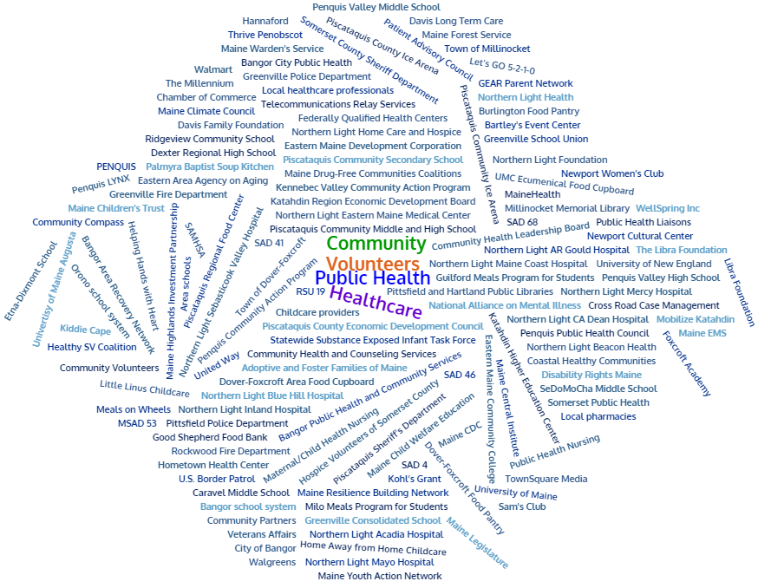
Partners
Notes:
Previous CHNA efforts point person

Slide 17
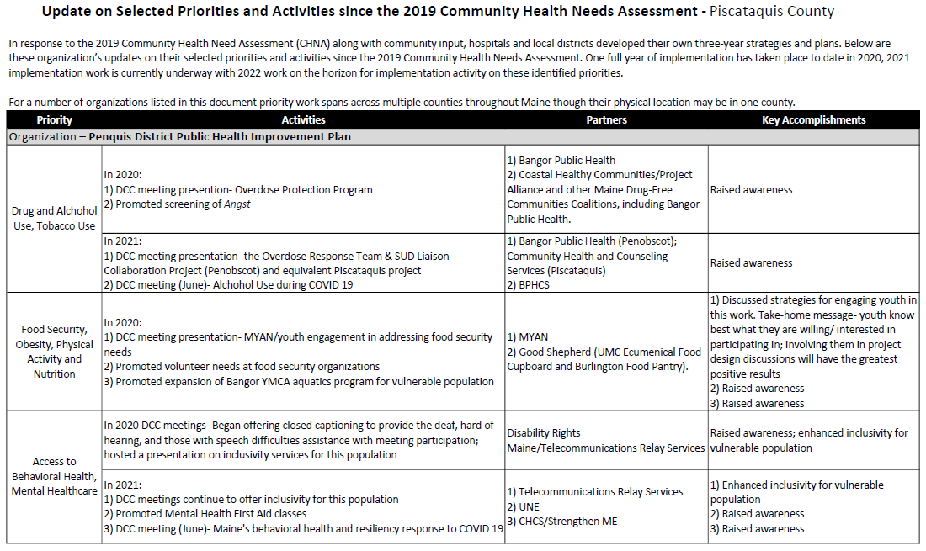
Accomplishments of Note
Update on selected priorities and activities since the 2019 Shared CHNA
Notes:
Previous CHNA efforts point person
Introduce JSI

Slide 18
How to Read the County Health Profiles and Health Equity Data Sheets
Notes:
JSI

Slide 19
How to Read County Health Profile
EXAMPLE
CHANGE shows statistically significant changes in the indicator over time, based on 95% confidence interval (see description on page 3).
ê | means the health issue or problem is getting better over time.
! | means the health issue or problem is getting worse over time.
○ | means the change was not statistically significant.
N/A | means there is not enough data to make a comparison.
BENCHMARK compares [COUNTY] data to state and national data, based on 95% confidence interval (see description on page 3).
ê | means [COUNTY] is doing significantly better than the state or national average.
! | means [COUNTY is doing significantly worse than the state or national average.
○ | means there is no statistically significant difference between the data points.
N/A | means there is not enough data to make a comparison.
ADDITIONAL SYMBOLS
* | means results may be statistically unreliable due to small numbers, use caution when interpreting.
— | means data is unavailable because of lack of data or suppressed data due to a small number of respondents.
Notes:
JSI
A star means that the health issue or problem is getting better over time or better in comparison to another place
A red exclamation point means that the health issue or problem is getting worse over time or worse in comparison to another place
A gray circle means that the dating hasn’t changed over time or isn’t much different in comparison to another place
N/A means that there was not enough data to be able to make a comparison
There are two additional symbols you might see:
A black dot means that you should use caution when interpreting the data – the results might be unreliable because of small numbers
A black dash means that data was unavailable, or that data was suppressed due to a small number of respondents
(Go to next slide and walk audience through an example)

Slide 20
How to Read County Health Profile
EXAMPLE
 | AROOSTOOK COUNTY |  |  | BENCHMARKS
INDICATOR | POINT 1 | POINT 2 | CHANGE | MAINE | +/- | U.S. | +/-
Individuals living in poverty | 2009-2011 15.6% | 2015-2019 16.1% | ¡ | 2015-2019 11.8% | ! | 2019 12.3% | N/A
Notes:
JSI
The charts in this presentation are all excerpts from the Data Health Profiles that were created by MaineHealth and the Maine CDC. They contain data pulled from publicly available sources that are designed to help people learn more about the health of their communities. Not all the data points are available for every measure, but we’ve included data wherever we can.
The green bars represent data from your community. The left most one represents a past data point, and the right bar represents the most recent data point available when the data was gathered. These are the same data points used in the Data Health Profiles.
The grey bars represent data for the state of Maine as a whole- on the left- and for the United States as a whole- on the right, when it is available.
We’ve also noted where differences in the data points are ‘statistically significant’. A difference between two measurements is significant when scientists can say, with a known degree of confidence, that the difference between them is large enough that the difference is most likely to be caused by an actual difference in the item being measured, and not caused by error associated taking the measurement. All of these tests are comparing the most recent data point for your community to other data points. A red exclamation mark indicates a difference that your community is significantly different in a less desirable direction compared to the data point with the symbol. A green star indicates that your community is significantly different in a more desirable direction. A grey circle indicates that there is no significant difference.

Slide 21
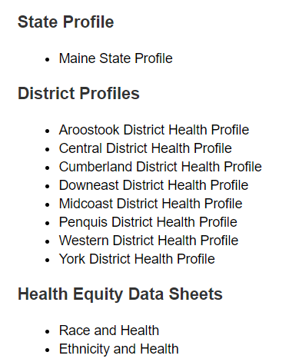
For More Data
www.mainechna.org
Notes:
The Maine Shared CHNA website contains health profiles for 3 of Maine’s largest cities, 16 counties, 5 public health districts, the state, as well as data provided by race, ethnicity, educational attainment, gender, sexual orientation, older adults, insurance status, income, and rurality.
In addition, there is an interactive data portal where you can search by specific data points. All these breakdowns are then provided by data point.

Slide 22
Key Findings
Notes:
JSI

Slide 23
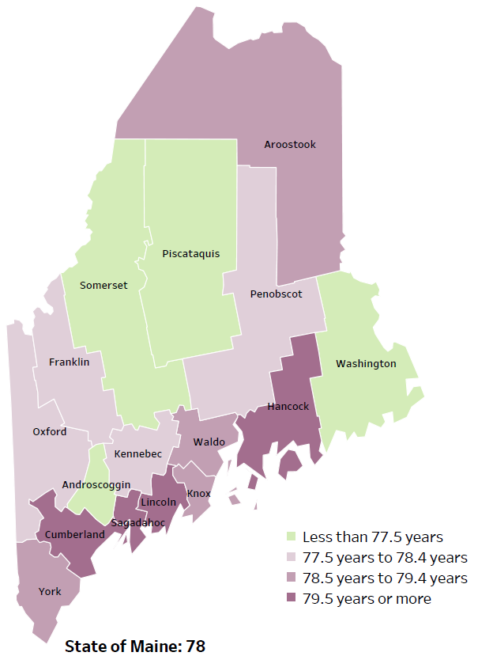
Demographics
Life Expectancy
2017-2019
National Center for Health Statistics,
CDC
RANK | MAINE | PISCATAQUIS COUNTY
1 | Cancer | Cancer
2 | Heart Disease | Heart Disease
3 | Unintentional Injury | Diabetes
4 | Chronic Lower Respiratory Disease | Unintentional Injury
5 | Stroke | Stroke
Notes:
The life expectancy in Piscataquis County is 76.7, which is significantly lower than the state average of 78. Piscataquis County has one of the lowest life expectancy in the state. This is an indication that more people are dying at younger ages than residents in many other counties in Maine.
The table on the right side of the slides shows the five leading causes of death in Piscataquis County. They are also the leading causes of death for the whole state of Maine.
The leading cause of death is cancer, the same as the state leading cause of death. As we will see later in the presentation, Piscataquis has a high rate of heart disease and diabetes, which is reflected as the leading causes of death.
Some highlights:
In Piscataquis County and Maine overall, the leading cause of death is Cancer followed by Heart Disease. The opposite is true in the U.S. overall- Heart Disease is the leading cause of death, and cancer is the 2nd leading cause. One of the reasons that this is true is because we have higher rates of risk factors for cancer, such as smoking/tobacco use. At the same time, there has been a lot of success implementing treatment of heart disease, resulting in folks with heart disease living longer.
The 4rd leading cause of death- Unintentional Injury- includes a number of accidental causes: Three of the most common causes are i) Deaths due to motor vehicle crashes, ii) deaths due to accidental falls, and iii) deaths due to poisonings that either were unintentional or the intent was undetermined. Suicides and Firearm deaths are classified as intentional injury.

Slide 24
Demographics
Age distribution for Piscataquis County
AGE
PISCATAQUIS COUNTY
POPULATION
16,836
STATE OF MAINE
POPULATION
1,362,359
Notes:
Piscataquis have the smallest population of any Maine county. The population is aging. There are fewer children and young adults and more adults over the age of 65, and fewer adults of the age where they might expect to have children.
Source: US Census Bureau, American Community Survey

Slide 25
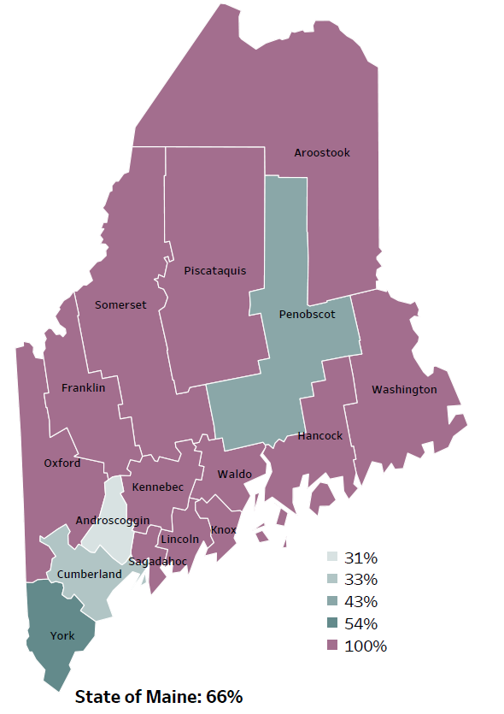
Demographics
Percentage of people living in
rural areas
2019
New England Rural Health Association
Notes:
Piscataquis county is one of 12 counties with no population in a metro area. These data are based on the most recent Census estimates at the Zip-code level, and calculated use rural Urban Commuting Area codes. The categories were established by the New England Rural Health Association. This data is NOT comparable to 2010 US Census data on populations living in rural areas, as that data uses a different definition for rural
Source: Data, Research and Vital Statistics town-level population file

Slide 26
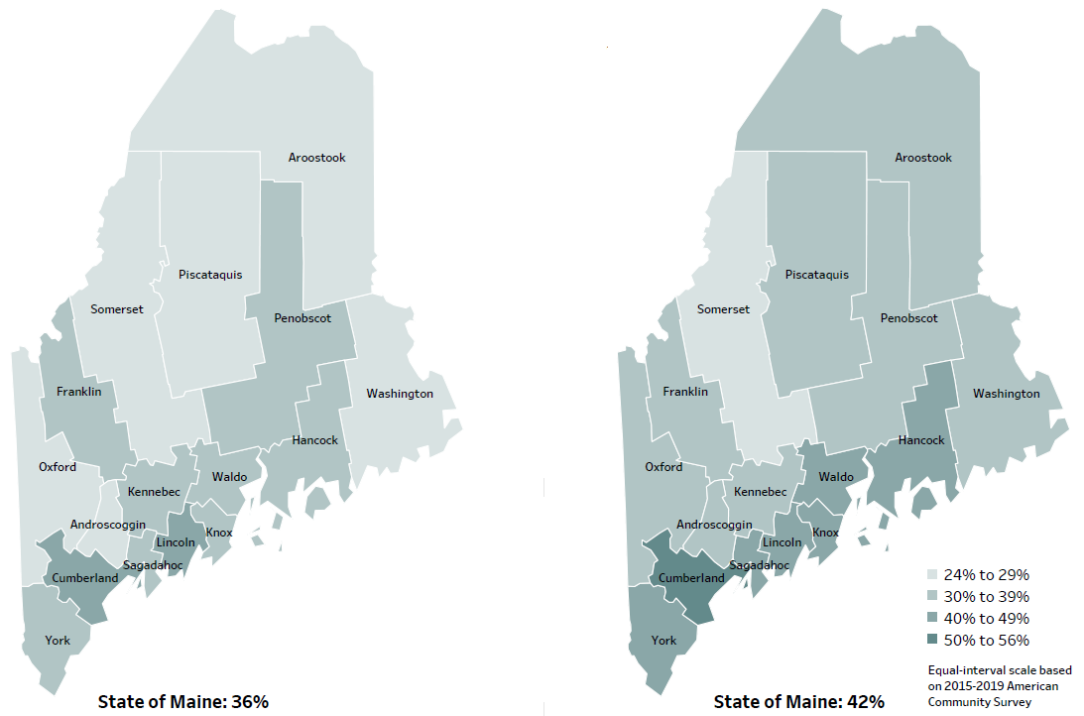
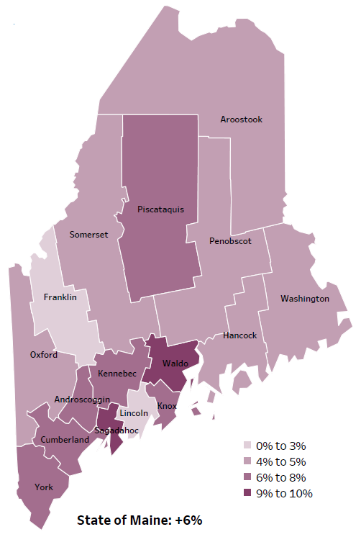
Demographics
Percent of population over age 25 with an associate’s degree or higher
2010
American Community
Survey
Change in percent of population over age 25 with an associate’s degree or higher
2010 to 2015-2019
2015-2019
American Community
Survey
Notes:
These maps show the educational attainment of adults over 25 for two different time periods. Piscataquis county has had an increase in the rate of adults who have achieved an associate’s degree or higher degree of education. This is highlighted in the change over time map, which shows that this was a greater increase than 8 other counties.
Source: US Census Bureau, American Community Survey

Slide 27
Demographics
Life Expectancy
2017-2019
National Center for Health Statistics,
CDC
Notes:
Piscataquis data has one of the lowest life expectancies in the state. This is an indication of premature deaths caused by any source.
Source: US Census Bureau, American Community Survey

Slide 28
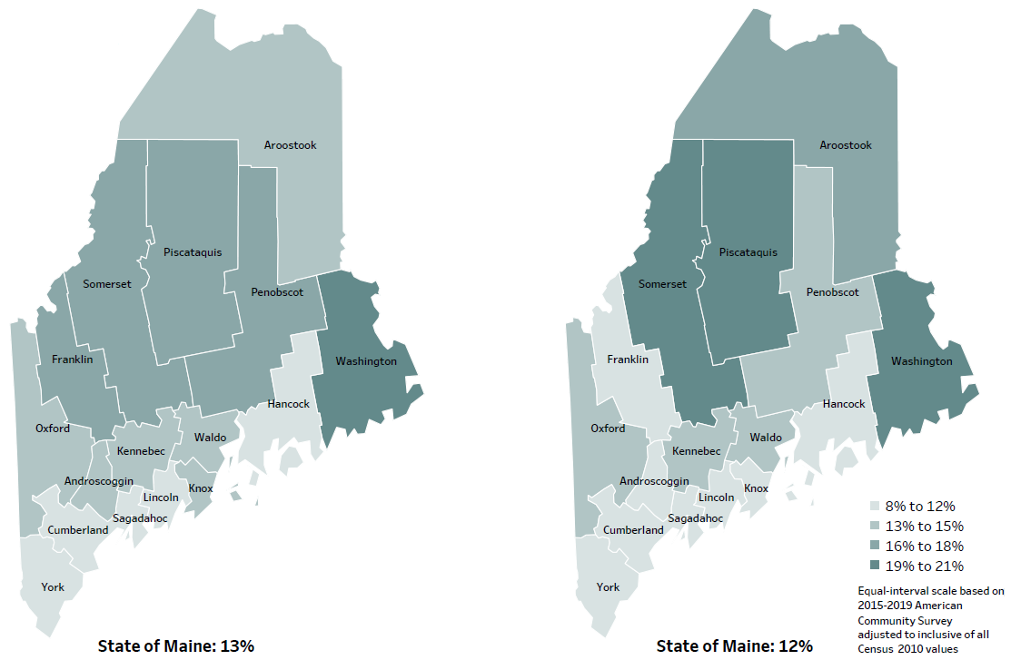
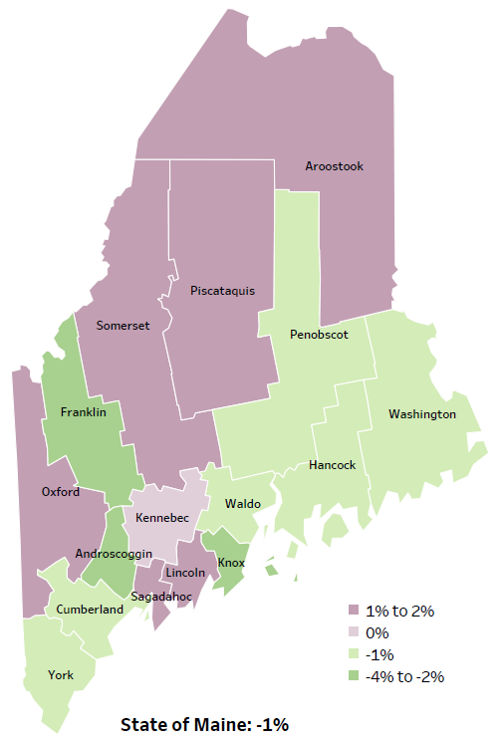
Demographics
Percent of population in poverty
2010
American Community
Survey
Change in percent of population in poverty
2010 to 2015-2019
2015-2019
American Community
Survey
Notes:
These maps show the rate of poverty for two different time periods. Piscataquis county’s poverty rate has increased over the time period, as shown in the change over time map. During this period, poverty decreased in Maine overall.
Source: US Census Bureau, American Community Survey

Slide 29
Health Indicators
Notes:
Piscataquis county has a significantly higher rate of uninured individual than the state, but no comparison could be made to the US because different years of data were used.
Source: US Census Bureau, American Community Survey

Slide 30
Health Indicators
Notes:
These graphs show that a higher rate of children under age 20 are enrolled in MaineCare in Piscataquis county when compared to the state. It has increased in the last year. This data does not have confidence intervals, so we can’t tell if the difference is statistically significant. The rate of enrollment is influenced by many things, including changing poverty levels (as more children are eligible) but could also be influenced by more eligible children enrolling in programs they were already eligible for. We do not know how much the differences shown here are influenced by these different factors.
Source: MaineCare

Slide 31
Health Indicators
Notes:
This number is the population of Piscataquis divided by the number of PCPs who practice in the County. The higher number reflects fewer PCPs available in the county then in the state overall. It does not reflect all the PCPs people in Piscataquis might see, since they might travel to another county to get primary care. However, this would represent people having to travel to receive the care they need.
Source: Health Resources and Services Administration

Slide 32
Health Indicators
Notes:
This is another measure of access to primary care providers. It shows that a higher percentage of visits required people to travel more that 30 miles. As with the previous measure, this reflects less access to PCPs than in other parts of the state.
Source: Maine Health Data Organization All Payer Claims Database

Slide 33
Health Indicators
Notes:
These are measures of quality of care, showing the rates of hospitalizations and visits to the ED for conditions that could have been handled in a doctor’s office include PCPs and urgent care. Often this happens because the patient does not have access to a PCP. Piscataquis has a significantly higher rate for both measures. These data combine 2 years, in order to make the data more precise.
Source: Maine Health Data Organization Hospital Inpatient Database

Slide 34
Health Indicators
Notes:
Cancer deaths in Piscataquis have increase over time, but not significantly. However, they are significantly higher than cancer deaths in the state. These data are age-adjusted, meaning that we have calculated the rates so that they can be compared to other parts of the state that might have a younger population. Older people tend to have higher rates of many diseases, including cancer. It’s important to adjust for age so that we don’t accidentally mistake a place with older people for a place with an unusual number of disease-related deaths.
Source: Maine CDC Vital Records

Slide 35
Health Indicators
Notes:
These graphs show that although cardiovascular disease deaths went down slightly in Piscataquis county over time but are significantly higher that the state. Again, this data is age adjusted, so the difference is NOT affected by Piscataquis’s older population relative the state’s population.
Source: Maine CDC Vital Records

Slide 36
Health Indicators
Notes:
This slide shows a similar story for one type of cardiovascular disease death - coronary heart disease.
Rates in Piscataquis County are significantly higher than the state.
Source: Maine CDC Vital Records

Slide 37
Health Indicators
Notes:
Is this slide, we see that Piscataquis county has a slightly lower rate of hospitalization due to high blood pressure. While this is significantly lower than the state as a whole. Piscataquis is trending in a negative direction. Note that while this may appear to be a sharp increase over time, the actual numbers are very small. Where the difference over time is not significant, it may be due more to measurement than to a real change in the incidence.
Source: Maine Health Data Organization Hospital Inpatient Database

Slide 38
Health Indicators
Notes:
This slide shows that obesity in middle school students in Piscataquis County is increasing and is significantly higher that the state rate. Although the increase look quite large, it is important to remember that because of the smaller number of middle school students in the county, a small change in the number of individuals effected can look large when expressed as a rate. This change over time is not statistically different.
Source: Maine Integrated Youth Health Survey

Slide 39
Health Indicators
Notes:
While these graphs show a higher percentage of adults in Piscataquis County are not engaging in physical activity outside of work, the difference- both compared to the past year and with Maine are not significant.
Source: Behavioral Risk Factor Surveillance System

Slide 40
Health Indicators
Notes:
This slide shows that more children in Piscataquis are getting appropriate screening for lead poisoning, but they are lagging children in the state generally. The rate of children with confirmed elevated blood lead levels in the county is also rising, which may be due in part to greater levels of screening. However, we can also see that this percentage is significantly higher than the percentage of children across the state.
Source: Maine CDC Childhood Lead Poisoning Prevention Unit

Slide 41
Health Indicators
Notes:
These graphs show that fewer two-years are up-to-date will all recommended immunizations and this has gone down in the last year. The higher rate of parents requesting exemption from school requirements for philosophical reasons may be reflected in the lower rates of immunizations. We do not have confidence intervals for these data, so we can’t tell is these differences are statistically significant. It is also important to note that the immunizations rates are based on where children get primary care, not where they live, so the first graph does not reflect Piscataquis children who go to a PCP in another county.
Source: Maine Immunization Program

Slide 42
Health Indicators
Notes:
This graph shows that injury deaths are increasing slightly (not statistically significant), and they are significantly higher in Piscataquis county than in the state generally.
Source: Maine CDC Vital Records

Slide 43
Health Indicators
Notes:
The rate of suicide deaths decreased slightly over time in Piscataquis county and are slightly higher than Maine as a whole. None of these differences are significantly different.
Source: Maine CDC Vital Records

Slide 44
Health Indicators
Notes:
The increase in intentional self injury among middle school students is not statistically significant, but there is a significantly higher percentage of middle school students in Piscataquis county reporting this behavior than in the State overall.
Source: Maine Integrated Youth Health Survey

Slide 45
Health Indicators
Notes:
These data show the similar results to the previous slide. Middle school students in Piscataquis county are significantly more likely than Maine middle school students as a whole to report feeling sad or hopeless for two weeks in a row, or to have seriously considered suicide. While the change over time is not significant, all these measures have reported small increases since 2017.
Source: Maine Integrated Youth Health Survey

Slide 46
Health Indicators
Notes:
This graph shows a significant increase over time in reported binge drinking among high school students, and no significant different between Piscataquis county and state.
Source: Maine Integrated Youth Health Survey

Slide 47
Health Indicators
Notes:
This graph shows a significant increase over time in reported marijuana use among middle school students, but no significant different between Piscataquis county and the state as a whole.
Source: Maine Integrated Youth Health Survey

Slide 48
Health Indicators
Notes:
This slide shows a significant decrease in cigarette smoking among Piscataquis county high school students between 2017 and 2019, but a significant increase in e-cigarette use. Neither is significantly different from the state percent.
Source: Maine Integrated Youth Health Survey

Slide 49
Breakout Discussions

Slide 50
Reconvene

Slide 51
Wrap up and Next Steps

Slide 52
Contacts
Deidre Gilbert, Director of Pharmacy, Northern Light CA Dean Hospital, dmgilbert@northernlight.org 207-695-5270
Hillary Starbird, Director of Community Outreach, Northern Light Mayo Hospital, hstarbird@northernlight.org , 207-564-4184
Nicole Hammar, Community Health Improvement Manager, Northern Light Health nhammar@northernlight.org 207-973-7245
Jessica Fogg, Penquis District Public Health Liaison, Jessica.fogg@maine.gov 207-561-4421
Maine Shared CHNA: info@mainechna.org
www.mainechna.org

