Slide 1
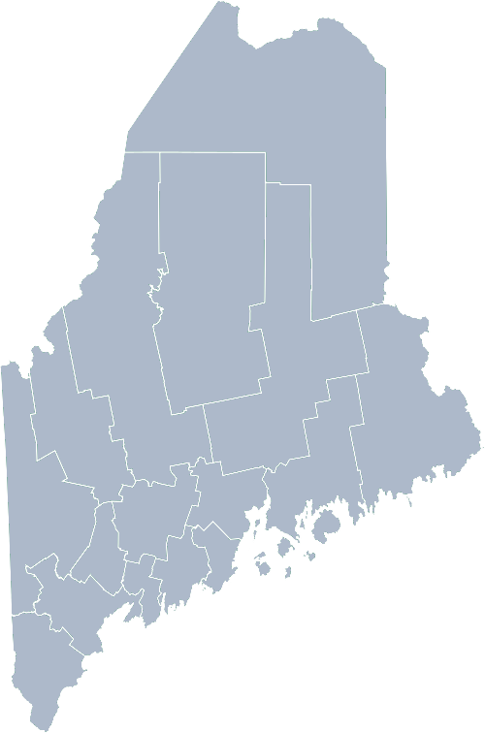
Maine Shared Community Health Needs Assessment Deaf, Hard of Hearing and Disabilities
2021
Notes:
Katrina to open our session

Slide 2
Welcome
Introductions
Overview of Tools
Purpose
Notes:
Katrina Welcomes participants
Request folks go ahead and enter their name in the chat box.
Introduces Jo Morrissey, Program Manager for the Maine Shared CHNA to walk us through some background and housekeeping

Slide 3
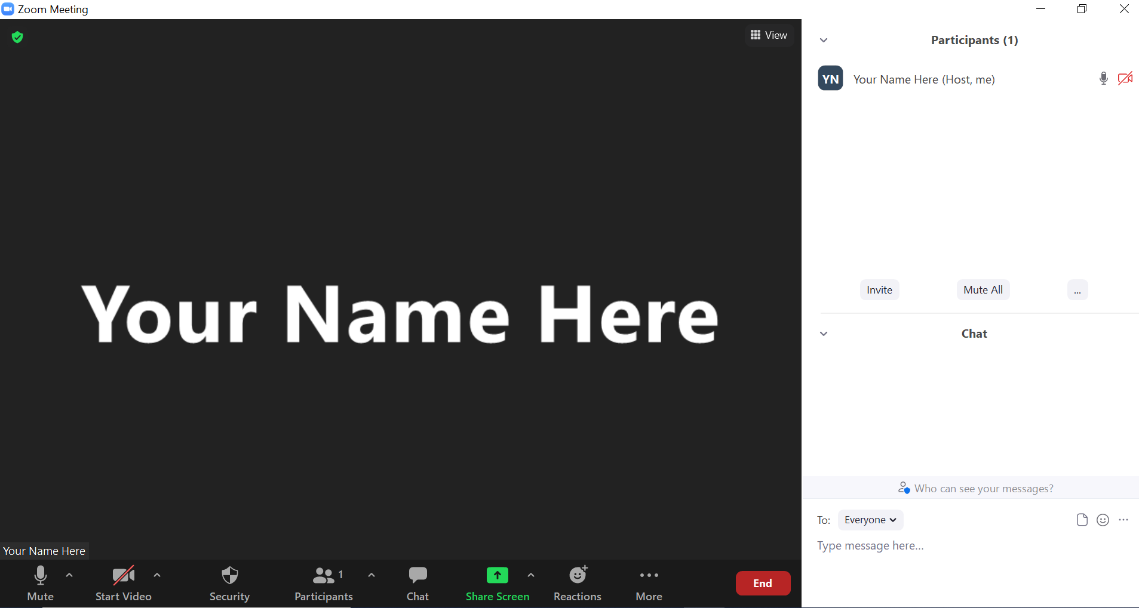
Share screen
Join Audio, Mute On/Off
Open/close participant list or chat
Turn Video On/Off
Reactions
Notes:
Jo

Slide 4
The Maine Shared CHNA is a collaboration between the Maine Center for Disease Control and Prevention (Maine CDC), Central Maine Healthcare, Northern Light Health, MaineGeneral Health, and MaineHealth.
Notes:
In 2014, the IRS made it a requirement for all non-profit hospitals across the country to conduct a triennial community health needs assessment. At about the same time, the Public Health Accreditation Board set out a set of standards for public health departments to meet in order to become accredited. One of those standards is to also conduct community health needs assessments. Given that Maine is a small town, it was natural partnership that a partnership between the Maine CDC and Maine’s hospital systems were formalized to conduct these needs assessments collaboratively.
In Maine, the idea of collaboration to conduct needs assessments was not a new idea. In fact, Maine has one of the oldest, if not THE oldest public health needs assessment partnerships in the nation. As you can see, we continue to learn and grow from our experiences.

Slide 5
Notes:
This event is sponsored by Disability Rights Maine.

Slide 6
Forum agenda
Time | Activity | Speaker/Facilitator
3:00 – 3:05 pm | Welcome and introductions | Katrina Ringrose, Disability Rights Maine
3:05 – 3:10 pm | Zoom environment and CHNA background | Jo Morrissey, Program Manager, Maine Shared Community Health Needs Assessment
3:10 – 3:35 pm | Presentation of key findings from the data | John Snow, Inc.
3:35 – 4:55 pm | Break-out session – facilitated discussion on data and health priority identification | Local Facilitator(s)
4:55 – 5:00 pm | Wrap up and next steps | Katrina Ringrose, Disability Rights Maine
Notes:
??
Local Planning Committee Member to go over agenda and then turn it over to Jo Morrissey to provide an overview of the Zoom tools available and the purpose of today’s forum

Slide 7
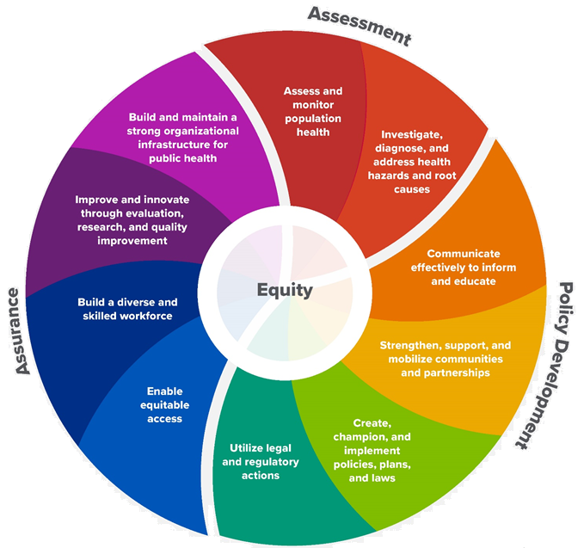
10 Essential Public Health Services
Notes:
WHY do the folks who work in public health conduct community health needs assessments?
As this wheel shows: conducting a community health needs assessment feeds into all other public health services. Such as: informing health improvement plans, choosing the right strategy at the right time for the right purpose, policy development, and ensuring equity.
By truly understanding the needs of those we serve, we can serve more effectively and efficiently.

Slide 8
The Evolution of an Idea…
2010 OneMaine | 2015 SHNAPP | 2018 Maine Shared CHNA | 2021 Maine Shared CHNA
Forums Surveys | 16 Forums 1639 Surveys | 22 Mainstream Forums (live) 2 Immigrant Forums 45 Interviews | 16+ Mainstream Forums (virtual) 12+ Community Sponsored Events 2000+ Oral Surveys
Notes:
This year is the most ambitious yet. In addition to the mainstream county forums, so far we’ve added 10 community sponsored events and aim to conduct up to 2000 oral surveys in order to capture meaningful input from voices not adequately amplified during mainstream forums. To date, our community sponsored event partners include:
Community Sponsored Event Partners include
Disability Rights Maine (2 events: people who are deaf or hard of hearing and people with other disabilities)
Maine Primary Care Association (People who are served by Maine’s Federally Qualified Health Centers
Maine Council on Aging (Older Adults 65+)
Consumer Right Council of Maine (people with a mental health diagnosis)
Formerly Incarcerated (Maine Prisoner Re-Entry Network)
Maine Youth Action Network and Friends (Raising the voices of Maine’s diverse youth)
Green Memorial A.M.E. Zion Church (Black/African American)
Health Equity Alliance (LGBTQ+ community)
Portland Recovery Center (for people with a substance use disorder or in recovery)
ADD HOUSING INSECURE IF NEED BE
ADD VETERAN IF NEED BE
Oral Survey Partners include:
Capital Area New Mainers
City of Portland’s Minority Health Program
New Mainer’s Public Health Initiative
Maine Immigrant Access Network
Gateway Community Services
Maine Immigrant and Refugee Services
Maine Community Integration
Mano en Mano
Sister Patricia Pora, formerly of the Portland Dioceses Hispanic Ministry
We are piloting these additional outreach methods with support from
State of Maine’s Preventative Health and Health Services Block Grant
Maine Health Access Foundation

Slide 9
Inputs and Outcomes
Ways to Provide Input
Data Collected
Outcomes
District & County Reports DUE APRIL 2022
4 Health Priorities by county
Related indicators
Gaps/barriers and resources/assets
Notable comparisons between attendee input and the data.
Description of those who provided input
Methodology
Mainstream county forums
Number of attendees
Where attendees live (not CSE)
List of data identified Forums and CSE only)
Discussion notes (Forums and CSE only)
Chat box comments (Forums and CSE only)
Health Priorities
Gaps and Resources
Community sponsored events
State Report DUE APRIL 2022
4 Health Priorities by Community Event and immigrant population.
Related indicators
Gaps/barriers and resources/assets,
Notable comparisons to mainstream population.
Description of those who provided input
Methodology
Oral Survey
Forums, Events and Surveys conducted Fall 2021
Notes:
What will WE do with the information you share with us today?
While we may use different formats to engage with different communities, the data we collect and how we will use that data is very similar.
Jo or JSI
Introduce Madison MacLEan of JSI who will walk you through some health related data.
As you list to Madison, jot down your questions or take notes on any data that stands out to you.
After the data presentation we will break out into those small group discussions. The first topic of discussion will be your questions and an opportunity for you to share your thoughts on the data.

Slide 10
Leadership remarks
Notes:
Katrina
Leader to introduce point person for review of previous health improvement efforts.
Introduce Madison MacLean from John Snow, Inc. who will review the health data with us.

Slide 11
How to Read the County Health Profiles and Health Equity Data Sheets
Notes:
Data Health profiles for each county, public health district, and the state of maine are continually being added to the Maine shared CHNA website. There is also a newly redesigned interactive data portal which is set to go live in the coming days.

Slide 12
How to Read County Health Profile
CHANGE shows statistically significant changes in the indicator over time, based on 95% confidence interval (see description on page 3).
ê | means the health issue or problem is getting better over time.
! | means the health issue or problem is getting worse over time.
○ | means the change was not statistically significant.
N/A | means there is not enough data to make a comparison.
BENCHMARK compares [COUNTY] data to state and national data, based on 95% confidence interval (see description on page 3).
ê | means [COUNTY] is doing significantly better than the state or national average.
! | means [COUNTY is doing significantly worse than the state or national average.
○ | means there is no statistically significant difference between the data points.
N/A | means there is not enough data to make a comparison.
ADDITIONAL SYMBOLS
* | means results may be statistically unreliable due to small numbers, use caution when interpreting.
— | means data is unavailable because of lack of data or suppressed data due to a small number of respondents.
EXAMPLE
Notes:
JSI or other facilitator
There are data health profiles on the maine shared CHNA website. Additional 2021 Data profiles are being added as they become complete. There is also an interactive data portal. The one currently on the site is undergoing a facelift with all new data and should launch in the next week or so.
A star means that the health issue or problem is getting better over time or better in comparison to another place
A red exclamation point means that the health issue or problem is getting worse over time or worse in comparison to another place
A gray circle means that the dating hasn’t changed over time or isn’t much different in comparison to another place
N/A means that there was not enough data to be able to make a comparison
There are two additional symbols you might see:
A black dot means that you should use caution when interpreting the data – the results might be unreliable because of small numbers
A black dash means that data was unavailable, or that data was suppressed due to a small number of respondents
(Go to next slide and walk audience through an example)

Slide 13
How to Read County Health Profile
EXAMPLE
 | AROOSTOOK COUNTY |  |  | BENCHMARKS
INDICATOR | POINT 1 | POINT 2 | CHANGE | MAINE | +/- | U.S. | +/-
Individuals living in poverty | 2009-2011 15.6% | 2015-2019 16.1% | ¡ | 2015-2019 11.8% | ! | 2019 12.3% | N/A
Notes:
JSI
Here’s an example of what the data looks like in our data health profiles.
Some things to look for to help you better understand the data:
Every data point is accompanied by a year. This is the year the measurement was taken. It is important to know that when multiple years are presented, or a range of years (as in this slide), the data refers to measurement that includes ALL the years indicated. It is NOT an average of the data from those years. It combines data from across those years into a single measurement. We sometimes need to do this if a single year does not have enough data to do our analysis.
Comparisons are made over time (Point 1 and Point 2), and from the county to the state and the state to the U.S. In this example, there is not a lot of change over time between Point 1 and Point 2 as shown by the grey circle. There is, however, a significantly worse condition in the County compared to the State as shown by the red exclamation point. Since the numbers are so small in Maine, there was not enough data to make a single year comparison between Maine and the U.S. as shown by the N/A.

Slide 14
How to Read the Data Slides
EXAMPLE
Notes:
Here’s an example of how that same data may show up in today’s presentation:
The green bars will show the Maine data and the grey bars will show comparisons to the state or nation.
When there is a statistically significant difference either over time or btween Maine and the U.S., we will tell you.
In this case, Maine has a slightly higher rate of children identified as having special healthcare needs than the US as a whole. This difference is not large enough to be considered significant, however.
(do not read but this note is provided in case someone asks) A difference between two measurements is significant when scientists can say, with a known degree of confidence, that the difference between them is large enough that the difference is most likely to be caused by an actual difference in the item being measured, and not caused by an error associated taking the measurement. All of these tests are comparing the most recent data point for your community to other data points.

Slide 15
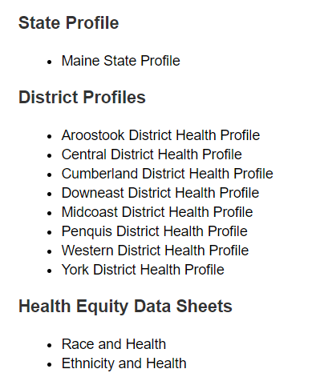
For More Data
www.mainechna.org
Notes:
The Maine Shared CHNA website contains health profiles for 3 of Maine’s largest cities, 16 counties, 5 public health districts, the state, as well as data provided by race, ethnicity, educational attainment, gender, sexual orientation, older adults, insurance status, income, and rurality.
In addition, there is an interactive data portal where you can search by specific data points. All these breakdowns are then provided by data point.

Slide 16
Key Findings

Slide 17
Demographics
Notes:
The median household income of Maine households is significantly lower than the median household income for all households in the US.
Source: US Census Bureau, American Community Survey

Slide 18
Demographics
Notes:
This tables displays the rate at which Maine residents of different racial categories have a disability. Maine’s American Indians or Alaska Natives are more likely to be people with a disability. Note that these numbers are not adjusted for age, which strongly correlates with people who have disabilities.
Source: American Communities Survey (ACS, 2019)

Slide 19
Demographics
Age distribution for Maine
AGE
STATE OF MAINE
POPULATION
1,362,359
Notes:
This chart shows the population of Maine by age. For those who have a disability, there is a close association with age- individuals over the age of 65 are much more likely to have a disability.
Source: US Census Bureau, American Community Survey

Slide 20
Demographics
Notes:
Maine is more likely than US to have people who identify as having a disability. This may be linked to Maine’s higher average age.
While more likely, the difference is not significantly different.
Source: US Census Bureau, American Community Survey

Slide 21
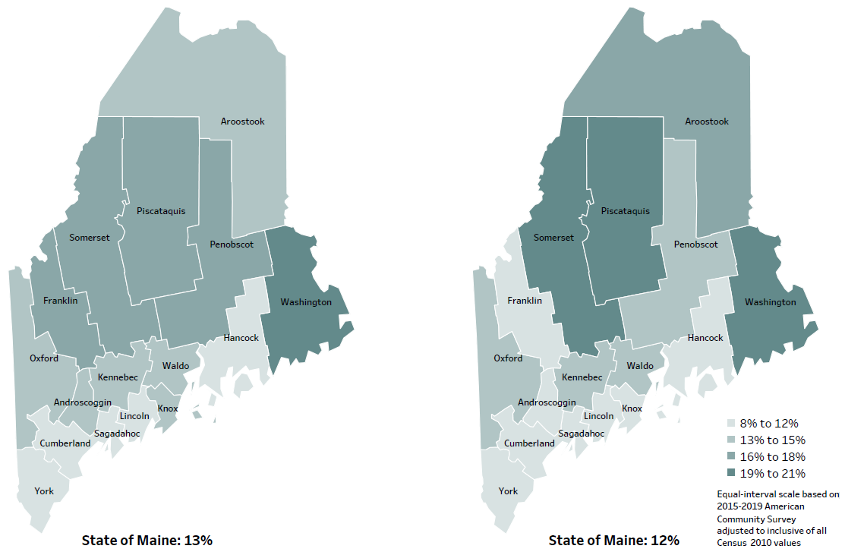
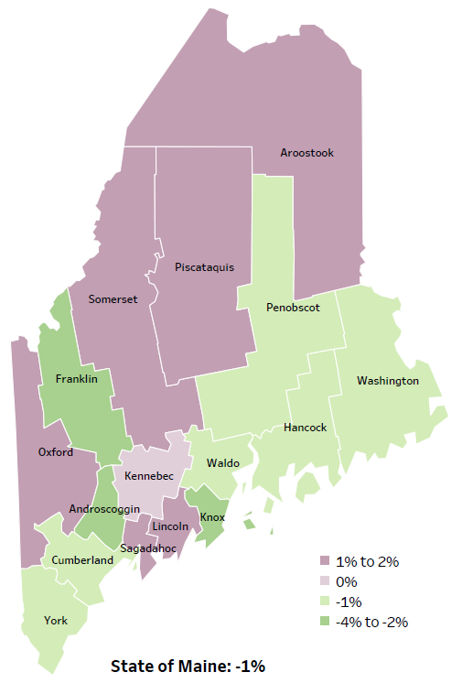
Social Determinants of Health
Percent of population in poverty
2010
American Community
Survey
Change in percent of population in poverty
2010 to 2015-2019
2015-2019
American Community
Survey
Notes:
Individuals with a disability are more likely to be in poverty. While the state of Maine overall has seen a decrease in the poverty rate, certain counties have experienced different patterns.
Source: US Census Bureau, American Community Survey

Slide 22
Social Determinants of Health
Notes:
Maine has a slightly higher rate of children identified as having special healthcare needs than the US as a whole. This difference is not large enough to be considered significant, however.
Source: National Survey of Children's Health

Slide 23
Social Determinants of Health
Notes:
The rate of poverty in Maine decreased between 2014 and 2019. However, this data only goes to 2019- the COVID pandemic may have notably impacted this rate, particularly for people with disabilities. Note the unemployment rate on the following slide.
Source: US Census Bureau, American Community Survey

Slide 24
Social Determinants of Health
Notes:
The unemployment rate in Maine dropped steadily from 2011 to 2019, before rising sharply in 2020.
Individuals with disabilities are more likely than others to be unemployed and shifts in unemployed tend to have outsized impact on individuals with disabilities.
This difference is not large enough to be considered significant, however.
Source: US Bureau of Labor Statistics

Slide 25
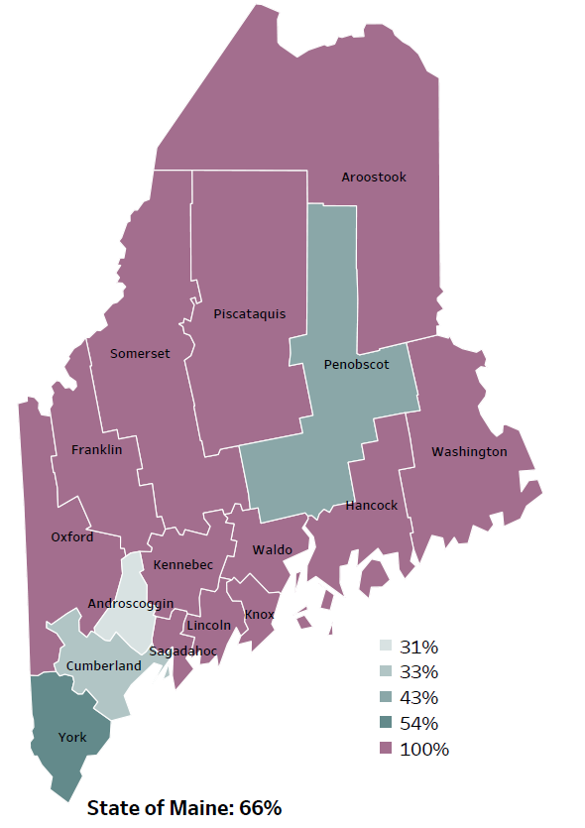
Social Determinants of Health
Percentage of people living in
rural areas
2019
New England Rural Health Association
Notes:
Maine is among the most rural states in the US. Most counties are considered completely rural by some measures. Having a highly rural population makes providing many sorts of services more difficult and expensive.
Source: Data, Research and Vital Statistics town-level population file

Slide 26
Social Determinants of Health
Notes:
About two percent of Maine residents have no vehicle in their home.
This can make accessing health care or work more difficult, especially in very rural areas. However, Mainers are more likely than individuals in the US generally to have a vehicle in their home.
This difference is not large enough to be considered significant, however.
Source: US Census Bureau, American Community Survey

Slide 27
Social Determinants of Health
Notes:
The incidence of adverse childhood experiences in Maine has decreased slightly since 2017.
While these two bars may make it look like there’s been a big decline, it is not a significant amount. Note the chart only goes up to 24%.
Source: Maine Integrated Youth Health Survey

Slide 28
Social Determinants of Health
Notes:
Diabetes is slightly more prevalent in Maine than the US as a whole.
Diabetes is associated with age, so these numbers are age adjusted so they can be compared more meaningfully.
This difference is not large enough to be considered significant, however.
Source: Behavioral Risk Factor Surveillance System

Slide 29
Social Determinants of Health
Notes:
Rates of high blood pressure have increased in Maine since 2011, while rates of asthma have declined slightly.
Source: Behavioral Risk Factor Surveillance System

Slide 30
Social Determinants of Health
14+ days lost due to poor mental health (adult) † Sad/hopeless for two weeks in a row (high school)
‡ Current symptoms of depression (adult)
Notes:
The rate at which high school students in Maine have reported feeling sad or hopeless has increased steadily since 2011. COVID may have impacted this. Mental health is more and more often recognized as an important category of disability.
Source: Maine Integrated Youth Health Survey and Behavioral Risk Factor Surveillance System

Slide 31
Social Determinants of Health
‡High school students who report past 30 day alcohol use
**High school students who report past 30 day marijuana use
Notes:
Overall alcohol use among Maine high school students has declined slightly since 2011. Reported marijuana use declined between 2011 and 2017 but has recently increased back to 2011 levels.
Source: Behavioral Risk Factor Surveillance System

Slide 32
Social Determinants of Health
Notes:
The rate of injury deaths in Maine has been increasing slowly since 2010 and is significantly higher in Maine than in the US generally.
Source: Maine CDC Vital Records

Slide 33
Social Determinants of Health
Notes:
MaineCare enrollment statewide increased notably after 2018, with more eligible individuals signing up for care. Many people with disabilities use public health insurance, and often report cost barriers to receiving health care.
Source: MaineCare

Slide 34
Social Determinants of Health
Notes:
Ambulatory Care Sensitive Conditions, in a nutshell, or chronic health conditions such as asthma or cardiovascular disease, that if well managed by a primary care physician, would not need to rise to the level of needing an emergency room visit.
Source: Maine Health Data Organization Hospital Inpatient Database

Slide 35
Breakout Discussions

Slide 36
Small Group Discussion Questions
Based on the data we just watched, What stood out to you? (5 mins)
Mark the indicators that are most important to you on the left-hand column of the Priority Handout. (10 mins)
Mark 4 Priority Health Topic Area on the right-hand column of the Priority Handout (10 mins)
Notes:
JSI or Other Facilitator
Overview/instructions (see page 11 of the Community Engagement Toolkit): These breakout sessions will provide an opportunity for you all to share their feedback. Table facilitators have question prompts to lead discussions. The purpose of these small group discussions is to identify up to 4 health priorities, local resources to address those priorities, and gaps in resources.
Leave this slide up during table breakouts

Slide 37
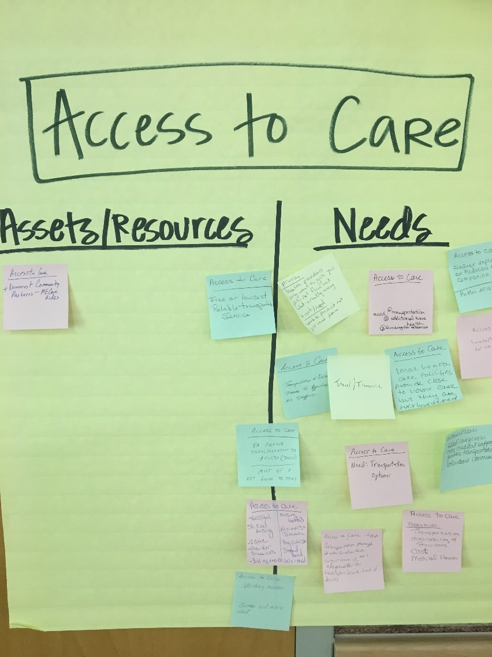
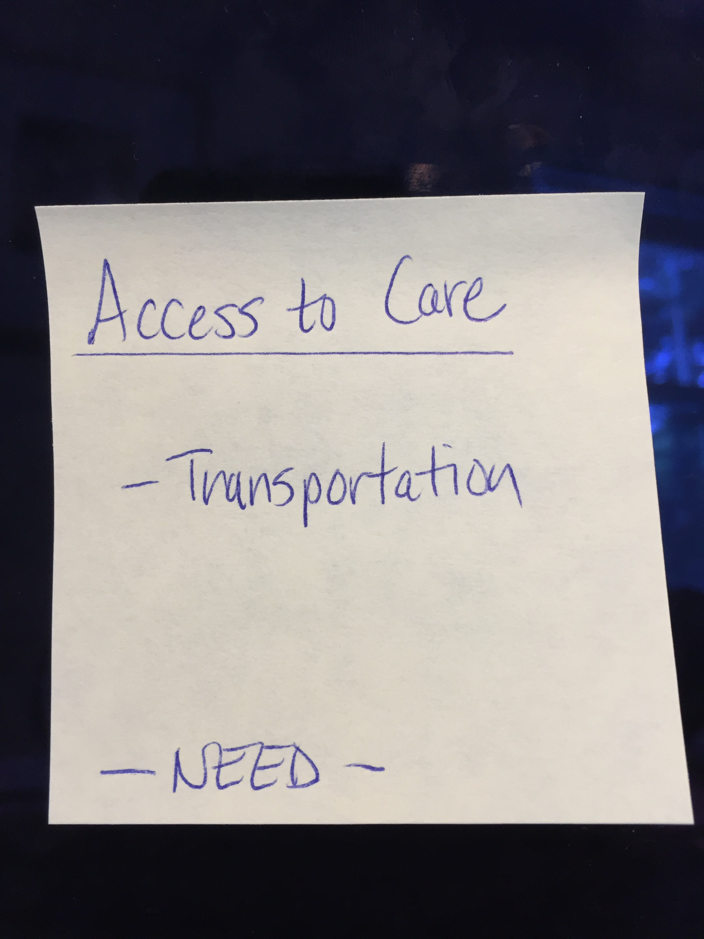
Assets/Resources and Needs
Notes:
JSI or other facilitator
Create sticky notes like the one you see here on the left. The priority area is on top, the asset or resource is on the note, and a label for Asset or Resource so that you remember later.
After we each have an individual opportunity to vote on the priorities which have been identified during the table breakouts, we will invite you to place your sticky notes with assets/resources and needs on the corresponding Priority Area sheet.
For those assets/resources and needs pertaining to other domains that did not make this forum’s final cut, please place then on the sheet marked “Other”. This is still valuable information that others may find useful down the road.

Slide 38
Reconvene

Slide 39
Wrap up and Next Steps

Slide 40
Contacts
Local Contact(s):
Thomas W. Minch, Advocate, tminch@drme.org
Riley Albair, Program Director, ralbair@drme.org
Katrina Ringrose, Deputy Director, Kringrose@drme.org
Kim Moody, Executive Director, kim@drme.org
Maine Shared CHNA: info@mainechna.org

