Slide 1
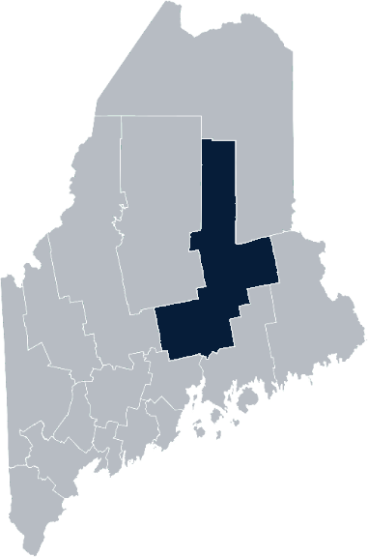
Maine Shared Community Health Needs Assessment Penobscot County
2021

Slide 2
Welcome
Introductions
Overview of Tools
Purpose
Notes:
Welcomes participants
Request folks go ahead and enter their name in the chat box.
Overview and purpose coming up, but first let us introduce ourselves.

Slide 3
The Maine Shared CHNA is a collaboration between the Maine Center for Disease Control and Prevention (Maine CDC), Central Maine Healthcare, Northern Light Health, MaineGeneral Health, and MaineHealth.
Notes:
Local Planning Committee Member

Slide 4
Thank you, forum sponsors
Bangor Public Health and Community Services | Northern Light Eastern Maine Medical Center
Health Access Network | Northern Light Mayo Hospital
Helping Hands with Heart | Northern Light Sebasticook Valley Hospital
Maine Center for Disease Control and Prevention | Penobscot Community Health Care
Millinocket Regional Hospital | Penobscot Valley Hospital
Northern Light Acadia Hospital | St. Joseph Healthcare & Hospital
Northern Light CA Dean Hospital | United Way of Eastern Maine
Notes:
Local Planning Committee Member

Slide 5
Forum agenda
Time | Activity | Penobscot
10:00 – 10:05 am | Welcome and introductions | Patty Hamilton, Director, Bangor Public Health and Community Services
10:05 – 10:10 am | Zoom environment and CHNA background | Jo Morrissey, Program Manager, Maine Shared Community Health Needs Assessment
10:10 – 10:15 am | Leadership remarks | Rand O’Leary, President, Northern Light Eastern Maine Medical Center
10:15 – 10:20 am | Review previous CHNA priorities and activities since last effort | Jessica Fogg, Penquis Public Health District Liaison, Maine CDC
10:20 – 10:45 am | Presentation of key findings from the data | John Snow, Inc.
10:45 – 11:45 am | Break-out session – facilitated discussion on data and health priority identification | John Snow, Inc. & Local Facilitator(s)
11:45 – 11:50 am | Wrap up and next steps | Scott Oxley, President, Northern Light Acadia Hospital
Notes:
Local Planning Committee Member to go over agenda and then turn it over to Jo Morrissey to provide an overview of the Zoom tools available and the purpose of today’s forum

Slide 6
Share screen
Join Audio, Mute On/Off
Open/close participant list or chat
Turn Video On/Off
Reactions
Notes:
Jo or JSI

Slide 7
Matching Interests
Maine Shared
Community Health Needs Assessment
Images of PHAB and IRS from the internet
Notes:
Jo or JSI

Slide 8
Maine Shared CHNA Organizational Chart
Steering Committee
Program Manager
Vendor Support
Metrics Committee
Health Equity Community Engagement Committee
Data Analysis Teams
Local Planning Teams
Notes:
Jo or JSI

Slide 9
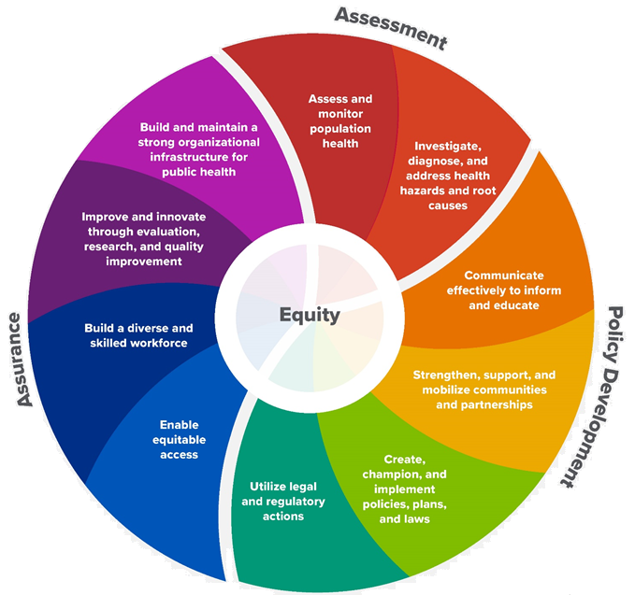
10 Essential Public Health Services
Notes:
Jo or JSI

Slide 10
The Evolution of an Idea…
2010 OneMaine | 2015 SHNAPP | 2018 Maine Shared CHNA | 2021 Maine Shared CHNA
Forums Surveys | 16 Forums 1639 Surveys | 22 Mainstream Forums (live) 2 Immigrant Forums 45 Interviews | 16+ Mainstream Forums (virtual) 12+ Community Sponsored Events 2000+ Oral Surveys
Notes:
Jo or JSI

Slide 11
Inputs and Outcomes
Ways to Provide Input
Data Collected
Outcomes
District & County Reports DUE APRIL 2022
4 Health Priorities by county
Related indicators
Gaps/barriers and resources/assets
Notable comparisons between attendee input and the data.
Description of those who provided input
Methodology
Mainstream county forums
Number of attendees
Where attendees live (not CSE)
List of data identified Forums and CSE only)
Discussion notes (Forums and CSE only)
Chat box comments (Forums and CSE only)
Health Priorities
Gaps and Resources
Community sponsored events
State Report DUE APRIL 2022
4 Health Priorities by Community Event and immigrant population.
Related indicators
Gaps/barriers and resources/assets,
Notable comparisons to mainstream population.
Description of those who provided input
Methodology
Oral Survey
Forums, Events and Surveys conducted Fall 2021
Notes:
Jo or JSI
While we may use different formats to engage with different communities, the data we collect and how we will use that data is very similar.
Introduce Rand O’Leary, President NLH Eastern Maine Medical Center for leadership remarks

Slide 12
Leadership remarks
Notes:
Leadership remarks
Leader to introduce point person for review of previous health improvement efforts.

Slide 13
Local Activities and Accomplishments
Notes:
Local facilitator

Slide 14
Penquis District – Penobscot County Hospital and District priority areas of work since the 2019 Shared CHNA
COVID-19 | Substance use | Mental health
Health Access Network Millinocket Regional Hospital Northern Light Acadia Hospital Northern Light Eastern Maine Medical Center Northern Light Sebasticook Valley Hospital Penobscot Community Health Care Penobscot Valley Hospital Penquis Public Health District (Maine CDC) St. Joseph Healthcare & Hospital | Health Access Network Millinocket Regional Hospital Northern Light Acadia Hospital Northern Light Eastern Maine Medical Center Northern Light Sebasticook Valley Hospital Penobscot Community Health Care Penobscot Valley Hospital Penquis Public Health District (Maine CDC) St. Joseph Healthcare & Hospital | Health Access Network Millinocket Regional Hospital Northern Light Acadia Hospital Northern Light Eastern Maine Medical Center Northern Light Sebasticook Valley Hospital Penobscot Valley Hospital Penquis Public Health District (Maine CDC) St. Joseph Healthcare & Hospital
Bangor Public Health and Community Services and United Way of Eastern Maine’s work spans all categories.
Notes:
Previous CHNA efforts point person

Slide 15
Penquis District – Penobscot County Hospital and District priority areas of work since the 2019 Shared CHNA
Social Determinants of Health | Access to care | Physical activity, nutrition, weight
Millinocket Regional Hospital Northern Light Acadia Hospital Northern Light Eastern Maine Medical Center Northern Light Sebasticook Valley Hospital Penobscot Community Health Care Penquis Public Health District (Maine CDC) St. Joseph Healthcare & Hospital | Millinocket Regional Hospital Northern Light Eastern Maine Medical Center Penobscot Community Health Care Penquis Public Health District (Maine CDC) St. Joseph Healthcare & Hospital | Health Access Network Millinocket Regional Hospital Northern Light Eastern Maine Medical Center Penobscot Community Health Care Penquis Public Health District (Maine CDC) St. Joseph Healthcare & Hospital
Behavioral health | Tobacco use
Penobscot Community Health Care Penquis Public Health District (Maine CDC) | Penobscot Community Health Care Penquis Public Health District (Maine CDC)
Chronic disease | Millinocket Regional Hospital
Healthy aging | Northern Light Sebasticook Valley Hospital
Bangor Public Health and Community Services and United Way of Eastern Maine’s work spans all categories.
Notes:
Previous CHNA efforts point person

Slide 16
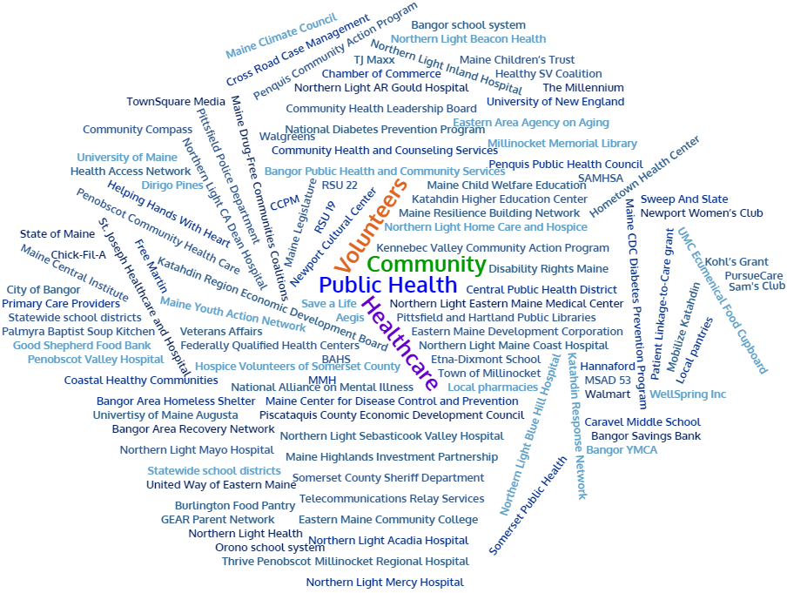
Partners
Notes:
Previous CHNA efforts point person

Slide 17
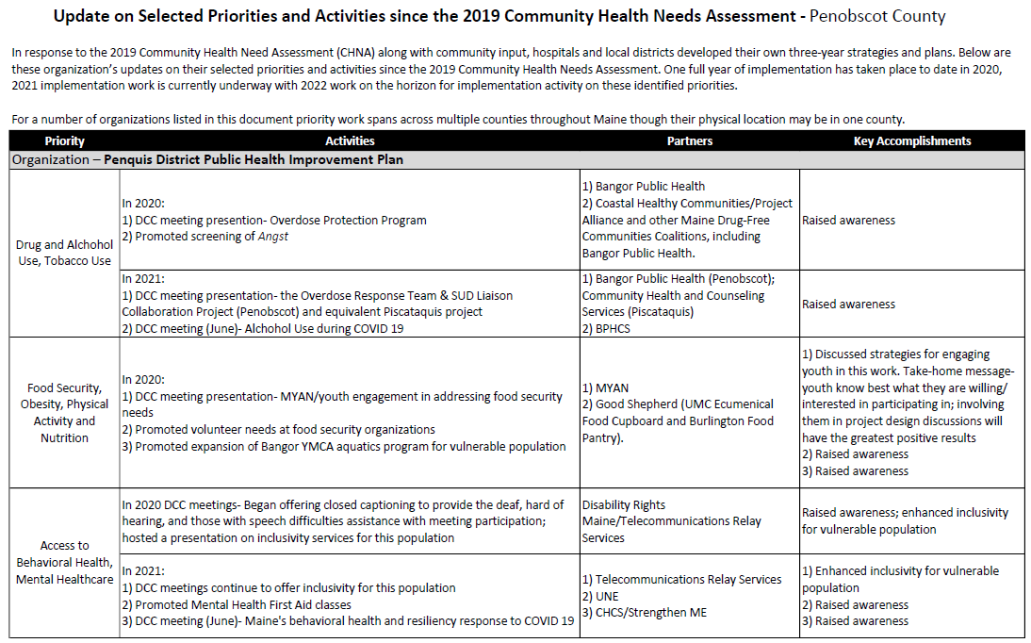
Accomplishments of Note
Update on selected priorities and activities since the 2019 Shared CHNA
Notes:
Previous CHNA efforts point person
Introduce Madison MacLean from JSI who will provide us an overview of relevant data to Penobscot County

Slide 18
How to Read the County Health Profiles and Health Equity Data Sheets

Slide 19
How to Read County Health Profile
CHANGE shows statistically significant changes in the indicator over time, based on 95% confidence interval (see description on page 3).
ê | means the health issue or problem is getting better over time.
! | means the health issue or problem is getting worse over time.
○ | means the change was not statistically significant.
N/A | means there is not enough data to make a comparison.
BENCHMARK compares [COUNTY] data to state and national data, based on 95% confidence interval (see description on page 3).
ê | means [COUNTY] is doing significantly better than the state or national average.
! | means [COUNTY is doing significantly worse than the state or national average.
○ | means there is no statistically significant difference between the data points.
N/A | means there is not enough data to make a comparison.
ADDITIONAL SYMBOLS
* | means results may be statistically unreliable due to small numbers, use caution when interpreting.
— | means data is unavailable because of lack of data or suppressed data due to a small number of respondents.
EXAMPLE
Notes:
JSI or other facilitator
A star means that the health issue or problem is getting better over time or better in comparison to another place
A red exclamation point means that the health issue or problem is getting worse over time or worse in comparison to another place
A gray circle means that the dating hasn’t changed over time or isn’t much different in comparison to another place
N/A means that there was not enough data to be able to make a comparison
There are two additional symbols you might see:
A black dot means that you should use caution when interpreting the data – the results might be unreliable because of small numbers
A black dash means that data was unavailable, or that data was suppressed due to a small number of respondents
(Go to next slide and walk audience through an example)

Slide 20
How to Read County Health Profile
EXAMPLE
 | AROOSTOOK COUNTY |  |  | BENCHMARKS
INDICATOR | POINT 1 | POINT 2 | CHANGE | MAINE | +/- | U.S. | +/-
Individuals living in poverty | 2009-2011 15.6% | 2015-2019 16.1% | ¡ | 2015-2019 11.8% | ! | 2019 12.3% | N/A
Notes:
The charts in this presentation are all excerpts from the Data Health Profiles that were created by MaineHealth and the Maine CDC. They contain data pulled from publicly available sources that are designed to help people learn more about the health of their communities. Not all the data points are available for every measure, but we’ve included data wherever we can.
There are some important notes about the data here that will help you understand it. First, the data comes from many sources. We’ve included those sources in the Data Health Profiles- you can get a copy to review from the presenter.
Every data point is accompanied by a year. This is the year the measurement was taken. It is important to know that when multiple years are presented, or a range of years (as in this slide), the data refers to measurement that includes ALL the years indicated. It is NOT an average of the data from those years. It combines data from across those years into a single measurement.

Slide 21
How to Read County Health Profile
EXAMPLE
 | AROOSTOOK COUNTY |  |  | BENCHMARKS
INDICATOR | POINT 1 | POINT 2 | CHANGE | MAINE | +/- | U.S. | +/-
Individuals living in poverty | 2009-2011 15.6% | 2015-2019 16.1% | ¡ | 2015-2019 11.8% | ! | 2019 12.3% | N/A
Notes:
Here’s an example of how we’ve visualized the data in the County Health Profiles.
The charts in this presentation are all excerpts from the Data Health Profiles that were created by MaineHealth and the Maine CDC. They contain data pulled from publicly available sources that are designed to help people learn more about the health of their communities. Not all the data points are available for every measure, but we’ve included data wherever we can.
The green bars represent data from your community. The left most one represents a past data point, and the right bar represents the most recent data point available when the data was gathered. These are the same data points used in the Data Health Profiles.
The grey bars represent data for the state of Maine as a whole- on the left- and for the United States as a whole- on the right, when it is available.
We’ve also noted where differences in the data points are ‘statistically significant’. A difference between two measurements is significant when scientists can say, with a known degree of confidence, that the difference between them is large enough that the difference is most likely to be caused by an actual difference in the item being measured, and not caused by error associated taking the measurement. All of these tests are comparing the most recent data point for your community to other data points. A red exclamation mark indicates a difference that your community is significantly different in a less desirable direction compared to the data point with the symbol. A green star indicates that your community is significantly different in a more desirable direction. A grey circle indicates that there is no significant difference.
(keep in presentation – do not read for deaf/HOH event or people with disabilities). A difference between two measurements is significant when scientists can say, with a known degree of confidence, that the difference between them is large enough that the difference is most likely to be caused by an actual difference in the item being measured, and not caused by an error associated taking the measurement. All of these tests are comparing the most recent data point for your community to other data points.
For example, in this slide, we have two symbols. The grey circle next to the measurement for 2009-2011 Aroostook County means that there is no significantly different change in the rate of poverty in Aroostook County when comparing the data from 2009-2011 to the data from 2015-2019. The red exclamation mark next to the Maine data point says there is a significant difference between 2015-2019 Aroostook County and 2015-2019 Maine, and that it is less desirable that Aroostook County has a higher rate of individuals living in poverty. No comparison could be made to the data for the U.S. because the years of data collection were different.

Slide 22
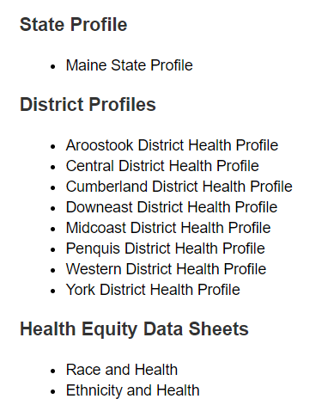
For More Data
www.mainechna.org
Notes:
The Maine Shared CHNA website contains health profiles for 3 of Maine’s largest cities, 16 counties, 5 public health districts, the state, as well as data provided by race, ethnicity, educational attainment, gender, sexual orientation, older adults, insurance status, income, and rurality.
IN addition, there is an interactive data portal where you can search by specific data points. All these breakdowns are then provided by data point.

Slide 23
Key Findings
Notes:
As you listen to the following data presentation
Take notes on any questions you may have, things that stand out to you, and data that is of particular concern to you.
We will be discussing this data in the next portion of our event.

Slide 24
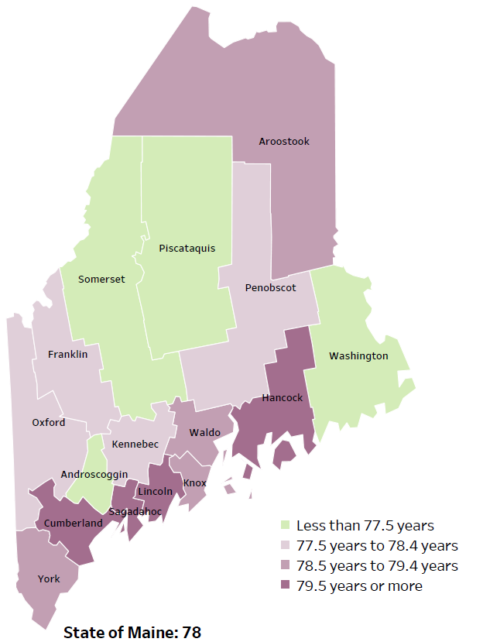
Demographics
Life Expectancy
2017-2019
National Center for Health Statistics,
CDC
RANK | MAINE | Penobscot County
1 | Cancer | Cancer
2 | Heart Disease | Heart Disease
3 | Unintentional Injury | Unintentional Injury
4 | Chronic Lower Respiratory Disease | Chronic Respiratory Disease
5 | Stroke | Stroke
Notes:
The life expectancy in Penobscot County is 77.7, which is slightly below the state average of 78. Penobscot County’s life expectancy is ranked 11th out of 16 in the state. This is an indication that more people are dying at younger ages than residents in many other counties in Maine.
The table on the right side of the slides shows the five leading causes of death in Penobscot County. They are also the leading causes of death for the whole state of Maine.
The leading cause of death is cancer, the same as the state leading cause of death. As we will see later in the presentation, Penobscot has a high rate of new cancer cases per 100,000 population, skin cancer diagnoses and higher smoking rates among students, which is reflected as the leading causes of death.
Some highlights:
In Penobscot County and Maine overall, the leading cause of death is Cancer followed by Heart Disease. The opposite is true in the U.S. overall- Heart Disease is the leading cause of death, and cancer is the 2nd leading cause. One of the reasons that this is true is because we have higher rates of risk factors for cancer, such as smoking/tobacco use. At the same time, there has been a lot of success implementing treatment of heart disease, resulting in folks with heart disease living longer.
The 3rd leading cause of death- Unintentional Injury- includes a number of accidental causes: Three of the most common causes are i) Deaths due to motor vehicle crashes, ii) deaths due to accidental falls, and iii) deaths due to poisonings that either were unintentional or the intent was undetermined. Suicides and Firearm deaths are classified as intentional injury.

Slide 25
Demographics
Age distribution for Penobscot County
AGE
PENOBSCOT COUNTY
POPULATION
151,774
STATE OF MAINE
POPULATION
1,362,359
Notes:
Penobscot County has the 3rd largest population of any Maine County after Cumberland and York. The population has fewer adults between 35 and 45 than adolescents and young adults. There are more children and young adults and fewer adults over the age of 65, and more adults of the age where they might expect to have children.
Source: US Census Bureau, American Community Survey

Slide 26
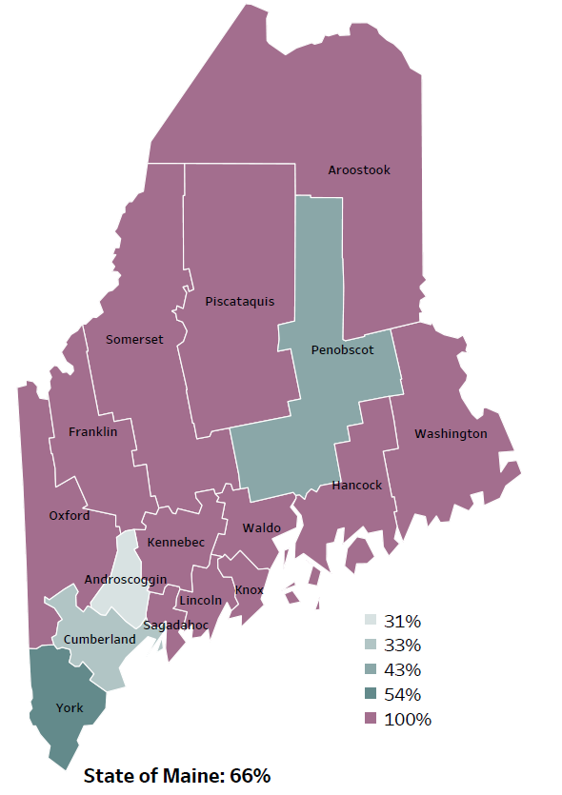
Demographics
Percentage of people living in
rural areas
2019
New England Round Table for Rural Health
Notes:
Penobscot County is one of 4 counties with a population in a metro area. These data are based on the most recent Census estimates at the Zip-code level, and calculated use rural Urban Commuting Area codes. The categories were established by the New England Rural Health Association. This data is NOT comparable to 2010 US Census data on populations living in rural areas, as that data uses a different definition for rural
Source: Data, Research and Vital Statistics town-level population file

Slide 27
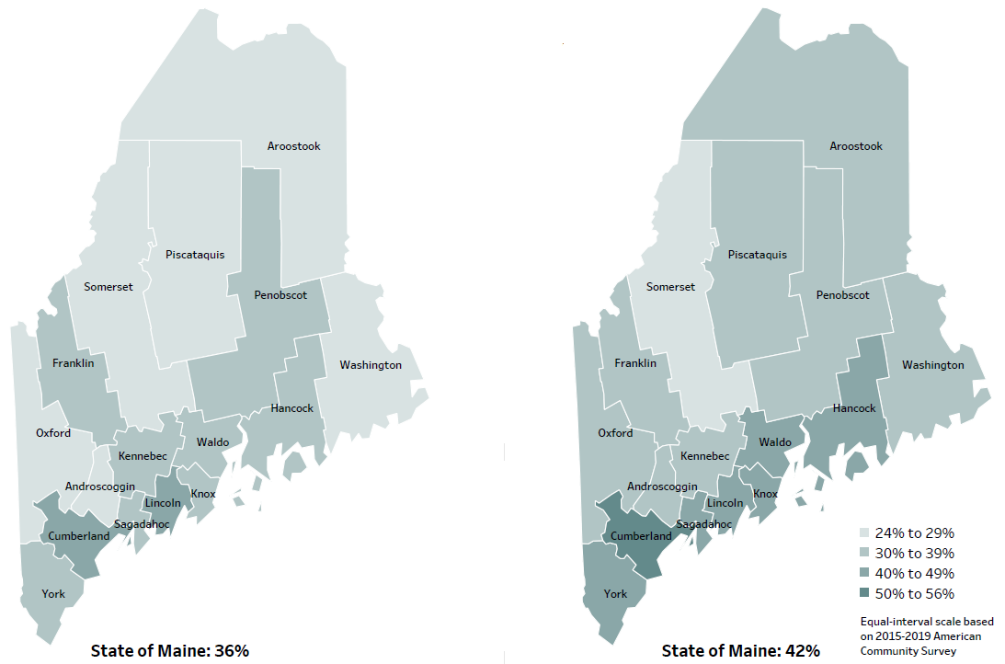
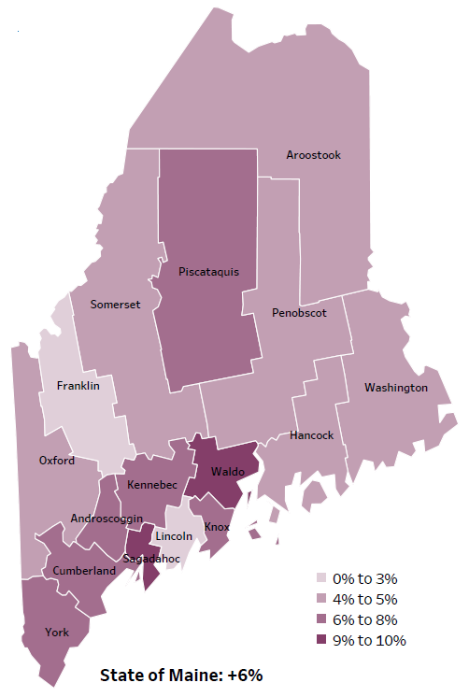
Demographics
Percent of population over age 25 with an associate’s degree or higher
2010
American Community
Survey
Change in percent of population over age 25 with an associate’s degree or higher
2010 to 2015-2019
2015-2019
American Community
Survey
Notes:
These maps show the educational attainment of adults over 25 for two different time periods. Penobscot County has had an increase in the rate of adults who have achieved an associate’s degree or higher degree of education. This is highlighted in the change over time map, which shows that this was a greater increase than 2 other counties and equal to 6 other counties.
Source: US Census Bureau, American Community Survey

Slide 28
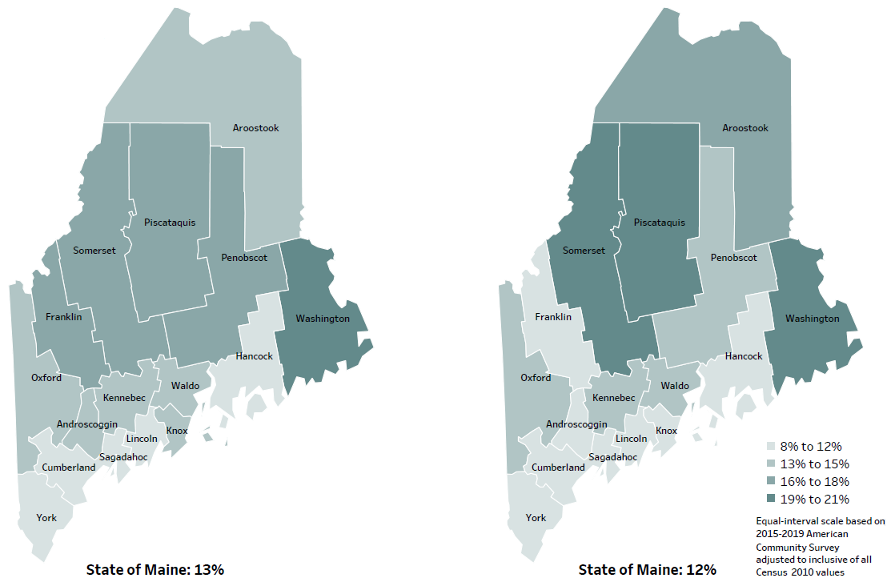
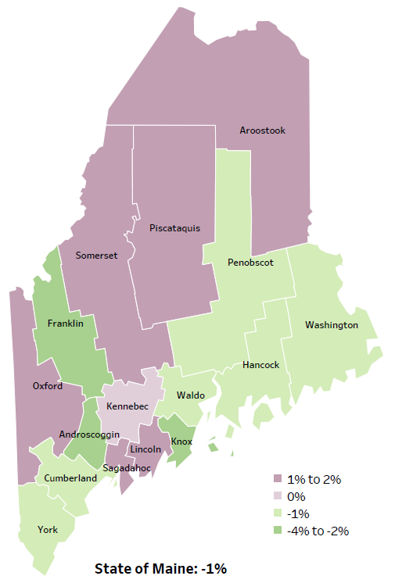
Demographics
Percent of population in poverty
2010
American Community
Survey
Change in percent of population in poverty
2010 to 2015-2019
2015-2019
American Community
Survey
Notes:
These maps show the rate of poverty for two different time periods. Penobscot county’s poverty rate has decreased slightly over the time period, as shown in the change over time map. During this period, poverty decreased in Maine overall.
Source: US Census Bureau, American Community Survey

Slide 29
Health Indicators
Notes:
This slide shows the percentage of adults who report their physical health was not good during the past 14 days. The rate of adults reporting poor health in Penobscot County is significantly higher than the state overall and has increased over time within the county.
Data Source: Behavioral Risk Factor Surveillance System

Slide 30
Health Indicators
Notes:
This indicator represents the rate per 100,000 people of the total number of years lost before the age of 75. This is calculated by subtracting the age at which a person died from 75, then adding all those years together. It helps do describe how many people die of premature death.
As you can see, the rate of life lost in Penobscot County is significantly higher than Maine overall. The rate is rising within the county, but this difference over time is not significant.
Data Source: County Health Rankings

Slide 31
Health Indicators
Notes:
Penobscot County has a significantly higher rate of uninsured than the state, however rates have improved significantly within the county when compared to 2009-2011.
Source: US Census Bureau, American Community Survey

Slide 32
Health Indicators
Notes:
Cancer deaths in Penobscot County have increased over time, but not significantly. However, they are significantly higher than cancer deaths in the state. These data are age-adjusted, meaning that we have calculated the rates so that they can be compared to other parts of the state that might have a younger population. Older people tend to have higher rates of many diseases, including cancer. It’s important to adjust for age so that we don’t accidentally mistake a place with older people for a place with an unusual number of disease-related deaths.
Data Source: Maine Cancer Registry

Slide 33
Health Indicators
Notes:
This chart shows the rate per 100,000 people who have been diagnosed with new cases of melanoma of the skin. Penobscot County’s rate is significantly higher than the state and rates have also risen significantly within the county.
Data Source: Maine Cancer Registry

Slide 34
Health Indicators
Notes:
This graph shows that cardiovascular disease deaths have gone down significantly in Penobscot County over time but are still significantly higher that the state. Again, this data is age adjusted, so the difference is NOT affected by Penobscot’s older population.
Data Source: Maine CDC Vital Records

Slide 35
Health Indicators
Notes:
This chart shows the rate per 10,000 people of hospital discharges with a principal diagnosis of hypertension. The rate of hospitalizations are significantly higher in Penobscot County when compared to both the state and 2016-2017 county rates.
Data Source: Maine Health Data Organization Hospital Inpatient Database

Slide 36
Health Indicators
Notes:
The number of obese adults has improved within Penobscot County since 2016, but not to a significant degree. The rates of obesity are slightly higher than the state, but that difference is not significant.
Data Source: Behavioral Risk Factor Surveillance System

Slide 37
Health Indicators
Notes:
Obesity among high school students has increased in Penobscot County since 2017 and are higher than the state overall. These differences are not significant.
Data Source: Maine Integrated Youth Health Survey

Slide 38
Health Indicators
Notes:
This graph shows that injury deaths have increased significantly in Penobscot County. Rates of injury deaths in Penobscot County are also higher than the state overall, but not significantly.
Data Source: Maine CDC Vital Records

Slide 39
Health Indicators
Notes:
Fall-related deaths have increased significantly in Penobscot County. The rates are slightly lower than the state overall. These differences are not significant.
Data Source: Maine CDC Vital Records

Slide 40
Health Indicators
Notes:
The rates of poisoning deaths within Penobscot County have increased significantly since 2007-2011. This indicator shows unintentional or undetermined poisoning, meaning these deaths are not due to suicide or other intentional injuries. While Penobscot County’s rate of deaths is slightly higher than the state of Maine’s, this difference is not significant.
Data Source: Maine CDC Vital Records

Slide 41
Health Indicators
Notes:
The rate of suicide deaths increased slightly over time in Penobscot County and are slightly lower than Maine as a whole. None of these differences are significantly different.
Source: Maine CDC Vital Records

Slide 42
Health Indicators
Notes:
The rate of depression among Penobscot County adults is significantly higher than the overall state rates. The change is not significant over time within Penobscot County.
Data Source: Behavioral Risk Factor Surveillance System

Slide 43
Health Indicators
Notes:
The number of high school students in Penobscot County who report feeling sad or hopeless for two weeks in a row has increased significantly since 2017. This is a small population so a small increase in students reporting symptoms could cause a significant change, however it is clear that the mental health of these students should be a priority.
Source: Maine Integrated Youth Health Survey

Slide 44
Health Indicators
Notes:
The number of overdose deaths have increased in Penobscot County after a short period of decline in 2018 and 2019. The rates are significantly higher than the state and the over time change within the county is also significant. These increases could be attributed to the opioid crisis in the state and across the country.
Source: Maine Office of the Medical Examiner

Slide 45
Health Indicators
Notes:
This graph shows rate of deaths for which drugs are the underlying cause, including those attributable to acute poisoning by drugs and those from medical conditions resulting from chronic drug use. Deaths due to alcohol use are not included. The rate of drug-induced deaths among Penobscot County residents is significantly higher with in the county, but not when compared to the state.
Source: Maine CDC Vital Records and CDC WONDER Online Database

Slide 46
Health Indicators
Notes:
Similar to the last slide, rates of alcohol-induced deaths are increasing in Penobscot County. Rates are also higher than the state, but this difference is not significant.
Source: Maine CDC Vital Records and CDC WONDER Online Database

Slide 47
Health Indicators
Notes:
This chart shows that chronic heavy drinking is rising among Penobscot County adults, but not to a significant degree. Men who have more than two drinks per day and women who have more than one drink per day are included in this measure.
Data Source: Behavioral Risk Factor Surveillance System

Slide 48
Health Indicators
Notes:
Binge drinking is defined as having five or more alcoholic drinks on at least one day in the last 30 days. This graph shows a decrease in reported binge drinking among high school students since 2019. The difference is significant within the county, but not the state.
Data Source: Maine Integrated Youth Health Survey

Slide 49
Health Indicators
Notes:
The use of e-cigarettes has increased significantly within Penobscot County since 2017. The rates are not significantly different from the state overall.
Data Source: Maine Integrated Youth Health Survey

Slide 50
Health Indicators
Notes:
Similar to high school students, the use of e-cigarettes has increased significantly among middle school students in Penobscot County. Use is slightly higher than the state, but the difference is not significant.
Data Source: Maine Integrated Youth Health Survey

Slide 51
Breakout Discussions

Slide 52
Reconvene

Slide 53
Wrap up and Next Steps

Slide 54
Contacts
Jessica Fogg, Penquis District Public Health Liaison, Jessica.fogg@maine.gov 207-561-4421
Nicole Hammar, Community Health Improvement Manager, Northern Light Health nhammar@northernlight.org 207-973-7245
Rick Redmond, AVP, Community Partnerships and Service Line Dev., Northern Light Acadia Hospital, rredmond@northernlight.org 207-973-6811
Ali Worster, VP, Human Resources and Patient Experience, Northern Light Eastern Maine Medical Center, aworster@northernlight.org 207-973-7067
Maine Shared CHNA: info@mainechna.org

