Slide 1
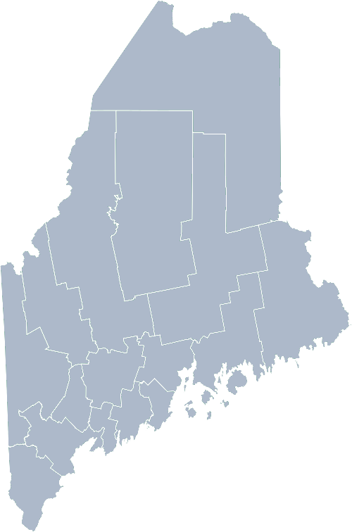
Maine Shared Community Health Needs Assessment People with Mental Health Diagnosis
2021

Slide 2
The Maine Shared CHNA is a collaboration between the Maine Center for Disease Control and Prevention (Maine CDC), Central Maine Healthcare, Northern Light Health, MaineGeneral Health, and MaineHealth.
Notes:
Local Planning Committee Member

Slide 4
Today’s Agenda
Time | Activity | Speaker/Facilitator
5:00 – 5:10 | Welcome and Introductions Housekeeping | Jo Morrissey, Maine Shared CHNA Program Manager
5:10 – 5:25 | Leadership Remarks | Melissa Caswell, Communications Coordinator, Consumer Council System of Maine Vickie McCarty, Consumer Council System of Maine
5:25 – 5:50 | Presentation of key findings from the data | John Snow, Inc.
5:50 – 6:50 | Break-out session – facilitated discussion on data and health priority identification | Local Facilitators
6:50 – 7:00 | Wrap up and next steps | Melissa Caswell, Communications Coordinator, Consumer Council System of Maine Vickie McCarty, Consumer Council System of Maine Jo Morrissey, Maine Shared CHNA Program Manager
Notes:
Jo Morrissey to provide an overview of agenda, the Zoom tools available and the purpose of today’s forum, and a bit about the MSCHNA

Slide 5
Share screen
Join Audio, Mute On/Off
Open/close participant list or chat
Turn Video On/Off
Reactions
Notes:
Jo or JSI

Slide 6
Matching Interests
Maine Shared
Community Health Needs Assessment
Images of PHAB and IRS from the internet
Notes:
Jo or JSI

Slide 7
The Evolution of an Idea…
2010 OneMaine | 2015 SHNAPP | 2018 Maine Shared CHNA | 2021 Maine Shared CHNA
Forums Surveys | 16 Forums 1639 Surveys | 22 Mainstream Forums (live) 2 Immigrant Forums 45 Interviews | 16+ Mainstream Forums (virtual) 10+ Community Sponsored Events 1000+ Oral Surveys
Notes:
Jo or JSI

Slide 8
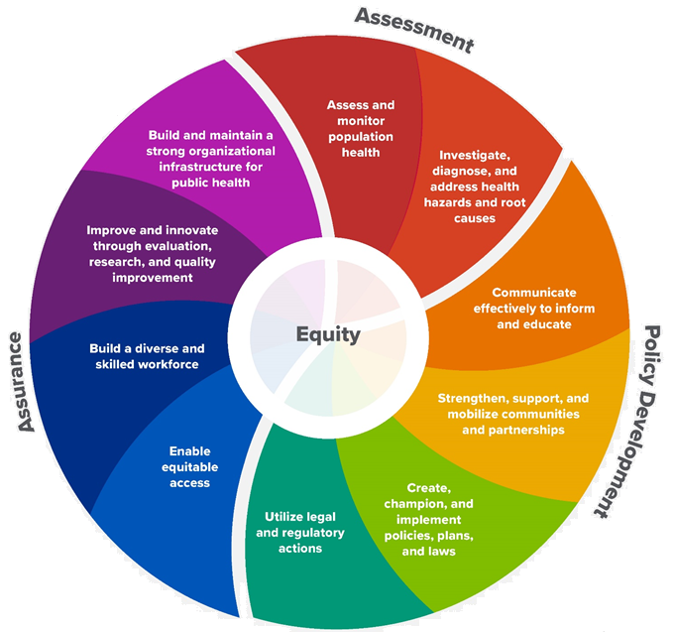
10 Essential Public Health Services
Notes:
Jo or JSI

Slide 9
Maine Shared CHNA Organizational Chart
Steering Committee
Program Manager
Vendor Support
Metrics Committee
Health Equity Community Engagement Committee
Data Analysis Teams
Local Planning Teams
Notes:
Jo or JSI

Slide 10
Inputs and Outcomes
Ways to Provide Input
Data Collected
Outcomes
District & County Reports DUE APRIL 2022
4 Health Priorities by county
Related indicators
Gaps/barriers and resources/assets
Notable comparisons between attendee input and the data.
Description of those who provided input
Methodology
Mainstream county forums
Number of attendees
Where attendees live (not CSE)
List of data identified Forums and CSE only)
Discussion notes (Forums and CSE only)
Chat box comments (Forums and CSE only)
Health Priorities
Gaps and Resources
Community sponsored events
State Report DUE APRIL 2022
4 Health Priorities by Community Event and immigrant population.
Related indicators
Gaps/barriers and resources/assets,
Notable comparisons to mainstream population.
Description of those who provided input
Methodology
Oral Survey
Forums, Events and Surveys conducted Fall 2021
Notes:
Jo or JSI
Community Sponsored Event Partners include
Disability Rights Maine (2 events: people who are deaf or hard of hearing and people with other disabilities)
Maine Primary Care Association (People who are served by Maine’s Federally Qualified Health Centers
Maine Council on Aging (Older Adults 65+
Consumer Right Council of Maine (people with a mental health diagnosis)
Formerly Incarcerated (Maine Prisoner Re-Entry Network)
Maine Youth Action Network and Friends (Raising the voices of Maine’s diverse youth)
Green Memorial A.M.E. Zion Church (Black/African American)
Health Equity Alliance (LGBTQ+ community)
Portland Recovery Center (for people with a substance use disorder or in recovery)
ADD HOUSING INSECURE IF NEED BE
ADD VETERAN IF NEED BE
Oral Survey Partners include:
City of Portland’s Minority Health Program
New Mainer’s Public Health Initiative
Maine Immigrant Access Network
Gateway Community Services
Maine Immigrant and Refugee Services
Maine Community Integration
Mano en Mano
We are piloting these additional outreach methods with support from
State of Maine’s Preventative Health and Health Services Block Grant
Maine Health Access Foundation
Introduce leader for leadership remarks

Slide 21
How to Read the County Health Profiles and Health Equity Data Sheets
Notes:
JSI or other facilitator

Slide 22
How to Read County Health Profile
CHANGE shows statistically significant changes in the indicator over time, based on 95% confidence interval (see description on page 3).
ê | means the health issue or problem is getting better over time.
! | means the health issue or problem is getting worse over time.
○ | means the change was not statistically significant.
N/A | means there is not enough data to make a comparison.
BENCHMARK compares [COUNTY] data to state and national data, based on 95% confidence interval (see description on page 3).
ê | means [COUNTY] is doing significantly better than the state or national average.
! | means [COUNTY is doing significantly worse than the state or national average.
○ | means there is no statistically significant difference between the data points.
N/A | means there is not enough data to make a comparison.
ADDITIONAL SYMBOLS
* | means results may be statistically unreliable due to small numbers, use caution when interpreting.
— | means data is unavailable because of lack of data or suppressed data due to a small number of respondents.
EXAMPLE
Notes:
JSI or other facilitator
A star means that the health issue or problem is getting better over time or better in comparison to another place
A red exclamation point means that the health issue or problem is getting worse over time or worse in comparison to another place
A gray circle means that the dating hasn’t changed over time or isn’t much different in comparison to another place
N/A means that there was not enough data to be able to make a comparison
There are two additional symbols you might see:
A black dot means that you should use caution when interpreting the data – the results might be unreliable because of small numbers
A black dash means that data was unavailable, or that data was suppressed due to a small number of respondents
(Go to next slide and walk audience through an example)

Slide 23
How to Read County Health Profile
EXAMPLE
 | AROOSTOOK COUNTY |  |  | BENCHMARKS
INDICATOR | POINT 1 | POINT 2 | CHANGE | MAINE | +/- | U.S. | +/-
Individuals living in poverty | 2009-2011 15.6% | 2015-2019 16.1% | ¡ | 2015-2019 11.8% | ! | 2019 12.3% | N/A
Notes:
Here’s an example of how we’ve visualized the data in the County Health Profiles.
The charts in this presentation are all excerpts from the Data Health Profiles. They contain data pulled from publicly available sources that are designed to help people learn more about the health of their communities. Not all the data points are available for every measure, but we’ve included data wherever we can.
The green bars represent data from your community. The left most one represents a past data point, and the right bar represents the most recent data point available when the data was gathered. These are the same data points used in the Data Health Profiles.
The grey bars represent data for the state of Maine as a whole- on the left- and for the United States as a whole- on the right, when it is available.
We’ve also noted where differences in the data points are ‘statistically significant’. A difference between two measurements is significant when scientists can say, with a known degree of confidence, that the difference between them is large enough that the difference is most likely to be caused by an actual difference in the item being measured, and not caused by error associated taking the measurement. All of these tests are comparing the most recent data point for your community to other data points. A red exclamation mark indicates a difference that your community is significantly different in a less desirable direction compared to the data point with the symbol. A green star indicates that your community is significantly different in a more desirable direction. A grey circle indicates that there is no significant difference.
For example, in this slide, we have two symbols. The grey circle next to the measurement for 2009-2011 Aroostook County means that there is no significantly different change in the rate of poverty in Aroostook County when comparing the data from 2009-2011 to the data from 2015-2019. The red exclamation mark next to the Maine data point says there is a significant difference between 2015-2019 Aroostook County and 2015-2019 Maine, and that it is less desirable that Aroostook County has a higher rate of individuals living in poverty. No comparison could be made to the data for the U.S. because the years of data collection were different.

Slide 24
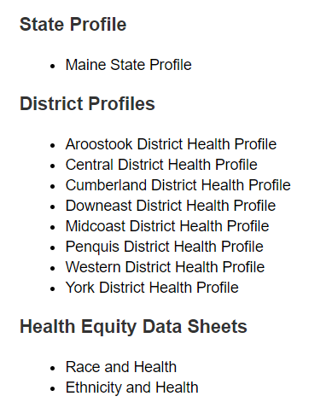
For More Data
www.mainechna.org
Notes:
The Maine Shared CHNA website contains health profiles for 3 of Maine’s largest cities, 16 counties, 5 public health districts, the state, as well as data provided by race, ethnicity, educational attainment, gender, sexual orientation, older adults, insurance status, income, and rurality.
IN addition, there is an interactive data portal where you can search by specific data points. All these breakdowns are then provided by data point.
REGARDING COVID-19 DATA
The Maine Shared CHNA data set does not include any data of COVID-19. This is largely due to the fact that there is a much more up-to-date and comprehensive Maine Data Dashboard continually being updated on the Maine CDC website.
Here you can find daily lab results, new case counts by date, trends, county breakdowns, data by race, and comparisons to other states and the nation.

Slide 25
Key Findings
Notes:
As we walk through the following data slides together, take notes. What surprises you? What stands out? What’s moving in the wrong direction?
Once the data presentation is over, you will be divided into breakout groups to discuss the data, share your top concerns, identify your top priorities, and share your knowledge about what’s working and what we need to work on to address those top concerns.
Ready? Here we go.

Slide 26
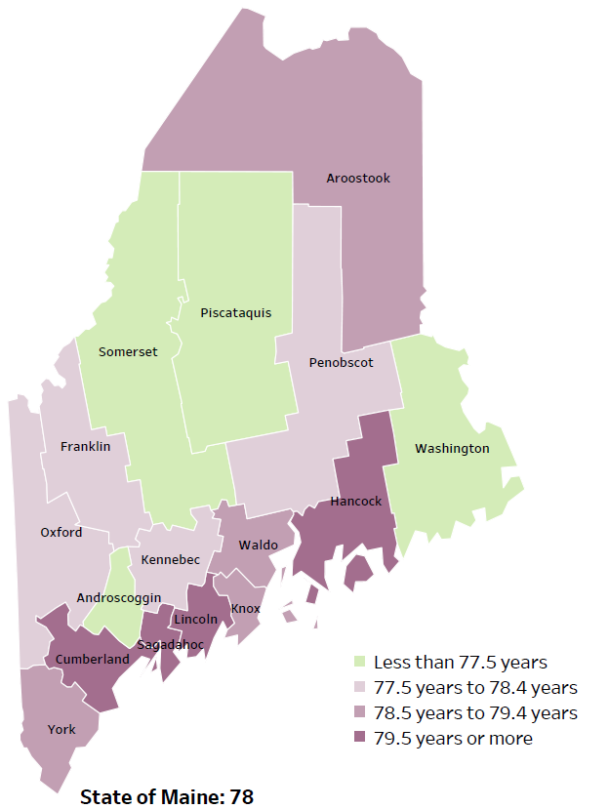
Demographics
Life Expectancy
2017-2019
National Center for Health Statistics,
CDC
Leading Causes of Death
RANK | MAINE
1 | Cancer
2 | Heart Disease
3 | Unintentional Injury
4 | Chronic Lower Respiratory Disease
5 | Stroke
Notes:
The life expectancy in Maine is 78, which is slightly lower than the U.S. life expectancy of 78.7. You can see in the map on the left that life expectancy varies across Maine’s 16 counties. Life expectancy is certainly influenced by individuals’ choices and behaviors related healthy lifestyles, but it is important to note that life expectancy is also influenced by the social and economic resources that individuals, families or communities have available for buying healthy foods, paying co-pays for doctor visits or medications.
The table on the right side of the slides shows the five leading causes of death in Maine. They are also the leading causes of death for many of the counties.
The leading cause of death is cancer. As we will see later in the presentation, Maine has both cost and location barriers to health care, which can impact cancer outcomes.
Some highlights:
Heart Disease is the 2nd leading cause of death. Maine residents have high rates of obesity, and many live a sedentary lifestyle.
The 3rd leading cause of death- Unintentional Injury- includes a number of accidental causes: Three of the most common causes are i) Deaths due to motor vehicle crashes, ii) deaths due to accidental falls, and iii) deaths due to poisonings that either were unintentional, or the intent was undetermined. Suicides and Firearm deaths are classified as intentional injury.

Slide 27
Demographics
Age distribution for Maine
AGE
STATE OF MAINE
POPULATION
1,362,359
STATE OF MAINE
MEDIAN AGE
44.7
Notes:
Maine has a population of about 1.4 million. The population is aging and is one of the oldest states in the country. There are fewer children and young adults and more adults over the age of 65. This is particularly true in more rural parts of the state.
Source: US Census Bureau, American Community Survey

Slide 28
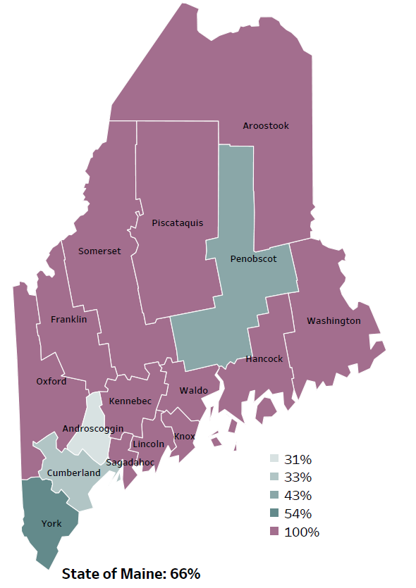
Demographics
Percentage of people living in
rural areas
2019
New England Round Table for Rural Health
Notes:
Maine is a largely rural area with only 4 counties with metro areas. Any County that you see in purple is 100% rural - As you can see on this map, that’s the case for 12 of Maine’s 16 counties.
Statewide, 66% of the state population reside in a rural area. These data are based on the most recent Census estimates at the Zip-code level, and calculated use rural Urban Commuting Area codes.
Source: Data, Research and Vital Statistics town-level population file

Slide 29
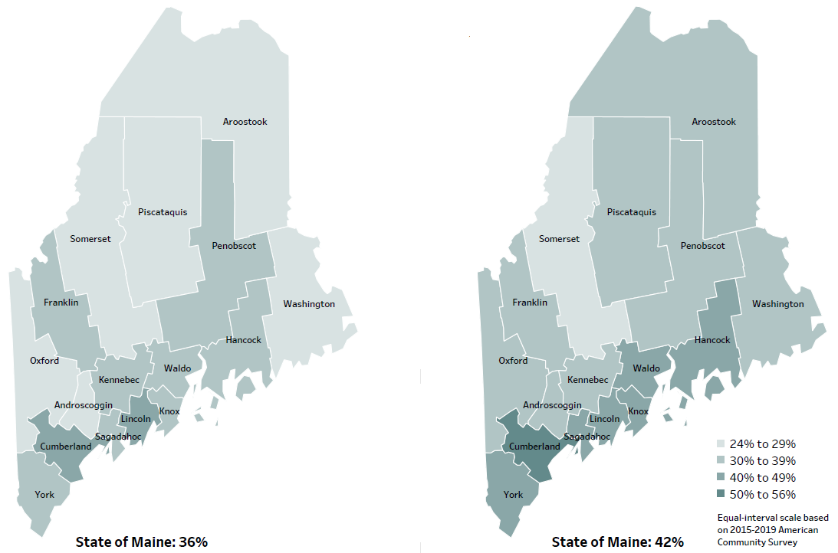
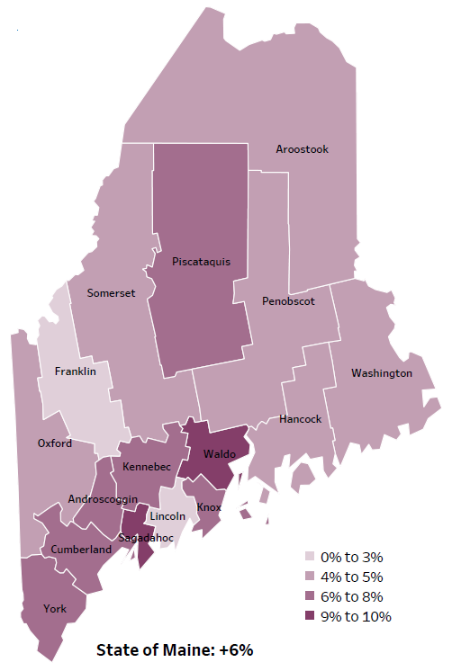
Demographics
Percent of population over age 25 with an associate’s degree or higher
2010
American Community
Survey
Change in percent of population over age 25 with an associate’s degree or higher
2010 to 2015-2019
2015-2019
American Community
Survey
Notes:
These maps show the educational attainment of adults over 25 for two different time periods. Maine has had an increase in the rate of adults who have attained an associate’s degree or higher degree of education with a 6% change between 2010 and 2015-2019. However, the degree of increase varies across Maine’s counties.
Source: US Census Bureau, American Community Survey

Slide 30
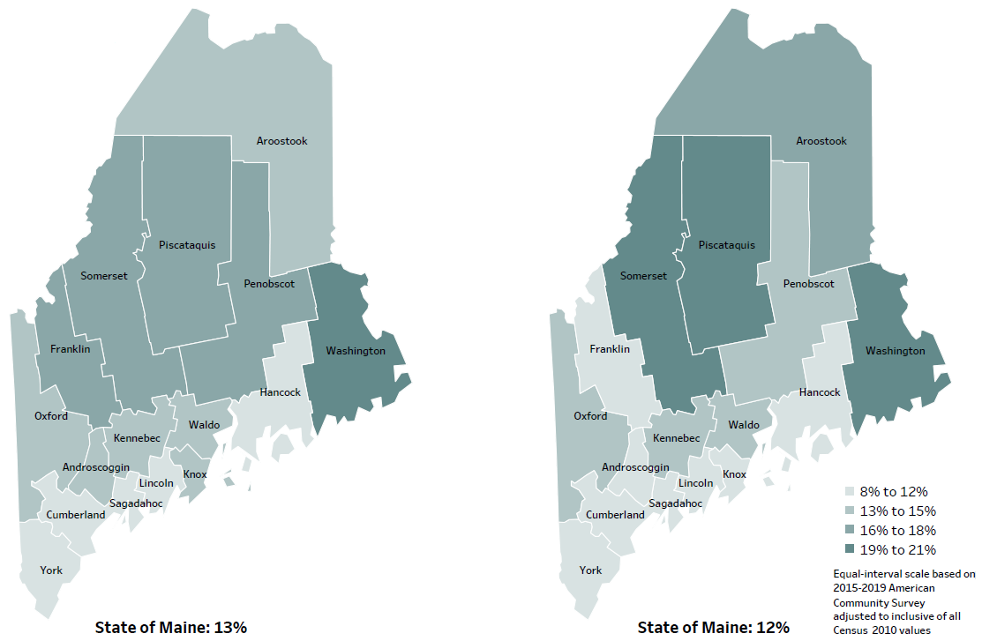
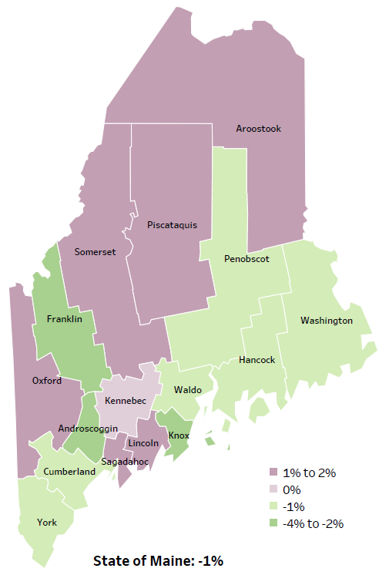
Demographics
Percent of population in poverty
2010
American Community
Survey
Change in percent of population in poverty
2010 to 2015-2019
2015-2019
American Community
Survey
Notes:
These maps show the rate of poverty for two different time periods. Overall, the percent of Maine’s population living in poverty has decreased over time. However, Maine has 6 counties that have had an increase in poverty levels between 2010 and 2015-2019 these counties are shaded in purple in the map on the right-hand side of the slide.
Source: US Census Bureau, American Community Survey

Slide 31
Health Indicators
Notes:
Maine has a higher percentage of veterans when compared to the US overall – approximately 10% of Maine’s population are Veterans, compared to approximately 7% in the US overall.
Data Source: US Census Bureau, American Community Survey To be read as needed. Definition: Percentage of residents who are veterans.

Slide 32
Health Indicators
Notes:
Maine has seen a steady increase in high school students self-identifying as gay, lesbian or bisexual – from 6% in 2011 to 12% in 2019. This may be due to changing norms that have allowed students to feel more comfortable disclosing this information.
Data Source: Maine Integrated Youth Health Survey To be read as needed. Definition: Percentage of high school students who identify as gay, lesbian, or bisexual. Data collected in odd numbered years.

Slide 33
Health Indicators
Notes:
As of 2019, 1.6% of Maine high school students are transgender.
Data Source: Maine Integrated Youth Health Survey To be read as needed. Definition: Percentage of high school students who identify as transgender. Data collected in odd numbered years.

Slide 34
Health Indicators
Notes:
Maine is more likely than US to have people who identify as having a disability. Six types of disability are included in this metric: hearing difficulty, vision difficulty, cognitive difficulty, ambulatory difficulty, self-care difficulty, independent living difficulty. The higher percentage with a disability may be linked to Maine’s higher average age.
Data Source: US Census Bureau, American Community Survey To be read as needed. Definition: Percentage of residents who report having any one of the six disability types: hearing difficulty, vision difficulty, cognitive difficulty, ambulatory difficulty, self-care difficulty, independent living difficulty.

Slide 35
Health Indicators
Notes:
Adverse Childhood Experiences, commonly referred to as ACES, have a significant impact on development and later achievement. This chart shows the percentage of high school students who report at least 4 out of 10 adverse events – over 20%. These events may include abuse, neglect, witnessing domestic violence or parental separation.
Data Source: Maine Integrated Youth Health Survey To be read as needed. Definition: Percentage of high school students who report at least four out of nine adverse childhood experiences. Data collected in odd numbered years.

Slide 36
Health Indicators
Notes:
These chart shows the percentage of adults who report their mental health was not good during 14 or more out of the past 30 days. Put another way, one out of every eight adults reported their mental health was not good for over half the month. The state rate is similar to the US overall and have remained relatively stable over time.
Data Source: Behavioral Risk Factor Surveillance System To be read as needed. Definition: Percentage of adults whose mental health was not good during 14 or more out of the past 30 days.

Slide 37
Health Indicators
Notes:
Food insecurity rates have been lowering steadily over the past several years. The percentage of Maine residents who experience food insecurity are roughly equal to the US overall.
Want to note that there are indicators that during the COVID pandemic- 2020 and 2021 that the percent of people/families experiencing food insecurity may have increased.
Data Source: Feeding America: Map the Meal To be read as needed. Definition: Percentage of households that lack access, at times, to enough food for an active, healthy life for all household members, or that have limited or uncertain availability of nutritionally adequate food.

Slide 38
Health Indicators
Notes:
The percentage of women who smoked during pregnancy is higher than the US average – approximately 12% in Maine vs 6% in the Country overall. This is concerning given the potential health and developmental risks associated with prenatal nicotine exposure.
Data Source: Maine CDC Vital Records To be read as needed. Definition: Percentage of new mothers who smoked cigarettes at any time during pregnancy.

Slide 39
Health Indicators
Notes:
As you can see in the graph on the left, the percentage of women who report drinking alcohol during pregnancy has ebbed and flowed over the years. But the percentage in 2019 – approximately 10% - is higher than the state overall – the state being at 8%.
Data Source: Pregnancy Risk Assessment Monitoring System To be read as needed. Definition: Percentage of new mothers who drank alcohol during the last three months of pregnancy.

Slide 40
Health Indicators
Notes:
This chart shows the percentage of adults 45 and older who have experienced confusion or memory loss that has worsened or happened more often within the past year.Cognitive Decline is an early sign of possible dementia, which can be caused by a number of things, including the most common, Alzheimer’s.
Something interesting to note is that the risk of having cognitive decline/issues also increases as one gets older and Maine has one of the oldest population. So, without any evidence to back this up, perhaps the fact that that our rate is not different than the U.S. might be a good sign.
Data Source: Behavioral Risk Factor Surveillance System To be read as needed. Definition: Percentage of adults, ages 45 and over, who experienced confusion or memory loss that happened more often or got worse within the past 12 months. Data collected in 2012 and 2016.

Slide 41
Health Indicators
Notes:
The rate of those treated in the emergency department for traumatic brain injuries, commonly referred to as TBI’s, is 39.3 per10,000 population. TBI’s can result in cognitive, behavioral and physical changes.
Data Source: Maine Health Data Organization Hospital Inpatient and Outpatient Databases To be read as needed. Definition: Rate per 10,000 people of emergency department discharges with a diagnoses of traumatic brain injury.

Slide 42
Health Indicators
Notes:
The suicide rate in Maine is higher than the US overall. Furthermore, the suicide rate within Maine has been rising over the past 4 years.
Data Source: Maine CDC Vital Records To be read as needed. Definition: Rate per 100,000 people of deaths due to suicide.

Slide 43
Health Indicators
Notes:
Nearly half of all middle school students reported that they had been bullied at school. Being bullied can lead to the victims struggling with emotional and behavioral health issues.
Data Source: Maine Integrated Youth Health Survey To be read as needed. Definition: Percentage of seventh- and eighth-grade students who have ever been bullied on school property. Data collected in odd numbered years.

Slide 44
Health Indicators
Notes:
Intentional self-injury is defined as something done to purposely hurt oneself, such as cutting or burning. One fifth, or one in every five 7th and 8th graders in Maine has engaged in self-injurious behaviors.
Data Source: Maine Integrated Youth Health Survey To be read as needed. Definition: Percentage of seventh- and eighth-grade students who have ever done something to purposely hurt themselves without wanting to die, such as cutting or burning themselves on purpose. Data collected in odd numbered years.

Slide 45
Health Indicators
Notes:
This chart shows the estimated percentages of adult Maine residents who have current symptoms of depression. These estimates are based on responses from adults responding to a screening tool that is included in the Behavioral Risk Factor Surveillance System. This screening tool also is used by health care providers in their practices. Those that have reported symptoms has remained relatively stable over the past several years.
Data Source: Behavioral Risk Factor Surveillance System To be read as needed. Definition: Percentage of adults who have current symptoms of depression based on two questions in the BRFSS

Slide 46
Health Indicators
Notes:
While the last slide showed those with current symptoms, this slide shows those that have been diagnosed with depression. The rate in Maine is slightly higher than the US.
Data Source: Behavioral Risk Factor Surveillance System To be read as needed. Definition: Percentage of adults who have ever been told by a healthcare provider that they have a depressive disorder.

Slide 47
Health Indicators
Notes:
This chart shows the percentage of Maine residents who have been diagnosed with an anxiety disorder at some point in their lifetime. You can see its been stable over time. But I do want to note that This percentage is double those who have been diagnosed with depression.
Data Source: Behavioral Risk Factor Surveillance System To be read as needed. Definition: Percentage of adults who have ever been told by a healthcare provider that they have an anxiety disorder.

Slide 48
Health Indicators
Notes:
The rate of Mainers seeking treatment in the emergency room for a mental health condition is 171 per 10,000. This reflects a challenge the state has faced for several years. Many people are being treated in the emergency department, rather than by outpatient mental health providers. In part, this is due to the limited number of mental health providers in many Maine communities.
Data Source: Maine Health Data Organization Hospital Inpatient and Outpatient Databases To be read as needed. Definition: Rate per 10,000 people of emergency department discharges with a principal diagnosis of mental health condition.

Slide 49
Health Indicators
Notes:
This slide show the ratio of psychiatrists in the state, meaning there are nearly 13,000 people for every available psychiatrist in the state. Several areas of the state, generally more rural areas, do not have the same access to psychiatric care as those in more populated areas.
Data Source: Health Resources and Services Administration
To be read as needed. Definition: Ratio of the population to practicing psychiatrists.

Slide 50
Health Indicators
Notes:
This chart shows the percentage of adults who are currently receiving outpatient mental health treatment, including therapy or medication management.
Data Source: Behavioral Risk Factor Surveillance System To be read as needed. Definition: Percentage of adults who are currently taking medicine or receiving treatment from a doctor for any type of mental health condition or emotional problem.

Slide 51
Health Indicators
Notes:
These two graphs show data reported by 7th and 8th graders. The first graph shows on the left shows that nearly a quarter of 7th and 8th graders have ever felt sad or hopeless almost every day for two weeks in a row. The second shows the percent of students who have seriously contemplated suicide. As we can see, these two charts show the same curve, with percentages of students reporting feeling sad or hopeless or considering suicide increasing in recent years.
Data for these measures are collected in odd numbered years.
Data Source: Maine Integrated Youth Health Survey To be read as needed. Definition: Percentage of seventh- and eighth-grade students who ever felt so sad or hopeless almost every day for two weeks or more in a row that they stopped doing some usual activities. Data collected in odd numbered years. To be read as needed. Definition: Percentage of seventh- and eighth-grade students who ever seriously considered attempting suicide. Data collected in odd numbered years.

Slide 52
Health Indicators
Notes:
After a short period of decline in 2018 and 2019, the number of overdose deaths in Maine have increased in 2020. Further, the rates are significantly higher in Maine than the country.
The increase in 2020 was driven by the continuing opioid crisis in Maine and across the country. Of the 504 drug deaths in 2020, statewide, 83% were caused by opioids. The rise from 2019 to 2020 was primarily due to overdoses of fentanyl- a nonpharmaceutical opioid. Further, more and more often, deaths due to fentanyl also involve use of methamphetamine or cocaine.
Source: Maine Office of the Medical Examiner
To be read as needed. Definition: Rate per 100,000 people of deaths due to a drug overdose.

Slide 53
Health Indicators
Notes:
Chronic heavy drinking is defined as more than 2 drinks per day for men and more than 1 drink per day for women. As we can see, the percentage of those considered heavy chronic drinkers has been increasing year over year. The rate in Maine is higher than the rate for the US.
Data Source: Behavioral Risk Factor Surveillance System To be read as needed. Definition: Percentage of adults who drink more than two drinks per day for men or more than one drink per day for women.

Slide 54
Health Indicators
Notes:
There has been a significant increase in the percentage of adults who have used marijuana in the past 30 days. This increase may be attributed to the changing laws and norms around the use of marijuana.
Data Source: Behavioral Risk Factor Surveillance System To be read as needed. Definition: Percentage of adults who used marijuana during the past 30 days.

Slide 55
Breakout Discussions

Slide 56
Reconvene

Slide 57
Wrap up and Next Steps

