Slide 1
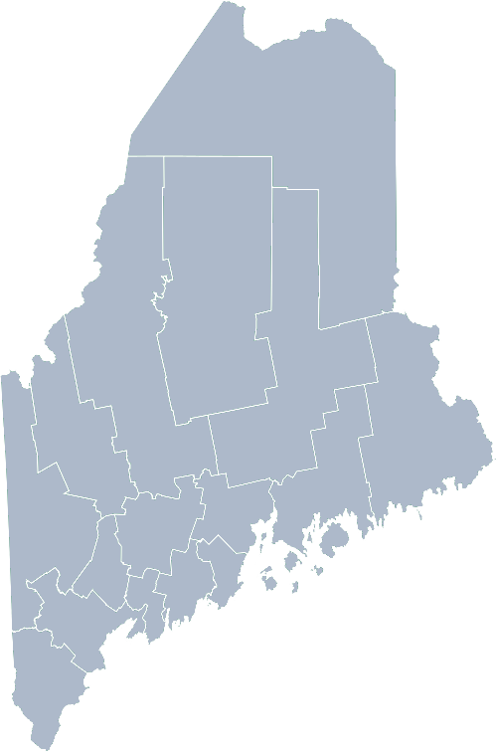
Maine Shared Community Health Needs Assessment Older Adults
2021

Slide 2
The Maine Shared CHNA is a collaboration between the Maine Center for Disease Control and Prevention (Maine CDC), Central Maine Healthcare, Northern Light Health, MaineGeneral Health, and MaineHealth.
Notes:
Local Planning Committee Member

Slide 3
Thank you to our host!

Slide 4
Forum agenda
Time | Activity | Speaker/Facilitator
10:00 – 10:05 am | Welcome and introductions | Jess Maurer, Executive Director, Maine Council on Aging and Project Manager for the Tri-State Learning Collaborative on Aging
10:05 – 10:10 am | Zoom environment and CHNA background | Jo Morrissey, Program Manager, Maine Shared Community Health Needs Assessment
10:10 – 10:25 am | Leadership remarks and previous priorities and activities | Jess Maurer, Executive Director, Maine Council on Aging and Project Manager for the Tri-State Learning Collaborative on Aging
10:25 – 10:50 am | Presentation of key findings from the data | Madison MacLean, Public Health Consultant, John Snow, Inc.
10:50 – 11:50 am | Break-out session – facilitated discussion on data and health priority identification | Local Facilitator(s) and Scribes
11:50 – noon | Wrap up and next steps | Jess Maurer, Executive Director, Maine Council on Aging and Project Manager for the Tri-State Learning Collaborative on Aging
Notes:
Local Planning Committee Member to go over agenda and then turn it over to Jo Morrissey to provide an overview of the Zoom tools available and the purpose of today’s forum

Slide 5
Share screen
Join Audio, Mute On/Off
Open/close participant list or chat
Turn Video On/Off
Reactions
Notes:
Jo or JSI

Slide 6
Matching Interests
Maine Shared
Community Health Needs Assessment
Images of PHAB and IRS from the internet
Notes:
Jo or JSI

Slide 7
The Evolution of an Idea…
2010 OneMaine | 2015 SHNAPP | 2018 Maine Shared CHNA | 2021 Maine Shared CHNA
Forums Surveys | 16 Forums 1639 Surveys | 22 Mainstream Forums (live) 2 Immigrant Forums 45 Interviews | 16+ Mainstream Forums (virtual) 12+ Community Sponsored Events 2000+ Oral Surveys
Notes:
Jo or JSI

Slide 8
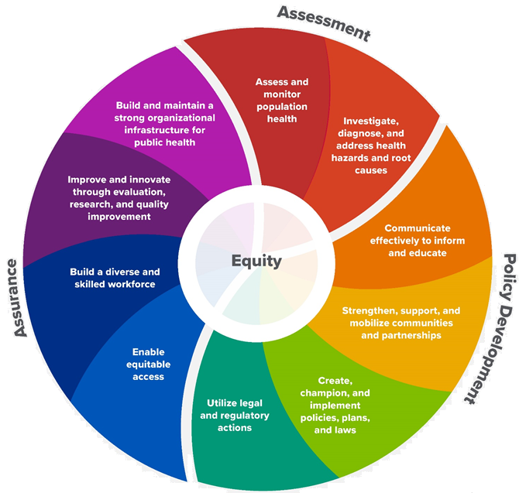
10 Essential Public Health Services
Notes:
Jo or JSI

Slide 9
Maine Shared CHNA Organizational Chart
Steering Committee
Program Manager
Vendor Support
Metrics Committee
Health Equity Community Engagement Committee
Data Analysis Teams
Local Planning Teams
Notes:
Jo or JSI

Slide 10
Inputs and Outcomes
Ways to Provide Input
Data Collected
Outcomes
District & County Reports DUE APRIL 2022
4 Health Priorities by county
Related indicators
Gaps/barriers and resources/assets
Notable comparisons between attendee input and the data.
Description of those who provided input
Methodology
Mainstream county forums
Number of attendees
Where attendees live (not CSE)
List of data identified Forums and CSE only)
Discussion notes (Forums and CSE only)
Chat box comments (Forums and CSE only)
Health Priorities
Gaps and Resources
Community sponsored events
State Report DUE APRIL 2022
4 Health Priorities by Community Event and immigrant population.
Related indicators
Gaps/barriers and resources/assets,
Notable comparisons to mainstream population.
Description of those who provided input
Methodology
Oral Survey
Forums, Events and Surveys conducted Fall 2021
Notes:
Jess Maurer, Executive Director, Maine Council on Aging and Project Manager for the Tri-State Learning Collaborative on Aging
Jo or JSI
Community Sponsored Event Partners include
Disability Rights Maine (2 events: people who are deaf or hard of hearing and people with other disabilities)
Maine Primary Care Association (People who are served by Maine’s Federally Qualified Health Centers
Maine Council on Aging (Older Adults 65+
Consumer Right Council of Maine (people with a mental health diagnosis)
Formerly Incarcerated (Maine Prisoner Re-Entry Network)
Maine Youth Action Network and Friends (Raising the voices of Maine’s diverse youth)
Green Memorial A.M.E. Zion Church (Black/African American)
Health Equity Alliance (LGBTQ+ community)
Portland Recovery Center (for people with a substance use disorder or in recovery)
ADD HOUSING INSECURE IF NEED BE
ADD VETERAN IF NEED BE
Oral Survey Partners include:
City of Portland’s Minority Health Program
New Mainer’s Public Health Initiative
Maine Immigrant Access Network
Gateway Community Services
Maine Immigrant and Refugee Services
Maine Community Integration
Mano en Mano
We are piloting these additional outreach methods with support from
State of Maine’s Preventative Health and Health Services Block Grant
Maine Health Access Foundation
Introduce leader for leadership remarks

Slide 11
MCOA Activities and Accomplishments
Notes:
Local Facilitator

Slide 12
Legislative Priorities
Strengthening Maine’s essential support workforce across all settings
Increasing housing and home repair options
Growing transportation options and funding
Expanding access to supports and services
Promoting integrated and coordinated care, with special focus on people living with dementia and their care partners
Increasing the food and financial stability of older Mainers

Slide 13
2021 Policy Priorities
COVID-19
Ageism & Equity
Social Connectedness
Core Supports & Services
Essential Support Workforce
Integrated & Coordinated Services
Affordable Housing Options
Care Partners
Local, statewide, and regional initiatives that support healthy aging

Slide 14
M-DASH:
Households with one or more people age 60+
Median Age
Maine | 44.6
Gray | 42.9
Hallowell | 39.5
Eastport | 54.1
South Portland | 41.9

Slide 15
Why we need to disaggregate

Slide 16
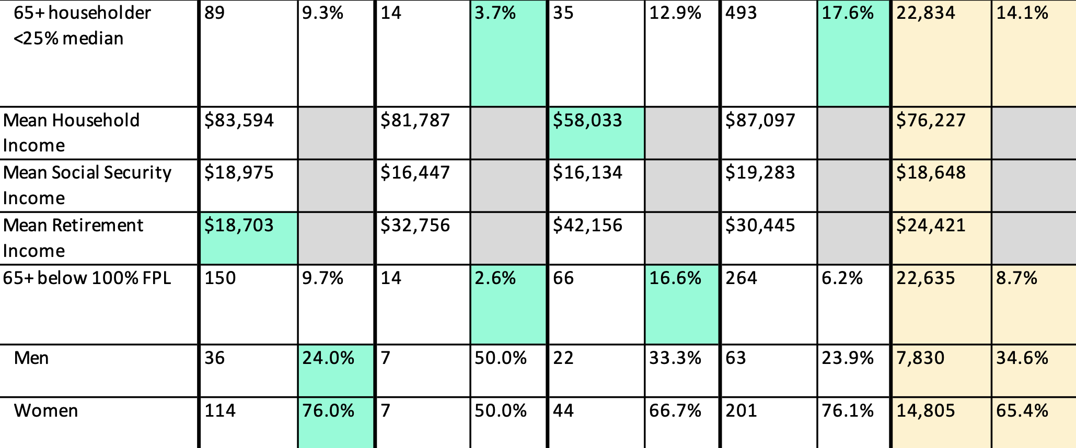
Digging Deeper on Income, Age & Gender

Slide 17
Income, Gender & Living Situations
Biggest gap: $21k
Smallest gap but lowest overall

Slide 18
Falls

Slide 19
How to Read the County Health Profiles and Health Equity Data Sheets
Notes:
JSI or other facilitator

Slide 20
How to Read County Health Profile
CHANGE shows statistically significant changes in the indicator over time, based on 95% confidence interval (see description on page 3).
ê | means the health issue or problem is getting better over time.
! | means the health issue or problem is getting worse over time.
○ | means the change was not statistically significant.
N/A | means there is not enough data to make a comparison.
BENCHMARK compares [COUNTY] data to state and national data, based on 95% confidence interval (see description on page 3).
ê | means [COUNTY] is doing significantly better than the state or national average.
! | means [COUNTY is doing significantly worse than the state or national average.
○ | means there is no statistically significant difference between the data points.
N/A | means there is not enough data to make a comparison.
ADDITIONAL SYMBOLS
* | means results may be statistically unreliable due to small numbers, use caution when interpreting.
— | means data is unavailable because of lack of data or suppressed data due to a small number of respondents.
EXAMPLE
Notes:
JSI or other facilitator
A star means that the health issue or problem is getting better over time or better in comparison to another place
A red exclamation point means that the health issue or problem is getting worse over time or worse in comparison to another place
A gray circle means that the dating hasn’t changed over time or isn’t much different in comparison to another place
N/A means that there was not enough data to be able to make a comparison
There are two additional symbols you might see:
A black dot means that you should use caution when interpreting the data – the results might be unreliable because of small numbers
A black dash means that data was unavailable, or that data was suppressed due to a small number of respondents
(Go to next slide and walk audience through an example)

Slide 21
How to Read County Health Profile
EXAMPLE
 | AROOSTOOK COUNTY |  |  | BENCHMARKS
INDICATOR | POINT 1 | POINT 2 | CHANGE | MAINE | +/- | U.S. | +/-
Individuals living in poverty | 2009-2011 15.6% | 2015-2019 16.1% | ¡ | 2015-2019 11.8% | ! | 2019 12.3% | N/A
Notes:
Here’s an example of how we’ve visualized the data in the County Health Profiles.
The charts in this presentation are all excerpts from the Data Health Profiles that were created by MaineHealth and the Maine CDC. They contain data pulled from publicly available sources that are designed to help people learn more about the health of their communities. Not all the data points are available for every measure, but we’ve included data wherever we can.
The green bars represent data from your community. The left most one represents a past data point, and the right bar represents the most recent data point available when the data was gathered. These are the same data points used in the Data Health Profiles.
The grey bars represent data for the state of Maine as a whole- on the left- and for the United States as a whole- on the right, when it is available.
We’ve also noted where differences in the data points are ‘statistically significant’. A difference between two measurements is significant when scientists can say, with a known degree of confidence, that the difference between them is large enough that the difference is most likely to be caused by an actual difference in the item being measured, and not caused by error associated taking the measurement. All of these tests are comparing the most recent data point for your community to other data points. A red exclamation mark indicates a difference that your community is significantly different in a less desirable direction compared to the data point with the symbol. A green star indicates that your community is significantly different in a more desirable direction. A grey circle indicates that there is no significant difference.
(keep in presentation – do not read for deaf/HOH event or people with disabilities). A difference between two measurements is significant when scientists can say, with a known degree of confidence, that the difference between them is large enough that the difference is most likely to be caused by an actual difference in the item being measured, and not caused by an error associated taking the measurement. All of these tests are comparing the most recent data point for your community to other data points.
For example, in this slide, we have two symbols. The grey circle next to the measurement for 2009-2011 Aroostook County means that there is no significantly different change in the rate of poverty in Aroostook County when comparing the data from 2009-2011 to the data from 2015-2019. The red exclamation mark next to the Maine data point says there is a significant difference between 2015-2019 Aroostook County and 2015-2019 Maine, and that it is less desirable that Aroostook County has a higher rate of individuals living in poverty. No comparison could be made to the data for the U.S. because the years of data collection were different.

Slide 22
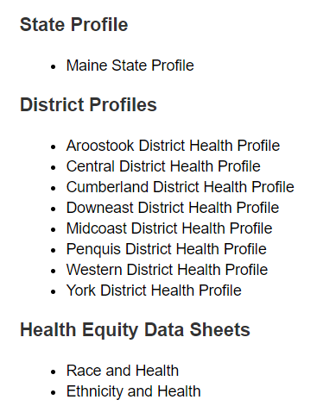
For More Data
www.mainechna.org
Notes:
The Maine Shared CHNA website contains health profiles for 3 of Maine’s largest cities, 16 counties, 5 public health districts, the state, as well as data provided by race, ethnicity, educational attainment, gender, sexual orientation, older adults, insurance status, income, and rurality.
In addition, there is an interactive data portal where you can search by specific data points. All these breakdowns are then provided by data point.
REGARDING COVID-19 DATA
The Maine Shared CHNA data set does not include any data of COVID-19. This is largely due to the fact that there is a much more up-to-date and comprehensive Maine Data Dashboard continually being updated on the Maine CDC website.
Here you can find daily lab results, new case counts by date, trends, county breakdowns, data by race, and comparisons to other states and the nation.
Introduce Madison MacLean of John Snow, Inc. (JSI) who will now give a data presentation on the top indicators

Slide 23
Key Findings
Notes:
As we walk through the following data slides together, take notes. What surprises you? What stands out? What’s moving in the wrong direction?
Once the data presentation is over, you will be divided into breakout groups to discuss the data, share your top concerns, identify your top priorities, and share your knowledge about what’s working and what we need to work on to address those top concerns.
Ready? Here we go.

Slide 24
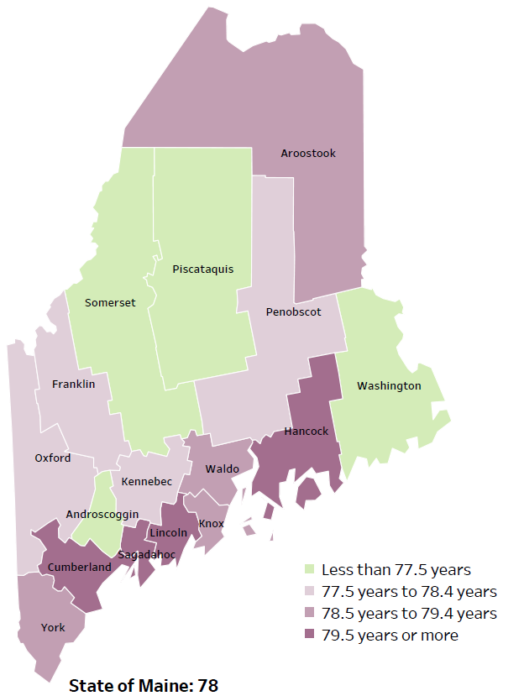
Demographics
Life Expectancy
2017-2019
National Center for Health Statistics,
CDC
Leading Causes of Death
RANK | MAINE
1 | Cancer
2 | Heart Disease
3 | Unintentional Injury
4 | Chronic Lower Respiratory Disease
5 | Stroke
Notes:
The life expectancy in Maine is 78, which is slightly lower than the U.S. life expectancy of 78.7.
The table on the right side of the slides shows the five leading causes of death in Maine. They are also the leading causes of death for many of the counties.
The leading cause of death is cancer. As we will see later in the presentation, Maine has both cost and location barriers to health care, which can impact cancer outcomes.
Some highlights:
Heart Disease is the 2nd leading cause of death. Maine residents have high rates of obesity, and many live a sedentary lifestyle. The leading cause of death in the U.S. is heart Disease and cancer is the 2nd leading cause. One of the reasons that this is true is because we have higher rates of risk factors for cancer, such as smoking/tobacco use. At the same time, there has been a lot of success implementing treatment of heart disease, resulting in folks with heart disease living longer.
The 3rd leading cause of death- Unintentional Injury- includes a number of accidental causes: Three of the most common causes are i) Deaths due to motor vehicle crashes, ii) deaths due to accidental falls, and iii) deaths due to poisonings that either were unintentional, or the intent was undetermined. Suicides and Firearm deaths are classified as intentional injury.

Slide 25
Demographics
Age distribution for Maine
AGE
STATE OF MAINE
POPULATION
1,362,359
STATE OF MAINE
MEDIAN AGE
44.7
Notes:
Maine has a population of 1,362,359. The population is aging and is one of the oldest states in the country. There are fewer children and young adults and more adults over the age of 65. This is particularly true in more rural parts of the state.
Source: US Census Bureau, American Community Survey

Slide 26
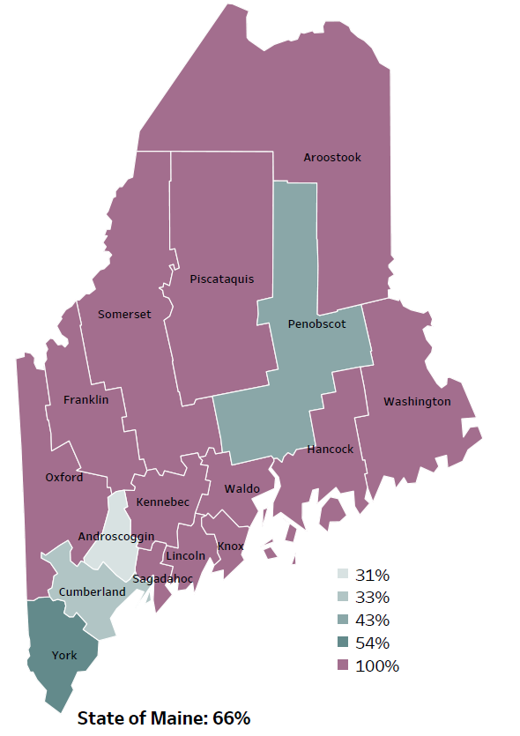
Demographics
Percentage of people living in
rural areas
2019
New England Round Table for Rural Health
Notes:
Maine is a largely rural area with only 4 counties with metro areas. As you can see on this map, 100% of the population of 12 of Maine’s 16 counties live in rural areas. Statewide, 66% of the state population reside in a rural area. These data are based on the most recent Census estimates at the Zip-code level, and calculated use rural Urban Commuting Area codes. The categories were established by the New England Rural Health Association. This data is NOT comparable to 2010 US Census data on populations living in rural areas, as that data uses a different definition for rural.
Source: Data, Research and Vital Statistics town-level population file

Slide 27
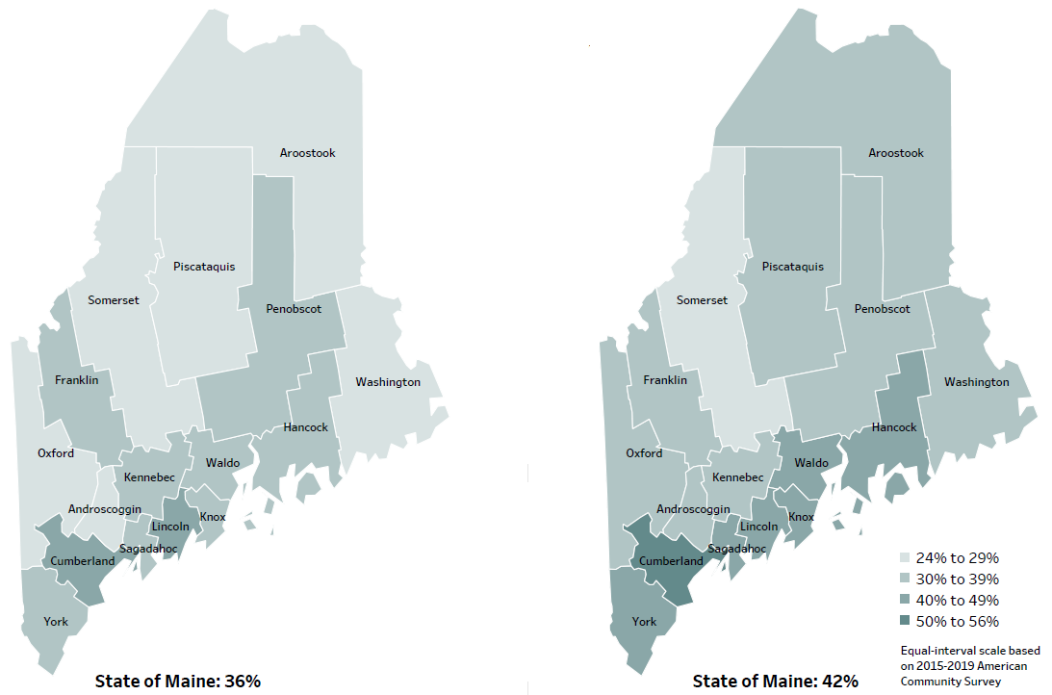
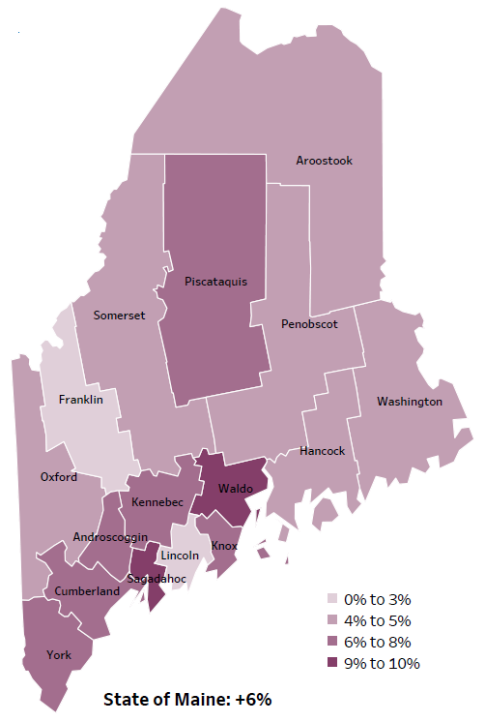
Demographics
Percent of population over age 25 with an associate’s degree or higher
2010
American Community
Survey
Change in percent of population over age 25 with an associate’s degree or higher
2010 to 2015-2019
2015-2019
American Community
Survey
Notes:
These maps show the educational attainment of adults over 25 for two different time periods. Maine has had an increase in the rate of adults who have attained an associate’s degree or higher degree of education with a 6% change between 2010 and 2015-2019.
Source: US Census Bureau, American Community Survey

Slide 28
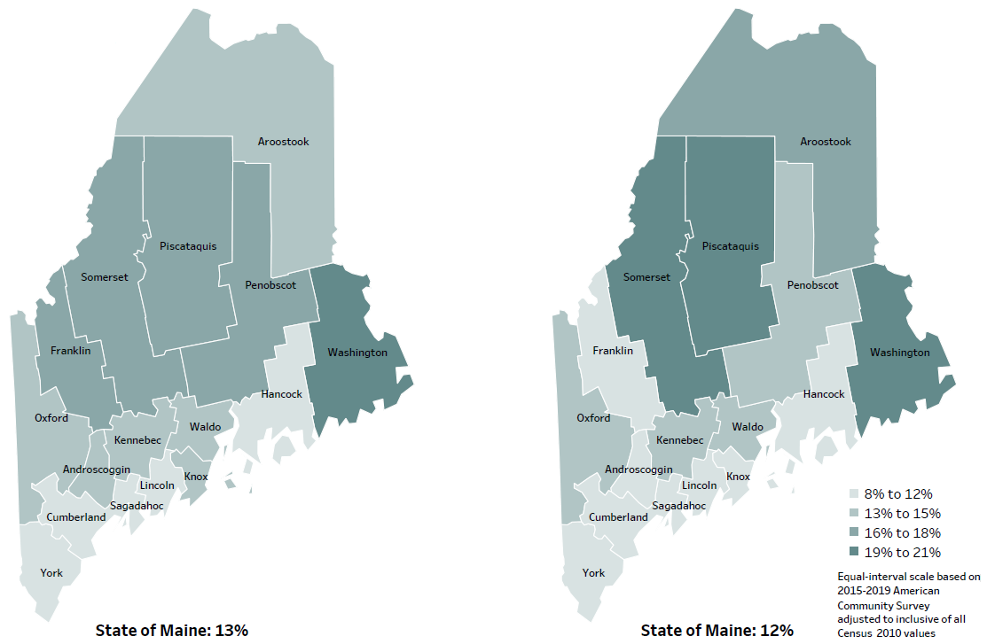
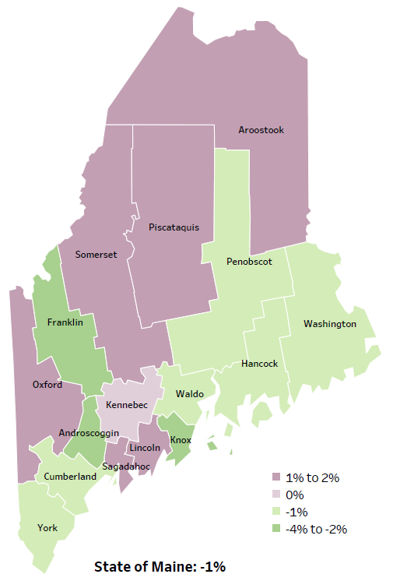
Demographics
Percent of population in poverty
2010
American Community
Survey
Change in percent of population in poverty
2010 to 2015-2019
2015-2019
American Community
Survey
Notes:
These maps show the rate of poverty for two different time periods. Maine has 6 counties that have had an increase in poverty levels between 2010 and 2015-2019. Poverty has decreased in the state overall.
Source: US Census Bureau, American Community Survey

Slide 29
Health Indicators
Notes:
The percentage of older adults with a disability is significantly higher than the state rate overall. There is also a notable increase between those that are 65-74 and 75 and older.
Data Source: US Census Bureau, American Community Survey To be read as needed. Definition: Percentage of people who answer yes to one of the five ACS questions. Questions about hearing, vision, cognitive ability, ambulatory, self-care and independent living are used to assess disability.

Slide 30
Health Indicators
Notes:
This chart shows the percentage of individuals living in poverty is higher for the state overall than those that are 65 years or older.
Data Source: US Census Bureau, American Community Survey To be read as needed. Definition: Percentage of individuals who live in households where the total income of the householder's family is below the established federal poverty level.

Slide 31
Health Indicators
Notes:
Nearly a third of Maine residents 65 and older are currently living alone. There are some risks associated with older adults living alone, including a variety of physical and mental conditions, as well as loneliness and isolation.
Data Source: US Census Bureau, American Community Survey National Institute of Health (risks)

Slide 32
Health Indicators
Notes:
Maine residents who are 75 or older are significantly more likely to self-report their health as fair or poor when compared to both those in the age 65-74 and Mainers as a whole.
Data Source: Behavioral Risk Factor Surveillance System To be read as needed. Definition: Percentage of adults who rate their health as fair or poor (vs. excellent, very good or good).

Slide 33
Health Indicators
Notes:
Compared to the state, those who are 75 or older are significantly more likely to have a three or more chronic conditions.
Data Source: Behavioral Risk Factor Surveillance System To be read as needed. Definition: Percentage of adults who have been diagnosed with three or more chronic health conditions (chronic conditions in skin cancer, other types of cancer, cardiovascular disease [such as stroke], coronary heart disease [such as heart attack], arthritis, COPD and asthma, obesity, and chronic kidney disease. Hypertension and high cholesterol are not included in this definition, because data on these conditions are collected biennially whereas the other conditions are collected annually.

Slide 34
Health Indicators
Notes:
An ambulatory care-sensitive condition is defined as one that early interventions and good outpatient care can prevent complications and the need for hospitalization. As this chart shows, the rate of those 85 years and older are hospitalized for such conditions are a significantly higher rate than the state of Maine and those 65-84.
The same is true for those treated in the emergency department for an ambulatory care-sensitive condition.
Data Source: Maine Health Data Organization Hospital Inpatient Database

Slide 35
Health Indicators
Notes:
This chart shows that the rate of cancer deaths increases with age among those 65 and older. The rate of death due to cancer for older adults is significantly higher than the state.
Data Source: Maine CDC Vital Records To be read as needed. Definition: Rate per 100,000 people of deaths from any type of cancer.

Slide 36
Health Indicators
Notes:
Similar to the previous slide, older adults are more likely to die from tobacco-related cancer deaths when compared to the overall state rate. The likelihood of a tobacco-related cancer death increases with age.
Data Source: Maine CDC Vital Records

Slide 37
Health Indicators
Notes:
Those who are 75 or older are significantly more likely to have a diagnosis of high blood pressure that the state and those 65-74 years old. Both older age groups are significantly more likely to have high blood pressure than the state.
Data Source: Behavioral Risk Factor Surveillance System To be read as needed. Definition: Percentage of adults who have ever been told by a healthcare provider that they have high blood pressure. Data collected in odd numbered years.

Slide 38
Health Indicators
Notes:
Those who are 65-74 years old are slightly more likely to have high cholesterol when compared to those 75 years or older, This difference is not significant. The difference is significant between older adults and the state overall.
Data Source: Behavioral Risk Factor Surveillance System To be read as needed. Definition: Percentage of adults who have been told by a healthcare provider that their blood cholesterol is high. Data collected in odd numbered years.

Slide 39
Health Indicators
Notes:
Older adults are more likely to have been diagnosed with diabetes. The difference between older adults and the state is significant.
Data Source: Behavioral Risk Factor Surveillance System To be read as needed. Definition: Percentage of adults that have ever been told by a doctor or healthcare provider that they have diabetes, excluding diabetes during pregnancy.

Slide 40
Health Indicators
Notes:
Obesity rates drop significantly between those 65-74 and those 75 or older. Obesity is defined as an adult with a Body Mass Index of 30 or more.
Data Source: Behavioral Risk Factor Surveillance System To be read as needed. Definition: Percentage of adults with a Body Mass Index of 30 or more, based on self-reported height and weight.

Slide 41
Health Indicators
Notes:
While few Maine residents 75 or older are obese when compared to those 65-74, they are slightly more likely to be overweight. However, this difference is not significant.
Data Source: Behavioral Risk Factor Surveillance System To be read as needed. Definition: Percentage of adults with a Body Mass Index between 25.0 and 29.9, based on self-reported height and weight.

Slide 42
Health Indicators
Notes:
Cognitive decline is defined as the percentage of adults 45 and older who have experienced confusion or memory loss that has increased in frequency or intensity within the past 12 months. As this chart shows, older adults are not significantly more likely to have a cognitive decline when compared to the overall state.
Data Source: Behavioral Risk Factor Surveillance System To be read as needed. Definition: Percentage of adults, ages 45 and over, who experienced confusion or memory loss that happened more often or got worse within the past 12 months. Data collected in 2012 and 2016.

Slide 43
Health Indicators
Notes:
This chart shows a sharp increase in injury deaths among Maine residents who are 85 years or older. This difference is significant when compared to both the state and those in the other older cohorts.
Data Source: Maine CDC Vital Records To be read as needed. Definition: Rate per 100,000 people of deaths due to injuries.

Slide 44
Health Indicators
Notes:
Decreased mobility contributes to falls that result in injury or death among older adults. Maine residents who are 85 or older are significantly more likely to sustain an injury from a fall when compared to the state and older adults between 65-84.
Data Source: Maine Health Data Organization Hospital Inpatient and Outpatient Databases To be read as needed. Definition: Rate per 10,000 people of emergency department discharges with a diagnoses of a fall-related injury.

Slide 45
Health Indicators
Notes:
Similar to what we saw in the previous slide, those 85 or older are significantly more likely to die due to a fall than those who are 65-84. 75-84 years old are significantly more likely to have a fall related death when compared to 65-74 year olds. All older adults are significantly more likely to die as a result of a fall when compared to the state rate.
Data Source: Maine CDC Vital Records To be read as needed. Definition: Rate per 100,000 people of deaths due to unintentional falls.

Slide 46
Health Indicators
Notes:
The rate of older adults committing suicide is higher than the rate in Maine as a whole, but the difference is not significant. The rise is suicide rates among older adults is concerning and warrants further resources dedicated to the mental health and well-being of seniors.
Data Source: Maine CDC Vital Records To be read as needed. Definition: Rate per 100,000 people of deaths due to suicide.

Slide 47
Health Indicators
Notes:
This chart shows that older adults are more likely to have had major tooth loss when compared to the state.
Data Source: Behavioral Risk Factor Surveillance System
To be read as needed. Definition: Percentage of adults who have lost six or more teeth due to tooth decay or gum disease. Data collected in even numbered years.

Slide 48
Breakout Discussions
Notes:
Local Facilitator(s) and Scribes

Slide 49
Reconvene

Slide 50
Wrap up and Next Steps
Notes:
Jess Maurer, Executive Director, Maine Council on Aging and Project Manager for the Tri-State Learning Collaborative on Aging

Slide 51
Contacts
Jess Maurer, Executive Director, Maine Council on Aging; Project Manager for the Tri-State Learning Collaborative on Aging jmaurer@mainecouncilonaging.org
Krista George, Operations Manager Maine Council on Aging; Project Manager Tri-State Learning Collaborative on Aging kgeorge@mainecouncilonaging.org
Jo Morrissey, Program Manager
Maine Shared CHNA
info@mainechna.org
www.mainechna.org

