Slide 1
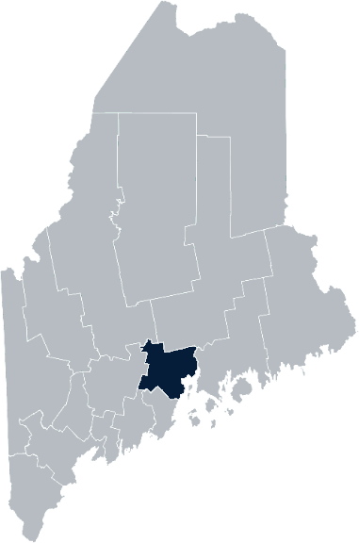
Maine Shared Community Health Needs Assessment Lincoln County
2021
Notes:
Cathy Cole

Slide 2
The Maine Shared CHNA is a collaboration between the Maine Center for Disease Control and Prevention (Maine CDC), Central Maine Healthcare, Northern Light Health, MaineGeneral Health, and MaineHealth.
Notes:
Cathy Cole

Slide 3
Forum Agenda
Time | Activity | Speaker/Facilitator
2:30- 2:35 pm | Welcome | Cathy Cole, LincolnHealth Community Health Improvement
2:35- 2:40 pm | Overview of Zoom | Jo Morrissey, Maine Shared CHNA Program Manager
2:40 – 2:45 pm | Leadership Remarks | Cindy Wade, CEO/President, LincolnHealth
2:45 – 2:55 pm | Review previous CHNA priorities and activities 2019-2021 | Drexell White, Public Health Liaison, Midcoast Public Health District Team Members, LincolnHealth and Coulombe Center Community Health Improvement
2:55 – 3:20 pm | Presentation of key findings from the data | John Snow, Inc.
3:20 –4:20 pm | Break-out session – facilitated discussion on data and health priority identification | John Snow, Inc. & Local Facilitators
4:20 – 4:30 pm | Reconvene and Review | John Snow, Inc.
4:30 – 4:45 pm | Break
4:45pm-5:45pm | Reconvene for Community Health Improvement Fund Forum | Lois Skillings, CEO/President, Mid Coast-Parkview Health Cindy Wade, CEO/President, LincolnHealth
Notes:
Cathy Cole
Introduce Jo Morrissey, Program Manager for the Maine Shared Community Health Needs Assessment to go over some housekeeping and background

Slide 4
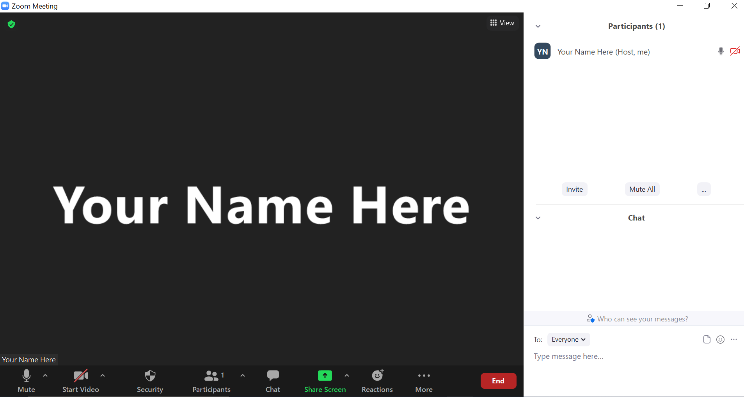
Share screen
Join Audio, Mute On/Off
Open/close participant list or chat
Turn Video On/Off
Reactions
Notes:
Jo or JSI

Slide 5
Matching Interests
Maine Shared
Community Health Needs Assessment
Images of PHAB and IRS from the internet
Notes:
Jo or JSI

Slide 6
The Evolution of an Idea…
2010 OneMaine | 2015 SHNAPP | 2018 Maine Shared CHNA | 2021 Maine Shared CHNA
Forums Surveys | 16 Forums 1639 Surveys | 22 Mainstream Forums (live) 2 Immigrant Forums 45 Interviews | 16+ Mainstream Forums (virtual) 12+ Community Sponsored Events 2000+ Oral Surveys
Notes:
Jo or JSI

Slide 7
Inputs and Outcomes
Ways to Provide Input
Data Collected
Outcomes
District & County Reports DUE APRIL 2022
4 Health Priorities by county
Related indicators
Gaps/barriers and resources/assets
Notable comparisons between attendee input and the data.
Description of those who provided input
Methodology
Mainstream county forums
Number of attendees
Where attendees live (not CSE)
List of data identified Forums and CSE only)
Discussion notes (Forums and CSE only)
Chat box comments (Forums and CSE only)
Health Priorities
Gaps and Resources
Community sponsored events
State Report DUE APRIL 2022
4 Health Priorities by Community Event and immigrant population.
Related indicators
Gaps/barriers and resources/assets,
Notable comparisons to mainstream population.
Description of those who provided input
Methodology
Oral Survey
Forums, Events and Surveys conducted Fall 2021
Notes:
[Add names of those doing the leadership remarks ie Susan Keiler, VP Strategic Development of Southern Maine Health Care
Dr. Patrick Taylor, CEO/President of York Hospital]
Jo or JSI
Community Sponsored Event Partners include
Disability Rights Maine (2 events: people who are deaf or hard of hearing and people with other disabilities)
Maine Primary Care Association (People who are served by Maine’s Federally Qualified Health Centers
Maine Council on Aging (Older Adults 65+
Consumer Right Council of Maine (people with a mental health diagnosis)
Formerly Incarcerated (Maine Prisoner Re-Entry Network)
Maine Youth Action Network and Friends (Raising the voices of Maine’s diverse youth)
Green Memorial A.M.E. Zion Church (Black/African American)
Health Equity Alliance (LGBTQ+ community)
Portland Recovery Center (for people with a substance use disorder or in recovery)
ADD HOUSING INSECURE IF NEED BE
ADD VETERAN IF NEED BE
Oral Survey Partners include:
City of Portland’s Minority Health Program
New Mainer’s Public Health Initiative
Maine Immigrant Access Network
Gateway Community Services
Maine Immigrant and Refugee Services
Maine Community Integration
Mano en Mano
We are piloting these additional outreach methods with support from
State of Maine’s Preventative Health and Health Services Block Grant
Maine Health Access Foundation
Introduce leader for leadership remarks

Slide 8
Leadership remarks
Notes:
Leadership remarks
Leader to introduce the following who will provide comments on recent health improvement efforts
ADD NAME OF THOSE WHO WILL BE DOING REVIEWING PREVIOUS EFFORTS
Adam Hartwig, District Liaison ME CDC
Sally Manninen, Director, Community Health, York Hospital
Betsy Kelly Director, Community Health Improvement, SMHC

Slide 9
Previous Health Improvement Efforts Lincoln County: Highlights 2019-2021
Notes:
Jo to introduce Drexell White, Public Health Liaison, Midcoast Public Health District
Cathy Cole, LH Community Health will introduce team members presenting health improvement efforts

Slide 10
Pandemic Acknowledgement and Thanks
During this past CHNA cycle – COVID-19 became a public health focus for everyone.
This was and continues to be a focus of many of our partners’ outreach, planning, and every day activities.
COVID vaccination clinics held throughout the county.
Notes:
Drexell
Number of COVID vaccination clinics and locations (to be provided)
Number of vaccines delivered (include school vaccinations)
Acknowledge volunteers and employees that made clinics happen
Thank you. I’m Drexell White, the Maine CDC District Public Health Liaison for the Midcoast District. Welcome to everyone who took time to join us today and help us map out our Community Health Needs. I’d like to start with an acknowledgement of the times in which we live and the tremendous ongoing effort to keep Maine safe and healthy.
The vaccination numbers on the slide illustrate one part of the unprecedented effort undertaken by our healthcare, public health, and social services systems, as well as State, County and Local governments, non-governmental organizations, businesses and individuals throughout the State.
This has been an all-hands-on-deck effort affecting everyone. To all our thanks for your efforts and continued support..

Slide 11
Midcoast District Public Health Council
Midcoast Public Health District:
One of Nine (9) Public Health Districts in Maine
Includes Knox, Lincoln, Sagadahoc & Waldo Counties (73 Municipalities, including six island communities)
Midcoast Public Health Council (MPHC):
District Coordinating Council (DCC) for Public Health with Membership/ Representation from the District’s Four Counties, plus Brunswick & Harpswell
District Work 2019 -2021– Mental Health, Obesity, Elevated Lead Levels & Climate Change
Notes:
Drexell
The Midcoast Public Health District is one of 9 Public Health Districts in Maine; 8 geographic-based Districts and one population-based District serving the State’s indigenous tribes.
The Midcoast District has a public health unit that includes Public Health Nursing, District Epidemiology, Health Inspections, Drinking Water, and the District Liaison and Council Coordinator. In addition to its regular functions, the Public Health Unit has been focused on the support of the Covid 19 response.
Our District includes Waldo, Knox, Lincoln and Sagadahoc Counties encompassing 73 municipalities. One of the unique features of our District are the six island communities of Islesboro, Isle au Haut, North Haven, Vinalhaven and Monhegan.
Next Slide Please.

Slide 12
Midcoast Public Health Council Highlights
MPHC Committees:
Mental Health - Mental Health First Aid Training – 80 persons trained
Obesity – Promotion of low/no cost physical activity opportunities
Elevated Lead Levels – Collaborating with pediatric practices to increase screening
MPHC-sponsored panel discussions on:
Social Isolation, Aging, & Elder Abuse
Vaccine Hesitancy, and Vaccination Efforts in the District
Coping with Covid – Building Hope & Resiliency
Climate Change and its Public Health Implications
Notes:
Drexell
The Midcoast Public Health Council continued its work on mental health, obesity and elevated blood lead levels in children. Through funding made available through Maine CDC, the MPHC was able to conduct a series of Mental Health First Aid programs in the District, training 80 persons.
Our Obesity Committee sought out opportunities to promote low and no cost physical activity opportunities through local land trusts and conservancies.
And,, our lead committee collaborated with pediatric providers to create strategies to improve blood lead level screening in children.
The Midcoast Public Health Council meets five times per year, and continued to meet throughout the pandemic, offering a variety virtual panel discussions and presentations. Thanks to the MPHC Leadership, Council Members and Stakeholders for continuing to plan, meet and engage during these challenging times.
Thank you for this opportunity to provide Midcoast Public Health District and Council highlights, I’ll now turn it back to Adrienne Gallant.

Slide 13
LincolnHealth CHNA 2019-2021 Priorities
Substance Use
Mental Health
Healthy Eating/Active Living/Obesity Prevention
Social Determinants of Health—Food Insecurity
Notes:
Cathy
(Narrative to be added by Cathy)
Next slide please

Slide 14
Substance Use
Activities and Key Accomplishments | Substance Use Disorder Collaborative of Lincoln County Expanded IMAT services at LincolnHealth Rapid Induction at LincolnHealth Miles Emergency Department Naloxone Distribution Medication Drug Take Back Days Town Based Support Groups YMCA Memberships for those in recovery School Prevention Programs—Healthy Lincoln County and LincolnHealth
Grant Work | MeHAF grant—LincolnHealth in collaboration with Lincoln County Recovery Council and MeHAF Grant Advisory Council Healthy Lincoln County—”Drug Free Communities” Grant
Notes:
Cathy Cole to present

Slide 15
Mental Health
Activities and Key Accomplishments | Five School Based Health Centers with Mental Health Services Boothbay Region High School and Elementary School 906 student visits (2019 to date) Lincoln Academy 374 student visits (2019 to date) Medomak Valley High School and Middle School 667 student visits (2019 to date) Maine Behavioral Health Clinicians embedded in Lincoln Medical Partners Provider Practices—individual and group services
Grant Work | Coulombe Center for Health Improvement Grant Maine Department of Health and Human Services, School Based Health Center grants
Notes:
Anni Pat McKenney to present

Slide 16
Obesity and Diabetes
Activities and Key Accomplishments | Let’s Go!—32 Lincoln County Sites LincolnHealth Employee Wellness Summer and Winter Community Shared Agriculture Winter and Spring Wellness Programs Annual Winter Physical Activity Challenge—over 900 participants from schools, local businesses and individuals National Diabetes Prevention Program—offered through CLC and Boothbay Region YMCA’s in collaboration with MaineHealth/LincolnHealth SNAP Ed—Nutrition Education—Healthy Lincoln County
Grant Work | Maine Prevention Services Grant (Let’s Go!)—LincolnHealth Maine Prevention Services Grant (SNAP Ed)—UNE/Healthy Lincoln County
Notes:
Kristina Verney to present

Slide 17
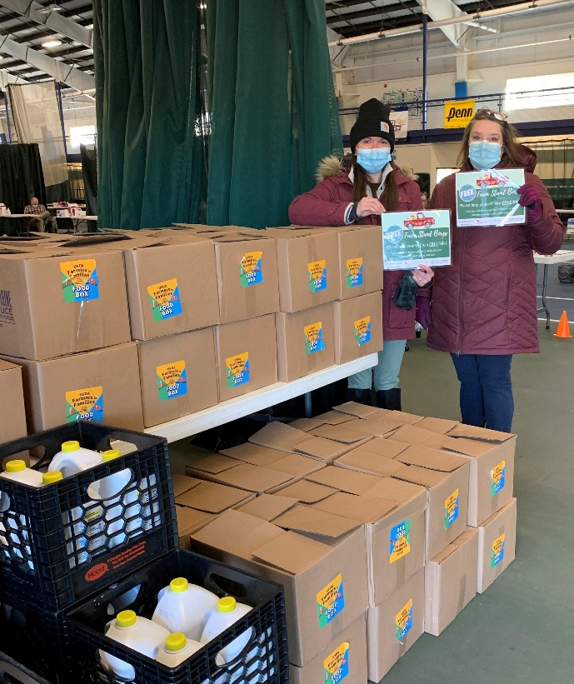
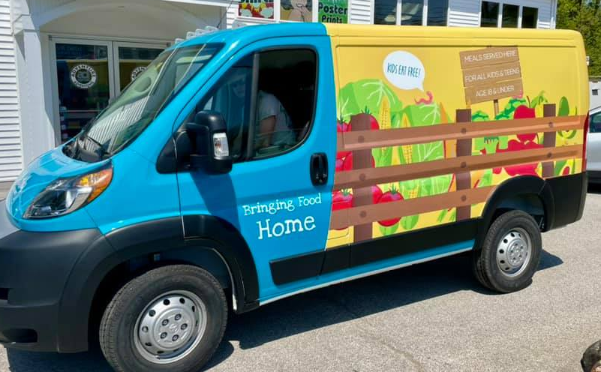
Food Insecurity
Education & Programs | Food Distribution Emergency Food Bags at LMP Family Damariscotta, Wiscasset, Boothbay and Waldoboro Drive-Through Food Box Pick-Ups Fresh, Seasonal Vegetable Program in LH LMP Provider Practices from: 13 Organic Raised-Bed Gardens on 3 LincolnHealth campuses Lincoln County Gleaners/Healthy Lincoln County LincolnHealth “Help Yourself Shelves”— access to non-perishable food items Partnership with Ecumenical Food Pantry Summer Food Program—27,000 meals distributed across 2 counties by Healthy Lincoln County
Grant Work | Good Shepherd Food Bank grant USDA COVID Relief Funds and Summer Food Service Program
Notes:
Gabby Tilton to present

Slide 18
How to Read the County Health Profiles and Health Equity Data Sheets
Notes:
JSI or other facilitator

Slide 19
How to Read County Health Profile
CHANGE shows statistically significant changes in the indicator over time, based on 95% confidence interval (see description on page 3).
ê | means the health issue or problem is getting better over time.
! | means the health issue or problem is getting worse over time.
○ | means the change was not statistically significant.
N/A | means there is not enough data to make a comparison.
BENCHMARK compares [COUNTY] data to state and national data, based on 95% confidence interval (see description on page 3).
ê | means [COUNTY] is doing significantly better than the state or national average.
! | means [COUNTY is doing significantly worse than the state or national average.
○ | means there is no statistically significant difference between the data points.
N/A | means there is not enough data to make a comparison.
ADDITIONAL SYMBOLS
* | means results may be statistically unreliable due to small numbers, use caution when interpreting.
— | means data is unavailable because of lack of data or suppressed data due to a small number of respondents.
EXAMPLE
Notes:
JSI or other facilitator
A star means that the health issue or problem is getting better over time or better in comparison to another place
A red exclamation point means that the health issue or problem is getting worse over time or worse in comparison to another place
A gray circle means that the dating hasn’t changed over time or isn’t much different in comparison to another place
N/A means that there was not enough data to be able to make a comparison
There are two additional symbols you might see:
A black dot means that you should use caution when interpreting the data – the results might be unreliable because of small numbers
A black dash means that data was unavailable, or that data was suppressed due to a small number of respondents
(Go to next slide and walk audience through an example)

Slide 20
How to Read County Health Profile
EXAMPLE
 | AROOSTOOK COUNTY |  |  | BENCHMARKS
INDICATOR | POINT 1 | POINT 2 | CHANGE | MAINE | +/- | U.S. | +/-
Individuals living in poverty | 2009-2011 15.6% | 2015-2019 16.1% | ¡ | 2015-2019 11.8% | ! | 2019 12.3% | N/A
Notes:
Here’s an example of how we’ve visualized the data in the County Health Profiles.
The charts in this presentation are all excerpts from the Data Health Profiles that were created by MaineHealth and the Maine CDC. They contain data pulled from publicly available sources that are designed to help people learn more about the health of their communities. Not all the data points are available for every measure, but we’ve included data wherever we can.
The green bars represent data from your community. The left most one represents a past data point, and the right bar represents the most recent data point available when the data was gathered. These are the same data points used in the Data Health Profiles.
The grey bars represent data for the state of Maine as a whole- on the left- and for the United States as a whole- on the right, when it is available.
We’ve also noted where differences in the data points are ‘statistically significant’. A difference between two measurements is significant when scientists can say, with a known degree of confidence, that the difference between them is large enough that the difference is most likely to be caused by an actual difference in the item being measured, and not caused by error associated taking the measurement. All of these tests are comparing the most recent data point for your community to other data points. A red exclamation mark indicates a difference that your community is significantly different in a less desirable direction compared to the data point with the symbol. A green star indicates that your community is significantly different in a more desirable direction. A grey circle indicates that there is no significant difference.
(keep in presentation – do not read for deaf/HOH event or people with disabilities). A difference between two measurements is significant when scientists can say, with a known degree of confidence, that the difference between them is large enough that the difference is most likely to be caused by an actual difference in the item being measured, and not caused by an error associated taking the measurement. All of these tests are comparing the most recent data point for your community to other data points.
For example, in this slide, we have two symbols. The grey circle next to the measurement for 2009-2011 Aroostook County means that there is no significantly different change in the rate of poverty in Aroostook County when comparing the data from 2009-2011 to the data from 2015-2019. The red exclamation mark next to the Maine data point says there is a significant difference between 2015-2019 Aroostook County and 2015-2019 Maine, and that it is less desirable that Aroostook County has a higher rate of individuals living in poverty. No comparison could be made to the data for the U.S. because the years of data collection were different.

Slide 21
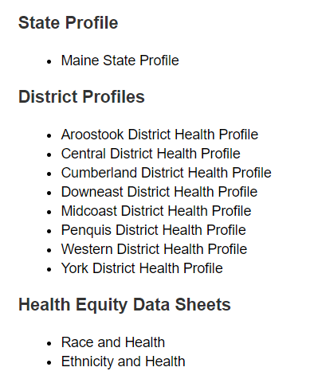
For More Data
www.mainechna.org
Notes:
The Maine Shared CHNA website contains health profiles for 3 of Maine’s largest cities, 16 counties, 5 public health districts, the state, as well as data provided by race, ethnicity, educational attainment, gender, sexual orientation, older adults, insurance status, income, and rurality.
IN addition, there is an interactive data portal where you can search by specific data points. All these breakdowns are then provided by data point.
REGARDING COVID-19 DATA
The Maine Shared CHNA data set does not include any data of COVID-19. This is largely due to the fact that there is a much more up-to-date and comprehensive Maine Data Dashboard continually being updated on the Maine CDC website.
Here you can find daily lab results, new case counts by date, trends, county breakdowns, data by race, and comparisons to other states and the nation.

Slide 22
Key Findings
Notes:
As we walk through the following data slides together, take notes. What surprises you? What stands out? What’s moving in the wrong direction?
Once the data presentation is over, you will be divided into breakout groups to discuss the data, share your top concerns, identify your top priorities, and share your knowledge about what’s working and what we need to work on to addres those top concerns.
Ready? Here we go.

Slide 23
Demographics
Age distribution for Lincoln County
AGE
SOMERSET COUNTY
POPULATION
34,201
STATE OF MAINE
POPULATION
1,362,359
Notes:
Lincoln County has the 4th smallest population of any Maine County, larger than only Washington, Franklin and Piscataquis. The population is aging, but the life expectancy is higher than is most of the other counties. There are fewer children and young adults and more adults over the age of 65, and fewer adults of the age where they might expect to have children.
Source: US Census Bureau, American Community Survey

Slide 24
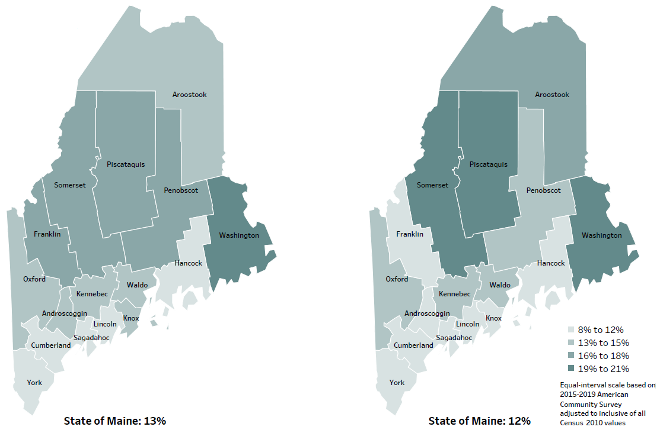
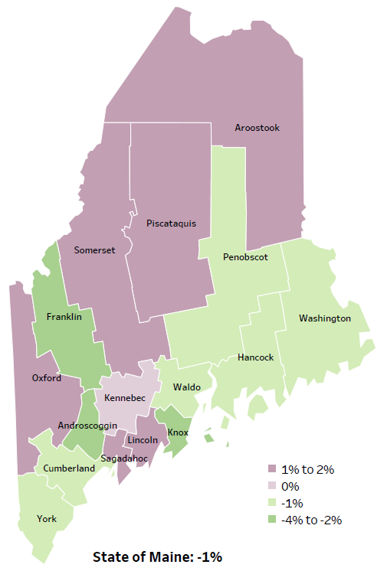
Social Determinants of Health
Percent of population in poverty
2010
American Community
Survey
Change in percent of population in poverty
2010 to 2015-2019
2015-2019
American Community
Survey
Notes:
These maps show the rate of poverty for two different time periods. Lincoln county’s poverty rate has increased slightly over the time period, as shown in the change over time map, but does have among the lowest levels of poverty in the state. During this period, poverty decreased in Maine overall.
Source: US Census Bureau, American Community Survey

Slide 25
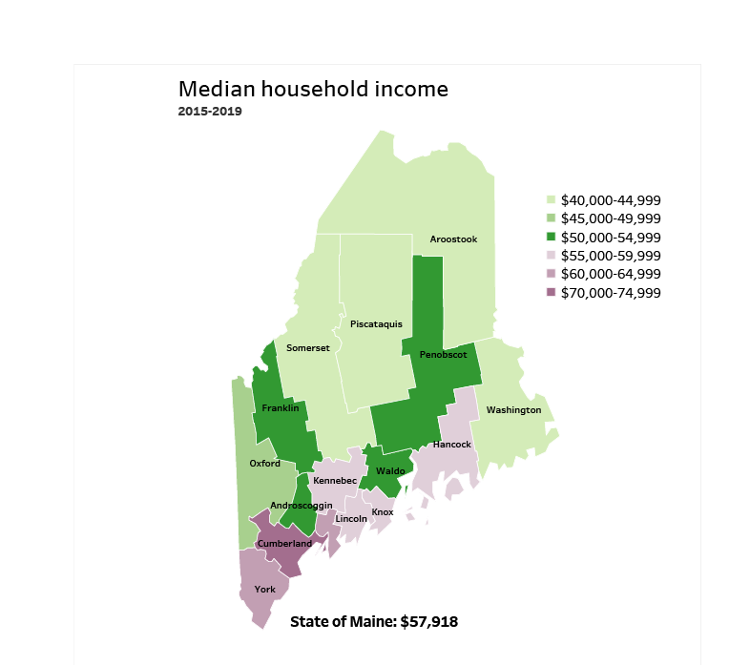
Social Determinants of Health
Notes:
Lincoln County has a median household income of $57,720. This is higher than 12 counties and lower than 3 other counties.
Source: American Community Survey

Slide 26
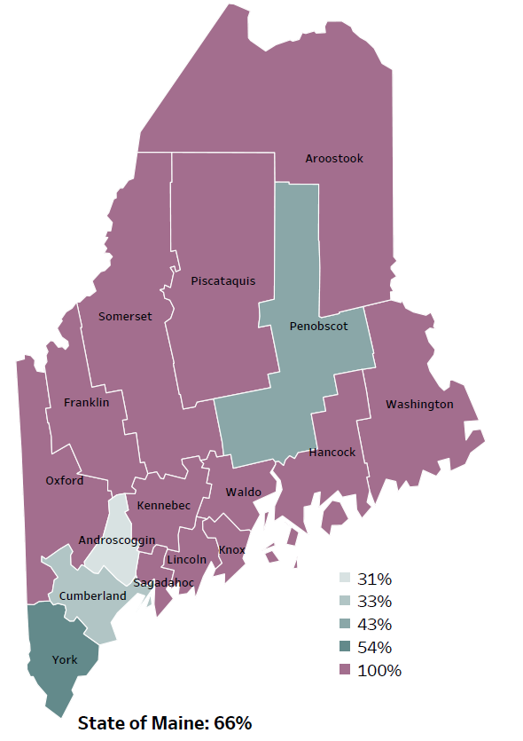
Social Determinants of Health
Percentage of people living in
rural areas
2019
New England Round Table for Rural Health
Notes:
Lincoln County is one of 12 counties with no population in an urban area. These data are based on the most recent Census estimates at the Zip-code level, and calculated use rural Urban Commuting Area codes. The categories were established by the New England Rural Health Association. This data is NOT comparable to 2010 US Census data on populations living in rural areas, as that data uses a different definition for rural]
Source: Data, Research and Vital Statistics town-level population file

Slide 27
Social Determinants of Health
Notes:
The percentage of Lincoln County households without a vehicle has increased significantly over time, however it remains below the overall state rate.
Data Source: US Census Bureau, American Community Survey
To be read as needed. Definition: Percentage of households where no one owns a motor vehicle.

Slide 28
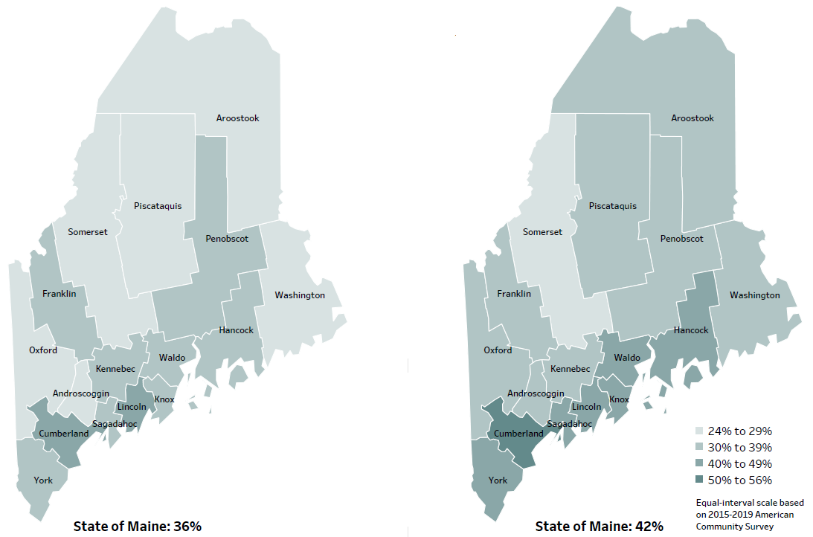
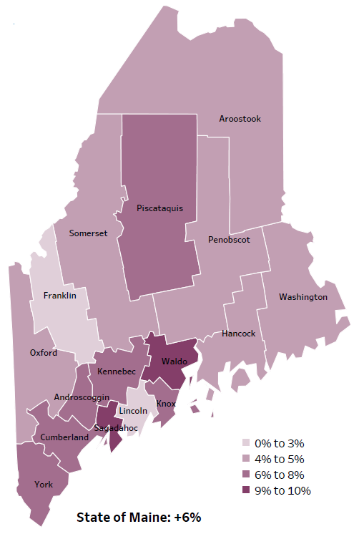
Social Determinants of Health
Percent of population over age 25 with an associate’s degree or higher
2010
American Community
Survey
Change in percent of population over age 25 with an associate’s degree or higher
2010 to 2015-2019
2015-2019
American Community
Survey
Notes:
These maps show the educational attainment of adults over 25 for two different time periods. Lincoln County has had little change in the rate of adults who have achieved an associate’s degree or more. This is highlighted in the change over time map, which shows that this was equal to 1 county and lower than 14 other counties. While the rate of change is lower than other counties, this is largely due to maintaining a relatively high rate of high educational attainment compared to other Maine counties.
Source: US Census Bureau, American Community Survey

Slide 29
General Health Status
Notes:
Lincoln county residents are significantly less likely to rate their health as fair or poor when compared to the state overall. For this measure, survey respondents subjectively rate their own health, rather than relying on some external measure like a diagnosis.
Data Source: Behavioral Risk Factor Surveillance System
To be read as needed. Definition: Percentage of adults who rate their health as fair or poor (vs. excellent, very good or good).

Slide 30
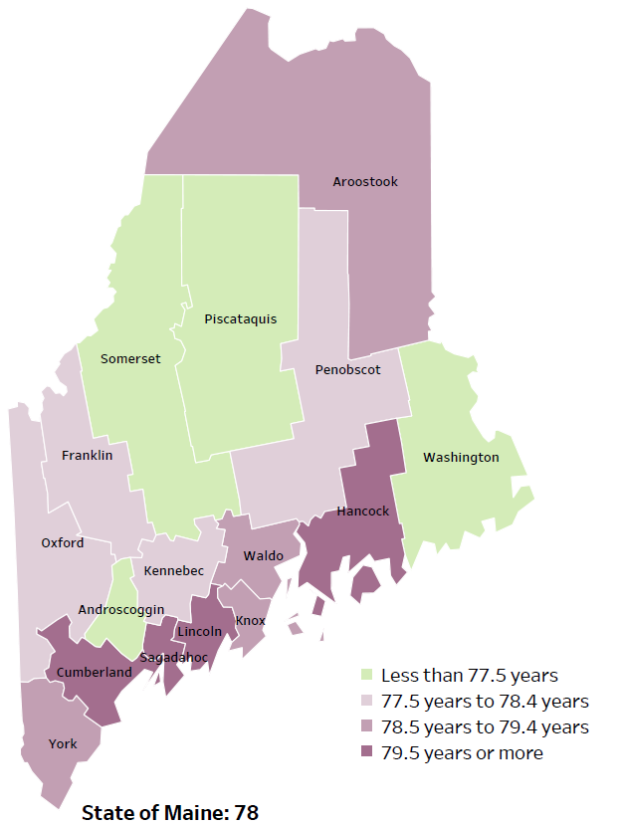
Overall Mortality
Life Expectancy
2017-2019
National Center for Health Statistics,
CDC
RANK | MAINE | LINCOLN COUNTY
1 | Cancer | Cancer
2 | Heart Disease | Heart Disease
3 | Unintentional Injury | Unintentional Injury
4 | Chronic Lower Respiratory Disease | Stroke
5 | Stroke | Chronic Lower Respiratory Disease
Notes:
The life expectancy in Lincoln County is 80.2, which is significantly higher than the state average of 78.7. Lincoln County has the second highest life expectancy in the state after Cumberland County This is an indication that more people are living to an older age than residents in many other counties in Maine.
The table on the right side of the slides shows the five leading causes of death in Lincoln County. They are also the leading causes of death for the whole state of Maine.
The leading cause of death is Cancer followed by Heart Disease, the same as the state. The opposite is true in the U.S. overall- Heart Disease is the leading cause of death, and cancer is the 2nd leading cause. As we will see later in the presentation, Lincoln County has a high rate of prostate cancer and chronic obstructive pulmonary disease, which is reflected as the leading causes of death.
The 3rd leading cause of death- Unintentional Injury- includes a number of accidental causes: Three of the most common causes are i) Deaths due to motor vehicle crashes, ii) deaths due to accidental falls, iii) deaths due to poisonings that either were unintentional, or the intent was undetermined. Some Firearm deaths may also be classified as unintentional. Suicides, some Firearm deaths and some Poisoning deaths are classified as intentional injury

Slide 31
Overall Mortality
Notes:
This graph shows the number of deaths per 100,000 within Lincoln county. This rate has decreased within the county over time and is significantly lower than the state rate. We have calculated the rates so that they can be compared to other parts of the state that might have a population with a different mix of ages. Older people tend to have higher rates of many diseases and health conditions. It’s important to adjust for age so that we don’t accidentally mistake a place with older people for a place with an unusual number of disease-related deaths.
Data Source: Maine CDC Vital Records and National Center for Health Statistics, US CDC
To be read as needed. Definition: Rate per 100,000 people of deaths from any cause.

Slide 32
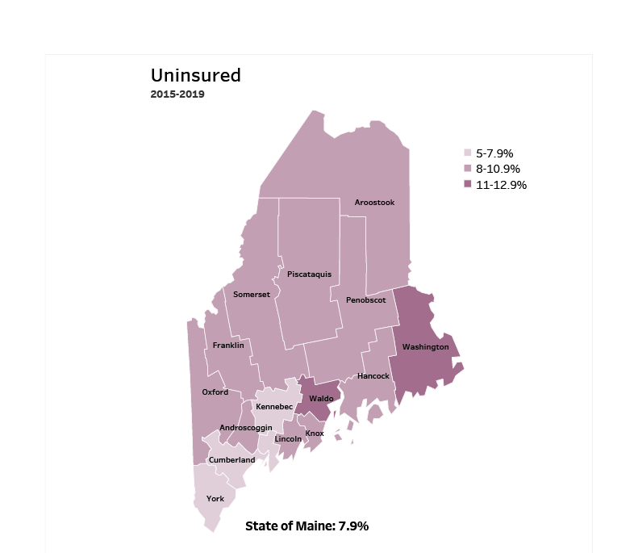
Access
Notes:
Lincoln County has an uninsured rate of 10%, which is higher than 11 other counties. 10 of the counties in Maine have an uninsured rate between 8-10.9%. Lack of insurance can lead to delayed medical care, emergency room treatment and poorer health outcomes.
Source: American Community Survey

Slide 33
Access
Notes:
Lincoln County residents are significantly less likely to have seen a primary care provider in the past year when compared to the state overall. Lack of care or delaying care is associated with worsening conditions and poorer long-term health outcomes.
Data Source: Behavioral Risk Factor Surveillance System
To be read as needed. Definition: Percentage of adults who had a regular physical exam (not for a specific injury, illness, or condition) within the last 12 months.

Slide 34
Cancer
Notes:
The rate of prostate cancer diagnoses has increased significantly within Lincoln County over time. The rate is also higher than the state, but this difference is not significant.
Data Source: Maine Cancer Registry
To be read as needed. Definition: Rate per 100,000 males of new cases of prostate cancer.
Age-Adjusted: We have calculated the rates so that they can be compared to other parts of the state that might have a population with a different mix of ages. Older people tend to have higher rates of many diseases and health conditions. It’s important to adjust for age so that we don’t accidentally mistake a place with older people for a place with an unusual number of disease-related deaths.

Slide 35
Respiratory Health
Notes:
Emergency department visits for asthma are significantly higher in Lincoln County than the state overall. Asthma is classified as an ambulatory-care sensitive condition, meaning with appropriate preventative care and treatment plan, worsening or acute symptoms can often be avoided.
Data Source: Maine Health Data Organization Hospital Inpatient and Outpatient Databases
National Institute of Health, https://www.ncbi.nlm.nih.gov/pmc/articles/PMC7429814/
To be read as needed. Definition: Rate per 10,000 people of emergency department discharges with a principal diagnosis of asthma.
Age- Adjusted: We have calculated the rates so that they can be compared to other parts of the state that might have a population with a different mix of ages. Older people tend to have higher rates of many diseases and health conditions. It’s important to adjust for age so that we don’t accidentally mistake a place with older people for a place with an unusual number of disease-related deaths.

Slide 36
Repiratory Health
Notes:
Lincoln county has a significantly higher rate of COPD hospitalizations than the state overall. COPD is a group of lung diseases, also an ambulatory care-sensitive condition, that block airflow and make it difficult to breath. Emphysema and chronic bronchitis are examples of COPD. Smoking is the primary cause of this condition. COPD is included in the category of chronic lower respiratory disease, the 5th leading cause of death in the county.
Data Source: Behavioral Risk Factor Surveillance System
American Lung Association, https://www.lung.org/lung-health-diseases/lung-disease-lookup/copd/symptoms-diagnosis
To be read as needed. Definition: Rate per 10,000 people of hospital discharges with a principal diagnosis of chronic obstructive pulmonary disease (COPD).
Age- Adjusted: We have calculated the rates so that they can be compared to other parts of the state that might have a population with a different mix of ages. Older people tend to have higher rates of many diseases and health conditions. It’s important to adjust for age so that we don’t accidentally mistake a place with older people for a place with an unusual number of disease-related deaths.

Slide 37
Physical Activity, Nutrition, and Weight
Notes:
There has been a significant decrease of middle school students who are meeting the recommended amount of physical activity in Lincoln County. The recommendation is at least 60 minutes everyday.
Data Source: Maine Integrated Youth Health Survey
To be read as needed. Definition: Percentage of seventh- and eighth-grade students who were physically active for a total of at least 60 minutes per day on seven of the past seven days. Data collected in odd numbered years.

Slide 38
Pregnancy and Birth Outcomes
Notes:
This chart shows that three-quarters of mothers in Lincoln County received more than 80% of expected prenatal visits. This is significantly lower than the state overall. Routine prenatal care reduces the risk of complications to both the mother and baby and provides necessary nutritional and medical education.
Data Source: Maine CDC Vital Records
National Institute of Health - https://www.nichd.nih.gov/health/topics/pregnancy/conditioninfo/prenatal-care
To be read as needed. Definition: Percentage of new mothers who had more than 80% of the expected prenatal visits.

Slide 39
Environmental Health
Notes:
The rates of children screened for lead between 12 and 23 months within Lincoln County increased significantly between 2015 and 2019, although the progress has not been steady. The screening rates remain significantly lower than the state overall. Lead testing is important given Maine’s older housing stock and the potential problems associated with childhood lead exposure.
Data Source: Maine CDC Childhood Lead Poisoning Prevention Unit
To be read as needed. Definition: Percentage of children, ages 24-35 months, who have had their blood tested for elevated blood lead levels.

Slide 40
Environmental Health
Notes:
Lead screening rates among 2-year-olds has improved significantly within Lincoln County but remains below the state.
Data Source: Maine CDC Childhood Lead Poisoning Prevention Unit
To be read as needed. Definition: Percentage of children, ages 12-23 months, who have had their blood tested for elevated blood lead levels.

Slide 41
Unintentional Injury
Notes:
Lincoln County has had a significant increase in fall-related deaths between 2007-2011 and 2015-2019 but remains below the state rate. This measure has been age-adjusted, so it cannot be attributed to Lincoln county’s older residents.
Data Source: Maine Health Data Organization Hospital Inpatient and Outpatient Databases
To be read as needed. To be read as needed. Definition: Rate per 10,000 people of emergency department discharges with a diagnoses of a fall-related injury.
Age Adjustment To be read as needed. Definition: We have calculated the rates so that they can be compared to other parts of the state that might have a population with a different mix of ages. Older people tend to have higher rates of many diseases and health conditions. It’s important to adjust for age so that we don’t accidentally mistake a place with older people for a place with an unusual number of disease-related deaths.

Slide 42
Unintentional Injury
Notes:
This indicator shows unintentional or undetermined poisoning, meaning these deaths are not due to suicide or other intentional injuries. It includes unintentional drug overdoses. The rate of poisoning deaths within Lincoln County has increased significantly but remains slightly below the state rate.
Data Source: Maine CDC Vital Records
To be read as needed. Definition: Rate per 100,000 people of deaths due to unintentional falls.
Age- Adjusted: We have calculated the rates so that they can be compared to other parts of the state that might have a population with a different mix of ages. Older people tend to have higher rates of many diseases and health conditions. It’s important to adjust for age so that we don’t accidentally mistake a place with older people for a place with an unusual number of disease-related deaths.

Slide 43
Intentional Injury
Notes:
Suicide deaths in Lincoln County have increased overtime and are higher than the state rate, but these differences are not significant.
Data Source: Maine CDC Vital Records
To be read as needed. Definition: Rate per 100,000 people of deaths due to suicide.
Age- Adjusted: We have calculated the rates so that they can be compared to other parts of the state that might have a population with a different mix of ages. Older people tend to have higher rates of many diseases and health conditions. It’s important to adjust for age so that we don’t accidentally mistake a place with older people for a place with an unusual number of disease-related deaths.

Slide 44
Mental Health
Notes:
This slide shows Lincoln County high school students who reported of feeling sad and hopeless for two weeks or more during the past 12 months and caused them to stop doing some of their usual activities. Depression in adolescence is linked with increased risks for negative effects on growth and development, school performance, and peer/family relationships in later adolescence. The precent has increased significantly in Lincoln County between 2017 and 2019. Lincoln County’s rate is higher than the overall State but the difference is not significant.
Data Source: Maine Integrated Youth Health Survey
Adolescent Mental Health Data.pdf (ucsf.edu)
Data Source: Maine Integrated Youth Health Survey To be read as needed. To be read as needed. Definition: Percentage of high school students who felt so sad or hopeless almost every day for two weeks or more in a row during the past 12 months that they stopped doing some usual activities. Data collected in odd numbered years.

Slide 45
Oral Health
Notes:
This slide shows the ratio of dentists to the overall population in Lincoln County. As you can see, Lincoln County has fewer practicing dentists per person when compared to the state overall. This may mean residents have to travel farther or have longer wait times to see a dentist.
Data Source: Health Resources and Services Administration
To be read as needed. Definition: Ratio of population to practicing dentists.

Slide 46
Oral Health
Notes:
This graph shows the rate of adults who were seen in the emergency room for a dental problem. Lincoln County has a significantly higher rate of ambulatory care sensitive dental emergency department visits than the state overall. These types of ED visits could be avoided with regular dental care and early intervention to prevent complications or more severe disease.
Data Source: Maine Health Data Organization Hospital Inpatient and Outpatient Databases
To be read as needed. Definition: Rate per 10,000 adults with emergency department (ED) visits for dental-related reasons for which good regular dental care can potentially prevent the need for hospitalization, or for which early intervention can prevent complications or more severe disease. Note that included conditions are different for adult than for children.
Age- Adjusted: We have calculated the rates so that they can be compared to other parts of the state that might have a population with a different mix of ages. Older people tend to have higher rates of many diseases and health conditions. It’s important to adjust for age so that we don’t accidentally mistake a place with older people for a place with an unusual number of disease-related deaths.

Slide 47
Oral Health
Notes:
This slide shows the rate of children within Lincoln County who needed ambulatory care due to a dental emergency, which primarily includes untreated cavities. Lincoln’s rate is significantly greater than Maine’s overall rate.
Data Source: Maine Health Data Organization Hospital Inpatient and Outpatient Databases To be read as needed. Definition: Rate per 10,000 children with emergency department (ED) visits for dental-related reasons for which good regular dental care can potentially prevent the need for hospitalization, or for which early intervention can prevent complications or more severe disease. Note that included conditions for children are primarily for untreated cavities and are different for adults.

Slide 48
Substance Use
Notes:
This slide shows the rate of infants who have been born addicted to a substance. This data is collected from healthcare providers who report there is a reasonable cause to suspect the baby has been affected by an illegal substance or is demonstrating withdrawal symptoms. The line graph shows the trend from 2011-2017. These single year data are not as reliable as the most recent two year data. The two-year rate of drug-affected infants born in Lincoln County is significantly higher than the State overall. The data shows the average annual rate for the two years and can be compared to the single year data. The reverse of the previous trend is a concern, given the birth and health risk associated with drug exposure in utero.
Data Source: Maine Automated Child Welfare Information System (Maine Office of Child and Family Services)
To be read as needed. To be read as needed. To be read as needed. Definition: Rate per 1,000 births of infants for which a healthcare provider reported that there was reasonable cause to suspect the baby may be affected by illegal substance abuse or demonstrating withdrawal symptoms resulting from prenatal drug exposure or has a fetal alcohol spectrum disorder.

Slide 49
Substance Use
Notes:
Here we see the rate of deaths for which substance use was the underlying cause, including those attributable to acute poisoning by drugs and those from medical conditions resulting from chronic drug use. Deaths due to alcohol use are not included. The rate of drug-induced deaths among Lincoln County residents is significantly higher within the county when compared to prior years and is now higher than the state rate.
Data Source: Maine CDC Vital Records and CDC WONDER Online Database
To be read as needed. Definition: Rate per 100,000 people of deaths for which drugs are the underlying cause, including those attributable to acute poisoning by drugs and those from medical conditions resulting from chronic drug use. Deaths due to alcohol use are excluded.
Age- Adjusted: We have calculated the rates so that they can be compared to other parts of the state that might have a population with a different mix of ages. Older people tend to have higher rates of many diseases and health conditions. It’s important to adjust for age so that we don’t accidentally mistake a place with older people for a place with an unusual number of disease-related deaths.

Slide 50
Substance Use
Notes:
This graph shows a significant decline over time in reported binge drinking among high school students. Binge drinking is defined as consuming 5 or more alcoholic drinks on at least one day in the past 30 days. This chart is missing 2017 data, which we are still working to get.
The data in the profile may look different. We have realized that 2017 and 2019 data in the Profile used a different denominator – only including those HS students who report any drinking. So, for 2019, 32.7% of students who reported drinking at all in the last 30 days also reported binge drinking. This translates to 9.4% of ALL high school students reporting binge drinking in Lincoln County. Lincoln County HS students binge drink at a similar rate as all Maine HS students.
Data Source: Maine Integrated Youth Health Survey
To be read as needed - To be read as needed. Definition: Percentage of high school students who had five or more alcoholic drinks on at least one day in the last 30 days. Data collected in odd numbered years.
of high school students who had five or more alcoholic drinks on at least one day in the last 30 days. Data collected in odd numbered years.

Slide 51
Tobacco Use
Notes:
Environmental tobacco smoke exposure among high school students has remained stable in Lincoln County between 2017 & 2019. Environmental smoke exposure is defined as being in the same room as someone who was smoking cigarettes at least one day during the past seven days. Lincoln County’s rate is significantly higher compared to the State’s rate of exposure.
Data Source: Maine Integrated Youth Health Survey To be read as needed. Definition: Percentage of high school students who were in the same room with someone who was smoking cigarettes at least one day during the past seven days. Data collected in odd numbered years.

Slide 52
Breakout Discussions

Slide 53
Reconvene

Slide 54
Wrap up and Next Steps

Slide 55
Contact
Cathy Cole, Director, LincolnHealth Community Health Improvement, Cathy.Cole@lchcare.org
Drexell White, District Liaison, Midcoast District, Maine CDC, Drexell.R.White@maine.gov
Jo Morrissey, MPH, Maine Shared CHNA, info@mainechna.org
www.mainechna.org

