Slide 1
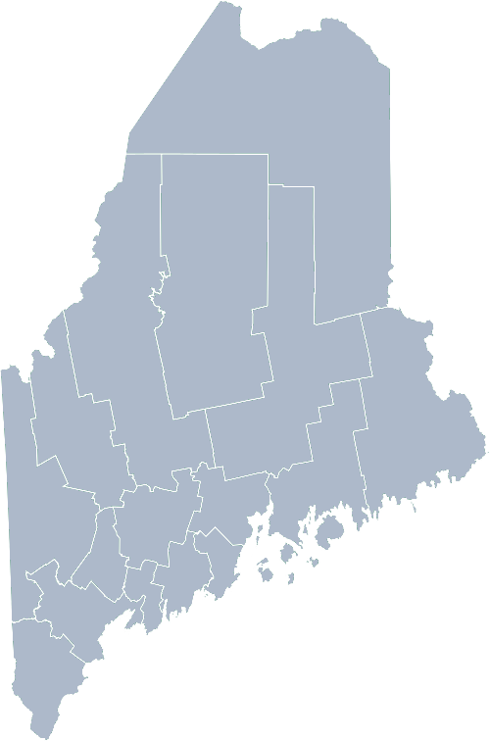
Maine Shared Community Health Needs Assessment LGBTQ+
2021
Notes:
Jennifer

Slide 2
The Maine Shared CHNA is a collaboration between the Maine Center for Disease Control and Prevention (Maine CDC), Central Maine Healthcare, Northern Light Health, MaineGeneral Health, and MaineHealth.
Notes:
Jennifer

Slide 3
Recognition
Notes:
Jennifer
Turn it over to Jo Morrissey, Maine Shared Community Health Needs Assessment for housekeeping and background.

Slide 4
Forum Agenda
Time | Activity | Speaker/Facilitator
4:00 – 4:05 pm | Welcome | Jennifer Thompson, Interim Executive Director, Health Equity Alliance
4:05 – 4:10 pm | Overview of Zoom; CHNA background | Jo Morrissey, Maine Shared CHNA Program Manager
4:10 – 4:20 pm | Leadership Remarks | Jennifer Thompson, Interim Executive Director, Health Equity Alliance
4:20– 4:40 pm | Presentation of key findings from the data | John Snow, Inc.
4:40 – 5:50 pm | Break-out session – facilitated discussion on data and health priority identification | Local Facilitators
5:50 – 6:00 pm | Reconvene, Wrap up and Next steps | Jennifer Thompson, Interim Executive Director, Health Equity Alliance
Notes:
Local Planning Committee Member to go over agenda and then turn it over to Jo Morrissey to provide an overview of the Zoom tools available and the purpose of today’s forum

Slide 5
Share screen
Join Audio, Mute On/Off
Open/close participant list or chat
Turn Video On/Off
Reactions
Notes:
Jo or JSI

Slide 6
Matching Interests
Maine Shared
Community Health Needs Assessment
Images of PHAB and IRS from the internet
Notes:
Jo or JSI

Slide 7
The Evolution of an Idea…
2010 OneMaine | 2015 SHNAPP | 2018 Maine Shared CHNA | 2021 Maine Shared CHNA
Forums Surveys | 16 Forums 1639 Surveys | 22 Mainstream Forums (live) 2 Immigrant Forums 45 Interviews | 16+ Mainstream Forums (virtual) 10+ Community Sponsored Events 1500+ Oral Surveys
Notes:
Jo or JSI

Slide 8
Inputs and Outcomes
Ways to Provide Input
Data Collected
Outcomes
District & County Reports DUE APRIL 2022
4 Health Priorities by county
Related indicators
Gaps/barriers and resources/assets
Notable comparisons between attendee input and the data.
Description of those who provided input
Methodology
Mainstream county forums
Number of attendees
Where attendees live (not CSE)
List of data identified Forums and CSE only)
Discussion notes (Forums and CSE only)
Chat box comments (Forums and CSE only)
Health Priorities
Gaps and Resources
Community sponsored events
State Report DUE APRIL 2022
4 Health Priorities by Community Event and immigrant population.
Related indicators
Gaps/barriers and resources/assets,
Notable comparisons to mainstream population.
Description of those who provided input
Methodology
Oral Survey
Forums, Events and Surveys conducted Fall 2021
Notes:
Jo to introduce Jennifer for leadership remarks
Jo or JSI
Community Sponsored Event Partners include
Disability Rights Maine (2 events: people who are deaf or hard of hearing and people with other disabilities)
Maine Primary Care Association (People who are served by Maine’s Federally Qualified Health Centers
Maine Council on Aging (Older Adults 65+
Consumer Right Council of Maine (people with a mental health diagnosis)
Formerly Incarcerated (Maine Prisoner Re-Entry Network)
Maine Youth Action Network and Friends (Raising the voices of Maine’s diverse youth)
Green Memorial A.M.E. Zion Church (Black/African American)
Health Equity Alliance (LGBTQ+ community)
Portland Recovery Center (for people with a substance use disorder or in recovery)
ADD HOUSING INSECURE IF NEED BE
ADD VETERAN IF NEED BE
Oral Survey Partners include:
City of Portland’s Minority Health Program
New Mainer’s Public Health Initiative
Maine Immigrant Access Network
Gateway Community Services
Maine Immigrant and Refugee Services
Maine Community Integration
Mano en Mano
We are piloting these additional outreach methods with support from
State of Maine’s Preventative Health and Health Services Block Grant
Maine Health Access Foundation
Introduce leader for leadership remarks

Slide 9
Leadership remarks
Notes:
Jennifer Thompson
Leader to introduce the following who will provide comments on recent health improvement efforts
ADD NAME OF THOSE WHO WILL BE DOING REVIEWING PREVIOUS EFFORTS

Slide 10
Previous Health Improvement Efforts
Notes:
Jennifer—
Can rename slide—depending on the topic of your remarks

Slide 11
Our commitment to people in Maine living with HIV, people who use drugs, and our LGBTQ+ community members has been at the core of our story, 35 years in the making.
HIV+ Care
Sexual Health and Wellness
Harm Reduction and Substance Use
Notes:
Jennifer
Introduce Madison MacLean of John Snow, Inc. (JSI) who will now give a data presentation on a list of data we’ve put together that we thought may be of interest to you.

Slide 12
Mission and Commitment
To collaborate with our community to serve the needs of our marginalized communities to combat stigma and advocate for health justice.
To be strategic and bold in our direct services and programming
To always advocate from those without a voice in our communities-local, state and federal levels
Serve our communities with compassionate care
Using current data to determine community need and build an ongoing plan to work in the unmet needs within our communities

Slide 13
The data
We would like to preface that the data presentation is sensitive in nature and we want to assure this group that while this maybe uncomfortable to discuss, it is why we are here-
We are striving to make our communities
better together.
Notes:
Jo to now turn this over to Madison from JSI

Slide 14
How to Read the County Health Profiles and Health Equity Data Sheets
Notes:
JSI or other facilitator

Slide 15
How to Read County Health Profile
CHANGE shows statistically significant changes in the indicator over time, based on 95% confidence interval (see description on page 3).
ê | means the health issue or problem is getting better over time.
! | means the health issue or problem is getting worse over time.
○ | means the change was not statistically significant.
N/A | means there is not enough data to make a comparison.
BENCHMARK compares [COUNTY] data to state and national data, based on 95% confidence interval (see description on page 3).
ê | means [COUNTY] is doing significantly better than the state or national average.
! | means [COUNTY is doing significantly worse than the state or national average.
○ | means there is no statistically significant difference between the data points.
N/A | means there is not enough data to make a comparison.
ADDITIONAL SYMBOLS
* | means results may be statistically unreliable due to small numbers, use caution when interpreting.
— | means data is unavailable because of lack of data or suppressed data due to a small number of respondents.
EXAMPLE
Notes:
JSI or other facilitator
A star means that the health issue or problem is getting better over time or better in comparison to another place
A red exclamation point means that the health issue or problem is getting worse over time or worse in comparison to another place
A gray circle means that the dating hasn’t changed over time or isn’t much different in comparison to another place
N/A means that there was not enough data to be able to make a comparison
There are two additional symbols you might see:
A black dot means that you should use caution when interpreting the data – the results might be unreliable because of small numbers
A black dash means that data was unavailable, or that data was suppressed due to a small number of respondents
(Go to next slide and walk audience through an example)

Slide 16
How to Read County Health Profile
EXAMPLE
 | AROOSTOOK COUNTY |  |  | BENCHMARKS
INDICATOR | POINT 1 | POINT 2 | CHANGE | MAINE | +/- | U.S. | +/-
Individuals living in poverty | 2009-2011 15.6% | 2015-2019 16.1% | ¡ | 2015-2019 11.8% | ! | 2019 12.3% | N/A
Notes:
Here’s an example of how we’ve visualized the data in the County Health Profiles.
The charts in this presentation are all excerpts from the Data Health Profiles that were created by MaineHealth and the Maine CDC. They contain data pulled from publicly available sources that are designed to help people learn more about the health of their communities. Not all the data points are available for every measure, but we’ve included data wherever we can.
The green bars represent data from your community. The left most one represents a past data point, and the right bar represents the most recent data point available when the data was gathered. These are the same data points used in the Data Health Profiles.
The grey bars represent data for the state of Maine as a whole- on the left- and for the United States as a whole- on the right, when it is available.
We’ve also noted where differences in the data points are ‘statistically significant’. A difference between two measurements is significant when scientists can say, with a known degree of confidence, that the difference between them is large enough that the difference is most likely to be caused by an actual difference in the item being measured, and not caused by error associated taking the measurement. All of these tests are comparing the most recent data point for your community to other data points. A red exclamation mark indicates a difference that your community is significantly different in a less desirable direction compared to the data point with the symbol. A green star indicates that your community is significantly different in a more desirable direction. A grey circle indicates that there is no significant difference.
(keep in presentation – do not read for deaf/HOH event or people with disabilities). A difference between two measurements is significant when scientists can say, with a known degree of confidence, that the difference between them is large enough that the difference is most likely to be caused by an actual difference in the item being measured, and not caused by an error associated taking the measurement. All of these tests are comparing the most recent data point for your community to other data points.
For example, in this slide, we have two symbols. The grey circle next to the measurement for 2009-2011 Aroostook County means that there is no significantly different change in the rate of poverty in Aroostook County when comparing the data from 2009-2011 to the data from 2015-2019. The red exclamation mark next to the Maine data point says there is a significant difference between 2015-2019 Aroostook County and 2015-2019 Maine, and that it is less desirable that Aroostook County has a higher rate of individuals living in poverty. No comparison could be made to the data for the U.S. because the years of data collection were different.

Slide 17
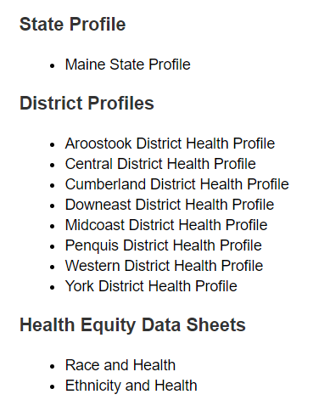
For More Data
www.mainechna.org
Notes:
The Maine Shared CHNA website contains health profiles for 3 of Maine’s largest cities, 16 counties, 5 public health districts, the state, as well as data provided by race, ethnicity, educational attainment, gender, sexual orientation, older adults, insurance status, income, and rurality.
IN addition, there is an interactive data portal where you can search by specific data points. All these breakdowns are then provided by data point.
REGARDING COVID-19 DATA
The Maine Shared CHNA data set does not include any data of COVID-19. This is largely due to the fact that there is a much more up-to-date and comprehensive Maine Data Dashboard continually being updated on the Maine CDC website.
Here you can find daily lab results, new case counts by date, trends, county breakdowns, data by race, and comparisons to other states and the nation.

Slide 18
Key Findings
Notes:
As we walk through the following data slides together, take notes. What surprises you? What stands out? What’s moving in the wrong direction?
Once the data presentation is over, you will be divided into breakout groups to discuss the data, share your top concerns, identify your top priorities, and share your knowledge about what’s working and what we need to work on to addres those top concerns.
Ready? Here we go.

Slide 19
Demographics
Notes:
Gender Identity is a different measure from sexual orientation and is now captured in both the youth and adult surveys with separate questions. We do not group Transgender people with GLB people in the analyses of these surveys. This slide shows the percentage of high school students who identify as transgender. The rate at which students who also identify as bisexual, gay, or lesbian identify as transgender is significantly higher than among students who identify as straight.
Because gender identity has only recently been added to the BRFSS, we do not yet have health data on transgender people in Maine. We expect to be able to present this data soon.
The remainder of the data we are presenting will be for LGB people.
Data Source: Maine Integrated Youth Health Survey
Definition: Percentage of high school students who identify as transgender. Data collected in odd numbered years.

Slide 20
Demographics
Age distribution for Maine
AGE
STATE OF MAINE
POPULATION
1,362,359
STATE OF MAINE
MEDIAN AGE
44.7
Notes:
Maine has a population of about 1.4 million. The population is aging and is one of the oldest states in the country. There are fewer children and young adults and more adults over the age of 65. This is particularly true in more rural parts of the state.
The percentage of people who identify and gay, lesbian or bisexual decreases by age group (12.4 % of high school students and 8.5% of 18-24 year-olds identify LGB, whereas 1 percent of those over age 75 identify as LGB.
Source: US Census Bureau, American Community Survey

Slide 21
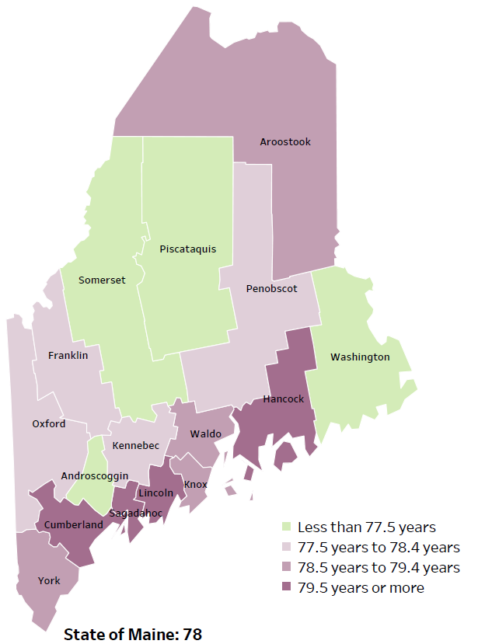
Overall Mortality
Life Expectancy
2017-2019
National Center for Health Statistics,
CDC
RANK | MAINE
1 | Cancer
2 | Heart Disease
3 | Unintentional Injury
4 | Chronic Lower Respiratory Disease
5 | Stroke
Notes:
The life expectancy in Maine is 78, which is slightly lower than the U.S. life expectancy of 78.7. You can see in the map on the left that life expectancy varies across Maine’s 16 counties.
The table on the right side of the slides shows the five leading causes of death in Maine. They are also the leading causes of death for many of the counties.
The leading cause of death is cancer. As we will see later in the presentation, Maine has both cost and location barriers to health care, which can impact cancer outcomes.
We do not have this data by sexual orientation.

Slide 22
Social Determinants of Health
LGBTQ population by geographic region
2012-2015, 2017
Data, Research and Vital Statistics
Notes:
A higher percentage of adults in Metro areas identify as LGB than in any size rural community. We looked at four categories of urban/rural based on the New England Rural health Roundtable’s grouping of “Rural Urban Commuting Area” codes by zip code. These groupings take into account both the size of the town or city and the general commuting patterns in the community. The difference is significant between Metro and large and isolated rural areas. The difference is not significant between metro and small rural areas, or between the various rural categories.
Source: BRFSS and Data, Research and Vital Statistics town-level population file

Slide 23
Social Determinants of Health
LGBTQ Educational Attainment
2012-2015, 2017
American Community Health Survey
Notes:
This graph shows percentage people who had attained different educational levels who were LGB. That is, 5.3% of those with a less than a HS Diploma of equivalent were LGB, whereas 4% of those with a bachelor degree or higher were LGB.
Source: BRFSS

Slide 24
Social Determinants of Health
LGBTQ Income
2012-2015, 2017
American Community Health Survey
Notes:
This graph shows percentage people with different income levels who were LGB. A higher percentage of those with lower incomes identify as LGB versus those with higher incomes. These are based on the household income, as reported by the respondent, and they are not controlled for household size.
Source: BRFSS

Slide 25
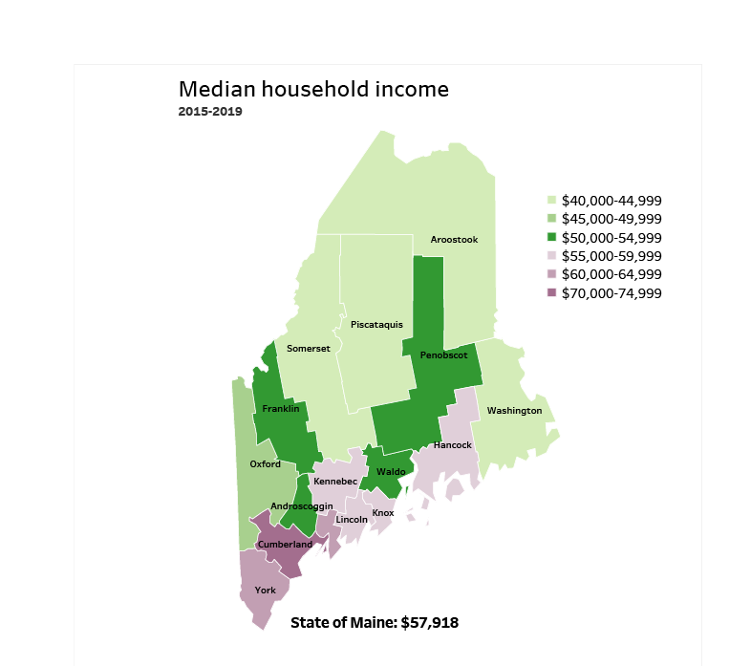
Social Determinants of Health
Notes:
Maine has a median household income of $57,918. The counties in Southern Maine and along the coast have higher household incomes. We do not have data on the median household income of GLB individuals, but this may provide more context for the previous slide.
Source: American Community Survey

Slide 26
Social Determinants of Health
Notes:
This slide shows the percentage of high school students who report they do not usually sleep in their parent’s or guardian’s home. Housing instability is significantly higher among LGBTQ youth than students who identify as straight.
Data Source: Maine Integrated Youth Health Survey
Definition: Percentage

Slide 27
Social Determinants of Health
Notes:
Adverse Childhood Experiences, commonly referred to as ACES, have a significant impact on development and later achievement. This chart shows the percentage of high school students who report at least 4 out of 10 adverse events. These events may include abuse, neglect, witnessing domestic violence or parental separation. LGBTQ high school students are significantly more likely to have experienced adverse childhood events when compared to straight students.
Data Source: Maine Integrated Youth Health Survey
Definition: Percentage of high school students who report at least four out of nine adverse childhood experiences. Data collected in odd numbered years.

Slide 28
Health Access
LGBTQ Insurance Status
2012-2015, 2017
American Community Health Survey
Notes:
This graph shows percentage people with different types of insurance who were LGB. A significantly higher percentage of those on MaineCare identify as LGB versus those with other types of insurance. The proportion of those who are uninsured who are LGB is also higher than those on Medicare and other insurances. The difference between those with private insurance is not significantly different than those without insurance.
Source: BRFSS

Slide 29
Health Access
Notes:
LGBTQ students are less likely to have seen a primary care provider in the past year. This difference is significant. LGBTQ individuals face health disparities linked to societal stigma and discrimination. Lack of care or delaying care is associated with worsening conditions and poorer long-term health outcomes.
Data Source: Behavioral Risk Factor Surveillance System
Office of Disease Prevention and Health Promotion, https://www.healthypeople.gov/2020/topics-objectives/topic/lesbian-gay-bisexual-and-transgender-health
Definition: Percentage of adults who had a regular physical exam (not for a specific injury, illness, or condition) within the last 12 months.

Slide 30
Respiratory Health
Notes:
LGBTQ adults are more likely to have been diagnosed with asthma. Bisexual and gay or lesbian adults are significantly more likely to have asthma than straight adults.
Data Source: Behavioral Risk Factor Surveillance System
Definition: Percentage of adults who have been told by a healthcare provider that they had asthma and that they still have asthma.

Slide 31
Physical Activity, Nutrition and Weight
Notes:
LGBTQ high school students are significantly more likely to be obese when compared to straight students. A high school student is considered obese if they have a body mass index between the 85th and 95th percentile for their age and gender. Obesity is associated with myriad medical comorbidities, including diabetes, hypertension, and sleep apnea.
Data Source: Maine Integrated Youth Health Survey
National Institute of Health https://pubmed.ncbi.nlm.nih.gov/10593535/#:~:text=These%20include%3A%20insulin%20resistance%2C%20glucose,and%20certain%20types%20of%20cancer.
Definition: Percentage of high school students who were obese (i.e., at or above the 95th percentile for body mass index, by age and sex). Data collected in odd numbered years.

Slide 32
Physical Activity, Nutrition and Weight
Notes:
This slide shows the percentage of high school students who were physically active for a total of at least 60 minutes per day. As you can see, LGBTQ students are less likely to meet physical activity recommendations. This difference is significantly lower when compared to straight or heterosexual students.
Data Source: Maine Integrated Youth Health Survey
Definition: Percentage of high school students who were physically active for a total of at least 60 minutes per day on seven of the past seven days. Data collected in odd numbered years.

Slide 33
Physical Activity, Nutrition and Weight
Notes:
This slide shows the percentage of high school students who watch less than 2 hours of screen time on the average school day. Screen time includes watching TV, playing video games or using the computer. LGBTQ students are significantly less likely to report under 2 hours of screen time, meaning they spend more time using screens.
Data Source: Maine Integrated Youth Health Survey
Definition: Percentage of high school students watching two or fewer hours of combined screen time (including television, video games, and computers) per day on an average school day. Data collected in odd numbered years.

Slide 34
Intentional Injury
Notes:
LGBTQ students are significantly more likely to be the victims of bullying. Being bullied is associated with both short- and long-term consequences, including higher rates of depression, anxiety, low self-esteem, aggression, drug use, sleep disorders, headaches, and poor academic performance.
Data Source: Maine Integrated Youth Health Survey
Stop Bullying https://www.stopbullying.gov/resources/research-resources/consequences-of-bullying
Definition: Percentage of high school students who have been bullied on school property in the past 12 months. Data collected in odd numbered years.

Slide 35
Intentional Injury
Notes:
This graph shows the percentage of high school students who engage in intentional self-injury. Intentional self-Injury is defined as a deliberate, self-inflicted damage of body tissue without suicidal intent. Methods of self-injury include cutting, burning, scratching, and banging or hitting, and most people who self-injure have used multiple methods. LBGTQ students are significantly more likely to engage in in self-injurious behaviors when compared to straight students.
Data Source: Maine Integrated Youth Health Survey
Klonsky, E. D., Victor, S. E., & Saffer, B. Y. (2014). Nonsuicidal self-injury: what we know, and what we need to know. Canadian journal of psychiatry. Revue canadienne de psychiatrie, 59(11), 565–568. https://doi.org/10.1177/070674371405901101
Definition: Percentage of high school students who have ever done something to purposely hurt themselves without wanting to die, such as cutting or burning themselves on purpose. Data collected in odd numbered years.

Slide 36
Mental Health
Notes:
This slide shows the percentage of high school students who have seriously considered suicide within the past year. LGTBQ students are significantly more likely to have considered suicide. This is of great concern and should be an area of focus.
Data Source: Maine Integrated Youth Health Survey
Definition: Percentage of high school students who seriously considered attempting suicide during the past 12 months. Data collected in odd numbered years.

Slide 37
Mental Health
Notes:
The percentage of LGBTQ adults who report current symptoms of depression is significantly higher than straight adults.
Data Source: Behavioral Risk Factor Surveillance System
Definition: Percentage of adults who have current symptoms of depression based on two questions in the BRFSS

Slide 38
Mental Health
Notes:
LGBTQ adults are significantly more likely to have current symptoms of depression, as we saw in the previous slide, and subsequently be diagnosed with a depressive disorder.
Data Source: Behavioral Risk Factor Surveillance System
Definition: Percentage of adults who have ever been told by a healthcare provider that they have a depressive disorder.

Slide 39
Mental Health
Notes:
Rates of anxiety are also significantly higher among the LGBTQ population in Maine. The higher rates of mental health conditions, bullying, suicidal ideation and self-injurious behavior are concerning and warrant further education and support.
Data Source: Behavioral Risk Factor Surveillance System
Definition: Percentage of adults who have ever been told by a healthcare provider that they have an anxiety disorder.

Slide 40
Mental Health
Notes:
This slide shows Maine high school students who reported of feeling sad and hopeless for two weeks or more during the past 12 months and caused them to stop doing some of their usual activities. Depression in adolescence is linked with increased risks for negative effects on growth and development, school performance, and peer/family relationships in later adolescence. The percent of LGBTQ students reporting feeling sad and hopeless is significantly higher than straight students.
Data Source: Maine Integrated Youth Health Survey
Adolescent Mental Health Data.pdf (ucsf.edu)
Definition: Percentage of high school students who felt so sad or hopeless almost every day for two weeks or more in a row during the past 12 months that they stopped doing some usual activities. Data collected in odd numbered years.

Slide 41
Mental Health
Notes:
As we saw in previous slides, those who are LGBTQ are more likely to have been diagnosed with depression and/or anxiety. It is promising to see that those who are bisexual, gay or lesbian are seeking treatment for mental health since LGBTQ individuals often face significant barriers in accessing services.
Data Source: Behavioral Risk Factor Surveillance System
Psychiatric Times, https://www.psychiatrictimes.com/view/lgbtq-mental-health-what-every-clinician-needs-know Definition: Percentage of adults who are currently taking medicine or receiving treatment from a doctor for any type of mental health condition or emotional problem.

Slide 42
Substance Use
Notes:
Marijuana use among LGBTQ adults in Maine is significantly higher when compared to straight adults.
Data Source: Behavioral Risk Factor Surveillance System
Definition: Percentage of adults who used marijuana during the past 30 days.

Slide 43
Substance Use
Notes:
Prescription drug misuse is taking a medication without a doctor’s prescription at least one time in the past 30 days. Prescription drug misuse is significantly higher among LGBTQ high school students.
Data Source: Maine Integrated Youth Health Survey
Definition: Percentage of high school students who used a prescription drug without a doctor's prescription at least one time in the last 30 days. Data collected in odd numbered years.

Slide 44
Tobacco Use
Notes:
This slide shows the percent of high school students who smoke cigarettes on at least one day in the past 30 days. LGBTQ students in Maine are significantly more likely to have smoked cigarettes in the last 30 days.
Source: Behavioral Risk Factor Surveillance System
Centers for Disease Control and Prevention (2017). https://www.cdc.gov/nchs/nhis/tobacco/tobacco_glossary.htm
Data Source: Maine Integrated Youth Health Survey
Definition: Percentage of high school students who smoked cigarettes on at least one day in the past 30 days. Data collected in odd numbered years.

Slide 45
Tobacco Use
Notes:
Similar to the previous slide, LGBTQ students are significantly more likely to have used tobacco in the past 30 days. In addition to cigarettes, this may include cigars, chewing tobacco, snuff or dip.
Data Source: Maine Integrated Youth Health Survey
Definition: Percentage of high school students who smoked cigarettes or cigars or used chewing tobacco, snuff, or dip on one or more of the past 30 days. Data collected in odd numbered years.

Slide 46
Tobacco Use
Notes:
Environmental tobacco smoke exposure among LGBTQ high school students is significantly higher when compared to straight students. Environmental smoke exposure is defined as being in the same room as someone who was smoking cigarettes at least one day during the past seven days.
Data Source: Maine Integrated Youth Health Survey
Definition: Percentage of high school students who were in the same room with someone who was smoking cigarettes at least one day during the past seven days. Data collected in odd numbered years.

Slide 47
Breakout Discussions

Slide 48
Reconvene

Slide 49
Wrap up and Next Steps

Slide 50
Contacts
Local Contact(s):
Jennifer Thompson, Interim Director, Health Equity Alliance, jennifer@mainehealthequity.org
Jo Morrissey, Program Manager, Maine Shared CHNA: info@mainechna.org or www.mainechna.org

