Slide 1
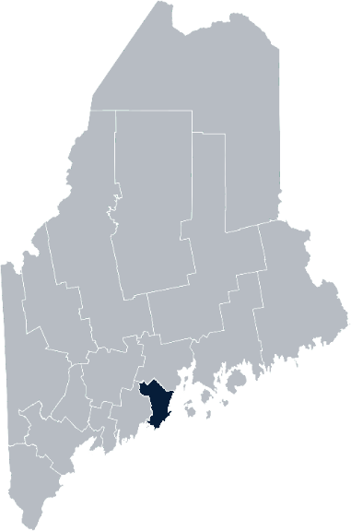
Maine Shared Community Health Needs Assessment Knox County
2021

Slide 2
The Maine Shared CHNA is a collaboration between the Maine Center for Disease Control and Prevention (Maine CDC), Central Maine Healthcare, Northern Light Health, MaineGeneral Health, and MaineHealth.
Notes:
Local Planning Committee Member

Slide 3
Forum Agenda
Time | Activity | Speaker/Facilitator
3:30- 3:35 pm | Welcome | Adrienne Gallant, CHA Community Health Improvement
3:35- 3:40 pm | Overview of Zoom | Jo Morrissey, Maine Shared CHNA Program Manager
3:40 – 3:45 pm | Leadership Remarks | Kendra Emery, MD, Medical Director, PBMC Community Health Improvement Mark Fourre, MD, CEO/President, Coastal Healthcare Alliance
3:45 – 3:55 pm | Review previous CHNA priorities and activities 2019-2021 | Drexell White, Public Health Liaison, Midcoast Public Health District Adrienne Gallant, CHA Community Health Improvement
3:55 – 4:15 pm | Presentation of key findings from the data | John Snow, Inc.
4:15 –4:40 pm | Break-out session – facilitated discussion on data and health priority identification | John Snow, Inc. & Local Facilitators
4:40 – 5:20 pm | Reconvene and Review | John Snow, Inc.
5:20 – 5:30 pm | Wrap up and next steps
Notes:
Local Planning Committee Member to go over agenda and then turn it over to Jo Morrissey to provide an overview of the Zoom tools available and the purpose of today’s forum

Slide 4
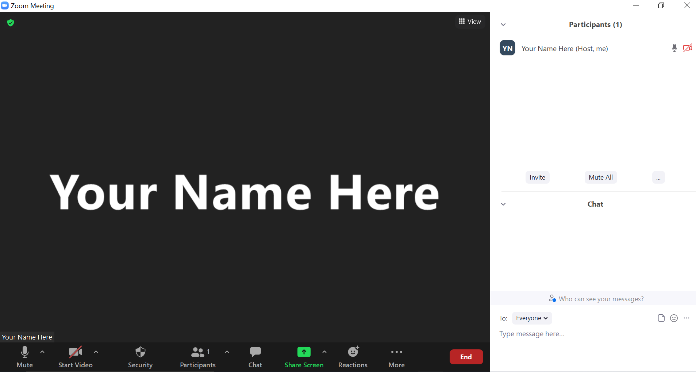
Share screen
Join Audio, Mute On/Off
Open/close participant list or chat
Turn Video On/Off
Reactions
Notes:
Jo or JSI

Slide 5
Matching Interests
Maine Shared
Community Health Needs Assessment
Images of PHAB and IRS from the internet
Notes:
Jo or JSI

Slide 6
The Evolution of an Idea…
2010 OneMaine | 2015 SHNAPP | 2018 Maine Shared CHNA | 2021 Maine Shared CHNA
Forums Surveys | 16 Forums 1639 Surveys | 22 Mainstream Forums (live) 2 Immigrant Forums 45 Interviews | 16+ Mainstream Forums (virtual) 10+ Community Sponsored Events 1500+ Oral Surveys
Notes:
Jo or JSI

Slide 7
Inputs and Outcomes
Ways to Provide Input
Data Collected
Outcomes
District & County Reports DUE APRIL 2022
4 Health Priorities by county
Related indicators
Gaps/barriers and resources/assets
Notable comparisons between attendee input and the data.
Description of those who provided input
Methodology
Mainstream county forums
Number of attendees
Where attendees live (not CSE)
List of data identified Forums and CSE only)
Discussion notes (Forums and CSE only)
Chat box comments (Forums and CSE only)
Health Priorities
Gaps and Resources
Community sponsored events
State Report DUE APRIL 2022
4 Health Priorities by Community Event and immigrant population.
Related indicators
Gaps/barriers and resources/assets,
Notable comparisons to mainstream population.
Description of those who provided input
Methodology
Oral Survey
Forums, Events and Surveys conducted Fall 2021
Notes:
Introduce:
Kendra Emery, MD, Medical Director, PBMC Community Health Improvement
Mark Fourre, MD, CEO/President, Coastal Healthcare Alliance
Jo or JSI
Community Sponsored Event Partners include
Disability Rights Maine (2 events: people who are deaf or hard of hearing and people with other disabilities)
Maine Primary Care Association (People who are served by Maine’s Federally Qualified Health Centers
Maine Council on Aging (Older Adults 65+
Consumer Right Council of Maine (people with a mental health diagnosis)
Formerly Incarcerated (Maine Prisoner Re-Entry Network)
Maine Youth Action Network and Friends (Raising the voices of Maine’s diverse youth)
Green Memorial A.M.E. Zion Church (Black/African American)
Health Equity Alliance (LGBTQ+ community)
Portland Recovery Center (for people with a substance use disorder or in recovery)
ADD HOUSING INSECURE IF NEED BE
ADD VETERAN IF NEED BE
Oral Survey Partners include:
City of Portland’s Minority Health Program
New Mainer’s Public Health Initiative
Maine Immigrant Access Network
Gateway Community Services
Maine Immigrant and Refugee Services
Maine Community Integration
Mano en Mano
We are piloting these additional outreach methods with support from
State of Maine’s Preventative Health and Health Services Block Grant
Maine Health Access Foundation
Introduce leader for leadership remarks

Slide 8
Leadership remarks
Notes:
Leadership remarks by
Kendra Emery, MD, Medical Director, PBMC Community Health Improvement
Mark Fourre, MD, CEO/President, Coastal Healthcare Alliance
Leader to introduce the following who will provide comments on recent health improvement efforts
Drexell White, Public Health Liaison, Midcoast Public Health District
Adrienne Gallant, CHA Community Health Improvement

Slide 9
Previous Health Improvement Efforts Knox County: Highlights 2019-2021
Notes:
Local Facilitator

Slide 10
Pandemic Acknowledgement and Thanks
During this past CHNA cycle – COVID-19 became a public health focus for everyone.
This was and continues to be a focus of many of our partners’ outreach, planning, and every day activities.
COVID vaccination clinics held throughout both counties.
Notes:
Drexell and Adrienne
Number of COVID vaccination clinics and locations (CONTACT STEVE GARHARTT)
Number of vaccines delivered (include school vaccinations)
Acknowledge volunteers and employees that made clinics happen
Thank you. I’m Drexell White, the Maine CDC District Public Health Liaison for the Midcoast District. Welcome to everyone who took time to join us today and help us map out our Community Health Needs. I’d like to start with an acknowledgement of the times in which we live and the tremendous ongoing effort to keep Maine safe and healthy.
The vaccination numbers on the slide illustrate one part of the unprecedented effort undertaken by our healthcare, public health, and social services systems, as well as State, County and Local governments, non-governmental organizations, businesses and individuals throughout the State.
This has been an all-hands-on-deck effort affecting everyone. To all our thanks for your efforts and continued support..

Slide 11
Midcoast District Public Health Council
Midcoast Public Health District:
One of Nine (9) Public Health Districts in Maine
Includes Knox, Lincoln, Sagadahoc & Waldo Counties (73 Municipalities, including six island communities)
Midcoast Public Health Council (MPHC):
District Coordinating Council (DCC) for Public Health with Membership/ Representation from the District’s Four Counties, plus Brunswick & Harpswell
District Work 2019 -2021– Mental Health, Obesity, Elevated Lead Levels & Climate Change
Notes:
The Midcoast Public Health District is one of 9 Public Health Districts in Maine; 8 geographic-based Districts and one population-based District serving the State’s indigenous tribes.
The Midcoast District has a public health unit that includes Public Health Nursing, District Epidemiology, Health Inspections, Drinking Water, and the District Liaison and Council Coordinator. In addition to its regular functions, the Public Health Unit has been focused on the support of the Covid 19 response.
Our District includes Waldo, Knox, Lincoln and Sagadahoc Counties encompassing 73 municipalities. One of the unique features of our District are the six island communities of Islesboro, Isle au Haut, North Haven, Vinalhaven and Monhegan.
Next Slide Please.

Slide 12
Midcoast Public Health Council Highlights
MPHC Committees:
Mental Health - Mental Health First Aid Training – 80 persons trained
Obesity – Promotion of low/no cost physical activity opportunities
Elevated Lead Levels – Collaborating with pediatric practices to increase screening
MPHC-sponsored panel discussions on:
Social Isolation, Aging, & Elder Abuse
Vaccine Hesitancy, and Vaccination Efforts in the District
Coping with Covid – Building Hope & Resiliency
Climate Change and its Public Health Implications
Notes:
The Midcoast Public Health Council continued its work on mental health, obesity and elevated blood lead levels in children. Through funding made available through Maine CDC, the MPHC was able to conduct a series of Mental Health First Aid programs in the District, training 80 persons.
Our Obesity Committee sought out opportunities to promote low and no cost physical activity opportunities through local land trusts and conservancies.
And,, our lead committee collaborated with pediatric providers to create strategies to improve blood lead level screening in children.
The Midcoast Public Health Council meets five times per year, and continued to meet throughout the pandemic, offering a variety virtual panel discussions and presentations. Thanks to the MPHC Leadership, Council Members and Stakeholders for continuing to plan, meet and engage during these challenging times.
Thank you for this opportunity to provide Midcoast Public Health District and Council highlights, I’ll now turn it back to Adrienne Gallant.

Slide 13
Pen Bay Medical Center/Waldo County General Hospital CHNA 2019-2021 Priorities
Substance Use
Tobacco
Obesity & Diabetes
Food Insecurity
Notes:
Before we delve into the next group of slides, I want to take a moment to mention that these upcoming slides are a snap shot of work done by the hospital and our community partner, the Knox County Community Health Coalition, with whom we collaborate on grant work to help move the needle on these health priorities. The work outlined here has been done between October 1, 2018 until September 2021. We fully recognize that we have many community partners who are also doing population health work in Knox County, many of which are here today. The
Onto our slides!
Next slide please

Slide 14
Substance Use
Education & Programs | Knox County Recovery Collaborative Waldo County Recovery Committee (WCRC) IMAT services at PBMC and WCGH Naloxone Quarterly online trainings 2,867 prescriptions written for PBMC 843 prescriptions written for WCGH Community Education—Knox County Community Health Coalition and WCRC Safe storage/disposal education workshops Medication take back Monthly prevention articles provided to schools Provided presentations to community and law enforcement on the importance of decreasing stigma Impairment detection trainings for local businesses, DHHS managers, CDS, others
Grant Work | HRSA Rural substance use disorder grant—PBMC Maine Prevention Services Grant—Knox County Community Health Coalition MeHAF grant—Knox County Community Health Coalition
Notes:
As the years move forward, we continue to see the impact substance use has on individuals, families, and the community at large. Work by our hospitals and community partners continues to be done to increase access to treatment and/or provide education on the implications of substance use on the individual, families, and our community.
In 2018 a group of providers from multiple community organizations came together in Waldo County to form the Waldo County Recovery Committee. Knox County followed suit in 2019 forming the Knox County Recovery Collaborative. The purpose of the groups is to increase communication between organizations and help those struggling the many aspects of substance use.
Pen Bay Medical Center and Waldo County General Hospital continue to offer Integrated Medication Assisted Treatment to those dealing with opioid use disorder. Between Pen Bay and Waldo County General Hospital’s practices, psychiatric and health centers there are 20 IMAT providers.
Pen Bay received a federal planning grant in September of 2020 to look at the gaps in needs and resources for individuals with opioid use disorder. Through the grant, we were able to conduct a needs assessment and start developing a plan to addressing some of the gaps.
Over the past three years, Waldo County Recovery Committee and the Knox County Community Health Coalition provided a variety of community and provider focused trainings and partnered with law enforcement to support county wide county wide medication take back events.
The Knox County Community Health coalition received a MeHAF grant that allowed them to partner with the Knox County Sheriff’s office to support discharge planning to connect inmates being released with community resources.
Next slide please

Slide 15
Tobacco Use
Education & Programs | Referrals to Maine Tobacco Helpline from providers over 3 years 1,182 Knox County 1,129 Waldo County New tobacco policies 20 Knox County 20 Waldo County (2019-2021) Community education and trainings on: Vaping awareness and prevention Tobacco prevention and education QuitLink Sidekicks
Grant Work | Maine Prevention Services Grant Tobacco Prevention Coordinator—Knox County Community Health Coalition Tobacco Prevention Coordinator—Waldo County General Hospital
Notes:
Tobacco use and tobacco prevention has been a focus across our counties. Work is done across sectors to develop policies, provide support for those that need or want to quit and educate people of all ages on the health risks of using tobacco and the need to become or remain tobacco free.
Over the past three years we’ve seen referrals from providers to the helpline increase each year.
Multiple trainings were provided to the community across both counties on vaping, tobacco prevention, the quitlink and the sidekicks program. Over 2500 people were reached with these trainings!
Next slide please

Slide 16
Obesity and Diabetes
Education & Programs | Let’s Go! 48 Knox County Sites 43 Waldo County Sites PBMC and WCGH Wellness 369 employees participated in 20 Works on Wellness programs Journey to Health classes 2,037 people registered for healthy eating and cooking, physical movement, and healthy mind and body classes 140 participants enrolled in fall prevention classes: Matter of Balance; Tai Chi for fall prevention and osteoporosis; Simple Fall Strategies National Diabetes Prevention Program
Grant Work | SNAP-Ed Nutrition education Grant SNAP-Ed Nutrition Educator—Waldo County General Hospital SNAP-Ed Nutrition Educator—Knox County Community Health Coalition Maine Prevention Services Grant (Let’s Go!)—PBMC and WCGH
Notes:
As you can see here there are a number of programs in our county working on reducing the incidence and impact of obesity and diabetes. From Let’s Go! To SNAP-Ed to MaineHealth’s Diabetes Prevention program. There’s a large focus on helping our community eat healthy, move more and access fresh fruits and vegetables on a budget.
We’ve seen an increase in engagement from our LG! sites this year. With the interruption of COVID we were not sure if the program would rebound but sites were happy to re-engage to continue to provide healthy spaces for kids to learn. And with everything that schools have been going through they’ve been willing to work with our coordinator on revising their wellness policies (3 revised, 7 in the works).
Maine SNAP-Ed is a federally funded program that provides nutrition education services in settings like schools, food pantries, Head Starts, other child care settings, grocery stores and regional DHHS offices, and our SNAP-Ed coordinators have been working hard to get this information out to these organizations and sites.
908 nutrition education classes were provided by the SNAP Educators in both Knox and Waldo counties to youth of all ages as well as adults reaching almost 2500 participants.
SNAP-Ed in Waldo County collaborated with WIC, the Women, Infant and Children program, to create YouTube videos on how to make healthy meals.
SNAP-Ed in Knox County provided nutritional and menu guidance for the AIO weekend meal program.
The National Diabetes Prevention Program started being offered statewide October 2019. The program had to pivot quickly to a remote option in March of 2020. Since going remote we’ve seen an increase in participation in the program from both Knox and Waldo County residents (as well as across the state). The ability to participate in this program remotely has increased access to the program in a way that we didn’t anticipate.
Next slide please

Slide 17
Food Insecurity
Education & Programs | Rockland Farmer’s Market collaboration with SNAP $18,063 in SNAP sales $13,364 in Maine Harvest Bucks sales Provider practices provided emergency food bags to patients in need 195 bags distributed across both hospital systems Free veggies for patients at PBMC and WCGH Approx. 3,075 pounds of free veggies distributed at PBMC Approx. 2,326 pounds of free veggies distributed at WCGH Knox County Gleaners—Knox County SNAP-Ed
Notes:
In Maine, people are living with food insecurity every day and Knox and Waldo counties are no different. Access to affordable fresh fruits and vegetables is a challenge for many of our residents. Over the past three years the hospitals and our community partners have been working to help those in need.
In the summer of 2019 PBMC partnered with the SNAP program and the Maine Federation of Farmer’s Markets to allow the use of SNAP benefits at the Rockland Farmer’s Market. As the summer progressed we saw an increase in the use of SNAP benefits. We also promoted the Harvest Bucks program: for every dollar spent, SNAP recipients would receive a dollar in harvest bucks that they could then use at the market to purchase fresh fruits and vegetables. The program was successful enough that the farmer’s market agreed to continue it for the following two summers (2020 and 2021). The program has continued to flourish!
Since December 2019, the hospital practices partnered with the Good Shepard Food Bank to distribute a total of 195 food bags to those identified as food insecure
Again in partnership with the Good Shepard Food Bank, under the Mainers Feeding Mainers initiative, PBMC and WCGH offered free veggies to patients. Between July and October of this year, both hospitals partnered with local farms to provide over 5,000 pounds of fresh vegetables to patients across both counties.
PBMC partnered with Maine Coast Heritage Farm for produce from Erickson Farm
WCGH partnered with Calyx Farm in Morrill
The SNAP-Ed coordinator for Knox County developed and expanded the Knox County Gleaners. Produce gleaned from farms was distributed among local food pantries, organizations and low-income senior residences. The coordinator also helped develop plans for a community kitchen where hands on classes can be taught and participants can gain cooking skills and understand how those skills can lead to a healthier life.
Now, I am happy to turn this back to JSI

Slide 18
How to Read the County Health Profiles and Health Equity Data Sheets
Notes:
JSI or other facilitator

Slide 19
How to Read County Health Profile
CHANGE shows statistically significant changes in the indicator over time, based on 95% confidence interval (see description on page 3).
ê | means the health issue or problem is getting better over time.
! | means the health issue or problem is getting worse over time.
○ | means the change was not statistically significant.
N/A | means there is not enough data to make a comparison.
BENCHMARK compares [COUNTY] data to state and national data, based on 95% confidence interval (see description on page 3).
ê | means [COUNTY] is doing significantly better than the state or national average.
! | means [COUNTY is doing significantly worse than the state or national average.
○ | means there is no statistically significant difference between the data points.
N/A | means there is not enough data to make a comparison.
ADDITIONAL SYMBOLS
* | means results may be statistically unreliable due to small numbers, use caution when interpreting.
— | means data is unavailable because of lack of data or suppressed data due to a small number of respondents.
EXAMPLE
Notes:
JSI or other facilitator
A star means that the health issue or problem is getting better over time or better in comparison to another place
A red exclamation point means that the health issue or problem is getting worse over time or worse in comparison to another place
A gray circle means that the dating hasn’t changed over time or isn’t much different in comparison to another place
N/A means that there was not enough data to be able to make a comparison
There are two additional symbols you might see:
A black dot means that you should use caution when interpreting the data – the results might be unreliable because of small numbers
A black dash means that data was unavailable, or that data was suppressed due to a small number of respondents
(Go to next slide and walk audience through an example)

Slide 20
How to Read County Health Profile
EXAMPLE
 | AROOSTOOK COUNTY |  |  | BENCHMARKS
INDICATOR | POINT 1 | POINT 2 | CHANGE | MAINE | +/- | U.S. | +/-
Individuals living in poverty | 2009-2011 15.6% | 2015-2019 16.1% | ¡ | 2015-2019 11.8% | ! | 2019 12.3% | N/A
Notes:
Here’s an example of how we’ve visualized the data in the County Health Profiles.
The charts in this presentation are all excerpts from the Data Health Profiles that were created by MaineHealth and the Maine CDC. They contain data pulled from publicly available sources that are designed to help people learn more about the health of their communities. Not all the data points are available for every measure, but we’ve included data wherever we can.
The green bars represent data from your community. The left most one represents a past data point, and the right bar represents the most recent data point available when the data was gathered. These are the same data points used in the Data Health Profiles.
The grey bars represent data for the state of Maine as a whole- on the left- and for the United States as a whole- on the right, when it is available.
We’ve also noted where differences in the data points are ‘statistically significant’. A difference between two measurements is significant when scientists can say, with a known degree of confidence, that the difference between them is large enough that the difference is most likely to be caused by an actual difference in the item being measured, and not caused by error associated taking the measurement. All of these tests are comparing the most recent data point for your community to other data points. A red exclamation mark indicates a difference that your community is significantly different in a less desirable direction compared to the data point with the symbol. A green star indicates that your community is significantly different in a more desirable direction. A grey circle indicates that there is no significant difference.
(keep in presentation – do not read for deaf/HOH event or people with disabilities). A difference between two measurements is significant when scientists can say, with a known degree of confidence, that the difference between them is large enough that the difference is most likely to be caused by an actual difference in the item being measured, and not caused by an error associated taking the measurement. All of these tests are comparing the most recent data point for your community to other data points.
For example, in this slide, we have two symbols. The grey circle next to the measurement for 2009-2011 Aroostook County means that there is no significantly different change in the rate of poverty in Aroostook County when comparing the data from 2009-2011 to the data from 2015-2019. The red exclamation mark next to the Maine data point says there is a significant difference between 2015-2019 Aroostook County and 2015-2019 Maine, and that it is less desirable that Aroostook County has a higher rate of individuals living in poverty. No comparison could be made to the data for the U.S. because the years of data collection were different.

Slide 21
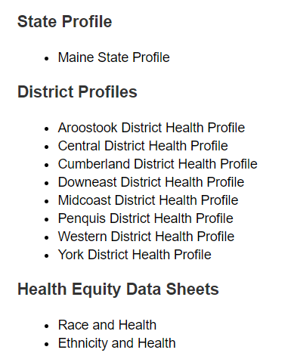
For More Data
www.mainechna.org
Notes:
The Maine Shared CHNA website contains health profiles for 3 of Maine’s largest cities, 16 counties, 5 public health districts, the state, as well as data provided by race, ethnicity, educational attainment, gender, sexual orientation, older adults, insurance status, income, and rurality.
IN addition, there is an interactive data portal where you can search by specific data points. All these breakdowns are then provided by data point.
REGARDING COVID-19 DATA
The Maine Shared CHNA data set does not include any data of COVID-19. This is largely due to the fact that there is a much more up-to-date and comprehensive Maine Data Dashboard continually being updated on the Maine CDC website.
Here you can find daily lab results, new case counts by date, trends, county breakdowns, data by race, and comparisons to other states and the nation.

Slide 22
Key Findings
Notes:
As we walk through the following data slides together, take notes. What surprises you? What stands out? What’s moving in the wrong direction?
Once the data presentation is over, you will be divided into breakout groups to discuss the data, share your top concerns, identify your top priorities, and share your knowledge about what’s working and what we need to work on to addres those top concerns.
Ready? Here we go.

Slide 23
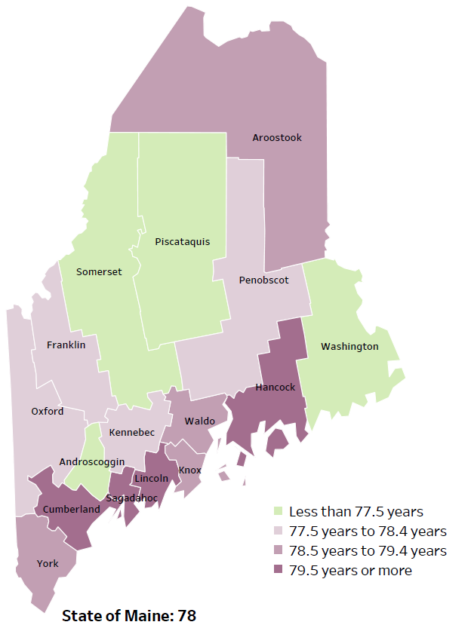
Demographics
Life Expectancy
2017-2019
National Center for Health Statistics,
CDC
RANK | MAINE | KNOX
1 | Cancer | Heart Disease
2 | Heart Disease | Cancer
3 | Unintentional Injury | Alzheimer's Disease
4 | Chronic Lower Respiratory Disease | Unintentional Injury
5 | Stroke | Stroke
Notes:
The life expectancy in Knox County is 79, which is higher than the state average of 78. Knox County has one of the highest life expectancies in the state. This is an indication that more people are dying at older ages than residents in many other counties in Maine.
The table on the right side of the slides shows the five leading causes of death in Knox County. They are also the leading causes of death for the whole state of Maine with the exception of Alzheimer's Disease, which is the 3rd leading cause of death in the county.
The leading cause of death is Heart disease and cancer is second. The is true in the U.S. overall- Heart Disease is the leading cause of death, and cancer is the 2nd leading cause. The opposite is true for Maine- Cancer is the leading cause of death, followed by heart disease. As we will see later in the presentation, Knox County has a high rate of fall-related injuries and death which is reflected as the leading causes of death.
The 4th leading cause of death- Unintentional Injury- includes a number of accidental causes: Three of the most common causes are i) Deaths due to motor vehicle crashes, ii) deaths due to accidental falls, iii) deaths due to poisonings that either were unintentional, or the intent was undetermined. Some Firearm deaths may also be classified as unintentional. Suicides, some Firearm deaths and some Poisoning deaths are classified as intentional injury

Slide 24
Demographics
Age distribution for Knox County
AGE
KNOX COUNTY
POPULATION
39,759
STATE OF MAINE
POPULATION
1,362,359
Notes:
Knox is the 10th most populated Maine County and it has a significantly lower population when compared to the more populated counties. The population is aging. There are fewer children and young adults and more adults over the age of 65, and fewer adults of the age where they might expect to have children.
Source: US Census Bureau, American Community Survey

Slide 25
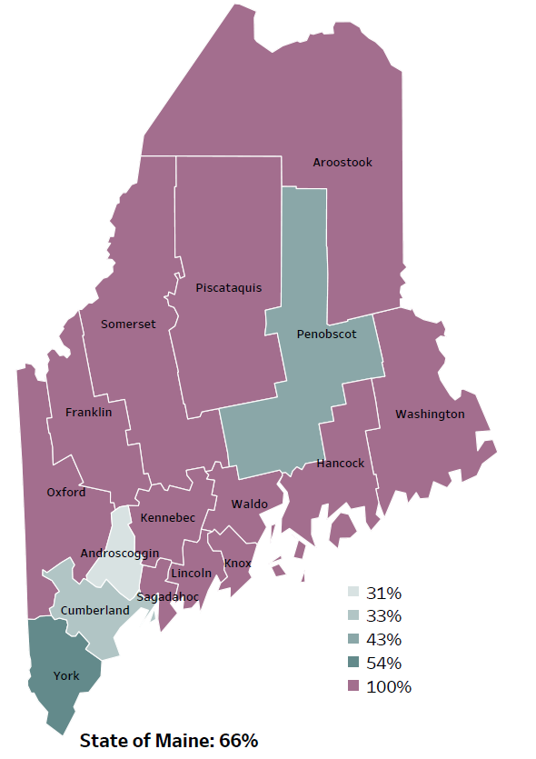
Social Determinants of Health
Percentage of people living in
rural areas
2019
New England Round Table for Rural Health
Notes:
Knox County is one of 12 counties with no population in a metro area. These data are based on the most recent Census estimates at the Zip-code level, and calculated use rural Urban Commuting Area codes. The categories were established by the New England Rural Health Association. This data is NOT comparable to 2010 US Census data on populations living in rural areas, as that data uses a different definition for rural.
Source: Data, Research and Vital Statistics town-level population file

Slide 26
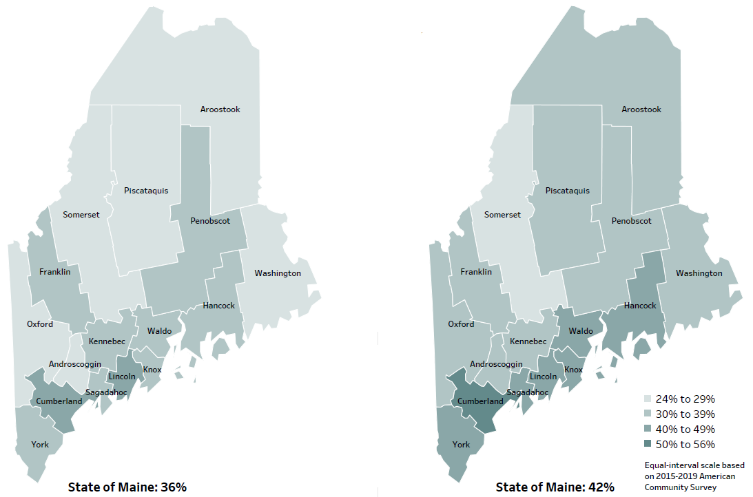
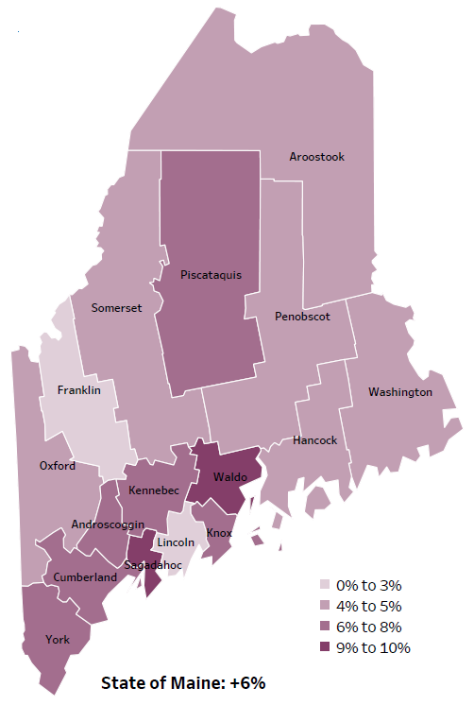
Social Determinants of Health
Percent of population over age 25 with an associate’s degree or higher
2010
American Community
Survey
Change in percent of population over age 25 with an associate’s degree or higher
2010 to 2015-2019
2015-2019
American Community
Survey
Notes:
These maps show the educational attainment of adults over 25 for two different time periods. Knox County has had an increase in the rate of adults who have achieved an associate’s degree or higher degree of education. This is highlighted in the change over time map, which shows that this was a greater increase than 8 other counties and equal to 6 other counties.
Source: US Census Bureau, American Community Survey

Slide 27
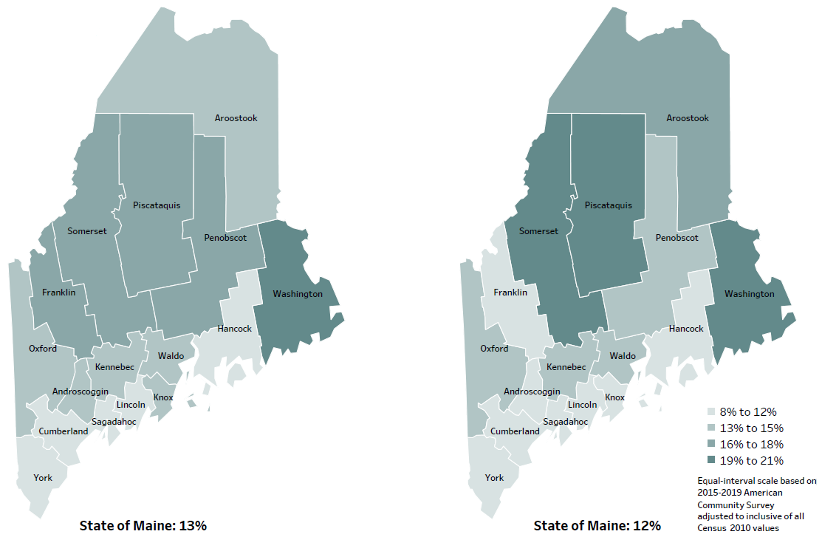
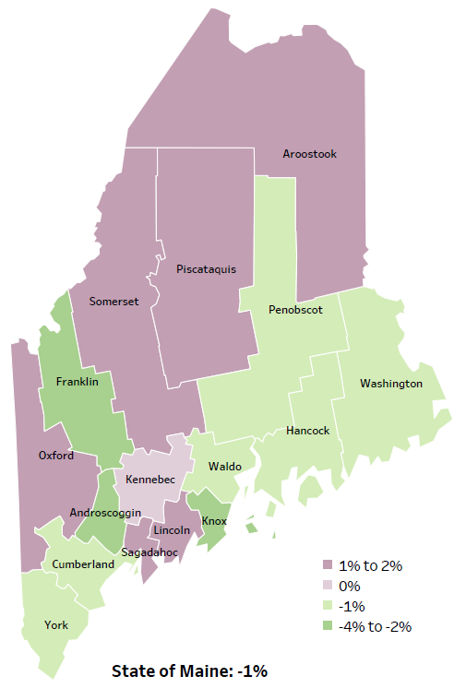
Social Determinants of Health
Percent of population in poverty
2010
American Community
Survey
Change in percent of population in poverty
2010 to 2015-2019
2015-2019
American Community
Survey
Notes:
These maps show the rate of poverty for two different time periods. Knox County’s poverty rate has decreased over the time period, as shown in the change over time map. During this period, poverty decreased in Maine overall.
Source: US Census Bureau, American Community Survey

Slide 28
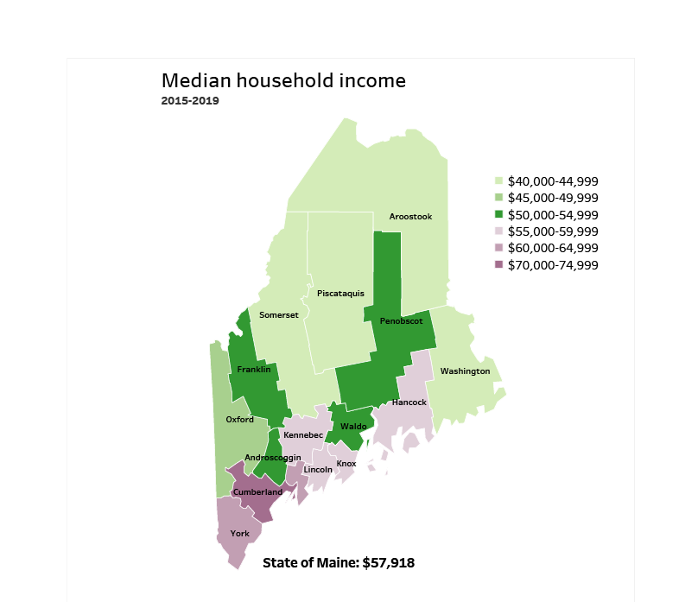
Social Determinants of Health
Notes:
Knox County has a median household income of $57,751, the 4th highest behind York, Cumberland and Sagadahoc.
Source: American Community Survey

Slide 29
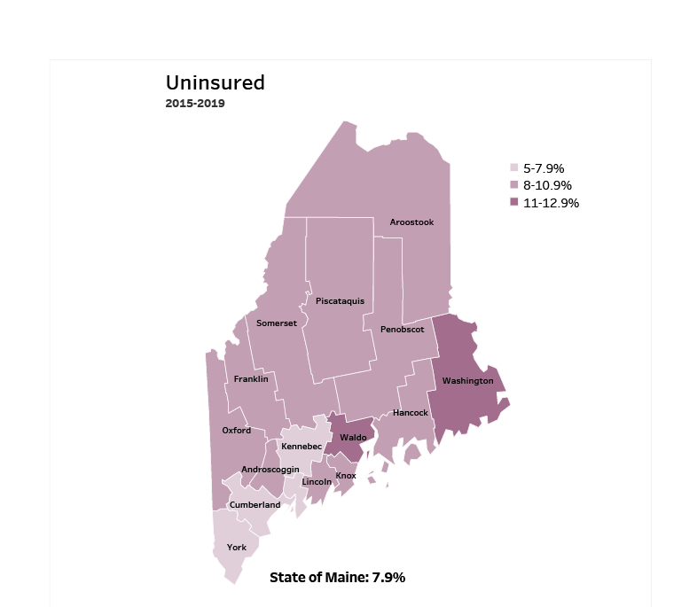
Access
Notes:
Knox County has an uninsured rate of 9.4%, which is higher than 4 counties and equal to 9 counties. Lack of insurance can lead to delayed medical care, emergency room treatment and poorer health outcomes.
Source: American Community Survey

Slide 30
Access
Notes:
This slide shows the percent of Knox County residence who have been seen by any primary care doctor within the past year. Given the rurality of Knox County, residents may have difficulty accessing care. Insufficient access to primary care and other essential services leads to poorer health outcomes and increases the likelihood of more costly, higher acuity episodes at the time of treatment. Knox residents are significantly less likely to visit their primary care doctor than the overall State.
Data Source: BRFSS

Slide 31
Cancer
Notes:
This slide shows the rate of women diagnosed with breast cancer in Knox County. The rate in Knox County is significantly higher than the State. We have calculated the rates so that they can be compared to other parts of the state that might have a population with a different mix of ages. Older people tend to have higher rates of many diseases and health conditions. It’s important to adjust for age so that we don’t accidentally mistake a place with older people for a place with an unusual number of disease-related deaths.
Source: Maine CDC Vital Records
Read as needed- Definition: Rate per 100,000 females of deaths from breast cancer.

Slide 32
Cancer
Notes:
Prostate cancer cases have increased significantly overtime within Knox County. The rate is also significantly higher than Maine overall.
Data Source: Maine Cancer Registry
Read as needed- Definition: Rate per 100,000 males of deaths from prostate cancer.
Age- Adjusted Definition: We have calculated the rates so that they can be compared to other parts of the state that might have a population with a different mix of ages. Older people tend to have higher rates of many diseases and health conditions. It’s important to adjust for age so that we don’t accidentally mistake a place with older people for a place with an unusual number of disease-related deaths.

Slide 33
Diabetes
Notes:
The rate of prediabetes are increasing within Knox County and remains significantly higher than the State. Prediabetes means that one has higher than normal blood sugar level. Long-term damage from diabetes puts one at a higher risk of heart disease and stroke. Lifestyle changes can reverse prediabetes. By eating healthy foods, regular physical activity, and staying at a healthy weight an individual can help bring their blood sugar level back to normal.
To be read as needed- Definition: Percentage of adults that have ever been told by a healthcare provider that they have pre-diabetes or borderline diabetes.
Data Source: Behavioral Risk Factor Surveillance System
Additional Data Source: The Mayo Clinic, (2021). Retrieved from: https://www.mayoclinic.org/diseases-conditions/prediabetes/symptoms-causes/syc-20355278d causes - Mayo Clinic

Slide 34
Respiratory Health
Notes:
Residents of Knox County are significantly more likely to require treatment in the emergency room for asthma when compared to the state overall.
Data Source: Maine Health Data Organization Hospital Inpatient and Outpatient Databases
Read as needed - Definition: Rate per 10,000 people of emergency department discharges with a principal diagnosis of asthma.
Age- Adjusted Definition: We have calculated the rates so that they can be compared to other parts of the state that might have a population with a different mix of ages. Older people tend to have higher rates of many diseases and health conditions. It’s important to adjust for age so that we don’t accidentally mistake a place with older people for a place with an unusual number of disease-related deaths.

Slide 35
Physical Activity, Nutrition and Weight
Notes:
This slide shows the percent of high school students in Knox County who are considered overweight, meaning their body mass index is at or above the 85th percentile, but below the 95th percentile. The percentage has decreased in Knox County since 2017 and is now significantly lower than the State.
Source: Maine Integrated Youth Health Survey
Read as needed. Definition: Percentage of high school students who were overweight (at or above the 85th percentile but below the 95th percentile for body mass index, by age and sex). Data collected in odd numbered years.

Slide 36
Pregnancy and Birth Outcomes
Notes:
Women in Knox County are significantly more likely to have smoked during pregnancy when compared to the state. The rate has improved slightly within the county, but the change is not significant. Nicotine exposure in utero can lead to preterm birth, low birth weight and increases the risk of birth defects and SIDS.
Data Source: Maine CDC Vital Records CDC - https://www.cdc.gov/tobacco/basic_information/health_effects/pregnancy/index.htm
Definition: Percentage of new mothers who smoked cigarettes at any time during pregnancy.

Slide 37
Environmental Health
Notes:
The rates of children screened for lead within Knox county have increased significantly since 2011. Screenings remain significantly lower in Knox county then the state overall.
Data Source: Maine CDC Childhood Lead Poisoning Prevention Unit
To be read as needed - Definition: Percentage of children, ages 24-35 months, who have had their blood tested for elevated blood lead levels.

Slide 38
Environmental Health
Notes:
The rates of Knox county children testing positive for lead has decreased slightly overtime, however the rate remains significantly higher than the state. Lead testing is important given Maine’s older housing stock and the potential problems associated with childhood lead exposure.
Data Source: Maine CDC Childhood Lead Poisoning Prevention Unit
To be read as needed - Definition: Percentage of children, ages 0-36 months, among those screened, who had a confirmed blood lead level above 5 micrograms per deciliter.

Slide 39
Unintentional Injury
Notes:
The rate of fall related deaths within Knox County have increased significantly since 2007-2011 and is now higher than the state’s rate.
Data Source: Maine CDC Vital Records
Read as needed - Definition: Rate per 100,000 people of deaths due to unintentional falls.
Age- Adjusted Definition: We have calculated the rates so that they can be compared to other parts of the state that might have a population with a different mix of ages. Older people tend to have higher rates of many diseases and health conditions. It’s important to adjust for age so that we don’t accidentally mistake a place with older people for a place with an unusual number of disease-related deaths.

Slide 40
Unintentional Injury
Notes:
Knox County has a significantly higher rate of ER discharges due to an unintentional fall-related injury when compared to the State overall. This measure has been age-adjusted, so it cannot be attributed to Knox County’s older residents.
Data Source: Maine Health Data Organization Hospital Inpatient and Outpatient Databases
To be read as needed - Definition: Rate per 10,000 people of emergency department discharges with a diagnoses of a fall-related injury.
Age- Adjusted Definition: We have calculated the rates so that they can be compared to other parts of the state that might have a population with a different mix of ages. Older people tend to have higher rates of many diseases and health conditions. It’s important to adjust for age so that we don’t accidentally mistake a place with older people for a place with an unusual number of disease-related deaths.

Slide 41
Unintentional Injury
Notes:
This indicator shows the rate of emergency department hospitalizations due to traumatic brain injury. Knox County’s rate is significantly higher than the State’s.
Source: Maine Health Data Organization Hospital Inpatient and Outpatient Databases
Read as needed- Definition: Rate per 10,000 people of emergency department discharges with a diagnoses of traumatic brain injury.
Age- Adjusted Definition: We have calculated the rates so that they can be compared to other parts of the state that might have a population with a different mix of ages. Older people tend to have higher rates of many diseases and health conditions. It’s important to adjust for age so that we don’t accidentally mistake a place with older people for a place with an unusual number of disease-related deaths.

Slide 42
Intentional Injury
Notes:
This graph shows the percentage of Knox high school students who engage in intentional self-injury. Intentional self-Injury is defined as a deliberate, self-inflicted damage of body tissue without suicidal intent. Methods of self-injury include cutting, burning, scratching, and banging or hitting, and most people who self-injure have used multiple methods. The County’s percentage has increased significantly since 2017, but remains significantly lower than the State’s overall.
Source: Maine Integrated Youth Health Survey
Klonsky, E. D., Victor, S. E., & Saffer, B. Y. (2014). Nonsuicidal self-injury: what we know, and what we need to know. Canadian journal of psychiatry. Revue canadienne de psychiatrie, 59(11), 565–568. https://doi.org/10.1177/070674371405901101
Read as needed- Definition: Percentage of high school students who have ever done something to purposely hurt themselves without wanting to die, such as cutting or burning themselves on purpose. Data collected in odd numbered years.

Slide 43
Mental Health
Notes:
This slide shows Knox County middle school students who reported of feeling sad and hopeless for two weeks or more during the past 12 months and caused them to stop doing some of their usual activities. Depression in early adolescence is linked with increased risks for negative effects on growth and development, school performance, and peer/family relationships in later adolescence. The precent in Knox County has increased between 2017 and 2019. Knox County’s rate is higher than the overall State but the difference is not significant.
Data Source: Maine Integrated Youth Health Survey
Adolescent Mental Health Data.pdf (ucsf.edu)
Data Source: Maine Integrated Youth Health Survey To be read as needed. Definition: Percentage of high school students who felt so sad or hopeless almost every day for two weeks or more in a row during the past 12 months that they stopped doing some usual activities. Data collected in odd numbered years.

Slide 44
Mental Health
Notes:
This graph shows the rate of Knox county middle schoolers who have seriously considered suicide. Data is collected in odd numbered years and, as you can see, those considering suicide has increased between 2017 & 2019. This increase is significant.
Data Source: Maine Integrated Youth Health Survey
Data source: Maine Integrated Youth Health Survey
To be read as needed- Definition: Percentage of seventh- and eighth-grade students who ever seriously considered attempting suicide. Data collected in odd numbered years.

Slide 45
Substance Use
Notes:
The number of overdose deaths have increased in Knox County since 2019 and are now higher than the State. The increase in 2020 was driven by the continuing opioid crisis in Maine and across the country. Note that the U.S. data shown here is for 2019 and the 2020 rate is likely to b higher. Of the 504 drug deaths in 2020, statewide, 83% were caused by opioids. The rise from 2019 to 2020 was primarily due to overdoses of fentanyl- a nonpharmaceutical opioid. Further, more and more often, deaths due to fentanyl also involve use of methamphetamine or cocaine.
Source: Maine Office of the Medical Examiner
Read as needed. Definition: Rate per 10,000 population of overdose emergency medical service responses, including overdoses from drugs, medications, alcohol, and inhalants.

Slide 46
Substance Use
Notes:
This slide shows the rate of infants who have been born addicted to a substance. This data is collected from healthcare providers who report there is a reasonable cause to suspect the baby has been affected by an illegal substance or is demonstrating withdrawal symptoms. The two-year rate of drug-affected infants born in Knox County is significantly higher than the State overall. The data shows the average annual rate for the two years, and therefore can be compared to the single year date. There is a concern given the birth and health risk associated with drug exposure in utero.
Data Source: Maine Automated Child Welfare Information System (Maine Office of Child and Family Services)
To be read as needed. To be read as needed. Definition: Rate per 1,000 births of infants for which a healthcare provider reported that there was reasonable cause to suspect the baby may be affected by illegal substance abuse or demonstrating withdrawal symptoms resulting from prenatal drug exposure or has a fetal alcohol spectrum disorder.

Slide 47
Substance Use
Notes:
This graph shows Knox county high school students who reported drinking alcohol within the past-30-days. There has been a significant increase in rate within the county since 2017. The likelihood of Knox students drinking alcohol within the past-30-days is significantly higher than Maine student’s overall.
Source: Maine Integrated Youth Health Survey
Read as needed- Definition: Percentage of high school students who had at least one drink of alcohol on at least one day in the past 30 days. Data collected in odd numbered years.

Slide 48
Substance Use
Notes:
This graph shows a significant increase of Knox county high school students who report binge drinking. Binge drinking is defined as consuming 5 or more alcoholic drinks on at least one day in the past 30 days. This chart is missing 2017 data, which we are still working to get.
The data in the profile may look different. We have realized that 2017 and 2019 data in the Profile use a different denominator – only including those HS students who report any drinking. So, for 2019, 36.1% of students who reported drinking at all in the last 30 days also reported binge drinking. This translates to 10.8% of ALL HS students who reported binge drinking. Knox County HS students binge drink significantly more than all Maine HS students.
Data Source: Maine Integrated Youth Health Survey
To be read as needed - Definition: Percentage of high school students who had five or more alcoholic drinks on at least one day in the last 30 days. Data collected in odd numbered years.

Slide 49
Substance Use
Notes:
This slide shows a decreasing rate of marijuana use among Knox County’s high school students. There has been a decline in marijuana misuse since 2011 and the rate remains significantly higher than the state.
Data Source: Maine Integrated Youth Health Survey
To be read as needed- Definition: Percentage of high school students who used marijuana at least one time in the last 30 days. Data collected in odd numbered years.

Slide 50
Breakout Discussions

Slide 51
Reconvene

Slide 52
Wrap up and Next Steps

Slide 53
Contact
Cathy Cole, Regional Director, Education, Lincoln Health, Pen Bay Medical Center and Waldo County General Hospital, Cathy.Cole@lchcare.org
Drexell White, District Liaison, Midcoast District, Maine CDC, Drexell.R.White@maine.gov
Jo Morrissey, MPH, Maine Shared CHNA, info@mainechna.org
www.mainechna.org

