Slide 1
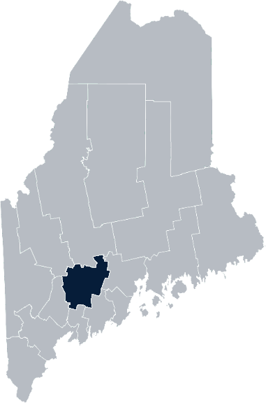
Maine Shared Community
Health Needs Assessment
Kennebec County
2021

Slide 2





The Maine Shared CHNA is a collaboration between the Maine Center for Disease Control and Prevention (Maine CDC), Central Maine Healthcare, Northern Light Health, MaineGeneral Health, and MaineHealth.
Notes:
Local Planning Committee Member

Slide 3
Thank you to Local Planning Committee !
Sara Berry, Northern Light Inland Hospital
Anne Conners, MaineGeneral Health
Melissa Emmons, MaineGeneral Health
Matt L’Italien, Somerset Public Health
Joy McKenna, MaineGeneral Health
Jessica Ouellette, Northern Light Sebasticook Valley Hospital
Bethany Shalit, Redington-Fairview General Hospital
Sherry Tardy, Northern Light Inland Hospital and Sebasticook Valley Hospital
Paula Thomson, Maine CDC
Brittney Watt, Redington Fairview General Hospital

Slide 4
Time | Activity | Speaker/Facilitator
4:30 – 4:40 pm | Welcome and Leadership Remarks | Terri Vieira, President, Northern Light Inland Hospital Chuck Hays, President & CEO, MaineGeneral Health
4:40 – 4:45 | Overview of Zoom and CHNA background | Jo Morrissey, Maine Shared CHNA Program Manager
4:45 – 4:55 | Review of previous CHNA priorities and activities since last effort | Anne Conners, Director of Community Health, MaineGeneral Health Sherry Tardy, Director of Community Health, Northern Light Inland Hospital
4:55 – 5:15 | Presentation of key findings from the data profile | John Snow, Inc.
5:15 – 6:15 | Break-out session – facilitated discussion on data and health priority identification | Local Facilitators
6:15 – 6:25 | Reconvene and Review | Local Facilitators and John Snow, Inc.
6:25 – 6:30 | Wrap up and next steps | Paula Thomson, Central District Public Health Liaison, Maine CDC

Slide 5
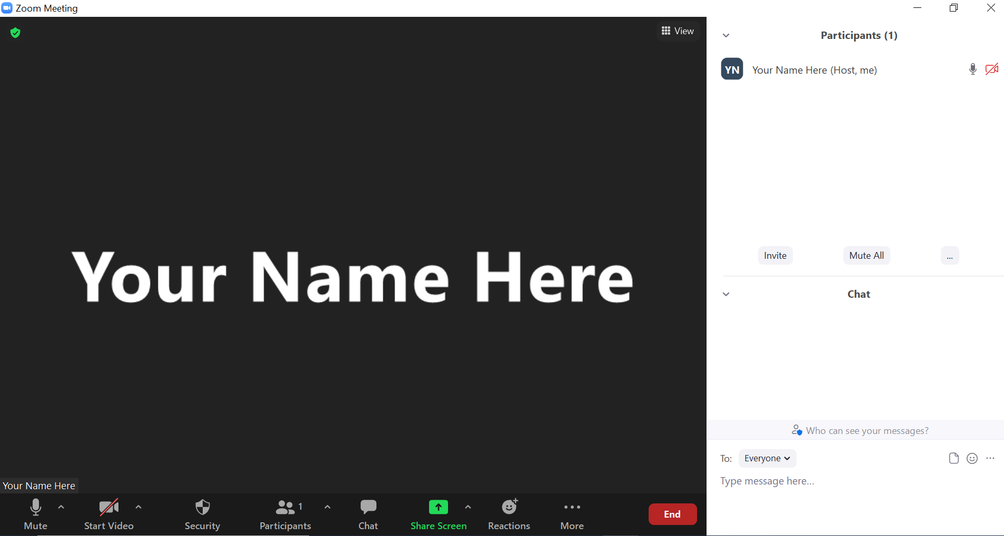
Share screen
Join Audio, Mute On/Off
Open/close participant list or chat
Turn Video On/Off
Reactions
Notes:
Jo or JSI

Slide 6


Matching Interests
Maine Shared
Community
Health Needs Assessment
Images of PHAB and IRS from the internet
Notes:
Jo or JSI

Slide 7
The Evolution of an Idea…
2010 OneMaine | 2015 SHNAPP | 2018 Maine Shared CHNA | 2021 Maine Shared CHNA
Forums Surveys | 16 Forums 1639 Surveys | 22 Mainstream Forums (live) 2 Immigrant Forums 45 Interviews | 16+ Mainstream Forums (virtual) 10+ Community Sponsored Events 1500+ Oral Surveys
Notes:
Jo or JSI

Slide 8
Inputs and Outcomes
Ways to Provide Input
Data Collected
Outcomes
District & County Reports DUE APRIL 2022
4 Health Priorities by county
Related indicators
Gaps/barriers and resources/assets
Notable comparisons between attendee input and the data.
Description of those who provided input
Methodology
Mainstream county forums
Number of attendees
Organizations represented
List of data identified Forums and CSE only)
Discussion notes (Forums and CSE only)
Chat box comments (Forums and CSE only)
Health Priorities
Gaps and Resources
Community sponsored events
State Report DUE APRIL 2022
4 Health Priorities by Community Event and immigrant population.
Related indicators
Gaps/barriers and resources/assets,
Notable comparisons to mainstream population.
Description of those who provided input
Methodology
Oral Survey
Forums, Events and Surveys conducted Fall 2021
Notes:
[Add names of those doing the leadership remarks]
Jo or JSI
Community Sponsored Event Partners include
Disability Rights Maine (2 events: people who are deaf or hard of hearing and people with other disabilities)
Maine Primary Care Association (People who are served by Maine’s Federally Qualified Health Centers
Maine Council on Aging (Older Adults 65+
Consumer Right Council of Maine (people with a mental health diagnosis)
Formerly Incarcerated (Maine Prisoner Re-Entry Network)
Maine Youth Action Network and Friends (Raising the voices of Maine’s diverse youth)
Green Memorial A.M.E. Zion Church (Black/African American)
Health Equity Alliance (LGBTQ+ community)
Bangor Public Health Shelter Plus Program (for housing insecure)
Oral Survey Partners include:
City of Portland’s Minority Health Program
New Mainer’s Public Health Initiative
Maine Immigrant Access Network
Gateway Community Services
Maine Immigrant and Refugee Services
Maine Community Integration
Mano en Mano
We are piloting these additional outreach methods with support from
State of Maine’s Preventative Health and Health Services Block Grant
Maine Health Access Foundation
Introduce leader for leadership remarks

Slide 9
Leadership remarks
Notes:
Leadership remarks
Leader to introduce the following who will provide comments on recent health improvement efforts
ADD NAME OF THOSE WHO WILL BE DOING REVIEWING PREVIOUS EFFORTS

Slide 10
Previous Health Improvement Efforts
Notes:
Local Facilitator

Slide 11
Central District 2020-22 Priority Areas
Hospital and District priority areas of work since the 2018 Shared CHNA
Access to Care | Adverse Childhood Experiences | Chronic Disease | Food Insecurity | Mental Health Services | Obesity, Physical Activity and Nutrition
MaineGeneral Health Redington-Fairview General Hospital | Central District Coordinating Council Northern Light Sebasticook Valley Hospital | MaineGeneral Health Redington-Fairview General Hospital | MaineGeneral Health Northern Light Sebasticook Valley Hospital Redington-Fairview General Hospital Northern Light Inland Hospital | Northern Light Inland Hospital Northern Light Sebasticook Valley Hospital MaineGeneral | Central District Coordinating Council MaineGeneral Health Northern Light Inland Hospital Redington-Fairview General Hospital
Oral Health | Poverty | Senior Health | Substance Use Disorder | Tobacco
Central District Coordinating Council MaineGeneral Health | Northern Light Inland Hospital | Redington-Fairview General Hospital Northern Light Sebasticook Valley Hospital | Central District Coordinating Council Northern Light Inland Hospital Northern Light Sebasticook Valley Hospital MaineGeneral Health Redington-Fairview General Hospital | MaineGeneral Health Northern Light Sebasticook Valley Hospital Redington-Fairview General Hospital
Notes:
Local Facilitator

Slide 12
Pandemic Acknowledgement and Thanks
During this past CHNA cycle – COVID-19 became a public health focus for everyone.
The Central District has experienced a high number of Covid-19 cases and Covid-19 deaths – but has also experienced high levels of collaboration with healthcare partners, emergency management, government, and community members in order to provide testing, vaccination, and other important supports to respond to the pandemic.
This was and continues to be a focus of much of our community work and every day activities.

Slide 13
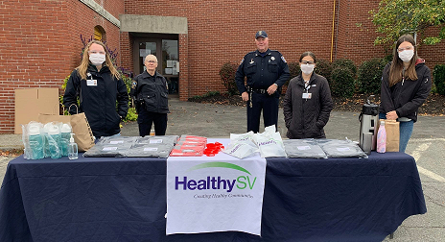




Successes and Outcomes
Northern Light Sebasticook Valley Hospital
MaineGeneral Health
Redington-Fairview General Hospital
Northern Light Inland Hospital
Notes:
Anne and Sherry will share highlights from the 2019-2022 CHNA Cycle

Slide 14
Community Health Needs Assessment Priorities
Northern Light Inland Hospital
MaineGeneral Health
Priority 1: Physical Activity, Nutrition, Weight
Priority 2: Mental Health
Priority 3: Substance Use
Priority 4: Social Determinants of Health
Priority 1: Chronic Disease Prevention and Management
Priority 2: Mental Health
Priority 3: Physical Activity, Nutrition, and Healthy Weight
Priority 4: Social Determinants of Health
Priority 5: Substance Use

Slide 15
How to Read the County Health Profiles and Health Equity Data Sheets
Notes:
JSI or other facilitator

Slide 16
How to Read County Health Profile
CHANGE shows statistically significant changes in the indicator over time, based on 95% confidence interval (see description on page 3).
ê | means the health issue or problem is getting better over time.
! | means the health issue or problem is getting worse over time.
○ | means the change was not statistically significant.
N/A | means there is not enough data to make a comparison.
BENCHMARK compares [COUNTY] data to state and national data, based on 95% confidence interval (see description on page 3).
ê | means [COUNTY] is doing significantly better than the state or national average.
! | means [COUNTY is doing significantly worse than the state or national average.
○ | means there is no statistically significant difference between the data points.
N/A | means there is not enough data to make a comparison.
ADDITIONAL SYMBOLS
* | means results may be statistically unreliable due to small numbers, use caution when interpreting.
— | means data is unavailable because of lack of data or suppressed data due to a small number of respondents.
EXAMPLE
Notes:
JSI or other facilitator
A star means that the health issue or problem is getting better over time or better in comparison to another place
A red exclamation point means that the health issue or problem is getting worse over time or worse in comparison to another place
A gray circle means that the dating hasn’t changed over time or isn’t much different in comparison to another place
N/A means that there was not enough data to be able to make a comparison
There are two additional symbols you might see:
A black dot means that you should use caution when interpreting the data – the results might be unreliable because of small numbers
A black dash means that data was unavailable, or that data was suppressed due to a small number of respondents
(Go to next slide and walk audience through an example)

Slide 17
How to Read County Health Profile
EXAMPLE
 | AROOSTOOK COUNTY |  |  | BENCHMARKS
INDICATOR | POINT 1 | POINT 2 | CHANGE | MAINE | +/- | U.S. | +/-
Individuals living in poverty | 2009-2011 15.6% | 2015-2019 16.1% | ¡ | 2015-2019 11.8% | ! | 2019 12.3% | N/A
Notes:
Here’s an example of how we’ve visualized the data in the County Health Profiles.
The charts in this presentation are all excerpts from the Data Health Profiles that were created by MaineHealth and the Maine CDC. They contain data pulled from publicly available sources that are designed to help people learn more about the health of their communities. Not all the data points are available for every measure, but we’ve included data wherever we can.
The green bars represent data from your community. The left most one represents a past data point, and the right bar represents the most recent data point available when the data was gathered. These are the same data points used in the Data Health Profiles.
The grey bars represent data for the state of Maine as a whole- on the left- and for the United States as a whole- on the right, when it is available.
We’ve also noted where differences in the data points are ‘statistically significant’. A difference between two measurements is significant when scientists can say, with a known degree of confidence, that the difference between them is large enough that the difference is most likely to be caused by an actual difference in the item being measured, and not caused by error associated taking the measurement. All of these tests are comparing the most recent data point for your community to other data points. A red exclamation mark indicates a difference that your community is significantly different in a less desirable direction compared to the data point with the symbol. A green star indicates that your community is significantly different in a more desirable direction. A grey circle indicates that there is no significant difference.
(keep in presentation – do not read for deaf/HOH event or people with disabilities). A difference between two measurements is significant when scientists can say, with a known degree of confidence, that the difference between them is large enough that the difference is most likely to be caused by an actual difference in the item being measured, and not caused by an error associated taking the measurement. All of these tests are comparing the most recent data point for your community to other data points.
For example, in this slide, we have two symbols. The grey circle next to the measurement for 2009-2011 Aroostook County means that there is no significantly different change in the rate of poverty in Aroostook County when comparing the data from 2009-2011 to the data from 2015-2019. The red exclamation mark next to the Maine data point says there is a significant difference between 2015-2019 Aroostook County and 2015-2019 Maine, and that it is less desirable that Aroostook County has a higher rate of individuals living in poverty. No comparison could be made to the data for the U.S. because the years of data collection were different.

Slide 18
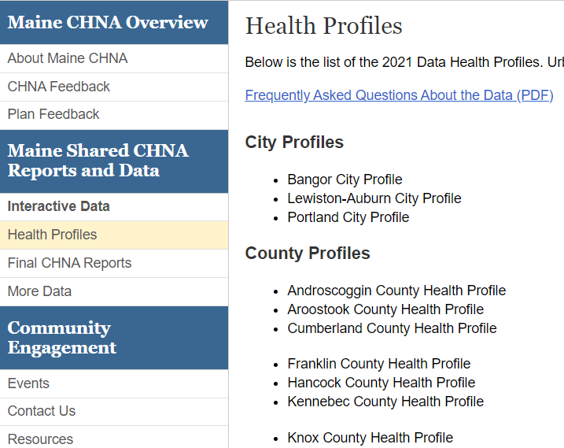
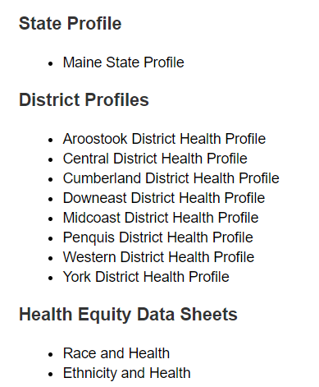
For More Data
www.mainechna.org
Notes:
The Maine Shared CHNA website contains health profiles for 3 of Maine’s largest cities, 16 counties, 5 public health districts, the state, as well as data provided by race, ethnicity, educational attainment, gender, sexual orientation, older adults, insurance status, income, and rurality.
IN addition, there is an interactive data portal where you can search by specific data points. All these breakdowns are then provided by data point.
REGARDING COVID-19 DATA
The Maine Shared CHNA data set does not include any data of COVID-19. This is largely due to the fact that there is a much more up-to-date and comprehensive Maine Data Dashboard continually being updated on the Maine CDC website.
Here you can find daily lab results, new case counts by date, trends, county breakdowns, data by race, and comparisons to other states and the nation.

Slide 19
Key Findings
Notes:
As we walk through the following data slides together, take notes. What surprises you? What stands out? What’s moving in the wrong direction?
Once the data presentation is over, you will be divided into breakout groups to discuss the data, share your top concerns, identify your top priorities, and share your knowledge about what’s working and what we need to work on to address those top concerns.
Ready? Here we go.

Slide 20
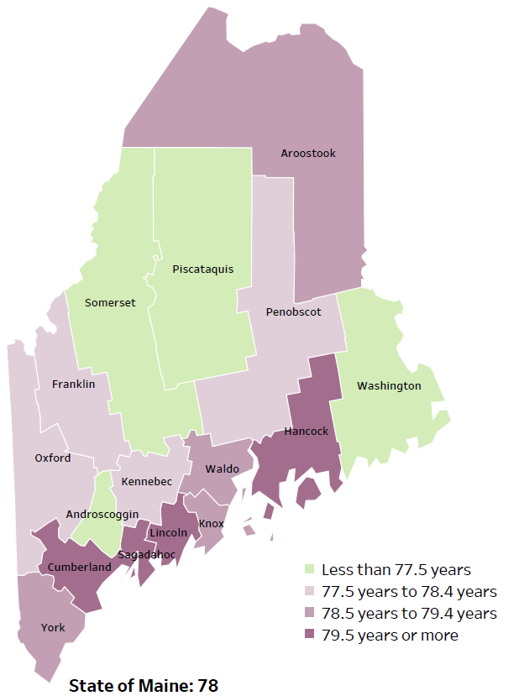
Demographics
Life Expectancy
2017-2019
National Center for Health Statistics,
CDC
RANK | MAINE | KENNEBEC COUNTY
1 | Cancer | Cancer
2 | Heart Disease | Heart Disease
3 | Unintentional Injury | Unintentional Injury
4 | Chronic Lower Respiratory Disease | Chronic Lower Respiratory Disease
5 | Stroke | Stroke
Notes:
The life expectancy in Kennebec County is 78.1, which is slightly lower than the state average of 78.7.
The table on the right side of the slides shows the five leading causes of death in Kennebec County. They are also the leading causes of death for the whole state of Maine.
The leading cause of death is Cancer, the same as the state leading cause of death. As we will see later in the presentation, Kennebec County has a higher rate of cardiovascular disease and high blood pressure.
Some highlights:
In Kennebec County and Maine overall, the leading cause of death is Cancer followed by Heart Disease. The opposite is true in the U.S. overall- Heart Disease is the leading cause of death, and cancer is the 2nd leading cause.
The 3rd leading cause of death- Unintentional Injury- includes a number of accidental causes: Three of the most common causes of unintentional injury deaths are i) motor vehicle crashes, ii) accidental falls, and iii) poisonings that either were unintentional, or the intent was undetermined. Suicides and Firearm deaths are classified as intentional injury.

Slide 21
Demographics
Age distribution for Kennebec County
AGE
KENNEBEC COUNTY
POPULATION
121,753
STATE OF MAINE
POPULATION
1,362,359
Notes:
Kennebec has the 4th largest population of any Maine County after Cumberland, York, and Penobscot County. Compared to other counties, the population is aging but less rapidly. There are fewer children and young adults and more adults over the age of 65, and fewer adults of the age where they might expect to have children. However, Kennebec county’s aging trend is less noteworthy than other Maine counties. While almost all Maine counties are getting older, Kennebec county is getting older more slowly.
Source: US Census Bureau, American Community Survey

Slide 22
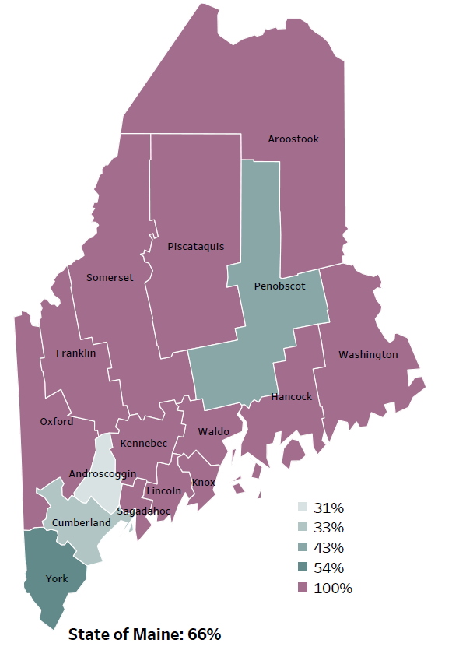
Demographics
Percentage of people living in
rural areas
2019
New England Round Table for Rural Health
Notes:
Kennebec County is one of 12 counties with no population in an urban area. These data are based on the most recent Census estimates at the Zip-code level, and calculated use rural Urban Commuting Area codes. The categories were established by the New England Rural Health Association. This data is NOT comparable to 2010 US Census data on populations living in rural areas, as that data uses a different definition for rural
Source: Data, Research and Vital Statistics town-level population file

Slide 23
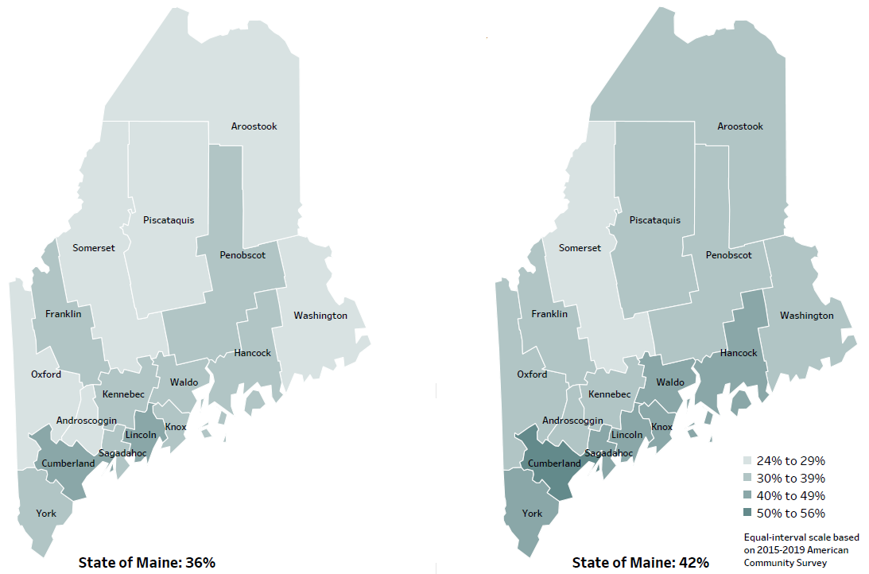
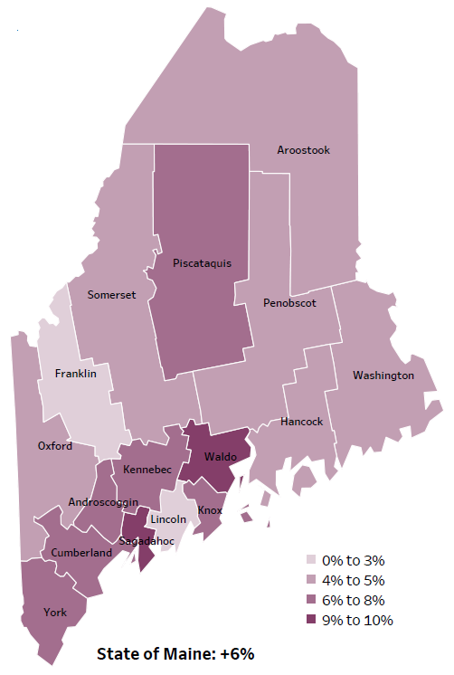
Demographics
Percent of population over age 25 with an associate’s degree or higher
2010
American Community
Survey
Change in percent of population over age 25 with an associate’s degree or higher
2010 to 2015-2019
2015-2019
American Community
Survey
Notes:
These maps show the educational attainment of adults over 25 for two different time periods. Kennebec County has had an increase in the rate of adults who have achieved an associate’s degree or higher degree of education. This is highlighted in the change over time map, which shows that this was a greater increase than 2 other counties and equal to 6 other counties.
Source: US Census Bureau, American Community Survey

Slide 24
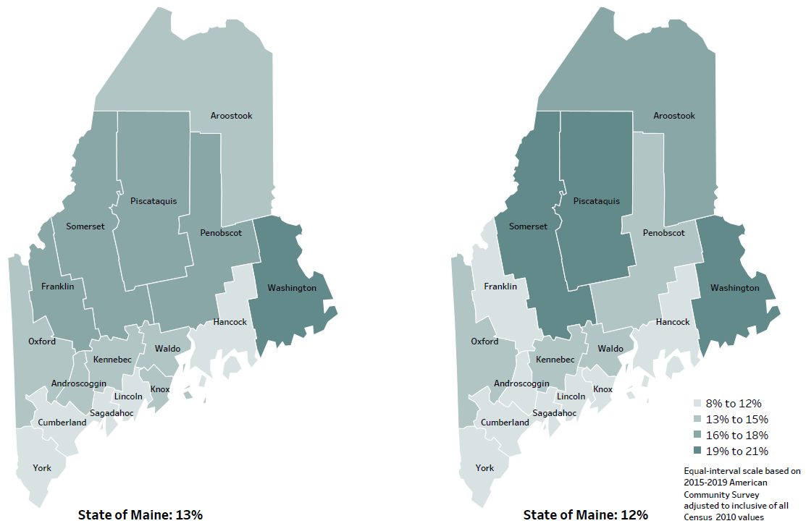
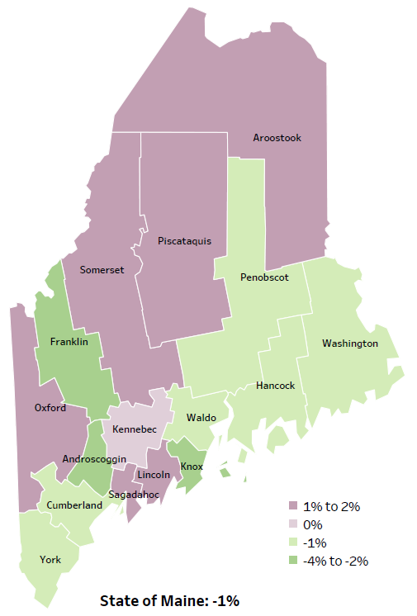
Demographics
Percent of population in poverty
2010
American Community
Survey
Change in percent of population in poverty
2010 to 2015-2019
2015-2019
American Community
Survey
Notes:
These maps show the rate of poverty for two different time periods. Kennebec county’s poverty rate has remained stable over the time period with a decrease of about 1%, as shown in the change over time map.
Source: US Census Bureau, American Community Survey

Slide 25
Health Indicators
Notes:
This graph shows the number of deaths per 100,000 within Kennebec county. This rate has remained stable within the county over time. However, it is significantly higher than both the State and U.S. rates.
Data Source: Maine CDC Vital Records and National Center for Health Statistics, US CDC
Read as needed - Definition: Rate per 100,000 people of deaths from any cause.

Slide 26
Health Indicators
Notes:
Cancer deaths in Kennebec have decreased slightly over time. The death rate is higher than the State’s overall rate, and remains significantly higher when compared to the U.S. These data are age-adjusted, meaning that we have calculated the rates so that they can be compared to other parts of the state that might have a population with a different mix of ages. Older people tend to have higher rates of many diseases, including cancer. It’s important to adjust for age so that we don’t accidentally mistake a place with older people for a place with an unusual number of disease-related deaths.
Data Source: Maine CDC Vital Records
To be read as needed - Definition: Rate per 100,000 people of deaths from any type of cancer.

Slide 27
Health Indicators
Notes:
Cardiovascular disease deaths have remained relatively stable within the county over time, seeing only a slight decrease. The State’s overall rate of deaths dur to cardiovascular disease is slightly lower than Kennebec County’s.
Data Source: Maine CDC Vital Records
To be read as needed - Definition: Rate per 100,000 people of deaths with cardiovascular disease as an underlying cause of death.

Slide 28
Health Indicators
Notes:
Coronary heart disease deaths in Kennebec County have decreased significantly over time. They are now only slightly higher than the state as a whole.
Data Source: Maine CDC Vital Records
To be read as needed - Definition: Rate per 100,000 people of deaths with coronary heart disease as an underlying cause of death.

Slide 29
Health Indicators
Notes:
Heart attack deaths in Kennebec county have decreased significantly over time and are now only slightly higher than in the state overall. These data are age-adjusted.
Data Source: Maine CDC Vital Records
To be read as needed - Definition: Rate per 100,000 people of deaths with heart attack as an underlying cause of death.
Age Adjusted: We have calculated the rates so that they can be compared to other parts of the state that might have a population with a different mix of ages. Older people tend to have higher rates of many diseases and conditions. It’s important to adjust for age so that we don’t accidentally mistake a place with older people for a place with an unusual number of disease-related deaths.

Slide 30
Health Indicators
Notes:
Kennebec County residents are significantly more likely to be hospitalized due to a heart attack when compared to the state.
Data Source: Maine Health Data Organization Hospital Inpatient Database
To be read as needed - Definition: Rate per 10,000 people of hospital discharges with a principal diagnosis of a heart attack.

Slide 31
Health Indicators
Notes:
This slide compares the rate of hospitalizations due to heart failure in Kennebec county to the state of Maine. As you can see, Kennebec county heart failure hospitalization does not differ significantly from the state overall.
Source: Maine Health Data Organization Hospital Inpatient Database
To be read as needed - Definition: Rate per 10,000 people of hospital discharges with a principal diagnosis of heart failure.

Slide 32
Health Indicators
Notes:
In this slide, we see that Kennebec county has a slightly lower rate of hospitalization due to high blood pressure, however there has been a significant increase within the county from 2016 to 2018. While the rate is lower than the state as a whole Kennebec is trending in a negative direction.
Note that while this may appear to be a sharp increase over time, the actual number of hospitalizations per 100,000 people are very small.
Source: Maine Health Data Organization Hospital Inpatient Database
To be read as needed - Definition: Rate per 10,000 people of hospital discharges with a principal diagnosis of hypertension.

Slide 33
Health Indicators
Notes:
This slide shows the percentage of homes with private well that have been tested for arsenic. The rate has been weighted, which means it is representative of all households in the county and the state. The rate of testing has increased when compared to previous years. Although the change is not significant, this is a promising improvement.
Data Source: Behavioral Risk Factor Surveillance System
To be read as needed - Definition: Percentage of households with a private well where the well water has been tested for arsenic. This data is weighted to be representative of all households in Maine. Percentage of households with a private well where the well water has been tested for arsenic. This data is weighted to be representative of all households in Maine.

Slide 34
Health Indicators
Notes:
The rates of children screened for lead within Kennebec county have increased significantly since 2011. Lead testing is important given Maine’s older housing stock and the potential problems associated with childhood lead exposure. Screenings are significantly higher in Kennebec county then the state overall.
Data Source: Maine CDC Childhood Lead Poisoning Prevention Unit
To be read as needed - Definition: Percentage of children, ages 24-35 months, who have had their blood tested for elevated blood lead levels.

Slide 35
Health Indicators
Notes:
Injury-related deaths within Kennebec County have increased significantly since 2007-2011. While Kennebec County’s rate is higher than the State and the U.S., the difference is not considered significant.
Source: Maine CDC Vital Records
To be read as needed - Definition: Rate per 100,000 people of deaths due to injuries.

Slide 36
Health Indicators
Notes:
The rates of poisoning deaths within Kennebec County have increased significantly since 2007-2011. This indicator shows unintentional or undetermined poisonings. This meaning the deaths counted here are not due to suicide or other intentional injuries. While Kennebec County’s rate is high than the state, the difference is not significant.
Source: Maine CDC Vital Records
To be read as needed - Definition: Rate per 100,000 people of deaths due to poisonings of unintentional and undetermined intent.

Slide 37
Health Indicators
Notes:
Kennebec County has a slightly higher rate of ER discharges due to an unintentional fall-related injury than the State overall. While Kennebec County’s rate is higher than the state, the difference is not significant.
Data Source: Maine Health Data Organization Hospital Inpatient and Outpatient Databases
To be read as needed - Definition: Rate per 10,000 people of emergency department discharges with a diagnoses of a fall-related injury.

Slide 38
Health Indicators
Notes:
Compared to the State, Kennebec County has a lower rate of ER discharges due to a traumatic brain injury, but the difference is not significant.
Data Source: Maine Health Data Organization Hospital Inpatient and Outpatient Databases
To be read as needed - Definition: Rate per 10,000 people of emergency department discharges with a diagnoses of traumatic brain injury.

Slide 39
Health Indicators
Notes:
This slide shows the rate of people seeking help for an issue related to mental health in the emergency department of a hospital. The rate of individuals in Kennebec County being discharged from an ED with a mental health condition as the primary diagnosis is significantly higher than the state rate overall.
Data Source: Maine Health Data Organization Hospital Inpatient and Outpatient Databases
To be read as needed - Definition: Rate per 10,000 people of emergency department discharges with a principal diagnosis of mental health condition.

Slide 40
Health Indicators
Notes:
Here we see the rate of deaths for which substance use was the underlying cause, including those attributable to acute poisoning by drugs and those from medical conditions resulting from chronic drug use. Deaths due to alcohol use are not included. The rate of drug-induced deaths among Kennebec County residents is significantly higher within the county when compared to prior years, as well as the state.
Source: Maine CDC Vital Records and CDC WONDER Online Database
To be read as needed - Definition: Rate per 100,000 people of deaths for which drugs are the underlying cause, including those attributable to acute poisoning by drugs and those from medical conditions resulting from chronic drug use. Deaths due to alcohol use are excluded.

Slide 41
Health Indicators
Notes:
This graph shows the EMS response to overdoses, including from drugs, medications, alcohol, and inhalants. As you can see, the rate has increased within Kennebec County between 2019 and 2020, but this change is not significant. Rates of emergency responses in Kennebec due to overdose are significantly higher than the State overall. These increases could be, in part, attributed to the opioid crisis in the state and across the country.
Data Source: Maine Emergency Medical Services
To be read as needed - Definition: Rate per 10,000 population of overdose emergency medical service responses, including overdoses from drugs, medications, alcohol, and inhalants.

Slide 42
Health Indicators
Notes:
Suicide deaths in Kennebec County have increased over time. The rate of deaths in Kennebec are slightly higher than the State overall, but it is not to a significant degree.
Data Source: Maine CDC Vital Records
To be read as needed - Definition: Rate per 100,000 people of deaths due to suicide.

Slide 43
Health Indicators
Notes:
This graph shows a decrease over time in reported binge drinking among high school students. Binge drinking is defined as consuming 5 or more alcoholic drinks on at least one day in the past 30 days. This chart is missing 2017 data, which we are still working to get.
The data in the profile may look different. We have realized that 2017 and 2019 data in the Profile use a different denominator – only including those HS students who report any drinking. So, for 2019, 34.6% of students who reported drinking at all in the last 30 days also reported binge drinking. This translates to 7.7% of ALL HS students who reported binge drinking. This is significantly LESS than in 2015. The state comparison chart shows the data based on those students who drink at all, and is only slightly less than the data for Kennebec County.
Data Source: Maine Integrated Youth Health Survey
To be read as needed - Definition: Percentage of high school students who had five or more alcoholic drinks on at least one day in the last 30 days. Data collected in odd numbered years.

Slide 44
Health Indicators
Notes:
This slide shows the percentage of Kennebec County high school students who have used an e-cigarette at least once in the last 30 days. Data is collected in odd numbered years and, as you can see, use has increased between 2017 & 2019. This increase is significant.
Data Source: Maine Integrated Youth Health Survey
To be read as needed - Definition: Percentage of high school students who used an electronic vapor product at least one day in the last 30 days. Data collected in odd numbered years.

Slide 45
Health Indicators
Notes:
Kennebec County’s median household income has increased significantly since 2007-2011 and remains slightly lower than the median income for the state overall.
Data Source: US Census Bureau, American Community Survey
To be read as needed - Definition: Dollar amount that divides all households in the specified geographic area into two equal groups: half of the households having more income and the other half having less income.

Slide 46
Breakout Discussions

Slide 47
Reconvene

Slide 48
Wrap up and Next Steps

Slide 49
For more information, please contact:
Anne Conners, Community Health Director, MaineGeneral Health: anne.conners@mainegeneral.org
Paula Thomson, Central District Public Health Liaison, Maine CDC: paula.thomson@maine.gov
Sherry Tardy, Community Health Director, Northern Light Inland Hospital and Sebasticook Valley Hospital: stardy@northernlight.org
Jo Morrissey, Program Manager, Maine Shared Community Health Needs Assessment, info@mainechna.org www.mainechna.org

