Slide 1
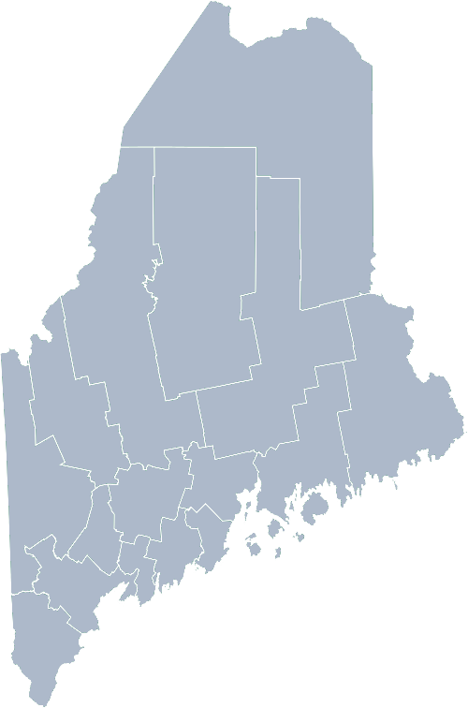
Maine Shared Community Health Needs Assessment Homeless Population
2021
Notes:
Awa welcomes participants

Slide 2
The Maine Shared CHNA is a collaboration between the Maine Center for Disease Control and Prevention (Maine CDC), Central Maine Healthcare, Northern Light Health, MaineGeneral Health, and MaineHealth.
Notes:
Awa

Slide 3
Recognition
Working together to avoid or exit quickly from homelessness, and to address its underlying causes.
https://www.mainehomelessplanning.org/maine-coc/
Notes:
Awa

Slide 4
Forum Agenda
Time | Activity | Speaker/Facilitator
10:00-10:05 am | Welcome | Awa Conteh, Tri-Chair, Maine Continuum of Care, Shelter Plus Care Specialist, Bangor Public Health and Community Services
10:05-10:10 am | Overview of Zoom, background information | Jo Morrissey, Maine Shared CHNA Program Manager
10:10-10:15 am | Leadership Remarks | Norman Maze, Tri-Chair, Maine Continuum of Care and Deputy Director, Shalom House
10:15-10:40 am | Presentation of key findings from the data | John Snow, Inc.
10:40-11:35 am | Break-out session – facilitated discussion on data and health priority identification | Facilitators and Scribes
11:35-11:45 am | Reconvene and Wrap Up | Jo Morrissey, Maine Shared CHNA Program Manager
Notes:
Awa review agenda and then turn it over to Jo Morrissey to provide an overview of the Zoom tools available and the purpose of today’s forum

Slide 5
Share screen
Join Audio, Mute On/Off
Open/close participant list or chat
Turn Video On/Off
Reactions
Notes:
Jo or JSI

Slide 6
Matching Interests
Maine Shared
Community Health Needs Assessment
Images of PHAB and IRS from the internet
Notes:
Jo or JSI

Slide 7
The Evolution of an Idea…
2010 OneMaine | 2015 SHNAPP | 2018 Maine Shared CHNA | 2021 Maine Shared CHNA
Forums Surveys | 16 Forums 1639 Surveys | 22 Mainstream Forums (live) 2 Immigrant Forums 45 Interviews | 16+ Mainstream Forums (virtual) 10+ Community Sponsored Events 1500+ Oral Surveys
Notes:
Jo
Jo or JSI
Community Sponsored Event Partners include
Disability Rights Maine (2 events: people who are deaf or hard of hearing and people with other disabilities)
Maine Primary Care Association (People who are served by Maine’s Federally Qualified Health Centers
Maine Council on Aging (Older Adults 65+
Consumer Right Council of Maine (people with a mental health diagnosis)
Formerly Incarcerated (Maine Prisoner Re-Entry Network)
Maine Youth Action Network and Friends (Raising the voices of Maine’s diverse youth)
Green Memorial A.M.E. Zion Church (Black/African American)
Health Equity Alliance (LGBTQ+ community)
Portland Recovery Center (for people with a substance use disorder or in recovery)
Housing insecure
Oral Survey Partners include:
City of Portland’s Minority Health Program
New Mainer’s Public Health Initiative
Maine Immigrant Access Network
Gateway Community Services
New England Arab American Organization
Maine Immigrant and Refugee Services
Maine Community Integration
Mano en Mano
We are piloting these additional outreach methods with support from
State of Maine’s Preventative Health and Health Services Block Grant
Maine Health Access Foundation

Slide 8
Inputs and Outcomes
Ways to Provide Input
Data Collected
Outcomes
District & County Reports DUE APRIL 2022
4 Health Priorities by county
Related indicators
Gaps/barriers and resources/assets
Notable comparisons between attendee input and the data.
Description of those who provided input
Methodology
Mainstream county forums
Number of attendees
Where attendees live (not CSE)
List of data identified Forums and CSE only)
Discussion notes (Forums and CSE only)
Chat box comments (Forums and CSE only)
Health Priorities
Gaps and Resources
Community sponsored events
State Report DUE APRIL 2022
4 Health Priorities by Community Event and immigrant population.
Related indicators
Gaps/barriers and resources/assets,
Notable comparisons to mainstream population.
Description of those who provided input
Methodology
Oral Survey
Forums, Events and Surveys conducted Fall 2021
Notes:
Jo to introduce Norman Maze, Chair of Maine’s Continuum of Care Collaborative and Deputy Director of Shalom House.

Slide 9
Leadership remarks
Notes:
Jo to introduce Madison

Slide 10
How to Read the County Health Profiles and Health Equity Data Sheets
Notes:
JSI or other facilitator

Slide 11
How to Read County Health Profile
CHANGE shows statistically significant changes in the indicator over time, based on 95% confidence interval (see description on page 3).
ê | means the health issue or problem is getting better over time.
! | means the health issue or problem is getting worse over time.
○ | means the change was not statistically significant.
N/A | means there is not enough data to make a comparison.
BENCHMARK compares [COUNTY] data to state and national data, based on 95% confidence interval (see description on page 3).
ê | means [COUNTY] is doing significantly better than the state or national average.
! | means [COUNTY is doing significantly worse than the state or national average.
○ | means there is no statistically significant difference between the data points.
N/A | means there is not enough data to make a comparison.
ADDITIONAL SYMBOLS
* | means results may be statistically unreliable due to small numbers, use caution when interpreting.
— | means data is unavailable because of lack of data or suppressed data due to a small number of respondents.
EXAMPLE
Notes:
JSI or other facilitator
A star means that the health issue or problem is getting better over time or better in comparison to another place
A red exclamation point means that the health issue or problem is getting worse over time or worse in comparison to another place
A gray circle means that the dating hasn’t changed over time or isn’t much different in comparison to another place
N/A means that there was not enough data to be able to make a comparison
There are two additional symbols you might see:
A black dot means that you should use caution when interpreting the data – the results might be unreliable because of small numbers
A black dash means that data was unavailable, or that data was suppressed due to a small number of respondents
(Go to next slide and walk audience through an example)

Slide 12
How to Read County Health Profile
EXAMPLE
 | AROOSTOOK COUNTY |  |  | BENCHMARKS
INDICATOR | POINT 1 | POINT 2 | CHANGE | MAINE | +/- | U.S. | +/-
Individuals living in poverty | 2009-2011 15.6% | 2015-2019 16.1% | ¡ | 2015-2019 11.8% | ! | 2019 12.3% | N/A
Notes:
Here’s an example of how we’ve visualized the data in the County Health Profiles.
The charts in this presentation are all excerpts from the Data Health Profiles that were created by MaineHealth and the Maine CDC. They contain data pulled from publicly available sources that are designed to help people learn more about the health of their communities. Not all the data points are available for every measure, but we’ve included data wherever we can.
The green bars represent data from your community. The left most one represents a past data point, and the right bar represents the most recent data point available when the data was gathered. These are the same data points used in the Data Health Profiles.
The grey bars represent data for the state of Maine as a whole- on the left- and for the United States as a whole- on the right, when it is available.
We’ve also noted where differences in the data points are ‘statistically significant’. A difference between two measurements is significant when scientists can say, with a known degree of confidence, that the difference between them is large enough that the difference is most likely to be caused by an actual difference in the item being measured, and not caused by error associated taking the measurement. All of these tests are comparing the most recent data point for your community to other data points. A red exclamation mark indicates a difference that your community is significantly different in a less desirable direction compared to the data point with the symbol. A green star indicates that your community is significantly different in a more desirable direction. A grey circle indicates that there is no significant difference.
(keep in presentation – do not read for deaf/HOH event or people with disabilities). A difference between two measurements is significant when scientists can say, with a known degree of confidence, that the difference between them is large enough that the difference is most likely to be caused by an actual difference in the item being measured, and not caused by an error associated taking the measurement. All of these tests are comparing the most recent data point for your community to other data points.
For example, in this slide, we have two symbols. The grey circle next to the measurement for 2009-2011 Aroostook County means that there is no significantly different change in the rate of poverty in Aroostook County when comparing the data from 2009-2011 to the data from 2015-2019. The red exclamation mark next to the Maine data point says there is a significant difference between 2015-2019 Aroostook County and 2015-2019 Maine, and that it is less desirable that Aroostook County has a higher rate of individuals living in poverty. No comparison could be made to the data for the U.S. because the years of data collection were different.

Slide 13
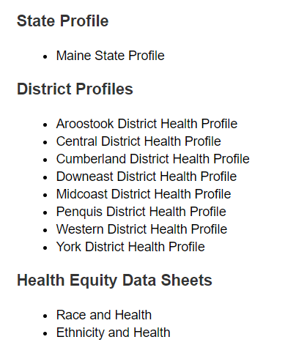
For More Data
www.mainechna.org
Notes:
The Maine Shared CHNA website contains health profiles for 3 of Maine’s largest cities, 16 counties, 5 public health districts, the state, as well as data provided by race, ethnicity, educational attainment, gender, sexual orientation, older adults, insurance status, income, and rurality.
IN addition, there is an interactive data portal where you can search by specific data points. All these breakdowns are then provided by data point.
REGARDING COVID-19 DATA
The Maine Shared CHNA data set does not include any data of COVID-19. This is largely due to the fact that there is a much more up-to-date and comprehensive Maine Data Dashboard continually being updated on the Maine CDC website.
Here you can find daily lab results, new case counts by date, trends, county breakdowns, data by race, and comparisons to other states and the nation.

Slide 14
Key Findings
Notes:
As we walk through the following data slides together, take notes. What surprises you? What stands out? What’s moving in the wrong direction?
Once the data presentation is over, you will be divided into breakout groups to discuss the data, share your top concerns, identify your top priorities, and share your knowledge about what’s working and what we need to work on to addres those top concerns.
Ready? Here we go.

Slide 15
Social Determinants of Health
Notes:
Reliable, consistently collected data on the number of people who are homeless or housing insecure is difficult to find, especially at the county level. One measure we can track is the percentage of rate of high school students who report they usually do not sleep in their parent’s or guardian’s home. This percentage has decreased between 2017 and 2019, however this difference is not significant.
Data Source: Maine Integrated Youth Health Survey
Definition: Percentage of high school students who report they usually do not sleep in their parent's or guardian's home. Data collected in odd numbered years.

Slide 16
Social Determinants of Health
Notes:
This graph shows the percentage of Maine households who spend more than 50% of their income toward housing. There is a shortage of affordable housing in Maine. According to the National Low Income Housing Coalition, a minimum wage worker in Maine would need to work 55 hours per week to afford a one-bedroom apartment. Lack of affordable housing is an obvious risk factor of homelessness.
Data Source: US Census Bureau, American Community Survey
National Low Income Housing Coalition, https://reports.nlihc.org/oor/maine
Definition: Percentage of households that spend 50% or more of their household income on housing.

Slide 17
Demographics
Age distribution for Maine
AGE
STATE OF MAINE
POPULATION
1,362,359
STATE OF MAINE
MEDIAN AGE
44.7
Notes:
Maine has a population of about 1.4 million. The population is aging and is one of the oldest states in the country. There are fewer children and young adults and more adults over the age of 65. This is particularly true in more rural parts of the state. The effect of being homeless may be different for people of different ages.
Source: US Census Bureau, American Community Survey

Slide 18
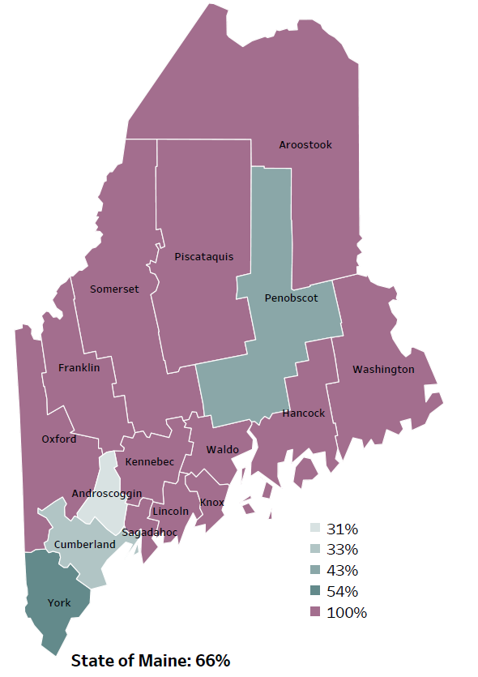
Social Determinants of Health
Percentage of people living in
rural areas
2019
New England Round Table for Rural Health
Notes:
Maine is a largely rural area with only 4 counties with metro areas. As you can see on this map, 100% of the population of 12 of Maine’s 16 counties live in rural areas. Statewide, 66% of the state population reside in a rural area. These data are based on the most recent Census estimates at the Zip-code level, and calculated use Rural Urban Commuting Area codes. The categories were established by the New England Rural Health Association. This data is NOT comparable to 2010 US Census data on populations living in rural areas, as that data uses a different definition for rural.
Counting homelessness in rural areas is particularly difficult.
Source: Data, Research and Vital Statistics town-level population file

Slide 19
Demographics
Notes:
Maine has a higher percentage of veterans when compared to the US overall. The percentage of Maine veterans has remained relatively stable over the past 5 years, but trends have been downward. The percentage of Maine people who are veterans is higher when compared to the US. This is a population for which there are particular concerns regarding homelessness.
Data Source: US Census Bureau, American Community Survey Definition: Percentage of residents who are veterans.

Slide 20
Demographics
Notes:
Maine is more likely than US to have people who identify as having a disability. Six types of disability are included in this metric: hearing difficulty, vision difficulty, cognitive difficulty, ambulatory difficulty, self-care difficulty, independent living difficulty. The higher percentage with a disability may be linked to Maine’s higher than average population age. Older individuals are much more likely to have serious difficulty than younger individuals in these areas.
Data Source: US Census Bureau, American Community Survey Definition: Percentage of residents who report having any one of the six disability types: hearing difficulty, vision difficulty, cognitive difficulty, ambulatory difficulty, self-care difficulty, independent living difficulty.

Slide 21
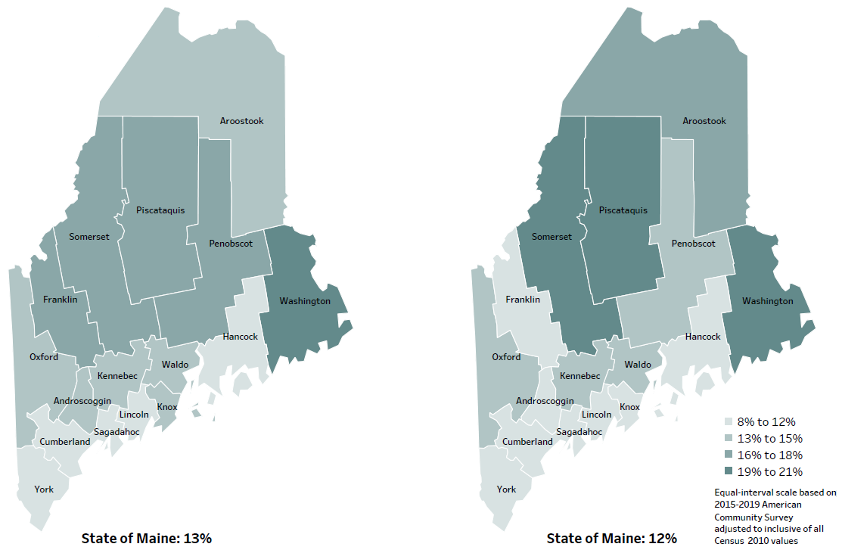
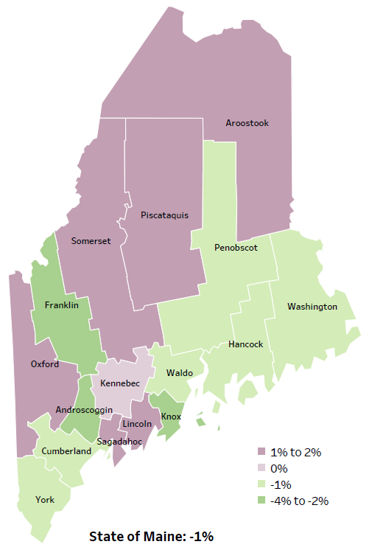
Social Determinants of Health
Percent of population in poverty
2010
American Community
Survey
Change in percent of population in poverty
2010 to 2015-2019
2015-2019
American Community
Survey
Notes:
These maps show the rate of poverty for two different time periods. Overall, the percent of Maine’s population living in poverty has decreased over time. However, Maine has 6 counties that have had an increase in poverty levels between 2010 and 2015-2019 these counties are shaded in purple in the map on the right-hand side of the slide.
Source: US Census Bureau, American Community Survey

Slide 22
Social Determinants of Health
Notes:
The rate of children living in poverty has been declining in Maine overtime and remains below the US average. The consequences of poverty in childhood is far-reaching with impacts to academic achievement, housing instability and to overall health and development.
Data Source: US Census Bureau, Small Area Income and Poverty Estimates
American Psychological Association, ‘ Childhood Poverty, living below the line,’ https://www.apa.org/pi/ses/resources/indicator/2014/06/childhood-poverty
Definition: Percentage of children, ages 0-17 years, who live in households where the total income of the householder's family is below the established federal poverty level.

Slide 23
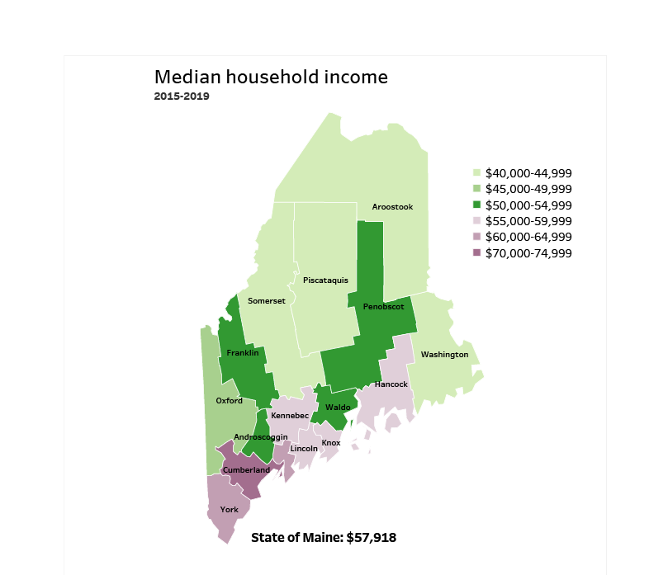
Social Determinants of Health
Notes:
Maine has a median household income of $57,918. The counties in Southern Maine and along the coast have higher household incomes. Median Household income provides additional context to poverty and the percentage of income going towards homelessness.
Source: American Community Survey

Slide 24
Social Determinants of Health
Notes:
The unemployment rate increased between 2018 and 2020, likely due in part to the effects of the Covid-19 pandemic. Prior to 2018, Maine had a steadily decline in the unemployment rate since 2012. While there has been a recent increase, the unemployment rate remains below the US rate. Employment affects housing insecurity and lack of housing can affect employment.
Data Source: US Bureau of Labor Statistics Definition: Percentage of non-institutionalized civilians in the labor force who were not employed. Reported monthly and rates are averaged for the full year.

Slide 25
Social Determinants of Health
Notes:
This slide shows the percentage of high school students who graduate with a regular diploma 4 years after starting the 9th grade. As you can see, the Maine graduation rate has been around 87% for the past 8 years is the about the same as the US rate.
Data Source: Maine Dept. of Education Definition: Percentage of high school students who graduate with a regular diploma four years after starting ninth grade. Graduation rates are determined for students in all public schools and in all private schools that have 60% or more publicly funded students.

Slide 26
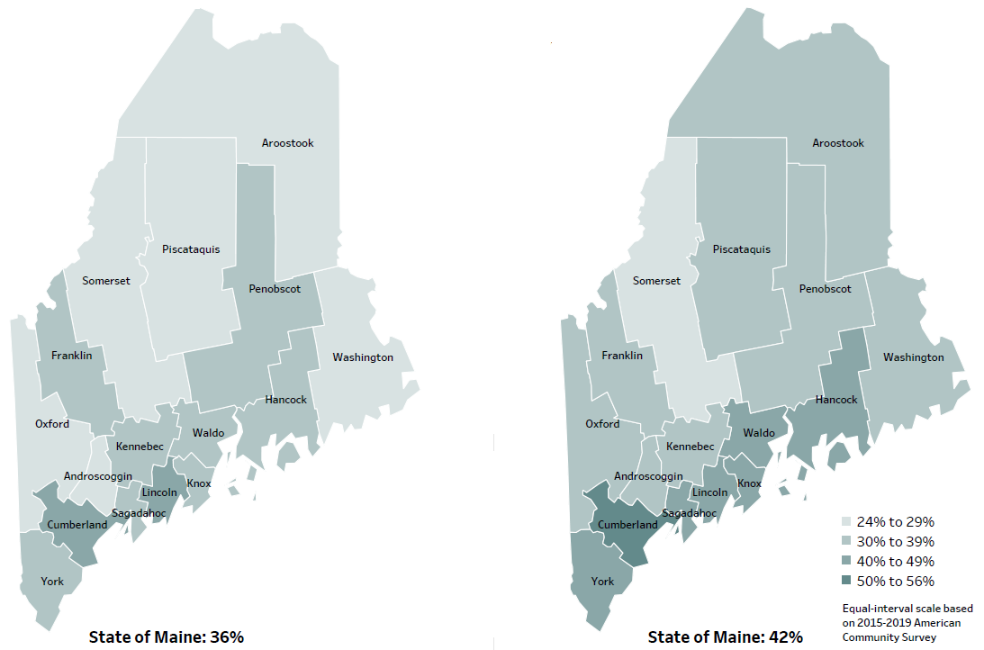
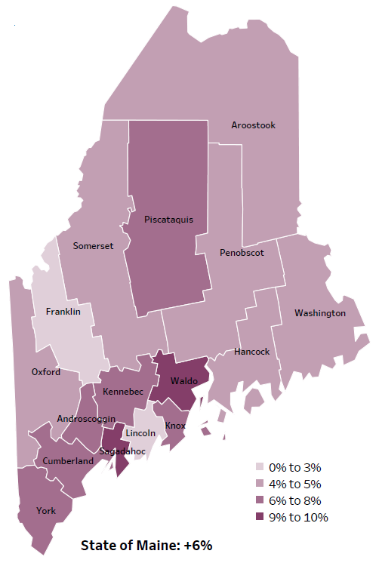
Social Determinants of Health
Percent of population over age 25 with an associate’s degree or higher
2010
American Community
Survey
Change in percent of population over age 25 with an associate’s degree or higher
2010 to 2015-2019
2015-2019
American Community
Survey
Notes:
These maps show the educational attainment of adults over 25 for two different time periods. Maine has had an increase in the rate of adults who have attained an associate’s degree or higher degree of education with a 6% change between 2010 and 2015-2019. However, the degree of increase varies across Maine’s counties.
Source: US Census Bureau, American Community Survey

Slide 27
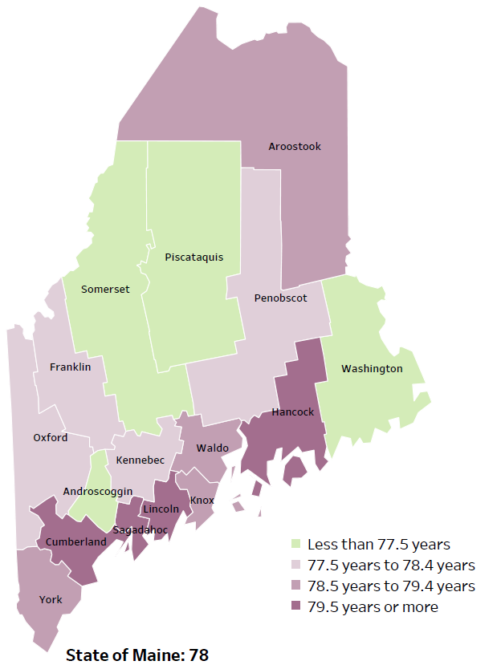
Overall Mortality
Life Expectancy
2017-2019
National Center for Health Statistics,
CDC
Leading Causes of Death
RANK | MAINE
1 | Cancer
2 | Heart Disease
3 | Unintentional Injury
4 | Chronic Lower Respiratory Disease
5 | Stroke
Notes:
The life expectancy in Maine is 78, which is slightly lower than the U.S. life expectancy of 78.7. You can see in the map on the left that life expectancy varies across Maine’s 16 counties. Life expectancy is influenced by the social and economic resources that individuals, families or communities have available for buying healthy foods, paying co-pays for doctor visits or medications, or having healthy and safe housing.
The table on the right side of the slides shows the five leading causes of death in Maine. They are also the leading causes of death for many of the counties.
The leading cause of death is cancer. Heart Disease is the 2nd leading cause of death. The leading cause of death in the U.S. is heart Disease and cancer is the 2nd leading cause.
The 3rd leading cause of death- Unintentional Injury- includes a number of accidental causes: Three of the most common causes are i) Deaths due to motor vehicle crashes, ii) deaths due to accidental falls, and iii) deaths due to poisonings that either were unintentional, or the intent was undetermined, and iv) Firearm deaths. Suicides are classified as intentional injury. Overdose deaths are part of Poisoning deaths and may be classified as intentional or unintentional.

Slide 28
Overall Mortality
Notes:
The overall death rate in Maine has remained relatively consistent over the past 5 years but remains significantly higher than the US. This measure has been age-adjusted so we cannot attribute these numbers to Maine’s older population.
Data Source: Maine CDC Vital Records and National Center for Health Statistics, US CDC Definition: Rate per 100,000 people of deaths from any cause.
We have calculated the rates so that they can be compared to other parts of the state that might have a population with a different mix of ages. Older people tend to have higher rates of many diseases and health conditions. It’s important to adjust for age so that we don’t accidentally mistake a place with older people for a place with an unusual number of disease-related deaths.

Slide 29
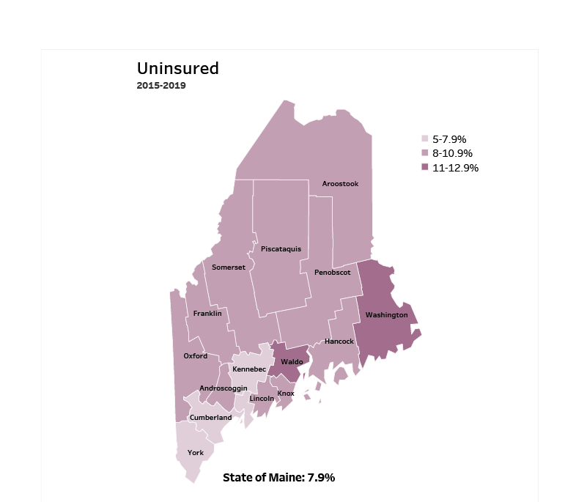
Access
Notes:
Maine has an uninsured rate of 7.9%. Lack of insurance can lead to delayed medical care, emergency room treatment and poorer health outcomes.
Source: American Community Survey

Slide 30
Access
Notes:
This slide shows the percentage of Maine residents who are enrolled in MaineCare. The rate has increased between 2019 and 2020. The rate of enrollment in MaineCare is higher than the average US Medicaid enrollment.
Data Source: MaineCare Definition: Percentage of individuals, of all ages, who were participating in MaineCare. Figures exclude individuals who were nonresidents or who were out of state.

Slide 31
Access
Notes:
Similar to the previous slide, we can see there has been an increase in children enrolled in Maine between 2018 and 2019.
Data Source: MaineCare
Definition: Percentage of children, ages 0-19 years, who were participating in MaineCare. Figures exclude individuals who were nonresidents or who were out of state.

Slide 32
Access
Notes:
This slide shows the percentage of Maine residents who reported there was a time in the past year when they needed to see a doctor but could not because of the cost. Delaying care leads to poorer health outcomes and increases the likelihood of more costly, higher acuity episodes at the time of treatment.
Data Source: Behavioral Risk Factor Surveillance System
American Hospital Association, (2019). Rural Report. Website: https://www.aha.org/system/files/2019-02/rural-report-2019.pdf
Definition: Percentage of adults reporting that there was a time during the last 12 months when they needed to see a doctor but could not because of the cost.

Slide 33
Physical Activity, Nutrition and Weight
Notes:
Food insecurity rates have been lowering steadily over the past several years. Those who experience food insecurity in Maine are roughly equal to the US overall. We cannot compare significance between the state and country since different years are being reported.
Note that there are indicators that during the COVID pandemic- 2020 and 2021 that the percent of people/families experiencing food insecurity may have increased.
Data Source: Feeding America: Map the Meal To be read as needed. Definition: Percentage of households that lack access, at times, to enough food for an active, healthy life for all household members, or that have limited or uncertain availability of nutritionally adequate food.

Slide 34
Physical Activity, Nutrition and Weight
Notes:
Similar to the previous slide, there has been a steady decrease in the percentage of children who have experienced food insecurity. Food insecurity is defined as a lack of access to enough food for an active, healthy life or a lack of availability of nutritionally dense foods.
Data Source: Feeding America: Map the Meal Definition: Percentage of households that lack access, at times, to enough food for an active, healthy life for all household members or that have limited or uncertain availability of nutritionally adequate food. Youth refers to children under 18.

Slide 35
Unintentional Injury
Notes:
Injury-related deaths are the 3rd leading cause of death in Maine. The rate has risen over the past 9 years and is significantly higher than the US rate.
Data Source: Maine CDC Vital Records
Read as needed- Definition: Rate per 100,000 people of deaths due to injuries.
Age Adjustment Definition: We have calculated the rates so that they can be compared to other parts of the state that might have a population with a different mix of ages. Older people tend to have higher rates of many diseases and health conditions. It’s important to adjust for age so that we don’t accidentally mistake a place with older people for a place with an unusual number of disease-related deaths.

Slide 36
Intentional Injury
Notes:
The suicide rate in Maine is higher than the US overall. Furthermore, the suicide rate within Maine has been rising over the past 4 years and is significantly higher than the US rate.
Data Source: Maine CDC Vital Records To be read as needed. Definition: Rate per 100,000 people of deaths due to suicide.

Slide 37
Intentional Injury
Notes:
Maine is ranked among the safest states in the nation. As this slide shows, the violent crime rate is significantly lower than the US rate. A violent crime is defined as a murder, sexual assault, robbery or aggravated assault.
Data Source: Maine Dept. of Public Safety
US News and World Report, https://www.usnews.com/news/best-states/rankings/crime-and-corrections/public-safety
Definition: Rate per 100,000 people of violent crime offenses. Violent crime is defined as a murder, rape, robbery or aggravated assault.
We have calculated the rates so that they can be compared to other parts of the state that might have a population with a different mix of ages. Older people tend to have higher rates of many diseases and health conditions. It’s important to adjust for age so that we don’t accidentally mistake a place with older people for a place with an unusual number of disease-related deaths.

Slide 38
Mental Health
Notes:
This chart shows the estimated percentages of adult Maine residents who have current symptoms of depression. These estimates are based on responses from adults responding to a screening tool that is included in the Behavioral Risk Factor Surveillance System. This screening tool also is used by health care providers in their practices. Those that have reported symptoms has remained relatively stable over the past several years.
Data Source: Behavioral Risk Factor Surveillance System To be read as needed. Definition: Percentage of adults who have current symptoms of depression based on two questions in the BRFSS

Slide 39
Substance Use
Notes:
After a short period of decline in 2018 and 2019, the number of overdose deaths in Maine have increased in 2020. Further, the rates are significantly higher in Maine than the country. Of the 504 drug deaths in 2020, statewide, 83% were caused by opioids.
The rise from 2019 to 2020 was primarily due to overdoses of fentanyl- a nonpharmaceutical opioid. Further, more and more often, deaths due to fentanyl also involve use of methamphetamine or cocaine.
Data Source: Maine Office of the Medical Examiner Definition: Rate per 100,000 people of deaths due to a drug overdose.

Slide 40
Substance Use
Notes:
This graph shows rate of deaths for which drugs are the underlying cause, including those attributable to acute poisoning by drugs and those from medical conditions resulting from chronic drug use.
Data Source: Maine CDC Vital Records and CDC WONDER Online Database Definition: Rate per 100,000 people of deaths for which drugs are the underlying cause, including those attributable to acute poisoning by drugs and those from medical conditions resulting from chronic drug use. Deaths due to alcohol use are excluded.
We have calculated the rates so that they can be compared to other parts of the state that might have a population with a different mix of ages. Older people tend to have higher rates of many diseases and health conditions. It’s important to adjust for age so that we don’t accidentally mistake a place with older people for a place with an unusual number of disease-related deaths.

Slide 41
Substance Use
Notes:
This graph shows rate of deaths with alcohol as the underlying cause. These deaths may be due to acute alcohol poisoning or from medical conditions resulting from chronic alcohol use.
Data Source: Maine CDC Vital Records and CDC WONDER Online Database Definition: Rate per 100,000 people of deaths for which alcohol is the underlying cause, including those attributable to acute alcohol poisoning and those from medical conditions resulting from chronic alcohol use.
We have calculated the rates so that they can be compared to other parts of the state that might have a population with a different mix of ages. Older people tend to have higher rates of many diseases and health conditions. It’s important to adjust for age so that we don’t accidentally mistake a place with older people for a place with an unusual number of disease-related deaths.

Slide 42
Substance Use
Notes:
Chronic heavy drinking is defined as having two or more drinks per day for men and more than one drink per day for women. The percentage of Maine residents who are considered chronic heavy drinkers is significantly higher than the US overall.
Data Source: Behavioral Risk Factor Surveillance System Definition: Percentage of adults who drink more than two drinks per day for men or more than one drink per day for women.

Slide 43
Substance Use
Notes:
The rate of EMS responses to overdoses from drugs, medications, alcohol or inhalants, has been increasing in Maine but not to a significant degree.
Data Source: Maine Emergency Medical Services Definition: Rate per 10,000 population of overdose emergency medical service responses, including overdoses from drugs, medications, alcohol, and inhalants.
We have calculated the rates so that they can be compared to other parts of the state that might have a population with a different mix of ages. Older people tend to have higher rates of many diseases and health conditions. It’s important to adjust for age so that we don’t accidentally mistake a place with older people for a place with an unusual number of disease-related deaths.

Slide 44
Tobacco Use
Notes:
The percentage of adult smokers in Maine has been decreasing and is now equal to the US. A current smoker is an adult who has smoked at least 100 cigarettes in their lifetime and currently smoke.
Data Source: Behavioral Risk Factor Surveillance System
Definition: Percentage of adults who have smoked at least 100 cigarettes in their lifetime and currently smoke.

Slide 45
Breakout Discussions

Slide 46
Reconvene

Slide 47
Wrap up and Next Steps

Slide 48
Contacts
Awa Conteh, Tri-Chair, Maine Continuum of Care, Shelter Plus Care Specialist, Bangor Public Health, awa.conteh@bangormaine.gov.
Norman Maze, Tri-Chair, Maine Continuum of Care, Deputy Director, Shalom House, NMaze@shalomhouseinc.org.
Jo Morrissey, Program Manager, Maine Shared CHNA, info@mainechna.org.
www.mainechna.org

