Slide 1
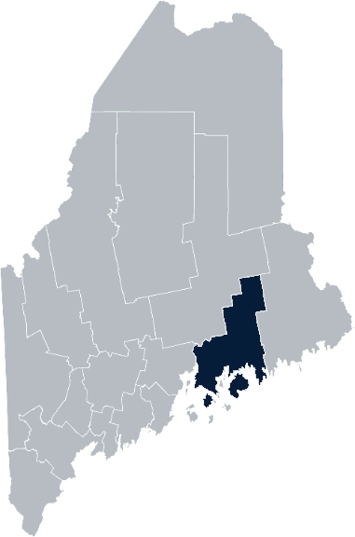
Maine Shared Community Health Needs Assessment Hancock County
2021

Slide 2
The Maine Shared CHNA is a collaboration between the Maine Center for Disease Control and Prevention (Maine CDC), Central Maine Healthcare, Northern Light Health, MaineGeneral Health, and MaineHealth.
Notes:
Local Planning Committee Member

Slide 3
Thank you, forum sponsors!
Downeast Community Partners | Mount Desert Island Hospital
Downeast Public Health Council | Northern Light Blue Hill Hospital
Eastern Area Agency on Aging | Northern Light Health
Hancock County Emergency Management Agency | Northern Light Maine Coast Hospital
Healthy Acadia | United Way of Eastern Maine
Maine Center for Disease Control and Prevention
Notes:
Local Planning Committee Member

Slide 4
Forum agenda
Time | Activity | Speaker/Facilitator
10:00 – 10:05 am | Welcome and introductions | Al May, Public Health Liaison, Downeast Public Health District
10:05 – 10:10 am | Zoom environment and CHNA background | Jo Morrissey, Program Manager, Maine Shared Community Health Needs Assessment
10:10 – 10:15 am | Leadership remarks | Christina Maguire, President/CEO, Mount Desert Island Hospital John Ronan, President, Northern Light Blue Hill Hospital and Northern Light Maine Coast Hospital
10:15 – 10:25 am | Review previous CHNA priorities and activities since last effort | Nikki Robichaud, Outpatient Quality Lead, Northern Light Blue Hill Hospital and Northern Light Maine Coast Hospital Al May, Public Health Liaison, Downeast Public Health District
10:25 – 10:50 am | Presentation of key findings from the data | John Snow, Inc.
10:50 – 11:50 am | Break-out session – facilitated discussion on data and health priority identification | John Snow, Inc. & Local Facilitator(s)
11:50 – noon | Wrap up and next steps | Nikki Robichaud, Outpatient Quality Lead, Northern Light Blue Hill Hospital and Northern Light Maine Coast Hospital
Notes:
Local Planning Committee Member to go over agenda and then turn it over to Jo Morrissey to provide an overview of the Zoom tools available and the purpose of today’s forum

Slide 5
Share screen
Join Audio, Mute On/Off
Open/close participant list or chat
Turn Video On/Off
Reactions
Notes:
Jo or JSI

Slide 6
Matching Interests
Maine Shared
Community Health Needs Assessment
Images of PHAB and IRS from the internet
Notes:
Jo or JSI

Slide 7
The Evolution of an Idea…
2010 OneMaine | 2015 SHNAPP | 2018 Maine Shared CHNA | 2021 Maine Shared CHNA
Forums Surveys | 16 Forums 1639 Surveys | 22 Mainstream Forums (live) 2 Immigrant Forums 45 Interviews | 16+ Mainstream Forums (virtual) 12+ Community Sponsored Events 2000+ Oral Surveys
Notes:
Jo or JSI

Slide 8
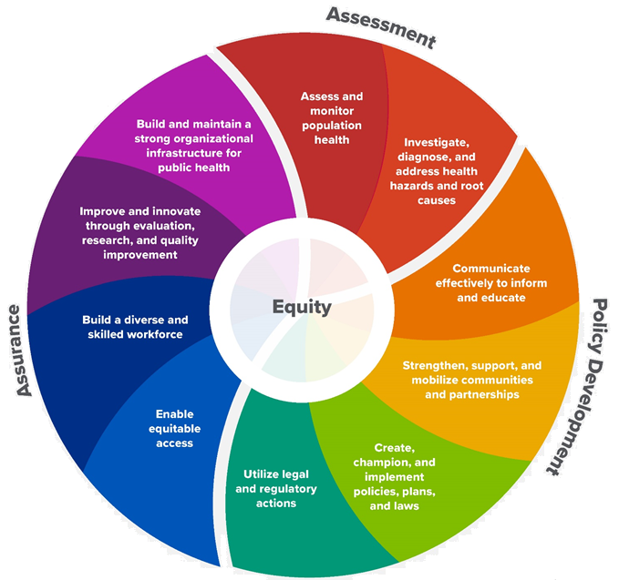
10 Essential Public Health Services
Notes:
Jo or JSI

Slide 9
Maine Shared CHNA Organizational Chart
Steering Committee
Program Manager
Vendor Support
Metrics Committee
Health Equity Community Engagement Committee
Data Analysis Teams
Local Planning Teams
Notes:
Jo or JSI

Slide 10
Inputs and Outcomes
Ways to Provide Input
Data Collected
Outcomes
District & County Reports DUE APRIL 2022
4 Health Priorities by county
Related indicators
Gaps/barriers and resources/assets
Notable comparisons between attendee input and the data.
Description of those who provided input
Methodology
Mainstream county forums
Number of attendees
Where attendees live (not CSE)
List of data identified Forums and CSE only)
Discussion notes (Forums and CSE only)
Chat box comments (Forums and CSE only)
Health Priorities
Gaps and Resources
Community sponsored events
State Report DUE APRIL 2022
4 Health Priorities by Community Event and immigrant population.
Related indicators
Gaps/barriers and resources/assets,
Notable comparisons to mainstream population.
Description of those who provided input
Methodology
Oral Survey
Forums, Events and Surveys conducted Fall 2021
Notes:
Christina Maguire, President/CEO, Mount Desert Island Hospital
John Ronan, President, Northern Light Blue Hill Hospital and Northern Light Maine Coast Hospital
Jo or JSI
Community Sponsored Event Partners include
Disability Rights Maine (2 events: people who are deaf or hard of hearing and people with other disabilities)
Maine Primary Care Association (People who are served by Maine’s Federally Qualified Health Centers
Maine Council on Aging (Older Adults 65+
Consumer Right Council of Maine (people with a mental health diagnosis)
Formerly Incarcerated (Maine Prisoner Re-Entry Network)
Maine Youth Action Network and Friends (Raising the voices of Maine’s diverse youth)
Green Memorial A.M.E. Zion Church (Black/African American)
Health Equity Alliance (LGBTQ+ community)
Portland Recovery Center (for people with a substance use disorder or in recovery)
ADD HOUSING INSECURE IF NEED BE
ADD VETERAN IF NEED BE
Oral Survey Partners include:
City of Portland’s Minority Health Program
New Mainer’s Public Health Initiative
Maine Immigrant Access Network
Gateway Community Services
Maine Immigrant and Refugee Services
Maine Community Integration
Mano en Mano
We are piloting these additional outreach methods with support from
State of Maine’s Preventative Health and Health Services Block Grant
Maine Health Access Foundation
Introduce leader for leadership remarks

Slide 11
Leadership remarks
Notes:
Leadership remarks
Leader to introduce point person for review of previous health improvement efforts.
Nikki Robichaud, Outpatient Quality Lead, Northern Light Blue Hill Hospital and Northern Light Maine Coast Hospital Al May, Public Health Liaison, Downeast Public Health District

Slide 12
Local Activities and Accomplishments
Notes:
Local facilitator
Nikki Robichaud, Outpatient Quality Lead, Northern Light Blue Hill Hospital and Northern Light Maine Coast Hospital Al May, Public Health Liaison, Downeast Public Health District

Slide 13
Downeast District – Hancock County Hospital and District priority areas of work since the 2019 Shared CHNA
COVID-19
Downeast Public Health District (Maine CDC) Mount Desert Island Hospital Northern Light Acadia Hospital Northern Light Blue Hill Hospital Northern Light Eastern Maine Medical Center Northern Light Maine Coast Hospital
Access to care
Mount Desert Island Hospital Northern Light Blue Hill Hospital Northern Light Eastern Maine Medical Center Northern Light Maine Coast Hospital
Social Determinants of Health
Mount Desert Island Hospital Northern Light Acadia Hospital Northern Light Blue Hill Hospital Northern Light Eastern Maine Medical Center Northern Light Maine Coast Hospital
Substance use
Mount Desert Island Hospital Northern Light Acadia Hospital Northern Light Blue Hill Hospital Northern Light Eastern Maine Medical Center Northern Light Maine Coast Hospital
Downeast Community Partners, Hancock County Emergency Management Agency, Eastern Area Agency on Aging, Healthy Acadia, and United Way of Eastern Maine’s work spans all categories.
Notes:
Previous CHNA efforts point person

Slide 14
Downeast District – Hancock County Hospital and District priority areas of work since the 2019 Shared CHNA
Mental Health
Mount Desert Island Hospital Northern Light Acadia Hospital Northern Light Eastern Maine Medical Center
Emergency Preparedness | Downeast Public Health District (Maine CDC)
Health Literacy | Downeast Public Health District (Maine CDC)
Healthy aging | Downeast Public Health District (Maine CDC)
Palliative Care and Hospice Service | Downeast Public Health District (Maine CDC)
Physical activity, nutrition, weight | Northern Light Eastern Maine Medical Center
Cancer | Downeast Public Health District (Maine CDC)
Downeast Community Partners, Hancock County Emergency Management Agency, Eastern Area Agency on Aging, Healthy Acadia, and United Way of Eastern Maine’s work spans all categories.
Notes:
Previous CHNA efforts point person

Slide 15
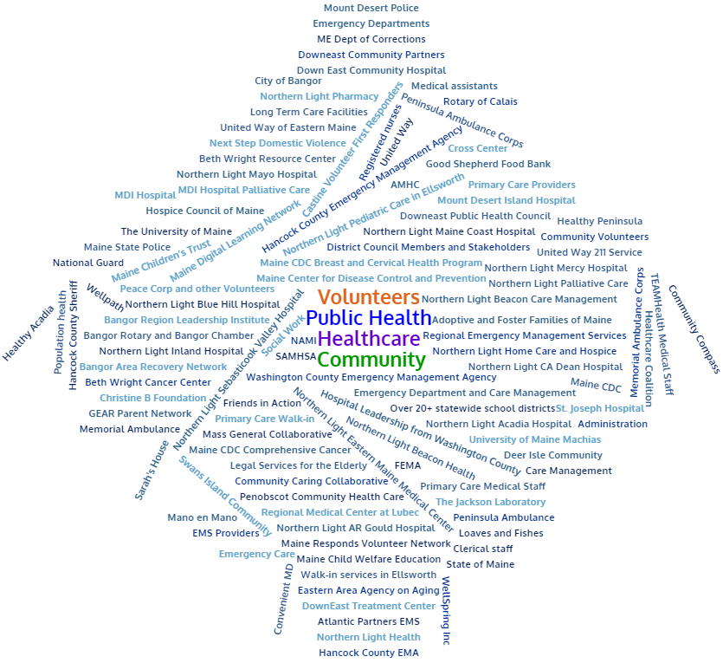
Partners
Notes:
Previous CHNA efforts point person

Slide 16
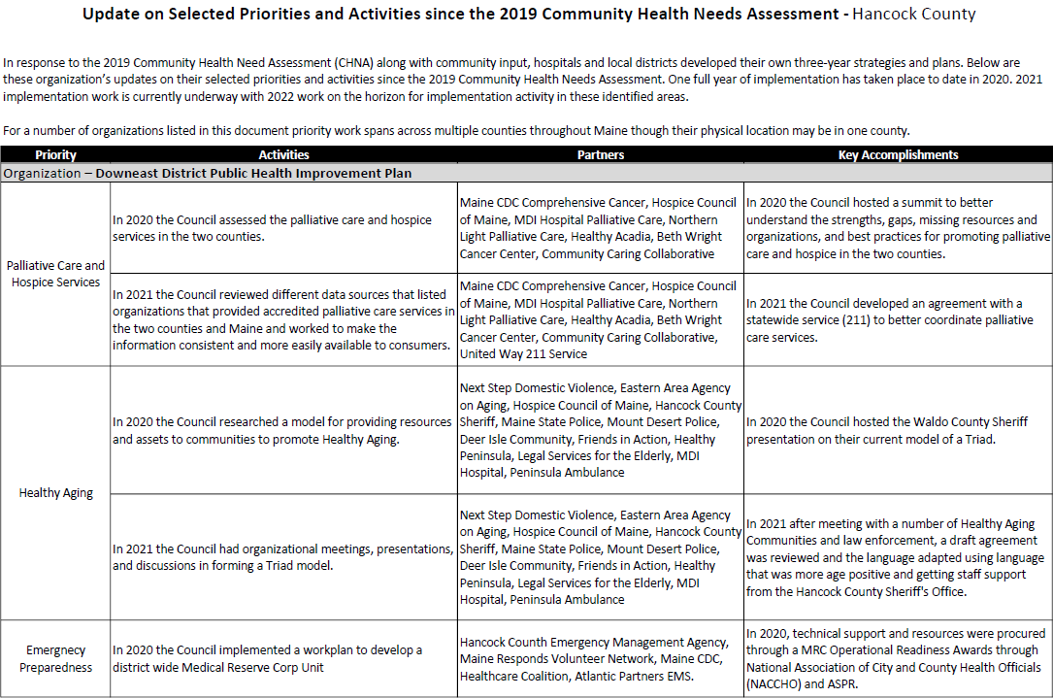
Accomplishments of Note
Update on selected priorities and activities since the 2019 Shared CHNA
Notes:
Previous CHNA efforts point person

Slide 17
Downeast Public Health District Downeast Public Health Council (DEPHC)
The Downeast Public Health District is one of nine Public Health Districts in Maine. The District includes Hancock and Washington Counties.
The Downeast Public Health Council is a representative, district-wide body authorized to engage in collaborative planning and decision making in the delivery and assurance of the ten essential public health services.
The Downeast Public Health Council creates a District Public Health Improvement Plan as one result of the Community Health Needs Assessment Process. Current 2019 – 2021 priorities are palliative care and hospice services, healthy aging, emergency preparedness, cancer and health literacy.
Notes:
Introduce Madison MacLean of John Snow, Inc. (JSI) who will now give a data presentation on the top indicators
Introduce JSI

Slide 18
How to Read the County Health Profiles and Health Equity Data Sheets
Notes:
JSI or other facilitator

Slide 19
How to Read County Health Profile
CHANGE shows statistically significant changes in the indicator over time, based on 95% confidence interval (see description on page 3).
ê | means the health issue or problem is getting better over time.
! | means the health issue or problem is getting worse over time.
○ | means the change was not statistically significant.
N/A | means there is not enough data to make a comparison.
BENCHMARK compares [COUNTY] data to state and national data, based on 95% confidence interval (see description on page 3).
ê | means [COUNTY] is doing significantly better than the state or national average.
! | means [COUNTY is doing significantly worse than the state or national average.
○ | means there is no statistically significant difference between the data points.
N/A | means there is not enough data to make a comparison.
ADDITIONAL SYMBOLS
* | means results may be statistically unreliable due to small numbers, use caution when interpreting.
— | means data is unavailable because of lack of data or suppressed data due to a small number of respondents.
EXAMPLE
Notes:
JSI or other facilitator
A star means that the health issue or problem is getting better over time or better in comparison to another place
A red exclamation point means that the health issue or problem is getting worse over time or worse in comparison to another place
A gray circle means that the dating hasn’t changed over time or isn’t much different in comparison to another place
N/A means that there was not enough data to be able to make a comparison
There are two additional symbols you might see:
A black dot means that you should use caution when interpreting the data – the results might be unreliable because of small numbers
A black dash means that data was unavailable, or that data was suppressed due to a small number of respondents
(Go to next slide and walk audience through an example)

Slide 20
How to Read County Health Profile
EXAMPLE
 | AROOSTOOK COUNTY |  |  | BENCHMARKS
INDICATOR | POINT 1 | POINT 2 | CHANGE | MAINE | +/- | U.S. | +/-
Individuals living in poverty | 2009-2011 15.6% | 2015-2019 16.1% | ¡ | 2015-2019 11.8% | ! | 2019 12.3% | N/A
Notes:
The charts in this presentation are all excerpts from the Data Health Profiles that were created by MaineHealth and the Maine CDC. They contain data pulled from publicly available sources that are designed to help people learn more about the health of their communities. Not all the data points are available for every measure, but we’ve included data wherever we can.
There are some important notes about the data here that will help you understand it. First, the data comes from many sources. We’ve included those sources in the Data Health Profiles- you can get a copy to review from the presenter.
Every data point is accompanied by a year. This is the year the measurement was taken. It is important to know that when multiple years are presented, or a range of years (as in this slide), the data refers to measurement that includes ALL the years indicated. It is NOT an average of the data from those years. It combines data from across those years into a single measurement.

Slide 21
How to Read County Health Profile
EXAMPLE
 | AROOSTOOK COUNTY |  |  | BENCHMARKS
INDICATOR | POINT 1 | POINT 2 | CHANGE | MAINE | +/- | U.S. | +/-
Individuals living in poverty | 2009-2011 15.6% | 2015-2019 16.1% | ¡ | 2015-2019 11.8% | ! | 2019 12.3% | N/A
Notes:
Here’s an example of how we’ve visualized the data in the County Health Profiles.
The charts in this presentation are all excerpts from the Data Health Profiles that were created by MaineHealth and the Maine CDC. They contain data pulled from publicly available sources that are designed to help people learn more about the health of their communities. Not all the data points are available for every measure, but we’ve included data wherever we can.
The green bars represent data from your community. The left most one represents a past data point, and the right bar represents the most recent data point available when the data was gathered. These are the same data points used in the Data Health Profiles.
The grey bars represent data for the state of Maine as a whole- on the left- and for the United States as a whole- on the right, when it is available.
We’ve also noted where differences in the data points are ‘statistically significant’. A difference between two measurements is significant when scientists can say, with a known degree of confidence, that the difference between them is large enough that the difference is most likely to be caused by an actual difference in the item being measured, and not caused by error associated taking the measurement. All of these tests are comparing the most recent data point for your community to other data points. A red exclamation mark indicates a difference that your community is significantly different in a less desirable direction compared to the data point with the symbol. A green star indicates that your community is significantly different in a more desirable direction. A grey circle indicates that there is no significant difference.
(keep in presentation – do not read for deaf/HOH event or people with disabilities). A difference between two measurements is significant when scientists can say, with a known degree of confidence, that the difference between them is large enough that the difference is most likely to be caused by an actual difference in the item being measured, and not caused by an error associated taking the measurement. All of these tests are comparing the most recent data point for your community to other data points.
For example, in this slide, we have two symbols. The grey circle next to the measurement for 2009-2011 Aroostook County means that there is no significantly different change in the rate of poverty in Aroostook County when comparing the data from 2009-2011 to the data from 2015-2019. The red exclamation mark next to the Maine data point says there is a significant difference between 2015-2019 Aroostook County and 2015-2019 Maine, and that it is less desirable that Aroostook County has a higher rate of individuals living in poverty. No comparison could be made to the data for the U.S. because the years of data collection were different.

Slide 22
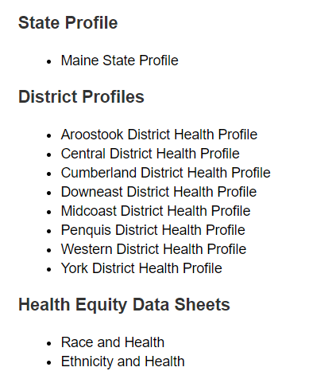
For More Data
www.mainechna.org
Notes:
The Maine Shared CHNA website contains health profiles for 3 of Maine’s largest cities, 16 counties, 5 public health districts, the state, as well as data provided by race, ethnicity, educational attainment, gender, sexual orientation, older adults, insurance status, income, and rurality.
IN addition, there is an interactive data portal where you can search by specific data points. All these breakdowns are then provided by data point.

Slide 23
Key Findings
Notes:
John Snow, Inc.

Slide 24
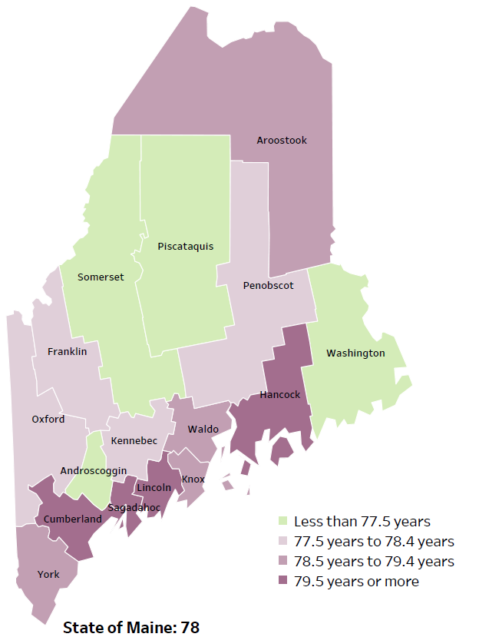
Demographics
Life Expectancy
2017-2019
National Center for Health Statistics,
CDC
RANK | MAINE | HANCOCK COUNTY
1 | Cancer | Cancer
2 | Heart Disease | Heart Disease
3 | Unintentional Injury | Chronic Lower Respiratory Disease
4 | Chronic Lower Respiratory Disease | Unintentional Injury
5 | Stroke | Stroke
Notes:
The life expectancy in Hancock County is 82, which is significantly higher than the state average of 78. Hancock County has one of the highest life expectancy in the state, one of 4 counties that has a life expectancy of 79.5 or older.
The table on the right side of the slides shows the five leading causes of death in Hancock County. They are also the leading causes of death for the whole state of Maine.
The leading cause of death is cancer, the same as the state leading cause of death. As we will see later in the presentation, Hancock County has higher rates of melanoma, colorectal, and prostate cancer than the State of Maine generally, which is reflected as the leading causes of death.
Some highlights:
In Hancock County and Maine overall, the leading cause of death is Cancer followed by Heart Disease. The opposite is true in the U.S. overall- Heart Disease is the leading cause of death, and cancer is the 2nd leading cause. One of the reasons that this is true is because we have higher rates of risk factors for cancer, such as smoking/tobacco use. At the same time, there has been a lot of success implementing treatment of heart disease, resulting in folks with heart disease living longer.
The 4th leading cause of death in Hancock County- Unintentional Injury- includes a number of accidental causes: Three of the most common causes are 1) deaths due to motor vehicle crashes, and 2) deaths due to accidental falls, and iii) deaths due to poisonings that either were unintentional or the intent was undetermined. Suicides and firearm deaths are classified as intentional injury.

Slide 25
Demographics
Age distribution for Hancock County
AGE
HANCOCK COUNTY
POPULATION
54,601
STATE OF MAINE
POPULATION
1,362,359
Notes:
Hancock County has the 8th largest population of any Maine County. The population is aging, but as we saw in the previous slide, the life expectancy is among the highest in the state. There are fewer children and young adults and more adults over the age of 65, and fewer adults of the age where they might expect to have children.
Source: US Census Bureau, American Community Survey

Slide 26
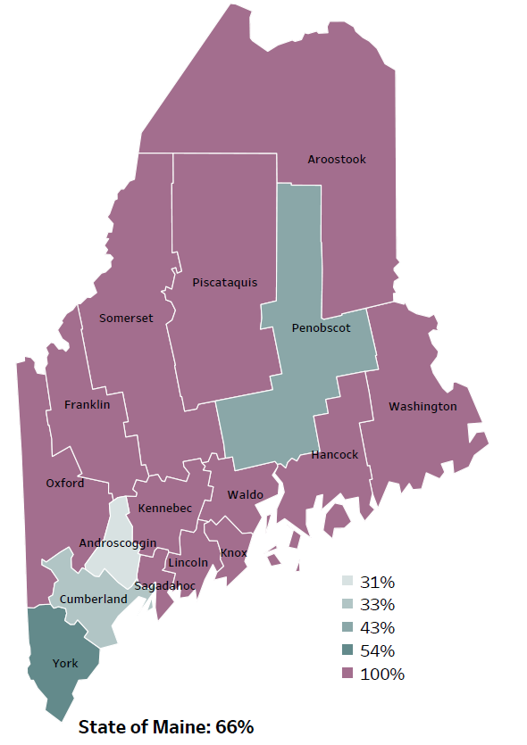
Demographics
Percentage of people living in
rural areas
2019
New England Round Table for Rural Health
Notes:
Hancock County is one of 12 counties with no population in a metro area. These data are based on the most recent Census estimates at the Zip-code level, and calculated use rural Urban Commuting Area codes. The categories were established by the New England Rural Health Association. This data is NOT comparable to 2010 US Census data on populations living in rural areas, as that data uses a different definition for rural.
Source: Data, Research and Vital Statistics town-level population file

Slide 27
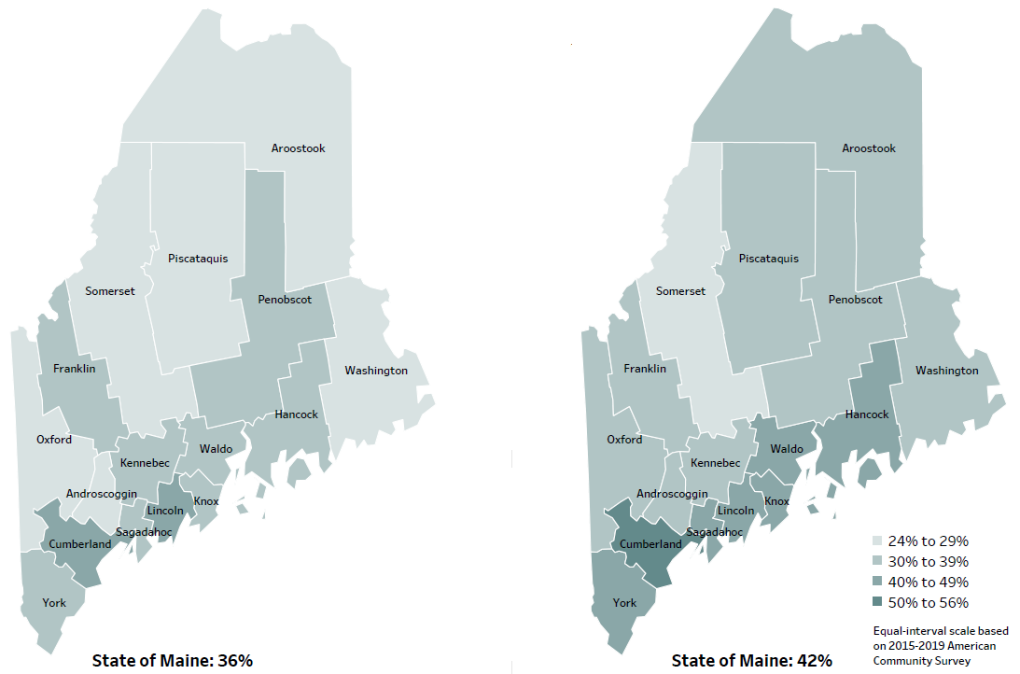
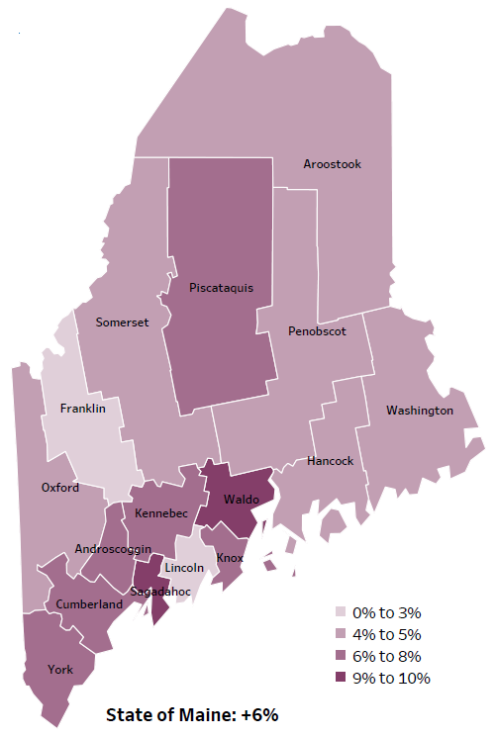
Demographics
Percent of population over age 25 with an associate’s degree or higher
2010
American Community
Survey
Change in percent of population over age 25 with an associate’s degree or higher
2010 to 2015-2019
2015-2019
American Community
Survey
Notes:
These maps show the educational attainment of adults over 25 for two different time periods. Hancock County has had a 4-5% increase in the rate of adults who have achieved an associate’s degree or higher degree of education. This is highlighted in the change over time map, which shows that this was a greater increase than 2 other counties and equal to 6 other counties.
Source: US Census Bureau, American Community Survey

Slide 28
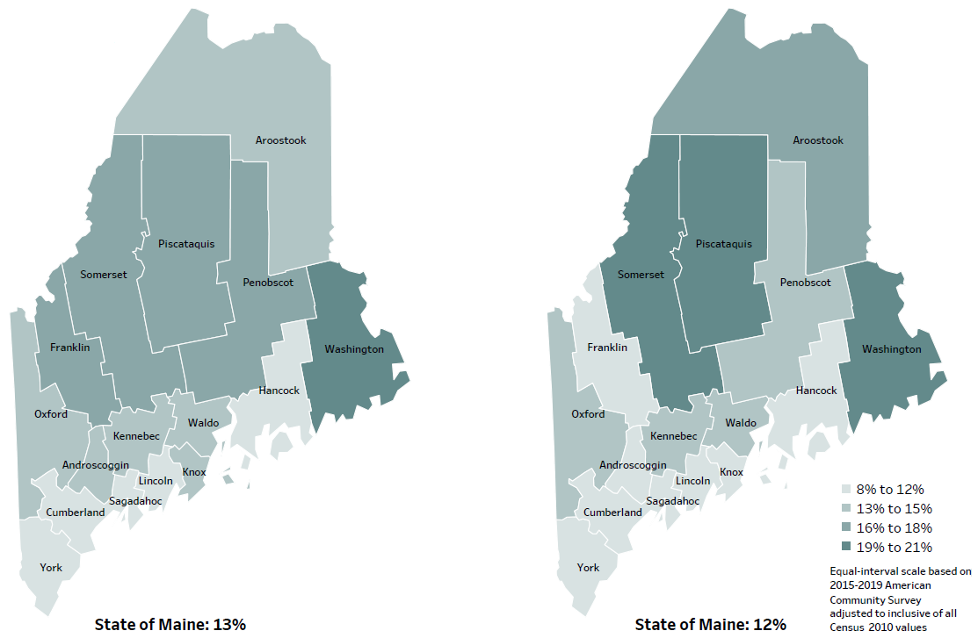
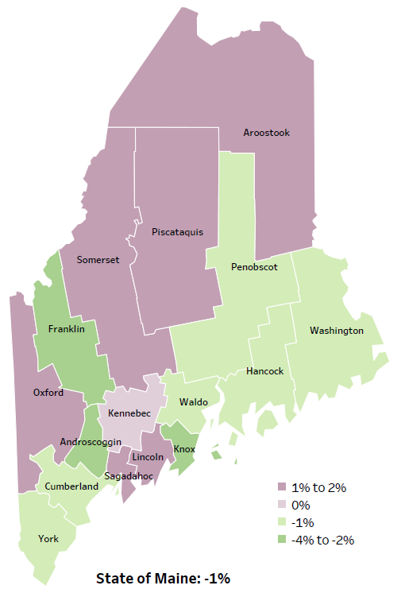
Demographics
Percent of population in poverty
2010
American Community
Survey
Change in percent of population in poverty
2010 to 2015-2019
2015-2019
American Community
Survey
Notes:
These maps show the rate of poverty for two different time periods. During this period, poverty decreased in Maine overall. Hancock County’s poverty rate has decreased slightly over the time period, as shown in the change over time map. Currently, about11% of the county population lives in poverty.
Source: US Census Bureau, American Community Survey

Slide 29
Health Indicators
Notes:
Hancock County has a significantly higher rate of uninsured residents than the state, but no comparison could be made to the US because different years of data were used. While rates are high in the county, they have improved significantly since 2009-2011.
Source: US Census Bureau, American Community Survey

Slide 30
Health Indicators
Notes:
These are measures of quality of care, showing the rates of hospitalizations and visits to the ED for conditions that could have been handled in a doctor’s office include PCPs and urgent care. Often this happens because the patient does not have access to a primary care provider or PCP. Hancock County has a significantly higher rate when compared to the state, but rates are improving within the county. These data combine multiple years, in order to make the data more precise.
Data Source: Maine Health Data Organization Hospital Inpatient Database

Slide 31
Health Indicators
Notes:
The rate of Hancock County residents who have been diagnosed with Lyme Disease has decreased between 2019 and 2020 but remains higher than the state overall. None of these measurements could be tested for significance.
Data Source: Maine Infectious Disease Surveillance System

Slide 32
Health Indicators
Notes:
The rate of new colorectal cancer diagnoses are significantly higher than the state overall. Rates are rising within the county, but not to a significant degree.
These data are age-adjusted, meaning that we have calculated the rates so that they can be compared to other parts of the state that might have a younger population. Older people tend to have higher rates of many diseases, including cancer. It’s important to adjust for age so that we don’t accidentally mistake a place with older people for a place with an unusual number of disease-related deaths.
Data Source: Maine Cancer Registry

Slide 33
Health Indicators
Notes:
Similar to the previous slide, the rate of those diagnosed with melanoma skin cancer is significantly higher than the state rate and rising within the county. This indicator is also age-adjusted.
Data Source: Maine Cancer Registry

Slide 34
Health Indicators
Notes:
Prostate cancer diagnoses are rising within Hancock County and the rate is significantly higher than the state overall. This too is an age-adjusted rate.
Data Source: Maine Cancer Registry

Slide 35
Health Indicators
Notes:
Hancock County residents are significantly more likely to be hospitalized due to a heart attack when compared to the state. The rate has decreased since 2016-2017, but not significantly.
Data Source: Maine Health Data Organization Hospital Inpatient Database

Slide 36
Health Indicators
Notes:
These graphs show a higher percentage of adults in Hancock County are not engaging in physical activity outside of work. Compared to past years the prevalence of sedentary lifestyles has increased significantly.
Data Source: Behavioral Risk Factor Surveillance System

Slide 37
Health Indicators
Notes:
The percentage of middle school students who are consuming fruits and vegetables at least 5 days a week has decreased since 2017 and is significantly lower than the state overall.
Data Source: BRFSS

Slide 38
Health Indicators
Notes:
Women in Hancock County who smoked during pregnancy is significantly higher than the state. Although rates have remained stable between 2016-2017 and 2018-2019 there is a concern given the birth and health outcomes associated with exposure to tobacco in utero.
Data Source: Maine CDC Vital Records

Slide 39
Health Indicators
Notes:
Toddlers in Hancock County are being tested for lead exposure at a significantly lower rate than the state. While there has been an increase within the county since 2018, this should be a focus area given the cognitive and health implications of lead exposure.
Data Source: Maine CDC Childhood Lead Poisoning Prevention Unit

Slide 40
Health Indicators
Notes:
Three years old being screened for lead exposure is significantly lower than the state, similar to what we saw in the previous slide. Those being tested has decreased within the county since 2018. Though this change is not itself significant, a lower measurement here is a concern.
Data Source: Maine CDC Childhood Lead Poisoning Prevention Unit

Slide 41
Health Indicators
Notes:
This graph shows that injury deaths have increased significantly in Hancock County over time. Rates of injury deaths in Hancock County are lower than the state overall but not significantly.
Data Source: Maine CDC Vital Records

Slide 42
Health Indicators
Notes:
The rates of poisoning deaths within Hancock County have increased significantly since 2007-2011. This indicator shows unintentional or undetermined poisoning, meaning these deaths are not due to suicide or other intentional injuries. While the Hancock County rate is lower than the state, the difference is not significant.
Data Source: Maine CDC Vital Records

Slide 43
Health Indicators
Notes:
The percentage of high school students who report they have felt sad and hopeless for two weeks in a row has been increasing over time. This indicator is defined as those who have stopped doing some of their usual activities for two week or more during the past 12 months.
Data Source: Maine Integrated Youth Health Survey

Slide 44
Health Indicators
Notes:
Similar to the previous slide, we are seeing an increase in middle school student who report they have felt sad or hopeless.
Data Source: Maine Integrated Youth Health Survey

Slide 45
Health Indicators
Notes:
Intentional self-injury, such as cutting or burning, is defined as harming oneself without wanting to die. The percentage of high school students who are engaging in self-injurious behaviors has increased significantly in Hancock County between 2017 and 2019 and is also significantly higher than the state.
Data Source: Maine Integrated Youth Health Survey

Slide 46
Health Indicators
Notes:
High school students in Hancock County are binge drinking at a significantly higher rate than in 2015. While Hancock County is lower than the state overall, the rise within the county is worth exploring.
Data Source: Maine Integrated Youth Health Survey

Slide 47
Health Indicators
Notes:
The number of overdose deaths have increased significantly in Hancock County between 2018 and 2019. The rates are higher than the state, but not significantly. These increases could be attributed to the opioid crisis in the state and across the country.
Data Source: Maine Emergency Medical Services

Slide 48
Health Indicators
Notes:
The misuse of prescription drugs among high school students has increased in Hancock County between 2017 and 2019.
Data Source: Maine Integrated Youth Health Survey

Slide 49
Health Indicators
Notes:
Similar to high school students, the percentage of middle school students misusing prescription drugs has increased since 2017 and is nearing the state rate.
Data Source: Maine Integrated Youth Health Survey

Slide 50
Health Indicators
Notes:
Fewer high school students are smoking cigarettes, but there has been a significant increase in those using e-cigarettes when compared to past years.
Data Source: Maine Integrated Youth Health Survey

Slide 51
Health Indicators
Notes:
Middle school students have also shown a significant increase in the use of e-cigarettes.
Data Source: Maine Integrated Youth Health Survey

Slide 52
Breakout Discussions

Slide 53
Reconvene

Slide 54
Wrap up and Next Steps

Slide 55
Contacts
Alfred May, Downeast District Public Health Liaison, alfred.may@maine.gov 207-255-2017
Nikki Robichaud, Outpatient Quality Lead, Northern Light Blue Hill Hospital and Maine Coast Hospital nirobichaud@northernlight.org 207-664-5368
Nicole Hammar, Manager, Community Health Improvement, Northern Light Health nhammar@northernlight.org 207-973-7245
Maine Shared CHNA: info@mainechna.org

