Slide 1
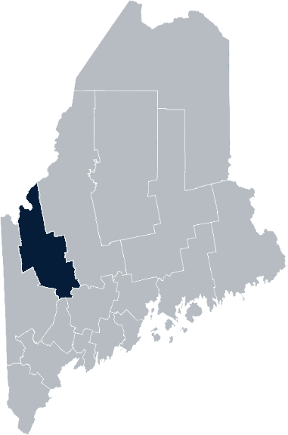
Maine Shared Community Health Needs Assessment Franklin County
2021
Notes:
Ellen

Slide 2
The Maine Shared CHNA is a collaboration between the Maine Center for Disease Control and Prevention (Maine CDC), Central Maine Healthcare, Northern Light Health, MaineGeneral Health, and MaineHealth.
Notes:
Ellen

Slide 3
Partners:
FCHN
United Way
HealthReach Network
School systems
Community Social Service agencies
Local businesses
Independent community members
Notes:
Ellen

Slide 4
Pandemic Acknowledgement and Thanks
During the past CHNA cycle – COVID-19 became a public health focus for everyone.
Western District, including Franklin county, experienced a significant number of COVID-19 cases and COVID-19 deaths in the state – but has also witnessed high levels of collaboration that brought together healthcare partners, emergency management, local governments and community members, in order to test, vaccinate, and educate around COVID-19.
This was and continues to be a focus of many of our partners’ outreach, planning, and everyday activities.
Notes:
Ellen

Slide 5
Franklin County COVID Response
22,014 of vaccines given by FCHN
57% of Franklin County eligible residents fully vaccinated
HRSA COVID vaccine grant awarded to HCC to address those hesitant to vaccinate
Municipal Funding awarded to 5 towns in Franklin County to increase COVID-19 awareness and safety precautions
Notes:
Ellen

Slide 6
Forum Agenda
Time | Activity | Speaker/Facilitator
5:00- 5:05 pm | Welcome | Ellen Thorne, Healthy Community Coalition
5:05- 5:10 pm | Overview of Zoom | Jo Morrissey, Maine Shared CHNA Program Manager
5:10-5:15 pm | Leadership Remarks | Trampas Hutches, President, Franklin Community Health Network
5:15 – 5:25 pm | Review previous CHNA priorities and activities 2019-2021 | Tracy Harty, Healthy Community Coalition
5:25 – 5:45 pm | Presentation of key findings from the data | John Snow, Inc.
5:45 –6:40 pm | Break-out session – facilitated discussion on data and health priority identification | Local Facilitators
6:40 – 6:50 pm | Reconvene and Review | John Snow, Inc.
6:50 – 7:00 pm | Wrap up and next steps | Ellen Thorne, Healthy Community Coalition
Notes:
Ellen
Introduce Jo Morrissey, Maine Shared Community Health Needs Assessment Program Manager for some housekeeping and background.

Slide 7
Share screen
Join Audio, Mute On/Off
Open/close participant list or chat
Turn Video On/Off
Reactions
Notes:
Jo or JSI

Slide 8
Matching Interests
Maine Shared
Community Health Needs Assessment
Images of PHAB and IRS from the internet
Notes:
Jo or JSI

Slide 9
The Evolution of an Idea…
2010 OneMaine | 2015 SHNAPP | 2018 Maine Shared CHNA | 2021 Maine Shared CHNA
Forums Surveys | 16 Forums 1639 Surveys | 22 Mainstream Forums (live) 2 Immigrant Forums 45 Interviews | 16+ Mainstream Forums (virtual) 10+ Community Sponsored Events 1500+ Oral Surveys
Notes:
Jo or JSI

Slide 10
Inputs and Outcomes
Ways to Provide Input
Data Collected
Outcomes
District & County Reports DUE APRIL 2022
4 Health Priorities by county
Related indicators
Gaps/barriers and resources/assets
Notable comparisons between attendee input and the data.
Description of those who provided input
Methodology
Mainstream county forums
Number of attendees
Where attendees live (not CSE)
List of data identified Forums and CSE only)
Discussion notes (Forums and CSE only)
Chat box comments (Forums and CSE only)
Health Priorities
Gaps and Resources
Community sponsored events
State Report DUE APRIL 2022
4 Health Priorities by Community Event and immigrant population.
Related indicators
Gaps/barriers and resources/assets,
Notable comparisons to mainstream population.
Description of those who provided input
Methodology
Oral Survey
Forums, Events and Surveys conducted Fall 2021
Notes:
[Jo to introduce: Trampas Hutches, President, Franklin Community Health Network
Jo or JSI
Community Sponsored Event Partners include
Disability Rights Maine (2 events: people who are deaf or hard of hearing and people with other disabilities)
Maine Primary Care Association (People who are served by Maine’s Federally Qualified Health Centers
Maine Council on Aging (Older Adults 65+
Consumer Right Council of Maine (people with a mental health diagnosis)
Formerly Incarcerated (Maine Prisoner Re-Entry Network)
Maine Youth Action Network and Friends (Raising the voices of Maine’s diverse youth)
Green Memorial A.M.E. Zion Church (Black/African American)
Health Equity Alliance (LGBTQ+ community)
Portland Recovery Center (for people with a substance use disorder or in recovery)
ADD HOUSING INSECURE IF NEED BE
ADD VETERAN IF NEED BE
Oral Survey Partners include:
City of Portland’s Minority Health Program
New Mainer’s Public Health Initiative
Maine Immigrant Access Network
Gateway Community Services
Maine Immigrant and Refugee Services
Maine Community Integration
Mano en Mano
We are piloting these additional outreach methods with support from
State of Maine’s Preventative Health and Health Services Block Grant
Maine Health Access Foundation
Introduce leader for leadership remarks

Slide 11
Leadership remarks
Notes:
Leadership remarks
Leader to introduce the following who will provide comments on recent health improvement efforts
Tracy Harty, Healthy Community Coalition

Slide 12
Previous Health Improvement Efforts
Notes:
Tracy

Slide 13
2019-2021 CHNA Priorities
Access to Care
Mental Health
Opioid Use Disorder
• Obesity Prevention
Poverty/Social Determinants of Health

Slide 14
Access to Care
Expanded the use of the Mobile Health Unit (MHU) for clinical services in rural isolated regions of Franklin County
Increased the number of individuals who have an established relationship with a Primary Care Provider
Increased home visits with Community Paramedicine and telehealth visits as part of the Community Care Transitions Program
Community Paramedicine visits significantly reduced ED visits and hospitalizations for those enrolled in the program
Mental Health /Adverse Childhood Experiences
Staff in multiple practices trained and 80% of pediatric patients screened for trauma in FY’20

Slide 15
Opioid Use Disorder (OUD)
Increased to 18 providers offering Medicated Assisted Treatment services for OUD
Peer recovery coaches trained to run peer led support groups.
All pregnant women and ED patients are being screened for substance use disorders at FCHN
Naloxone distribution program started in December 2020 and trainings provided to community members and local organizations
Maternal Child project offering Recovery Kits with Naloxone and Recovery resources distributed to over 60% of new moms
Recovery Navigator in place in Primary Care office

Slide 16
Obesity Prevention
Increase access to diabetes education through MaineHealth’s National Diabetes Prevention Program (NDPP)
Increase pre-diabetes/diabetes screening on the Mobile Health Unit
Let's Go! is in all schools in Franklin County and has expanded the number of early care provider and office practices
SNAP-Ed program has offered nutrition and cooking classes in childcare, school, and community settings for children and adults all through Franklin County

Slide 17
Poverty/Social Determinants of Health: Food Insecurity
Poverty stigma education provided at 3 sites in FY 20
Provided emergency food bags for patients at all primary care practices
Increased screening for food insecurity to two additional practices and 89% of all patients screened in FY 20
Distributed 2200 lbs of food from October 2019-September 2020
Opened a food pantry at Franklin Memorial June 2021 for patients, community and staff
Distributed an additional 350,000 pounds of food through emergency food boxes during the winter of 2020-2021

Slide 18
How to Read the County Health Profiles and Health Equity Data Sheets
Notes:
Jo will thank Tracy and introduce Madison MacLean, John Snow, Inc. to walk us through the data presentation

Slide 19
How to Read County Health Profile
CHANGE shows statistically significant changes in the indicator over time, based on 95% confidence interval (see description on page 3).
ê | means the health issue or problem is getting better over time.
! | means the health issue or problem is getting worse over time.
○ | means the change was not statistically significant.
N/A | means there is not enough data to make a comparison.
BENCHMARK compares [COUNTY] data to state and national data, based on 95% confidence interval (see description on page 3).
ê | means [COUNTY] is doing significantly better than the state or national average.
! | means [COUNTY is doing significantly worse than the state or national average.
○ | means there is no statistically significant difference between the data points.
N/A | means there is not enough data to make a comparison.
ADDITIONAL SYMBOLS
* | means results may be statistically unreliable due to small numbers, use caution when interpreting.
— | means data is unavailable because of lack of data or suppressed data due to a small number of respondents.
EXAMPLE
Notes:
JSI or other facilitator
A star means that the health issue or problem is getting better over time or better in comparison to another place
A red exclamation point means that the health issue or problem is getting worse over time or worse in comparison to another place
A gray circle means that the dating hasn’t changed over time or isn’t much different in comparison to another place
N/A means that there was not enough data to be able to make a comparison
There are two additional symbols you might see:
A black dot means that you should use caution when interpreting the data – the results might be unreliable because of small numbers
A black dash means that data was unavailable, or that data was suppressed due to a small number of respondents
(Go to next slide and walk audience through an example)

Slide 20
How to Read County Health Profile
EXAMPLE
 | AROOSTOOK COUNTY |  |  | BENCHMARKS
INDICATOR | POINT 1 | POINT 2 | CHANGE | MAINE | +/- | U.S. | +/-
Individuals living in poverty | 2009-2011 15.6% | 2015-2019 16.1% | ¡ | 2015-2019 11.8% | ! | 2019 12.3% | N/A
Notes:
Here’s an example of how we’ve visualized the data in the County Health Profiles.
The charts in this presentation are all excerpts from the Data Health Profiles that were created by MaineHealth and the Maine CDC. They contain data pulled from publicly available sources that are designed to help people learn more about the health of their communities. Not all the data points are available for every measure, but we’ve included data wherever we can.
The green bars represent data from your community. The left most one represents a past data point, and the right bar represents the most recent data point available when the data was gathered. These are the same data points used in the Data Health Profiles.
The grey bars represent data for the state of Maine as a whole- on the left- and for the United States as a whole- on the right, when it is available.
We’ve also noted where differences in the data points are ‘statistically significant’. A difference between two measurements is significant when scientists can say, with a known degree of confidence, that the difference between them is large enough that the difference is most likely to be caused by an actual difference in the item being measured, and not caused by error associated taking the measurement. All of these tests are comparing the most recent data point for your community to other data points. A red exclamation mark indicates a difference that your community is significantly different in a less desirable direction compared to the data point with the symbol. A green star indicates that your community is significantly different in a more desirable direction. A grey circle indicates that there is no significant difference.
(keep in presentation – do not read for deaf/HOH event or people with disabilities). A difference between two measurements is significant when scientists can say, with a known degree of confidence, that the difference between them is large enough that the difference is most likely to be caused by an actual difference in the item being measured, and not caused by an error associated taking the measurement. All of these tests are comparing the most recent data point for your community to other data points.
For example, in this slide, we have two symbols. The grey circle next to the measurement for 2009-2011 Aroostook County means that there is no significantly different change in the rate of poverty in Aroostook County when comparing the data from 2009-2011 to the data from 2015-2019. The red exclamation mark next to the Maine data point says there is a significant difference between 2015-2019 Aroostook County and 2015-2019 Maine, and that it is less desirable that Aroostook County has a higher rate of individuals living in poverty. No comparison could be made to the data for the U.S. because the years of data collection were different.

Slide 21
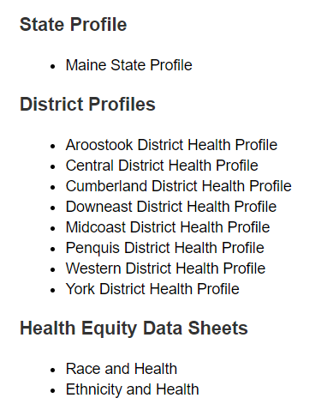
For More Data
www.mainechna.org
Notes:
The Maine Shared CHNA website contains health profiles for 3 of Maine’s largest cities, 16 counties, 5 public health districts, the state, as well as data provided by race, ethnicity, educational attainment, gender, sexual orientation, older adults, insurance status, income, and rurality.
IN addition, there is an interactive data portal where you can search by specific data points. All these breakdowns are then provided by data point.
REGARDING COVID-19 DATA
The Maine Shared CHNA data set does not include any data of COVID-19. This is largely due to the fact that there is a much more up-to-date and comprehensive Maine Data Dashboard continually being updated on the Maine CDC website.
Here you can find daily lab results, new case counts by date, trends, county breakdowns, data by race, and comparisons to other states and the nation.

Slide 22
Key Findings
Notes:
As we walk through the following data slides together, take notes. What surprises you? What stands out? What’s moving in the wrong direction?
Once the data presentation is over, you will be divided into breakout groups to discuss the data, share your top concerns, identify your top priorities, and share your knowledge about what’s working and what we need to work on to address those top concerns.
Ready? Here we go.

Slide 23
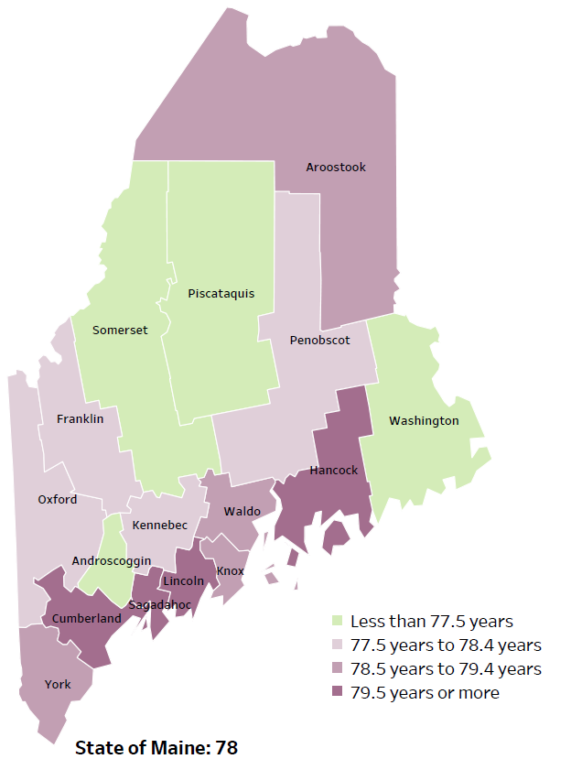
Demographics
Life Expectancy
2017-2019
National Center for Health Statistics,
CDC
RANK | MAINE | FRANKLIN COUNTY
1 | Cancer | Cancer
2 | Heart Disease | Heart Disease
3 | Unintentional Injury | Chronic Lower Respiratory Disease
4 | Chronic Lower Respiratory Disease | Unintentional Injury
5 | Stroke | Stroke
Notes:
The life expectancy in Franklin County is 78.1, which is close to the state average of 78.7.
The table on the right side of the slides shows the five leading causes of death in Franklin County. They are also the leading causes of death for the whole state of Maine.
In Franklin County and Maine overall, the leading cause of death is Cancer followed by Heart Disease. The opposite is true in the U.S. overall- Heart Disease is the leading cause of death, and cancer is the 2nd leading cause. As we will see later in the presentation, Franklin has a high rate of smoking, which contributes to the leading cause of death.
The 3rd leading cause of death- Chronic Lower Respiratory Disease –includes risk factors such as smoking.
The 4th leading cause of death- Unintentional Injury- includes a number of accidental causes: Three of the most common causes are i) Deaths due to motor vehicle crashes, ii) deaths due to accidental falls, iii) deaths due to poisonings that either were unintentional, or the intent was undetermined. Some Firearm deaths may also be classified as unintentional. Suicides, some Firearm deaths and some Poisoning deaths are classified as intentional injury.

Slide 24
Demographics
Age distribution for Franklin County
AGE
FRANKLIN COUNTY
POPULATION
29,982
STATE OF MAINE
POPULATION
1,362,359
Notes:
Franklin County has the 2nd smallest population of any Maine County. Only Piscataquis County has fewer people. The population is aging. There are fewer children and young adults and more adults over the age of 65, and fewer adults of the age where they might expect to have children.
Source: US Census Bureau, American Community Survey

Slide 25
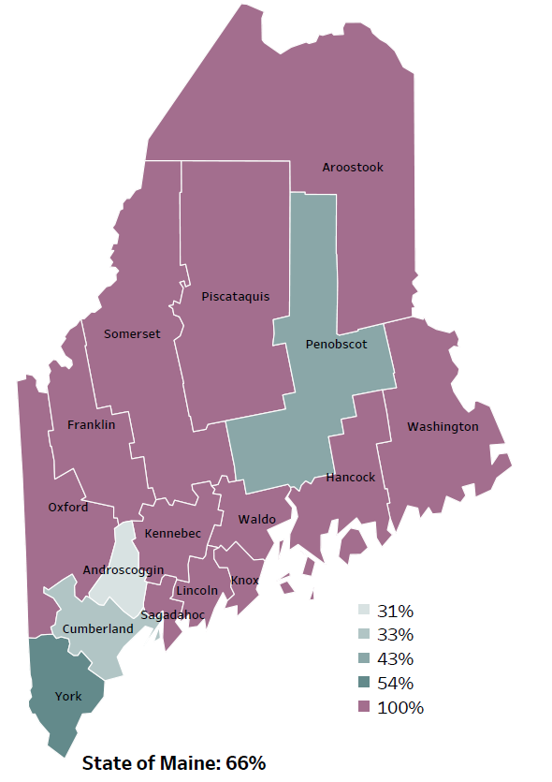
Demographics
Percentage of people living in
rural areas
2019
New England Round Table for Rural Health
Notes:
Franklin County is one of 12 counties with no population in an urban area. These data are based on the most recent Census estimates at the Zip-code level and calculated using Rural Urban Commuting Area codes. The categories were established by the New England Rural Health Association. This data is NOT comparable to 2010 US Census data on populations living in rural areas, as that data uses a different definition for rural
Source: Data, Research and Vital Statistics town-level population file

Slide 26
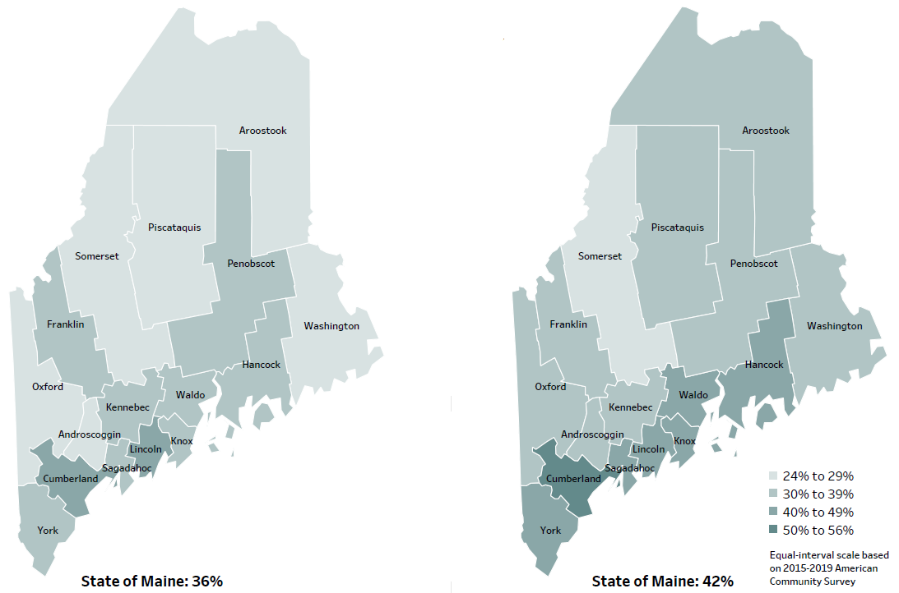
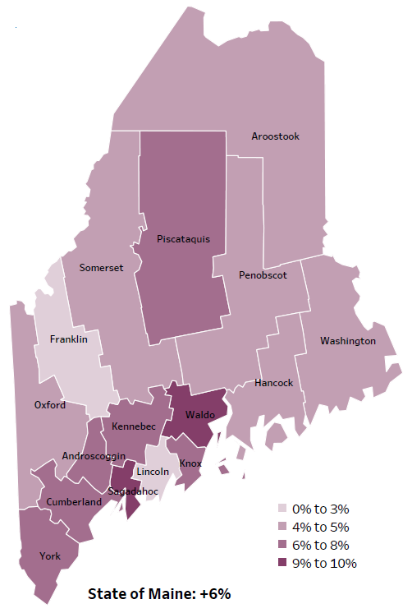
Demographics
Percent of population over age 25 with an associate’s degree or higher
2010
American Community
Survey
Change in percent of population over age 25 with an associate’s degree or higher
2010 to 2015-2019
2015-2019
American Community
Survey
Notes:
These maps show the educational attainment of adults over 25 for two different time periods. Franklin County’s rate has remained stable over time. This is highlighted in the change over time map. The map shows that Franklin is one out of two counties that had little to no change. The change within Franklin is less than 14 other counties and is equal to Lincoln county.
Source: US Census Bureau, American Community Survey

Slide 27
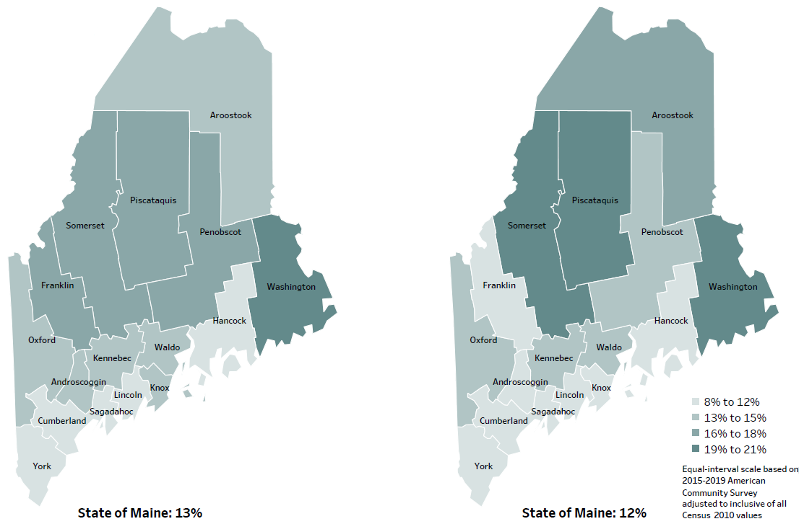
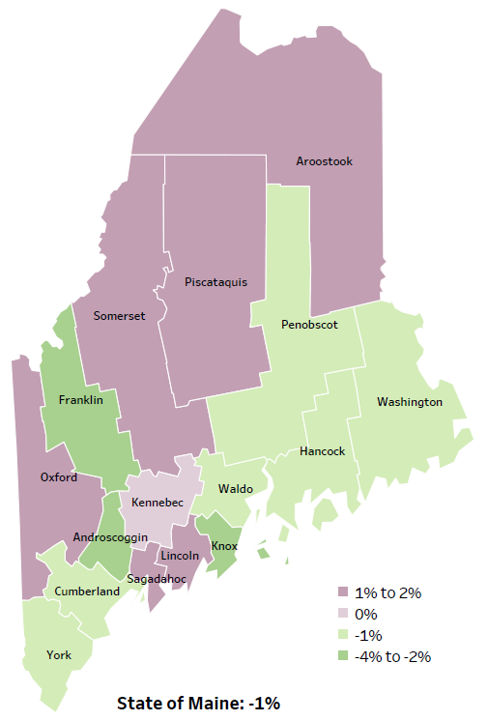
Demographics
Percent of population in poverty
2010
American Community
Survey
Change in percent of population in poverty
2010 to 2015-2019
2015-2019
American Community
Survey
Notes:
These maps show the rate of poverty for two different time periods. The slight decease in Franklin county’s poverty rate is one of the greatest in the state over the time period, as shown in the change over time map. During this period, poverty decreased in Maine overall.
Source: US Census Bureau, American Community Survey

Slide 28
Health Indicators
Notes:
Franklin County’s median household income has significantly increased since 2007-2011 and remains slightly lower than the median income for the state overall.
Data Source: US Census Bureau, American Community Survey
Read as needed. Definition: Dollar amount that divides all households in the specified geographic area into two equal groups: half of the households having more income and the other half having less income.

Slide 29
Health Indicators
Notes:
This slide shows that almost one in ten Franklin county residents spend more than 50% of their income toward housing. This is significantly lower than the overall percentage of Maine residents, which may be due in part to the lower cost of housing in Franklin County when compared to other areas of the state.
Source: US Census Bureau, American Community Survey
https://www.bestplaces.net/cost_of_living/city/maine/franklin
Read as needed. Definition: Percentage of households that spend 50% or more of their household income on housing.

Slide 30
Health Indicators
Notes:
This graph shows the number of deaths per 100,000 within Franklin county. This rate has remained stable within the county over time, However it is significantly higher than both the State and U.S. rates. We have calculated the rates so that they can be compared to other parts of the state that might have a population with a different mix of ages. Older people tend to have higher rates of many diseases and health conditions. It’s important to adjust for age so that we don’t accidentally mistake a place with older people for a place with an unusual number of disease-related deaths.
Data Source: Maine CDC Vital Records and National Center for Health Statistics, US CDC
Read as needed. Definition: Rate per 100,000 people of deaths from any cause.

Slide 31
Health Indicators
Notes:
Franklin County has a significantly higher rate of uninsured people than the state, but no comparison could be made to the US because different years of data were used. While rates are high in the county, they have declined slightly since 2009-2011.
Source: US Census Bureau, American Community Survey
Read as needed. Definition: Percentage of people who do not currently have any form of health insurance (either individually purchased, provided through their employer, or provided through the government).

Slide 32
Health Indicators
Notes:
This slide shows the percent of Franklin County residence who have been seen by any primary care doctor within the past year. Given the rurality of Franklin County, residents may have difficulty accessing care. Insufficient access to primary care and other essential services leads to poorer health outcomes and increases the likelihood of more costly, higher acuity episodes at the time of treatment. Franklin residence are significantly less likely to visit their primary care doctor than the overall State. This difference is not significant over time.
Source: Health Data Organization All Payer Claims Database
American Hospital Association, (2019). Rural Report. Website: https://www.aha.org/system/files/2019-02/rural-report-2019.pdf
Read as needed. Definition: Visits to a primary care provider who is located more than 30 miles from the patient home.

Slide 33
Health Indicators
Notes:
Ambulatory care sensitive conditions are ones for which good outpatient care can potentially prevent the need for hospitalization or early intervention can prevent the progression or severity of the disease. A few examples of this type of condition are asthma, atrial fibrillation, gastroenteritis and pneumonia. As this chart shows, residents in Franklin county are significantly more likely to be hospitalized for these types of conditions when compared to the state overall.
Data Source: Maine Health Data Organization Hospital Inpatient Database
National Institute of Health https://www.ncbi.nlm.nih.gov/pmc/articles/PMC7429814/
Read as needed. Definition: Rate per 10,000 people of hospitalizations with a principal diagnosis of an ambulatory care-sensitive condition. ACSCs are conditions for which good outpatient care can potentially prevent the need for hospitalization, or for which early intervention can prevent complications or more severe disease.
Age-adjusted definition: We have calculated the rates so that they can be compared to other parts of the state that might have a population with a different mix of ages. Older people tend to have higher rates of many diseases and health conditions. It’s important to adjust for age so that we don’t accidentally mistake a place with older people for a place with an unusual number of disease-related deaths.

Slide 34
Health Indicators
Notes:
Franklin County residents are significantly less likely to be hospitalized due to a heart attack when compared to the State. There has been an increase since 2016, but the difference is not significant.
Data Source: Maine Health Data Organization Hospital Inpatient Database
Read as needed. Definition: Rate per 10,000 people of hospital discharges with a principal diagnosis of a heart attack.
Age-adjusted definition: We have calculated the rates so that they can be compared to other parts of the state that might have a population with a different mix of ages. Older people tend to have higher rates of many diseases and health conditions. It’s important to adjust for age so that we don’t accidentally mistake a place with older people for a place with an unusual number of disease-related deaths.

Slide 35
Health Indicators
Notes:
Rates of hospitalization due to diabetes are higher in Franklin County than the State overall, but the difference is not significant.
Source: Maine CDC Vital Records
Read as needed: Rate per 10,000 people of hospital discharges with a principal diagnosis of diabetes.
Age-adjusted definition: We have calculated the rates so that they can be compared to other parts of the state that might have a population with a different mix of ages. Older people tend to have higher rates of many diseases and health conditions. It’s important to adjust for age so that we don’t accidentally mistake a place with older people for a place with an unusual number of disease-related deaths.

Slide 36
Health Indicators
Notes:
This slide shows the percent of adults in Franklin county who are considered overweight, meaning their body mass index is between 25 and 29.9. The percentage has decreased in Franklin County since 2016 and is lower than both the state and US rates. These differences are not significant.
Source: Behavioral Risk Factor Surveillance System
Read as needed. Definition: Percentage of adults with a Body Mass Index between 25.0 and 29.9, based on self-reported height and weight.

Slide 37
Health Indicators
Notes:
This slide shows the rate of obesity among Franklin County high school students. A high school student is considered obese if they have a body mass index between the 85th and 95th percentile for their age and gender. Obesity is associated with myriad medical comorbidities, including diabetes, hypertension, and sleep apnea. The percentage of obese high school students has increased in Franklin County between 2017 and 2019 and is also significantly higher than the State.
Source: Maine Integrated Youth Health Survey
National Institute of Health https://pubmed.ncbi.nlm.nih.gov/10593535/#:~:text=These%20include%3A%20insulin%20resistance%2C%20glucose,and%20certain%20types%20of%20cancer.
Read as needed. Definition: Percentage of high school students who were overweight (at or above the 85th percentile but below the 95th percentile for body mass index, by age and sex). Data collected in odd numbered years.

Slide 38
Health Indicators
Notes:
This slide shows the rate of infants who have been born weighing less than <2,500 grams (5.5 lbs.). While the majority of low-birth-weight children have normal outcomes, as a group they generally have higher rates of subnormal growth, illnesses, and neurodevelopmental problems. These problems increase as the child's birth weight decreases. The percentage of infants with low birth weight has significantly increased in Franklin County between 2016-2017 and 2018-2019. The percentage is also significantly higher than Maine and U.S.
Source: National Library of Medicine Long-term developmental outcomes of low birth weight infants - PubMed (nih.gov)
Source: Maine CDC Vital Records
Read as needed. Definition: Percentage of babies born with a weight less than 2,500 grams.

Slide 39
Health Indicators
Notes:
Franklin County has a higher rate of ER discharges due to an unintentional fall-related injury than the State overall. While Franklin County’s rate is significantly higher than Maine as a whole.
Data Source: Maine Health Data Organization Hospital Inpatient and Outpatient Databases
Read as needed. Definition: Rate per 10,000 people of emergency department discharges with a diagnoses of a fall-related injury.
Age-adjusted definition: We have calculated the rates so that they can be compared to other parts of the state that might have a population with a different mix of ages. Older people tend to have higher rates of many diseases and health conditions. It’s important to adjust for age so that we don’t accidentally mistake a place with older people for a place with an unusual number of disease-related deaths.

Slide 40
Health Indicators
Notes:
This slide shows the percentage of Franklin County high school students who always wear a seatbelt. The rate has increased significantly since 2017 but remains significantly lower than the State’s overall.
Source: Maine Integrated Youth Health Survey
Read as needed. Definition: Percentage of high school students who always wear a seatbelt when riding in a vehicle. Data collected in odd numbered years.

Slide 41
Health Indicators
Notes:
Intentional self-injury, such as cutting or burning, is defined as harming oneself without wanting to die. The percentage of high school students who are engaging in self-injurious behaviors has slightly increased in Franklin County between 2017 and 2019. Franklin County’s rate significantly higher than the State.
Data Source: Maine Integrated Youth Health Survey
Read as needed. Definition: Percentage of high school students who have ever done something to purposely hurt themselves without wanting to die, such as cutting or burning themselves on purpose. Data collected in odd numbered years.

Slide 42
Health Indicators
Notes:
This slide shows Franklin County high school students who reported of feeling sad and hopeless for two weeks or more during the past 12 months and caused them to stop doing some of their usual activities. Depression in early adolescence is linked with increased risks for negative effects on growth and development, school performance, and peer/family relationships in later adolescence. The precent has significantly increased in Franklin County between 2017 and 2019. Franklin County’s rate is slightly higher than the overall State.
Data Source: Maine Integrated Youth Health Survey
Adolescent Mental Health Data.pdf (ucsf.edu)
Read as needed. Definition: Percentage of high school students who felt so sad or hopeless almost every day for two weeks or more in a row during the past 12 months that they stopped doing some usual activities. Data collected in odd numbered years.

Slide 43
Health Indicators
Notes:
Similar to the previous slide, 7th and 8th grade students are significantly more likely than Maine middle school students as a whole who report feeling sad or hopeless for two weeks in a row within the past year. The change over time within the county is also significant. This is a small population so a small increase in students reporting symptoms could cause a significant change, however it is clear that the mental health of these students should be a priority.
Source: Maine Integrated Youth Health Survey
Read as needed. Definition: Percentage of seventh- and eighth-grade students who ever felt so sad or hopeless almost every day for two weeks or more in a row that they stopped doing some usual activities. Data collected in odd numbered years.

Slide 44
Health Indicators
Notes:
This measure shows the percentage of adults who have lost 6 or more teeth due to tooth decay or gum disease. As you can see, the percentage of adults in Franklin County who have dealt with tooth loss is higher than the State overall. This difference is considered significant.
Data Source: Maine Health Data Organization Hospital Inpatient and Outpatient Databases
Read as needed. Definition: Percentage of adults who have lost six or more teeth due to tooth decay or gum disease. Data collected in even numbered years.

Slide 45
Health Indicators
Notes:
This graph shows a decrease over time in reported binge drinking among high school students. Binge drinking is defined as consuming 5 or more alcoholic drinks on at least one day in the past 30 days. This chart is missing 2017 data, which we are still working to get.
The data in the profile may look different. We have realized that 2017 and 2019 data in the Profile use a different denominator – only including those HS students who report any drinking. So, for 2019, 28.2% of students who reported drinking at all in the last 30 days also reported binge drinking. This translates to 8.2% of ALL HS students. This is significantly LESS than in 2015.
The state comparison chart shows the data based on those students who have drunk alcohol in the past 30 days, and is only slightly less than the data for Franklin County.
Data Source: Maine Integrated Youth Health Survey
To be read as needed - Definition: Percentage of high school students who had five or more alcoholic drinks on at least one day in the last 30 days. Data collected in odd numbered years.

Slide 46
Health Indicators
Notes:
This measure shows the percentage of middle school students misusing prescription drugs, meaning they have used a medication with a doctor’s prescriptions at least one time in the last 30 days. Franklin County’s rate has increased significantly since 2017.
Data Source: Maine Integrated Youth Health Survey
Read as needed. Definition: Percentage of seventh- and eighth-grade students who used a prescription drug without a doctor's prescription at least one time in the last 30 days. Data collected in odd numbered years.

Slide 47
Health Indicators
Notes:
This slide shows the rate of infants who have been born addicted to a substance. This data is collected from healthcare providers who report there is a reasonable cause to suspect the baby has been affected by an illegal substance or is demonstrating withdrawal symptoms. The rate of drug-affected infants born in Franklin County is lower than the State overall, but has been increasing over time. These single year data are not as reliable as the most recent two year, but still show a clear increase. The two-year rate of drug-affected infants born in Aroostook County is significantly higher than the State overall. The data shows the average annual rate for the two years, and therefore can be compared to the single year data. There is a concern given the birth and health risk associated with drug exposure in utero.
Data Source: Maine CDC Vital Records
Read as needed. Definition: Rate per 1,000 births of infants for which a healthcare provider reported that there was reasonable cause to suspect the baby may be affected by illegal substance abuse or demonstrating withdrawal symptoms resulting from prenatal drug exposure or has a fetal alcohol spectrum disorder.

Slide 48
Health Indicators
Notes:
The number of overdose deaths have increased in Franklin County since 2019 but still remain lower than the State. These increases could be attributed to the opioid crisis in the state and across the country.
Source: Maine Office of the Medical Examiner
Read as needed. Definition: Rate per 10,000 population of overdose emergency medical service responses, including overdoses from drugs, medications, alcohol, and inhalants.

Slide 49
Health Indicators
Notes:
This slide shows the percent of adults who currently smoke cigarettes on a regular basis in Franklin County. A current smoker is defined, as “an adult who has smoked 100 cigarettes in his or her lifetime and who currently smokes cigarettes.” The rate has increased over time and remains higher than the State’s and U.S.’s., however the difference is not considered significant.
Source: Behavioral Risk Factor Surveillance System
Centers for Disease Control and Prevention (2017). https://www.cdc.gov/nchs/nhis/tobacco/tobacco_glossary.htm
Read as Needed: Percentage of adults who have smoked at least 100 cigarettes in their lifetime and currently smoke.

Slide 50
Health Indicators
Notes:
This slide shows the percentage of Franklin County high school students who have used an e-cigarette at least once in the last 30 days. Data is collected in odd numbered years and, as you can see, use has increased between 2017 & 2019. The change over time is significant.
Data Source: Maine Integrated Youth Health Survey
Read as Needed. Definition: Percentage of high school students who used an electronic vapor product at least one day in the last 30 days. Data collected in odd numbered years.

Slide 51
Breakout Discussions

Slide 52
Reconvene

Slide 53
Wrap up and Next Steps

Slide 54
Contacts
Tracy Harty, Senior Program Director, Healthy Community Coalition, tharty@fchn.org
Ellen Thorne, Program Manager, Healthy Community Coalition, ethorne@fchn.org
Jamie Paul, Liaison, Western District, Paul, Jamie.L.Paul@maine.gov
Jo Morrissey, Program Manager, Maine Shared CHNA info@mainechna.org www.mainechna.org

