Slide 1
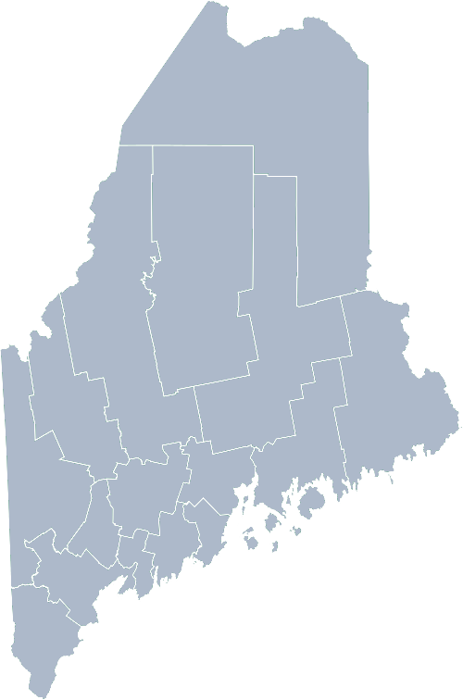
Maine Shared Community Health Needs Assessment Federally Qualified Health Centers
2021

Slide 2
Forum Agenda
Time | Activity | Speaker/Facilitator
3:30 – 3:35 | Welcome and Introductions Housekeeping | Darcy Shargo, Maine Primary Care Association Chief Executive Officer Jo Morrissey, Maine Shared CHNA Program Manager
3:35 – 3:40 | Leadership Remarks | Darcy Shargo, Maine Primary Care Association Chief Executive Officer
3:40– 4:00 | Presentation of key findings from the data | John Snow, Inc.
4:00- 4:55 | Break-out session – facilitated discussion on data and health priority identification | John Snow, Inc. & Local Facilitators
4:55 – 5:00 | Wrap up and next steps | Darcy Shargo, Maine Primary Care Association Chief Executive Officer
Notes:
Local Planning Committee Member to go over agenda and then turn it over to Jo Morrissey to provide an overview of the Zoom tools available and the purpose of today’s forum

Slide 3
The Maine Shared CHNA is a collaboration between the Maine Center for Disease Control and Prevention (Maine CDC), Central Maine Healthcare, Northern Light Health, MaineGeneral Health, and MaineHealth.
Notes:
Local Planning Committee Member

Slide 4
Share screen
Join Audio, Mute On/Off
Open/close participant list or chat
Turn Video On/Off
Reactions
Notes:
Jo or JSI

Slide 5
Matching Interests
Maine Shared
Community Health Needs Assessment
Images of PHAB and IRS from the internet
Notes:
Jo or JSI

Slide 6
The Evolution of an Idea…
2010 OneMaine | 2015 SHNAPP | 2018 Maine Shared CHNA | 2021 Maine Shared CHNA
Forums Surveys | 16 Forums 1639 Surveys | 22 Mainstream Forums (live) 2 Immigrant Forums 45 Interviews | 16+ Mainstream Forums (virtual) 10+ Community Sponsored Events 1500+ Oral Surveys
Notes:
Jo or JSI

Slide 7
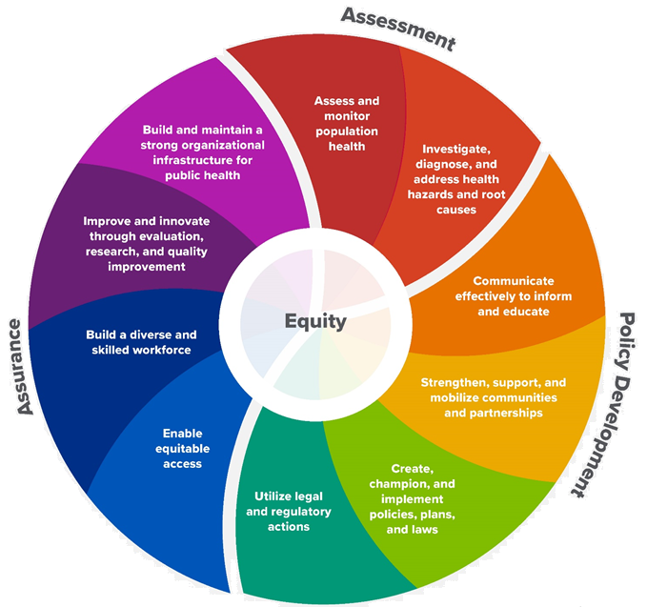
10 Essential Public Health Services
Notes:
Jo or JSI

Slide 8
Maine Shared CHNA Organizational Chart
Steering Committee
Program Manager
Vendor Support
Metrics Committee
Health Equity Community Engagement Committee
Data Analysis Teams
Local Planning Teams
Notes:
Jo or JSI

Slide 9
Inputs and Outcomes
Ways to Provide Input
Data Collected
Outcomes
District & County Reports DUE APRIL 2022
4 Health Priorities by county
Related indicators
Gaps/barriers and resources/assets
Notable comparisons between attendee input and the data.
Description of those who provided input
Methodology
Mainstream county forums
Number of attendees
Where attendees live (not CSE)
List of data identified Forums and CSE only)
Discussion notes (Forums and CSE only)
Chat box comments (Forums and CSE only)
Health Priorities
Gaps and Resources
Community sponsored events
State Report DUE APRIL 2022
4 Health Priorities by Community Event and immigrant population.
Related indicators
Gaps/barriers and resources/assets,
Notable comparisons to mainstream population.
Description of those who provided input
Methodology
Oral Survey
Forums, Events and Surveys conducted Fall 2021
Notes:
Jo or JSI
Community Sponsored Event Partners include
Disability Rights Maine (2 events: people who are deaf or hard of hearing and people with other disabilities)
Maine Primary Care Association (People who are served by Maine’s Federally Qualified Health Centers
Maine Council on Aging (Older Adults 65+
Consumer Right Council of Maine (people with a mental health diagnosis)
Formerly Incarcerated (Maine Prisoner Re-Entry Network)
Maine Youth Action Network and Friends (Raising the voices of Maine’s diverse youth)
Green Memorial A.M.E. Zion Church (Black/African American)
Health Equity Alliance (LGBTQ+ community)
Portland Recovery Center (for people with a substance use disorder or in recovery)
ADD HOUSING INSECURE IF NEED BE
ADD VETERAN IF NEED BE
Oral Survey Partners include:
City of Portland’s Minority Health Program
New Mainer’s Public Health Initiative
Maine Immigrant Access Network
Gateway Community Services
Maine Immigrant and Refugee Services
Maine Community Integration
Mano en Mano
We are piloting these additional outreach methods with support from
State of Maine’s Preventative Health and Health Services Block Grant
Maine Health Access Foundation
Introduce leader for leadership remarks

Slide 10
Leadership remarks
Notes:
Leadership remarks
Leader to introduce point person for review of previous health improvement efforts.

Slide 11
MPCA Member Health Centers
73 Winthrop St., Augusta, Me 04330 | (207) 621-0677
mepca.org

Slide 12
Key Findings
Notes:
For today’s event, we have selected a set of statewide indicators that we felt may be of interest to you.
As we walk through the following data slides together, take notes. What surprises you? What stands out? What’s moving in the wrong direction?
Once the data presentation is over, you will be divided into breakout groups to discuss the data, share your top concerns, identify your top priorities, and share your knowledge about what’s working and what we need to work on to address those top concerns.
Ready? Here we go.

Slide 13
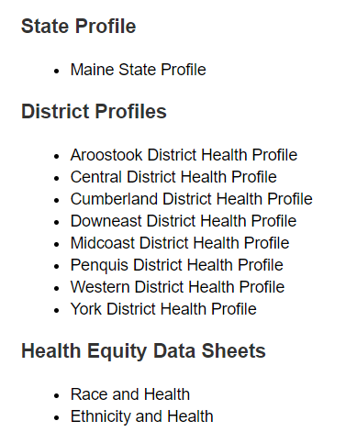
For More Data
www.mainechna.org
Notes:
The Maine Shared CHNA website contains health profiles for 3 of Maine’s largest cities, 16 counties, 5 public health districts, the state, as well as data provided by race, ethnicity, educational attainment, gender, sexual orientation, older adults, insurance status, income, and rurality.
IN addition, there is an interactive data portal where you can search by specific data points. All these breakdowns are then provided by data point.

Slide 14
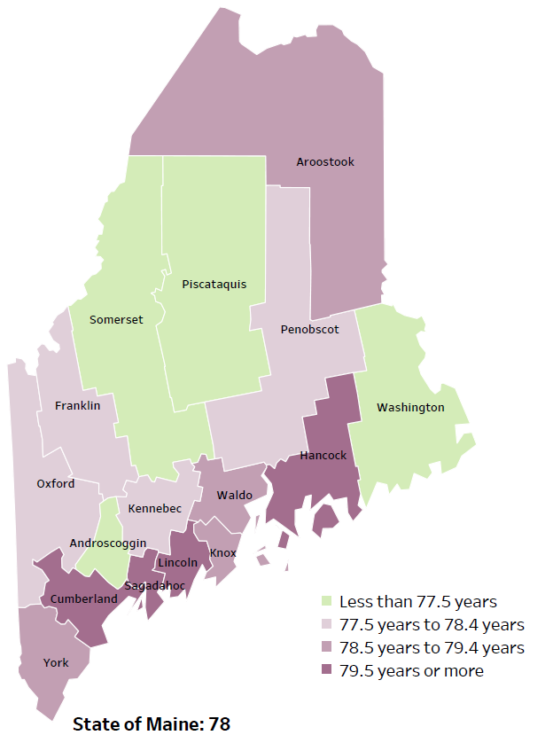
Demographics
Life Expectancy
2017-2019
National Center for Health Statistics,
CDC
RANK | MAINE
1 | Cancer
2 | Heart Disease
3 | Unintentional Injury
4 | Chronic Lower Respiratory Disease
5 | Stroke
Notes:
The life expectancy in Maine is 78, which is slightly lower than the U.S. life expectancy of 78.7.
The table on the right side of the slides shows the five leading causes of death in Maine. They are also the leading causes of death for many of the counties.
The leading cause of death is cancer. As we will see later in the presentation, Maine has both cost and location barriers to health care, which can impact cancer outcomes.
Some highlights:
Heart Disease is the 2nd leading cause of death. Maine residents have high rates of obesity, and many live a sedentary lifestyle. The leading cause of death in the U.S. is heart Disease and cancer is the 2nd leading cause. One of the reasons that this is true is because we have higher rates of risk factors for cancer, such as smoking/tobacco use. At the same time, there has been a lot of success implementing treatment of heart disease, resulting in folks with heart disease living longer.
The 3rd leading cause of death- Unintentional Injury- includes a number of accidental causes: Three of the most common causes are i) Deaths due to motor vehicle crashes, ii) deaths due to accidental falls, and iii) deaths due to poisonings that either were unintentional, or the intent was undetermined. Suicides and Firearm deaths are classified as intentional injury.

Slide 15
Demographics
Age distribution for Maine
AGE
STATE OF MAINE
POPULATION
1,362,359
Notes:
Maine has a population of 1,362,359. The population is aging and is one of the oldest states in the country. There are fewer children and young adults particularly in more rural areas and more adults over the age of 65.
Source: US Census Bureau, American Community Survey

Slide 16
Health Indicators
Notes:
This indicator represents the rate per 100,000 people of the total number of years lost before the age of 75. This is calculated by subtracting the age at which a person died from 75. The difference in years (of potential life lost) for all those who died before age 75 is added together. As you can see, the rate of life lost in Maine has been increasing over time and is higher than the US overall.
Data Source: County Health Rankings

Slide 17
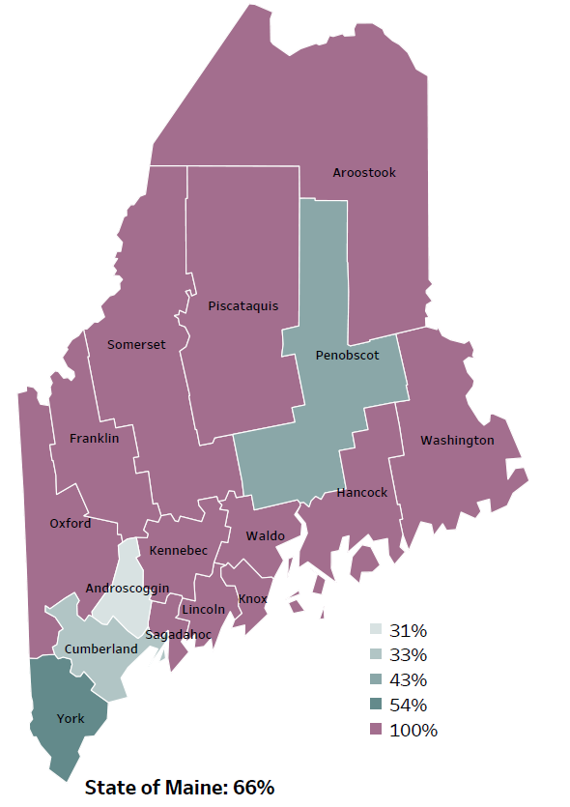
Demographics
Percentage of people living in
rural areas
2019
New England Round Table for Rural Health
Notes:
Maine is a largely rural area with only 4 counties with metro areas. As you can see on this map, 100% of the population within 12 counties live in rural areas and overall, 66% of the state population reside in a rural area. These data are based on the most recent Census estimates at the Zip-code level, and calculated use rural Urban Commuting Area codes. The categories were established by the New England Rural Health Association. This data is NOT comparable to 2010 US Census data on populations living in rural areas, as that data uses a different definition for rural.
Source: Data, Research and Vital Statistics town-level population file

Slide 18
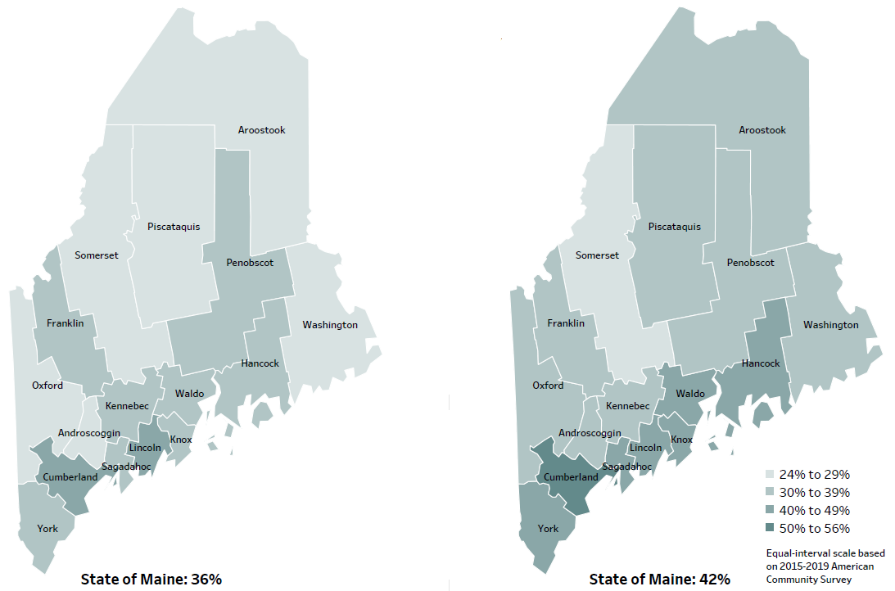
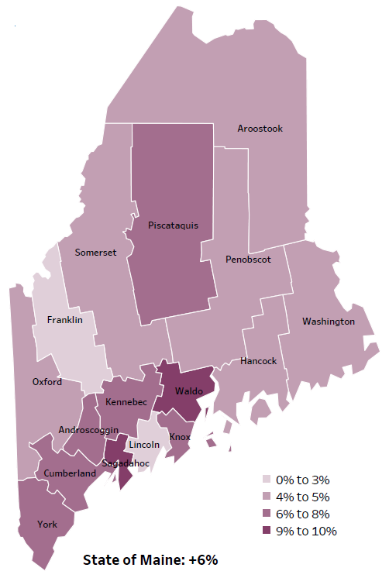
Demographics
Percent of population over age 25 with an associate’s degree or higher
2010
American Community
Survey
Change in percent of population over age 25 with an associate’s degree or higher
2010 to 2015-2019
2015-2019
American Community
Survey
Notes:
These maps show the educational attainment of adults over 25 for two different time periods. Maine has had an increase in the rate of adults who have attained an associate’s degree or higher degree of education with a 6% change between 2010 and 2015-2019.
Source: US Census Bureau, American Community Survey

Slide 19
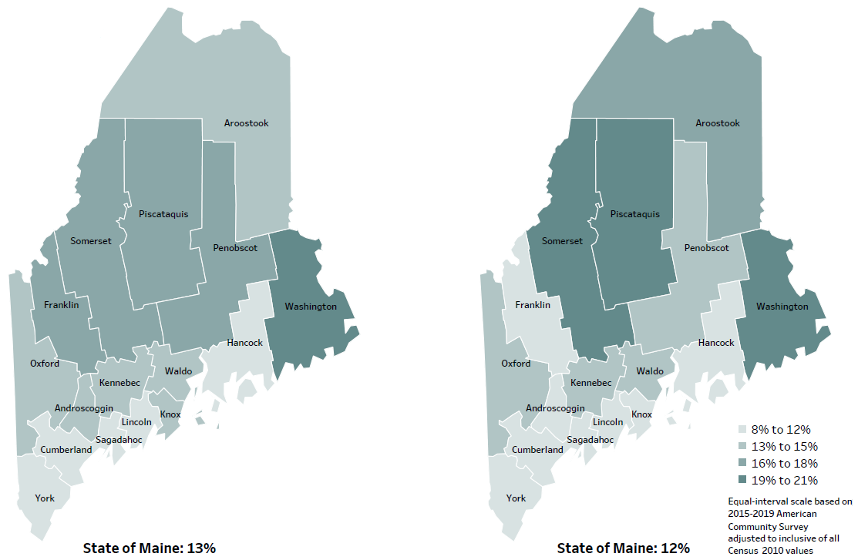
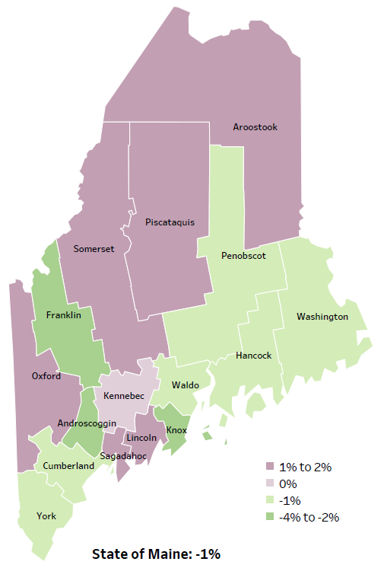
Demographics
Percent of population in poverty
2010
American Community
Survey
Change in percent of population in poverty
2010 to 2015-2019
2015-2019
American Community
Survey
Notes:
These maps show the rate of poverty for two different time periods. Maine has 6 counties that have had an increase in poverty levels between 2010 and 2015-2019, however poverty has decreased in the state overall.
Source: US Census Bureau, American Community Survey

Slide 20
Health Indicators
Notes:
Poverty rates have been decreasing in Maine since 2012 and is lower than the US overall. There is not a significant difference in poverty levels between 2018 and 2019.
Source: US Census Bureau, American Community Survey

Slide 21
Health Indicators
Notes:
The median household shows incremental increases over time, with the exception of a dip in 2018. Maine trails behind the US median income, $58,924 for the state compared to $65,712 nationwide.
Source: US Census Bureau, American Community Survey

Slide 22
Health Indicators
Notes:
Maine’s high school graduation rate is the same as the US rate. Maine saw a decrease in graduates between 2015 and 2018, but the rate has been rising steadily over the past two years.
Source: Maine Dept. of Education

Slide 23
Health Indicators
Notes:
This slide shows the percentage of adults whose physical health was not good during 14 or more out of the past 30 days. This number has remained relatively stable over time with a slight increase in 2016 and 2017. This difference is not significant.
Data Source: Behavioral Risk Factor Surveillance System

Slide 24
Health Indicators
Notes:
Similar to days lost due to physical health, 13% of adults’ mental health was not good during 14 or more out of the past 30 days. The percentage increased between 2016 and 2017 but not to a significant degree.
Data Source: Behavioral Risk Factor Surveillance System

Slide 25
Health Indicators
Notes:
Currently, 15% of Mainers have three or more chronic conditions. This measure has been increasing over time. There was a decrease between 2016 and 2017, but this was not a significant change.
Source: Behavioral Risk Factor Surveillance System

Slide 26
Health Indicators
Notes:
The rate of those who are uninsured has decreased since 2013 and has been remained stable at 8% for the past four years. The uninsured rate is higher for the US overall than Maine.
Source: US Census Bureau, American Community Survey

Slide 27
Health Indicators
Notes:
Four-fifths of Maine residents are able to see their usual primary care physician when they need care, while three-quarters in the US are able to see their usual provider. The indicator has remained stable in the state overtime despite the obstacles associated with health care costs, the rural nature of the state and transportation to the doctor.
Source: Behavioral Risk Factor Surveillance System

Slide 28
Health Indicators
Notes:
Nearly three-quarters of Mainers have had a primary care visit, not necessarily with their own provider, in the past year. This rate is roughly equal to the US.
Source: Behavioral Risk Factor Surveillance System

Slide 29
Health Indicators
Notes:
Obesity rates in Maine are on par with the US, with nearly a third of adults being considered obese. There have been no significant changes in the obesity rate between 2011 and 2017.
Data Source: Behavioral Risk Factor Surveillance System

Slide 30
Health Indicators
Notes:
A quarter of the population in Maine has not engaged in leisure time physical activity in the past month, the same as the US. A sedentary lifestyle is associated with myriad health concerns, including high cholesterol, heart disease, and depression. There has been a significant difference in the percentage of sedentary adults between 2016 and 2017.
Source: Behavioral Risk Factor Surveillance System

Slide 31
Health Indicators
Notes:
This graph shows that injury deaths have increased in Maine and the state has a higher rate of injury deaths when compared to the US. Rates have risen steadily over time. These data are age-adjusted, meaning that we have calculated the rates so that they can be compared across the full age distribution of the state.
Data Source: Maine CDC Vital Records

Slide 32
Health Indicators
Notes:
Fall-related deaths have increased significantly in Penobscot County between 2017 and 2019. The rates have been increasing overtime and are higher than the US overall. This measure has been age-adjusted.
Data Source: Maine CDC Vital Records

Slide 33
Health Indicators
Notes:
This indicator shows unintentional or undetermined poisoning, meaning these deaths are not due to suicide or other intentional injuries. The rates of poisoning deaths within the state have increased in the state over time with a high in 2017. The rate has not changed significantly between 2017 and 2019. While the rate decreased in 2019 it remains higher than the US rate.
Source: Maine CDC Vital Records

Slide 34
Health Indicators
Notes:
The number of overdose deaths in each county has increased significantly between 2019 and 2020 and is higher than the U.S rate. The rate has been increasing over the past several years, a reflection of the opioid crisis in the state and across the county.
Of the 504 drug deaths in 2020, statewide, 83% were caused by opioids. The rise from 2019 to 2020 was primarily due to overdoses of fentanyl- a nonpharmaceutical opioid. Further, more and more often, deaths due to fentanyl also involve use of methamphetamine or cocaine.
Of note, these rates include both unintentional and intentional drug overdose deaths.
These rates do NOT include overdose deaths where alcohol was the only substance/cause of overdose.
Source: Maine Office of the Medical Examiner

Slide 35
Health Indicators
Notes:
The percentage of adults who have used marijuana in the past 30 days has increased steadily over time with a significant difference between 2012 and 2017. This increased use could be a result of changing laws regarding the use and legality of marijuana.
Source: Behavioral Risk Factor Surveillance System

Slide 36
Breakout Discussions

Slide 37
Wrap up and Next Steps

Slide 38
Contacts
Megan Cross, Program Coordinator, Maine Primary Care Association, mcross@mepca.org
Kristen Kilcollins, Program Coordinator, Maine Primary Care Association, kkilcollins@mepca.org
Chris Pezzullo, DO, Clinical Director, Maine Primary Care Association, cpezzullo@mepca.org
Darcy Shargo, Chief Executive Officer, Maine Primary Care Association, dshargo@mepca.org
Jo Morrissey, Program Manager, Maine Shared CHNA
www.mainechna.org info@mainechna.org

