Slide 1
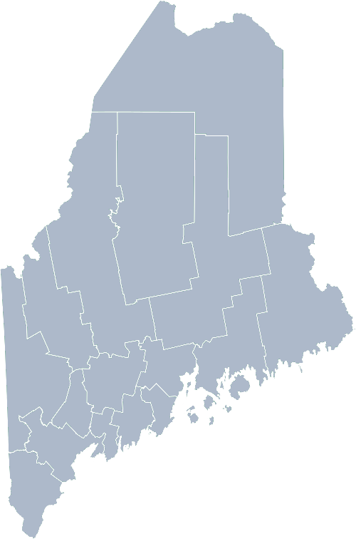
Maine Shared Community Health Needs Assessment Deaf, Hard of Hearing and Disabilities
2021

Slide 2
The Maine Shared CHNA is a collaboration between the Maine Center for Disease Control and Prevention (Maine CDC), Central Maine Healthcare, Northern Light Health, MaineGeneral Health, and MaineHealth.

Slide 3
Welcome
Introductions
Overview of Tools
Purpose

Slide 4
Matching Interests
Maine Shared
Community Health Needs Assessment
Images of PHAB and IRS from the internet

Slide 5
The Evolution of an Idea…
2010 OneMaine | 2015 SHNAPP | 2018 Maine Shared CHNA | 2021 Maine Shared CHNA
Forums Surveys | 16 Forums 1639 Surveys | 22 Mainstream Forums (live) 2 Immigrant Forums 45 Interviews | 16+ Mainstream Forums (virtual) 12+ Community Sponsored Events 2000+ Oral Surveys

Slide 6
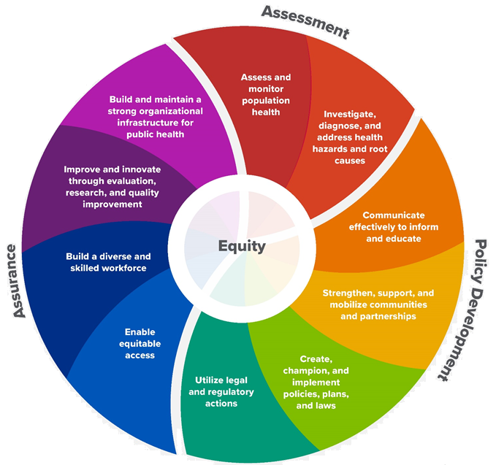
10 Essential Public Health Services

Slide 7
Maine Shared CHNA Organizational Chart
Steering Committee
Program Manager
Vendor Support
Metrics Committee
Health Equity Community Engagement Committee
Data Analysis Teams
Local Planning Teams

Slide 8
2019-2022 Timeline Maine Shared Community Health Needs Assessment
Update Data, post on interactive data portal
Contract with C&C vendors
Contract with Data vendor
Draft Final reports
Indicator list and analysis plan
RFP Process
Schedule, plan, & conduct outreach
Compile data
Health Improvement Planning
2019
2020
2021
2022
Sep | Oct | Nov | Dec | Jan | Feb | Mar | Apr | May | Jun | Jul | Aug | Sep | Oct | Nov | Dec | Jan | Feb | Mar | Apr | May | Jun | Jul | Aug | Sep | Oct | Nov | Dec | Jan | Feb | Mar | Apr | May | June | Jul | Aug | Sep | Oct | Nov | Dec
2019-2021
Hospital’s Adopt ISs
Release 2021 Health Profiles
Release 2022
CHNA Reports
Conduct QI on CE materials
Conduct Engagement Activities
Renew MOU

Slide 9
How to Read the County Health Profiles and Health Equity Data Sheets

Slide 10
How to Read County Health Profile
CHANGE shows statistically significant changes in the indicator over time, based on 95% confidence interval (see description on page 3).
ê | means the health issue or problem is getting better over time.
! | means the health issue or problem is getting worse over time.
○ | means the change was not statistically significant.
N/A | means there is not enough data to make a comparison.
BENCHMARK compares [COUNTY] data to state and national data, based on 95% confidence interval (see description on page 3).
ê | means [COUNTY] is doing significantly better than the state or national average.
! | means [COUNTY is doing significantly worse than the state or national average.
○ | means there is no statistically significant difference between the data points.
N/A | means there is not enough data to make a comparison.
ADDITIONAL SYMBOLS
* | means results may be statistically unreliable due to small numbers, use caution when interpreting.
— | means data is unavailable because of lack of data or suppressed data due to a small number of respondents.
EXAMPLE
Notes:
JSI or other facilitator
A star means that the health issue or problem is getting better over time or better in comparison to another place
A red exclamation point means that the health issue or problem is getting worse over time or worse in comparison to another place
A gray circle means that the dating hasn’t changed over time or isn’t much different in comparison to another place
N/A means that there was not enough data to be able to make a comparison
There are two additional symbols you might see:
A black dot means that you should use caution when interpreting the data – the results might be unreliable because of small numbers
A black dash means that data was unavailable, or that data was suppressed due to a small number of respondents
(Go to next slide and walk audience through an example)

Slide 11
How to Read County Health Profile
EXAMPLE
 | AROOSTOOK COUNTY |  |  | BENCHMARKS
INDICATOR | POINT 1 | POINT 2 | CHANGE | MAINE | +/- | U.S. | +/-
Individuals living in poverty | 2009-2011 15.6% | 2015-2019 16.1% | ¡ | 2015-2019 11.8% | ! | 2019 12.3% | N/A
Notes:
JSI
The charts in this presentation are all excerpts from the Data Health Profiles that were created by MaineHealth and the Maine CDC. They contain data pulled from publicly available sources that are designed to help people learn more about the health of their communities. Not all the data points are available for every measure, but we’ve included data wherever we can.
There are some important notes about the data here that will help you understand it. First, the data comes from many sources. We’ve included those sources in the Data Health Profiles- you can get a copy to review from the presenter.
Every data point is accompanied by a year. This is the year the measurement was taken. It is important to know that when multiple years are presented, or a range of years (as in this slide), the data refers to measurement that includes ALL the years indicated. It is NOT an average of the data from those years. It combines data from across those years into a single measurement.

Slide 12
How to Read County Health Profile
EXAMPLE
 | AROOSTOOK COUNTY |  |  | BENCHMARKS
INDICATOR | POINT 1 | POINT 2 | CHANGE | MAINE | +/- | U.S. | +/-
Individuals living in poverty | 2009-2011 15.6% | 2015-2019 16.1% | ¡ | 2015-2019 11.8% | ! | 2019 12.3% | N/A
Notes:
Here’s an example of how we’ve visualized the data in the County Health Profiles.
The charts in this presentation are all excerpts from the Data Health Profiles that were created by MaineHealth and the Maine CDC. They contain data pulled from publicly available sources that are designed to help people learn more about the health of their communities. Not all the data points are available for every measure, but we’ve included data wherever we can.
The green bars represent data from your community. The left most one represents a past data point, and the right bar represents the most recent data point available when the data was gathered. These are the same data points used in the Data Health Profiles.
The grey bars represent data for the state of Maine as a whole- on the left- and for the United States as a whole- on the right, when it is available.
We’ve also noted where differences in the data points are ‘statistically significant’. A difference between two measurements is significant when scientists can say, with a known degree of confidence, that the difference between them is large enough that the difference is most likely to be caused by an actual difference in the item being measured, and not caused by error associated taking the measurement. All of these tests are comparing the most recent data point for your community to other data points. A red exclamation mark indicates a difference that your community is significantly different in a less desirable direction compared to the data point with the symbol. A green star indicates that your community is significantly different in a more desirable direction. A grey circle indicates that there is no significant difference.
(keep in presentation – do not read for deaf/HOH event or people with disabilities). A difference between two measurements is significant when scientists can say, with a known degree of confidence, that the difference between them is large enough that the difference is most likely to be caused by an actual difference in the item being measured, and not caused by an error associated taking the measurement. All of these tests are comparing the most recent data point for your community to other data points.

Slide 13
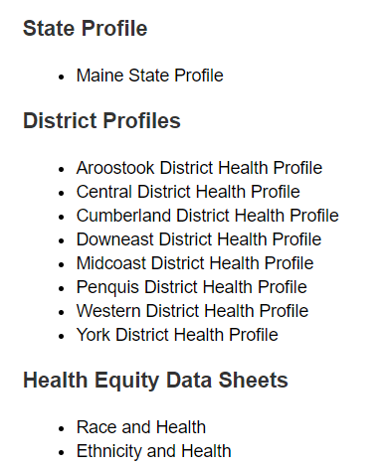
For More Data
www.mainechna.org
Notes:
The Maine Shared CHNA website contains health profiles for 3 of Maine’s largest cities, 16 counties, 5 public health districts, the state, as well as data provided by race, ethnicity, educational attainment, gender, sexual orientation, older adults, insurance status, income, and rurality.
In addition, there is an interactive data portal where you can search by specific data points. All these breakdowns are then provided by data point.

Slide 14
Key Findings

Slide 15
Demographics
Notes:
The median household income of Maine households is significantly lower than the median household income for all households in the US.
Source: US Census Bureau, American Community Survey

Slide 16
Demographics
Notes:
This tables displays the rate at which Maine residents of different racial categories have a disability. Maine’s American Indians or Alaska Natives are more likely to be people with a disability. Note that these numbers are not adjusted for age, which strongly correlates with people who have disabilities.
Source: American Communities Survey (ACS, 2019)

Slide 17
Demographics
Age distribution for Maine
AGE
STATE OF MAINE
POPULATION
1,362,359
Notes:
This chart shows the population of Maine by age. For those who have a disability, there is a close association with age- individuals over the age of 65 are much more likely to have a disability.
Source: US Census Bureau, American Community Survey

Slide 18
Demographics
Notes:
Maine is more likely than US to have people who identify as having a disability. This may be linked to Maine’s higher average age.
While more likely, the difference is not significantly different.
Source: US Census Bureau, American Community Survey

Slide 19
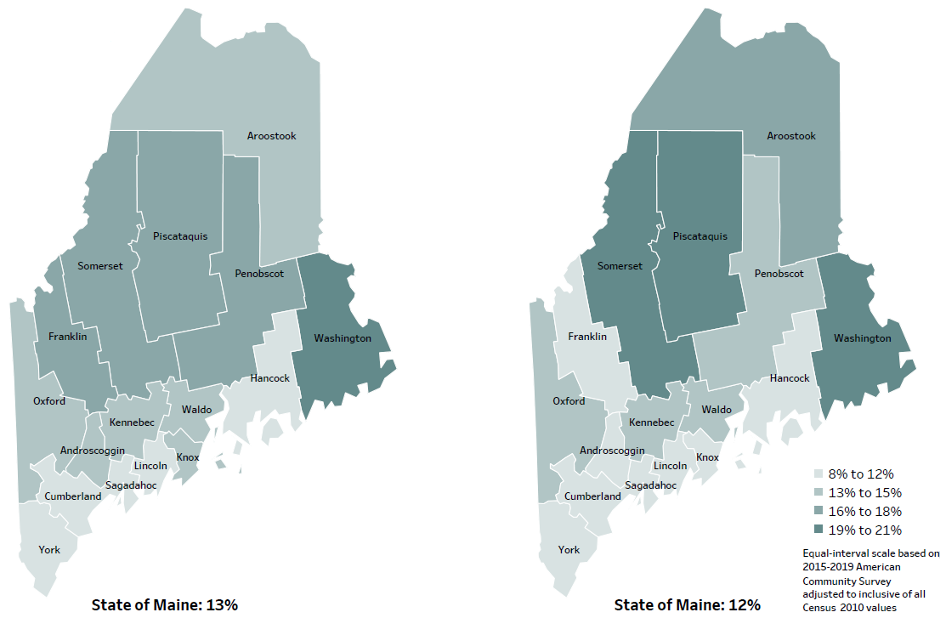
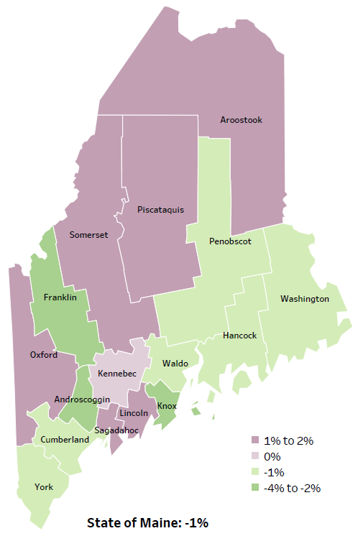
Social Determinants of Health
Percent of population in poverty
2010
American Community
Survey
Change in percent of population in poverty
2010 to 2015-2019
2015-2019
American Community
Survey
Notes:
Individuals with a disability are more likely to be in poverty. While the state of Maine overall has seen a decrease in the poverty rate, certain counties have experienced different patterns.
Source: US Census Bureau, American Community Survey

Slide 20
Social Determinants of Health
Notes:
Maine has a slightly higher rate of children identified as having special healthcare needs than the US as a whole. This difference is not large enough to be considered significant, however.
Source: National Survey of Children's Health

Slide 21
Social Determinants of Health
Notes:
The rate of poverty in Maine decreased between 2014 and 2019. However, this data only goes to 2019- the COVID pandemic may have notably impacted this rate, particularly for people with disabilities. Note the unemployment rate on the following slide.
Source: US Census Bureau, American Community Survey

Slide 22
Social Determinants of Health
Notes:
The unemployment rate in Maine dropped steadily from 2011 to 2019, before rising sharply in 2020.
Individuals with disabilities are more likely than others to be unemployed and shifts in unemployed tend to have outsized impact on individuals with disabilities.
This difference is not large enough to be considered significant, however.
Source: US Bureau of Labor Statistics

Slide 23
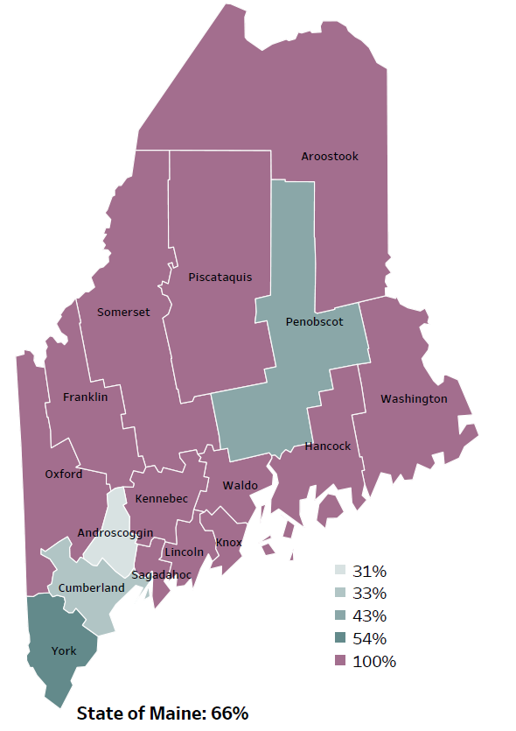
Social Determinants of Health
Percentage of people living in
rural areas
2019
New England Rural Health Association
Notes:
Maine is among the most rural states in the US. Most counties are considered completely rural by some measures. Having a highly rural population makes providing many sorts of services more difficult and expensive.
Source: Data, Research and Vital Statistics town-level population file

Slide 24
Social Determinants of Health
Notes:
About two percent of Maine residents have no vehicle in their home.
This can make accessing health care or work more difficult, especially in very rural areas. However, Mainers are more likely than individuals in the US generally to have a vehicle in their home.
This difference is not large enough to be considered significant, however.
Source: US Census Bureau, American Community Survey

Slide 25
Social Determinants of Health
Notes:
The incidence of adverse childhood experiences in Maine has decreased slightly since 2017.
While these two bars may make it look like there’s been a big decline, it is not a significant amount. Note the chart only goes up to 24%.
Source: Maine Integrated Youth Health Survey

Slide 26
Social Determinants of Health
Notes:
Diabetes is slightly more prevalent in Maine than the US as a whole.
Diabetes is associated with age, so these numbers are age adjusted so they can be compared more meaningfully.
This difference is not large enough to be considered significant, however.
Source: Behavioral Risk Factor Surveillance System

Slide 27
Social Determinants of Health
Notes:
Rates of high blood pressure have increased in Maine since 2011, while rates of asthma have declined slightly.
Source: Behavioral Risk Factor Surveillance System

Slide 28
Social Determinants of Health
14+ days lost due to poor mental health (adult) † Sad/hopeless for two weeks in a row (high school)
‡ Current symptoms of depression (adult)
Notes:
The rate at which high school students in Maine have reported feeling sad or hopeless has increased steadily since 2011. COVID may have impacted this. Mental health is more and more often recognized as an important category of disability.
Source: Maine Integrated Youth Health Survey and Behavioral Risk Factor Surveillance System

Slide 29
Social Determinants of Health
‡High school students who report past 30 day alcohol use
**High school students who report past 30 day marijuana use
Notes:
Overall alcohol use among Maine high school students has declined slightly since 2011. Reported marijuana use declined between 2011 and 2017 but has recently increased back to 2011 levels.
Source: Behavioral Risk Factor Surveillance System

Slide 30
Social Determinants of Health
Notes:
The rate of injury deaths in Maine has been increasing slowly since 2010 and is significantly higher in Maine than in the US generally.
Source: Maine CDC Vital Records

Slide 31
Social Determinants of Health
Notes:
MaineCare enrollment statewide increased notably after 2018, with more eligible individuals signing up for care. Many people with disabilities use public health insurance, and often report cost barriers to receiving health care.
Source: MaineCare

Slide 32
Social Determinants of Health
Notes:
Ambulatory Care Sensitive Conditions, in a nutshell, or chronic health conditions such as asthma or cardiovascular disease, that if well managed by a primary care physician, would not need to rise to the level of needing an emergency room visit.
Source: Maine Health Data Organization Hospital Inpatient Database

Slide 33
Breakout Discussions

Slide 34
Small Group Discussion Questions
Based on the data we just watched, What stood out to you? (5 mins)
Mark the indicators that are most important to you on the left-hand column of the Priority Handout. (10 mins)
Mark 4 Priority Health Topic Area on the right-hand column of the Priority Handout (10 mins)
Notes:
JSI or Other Facilitator
Overview/instructions (see page 11 of the Community Engagement Toolkit): These breakout sessions will provide an opportunity for you all to share their feedback. Table facilitators have question prompts to lead discussions. The purpose of these small group discussions is to identify up to 4 health priorities, local resources to address those priorities, and gaps in resources.
Leave this slide up during table breakouts

Slide 35
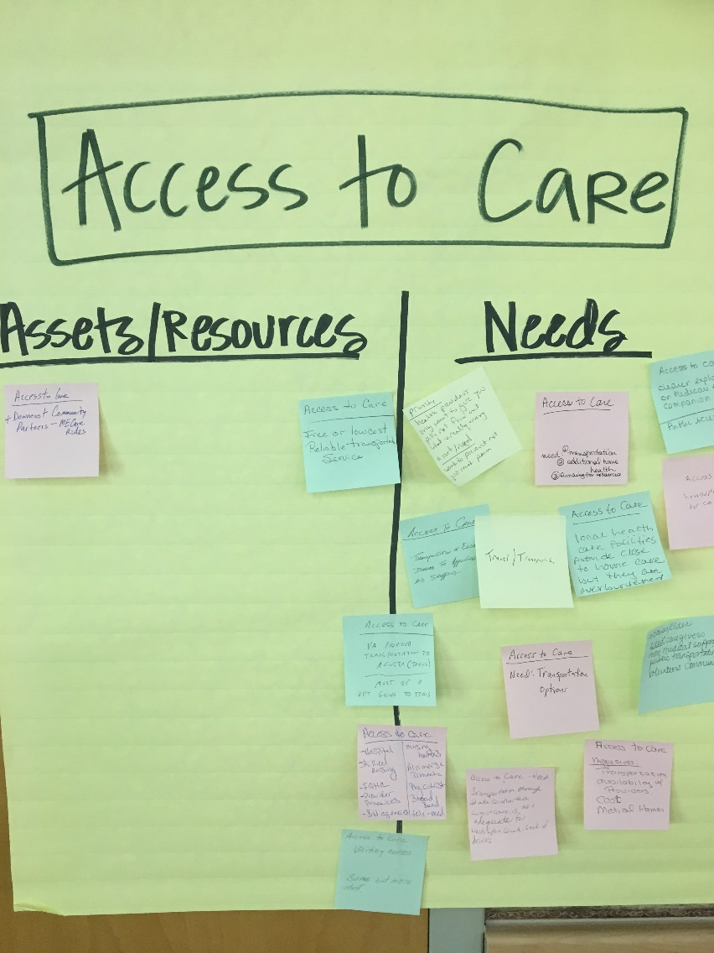
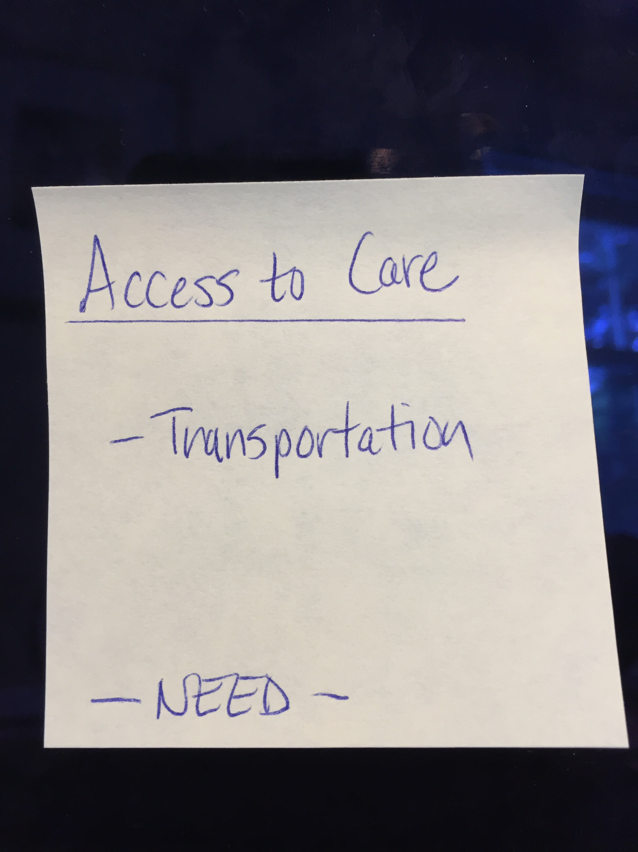
Assets/Resources and Needs
Notes:
JSI or other facilitator
Create sticky notes like the one you see here on the left. The priority area is on top, the asset or resource is on the note, and a label for Asset or Resource so that you remember later.
After we each have an individual opportunity to vote on the priorities which have been identified during the table breakouts, we will invite you to place your sticky notes with assets/resources and needs on the corresponding Priority Area sheet.
For those assets/resources and needs pertaining to other domains that did not make this forum’s final cut, please place then on the sheet marked “Other”. This is still valuable information that others may find useful down the road.

Slide 36
Reconvene

Slide 37
Wrap up and Next Steps

Slide 38
Contacts
Local Contact(s):
Thomas W. Minch, Advocate, tminch@drme.org
Riley Albair, Program Director, ralbair@drme.org
Katrina Ringrose, Deputy Director, Kringrose@drme.org
Kim Moody, Executive Director, kim@drme.org
Maine Shared CHNA: info@mainechna.org

