Slide 1
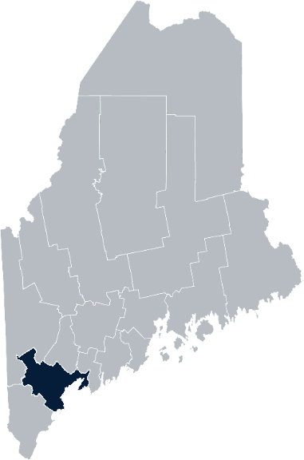
Maine Shared Community Health Needs Assessment Cumberland- Greater Portland
2021

Slide 2
The Maine Shared CHNA is a collaboration between the Maine Center for Disease Control and Prevention (Maine CDC), Central Maine Healthcare, Northern Light Health, MaineGeneral Health, and MaineHealth.
Notes:
Local Planning Committee Member

Slide 3
Thank you, local planning team
Catholic Charities City of Portland, Offices of Public Health and Minority Health Central Maine Healthcare- Bridgton Hospital Greater Portland Health Maine Medical Center/Maine Medical Partners | Maine Behavioral Healthcare Maine CDC MaineHealth Northern Light Mercy Hospital Northern Light Home Care & Hospice United Way of Southern Maine
Notes:
Local Planning Committee Member

Slide 4
Forum Agenda
Time | Activity | Speaker/Facilitator
4:00- 4:05 pm | Welcome
4:05- 4:10 pm | Overview of Zoom | Jo Morrissey, Maine Shared CHNA Program Manager
4:10 – 4:15 pm | Leadership Remarks | Kenneth Lombard, MD, Chief Medical Officer, Maine Medical Partners Charlie Therrien, President, Northern Light Mercy Hospital
4:15 – 4:25 pm | Review previous CHNA priorities and activities 2019-2021 | Kristine Jenkins, District Liaison, Cumberland Public Health District
4:25 – 4:45 pm | Presentation of key findings from the data | John Snow, Inc.
4:45 –5:40 pm | Break-out session – facilitated discussion on data and health priority identification | John Snow, Inc. & Local Facilitators
5:40 – 5:50 pm | Reconvene and Review | John Snow, Inc.
5:50 – 6:00 pm | Wrap up and next steps
Notes:
Local Planning Committee Member to go over agenda and then turn it over to Jo Morrissey to provide an overview of the Zoom tools available and the purpose of today’s forum

Slide 5
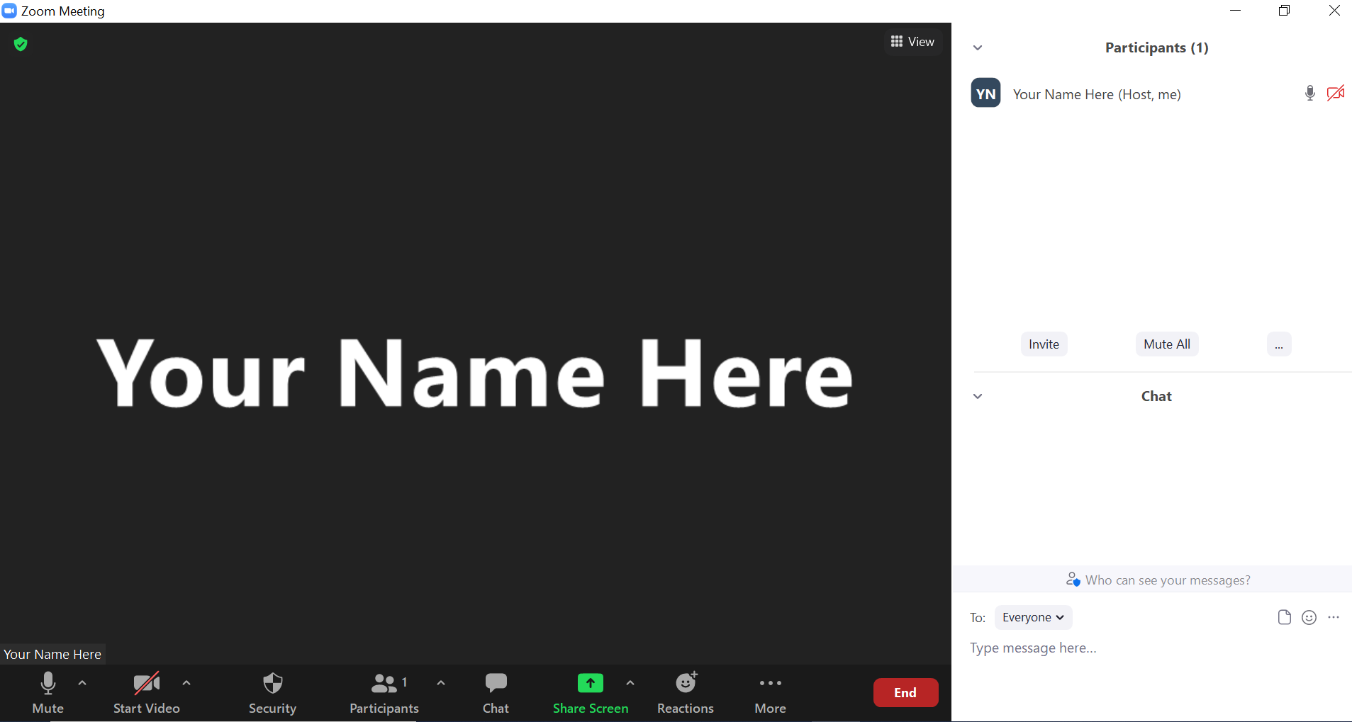
Share screen
Join Audio, Mute On/Off
Open/close participant list or chat
Turn Video On/Off
Reactions
Notes:
Jo or JSI

Slide 6
Matching Interests
Maine Shared
Community Health Needs Assessment
Images of PHAB and IRS from the internet
Notes:
Jo or JSI

Slide 7
The Evolution of an Idea…
2010 OneMaine | 2015 SHNAPP | 2018 Maine Shared CHNA | 2021 Maine Shared CHNA
Forums Surveys | 16 Forums 1639 Surveys | 22 Mainstream Forums (live) 2 Immigrant Forums 45 Interviews | 16+ Mainstream Forums (virtual) 12+ Community Sponsored Events 2000+ Oral Surveys
Notes:
Jo or JSI

Slide 8
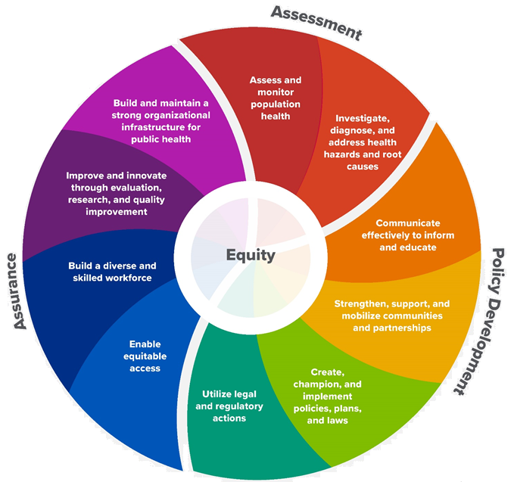
10 Essential Public Health Services
Notes:
Jo or JSI

Slide 9
Maine Shared CHNA Organizational Chart
Steering Committee
Program Manager
Vendor Support
Metrics Committee
Health Equity Community Engagement Committee
Data Analysis Teams
Local Planning Teams
Notes:
Jo or JSI

Slide 10
Inputs and Outcomes
Ways to Provide Input
Data Collected
Outcomes
District & County Reports DUE APRIL 2022
4 Health Priorities by county
Related indicators
Gaps/barriers and resources/assets
Notable comparisons between attendee input and the data.
Description of those who provided input
Methodology
Mainstream county forums
Number of attendees
Where attendees live (not CSE)
List of data identified Forums and CSE only)
Discussion notes (Forums and CSE only)
Chat box comments (Forums and CSE only)
Health Priorities
Gaps and Resources
Community sponsored events
State Report DUE APRIL 2022
4 Health Priorities by Community Event and immigrant population.
Related indicators
Gaps/barriers and resources/assets,
Notable comparisons to mainstream population.
Description of those who provided input
Methodology
Oral Survey
Forums, Events and Surveys conducted Fall 2021
Notes:
Introduce:
Kenneth Lombard, MD, Chief Medical Officer, Maine Medical Partners
Charlie Therrien, President, Northern Light Mercy Hospital
Jo or JSI
Community Sponsored Event Partners include
Disability Rights Maine (2 events: people who are deaf or hard of hearing and people with other disabilities)
Maine Primary Care Association (People who are served by Maine’s Federally Qualified Health Centers
Maine Council on Aging (Older Adults 65+
Consumer Right Council of Maine (people with a mental health diagnosis)
Formerly Incarcerated (Maine Prisoner Re-Entry Network)
Maine Youth Action Network and Friends (Raising the voices of Maine’s diverse youth)
Green Memorial A.M.E. Zion Church (Black/African American)
Health Equity Alliance (LGBTQ+ community)
Portland Recovery Center (for people with a substance use disorder or in recovery)
ADD HOUSING INSECURE IF NEED BE
ADD VETERAN IF NEED BE
Oral Survey Partners include:
City of Portland’s Minority Health Program
New Mainer’s Public Health Initiative
Maine Immigrant Access Network
Gateway Community Services
Maine Immigrant and Refugee Services
Maine Community Integration
Mano en Mano
We are piloting these additional outreach methods with support from
State of Maine’s Preventative Health and Health Services Block Grant
Maine Health Access Foundation
Introduce leader for leadership remarks

Slide 11
Leadership remarks
Notes:
Leadership remarks
Leader to introduce the following who will provide comments on recent health improvement efforts
Kristine Jenkins, District Liaison, Cumberland Public Health District

Slide 12
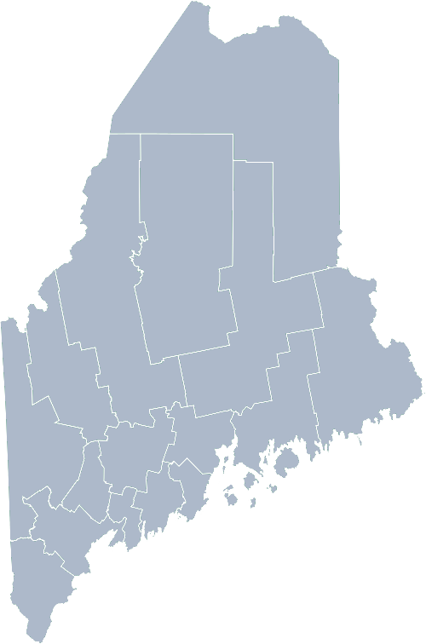
Maine Shared Community Health Needs Assessment Cumberland County/Greater Portland: Highlights 2019-2021
2021

Slide 13
Pandemic Acknowledgement and Thanks
During this past CHNA cycle – COVID-19 become a public health focus for everyone.
Cumberland District experienced the highest number of Covid-19 cases, and Covid-19 deaths in the State – but has also witnessed high levels of collaboration that brought together healthcare partners, emergency management, local governments and community members, in order to test, vaccinate, and educate around COVID-19.
This was and continues to be a focus of many of our partners’ outreach, planning, and every day activities.

Slide 14
Cumberland District Public Health Council
Engaged in Covid-19 response with Council leadership, members, and partners (2020-2021)
Convened stakeholder conversations on Covid-19 racial and ethnic disparities, and produced Council Statement (2020)
Established health priorities for Council efforts: Sexual Health, Youth Mental Health, and Adverse Childhood Experiences/Poverty- with cross-cutting focus on immigrant and refugee communities (2019)
Compiled Cumberland District Behavioral and Mental Health Resources Guide (2019)
Established working group on youth mental health, produced position paper (2019)

Slide 15
Cumberland District CHNA 2019-2021 Priorities
Mental Health
Substance Misuse
Access to Care
Social Determinants of Health
Healthy Aging

Slide 16
Cumberland District Public Health Council
Engaged in Covid-19 response with Council leadership, members, and partners (2020-2021)
Convened stakeholder conversations on Covid-19 racial and ethnic disparities, and produced Council Statement (2020)
Established health priorities for Council efforts: Sexual Health, Youth Mental Health, and Adverse Childhood Experiences/Poverty- with cross-cutting focus on immigrant and refugee communities (2019)
Compiled Cumberland District Behavioral and Mental Health Resources Guide (2019)
Established working group on youth mental health, produced position paper (2019)

Slide 17
City of Portland Public Health
Created the Research and Evaluation Program
Published the 1st Health of Portland Report
Expanded the STD Clinic’s PrEP (pre-exposure prophylaxis) program
Developed the Minority Health Program’s Alignment Group
Expanded access to healthcare through Mobile Medical Outreach
Participated in the Maine Naloxone Distribution Initiative as one of four Tier 1 distributors
Passed 50+ tobacco policies since the onset of the COVID-19 Pandemic

Slide 18
Maine Medical Center/Maine Medical Partners and Maine Behavioral Healthcare/Spring Harbor Hospital
Substance Use Disorder
Trained providers to conduct Screening Brief Intervention Referral and Treatment Screening (SBIRT) for all patients
Implemented the State of Maine’s Opioid Health Home (OHH) program in 4 Primary Care practices
Increased access to Peer Recovery Services at all Maine Behavioral Healthcare Substance Use Treatment Hubs
Increased access to treatment through Integrated Medical Assisted Therapy (IMAT) serving 1,471 patients in FY 21
Implemented Rapid Access for IMAT in the Emergency Department at MMC
Access to Mental Health
Increased tele-crisis capability and expanded the hours of coverage to 7 MaineHealth hospitals
Opened 25 new psychiatric beds in Southern Maine
Trained 1,057 Maine Behavioral Healthcare and MaineHealth clinical staff in trauma informed healthcare delivery to support patients with ACEs/trauma needs

Slide 19
Maine Medical Center/Maine Medical Partners
ACEs
Trauma screening rate for patients from birth to age 17 at 94%
ACEs screening rate for patients age 3 to 17 at 78.5%
Childhood Obesity Prevention
50% of Cumberland school districts signed the Let’s Go! Partnership Agreement to improve healthy eating and active living for 13,400 students and 1,800 staff in their districts
Healthy Aging
Advance Care Directives documented for 40% of MMP primary care patients age 65 or older
Serious Illness Conversation conducted with 25% of high risk patients identified
COVID Response
Opened two vaccination sites in Cumberland at Scarborough Downs and Westbrook
160,318 individuals vaccinated at the two sites
As of June 28th, 203,604 (69%) of all Cumberland residents vaccinated

Slide 20
Northern Light Mercy Hospital
Mental Health
Increased clinician comfort in addressing & identifying mental health concerns their through expanded education
Access to Care
Partnered with housing organizations & increased screening, resource identification and referrals in low-income housing sites
Developed screening program aimed at identifying & treating gastrointestinal cancers in new Mainer communities by partnering with primary care, community & church orgs, & interpreting companies
Focused all COVID-19 efforts (testing, vaccination) on communities with limited access to health care services
Substance Use
Expansion of MAT access in Emergency Department, primary care and jail partnership
Added second McAuley Residence –comprehensive two-generational program with housing for women with substance use disorder
Partnered with State for Maine MOM program for expectant mothers with opiate use disorders
Social Determinants
Implemented system wide screening tool for identifying SDOH needs with hard wired referral system for patients in all settings

Slide 21
Bridgton Hospital
Overall
A full-time Health Promotion Coordinator was hired to coordinate the Community Health Needs Implementation Plan as well as facilitate the current Community Health Needs Assessment.
Substance Misuse
Incorporated Suboxone Induction Program in the Emergency Department.
Added a bus stop at Bridgton Hospital with the Lakes Region Explorer Bus.
Created a referral system between the Emergency Department and the Lakes Region Recovery Center to connect patients with Substance Use Disorder to Medication Assisted Treatment and support services.
From January 1 to December 31, 2020: 30 patients were referred to the Lakes Region Recovery Center
From January 1 to September 1, 2021: 62 patients were referred to the Lakes Region Recovery Center
Access to Care
In 2021, primary care access in the Lakes Region service area is higher than 94% of all US hospitals’ populations, compared to 88% in 2018.
Notes:
Previous CHNA efforts point person
INTRODUCE THE PERSON WHO WILL REVIEW THE NEXT SECTION ON THE LAST COMMUNITY SLIDE
Introduce Madison MacLean of John Snow, Inc. (JSI) who will now give a data presentation on the top indicators

Slide 22
How to Read the County Health Profiles and Health Equity Data Sheets
Notes:
JSI or other facilitator

Slide 23
How to Read County Health Profile
CHANGE shows statistically significant changes in the indicator over time, based on 95% confidence interval (see description on page 3).
ê | means the health issue or problem is getting better over time.
! | means the health issue or problem is getting worse over time.
○ | means the change was not statistically significant.
N/A | means there is not enough data to make a comparison.
BENCHMARK compares CUMBERLAND data to state and national data, based on 95% confidence interval (see description on page 3).
ê | means CUMBERLAND is doing significantly better than the state or national average.
! | means [COUNTY is doing significantly worse than the state or national average.
○ | means there is no statistically significant difference between the data points.
N/A | means there is not enough data to make a comparison.
ADDITIONAL SYMBOLS
* | means results may be statistically unreliable due to small numbers, use caution when interpreting.
— | means data is unavailable because of lack of data or suppressed data due to a small number of respondents.
EXAMPLE
Notes:
JSI or other facilitator
A star means that the health issue or problem is getting better over time or better in comparison to another place
A red exclamation point means that the health issue or problem is getting worse over time or worse in comparison to another place
A gray circle means that the dating hasn’t changed over time or isn’t much different in comparison to another place
N/A means that there was not enough data to be able to make a comparison
There are two additional symbols you might see:
A black dot means that you should use caution when interpreting the data – the results might be unreliable because of small numbers
A black dash means that data was unavailable, or that data was suppressed due to a small number of respondents
(Go to next slide and walk audience through an example)

Slide 24
How to Read County Health Profile
EXAMPLE
 | AROOSTOOK COUNTY |  |  | BENCHMARKS
INDICATOR | POINT 1 | POINT 2 | CHANGE | MAINE | +/- | U.S. | +/-
Individuals living in poverty | 2009-2011 15.6% | 2015-2019 16.1% | ¡ | 2015-2019 11.8% | ! | 2019 12.3% | N/A
Notes:
Here’s an example of how we’ve visualized the data in the County Health Profiles.
The charts in this presentation are all excerpts from the Data Health Profiles that were created by the Maine Shared CHNA and the Maine CDC. They contain data pulled from publicly available sources that are designed to help people learn more about the health of their communities. Not all the data points are available for every measure, but we’ve included data wherever we can.
The green bars represent data from your community. The left most one represents a past data point, and the right bar represents the most recent data point available when the data was gathered. These are the same data points used in the Data Health Profiles.
The grey bars represent data for the state of Maine as a whole- on the left- and for the United States as a whole- on the right, when it is available.
We’ve also noted where differences in the data points are ‘statistically significant’. A difference between two measurements is significant when scientists can say, with a known degree of confidence, that the difference between them is large enough that the difference is most likely to be caused by an actual difference in the item being measured, and not caused by error associated taking the measurement. All of these tests are comparing the most recent data point for your community to other data points. A red exclamation mark indicates a difference that your community is significantly different in a less desirable direction compared to the data point with the symbol. A green star indicates that your community is significantly different in a more desirable direction. A grey circle indicates that there is no significant difference.
(keep in presentation – do not read for deaf/HOH event or people with disabilities). A difference between two measurements is significant when scientists can say, with a known degree of confidence, that the difference between them is large enough that the difference is most likely to be caused by an actual difference in the item being measured, and not caused by an error associated taking the measurement. All of these tests are comparing the most recent data point for your community to other data points.
For example, in this slide, we have two symbols. The grey circle next to the measurement for 2009-2011 Aroostook County means that there is no significantly different change in the rate of poverty in Aroostook County when comparing the data from 2009-2011 to the data from 2015-2019. The red exclamation mark next to the Maine data point says there is a significant difference between 2015-2019 Aroostook County and 2015-2019 Maine, and that it is less desirable that Aroostook County has a higher rate of individuals living in poverty. No comparison could be made to the data for the U.S. because the years of data collection were different.

Slide 25
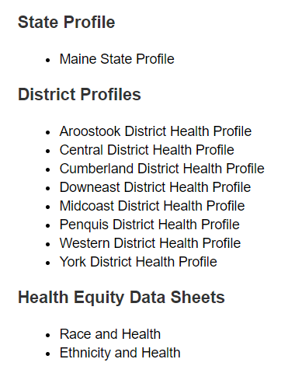
For More Data
www.mainechna.org
Notes:
The Maine Shared CHNA website contains health profiles for 3 of Maine’s largest cities, 16 counties, 5 public health districts, the state, as well as data provided by race, ethnicity, educational attainment, gender, sexual orientation, older adults, insurance status, income, and rurality.
IN addition, there is an interactive data portal where you can search by specific data points. All these breakdowns are then provided by data point.
REGARDING COVID-19 DATA
The Maine Shared CHNA data set does not include any data of COVID-19. This is largely due to the fact that there is a much more up-to-date and comprehensive Maine Data Dashboard continually being updated on the Maine CDC website.
Here you can find daily lab results, new case counts by date, trends, county breakdowns, data by race, and comparisons to other states and the nation.
INTRODUCE THE PERSON WHO WILL REVIEW THE NEXT SECTION ON THE LAST COMMUNITY SLIDE
Introduce facilitator John Snow, Inc. (JSI) who will now give a data presentation on the top indicators

Slide 26
Key Findings
Notes:
As we walk through the following data slides together, take notes. What surprises you? What stands out? What’s moving in the wrong direction?
Once the data presentation is over, you will be divided into breakout groups to discuss the data, share your top concerns, identify your top priorities, and share your knowledge about what’s working and what we need to work on to address those top concerns.
Ready? Here we go.

Slide 27
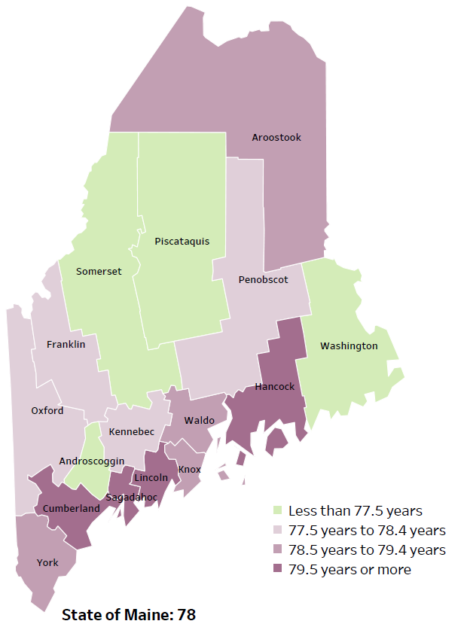
Demographics
Life Expectancy
2017-2019
National Center for Health Statistics,
CDC
RANK | MAINE | CUMBERLAND
1 | Cancer | Cancer
2 | Heart Disease | Heart Disease
3 | Unintentional Injury | Unintentional Injury
4 | Chronic Lower Respiratory Disease | Chronic Lower Respiratory Disease
5 | Stroke | Alzheimer's Disease
Notes:
The life expectancy in Cumberland County is 79.5 years or more, which is higher than the state average of 78. Cumberland County has one of the highest life expectancy in the state.
The table on the right side of the slides shows the five leading causes of death in the County – you’ll notice that They mirror the leading causes of death for the state as a whole, with the exception of Alzheimer’s disease as the 5th leading cause in Cumberland County.
The leading cause of death in the state and the county is cancer, followed by heart disease. If we were to look at a list for the US overall, you’d see that these are flipped, with heart disease being the leading cause of death in the nation.
One of the reasons we may see cancer as the leading cause in Maine is because we have higher rates of common risk factors for cancer, including smoking and tobacco use.
The 3rd leading cause of death- Unintentional Injury- includes a number of accidental causes: Three of the most common causes are i) Deaths due to motor vehicle crashes, ii) deaths due to accidental falls, and iii) deaths due to poisonings that either were unintentional, or the intent was undetermined. Suicides and Firearm deaths are classified as intentional injury.

Slide 28
Demographics
Age distribution for CUMBERLAND County
AGE
CUMBERLAND COUNTY
POPULATION
292,307
STATE OF MAINE
POPULATION
1,362,359
Notes:
Cumberland has the largest population of any Maine County. The population has increased by more than ten thousand between 2010 and 2019. Over time, we see there are now fewer children and teenagers, more adults aged 20 to 34, less adults aged 35 to 54, and more adults over 55.
Source: US Census Bureau, American Community Survey

Slide 29
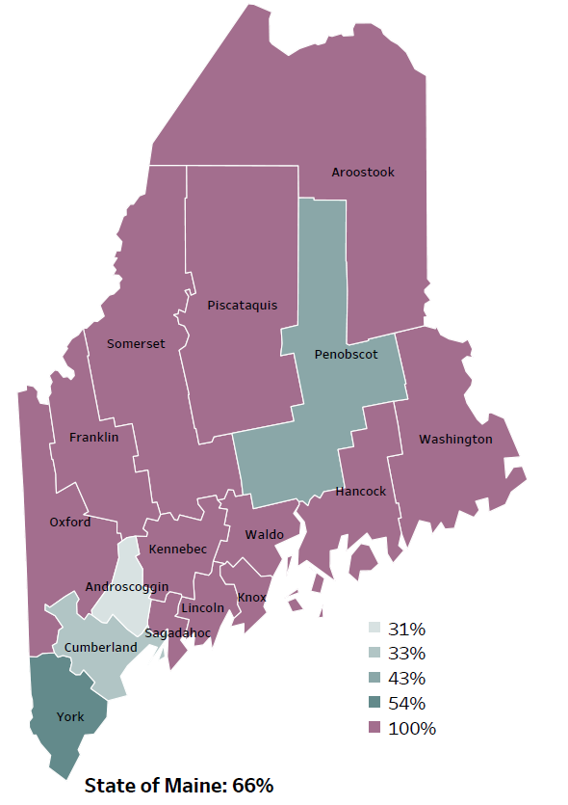
Demographics
Percentage of people living in
rural areas
2019
New England Round Table for Rural Health
Notes:
Cumberland County is one of 4 counties in the state with a metropolitan area. All of the counties on this map that are purple, are counties that are considered to be 100% rural. These data are based on the most recent Census estimates at the Zip-code level
Source: Data, Research and Vital Statistics town-level population file

Slide 30
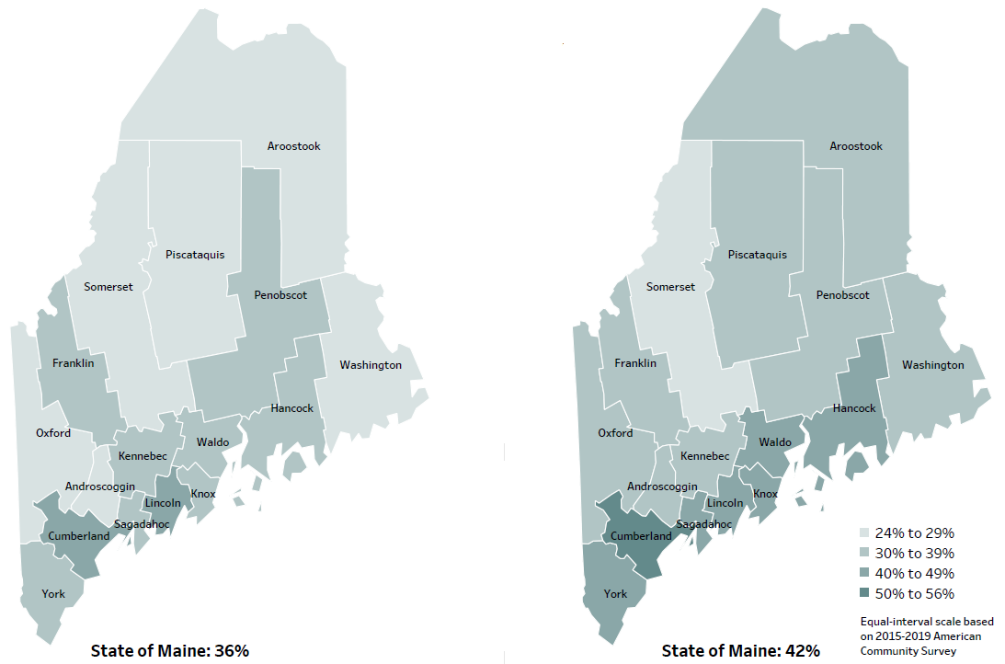
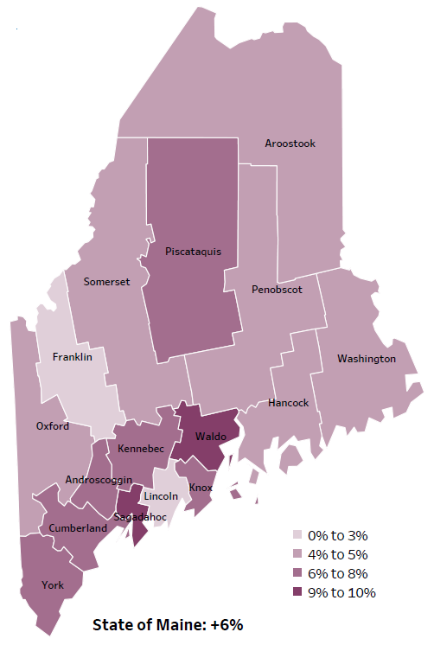
Demographics
Percent of population over age 25 with an associate’s degree or higher
2010
American Community
Survey
Change in percent of population over age 25 with an associate’s degree or higher
2010 to 2015-2019
2015-2019
American Community
Survey
Notes:
These maps show the educational attainment of adults over 25 for two different time periods. Between 2010 and 2015-2019, Cumberland County has seen a 6-8% increase in the percentage of adults who have achieved an associate’s degree or higher degree of education.
This is highlighted in the change over time map on the right side of this slide- the purple map. Cumberland County saw a greater increase than 8 other counties and equal to 6 other counties.
Source: US Census Bureau, American Community Survey

Slide 31
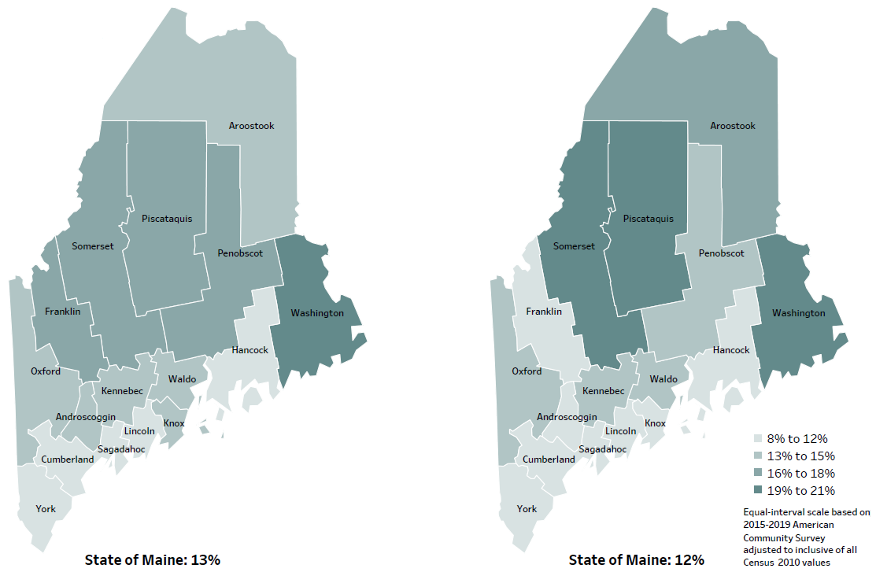
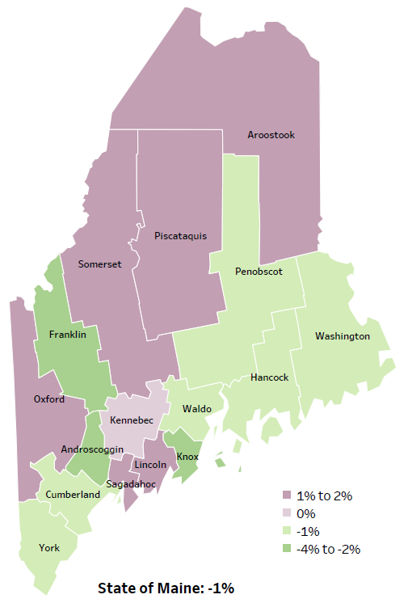
Demographics
Percent of population in poverty
2010
American Community
Survey
Change in percent of population in poverty
2010 to 2015-2019
2015-2019
American Community
Survey
Notes:
These maps show the percentage of the population in poverty for two different time periods. In Cumberland County, the percentage of folks in poverty has decreased slightly over the time period – it’s decreased by 1%, and has among the lowest levels of poverty in the state.
Source: US Census Bureau, American Community Survey

Slide 32
Health Indicators
Notes:
Getting in to some of our health indicators now. This slide shows the percentage of Cumberland County residents who rate their overall health as fair or poor. You’ll see that the percentage has decrased slightly over time, from 11.5% in 2011-2013 to 10% in 2015-2017. The rate is significantly lower than the state overall – the state being at 16%.
Data Source: Behavioral Risk Factor Surveillance System Definition: Percentage of adults who rate their health as fair or poor (vs. excellent, very good or good).

Slide 33
Health Indicators
Notes:
Cancer deaths in Cumberland County have decreased significantly over time. You’ll notice that the rate is lower than the state overall, and about equal to the US.
I want to point out that These data are age-adjusted, meaning that we have calculated the rates so that they can be compared to other parts of the state that might have a younger population. Older people tend to have higher rates of many diseases, including cancer. It’s important to adjust for age so that we don’t accidentally mistake a place with older people for a place with an unusual number of disease-related deaths.
Source: Maine CDC Vital Records

Slide 34
Health Indicators
Notes:
Compared to the state overall, Cumberland county has a slightly lower rate of hospitalizations due to high blood pressure. Note that there was a significant increase in hospitalizations between 2016-2017 and 2016-2018
Source: Maine Health Data Organization Hospital Inpatient Database

Slide 35
Health Indicators
Notes:
Looking at the graph on the left, we see that there has been an increase in percentage of adults in Cumberland County who report no leisure time physical activity. The percentage – 18.3%- is smaller compared to the state overall – the state being at 25%
Source: Behavioral Risk Factor Surveillance System

Slide 36
Health Indicators
Notes:
This slide shows the percentage of children with lead screenings at two different age groups. For both ages, you’ll see that the percentage of children receiving lead screenings has increased from 2018-2019, but both percentages are significantly low compared to the state overall.
Source: Maine CDC Childhood Lead Poisoning Prevention Unit

Slide 37
Health Indicators
Notes:
The rate of new Hepatitis B (acute) cases increased between 2019 and 2020 in Cumberland county. Infections are higher than the state and the U.S. overall.
Data Source: Maine Infectious Disease Surveillance System
Definition: Rate per 100,000 people of new cases of acute hepatitis B.

Slide 38
Health Indicators
Notes:
And the rate of new Hepatitis C (acute) cases have increased sharply between 2019 and 2020 in Cumberland county. Infections in Cumberland County and the State of Maine are significantly high compared to the US overall.
Data Source: Maine Infectious Disease Surveillance System Definition: Rate per 100,000 people of new cases of acute hepatitis C.

Slide 39
Health Indicators
Notes:
The rate of new gonorrhea cases increased between 2019 and 2020 in Cumberland county. Infections in Cumberland County and the State of Maine are significantly lower than the U.S. overall
Data Source: Maine Infectious Disease Surveillance System Definition: Rate per 100,000 people of new cases of gonorrhea.

Slide 40
Health Indicators
Notes:
The rate of fall related deaths has increased significantly over time, from 6.3 to 15.2 per 100,000 from 2007-2011 to 2015-2019. The rate is higher than the state and the U.S. overall, but not to a significant degree.
Data Source: Maine CDC Vital Records

Slide 41
Health Indicators
Notes:
Between 2017 and 2019, there was a significant increase in the percentage of middle school students who reported that they had seriouslyc onsidered suicide. The percentage in Cumberland County is similar to the state overall.
Source: Behavioral Risk Factor Surveillance System

Slide 42
Health Indicators
Notes:
On this slide we see deaths due to unintentional poisonings, or poisonings where the intent was undetermined. This means that deaths due to suicide or other intentional poisonings are not reflected here. The rates of poisoning deaths within Cumberland County has increased significantly since 2007-2011. The rate in Cumberland County is similar to the state overall.
Source: Maine CDC Vital Records

Slide 43
Health Indicators
Notes:
This graph shows rate of deaths for which drugs are the underlying cause, including those attributable to acute poisoning by drugs and those from medical conditions resulting from chronic drug use. Deaths due to alcohol use are not included. The rate of drug-induced deaths has increased significantly in the County, from 12.3 in 2007-2011 to 27.3 in 2015-2019. The rate is similar to the state rate overall, of 29.5 per 100,000.
Source: Maine CDC Vital Records and CDC WONDER Online Database

Slide 44
Health Indicators
Notes:
Cumberland County has significantly higher rate of opiate poisoning emergency department discharges than the State of Maine.
Data Source: Maine Health Data Organization Hospital Inpatient and Outpatient Databases

Slide 45
Health Indicators
Notes:
Rates of alcohol-induced deaths have increased significantly in Cumberland County over time. Rates are similar to the state.
Source: Maine CDC Vital Records and CDC WONDER Online Database

Slide 46
Health Indicators
Notes:
This graph shows a significant increase in reported marijuana use among middle school students, from 11% in 2013-2016 to 17% in 2017. The County percentage is similar to the state as a whole.
Source: Maine Integrated Youth Health Survey

Slide 47
Health Indicators
Notes:
From 2017 to 2018-2019, the rate of drug-affected infant reports decreased significantly. This rate is also significantly low compared to the state overall.
Data Source: Maine Automated Child Welfare Information System (Maine Office of Child and Family Services)

Slide 48
Health Indicators
Notes:
Looking at the graph on the left, you can see that from 2013 to 2019, the percentage of high school students who reported increased significantly. Compared to the state overall, percentages are very similar.
Source: Maine Integrated Youth Health Survey

Slide 49
Health Indicators
Notes:
Cigarette smoking among high school students has decreased significantly over time, from 11% in 2013 to 6% in 2019. The percentage of students who smoke in Cumberland County is slightly lower than the state overall.
Data Source: Maine Integrated Youth Health Survey

Slide 50
Health Indicators
Notes:
Similar to the prior slide, the percentage of middle school students who smoke cigarettes has decreased over time, from 3% in 2013 to 1% in 2019. The rate is slightly lower than the state overall.
Data Source: Maine Integrated Youth Health Survey

Slide 51
Health Indicators
Notes:
This graph shows a significant increase in reported marijuana use among high school students over time – from 19% in 2017 to 24% in 2019. The percentage in Cumberland County and state are very similar.
Source: Maine Integrated Youth Health Survey

Slide 52
Health Indicators
Notes:
This graph shows a significant increase over time in reported prescription drug misuse among middle school students, but no significant difference between Cumberland county and the state as a whole.
Source: Maine Integrated Youth Health Survey

Slide 53
Health Indicators
Notes:
While fewer high school students are smoking cigarettes, there has been a significant increase in those using e-cigarettes when compared to past years.
Data Source: Maine Integrated Youth Health Survey

Slide 54
Health Indicators
Notes:
As was seen with high school students, significantly more middle school students are using e-cigarettes when compared to past years. Cumberland County and the state have relatively the same percentage of students reporting the use of e-cigarettes.
Data Source: Maine Integrated Youth Health Survey

Slide 55
Health Indicators
Notes:
In Cumberland County the rate of lung cancer deaths has decreased significantly over time. The rate is also significantly lower compared to the State overall.
Data Source: Maine CDC Vital Records
Definition: Rate per 100,000 people of deaths from lung or bronchus cancers.

Slide 56
Health Indicators
Notes:
This slide here looks at the percentage of high school students who report adverse childhood experiences. Adverse childhood experiences are potentially traumatic events – things like experiencing violence, abuse, or neglect. In Cumberland County, the percentage decreased between 2017 to 2019, from 20% to 18%. The Percentage is significantly lower than the State overall.
Data Source: Maine Integrated Youth Health Survey

Slide 57
Breakout Discussions

Slide 58
Reconvene

Slide 59
Wrap up and Next Steps

Slide 60
Contact
Jo Morrissey, MPH
Maine Shared CHNA
www.mainechna.org
info@mainechna.org

