Slide 1
Maine Shared Community Health Needs Assessment
Cumberland Public Health District:
NAPLES
Notes:
Local Facilitator

Slide 2







Thank you to the following sponsors of Cumberland County forums
Notes:
Local Facilitator

Slide 3
Welcome and Introductions
Notes:
Local Facilitator

Slide 4
Forum Agenda
Cumberland County Community Health Forum: Naples
3:30 – 4:00 p.m. Registration and refreshments
4:00 – 4:05 p.m. | Welcome and introductions | Dr. David Tupponce Executive Vice President, Central Maine Healthcare Mary Jane Krebs, President, Spring Harbor Hospital SVP, Intensive Services, Maine Behavioral Healthcare
4:05 – 4:20 p.m. | 2016 CHNA priorities and highlights | Kristine Jenkins, District Liaison, Cumberland Public Health District
4:20 – 4:50 p.m. | Review Cumberland County Data Profile | JSI
4:50 – 5:25 p.m. | Discussion on data and health priorities | JSI
5:25 – 5:45 p.m. | Generate priorities from forum | JSI
5:45 – 6:00 p.m. | Evaluation and adjournment | Ryan McKeown, VP of Strategy and Managed Care, Central Maine Healthcare Kristine Jenkins
Notes:
Local Facilitator

Slide 5
Why are we here?
Notes:
JSI or Other Facilitator
There are a number of things that bring us here today from the IRS, national accreditation boards, as well as the insight and leadership from the Maine Shared CHNA leader ship who long before the IRS and accreditation requirements saw an opportunity to work together to make Maine the healthiest state in the nation.

Slide 6

Guidance, Regulations & the Law
Maine Shared
Community
Health Needs Assessment
Images of PHAB and IRS from the internet
Notes:
JSI or Other Facilitator
See page 28 of the Community Engagement Toolkit for more information
Maine is the only state in the nation that conducts a statewide community health needs assessment through our unique public private partnership. These community health needs assessments – referred to as “CHNAs” – are required for non-profit hospitals (under the IRS and ACA) and for local health departments to meet requirements under the Public Health Accreditation Board (PHAB). Among the required activities are:
Obtain input from the community, including providers and communities served, on health needs (which is why we’re here today)
Evaluate previous actions taken to address needs identified in previous CHNAs
Choose needs to be addressed (and provide justification)
Summarize an implementation strategy

Slide 7
Maine Shared CHNA
Program Manager
Metrics Committee
Steering Committee
Data Analysis Team
Community Engagement Committee
Local Planning Teams
JSI
Governance
Notes:
JSI or Other Facilitator
Steering Committee consists of representatives from the signatory members: Central Maine Heath Care, Eastern Maine Healthcare (EMHS to become Northern Light Health on October 1) Maine General Healthcare, MaineHealth, and the Maine Center for Disease Control and Prevention. Major funding for the Maine Shared CHNA is provided by the partnering healthcare systems with generous in-kind support from the Maine CDC and the countless organizations who contribute to this effort.
Funding supports the Program Manager and contracting with a vendor to support this effort. John Snow, Inc. (JSI) was selected in January, 2018. Ask folks to stand if they have served in any or all of the following roles:
Data Analysis Team is made up of a subgroup with representatives from the Metrics Committee, analysts from Maine CDC, USM, and JSI. Their role has been to collect and analyze the list of 200 indicators identified by the Metrics Committee
Metrics Committee is made up of representatives from the signatory members with further support from UNE, USM, and subject matter experts.
The CEA made up of a subgroup with representatives from the Statewide Community Engagement Committee. Their role has been to provide advice and guidance to the Program Manager on every aspect of community engagement.
Statewide Community Engagement includes partners and interested parties who have provided feedback on all aspects of community engagement
Local Planning Teams have set dates, found venues, and organized every aspect of today’s event.
They deserve a hand!

Slide 8
Health Improvement Process
Community Health Needs Assessment (CHNA)
Hospital Implementation Strategies
(IS)
Public Health
District Health Improvement Plan
(DPHIP)
State Health Improvement Plan
(SHIP)
Evaluate
Partners
Partners
Partners
Partners
Partners
Partners
Notes:
JSI or other facilitator
Best practice = including regular community assessment of data and progress, which creates multi level health improvement plans, which are evaluated regularly. Health Improvement Plans cannot succeed without partners – many who are here today.

Slide 9
Local Activities and Accomplishments
Notes:
Local Facilitator

Slide 10
Cumberland County Accomplishments
Priority: Substance Use
Hospital/Health System
Strategies/Activities
Maine Medical Center/Maine Behavioral Healthcare
With Maine Behavioral Healthcare, implemented IMAT-Integrated Medication Assisted Treatment- across the MaineHealth system and have served 856 patients August 2017-April 2018 (328 in Cumberland County through June).
Over 100 providers trained to provide buprenorphine
Mercy Hospital
Convened Greater Portland Addiction Collaborative (GPAC) to expand access to treatment & housing by utilizing new financial model & a multi-sector integrated data platform.
Implemented rapid access MAT program out of the ED, with next day follow-up in a primary care setting.
McAuley Residence – two-generational approach with housing for families affected by substance use disorder.
Bridgton Hospital
Physicians providing IMAT in Bridgton Hospital service area
Cumberland District Public Health Council
District-wide community scan mapped efforts and needs around opiate use
Tool created for municipalities for reducing opiate use
Spring Harbor Hospital/Maine Behavioral Healthcare
IMAT (see above)
Notes:
Local Facilitator

Slide 11
Cumberland County Accomplishments
Priority: Mental Health
Hospital/Health System
Strategies/Activity
Maine Medical Center/Maine Behavioral Healthcare
Screen 80% of children for trauma at all Maine Medical Partners practices. Referrals made to integrated behavioral health clinician from Maine Behavioral Healthcare.
100% of medical practices are integrated with behavioral health clinicians
Mercy Hospital
Implemented peer support model for emergency department patients 7 days a week
Expanded access to integrated behavioral health in all primary care
Bridgton Hospital
First Aid for Mental Health Trainings held at Bridgton Hospital for 20 staff
Spring Harbor Hospital/Maine Behavioral Healthcare
Behavioral Health Integration in MMP practices (see above)
Opening of 12 new adult inpatients beds
Notes:
Local Facilitator

Slide 12
Cumberland County Accomplishments
Priority: Obesity
Hospital/Health System
Strategies/Activities
Maine Medical Center
Between 2006 and 2016, the prevalence of obesity for Greater Portland patients in Let’s Go! monitored practices was lower than the national rate representing approximately 17,000 children and youth, aged 3-18
Let’s Go! utilized in over 70% of Maine Medical Center primary care practices & expanded across the state in partnership w/ Maine CDC
“Small Steps” weight management for adults implemented at > 50% of Maine Medical Partners primary care sites that are registered with Let’s Go!
Bridgton Hospital
Work group formed to increase referrals to the Nutrition Coordinator for nutritional assessment & action planning
Development of The Hunger Game Project in conjunction with the local food bank & The Good Shepard Food Bank
Staff using the two established Hunger Vital Sign questions and providing bag of food at discharge for patients in need
Cumberland District Public Health Council
Environmental scan created to identify partners for technical assistance (TA) with Complete Streets and Active Commuting Employer program
7 communities identified to receive TA with Complete Streets
Workshop held on Complete Streets at Greater Portland Council of Governments (GPCOG) annual meeting
Notes:
Local Facilitator

Slide 13
Cumberland County Accomplishments
Additional Priorities Selected: Access to Care, Oral Health
Hospital/Health System
Strategies/Activities
Mercy Hospital:
Access to Care
Continue to sponsor community initiative focused on connecting vulnerable ED patients with appropriate resources e.g. primary care, housing, mental health services, and concrete supports
Shifted focus of financial counselors to secure health insurance coverage for 300 un- or under-insured persons
Cumberland District Public Health Council:
Oral Health and Care for Children
(0-6)
Funding provided to Smile Partners to update 211’s oral health resources, to assess resources and to engage Community Health Workers in assisting vulnerable populations w/ navigating oral health
2,600 “Benefits of Breastfeeding” and “Latch 1-2-3” brochures translated into 7 languages and distributed
Cultural Competency training provided to 23 home health workers
Spring Harbor Hospital/Maine Behavioral Healthcare:
Access to Mental Health
Training and psychiatric consultation to providers across the MaineHealth system
Reduced wait times for patients discharged from Spring Harbor Hospital seeking outpatient care from 14 to 8 days
Decreased Emergency Department use 17% for “high utilizers” enrolled in Behavioral Health Home by improving care coordination at primary care and outpatient behavioral health settings
Notes:
Local Facilitator

Slide 14
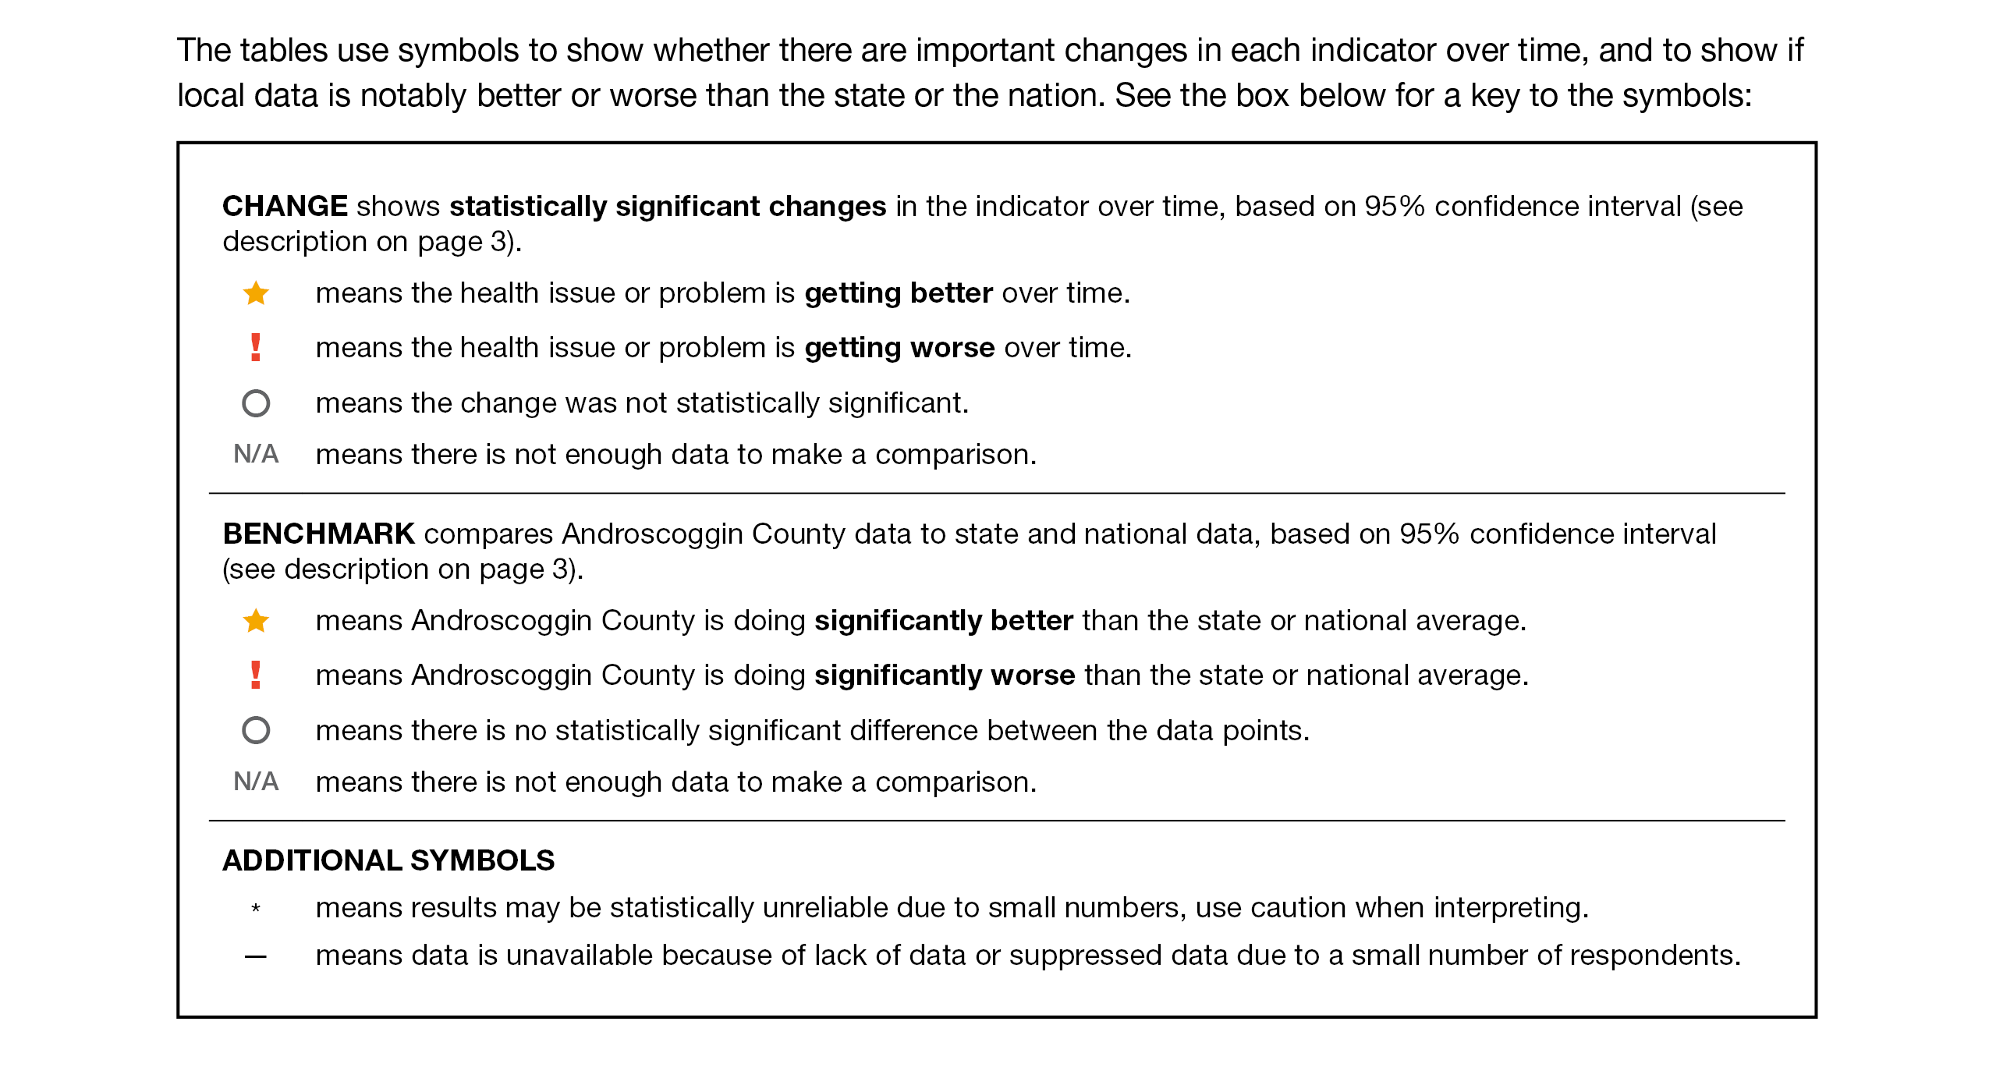
How to Read County Health Profile
EXAMPLE
Notes:
JSI or other facilitator
The County Profile provides almost 200 health data indicators from over 30 sources. Looking through the document, you’ll see that wherever possible, we’ve included data for the county for two points in time (to note any changes over time), state data (to compare the county to the state), and national data (to compare the county and the state to the US). Along with the data, you’ll notice some symbols. These symbols show whether there are important changes in the data over time, and show where County data is notably better or worse than the state or the nation.
When we’re looking at the County level data to see if things changed over time:
A star means that the health issue or problem is getting better over time
A red exclamation point means that the health issue or problem is getting worse over time
A gray circle means that any change in the data over time is not statistically significant
N/A means that there was not enough data to be able to make a comparison
Looking at County data in comparison to the state and national data:
A star means that the County is doing significantly better than the state or national average
An exclamation point means that the county is doing significantly worse than the state or national average
A gray circle means there is no statistically significance between the County and the state or national average
N/A means that there isn’t enough data to make a comparison
There are two additional symbols you might see:
A black dot means that you should use caution when interpreting the data – the results might be unreliable because of small numbers
A black dash means that data was unavailable, or that data was suppressed due to a small number of respondents
(Go to next slide and walk audience through an example)

Slide 15
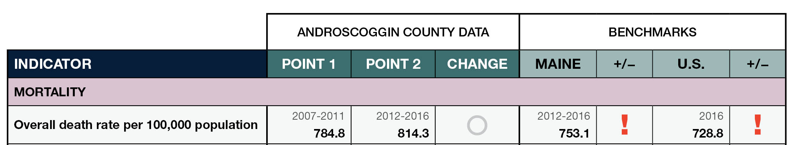
How to Read County Health Profile
EXAMPLE
Notes:
JSI or other facilitator
Lets use this line as an example
Here, we can compare the overall death rate in Androscoggin County between 2007-2011 and 2012-2016. Although the rate is higher in Point 2, the gray circle tells us that the change over time was not significant.
We then look at the most recent data compared to the state and to the US. Here, the red exclamation point tells us that the County rate is significantly higher then the state and the US.

Slide 16
Key Findings
Notes:
JSI or Other Facilitator
We encourage you to spend some time looking through the County Health Profile. We won’t be able to cover all that is in the document during this presentation today, but we’ve pulled out a number of key findings to give you an overview of health in each county.
The following data was chosen for this PowerPoint based on the criteria below:
Previous County Priorities
Indicators visualized in the County Health Profile
The county level data significantly diverges from the state and/or nation in either a positive or negative direction.
Significant changes in prevalence, incidence or health behavior over time (trend)
The magnitude of impact is significant (i.e. high rates of prevalence and incidence). (i.e.: does this indicator impact leading cause of mortality and/or morbidity?)
Based on the criteria above, the “33 Key Indicators” were used to prioritize “tie breaks”
Requests by local planning teams

Slide 17
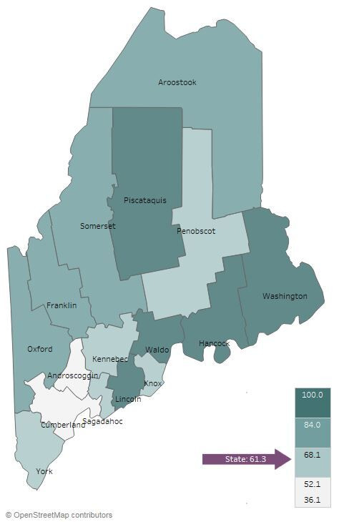

Demographics
Cumberland County: Age Distribution
Percent of Population Living in Rural Areas, 2012-2016
Notes:
JSI or Other Facilitator
Direct people to Page 5-8 of County Profile for more information on demographics
AGE:
Cumberland is one of 5 counties where 12-18% of population is over 65 – the lowest percentages in the state.
It’s important to understand the age distribution in a community when assessing health status – for example, older individuals typically have more complex/chronic conditions and physical vulnerabilities (e.g. falls) and young people may be more apt to engage in risky behaviors (e.g alcohol and tobacco use, unprotected sex)
RURALITY:
Of all counties in Maine, Cumberland has the lowest percentage of people living in a rural area – 36%. This is about half of the percentage for the state overall (61%)
There are a number of risk factors associated with urban living that have an affect on ones health – population density, pollution, crime, lack of safe green space, and housing related health risks – just to name a few.

Slide 18
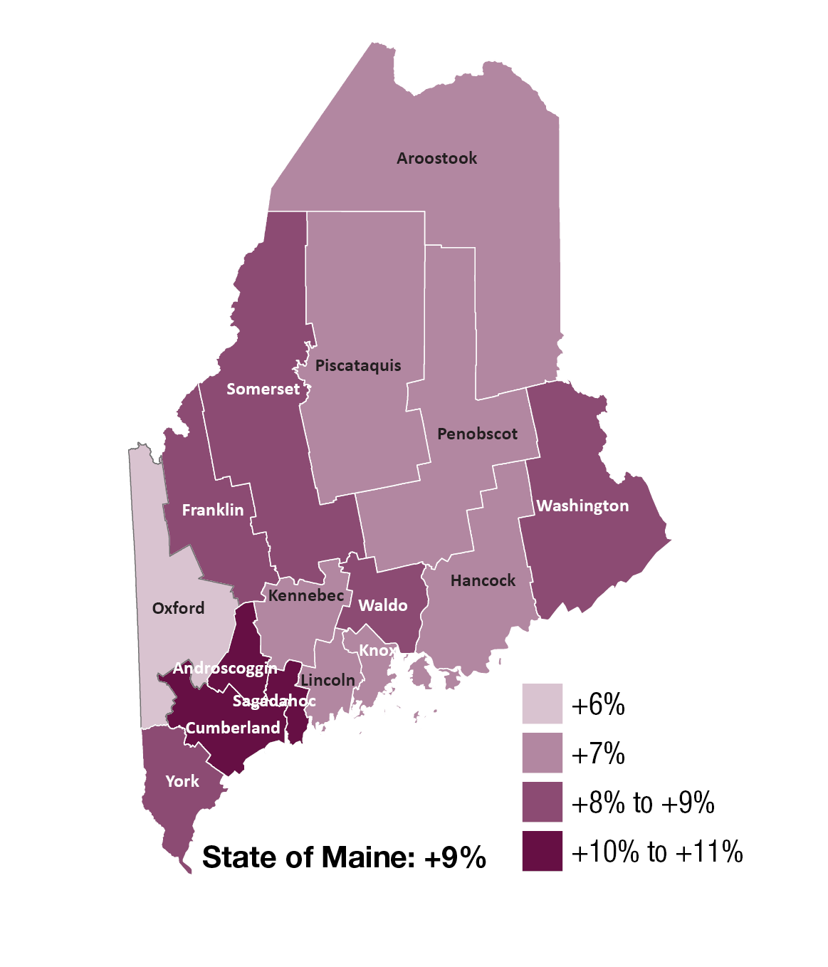
Demographics
Change in Percent of Population Age 25+ With Associates Degrees or Higher, 2000-2016
Notes:
JSI or Other Facilitator
EDUCATION:
Darker purple on the map shows an increase between the year 2000 and 2016. In Cumberland County, the percentage of population with an Assoc degree or higher increased approximately between 10-11% between 2000 and 2016. Cumberland County has the highest percentage of residents with Assoc Degree or higher – 53% compared to 37% for the state overall.
Higher education is associated with improved health outcomes and social development at the individual and community level. The health benefits of higher education typically include better access to resources, safer and more stable housing, and better engagement with providers. Those with lower levels of education typically have more difficulty navigating the health system and are exposed to more chronic stress.
Turn to Page 18 of the County Health Profile – the Social Determinants of Health Section. Here you find other data points related to socioeconomic status, like median household income and unemployment rate.

Slide 19
Demographics
Cumberland County: Gay, Lesbian, and Bisexual High School Students
12%
Maine 11%
2011
2017
Notes:
JSI or Other Facilitator
LGBT:
Between 2011 and 2017, the percentage of high school students identifying as LGB in Cumberland County nearly doubled – from 6% to 11%
Those that identify as LGB may face obstacles in accessing culturally competent health care services
LGB individuals are at a higher risk of being homeless when they are young, are more likely to be harassed and discriminated against at school and in the workplace, and face disparities with respect to rates of chronic disease, substance use, mental health issues, sexual health issues, and violence
The percentage of adults who identify as LGBTQ is 4.3%

Slide 20
Health Equity Data
Handouts include selected data for:
Sex
Race
Ethnicity
Sexual orientation
Education
Income
Rurality
Notes:
JSI or Other Facilitator
In addition to the county health profiles, we are providing some tables showing health disparities among some populations within Maine.
These data are state level data. When we try to look at the same data at the county level, we generally found that:
Much of the data is suppressed due to small numbers and privacy concerns
The variation between these groups does not change very much from county to county. If the group shows a disparity at the state level, the same disparity will be at the local level
These tables show the percentage or rate of health or social determinants of health indicators (rows) by varying
education groups in Maine (columns). In the example on the screen, 59.6% of adults with less than a high school diploma have an income of less than $25,000, while 9.7% of adults with a bachelor’s degree or higher have an income of less than $25,000.
The columns in each row therefore do not add up to one hundred.
The bar chart in the final column shows the same data in the same order in a chart format. In the example on the on the screen, you can see that many indicators show better outcomes as peoples’ educational increases

Slide 21
Years of Potential Life Lost
Cumberland County: Years of Potential Life Lost Per 100,000 Population
10,000
YPLL measures premature death, or the years of potential life lost before the age of 75.
Maine 6529.2
Notes:
JSI or Other Facilitator
Rate of years of potential life can be found in the table on Page 14 of the County Health profile
The YPLL measure is used because simple mortality rates do not fully address the issue of premature death, the impact of disease and death, and their cost to society. The YPLL increased in Cumberland County between 2010-2012 and 2014-2016, though only very slightly. Cumberland County has a significantly LOWER YPLL compared to the rest of the state indicating there are fewer preventable deaths.
A high YPLL tells us that there is reason to focus attention on deaths that could have been prevented – there is reason to investigate the causes of premature death.
For example, a person dying at age 25 contributes 50 years of life lost, whereas a person who dies at 65 contributes 10 years of life lost to a County’s YPLL. In other words, high rates of years of potential life lost is an indicator of people dying young.

Slide 22
Social Determinants of Health
Unemployment rate (2012-2016)
Cumberland County: Percent of Individuals Living in Poverty, 2000-2016
25%
Maine 14%
2009-2011
2012-2016
Notes:
JSI or Other Facilitator
Direct people to page 18 of the county health profile for more data on the social determinants of health. The social determinants of health are the conditions that effect the environments in which people live, work, learn, and play
POVERTY:
Poverty impacts all facets of an individuals life – it may prevent someone from continuing their education, can impede access to healthy food and safe housing, and overall, makes it more difficult to maintain good health.
In Cumberland County , the % of population living in poverty has remained steady, around 11%. This percentage is lower than the state overall (14%).
The median household income increased by approximately $4.5K (increase from 57.2K to 62K) between 2007-2011 and 2012-2016, and is approximately $11K higher than the state

Slide 23
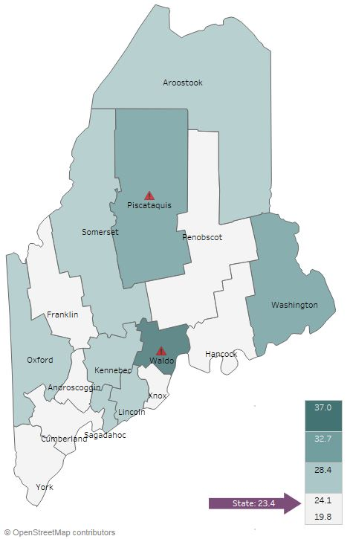

Social Determinants of Health
Adverse Childhood Experiences, 2017
Notes:
JSI or Other Facilitator
This map shows the percentage of high school students who report at least three out of eight adverse childhood experiences – such as abuse, neglect, and other stressful and/or traumatic events. Cumberland has the lowest percentage among all counties – 19.8% vs. 23.4% for the state overall.

Slide 24
Social Determinants of Health
Cumberland County: Violent Crime Rate Per 100,000 Population
450.0
Maine 366.7
Notes:
JSI or Other Facilitator
Crime and violence are public health issues that impact health status on many levels – from death to injury, trauma, anxiety, isolation, and community cohesion
From 2010-2013 and 2014-2016, the rate of violent crime in Cumberland County decreased from 413 per 100,000 to 394 per 100,000. (this change is not statistically significant). And the crime rate while higher, is not statistically different than the state average (367).
Direct people to Page 25 of the County Health Profile for more data on violence and intentional injury

Slide 25
Health Behaviors - Obesity
Cumberland County: Obesity (Adults)
Cumberland County: Obesity (High School)
40%
40%
Maine 30%
Maine 15%
2011
2016
2011
2017
Notes:
JSI or Other Facilitator
Lack of physical activity, poor nutrition, and obesity are among the leading risk factors associated with chronic health issues. Adequate nutrition helps prevent disease and is essential for the healthy growth and development of children and adolescents. Being physically active reduces the risk for many chronic health conditions and is linked to good emotional health.
Starting at the bottom of Page 21 and moving into Page 22 of the County Health Profile, you’ll find data on physical activity, nutrition, and weight.
Obesity – Adults
The percentage of adults in Cumberland County that are obese is lower than the state overall, and the data shows an increase over time, though the change is not statistically significant.
Cumberland County data indicates a high rate of healthy behaviors compared to the state overall. On Page 22, you’ll see that the percentage of adults who reported meeting physical activity recommendations was significantly higher than the state (62 vs 54%), and the percentage with less than one serving of fruit and vegetables a day were both lower than the state.
Obesity – High School
The percentage of high school students in Cumberland County that are obese is lower than the state overall, and has increased over time.
On Page 22, you’ll see that the percentage of high school students who reported meeting physical activity recommendations was similar to the state overall (20%), while the percentage who consumed 5+ servings of fruits and vegetables a day was significantly higher (18 vs. 16%)

Slide 26
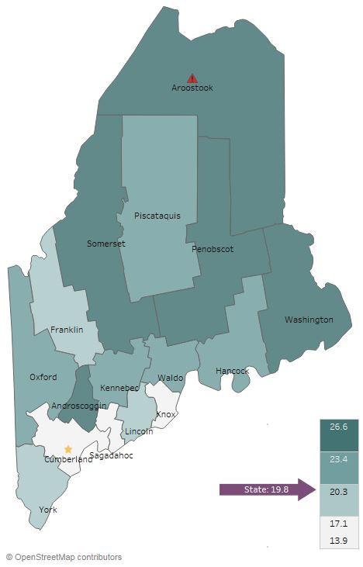
Health Behaviors- Smoking
Current Smoking (Adults), 2016
Notes:
JSI or Other Facilitator
Reducing tobacco use is the single most effective way to prevent death and disease in the US. Each year, almost half a million Americans die from tobacco related illnesses. For every person who dies from tobacco use, 30 more suffer with at least one serious tobacco-related illness, such as COPD, heart disease, or cancer
Page 27 of the County Health Profile has additional data on Tobacco Use
ADULT CURRENT SMOKING:
Cumberland is the only county that has a significantly fewer adult smokers compared to the state overall (14 vs 20%)

Slide 27
Health Behaviors- Smoking
Cumberland County: Past 30 Day Cigarette Smoking (High School)
Cumberland County: Past 30 Day E-Cigarette Use (High School)
25%
25%
Maine 15%
Notes:
JSI or Other Facilitator
PAST 30 DAY HIGH SCHOOL:
Over time, the percentage of high school students who reported smoking cigarettes in the past 30 days has decreased significantly, from 13 to 7%. The current percentage (7%) is significantly lower than the state (9%)
The percentage of high school students who reported e-cigarette use in the past 30 days has also decreased, though not significantly
As you can see on the County Health Profile, the percentage of high school students exposed to secondhand smoke decreased over time, from 36 to 24%, and is significantly lower than the state (31%)

Slide 28
Health Behaviors- Alcohol and Marijuana
Cumberland County: Past 30-day Alcohol and Marijuana Use (High School)
35%
Notes:
JSI or Other Facilitator
Youth substance use can lead to problems in school, can aggravate physical and/or mental health issues, contribute to accidents and injury, and create lifelong health problems. Please see Page 26 and 27 of the County Health Profile for additional data on substance use
The line graph on the right shows past 30-day use for alcohol and marijuana among high school students over time.
Past 30 day alcohol use has decreased significantly over time, from 29% to 24%
Past 30 day marijuana use has also significantly decreased over time, from 23 to 19%, but not significantly.

Slide 29
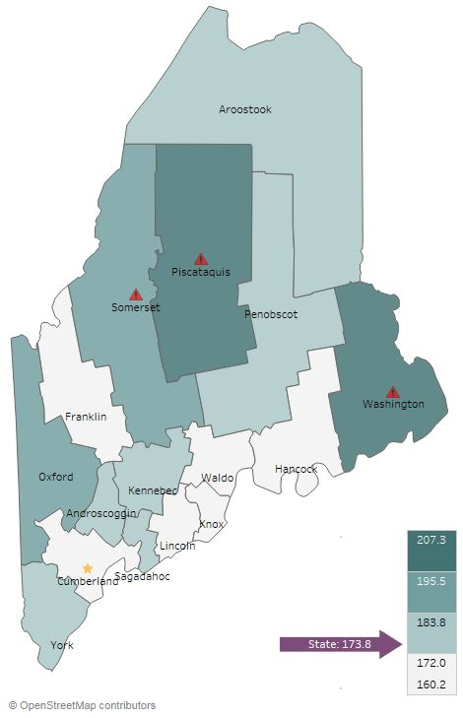
Health Outcomes-Cancer
All Cancer Deaths, 2016
Cumberland County:
All Cancer Incidence Per 10,000 Population
500.0
Notes:
JSI or Other Facilitator
Experts have an idea of the risk and causal factors associated with cancer, but more research is needed to understand the many unknowns that still exist. What we do know is that there are several common risk factors: age, family history, tobacco use, overweight/obesity, excessive alcohol consumption, exposure to the sun, and exposure to environmental and occupational pollutants.
Cancer is the leading cause of death in Cumberland County and the state overall. The rate of all cancer deaths in Cumberland County is significantly lower than the state– 161.5 vs. 173.8 per 100,000. Cumberland is the only county faring significantly better than the state overall. All-cancer incidence is shown in the graph on the right. Cumberland is the only county in the state where the rate of all new cancer cases significantly decreased over time, from 488 to 459 per 100,000 population.
In the County Health Profile on Pages 19 and 20, you’ll see a number of other cancer-related data points, including death and incidence rates many different forms of cancer.

Slide 30
Health Outcomes - Cancer
Cumberland County:
Colorectal Cancer Screening (Adults 50+)
100%
Maine 75%
2012 & 2014
2014 & 2016
Notes:
JSI or Other Facilitator
Colorectal cancer screening is an example where Cumberland County is seeing increasing screening rates, and a screening rate that is significantly higher than the state overall and the national average of 68%.

Slide 31
Health Outcomes-Adult Chronic Disease
Cumberland County: Diabetes Prevalence (Adults)
Cumberland County: Asthma Prevalence (Adults)
15%
15%
Maine 12%
Maine 10%
Notes:
JSI or Other Facilitator
In Cumberland, the percent of adults with diabetes increased significantly over time – from 8% to10%. The current prevalence is right on par with the state. On page 21 of the county health profile, you’ll see other data points around diabetes. Notice that the rate of diabetes hospitalizations is significantly lower than the state (9 vs 12 per 10,000 population), as the number of diabetes deaths per 100,000. (15.7 in Cumberland vs. 22.0 State)
The percent of adults with asthma decreased slightly over time, and is also very similar to the state (10% vs. 12%). Page 21 also includes a number of data points around asthma and other respiratory conditions. Notice that the asthma ED rate significantly decreased over time in Cumberland County, from 47 to 45 per 10,000 population, and is significantly lower than the state overall (58).

Slide 32
Health Outcomes-Adult Chronic Disease
Cumberland County:
High Cholesterol (Adults)
Cumberland County:
High Blood Pressure (Adults)
Maine 39%
Notes:
JSI or Other Facilitator
The percentage of adults in Cumberland County with high cholesterol is similar to the state. The percentage of individuals with high blood pressure is significantly lower than the state rate of 34%.
Both of these are risk factors for a number of cardiovascular diseases and conditions, including coronary heart disease, heart attack, and stroke. On Page 20 of the County Health Profile, you will see a number of data points related to cardiovascular disease
Of note is that coronary heart disease deaths per 100,000 had a significant between 2007 and 2016, and rate of death in Cumberland is significantly lower than the state and the nation.

Slide 33
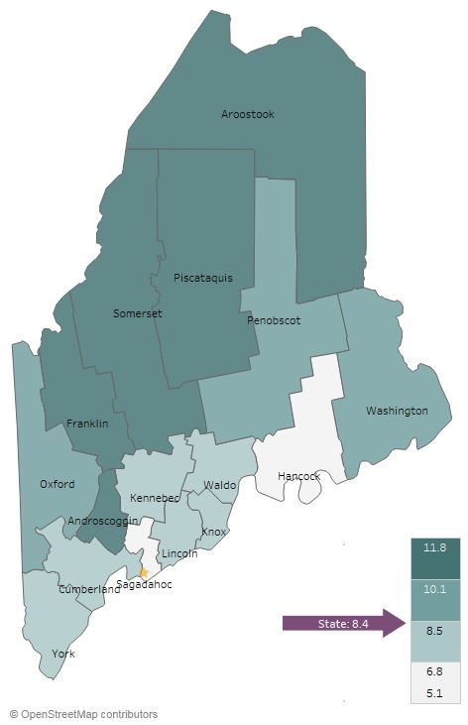
Health Outcomes - Mental Health
Current Depression (Adults), 2014-2016
Cumberland County: Sad/Hopeless
2+ Weeks in a Row (High School)
35%
Maine 27%
2011
2017
Notes:
JSI or Other Facilitator
Mental health has an impact on individuals, families, and communities. Like substance use, mental health impacts all segments of the population, across demographic and socioeconomic lines. You can see more data on mental health on Pages 25 and 26 of the County Profile.
Adults
Looking at the map, you’ll see that the percentage of adults with depression is right around the state percentage – 7% in Cumberland County , and 8% in Maine overall
High School
Between 2011 and 2017, the percentage of high school students who reported being sad or hopeless for more than two weeks in a row increased from 21 to 25% but this change is not statistically significant. Rate of students considering suicide did not change.

Slide 34
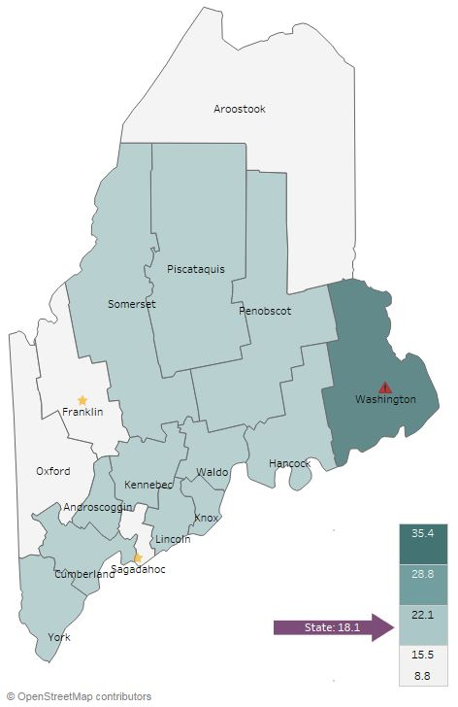
Health Outcomes - Substance Use
Overdose Deaths Per 100,000
2012-2016
Notes:
JSI or Other Facilitator
The rate of overdose deaths in Cumberland County significantly increased over time – from 12 to 18 per 100,000. The current death rate mirrors that of the state (also 18 per 100,000), and higher than national rate.
Additional data on substance use can be seen on Page 26 of the county Health Profile and will be discussed in the next slide

Slide 35
Health Outcomes – Substance Use
Cumberland County: Drug Induced
Deaths Per 100,000
100
Maine 18.9
Notes:
JSI or Other Facilitator
Between 2007-2011 and 2012-2016, drug induced deaths per 100,000 increased significantly in Cumberland County. This is likely due to the opioid epidemic

Slide 36
Health Outcomes – Substance Use
Cumberland County: Drug-Affected Infants
Per 1,000 births
100
2017
114
Maine 77.9
Notes:
JSI or Other Facilitator
The reports of drug-affected infants also increased over time – in fact, it more than doubled. However, the rate of reports was still lower compared to Maine overall (77.9).

Slide 37
Health Outcomes – Injury
Cumberland County: Injury Deaths Per 100,000
Cumberland County: Unintentional Fall Related Deaths Per 10,000
100
100
2017
114
Maine 67.9
Maine 9.6
Notes:
JSI or Other Facilitator
In Cumberland County, the rate of injury deaths increased significantly over time, from 51 to 59 per 100,000 population. However, this current rate remains significantly lower than the state and national rates. One of three counties where this rate increased.
In a related data point, the rate of unintentional fall-related deaths also increased significantly over time. The current rate is right on par with the state 910 per 100,000).
Unintentional and undetermined poisoning deaths per 100,000 also increased from 11.7 to 18.4)

Slide 38
Health Outcomes - Infectious Disease
Cumberland County, Incidence Per 100,000
350.0
Maine 293.4
Maine 92.8
Maine 96.5
Notes:
JSI or Other Facilitator
Though great strides have been made to control the spread of infectious disease in the U.S., they remain a major cause of illness, disability and even death. Sexually transmitted infections, diseases transmitted through drug use, vector-borne illnesses, tuberculosis and pneumonia/influenza are among the infectious diseases that have the greatest impact on modern American populations.
Incidence of Hep C, Lyme Disease, and Chlamydia all increased over time. Based on way the rates are determined we cannot say these increases are statistically significant- however observing these trends is important. In the County Health Profile, you’ll see that incidence of several other infectious diseases, including Pertussis, Tuberculosis, Gonorrhea, and syphilis, also increased over time.
You can find more data on infectious disease on Page 24 of the County Health Profile

Slide 39
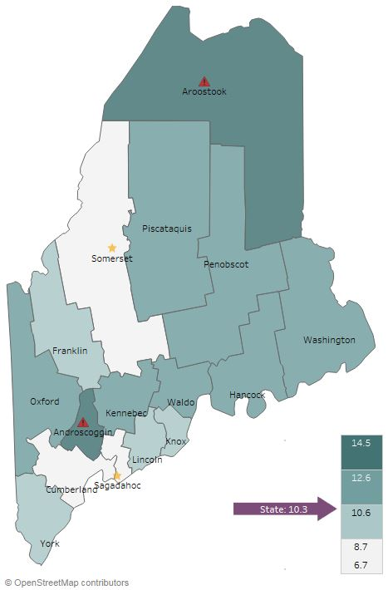
Health Access and Quality
Unable to Obtain Care Due to Cost, 2014-2016
Notes:
JSI or Other Facilitator
When it comes to cost barriers to health care, Cumberland fares slightly better than the state overall – 9.5% of individuals in Cumberland County report being unable to obtain care due to cost, compared to 10% for the state overall.

Slide 40
Facilitated Discussion
Notes:
JSI or Other Facilitator

Slide 41
Small Group Discussion Questions
Based on your own knowledge and experiences, are there any major health issues that are not represented in the data? (10 mins)
Based on the data, past priorities, and your observations, what do you see as the top needs of our community? (20 mins)
What community resources are available to address these needs, and what more may be needed? (5 mins)
Notes:
JSI or Other Facilitator
Overview/instructions (see page 11 of the Community Engagement Toolkit): These breakout sessions will provide an opportunity for you all to share their feedback. Table facilitators have question prompts to lead discussions. The purpose of these small group discussions is to identify up to 4 health priorities, local resources to address those priorities, and gaps in resources.
Leave this slide up during table breakouts

Slide 42
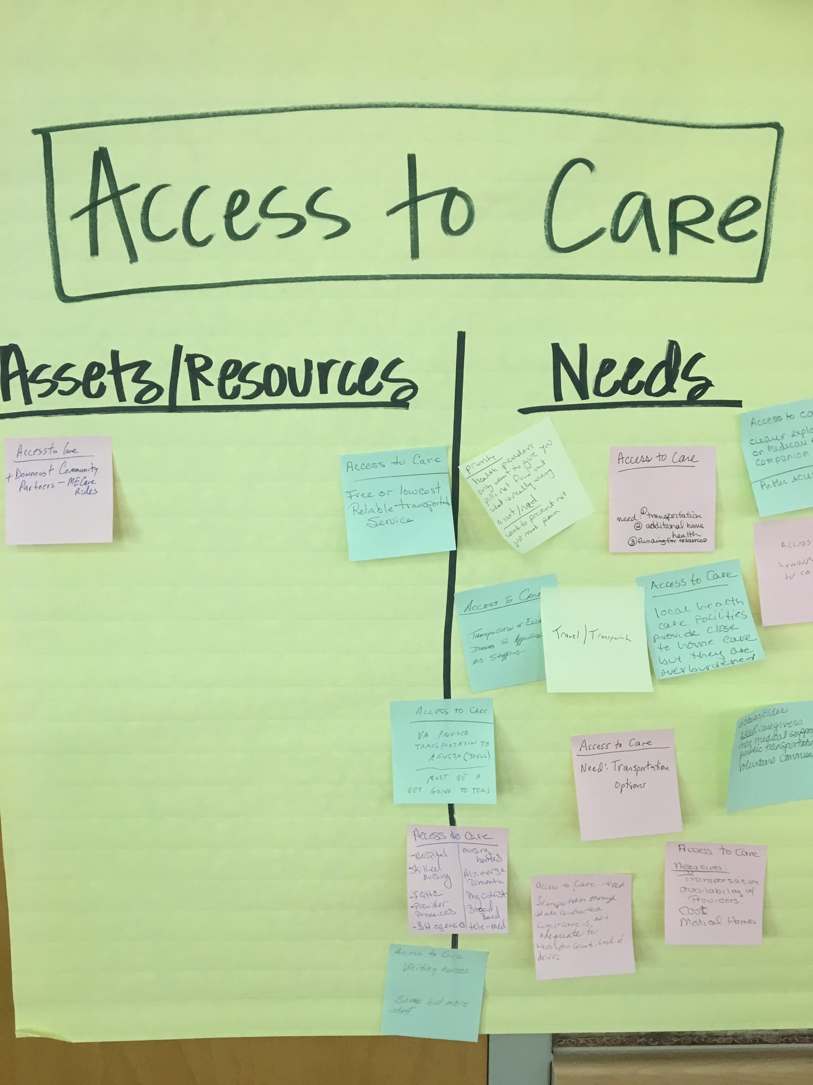
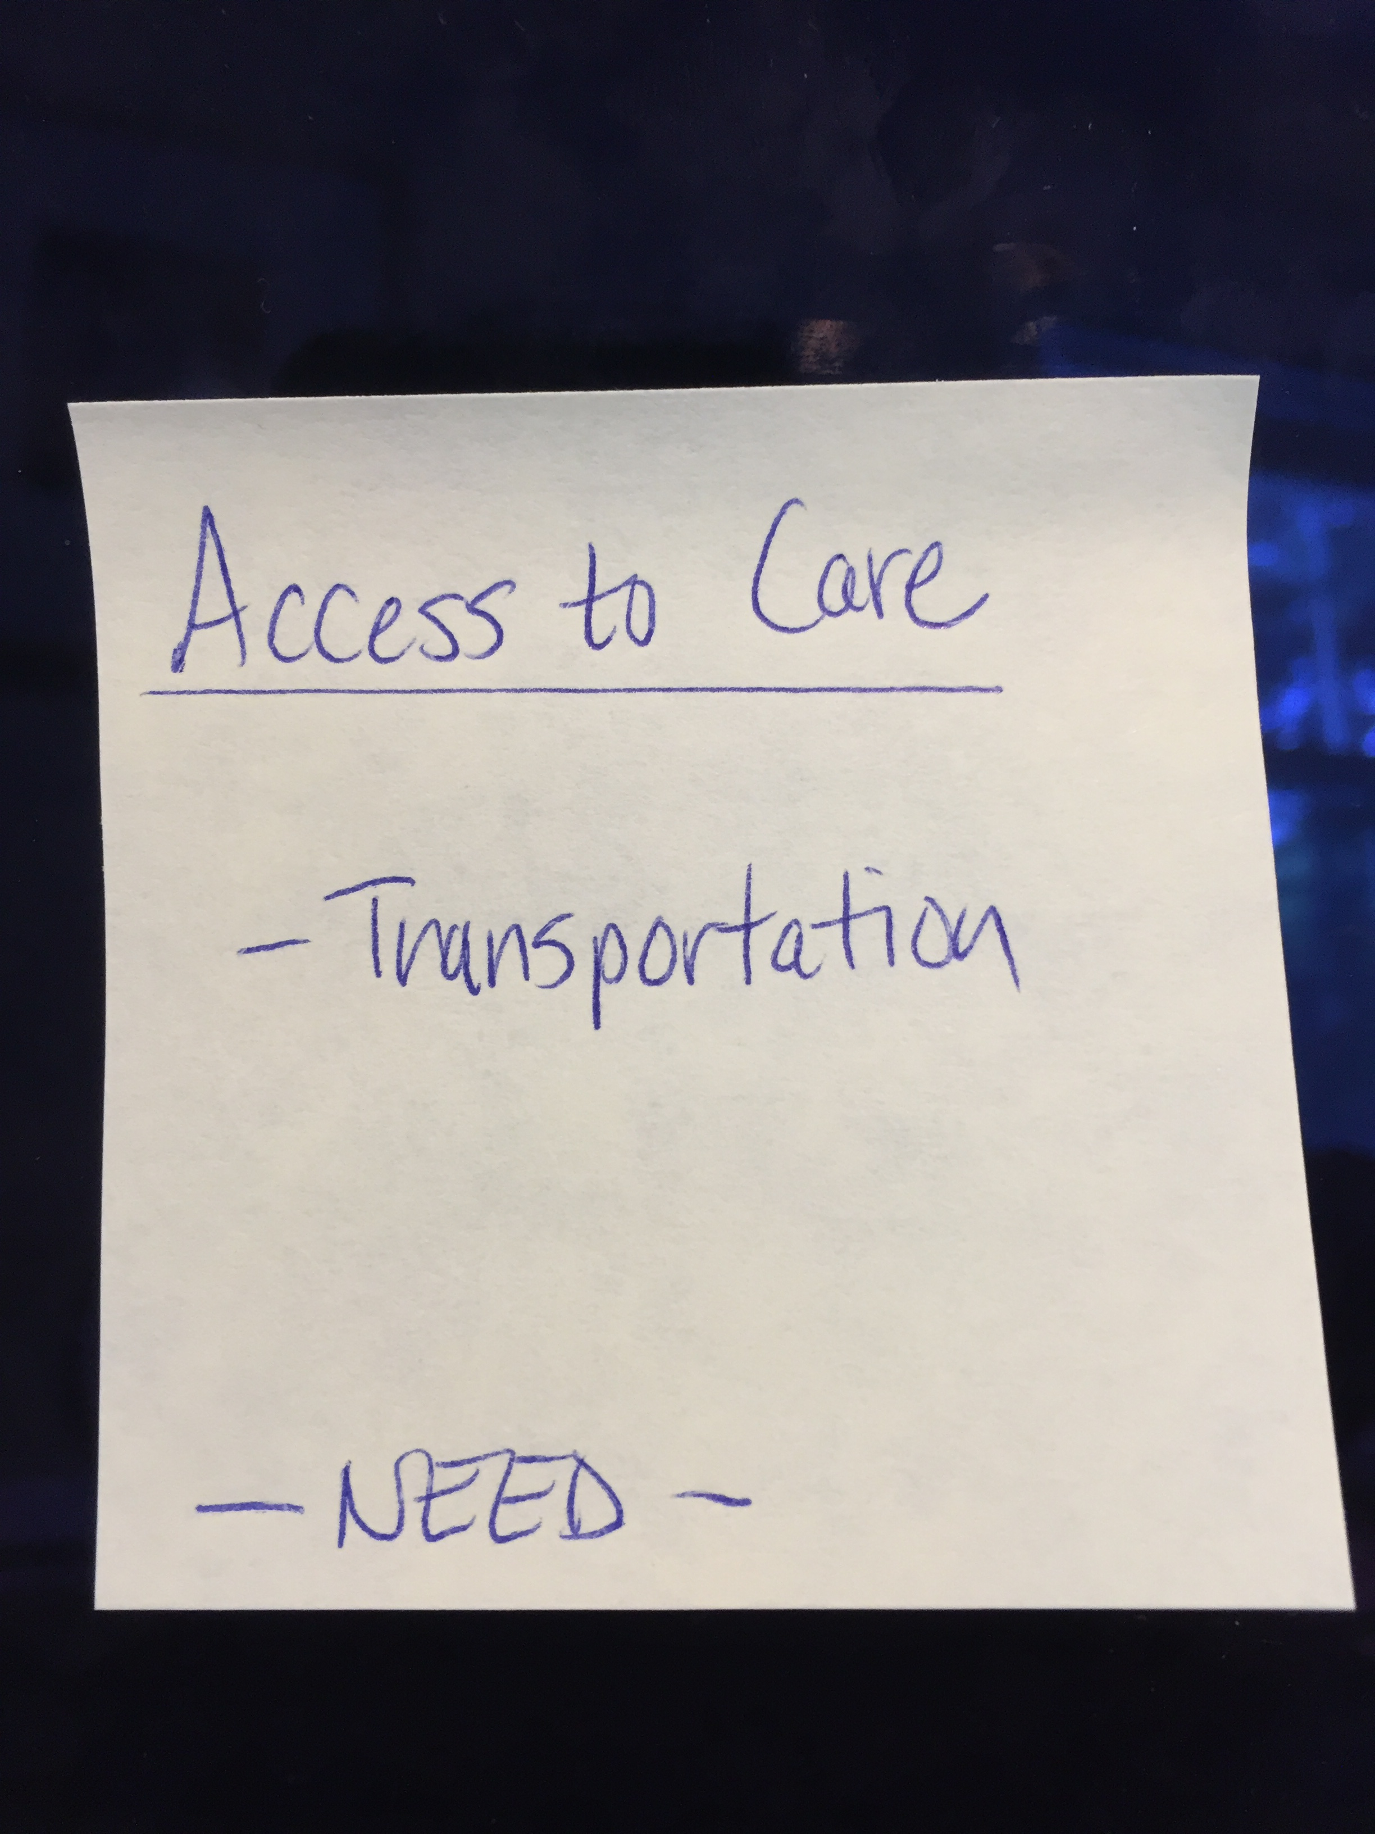
Assets/Resources and Needs
Notes:
JSI or other facilitator
Create sticky notes like the one you see here on the left. The priority area is on top, the asset or resource is on the note, and a label for Asset or Resource so that you remember later.
After we each have an individual oppty to vote on the priorities which have been identified during the table breakouts, we will invite you to place your sticky notes with assets/resources and needs on the corresponding Priority Area sheet.
For those assets/resources and needs pertaining to other domains that did not make this forum’s final cut, please place then on the sheet marked “Other”. This is still valuable information that others may find useful down the road.

Slide 43
Prioritization Exercise
Notes:
JSI or Other Facilitator

Slide 44
Wrap Up and Next Steps
Contact: Kristine Jenkins
Cumberland District Public Health Liaison
Kristine.L.Jenkins@maine.gov
Notes:
Local Facilitator

