Slide 1
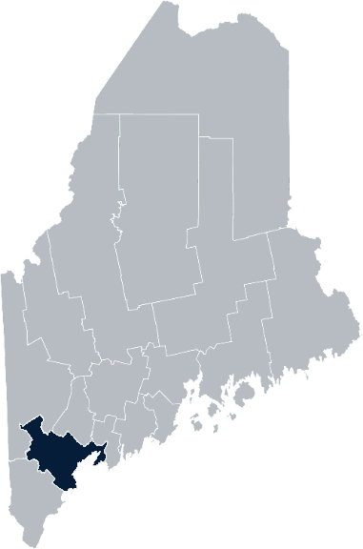
Maine Shared Community Health Needs Assessment Cumberland County/ Lakes Region
2021

Slide 2
The Maine Shared CHNA is a collaboration between the Maine Center for Disease Control and Prevention (Maine CDC), Central Maine Healthcare, Northern Light Health, MaineGeneral Health, and MaineHealth.
Notes:
Local Planning Committee Member

Slide 3
Thank you, local planning team
Catholic Charities
City of Portland, Offices of Public Health and Minority Health
Central Maine Healthcare – Bridgton Hospital
Greater Portland Health
Maine Medical Center/Maine Medical Partners
Maine Behavioral Health
Maine CDC
MaineHealth
Northern Light Mercy Hospital
Northern Light Home Care & Hospice
The Opportunity Alliance – Public Health Program
United Way of Southern Maine
Notes:
Local Planning Committee Member

Slide 4
Forum Agenda
Time | Activity | Speaker/Facilitator
4:30 – 4:35 pm | Welcome
4:35 – 4:40 pm | Overview of Zoom | Jo Morrissey, Maine Shared CHNA Program Manager
4:40 – 4:45 pm | Leadership Remarks | Peter Wright, FACHE, President of Bridgton Hospital and Rumford Hospital Kelly Barton, MPH, FACHE, President of Maine Behavioral Healthcare
4:45 – 4:55 pm | Review previous CHNA priorities and activities 2019-2021 | Kristine Jenkins, District Liaison, Maine CDC
4:55 – 5:15 pm | Presentation of key findings from the data | John Snow, Inc.
5:15 – 6:10 pm | Break-out session – facilitated discussion on data and health priority identification | John Snow, Inc. & Local Facilitators
6:10 – 6:20 pm | Reconvene and Review | John Snow, Inc.
6:20 – 6:30 pm | Wrap up and next steps
Notes:
Local Planning Committee Member to go over agenda and then turn it over to Jo Morrissey to provide an overview of the Zoom tools available and the purpose of today’s forum

Slide 5
Share screen
Join Audio, Mute On/Off
Open/close participant list or chat
Turn Video On/Off
Reactions
Notes:
Jo or JSI

Slide 6
Matching Interests
Maine Shared
Community Health Needs Assessment
Images of PHAB and IRS from the internet
Notes:
Jo or JSI

Slide 7
The Evolution of an Idea…
2010 OneMaine | 2015 SHNAPP | 2018 Maine Shared CHNA | 2021 Maine Shared CHNA
Forums Surveys | 16 Forums 1639 Surveys | 22 Mainstream Forums (live) 2 Immigrant Forums 45 Interviews | 16+ Mainstream Forums (virtual) 12+ Community Sponsored Events 2000+ Oral Surveys
Notes:
Jo or JSI

Slide 8
10 Essential Public Health Services
Notes:
Jo or JSI

Slide 9
Maine Shared CHNA Organizational Chart
Steering Committee
Program Manager
Vendor Support
Metrics Committee
Health Equity Community Engagement Committee
Data Analysis Teams
Local Planning Teams
Notes:
Jo or JSI

Slide 10
Inputs and Outcomes
Ways to Provide Input
Data Collected
Outcomes
District & County Reports DUE APRIL 2022
4 Health Priorities by county
Related indicators
Gaps/barriers and resources/assets
Notable comparisons between attendee input and the data.
Description of those who provided input
Methodology
Mainstream county forums
Number of attendees
Where attendees live (not CSE)
List of data identified Forums and CSE only)
Discussion notes (Forums and CSE only)
Chat box comments (Forums and CSE only)
Health Priorities
Gaps and Resources
Community sponsored events
State Report DUE APRIL 2022
4 Health Priorities by Community Event and immigrant population.
Related indicators
Gaps/barriers and resources/assets,
Notable comparisons to mainstream population.
Description of those who provided input
Methodology
Oral Survey
Forums, Events and Surveys conducted Fall 2021
Notes:
[Add names of those doing the leadership remarks ie Susan Keiler, VP Strategic Development of Southern Maine Health Care
Dr. Patrick Taylor, CEO/President of Cumberland Hospital]
Jo or JSI
Community Sponsored Event Partners include
Disability Rights Maine (2 events: people who are deaf or hard of hearing and people with other disabilities)
Maine Primary Care Association (People who are served by Maine’s Federally Qualified Health Centers
Maine Council on Aging (Older Adults 65+
Consumer Right Council of Maine (people with a mental health diagnosis)
Formerly Incarcerated (Maine Prisoner Re-Entry Network)
Maine Youth Action Network and Friends (Raising the voices of Maine’s diverse youth)
Green Memorial A.M.E. Zion Church (Black/African American)
Health Equity Alliance (LGBTQ+ community)
Portland Recovery Center (for people with a substance use disorder or in recovery)
ADD HOUSING INSECURE IF NEED BE
ADD VETERAN IF NEED BE
Oral Survey Partners include:
City of Portland’s Minority Health Program
New Mainer’s Public Health Initiative
Maine Immigrant Access Network
Gateway Community Services
Maine Immigrant and Refugee Services
Maine Community Integration
Mano en Mano
We are piloting these additional outreach methods with support from
State of Maine’s Preventative Health and Health Services Block Grant
Maine Health Access Foundation
Introduce leader for leadership remarks

Slide 11
Leadership remarks
Notes:
Leadership remarks
Leader to introduce the following who will provide comments on recent health improvement efforts
Peter Wright, FACHE, President of Bridgton Hospital and Rumford Hospital
Kelly Barton, MPH, FACHE, President of Maine Behavioral Healthcare

Slide 12
Health Improvement Efforts and Accomplishments
Notes:
Local Facilitator

Slide 13
Cumberland District CHNA 2019-2021 Priorities
Mental Health
Substance Misuse
Access to Care
Social Determinants of Health
Healthy Aging
Notes:
Kristine Jenkins, District Liaison, Maine CDC

Slide 14
Cumberland District Public Health Council
Engaged in Covid-19 response with Council leadership, members, and partners (2020-2021)
Convened stakeholder conversations on Covid-19 racial and ethnic disparities, and produced Council Statement (2020)
Established health priorities for Council efforts: Sexual Health, Youth Mental Health, and Adverse Childhood Experiences/Poverty- with cross-cutting focus on immigrant and refugee communities (2019)
Compiled Cumberland District Behavioral and Mental Health Resources Guide (2019)
Established working group on youth mental health, produced position paper (2019)
Notes:
Kristine Jenkins, District Liaison, Maine CDC

Slide 15
Central Maine Healthcare - Bridgton Hospital
Overall
A full-time Health Promotion Coordinator was hired to coordinate the Community Health Needs Implementation Plan as well as facilitate the current Community Health Needs Assessment
Substance Misuse
Incorporated Suboxone Induction Program in the Emergency Department.
Created a referral system between the Emergency Department and the Lakes Region Recovery Center to connect patients with Substance Use Disorder to Medication Assisted Treatment and support services
From January 1 to December 31, 2020: 30 patients were referred to the Lakes Region Recovery Center
From January 1 to September 1, 2021: 62 patients were referred to the Lakes Region Recovery Center
Access to Care
In 2021, primary care access in the Lakes Region service area is higher than 94% of all US hospitals’ populations, compared to 88% in 2018
Added a bus stop at Bridgton Hospital with the Lakes Region Explorer Bus
Notes:
Kristine Jenkins, District Liaison, Maine CDC

Slide 16
City of Portland Public Health
Created the Research and Evaluation Program
Published the 1st Health of Portland Report
Expanded the STD Clinic’s PrEP (pre-exposure prophylaxis) program
Developed the Minority Health Program’s Alignment Group
Expanded access to healthcare through Mobile Medical Outreach
Participated in the Maine Naloxone Distribution Initiative as one of four Tier 1 distributors
Passed 50+ tobacco policies since the onset of the COVID-19 Pandemic
Notes:
Kristine Jenkins, District Liaison, Maine CDC

Slide 17
Maine Medical Center/Maine Medical Partners and Maine Behavioral Healthcare/Spring Harbor Hospital
Substance Use Disorder
Trained providers to conduct Screening Brief Intervention Referral and Treatment Screening (SBIRT) for all patients
Implemented the State of Maine’s Opioid Health Home (OHH) program in 4 Primary Care practices
Increased access to Peer Recovery Services at all Maine Behavioral Healthcare Substance Use Treatment Hubs
Increased access to treatment through Integrated Medical Assisted Therapy (IMAT) serving 1,471 patients in FY 21
Implemented Rapid Access for IMAT in the Emergency Department at MMC
Access to Mental Health
Increased tele-crisis capability and expanded the hours of coverage to 7 MaineHealth hospitals
Opened 25 new psychiatric beds in Southern Maine
Trained 1,057 Maine Behavioral Healthcare and MaineHealth clinical staff in trauma informed healthcare delivery to support patients with ACEs/trauma needs
Notes:
Kristine Jenkins, District Liaison, Maine CDC

Slide 18
Maine Medical Center/Maine Medical Partners
Adverse Childhood Experiences
Trauma screening rate for patients from birth to age 17 at 94%
ACEs screening rate for patients age 3 to 17 at 78.5%
Childhood Obesity Prevention
50% of Cumberland school districts signed the Let’s Go! Partnership Agreement to improve healthy eating and active living for 13,400 students and 1,800 staff in their districts
Healthy Aging
Advance Care Directives documented for 40% of MMP primary care patients age 65 or older
Serious Illness Conversation conducted with 25% of high risk patients identified
COVID Response
Opened two vaccination sites in Cumberland at Scarborough Downs and Westbrook
160,318 individuals vaccinated at the two sites
As of June 28th, 203,604 (69%) of all Cumberland residents vaccinated
Notes:
Kristine Jenkins, District Liaison, Maine CDC

Slide 19
Northern Light Mercy Hospital
Mental Health
Increased clinician comfort in addressing & identifying mental health concerns through expanded education
Access to Care
Partnered with housing organizations & increased screening, resource identification and referrals in low-income housing sites
Developed screening program aimed at identifying & treating gastrointestinal cancers in new Mainer communities by partnering with primary care, community & church orgs, & interpreting companies
Focused all COVID-19 efforts (testing, vaccination) on communities with limited access to health care services
Substance Use
Expansion of MAT access in Emergency Department, primary care and jail partnership
Added second McAuley Residence –comprehensive two-generational program with housing for women with substance use disorder
Partnered with State for Maine MOM program for expectant mothers with opiate use disorders
Social Determinants
Implemented system wide screening tool for identifying SDOH needs with hard wired referral system for patients in all settings
Notes:
Kristine Jenkins, District Liaison, Maine CDC

Slide 20
How to Read the County Health Profiles and Health Equity Data Sheets
Notes:
JSI or other facilitator

Slide 21
How to Read County Health Profile
CHANGE shows statistically significant changes in the indicator over time, based on 95% confidence interval (see description on page 3).
ê | means the health issue or problem is getting better over time.
! | means the health issue or problem is getting worse over time.
○ | means the change was not statistically significant.
N/A | means there is not enough data to make a comparison.
BENCHMARK compares CUMBERLAND data to state and national data, based on 95% confidence interval (see description on page 3).
ê | means CUMBERLAND is doing significantly better than the state or national average.
! | means [COUNTY is doing significantly worse than the state or national average.
○ | means there is no statistically significant difference between the data points.
N/A | means there is not enough data to make a comparison.
ADDITIONAL SYMBOLS
* | means results may be statistically unreliable due to small numbers, use caution when interpreting.
— | means data is unavailable because of lack of data or suppressed data due to a small number of respondents.
EXAMPLE
Notes:
JSI or other facilitator
A star means that the health issue or problem is getting better over time or better in comparison to another place
A red exclamation point means that the health issue or problem is getting worse over time or worse in comparison to another place
A gray circle means that the dating hasn’t changed over time or isn’t much different in comparison to another place
N/A means that there was not enough data to be able to make a comparison
There are two additional symbols you might see:
A black dot means that you should use caution when interpreting the data – the results might be unreliable because of small numbers
A black dash means that data was unavailable, or that data was suppressed due to a small number of respondents
(Go to next slide and walk audience through an example)

Slide 22
How to Read County Health Profile
EXAMPLE
 | AROOSTOOK COUNTY |  |  | BENCHMARKS
INDICATOR | POINT 1 | POINT 2 | CHANGE | MAINE | +/- | U.S. | +/-
Individuals living in poverty | 2009-2011 15.6% | 2015-2019 16.1% | ¡ | 2015-2019 11.8% | ! | 2019 12.3% | N/A
Notes:
Here’s an example of how we’ve visualized the data in the County Health Profiles.
The charts in this presentation are all excerpts from the Data Health Profiles that were created by MaineHealth and the Maine CDC. They contain data pulled from publicly available sources that are designed to help people learn more about the health of their communities. Not all the data points are available for every measure, but we’ve included data wherever we can.
The green bars represent data from your community. The left most one represents a past data point, and the right bar represents the most recent data point available when the data was gathered. These are the same data points used in the Data Health Profiles.
The grey bars represent data for the state of Maine as a whole- on the left- and for the United States as a whole- on the right, when it is available.
We’ve also noted where differences in the data points are ‘statistically significant’. A difference between two measurements is significant when scientists can say, with a known degree of confidence, that the difference between them is large enough that the difference is most likely to be caused by an actual difference in the item being measured, and not caused by error associated taking the measurement. All of these tests are comparing the most recent data point for your community to other data points. A red exclamation mark indicates a difference that your community is significantly different in a less desirable direction compared to the data point with the symbol. A green star indicates that your community is significantly different in a more desirable direction. A grey circle indicates that there is no significant difference.
(keep in presentation – do not read for deaf/HOH event or people with disabilities). A difference between two measurements is significant when scientists can say, with a known degree of confidence, that the difference between them is large enough that the difference is most likely to be caused by an actual difference in the item being measured, and not caused by an error associated taking the measurement. All of these tests are comparing the most recent data point for your community to other data points.
For example, in this slide, we have two symbols. The grey circle next to the measurement for 2009-2011 Aroostook County means that there is no significantly different change in the rate of poverty in Aroostook County when comparing the data from 2009-2011 to the data from 2015-2019. The red exclamation mark next to the Maine data point says there is a significant difference between 2015-2019 Aroostook County and 2015-2019 Maine, and that it is less desirable that Aroostook County has a higher rate of individuals living in poverty. No comparison could be made to the data for the U.S. because the years of data collection were different.

Slide 23
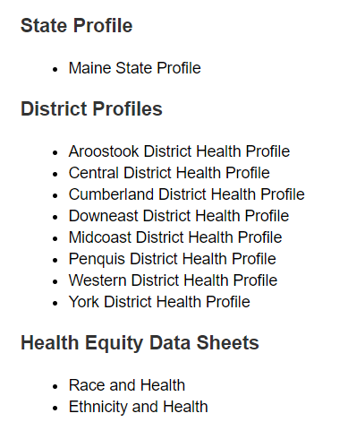
For More Data
www.mainechna.org
Notes:
The Maine Shared CHNA website contains health profiles for 3 of Maine’s largest cities, 16 counties, 5 public health districts, the state, as well as data provided by race, ethnicity, educational attainment, gender, sexual orientation, older adults, insurance status, income, and rurality.
In addition, there is an interactive data portal where you can search by specific data points. All these breakdowns are then provided by data point.
REGARDING COVID-19 DATA
The Maine Shared CHNA data set does not include any data of COVID-19. This is largely due to the fact that there is a much more up-to-date and comprehensive Maine Data Dashboard continually being updated on the Maine CDC website.
Here you can find daily lab results, new case counts by date, trends, county breakdowns, data by race, and comparisons to other states and the nation.
INTRODUCE THE PERSON WHO WILL REVIEW THE NEXT SECTION ON THE LAST COMMUNITY SLIDE
Introduce facilitator John Snow, Inc. (JSI) who will now give a data presentation on the top indicators

Slide 24
Key Findings
Notes:
As we walk through the following data slides together, take notes. What surprises you? What stands out? What’s moving in the wrong direction?
Once the data presentation is over, you will be divided into breakout groups to discuss the data, share your top concerns, identify your top priorities, and share your knowledge about what’s working and what we need to work on to address those top concerns.
Ready? Here we go.

Slide 25
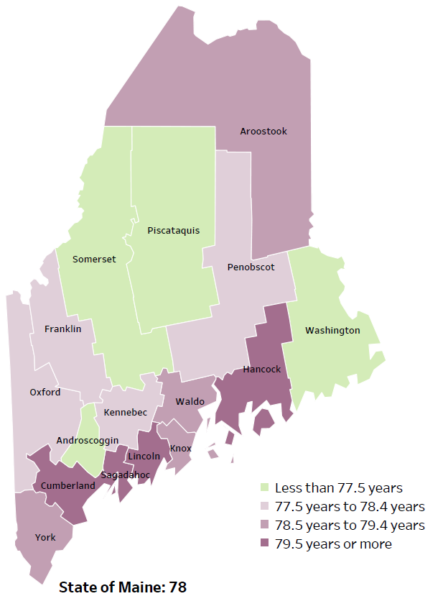
Demographics
Life Expectancy
2017-2019
National Center for Health Statistics,
CDC
RANK | MAINE | CUMBERLAND | OXFORD
1 | Cancer | Cancer | Cancer
2 | Heart Disease | Heart Disease | Heart Disease
3 | Unintentional Injury | Unintentional Injury | Chronic Lower Respiratory Disease
4 | Chronic Lower Respiratory Disease | Chronic Lower Respiratory Disease | Unintentional Injury
5 | Stroke | Alzheimer's Disease | Stroke
Notes:
The life expectancy in Cumberland County is 79.5 years or more, which is higher than the state average of 78. Cumberland County has one of the highest life expectancy in the state. This is an indication that more people are dying at an older age than residents in many other counties in Maine.
The life expectancy in Oxford County is 77.5 to 78.4 years, which is approximately the state average of 78. This is an indication that people are dying at about the same age as residents in most other counties in Maine.
The table on the right side of the slides shows the five leading causes of death in Cumberland and Oxford County. For Cumberland County, they are also the leading causes of death for the whole state of Maine other than Alzheimer’s Disease. Oxford County and Maine have the same top three leading causes of death and the same fifth leading cause of death being stroke.
The leading cause of death in each county is Cancer, the same as the state’s leading cause of death. As we will see in the next slide, Cumberland has an older population. Cancer is a leading cause of death with older individuals. However, Cumberland has significantly less cancer deaths than the state overall. As we will see later in the presentation Cumberland has lower rates of diseases related to cancer death such as diabetes. Whereas, Oxford has higher rates of diabetes.
Some highlights:
In Cumberland County, Oxford County, and Maine overall, the leading cause of death is Cancer followed by Heart Disease. The opposite is true in the U.S. overall- Heart Disease is the leading cause of death, and cancer is the 2nd leading cause. One of the reasons that this is true is because we have higher rates of risk factors for cancer, such as smoking/tobacco use. At the same time, there has been a lot of success implementing treatment of heart disease, resulting in folks with heart disease living longer.
In Cumberland County, the 3rd leading cause of death- Unintentional Injury- includes a number of accidental causes: Three of the most common causes are i) Deaths due to motor vehicle crashes, ii) deaths due to accidental falls, and iii) deaths due to poisonings that either were unintentional, or the intent was undetermined. Suicides and Firearm deaths are classified as intentional injury.
In Oxford County, the 3rd leading cause of death is Chronic Lower Respiratory Disease which risk factors include tobacco smoking.

Slide 26
Demographics
Age distribution for Cumberland County
AGE
CUMBERLAND COUNTY
POPULATION
292,307
STATE OF MAINE
POPULATION
1,362,359
Notes:
Cumberland has the largest population of any Maine County. The population has increased by more than ten thousand between 2010 and 2019. There are fewer children and teenagers, more adults aged 20 to 34, less adults aged 35 to 54, and more adults over 55. There are more adults of the age where they might expect to have children.
Source: US Census Bureau, American Community Survey

Slide 27
Demographics
Age distribution for Oxford County
AGE
OXFORD COUNTY
POPULATION
57,550
STATE OF MAINE
POPULATION
1,362,359
Notes:
Oxford has a medium sized population relative to other Maine Counties.
The population has increased by approximately 300 between 2010 and 2019. There are less children and teenagers, there are approximately the same number of adults aged 20 to 34, there are more adults aged 35 to 54, and there are less adults over age 55. There are about 2000 less adults of the age where they might expect to have children between 2010 and 2019.
Source: US Census Bureau, American Community Survey

Slide 28
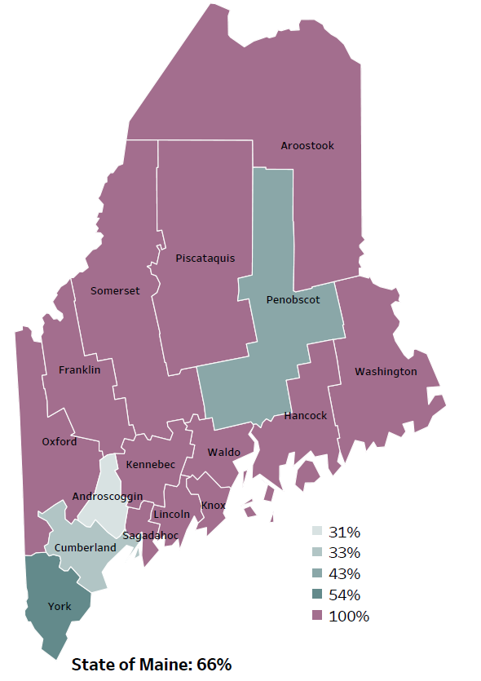
Demographics
Percentage of people living in
rural areas
2019
New England Round Table for Rural Health
Notes:
Cumberland County is one of 4 counties with population in a metro area. Oxford County is one of 12 counties with a 100% rural population.
These data are based on the most recent Census estimates at the Zip-code level, and calculated use rural Urban Commuting Area codes. The categories were established by the New England Rural Health Association. This data is NOT comparable to 2010 US Census data on populations living in rural areas, as that data uses a different definition for rural.
Source: Data, Research and Vital Statistics town-level population file

Slide 29
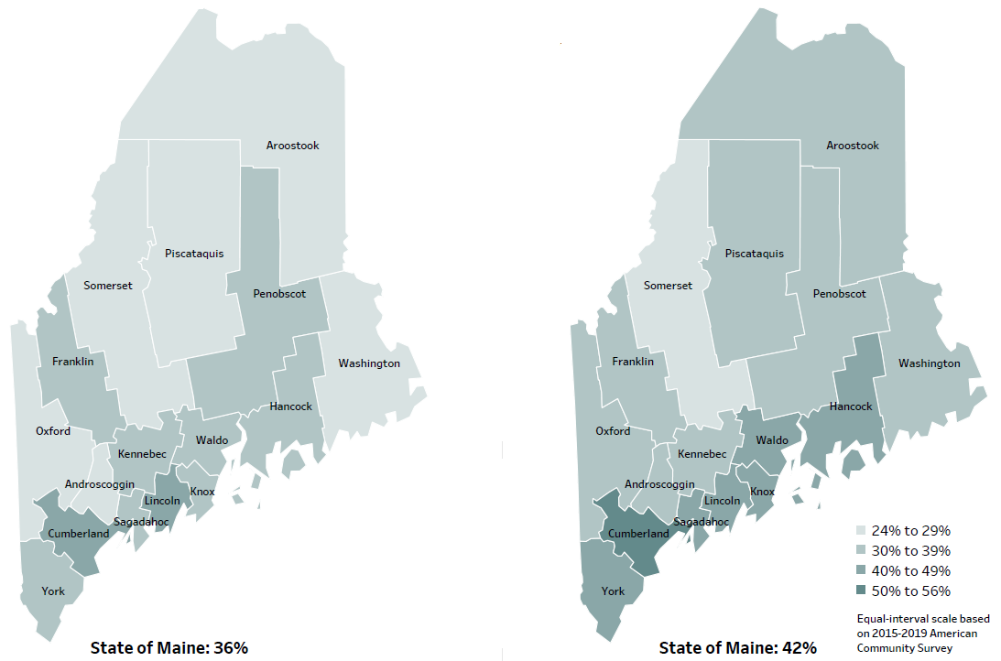
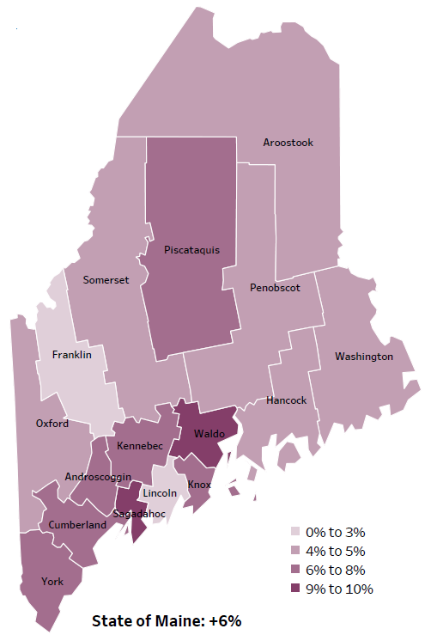
Demographics
Percent of population over age 25 with an associate’s degree or higher
2010
American Community
Survey
Change in percent of population over age 25 with an associate’s degree or higher
2010 to 2015-2019
2015-2019
American Community
Survey
Notes:
These maps show the educational attainment of adults over 25 for two different time periods. Cumberland and Oxford County has each had an increase in the rate of adults who have achieved an associate’s degree or higher degree of education. This is highlighted in the change over time map.
This map shows that Cumberland has had a greater increase than 8 other counties and equal to 6 other counties.
Oxford has a had a greater increase than 2 other counties and equal to 5 other counties.
Source: US Census Bureau, American Community Survey

Slide 30
Demographics
Life Expectancy
2017-2019
National Center for Health Statistics,
CDC
Notes:
Cumberland County has one of the highest life expectancies in the state. Cumberland has significantly lower levels of individuals and children living in poverty, high blood pressure, diabetes deaths, respiratory health problems, unintentional and intentional injury deaths, mental health related emergency room visits, and drug-affected infant reports than the State of Maine overall.
Oxford County has approximately the average life expectancy within the State of Maine. Oxford has significantly higher levels of individuals living in poverty, diabetes deaths, respiratory health problems, and drug-affected infant reports than the state. The county has significantly lower unintentional fall-related injury emergency department rates and opiate poisoning emergency department rates than the state overall.
Source: US Census Bureau, American Community Survey

Slide 31
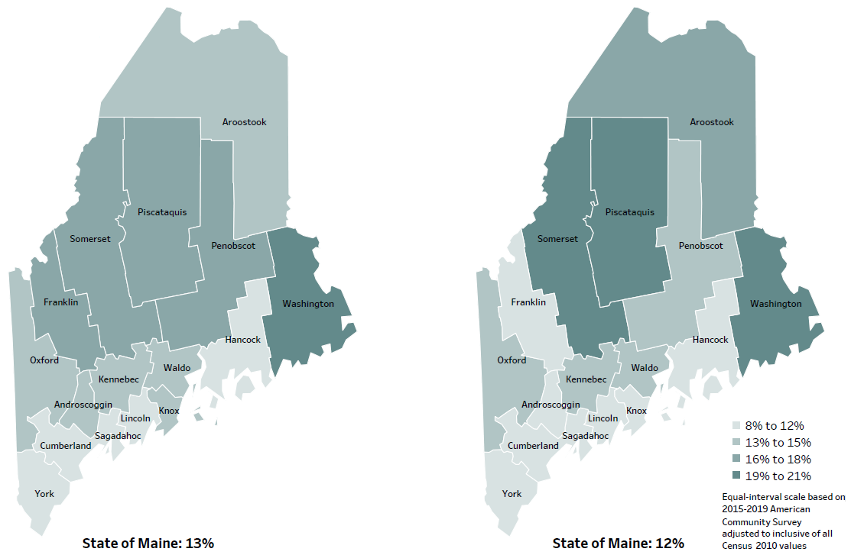
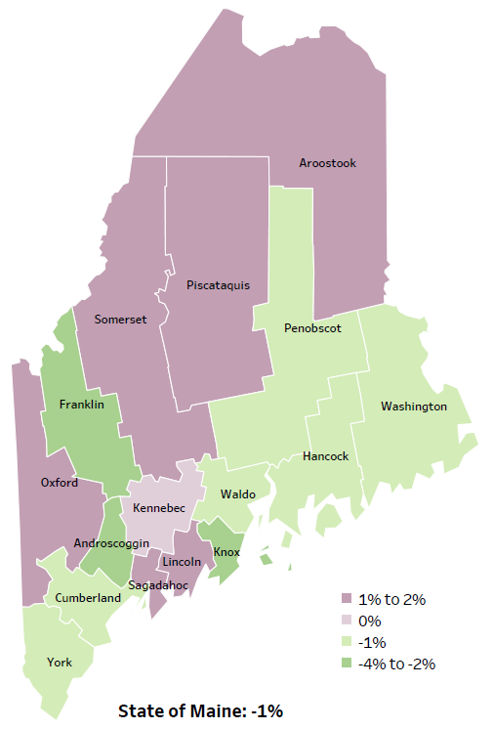
Demographics
Percent of population in poverty
2010
American Community
Survey
Change in percent of population in poverty
2010 to 2015-2019
2015-2019
American Community
Survey
Notes:
These maps show the rate of poverty for two different time periods. Cumberland county’s poverty rate has decreased slightly over the time period, as shown in the change over time map, and has among the lowest levels of poverty in the state. Poverty in Oxford has increased 1 to 2 percent between the two time periods. During this period, poverty decreased in Maine overall.
Source: US Census Bureau, American Community Survey

Slide 32
Health Indicators
Notes:
Cumberland County has seen a significant decrease in the percent of individuals living in poverty since 2009, whereas the State of Maine has seen a slight increase.
Oxford County has seen a significant increase in the percent of individuals living in poverty relative to the State of Maine overall.
Data Source: US Census Bureau, American Community Survey Read as needed. Definition: Percentage of individuals who live in households where the total income of the householder's family is below the established federal poverty level.

Slide 33
Health Indicators
Notes:
Cancer deaths in Cumberland have decreased significantly over time. The rate of deaths in Cumberland county are slightly higher than U.S. rates. These data are age-adjusted, meaning that we have calculated the rates so that they can be compared to other parts of the state that might have a younger population. Older people tend to have higher rates of many diseases, including cancer. It’s important to adjust for age so that we don’t accidentally mistake a place with older people for a place with an unusual number of disease-related deaths.
There is no Oxford data on this indicator.
Source: Maine CDC Vital Records

Slide 34
Health Indicators
Notes:
Is this slide, we see that Cumberland county has a significantly lower rate of hospitalization due to high blood pressure compared to the State of Maine.
There is no Oxford data on this indicator.
Source: Maine Health Data Organization Hospital Inpatient Database

Slide 35
Health Indicators
Notes:
Cumberland County has seen a significant decrease in diabetes deaths relative to the State of Maine overall. However, the county has had an increase, albeit not a significant increase, in diabetes deaths.
Oxford County has seen a significant increase in diabetes deaths relative to the State of Maine overall. Common causes for diabetes deaths are cardiovascular diseases and cancer.
Source: https://pubmed.ncbi.nlm.nih.gov/30296369/#:~:text=The%20most%20common%20causes%20of,early%20onset%20of%20the%20disease.
Data Source: Maine CDC Vital Records Read as needed. Definition: Rate per 100,000 people of deaths with diabetes as an underlying cause of death.

Slide 36
Health Indicators
Notes:
Cumberland County has significantly lower rates of asthma emergency department visits than the State of Maine overall. Oxford has significantly higher rates of asthma emergency department visits than the state.
“Those patients with one asthma-related ED visit are more likely to experience a subsequent ED visit within 1 year. Factors associated with an emergency department revisit within 1 week include age (less than 2 years), race, ethnicity, categorization of persistent asthma, government-assisted insurance, poor quality of life due to asthma symptoms, and increased use of health care resources in the preceding 12 months for asthma.”
Source: https://www.ncbi.nlm.nih.gov/pmc/articles/PMC4950546/#:~:text=Factors%20associated%20with%20an%20ED,preceding%2012%20months%20for%20asthma.
Data Source: Maine Health Data Organization Hospital Inpatient and Outpatient Databases Read as needed. Definition: Rate per 10,000 people of emergency department discharges with a principal diagnosis of asthma.

Slide 37
Health Indicators
Notes:
Cumberland County had significantly less pneumonia hospitalizations than the State of Maine. Oxford county had significantly more pneumonia hospitalizations that the state overall.
Recently, pneumonia has been a leading cause of hospitalizations in the US.
Source: https://www.cdc.gov/media/releases/2015/p0714-pneumonia-hospitalizations.html
Data Source: Maine Health Data Organization Hospital Inpatient Database Read as needed. Definition: Rate per 10,000 people of hospital discharges with a principal diagnosis of pneumonia.

Slide 38
Health Indicators
Notes:
Injury related deaths are significantly higher in Cumberland County between time periods. However, these deaths are significantly lower than the State of Maine overall.
As note earlier, three of the most common causes are i) Deaths due to motor vehicle crashes, ii) deaths due to accidental falls, and iii) deaths due to poisonings that either were unintentional, or the intent was undetermined.
There is no Oxford County data on this indicator.
Data Source: Maine CDC Vital Records Read as needed. Definition: Rate per 100,000 people of deaths due to injuries.

Slide 39
Health Indicators
Notes:
In Cumberland and Oxford County, there are significantly less fall-related injury emergency department visits compared to the state overall.
Data Source: Maine Health Data Organization Hospital Inpatient and Outpatient Databases Read as needed. Definition: Rate per 10,000 people of emergency department discharges with a diagnoses of a fall-related injury.

Slide 40
Health Indicators
Notes:
The rates of poisoning deaths within Cumberland County have increased significantly since 2007-2011. This indicator shows unintentional or undetermined poisoning, meaning these deaths are not due to suicide or other intentional injuries. While the Cumberland County rate is lower than the state, the difference is not significant.
Data is unavailable for Oxford County on this indicator.
Source: Maine CDC Vital Records

Slide 41
Health Indicators
Notes:
Cumberland County had significantly less mental health emergency department visits than the State of Maine overall. Nationwide, emergency department visits tend to be higher among adults aged 18-44 years old. Source: https://www.cdc.gov/mmwr/volumes/69/wr/mm6948a13.htm
Data Source: Maine Health Data Organization Hospital Inpatient and Outpatient Databases To be read as needed. Read as needed. Definition: Rate per 10,000 people of emergency department discharges with a principal diagnosis of mental health condition.

Slide 42
Health Indicators
Notes:
This graph shows rate of deaths for which drugs are the underlying cause, including those attributable to acute poisoning by drugs and those from medical conditions resulting from chronic drug use. Deaths due to alcohol use are not included. The rate of drug-induced deaths among Cumberland County residents is significantly higher within the county. There is not a significant difference between the county and the state.
Data is not available for Oxford County on this indicator.
Source: Maine CDC Vital Records and CDC WONDER Online Database

Slide 43
Health Indicators
Notes:
The percent of middle school students in Cumberland County who have seriously considered suicide has increased between the two time periods. The difference between the two time points is significant.
Data Source: Maine Integrated Youth Health Survey To be read as needed. Read as needed. Definition: Percentage of seventh- and eighth-grade students who ever seriously considered attempting suicide. Data collected in odd numbered years.

Slide 44
Health Indicators
Notes:
The percent of Cumberland and Oxford County middle school students reporting feeling sad or hopeless for two week in a row has increased, however this difference is not significant.
Data Source: Maine Integrated Youth Health Survey To be read as needed. Read as needed. Definition: Percentage of seventh- and eighth-grade students who ever felt so sad or hopeless almost every day for two weeks or more in a row that they stopped doing some usual activities. Data collected in odd numbered years.

Slide 45
Health Indicators
Notes:
This graph shows the percentage of 7th and 8th graders feeling sad or hopeless for two weeks in a row from 2015, 2017, and 2019.
In 2015 in Oxford County 28% reported feeling sad or hopeless, this decreased to 20% in 2017, then increased to 25% in 2019.
Cumberland County has seen an increasing trend of feeling sad/hopeless from 2015, to 2017, to 2019.
In 2019, each county saw increase in feelings of sadness and hopelessness amongst middle school students.
Data for these measures are collected in odd numbered years.
Data Source: Maine Integrated Youth Health Survey To be read as needed. Read as needed. Definition: Percentage of seventh- and eighth-grade students who ever felt so sad or hopeless almost every day for two weeks or more in a row that they stopped doing some usual activities. Data collected in odd numbered years. To be read as needed. Read as needed. Definition: Percentage of seventh- and eighth-grade students who ever seriously considered attempting suicide. Data collected in odd numbered years.

Slide 46
Health Indicators
Notes:
Between time periods, Cumberland County has seen a significant decrease in drug-affected infant births between time periods and compared to the State of Maine overall.
Oxford County has experienced a decrease in drug-affected infant births between time periods. However, the number of drug-affected infant births is significantly higher than the state.
Source: Maine Automated Child Welfare Information System (Maine Office of Child and Family Services)

Slide 47
Health Indicators
Notes:
This graph shows the rate of drug-affected infant births per 1,000 births from 2015 through 2018-2019. Cumberland County has ranged between 29 and 42 over the range of dates. Oxford County saw a dramatic increase to 143 in 2017 which decreased to 121 in 2018-2019. This is still above the State average of 74 during 2018-2019.
Data Source: Maine Automated Child Welfare Information System (Maine Office of Child and Family Services) Read as needed. Definition: Rate per 1,000 births of infants for which a healthcare provider reported that there was reasonable cause to suspect the baby may be affected by illegal substance abuse or demonstrating withdrawal symptoms resulting from prenatal drug exposure or has a fetal alcohol spectrum disorder.

Slide 48
Health Indicators
Notes:
Between time periods, the percentage of alcohol-induced deaths increased significantly in Cumberland County.
Nationwide, more than half of deaths are due to drinking too much over time, such as such as various types of cancer, liver disease, and heart disease. Short-term causes of death include poisonings involving other substances (e.g., drug overdoses), suicide, and motor vehicle crashes.
Source: https://www.cdc.gov/alcohol/features/excessive-alcohol-deaths.html
Data is not available for Oxford County on this indicator.
Data source: Maine CDC Vital Records and CDC WONDER Online Database

Slide 49
Health Indicators
Notes:
In Cumberland County past-30-day marijuana use amongst adults has increased significantly between time periods.
Data is not available for Oxford County on this indicator.
Source: Behavioral Risk Factor Surveillance System

Slide 50
Health Indicators
Notes:
In Cumberland County, the percentage of high school students' binge drinking has increased significantly between time periods.
Nationwide and reversing a trend, in 2019 females were more likely than males to report binge drinking. Youths who drink alcohol underage are more likely to experience school, social, legal, and physical problems. They are also more likely to experience physical or sexual violence, increased risk of suicide and homicide, motor vehicle crashes, among other problems.
Source: https://www.cdc.gov/alcohol/fact-sheets/underage-drinking.htm#:~:text=Although%20males%20historically%20had%20higher,than%20male%20high%20school%20students.&text=19%25%20of%20young%20people%20aged,in%20the%20past%2030%20days.
Data is not available for Oxford County on this indicator.
Source: Maine Integrated Youth Health Survey

Slide 51
Health Indicators
Notes:
This graph show reported binge drinking amongst Cumberland County high school students from 2013 to 2019. Binge drinking took a notable and sustained increase between 2015 and 2017.
Data Source: Maine Integrated Youth Health Survey Read as needed. Definition: Percentage of high school students who had five or more alcoholic drinks on at least one day in the last 30 days. Data collected in odd numbered years.

Slide 52
Health Indicators
Notes:
The percentage of high school students reporting marijuana use over the past-30-days has increased significantly between time periods.
Teenage marijuana use may harm the actively developing teenage brain. Negative effects include: difficulty thinking and problem solving, problems with memory and learning, impaired coordination, and difficulty maintaining attention.
Source: https://www.cdc.gov/marijuana/factsheets/teens.htm
Data is not available for Oxford County on this indicator.
Data Source: Maine Integrated Youth Health Survey

Slide 53
Health Indicators
Notes:
This graph show reported marijuana use over the past-30 days amongst Cumberland County high school students from 2013 to 2019.
Data Source: Maine Integrated Youth Health Survey Read as needed. Definition: Percentage of high school students who used marijuana at least one time in the last 30 days. Data collected in odd numbered years.

Slide 54
Health Indicators
Notes:
Cumberland County has significantly higher rates of opiate poisoning emergency department discharges than the State of Maine. Oxford County has significantly less opiate poisoning emergency department discharges than the State of Maine.
Data Source: Maine Health Data Organization Hospital Inpatient and Outpatient Databases

Slide 55
Breakout Discussions

Slide 56
Reconvene

Slide 57
Wrap up and Next Steps

Slide 58
Contact
Cecilia Natale, Health Promotion Coordinator, Central Maine Healthcare - Bridgton Hospital natalece@cmhc.org 207-795-5792
Maine Shared CHNA: info@mainechna.org www.mainechna.org

