Slide 1
Maine Shared Community Health Needs Assessment
Aroostook District
Notes:
Local facilitator

Slide 2
Welcome and Introductions
Notes:
Local Facilitator

Slide 3
Thank you to the following sponsors of this forum!
Laura Turner | The Aroostook Medical Center
Leah Buck | Northern Maine AHEC
Nichole Cullinan | Houlton Regional Hospital
Rachael Albert | University of Maine at Fort Kent
Nicole Hammar | EMHS
Bill Flagg | Cary Medical Center
Susan Bouchard | Fish River Rural Health
Joy Barresi Saucier | Aroostook Agency on Aging
Stacy Boucher | Aroostook District Coordinating Council
Joanne Fortin | Northern Maine Medical Center
Carol Bell | Community Member
Greg Disy | Aroostook Mental Health Center
Amy Kane | Pines Health Service/Aroostook County Health Network
Notes:
Local Facilitator

Slide 4
Forum Agenda
Time Spent | Activity | Speaker/Facilitator
5 minutes | Welcome and Introductions | Local Facilitator
10-15 minutes | Review of previously identified priorities and activities since last effort | Local Facilitator
25 minutes | Present key findings from Data Profile Q&A | JSI
35-45 minutes | Facilitated discussion on data and identifying health priorities | JSI & Local Facilitators
20 minutes | Reconvene and full vote on health priorities | JSI
10 minutes | Wrap up and next steps | Local Facilitator (or JSI if preferred)
Notes:
Local Facilitator

Slide 5
Why are we here?
Notes:
JSI or other facilitator
There are a number of things that bring us here today from the IRS, national accreditation boards, as well as the insight and leadership from the Maine Shared CHNA leader ship who long before the IRS and accreditation requirements saw an opportunity to work together to make Maine the healthiest state in the nation.

Slide 6
Guidance, Regulations & the Law
Maine Shared
Community Health Needs Assessment
Images of PHAB and IRS from the internet
Notes:
JSI or other facilitator
"Refer to page 27 in the Maine Shared CHNA Toolkit for more background. Optional handout.“
Maine is the only state in the nation that conducts a statewide community health needs assessment through our unique public private partnership. These community health needs assessments – referred to as “CHNAs” – are required for non-profit hospitals (under the IRS and ACA) and for local health departments to meet requirements under the Public Health Accreditation Board (PHAB). Among the required activities are:
Obtain input from the community, including providers and communities served, on health needs (which is why we’re here today)
Evaluate previous actions taken to address needs identified in previous CHNAs
Choose needs to be addressed (and provide justification)
Summarize an implementation strategy

Slide 7
Maine Shared CHNA
Program Manager
Metrics Committee
Steering Committee
Data Analysis Team
Community Engagement Committee
Local Planning Teams
JSI
Governance
Notes:
JSI or other facilitator
Steering Committee consists of representatives from the signatory members: Central Maine Heath Care, Eastern Maine Healthcare (EMHS to become Northern Light Health on October 1) Maine General Healthcare, MaineHealth, and the Maine Center for Disease Control and Prevention. Major funding for the Maine Shared CHNA is provided by the partnering healthcare systems with generous in-kind support from the Maine CDC and the countless organizations who contribute to this effort.
Funding supports the Program Manager and contracting with a vendor to support this effort. John Snow, Inc. (JSI) was selected in January, 2018. Ask folks to stand if they have served in any or all of the following roles:
Data Analysis Team is made up of a subgroup with representatives from the Metrics Committee, analysts from Maine CDC, USM, and JSI. Their role has been to collect and analyze the list of 200 indicators identified by the Metrics Committee
Metrics Committee is made up of representatives from the signatory members with further support from UNE, USM, and subject matter experts.
The CEA made up of a subgroup with representatives from the Statewide Community Engagement Committee. Their role has been to provide advice and guidance to the Program Manager on every aspect of community engagement.
Statewide Community Engagement includes partners and interested parties who have provided feedback on all aspects of community engagement
Local Planning Teams have set dates, found venues, and organized every aspect of today’s event.
They deserve a hand!

Slide 8
Health Improvement Process
Community Health Needs Assessment (CHNA)
Hospital Implementation Strategies
(IS)
Public Health
District Health Improvement Plan
(DPHIP)
State Health Improvement Plan
(SHIP)
Evaluate
Partners
Partners
Partners
Partners
Partners
Partners
Notes:
JSI or other facilitator
Best practice = including regular community assessment of data and progress, which creates multi level health improvement plans, which are evaluated regularly. Health Improvement Plans cannot succeed without partners – many who are here today.

Slide 9
Local Activities and Accomplishments
Notes:
Local Facilitator
There are a number of things that bring us here today from the IRS, national accreditation boards, as well as the insight and leadership from the Maine Shared CHNA leader ship who long before the IRS and accreditation requirements saw an opportunity to work together to make Maine the healthiest state in the nation.

Slide 10
Aroostook District – Aroostook County
Hospital and District priority areas of work since the 2016 Shared CHNA
Access to Care | Aging Problems | Cardiovascular Disease | Chronic Disease | Food Insecurity
Aroostook DCC The Aroostook Medical Center Cary Medical Center | Aroostook DCC The Aroostook Medical Center Cary Medical Center Northern Maine Medical Center | Aroostook DCC The Aroostook Medical Center Cary Medical Center Northern Maine Medical Center | The Aroostook Medical Center Cary Medical Center | Aroostook DCC The Aroostook Medical Center Cary Medical Center Northern Maine Medical Center Houlton Regional Hospital
Maintain Community Based Hospital | Mental Health Services | Obesity | Preventable Hospitalizations | Substance Use Disorder
The Aroostook Medical Center Cary Medical Center Northern Maine Medical Center Houlton Regional Hospital | Aroostook DCC The Aroostook Medical Center Cary Medical Center | Aroostook DCC The Aroostook Medical Center Cary Medical Center Northern Maine Medical Center Houlton Regional Hospital | The Aroostook Medical Center Cary Medical Center Northern Maine Medical Center | Aroostook DCC The Aroostook Medical Center Cary Medical Center Northern Maine Medical Center
Notes:
Local Facilitator

Slide 11
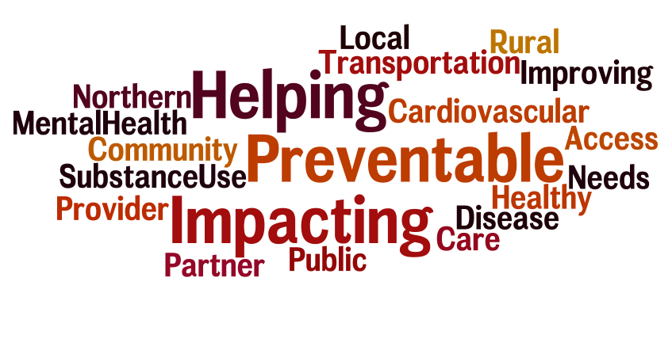
Partners
Notes:
Local Facilitator
TO MAKE YOUR OWN WORDLE: http://www.wordle.net/
PLEASE SEE COLOR SCHEME FOR RGB #S TO MATCH TEMPLATE COLORS

Slide 12
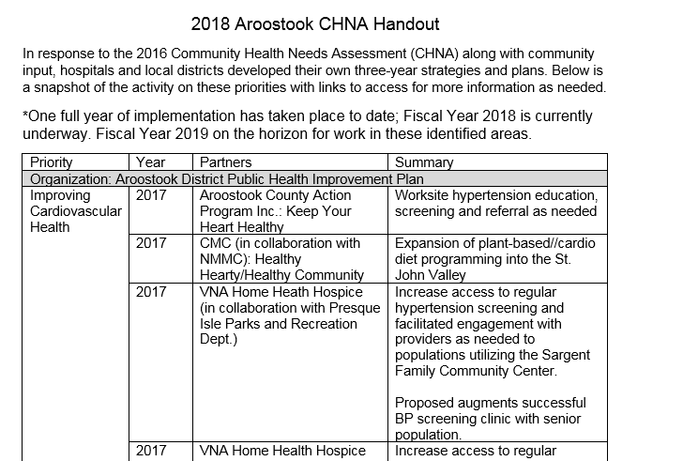
Accomplishments of Note
See Handout
Notes:
Local Facilitator
Segue to next slide: “And it is here where we return full circle to the beginning of the Health Improvement Process.
To talk more about that, and the most recent data, here’s _{JSI, JO/NANCY, other} again

Slide 13
How to Read County Health Profile
EXAMPLE
Notes:
JSI or other facilitator
The County Profile provides almost 200 health data indicators from over 30 sources. Looking through the document, you’ll see that wherever possible, we’ve included data for the county for two points in time (to note any changes over time), state data (to compare the county to the state), and national data (to compare the county and the state to the US). Along with the data, you’ll notice some symbols. These symbols show whether there are important changes in the data over time, and show where County data is notably better or worse than the state or the nation.
When we’re looking at the County level data to see if things changed over time:
A star means that the health issue or problem is getting better over time
A red exclamation point means that the health issue or problem is getting worse over time
A gray circle means that any change in the data over time is not statistically significant
N/A means that there was not enough data to be able to make a comparison
Looking at County data in comparison to the state and national data:
A star means that the County is doing significantly better than the state or national average
An exclamation point means that the county is doing significantly worse than the state or national average
A gray circle means there is no statistically significance between the County and the state or national average
N/A means that there isn’t enough data to make a comparison
There are two additional symbols you might see:
A black dot means that you should use caution when interpreting the data – the results might be unreliable because of small numbers
A black dash means that data was unavailable, or that data was suppressed due to a small number of respondents
(Go to next slide and walk audience through an example)
The following data was chosen for this PowerPoint based on the criteria below:
Previous County Priorities
Indicators visualized in the County Health Profile
The county level data significantly diverges from the state and/or nation in either a positive or negative direction.
Significant changes in prevalence, incidence or health behavior over time (trend)
The magnitude of impact is significant (i.e. high rates of prevalence and incidence). (i.e.: does this indicator impact leading cause of mortality and/or morbidity?)
Based on the criteria above, the “33 Key Indicators” were used to prioritize “tie breaks”
Requests by local planning teams
we should direct people to the "how to read this profile page in the profile, and walk them through key points. I am sorry, this just occurred to me, but it is critical to orient people to the profiles. It might be worth (yet) another slide??

Slide 14
How to Read County Health Profile
EXAMPLE
Notes:
JSI or other facilitator
Lets use this line as an example
Here, we can compare the overall death rate in this County between 2007-2011 and 2012-2016. Although the rate is higher in Point 2, the gray circle tells us that the change over time was not significant.
We then look at the most recent data compared to the state and to the US. Here, the red exclamation point tells us that the County rate is significantly higher then the state and the US.

Slide 15
Key Findings
Notes:
JSI or other facilitator
We encourage you to spend some time looking through the County Health Profile. We won’t be able to cover all that is in the document during this presentation today, but we’ve pulled out a number of key findings to give you an overview of health in each county.
The following data was chosen for this PowerPoint based on the criteria below:
Previous County Priorities
Indicators visualized in the County Health Profile
The county level data significantly diverges from the state and/or nation in either a positive or negative direction.
Significant changes in prevalence, incidence or health behavior over time (trend)
The magnitude of impact is significant (i.e. high rates of prevalence and incidence). (i.e.: does this indicator impact leading cause of mortality and/or morbidity?)
Based on the criteria above, the “33 Key Indicators” were used to prioritize “tie breaks”
Requests by local planning teams

Slide 16
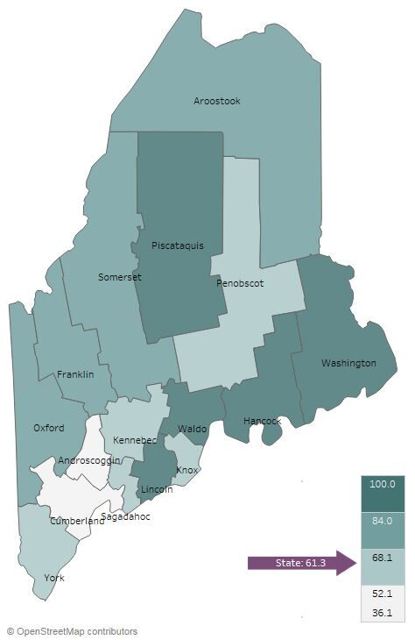
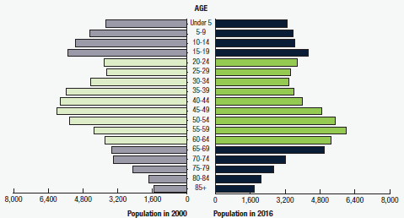
Demographics
Aroostook: Age Distribution
Percent of Population Living in Rural Areas, 2012-2016
Notes:
JSI or other facilitator
Direct people to Page 5-8 of County Profile for more information on demographics
AGE:
The county is aging. Aroostook is one of 4 counties where the 21-23% of population is over 65. In 2000, no county in Maine had more than 18% of the population over age 65.
Approximately 20% (18.9) of Aroostook County’s population is under 18, while slightly over 20% (21.3) is 65 or older.
It’s important to understand the age distribution in a community when assessing health status – for example, older individuals typically have more complex/chronic conditions and physical vulnerabilities (e.g. falls) and young people may be more apt to engage in risky behaviors (e.g., alcohol and tobacco use, unprotected sex)
For additional information on age, there is a map showing percent of the population over age 65 in the profile on page 8
RURALITY:
Looking at this map, you can see that Aroostook is among a handful of counties where approximately 70-85% of the population lives in a rural area.
There are a number of risk factors associated with rural living that have an affect on ones health – geographic isolation, lower SES, higher rates of health risk behaviors, limited job opportunities, etc. Rural communities tend to have higher rates of poor overall health and chronic disease compared to urban populations

Slide 17
Demographics
Change in Percent of Population Age 25+ With Associates Degrees or Higher, 2000-2016
Change in Percent of Population Living in Poverty, 2000-2016
Notes:
JSI or other facilitator
These maps show the trend in time in demographics of education and poverty. Darker purple on the map shows an increase between the year 2000 and 2016.
Direct people to Page 18 of the County Health Profile – the Social Determinants of Health Section. Here you find other data points related to socioeconomic status, like median household income and unemployment rate.
EDUCATION:
Higher education is associated with improved health outcomes and social development at the individual and community level. The health benefits of higher education typically include better access to resources, safer and more stable housing, and better engagement with providers. Those with lower levels of education typically have more difficulty navigating the health system and are exposed to more chronic stress.
There has been an increase in the percent of the population with an associates degree or higher since 2000. 28% of Aroostook residents have an Associates degree or higher, which is lower compared to Maine’s population overall (37%). However, the estimated high school graduate rate is higher in Aroostook (90%) compared to the state overall (87%)
POVERTY:
Poverty impacts all facets of an individuals life – it may prevent someone from continuing their education, can impede access to healthy food and safe housing, and overall, makes it more difficult to maintain good health.
In Aroostook, the % of population living in poverty has increased since the year 2000. Approximately 18% (17.7) of the population lives in poverty, compared to 14% (13.5) of Maine’s population overall.
Looking specifically at children living in poverty, Aroostook again has a percentage higher than the state – 27% (23.6) compared to 17% (17.2) for the state overall
The median household income in Aroostook is approximately $12,000 lower than the state ($38K vs. 51K)

Slide 18
Demographics
Aroostook: Gay, Lesbian, and Bisexual High School Students
12%
Maine 11%
2011
2017
Notes:
JSI or other facilitator
LGBT:
Between 2011 and 2017, the percentage of high school students identifying as LGB doubled in Aroostook County
Those that identify as LGB may face obstacles in accessing culturally competent health care services
LGB individuals are at a higher risk of being homeless when they are young, are more likely to be harassed and discriminated against at school and in the workplace, and face disparities with respect to rates of chronic disease, substance use, mental health issues, sexual health issues, and violence
The percentage of adults who identify as LGBTQ is 2.3%

Slide 19
Health Equity Data
Handouts include selected data for:
Sex
Race
Ethnicity
Sexual orientation
Education
Income
Rurality
Notes:
JSI or other facilitator
In addition to the county health profiles, we are providing some tables showing health disparities among some populations within Maine.
These data are state level data. When we try to look at the same data at the county level, we generally found that:
Much of the data is suppressed due to small numbers and privacy concerns
The variation between these groups does not change very much from county to county. If the group shows a disparity at the state level, the same disparity will be at the local level
These tables show the percentage or rate of health or social determinants of health indicators (rows) by varying
education groups in Maine (columns). In the example on the screen, 59.6% of adults with less than a high school diploma have an income of less than $25,000, while 9.7% of adults with a bachelor’s degree or higher have an income of less than $25,000.
The columns in each row therefore do not add up to one hundred.
The bar chart in the final column shows the same data in the same order in a chart format. In the example on the on the screen, you can see that many indicators show better outcomes as peoples’ educational level increases.

Slide 20
Years of Potential Life Lost
Aroostook: Years of Potential Life Lost per 100,000 Population
8000.0
Maine 6529.2
YPLL measures premature death, or the years of potential life lost before the age of 75.
Notes:
JSI or other facilitator
The YPLL measure is used because simple mortality rates do not fully address the issue of premature death, the impact of disease and death, and their cost to society. The YPLL increased in Aroostook between 2010-2012 and 2014-2016. Compared to Maine overall, the years of potential life in Aroostook County is significantly high.
A high YPLL tells us that there is reason to focus attention on deaths that could have been prevented – there is reason to investigate the causes of premature death.
For example, a person dying at age 25 contributes 50 years of life lost, whereas a person who dies at 65 contributes 10 years of life lost to a County’s YPLL. In other words, high rates of years of potential life lost is an indicator of people dying young.
Leading causes of death by county and state can be found on page 15 of the County Health Profile. Other mortality stats can be found on page 19.

Slide 21
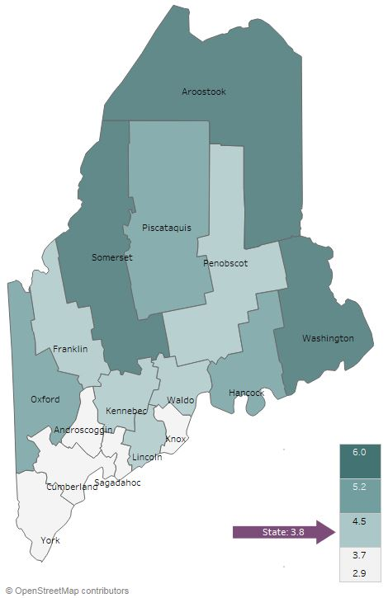
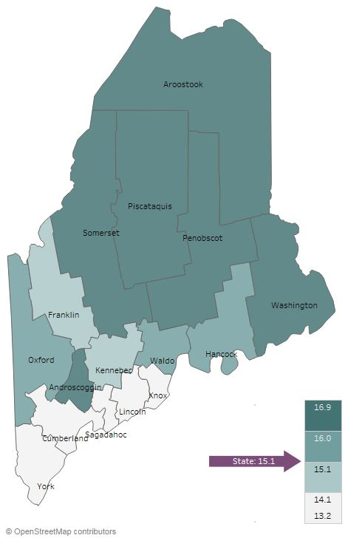
Social Determinants of Health
Unemployment Rate, 2012-2016
Percentage of Households that are Food Insecure, 2012-2016
Notes:
JSI or other facilitator
Direct people to page 18 of the county health profile for more data on the social determinants of health. The social determinants of health are the conditions that effect the environments in which people live, work, learn, and play
UNEMPLOYMENT
The unemployment rate in Aroostook County is 6%. As you can see in this map, it is one of three counties in the state with an unemployment rate between 5.2 and 6%
Lack of gainful employment is linked to several barriers to good health – lack of health insurance and inability to pay for care, inability to pay for transportation to/from appointments, etc.
FOOD INSECURITY
Food insecurity is the inability to access to enough nutritional food.
The map above shows the percentage of households in each county that lack access to enough food to maintain an active, healthy lifestyle for all household members. You’ll see that Aroostook is one of six counties in the state where over 16% of households are food insecure.
Food insecurity has been linked to poor health outcomes, including obesity.

Slide 22
Social Determinants of Health
Aroostook: Violent Crime Rate Per 100,000 Population
400.0
Maine 366.7
Notes:
JSI or other facilitator
Direct people to Page 25 of the County Health Profile for more data on violence and intentional injury
Crime and violence are public health issues that impact health status on many levels – from death to injury, trauma, anxiety, isolation, and community cohesion
From 2010-2013 and 2014-2016, the rate of violent crime in Aroostook County increased significantly from 233 per 100,000 to 350 per 100,000. Though there was a significant increase within the County, the current rate of violent crime is lower than the state rate (367)

Slide 23
Health Behaviors- Obesity
40%
40%
Maine 30%
Maine 15%
2011
2017
2011
2017
Notes:
JSI or other facilitator
Lack of physical activity, poor nutrition, and obesity are among the leading risk factors associated with chronic health issues. Adequate nutrition helps prevent disease and is essential for the healthy growth and development of children and adolescents. Being physically active reduces the risk for many chronic health conditions and is linked to good emotional health.
Starting at the bottom of Page 21 and moving into Page 22 of the County Health Profile, you’ll find data on physical activity, nutrition, and weight.
Obesity – Adults
The percentage of adults in Aroostook that are obese is higher than the state overall.
As you can see in the County Health Profile on Page 22, significantly fewer adults reported that they met aerobic physical activity guidelines compared to the state overall
Obesity – High School
The percentage of high school students in Aroostook that are obese is significantly higher than the state overall
If you turn to page 22 of the County Health Profile, you’ll see data around nutrition that may be having an impact on this rate. Notice that the percentage of high school students who met physical activity recommendations decreased, and the several data points around nutrition

Slide 24
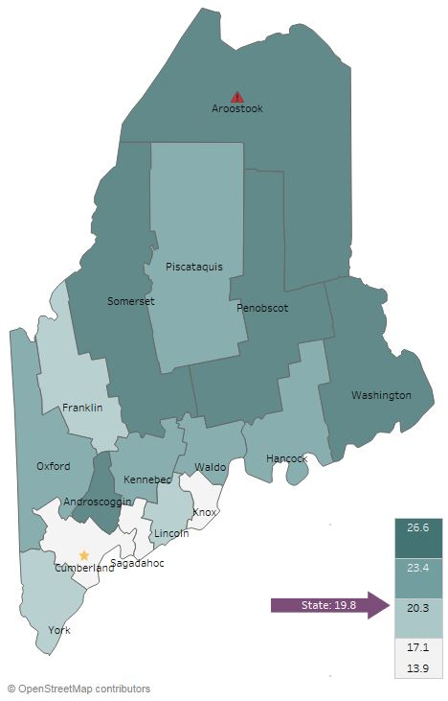
Health Behaviors- Smoking
Current Smoking (Adults), 2016
Notes:
JSI or other facilitator
The percentage of high school students who reported e-cigarette use in the past 30 days has declined between 2015 and 2017
ADULT CURRENT SMOKING:
As you can see on this map, Aroostook is the only county where the percent of adults who currently smoke cigarettes is significantly higher than the state
See page 27 of the County Health Profile for data on secondhand smoke exposure

Slide 25
Health Behaviors- Smoking
Aroostook: Past-30-day E-Cigarette Use (High School)
Aroostook: Past-30-day Cigarette Smoking (High School)
25%
18%
Notes:
JSI or other facilitator
Page 27 of the County Health Profile has additional data on Tobacco Use
Reducing tobacco use is the single most effective way to prevent death and disease in the US. Each year, almost half a million Americans die from tobacco related illnesses. For every person who dies from tobacco use, 30 more suffer with at least one serious tobacco-related illness, such as COPD, heart disease, or cancer
PAST 30 DAY HIGH SCHOOL:
Over time, the percentage of high school students who reported smoking cigarettes in the past 30 days has decreased. However, as you can see in the County Health Profile on Page 27, the percentage in 2017 was significantly higher than the state
The percentage of high school students who reported e-cigarette use in the past 30 days has declined between 2015 and 2017

Slide 26
Health Behaviors- Substance Use
Aroostook: Past-30-day Alcohol and Marijuana Use (High School)
30%
Notes:
JSI or other facilitator
Please see Page 26 and 27 of the County Health Profile for additional data on substance use
As you can see on this graph, the percentage of high school students who reported alcohol or marijuana use in the past 30 days has declined over time. If you look at the county health profile, on page 26, you’ll see that the percentage of students who reported marijuana use in the past 30 days in 2017 was significantly lower than the state
On Pages 26 and 27, you should also note that:
The percentage of high school students who reported binge drinking was significantly higher than the state, and it should also be noted that because the question changed in 2017, the 2017 data is not included in the profiles since the data is not comparable to previous years
Between 2011-2013 and 2014-2016, the percentage of adults who reported chronic heavy drinking increased from 4.7 to 5.8%
Youth substance use can lead to problems in school, can aggravate physical and/or mental health issues, contribute to accidents and injury, and create lifelong health problems.
The percentage of HS students who reported marijuana or alcohol use in the past 30 days declined from 2011 to 2017 – in fact, the percentage of students who reported past 30-day marijuana use
Among high school students:
The percentage of high school students who reported using marijuana or alcohol in the past 30 days decreased from 2011 to 2017
The percentage of high school students who reported past 30-day marijuana use was significantly lower in Aroostook County compared to the state overall
was significantly lower in Aroostook County compared to the state overall

Slide 27
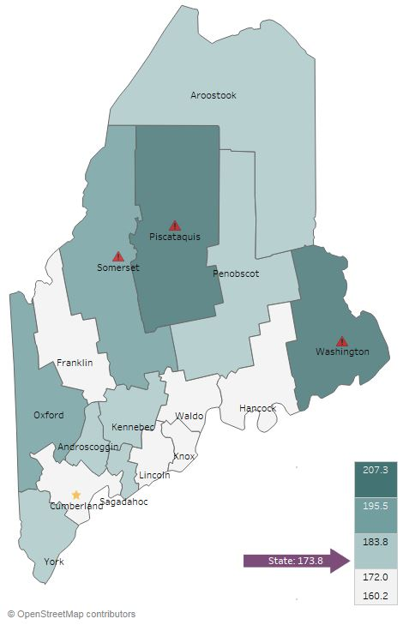
Health Outcomes- Cancer
All Cancer Deaths, 2016
Notes:
JSI or other facilitator
Please see Pages 19 and 20 of the County Health Profile for more Cancer related data
Experts have an idea of the risk and causal factors associated with cancer, but more research is needed to understand the many unknowns that still exist. What we do know is that there are several common risk factors: age, family history, tobacco use, overweight/obesity, excessive alcohol consumption, exposure to the sun, and exposure to environmental and occupational pollutants.
Cancer is the leading causes of death for the state and for Aroostook County.
Aroostook is one of two counties in the state where the rate of death due to all types of cancer declined between 2007-2011 and 2012-2016 – from 200 to 175. However, in the County Health Profile on page 19, you’ll see a number of other cancer-related data points. Notably-
The death rate due to lung cancer is significantly high in Aroostook County compared to the US (56 vs 41)
The all-cancer incidence (478 vs. 437), bladder cancer incidence (30 vs. 20), lung cancer incidence (79 vs. 59), and prostate cancer incidence (121 vs 95) are all significantly higher in Aroostook County compared to the US

Slide 28
Health Outcomes- Adult Chronic Disease
Aroostook: Diabetes Prevalence (Adults)
Aroostook: Asthma Prevalence (Adults)
15%
15%
Maine 12%
Maine 10%
Notes:
JSI or other facilitator
Rate of diabetes in Aroostook County is significantly higher than in the state. You can see more data on Diabetes on Page 21 of the County Health Profile
Asthma rates are not significantly higher for adults or children than the state, but are higher than nationals rates (9.3% adults) and (8.5% children)

Slide 29
Health Outcomes-Adult Chronic Disease
Aroostook: High Cholesterol
(Adults)
Aroostook: High Blood Pressure (Adults)
60%
60%
Maine 39%
Maine 34%
Notes:
JSI or other facilitator
High cholesterol and high blood pressure is significantly higher in Aroostook than the state. Both of these are risk factors for a number of cardiovascular diseases and conditions, including coronary heart disease, heart attack, and stroke. On Page 20 of the County Health Profile, you will see a number of data points related to cardiovascular disease

Slide 30
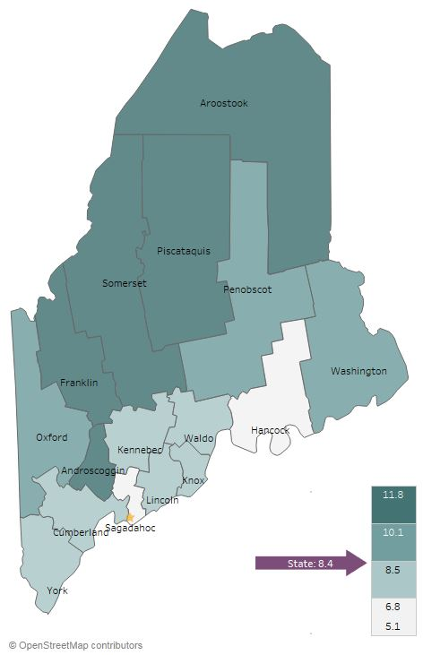
Health Outcomes- Mental Health
Current Depression (Adults), 2014-2016
Aroostook: Sad/Hopeless for 2 Weeks in a Row (High School)
30%
Maine 27%
2011
2017
Notes:
JSI or other facilitator
Mental health has an impact on individuals, families, and communities. Like substance use, mental health impacts all segments of the population, across demographic and socioeconomic lines.
You can see more data on mental health on Pages 25 and 26 of the County Profile.
Looking at the map, you’ll see that Aroostook is one of four counties with the highest percentage of depressed adults.
Between 2011 and 2017, you’ll see that the percentage of high school students who reported being sad or hopeless for more than two weeks in a row increased 5%.

Slide 31
Health Outcomes- Mental Health
Aroostook: Suicide Deaths per
100,000 Population
25.0
Maine 15.9
Notes:
JSI or other facilitator
In Aroostook County, suicide deaths per 100,000 were higher than the state (16), and were significantly higher than the US average (13.5).

Slide 32
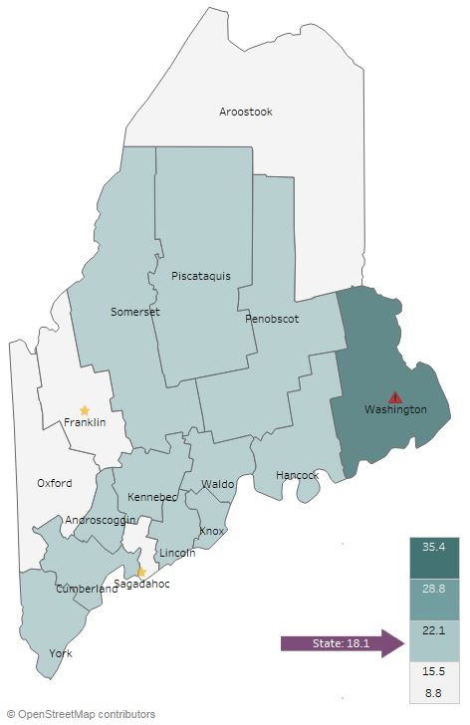
Health Outcomes- Substance Use
Overdose Deaths Per 100,000 Population, 2012-2016
Aroostook: Drug-Affected Infant Reports per 100,000 Population
2017
114
2010
55
Notes:
JSI or other facilitator
The rate of overdose deaths per 100,000 was lower in Aroostook County compared to Maine overall. You can see that it has one of the lowest overdose death rates among all counties.
The rate of drug-affected infant reports has more than doubled from 2010 to 2017
Additional data on substance use can be seen on Page 26 of the county Health Profile

Slide 33
Health Outcomes- Infectious Disease
Aroostook: New cases per 100,000 Population
300.0
Maine 293.4
Maine 92.8
Maine 45.5
Notes:
JSI or other facilitator
Though great strides have been made to control the spread of infectious disease in the U.S., they remain a major cause of illness, disability and even death. Sexually transmitted infections, diseases transmitted through drug use, vector-borne illnesses, tuberculosis and pneumonia/influenza are among the infectious diseases that have the greatest impact on modern American populations.
Incidence of gastro-intestinal disease, chronic Hepatitis C, and Chlamydia all increased between 2008-2012 and 2013-2017.
Based on way the rates are determined we cannot say these increases are statistically significant- however observing these trends is important. You can find more data on infectious disease on Page 24 of the County Health Profile

Slide 34
Health Access and Quality
Aroostook: Patients with Hospital Re-admissions within 30 Days of Discharge After Surgery
20%
Maine 14%
Notes:
JSI or other facilitator
Page 19 of the County Health Profile has a number of data points related to health care quality and access.
Tracking the number of patients who experience unplanned readmissions is important – it helps to understand and evaluate the quality of care being provided in the hospital. It is important to note that not all unplanned readmissions are preventable
The percentage of patients with readmissions within 30 days after having surgery decreased slightly between the two time periods, and is right on par with the state

Slide 35
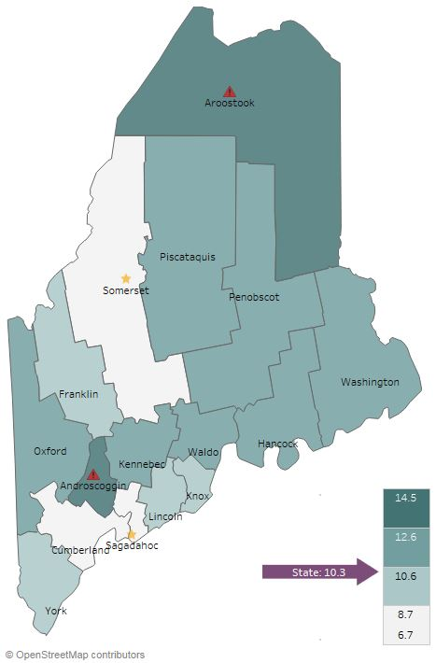
Health Access and Quality
Unable to Obtain Care Due to Cost, 2014-2016
Notes:
JSI or other facilitator
As shown in the map, Aroostook is one of two counties where the percentage of adults who reported being unable to obtain care due to costs was significantly higher than the state.

Slide 36
Facilitated Discussion
Notes:
JSI or other facilitator

Slide 37
Small Group Discussion Questions
Based on your own knowledge and experiences, are there any major health issues that are not represented in the data? (10 mins)
Based on the data, past priorities, and your observations, what do you see as the top needs of our community? (20-25 mins)
What community resources are available to address these needs, and what more may be needed? (5-10 mins)
Notes:
JSI or other facilitator
Overview/instructions (see page 11 of the Community Engagement Toolkit): These breakout sessions will provide an opportunity for you all to share their feedback. Table facilitators have question prompts to lead discussions. The purpose of these small group discussions is to identify up to 4 health priorities, local resources to address those priorities, and gaps in resources.
Leave this slide up during table breakouts

Slide 38
Report Back
Notes:
JSI or other facilitator

Slide 39
Prioritization Exercise
Notes:
JSI or other facilitator

Slide 40
Wrap Up and Next Steps
Notes:
Local facilitator

