Slide 1
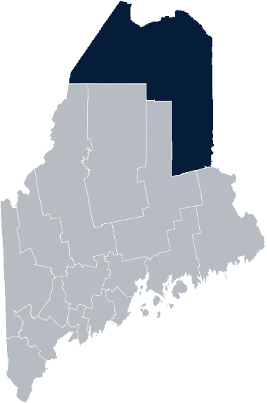
Maine Shared Community Health Needs Assessment Aroostook County
2021
Notes:
Stacy

Slide 2
The Maine Shared CHNA is a collaboration between the Maine Center for Disease Control and Prevention (Maine CDC), Central Maine Healthcare, Northern Light Health, MaineGeneral Health, and MaineHealth.
Notes:
Stacy

Slide 3
Thank you, forum sponsors!
Dawn Roberts | Northern Light AR Gould Hospital
Leah Buck | Northern Maine AHEC
Gina Brown | Houlton Regional Hospital
Rachael Albert | University of Maine at Fort Kent
Nicole Hammar | Northern Light Health
Bill Flagg | Cary Medical Center
Susan Bouchard | Fish River Rural Health
Joy Barresi Saucier | Aroostook Agency on Aging
Stacy Boucher | Maine CDC Aroostook District Liaison
Alain Bois | Northern Maine Medical Center
Carol Bell | Community Member
Ellen Bemis | Aroostook Mental Health Center
Laura Turner | Northern Light AR Gould Hospital
Maura Goss | Aroostook Public Health Council
Notes:
Stacy

Slide 4
Forum agenda
Time | Activity | Speaker/Facilitator
 | Welcome and introductions | Stacy Boucher, Maine CDC Aroostook District Liaison
 | Zoom environment and CHNA background | Jo Morrissey, Program Manager, Maine Shared Community Health Needs Assessment
 | Leadership remarks | Peter Sirois, CEO, Northern Maine Medical Center Greg LaFrancois, CEO, Northern Light AR Gould Hospital Kris Doody, CEO, Cary Medical Center Shawn Anderson, CEO, Houlton Regional Hospital
 | Review previous CHNA priorities and activities since last effort | Dr. Rachael Albert, UMFK
 | Presentation of key findings from the data | John Snow, Inc.
 | Break-out session – facilitated discussion on data and health priority identification | Local Facilitators
 | Wrap up and next steps | Dawn Roberts, Northern Light AR Gould Hospital
Notes:
Stacy
Then introduce JO Morrissey for some housekeeping and CHNA overview

Slide 5
Share screen
Join Audio, Mute On/Off
Open/close participant list or chat
Turn Video On/Off
Reactions
Notes:
Jo or JSI

Slide 6
Matching Interests
Maine Shared
Community Health Needs Assessment
Images of PHAB and IRS from the internet
Notes:
Jo or JSI

Slide 7
The Evolution of an Idea…
2010 OneMaine | 2015 SHNAPP | 2018 Maine Shared CHNA | 2021 Maine Shared CHNA
Forums Surveys | 16 Forums 1639 Surveys | 22 Mainstream Forums (live) 2 Immigrant Forums 45 Interviews | 16+ Mainstream Forums (virtual) 10+ Community Sponsored Events 1500+ Oral Surveys
Notes:
Jo or JSI

Slide 8
Inputs and Outcomes
Outcomes
District & County Reports DUE APRIL 2022
4 Health Priorities by county
Related indicators
Gaps/barriers and resources/assets
Notable comparisons between attendee input and the data.
Description of those who provided input
Methodology
Ways to Provide Input
Data Collected
Mainstream county forums
Number of attendees
Where attendees live (not CSE)
List of data identified Forums and CSE only)
Discussion notes (Forums and CSE only)
Chat box comments (Forums and CSE only)
Health Priorities
Gaps and Resources
Community sponsored events
State Report DUE APRIL 2022
4 Health Priorities by Community Event and immigrant population.
Related indicators
Gaps/barriers and resources/assets,
Notable comparisons to mainstream population.
Description of those who provided input
Methodology
Oral Survey
Forums, Events and Surveys conducted Fall 2021
Notes:
Introduce:
Peter Sirois, CEO, Northern Maine Medical Center
Greg LaFrancois, CEO, Northern Light AR Gould Hospital
Kris Doody, CEO, Cary Medical Center
Shawn Anderson, CEO, Houlton Regional Hospital
Jo or JSI
Community Sponsored Event Partners include
Disability Rights Maine (2 events: people who are deaf or hard of hearing and people with other disabilities)
Maine Primary Care Association (People who are served by Maine’s Federally Qualified Health Centers
Maine Council on Aging (Older Adults 65+
Consumer Right Council of Maine (people with a mental health diagnosis)
Formerly Incarcerated (Maine Prisoner Re-Entry Network)
Maine Youth Action Network and Friends (Raising the voices of Maine’s diverse youth)
Green Memorial A.M.E. Zion Church (Black/African American)
Health Equity Alliance (LGBTQ+ community)
Portland Recovery Center (for people with a substance use disorder or in recovery)
ADD HOUSING INSECURE IF NEED BE
ADD VETERAN IF NEED BE
Oral Survey Partners include:
City of Portland’s Minority Health Program
New Mainer’s Public Health Initiative
Maine Immigrant Access Network
Gateway Community Services
Maine Immigrant and Refugee Services
Maine Community Integration
Mano en Mano
We are piloting these additional outreach methods with support from
State of Maine’s Preventative Health and Health Services Block Grant
Maine Health Access Foundation
Introduce leader for leadership remarks

Slide 9
Leadership remarks
Notes:
Leadership remarks
Leader to introduce Dr. Rachael Albert, UMFK who will provide comments on recent health improvement efforts

Slide 10
Local Activities and Accomplishments
Notes:
Rachael

Slide 11
Aroostook District – Aroostook County Hospital and District priority areas of work since the 2019 Shared CHNA
COVID-19
Aroostook Public Health Council Northern Light AR Gould Hospital Cary Medical Center Houlton Regional Hospital Northern Maine Medical Center
Access to Care
Aroostook Public Health Council Houlton Regional Hospital NL AR Gould Hospital Northern Maine Medical Center
Healthy Aging
Aroostook Public Health Council Northern Light AR Gould Hospital Houlton Regional Hospital
Substance and Alcohol use
Aroostook Public Health Council Northern Light AR Gould Hospital Cary Medical Center Houlton Regional Hospital Northern Maine Medical Center
Notes:
Rachael

Slide 12
Aroostook District – Aroostook County Hospital and District priority areas of work since the 2019 Shared CHNA
Emergency Planning | Aroostook Public Health Council
Mental Health | Cary Medical Center Houlton Regional Hospital Northern Maine Medical Center
Tobacco | Cary Medical Center
Social Determinants of Health | Northern Light AR Gould Hospital
Physical activity, nutrition, weight | Aroostook Public Health Council Northern Light AR Gould Hospital Houlton Regional Hospital Northern Maine Medical Center
Diabetes | Cary Medical Center
Cardiovascular Disease | Northern Maine Medical Center
Notes:
Rachael

Slide 13
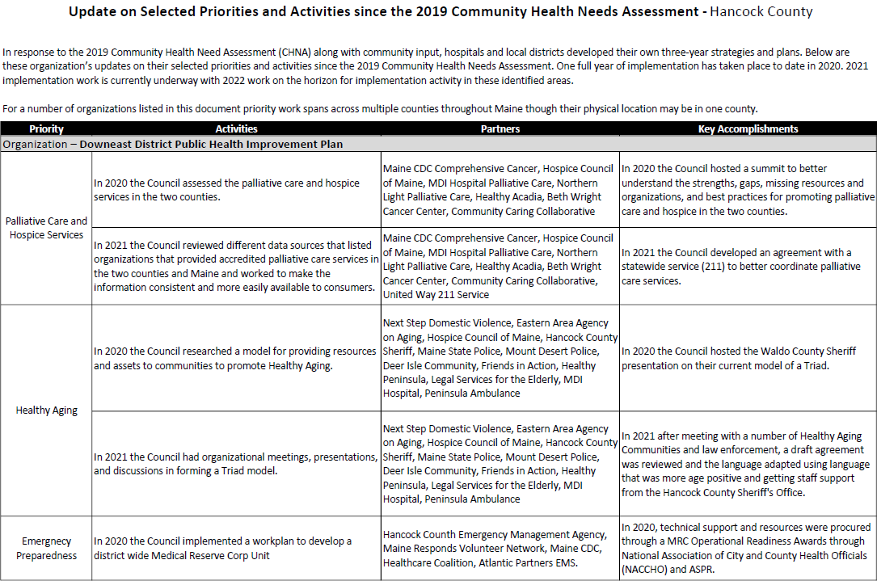
Accomplishments of Note
Update on selected priorities and activities since the 2019 Shared CHNA
Notes:
Rachael

Slide 14
Aroostook Public Health District Aroostook Public Health Council (APHC)
The Aroostook Public Health Council is a representative, district-wide body authorized to engage in collaborative planning and decision making in the delivery and assurance of the ten essential public health services.
Current 2019 – 2021 priorities are healthy aging; access to care; physical activity, nutrition and weight; substance and alcohol use .
Notes:
Rachael

Slide 15
How to Read the County Health Profiles and Health Equity Data Sheets
Notes:
JO to introduce Madison who will walk us through some data that has been curated by the local planning team that may be of interest to you.

Slide 16
How to Read County Health Profile
CHANGE shows statistically significant changes in the indicator over time, based on 95% confidence interval (see description on page 3).
ê | means the health issue or problem is getting better over time.
! | means the health issue or problem is getting worse over time.
○ | means the change was not statistically significant.
N/A | means there is not enough data to make a comparison.
BENCHMARK compares [COUNTY] data to state and national data, based on 95% confidence interval (see description on page 3).
ê | means [COUNTY] is doing significantly better than the state or national average.
! | means [COUNTY is doing significantly worse than the state or national average.
○ | means there is no statistically significant difference between the data points.
N/A | means there is not enough data to make a comparison.
ADDITIONAL SYMBOLS
* | means results may be statistically unreliable due to small numbers, use caution when interpreting.
— | means data is unavailable because of lack of data or suppressed data due to a small number of respondents.
EXAMPLE
Notes:
JSI or other facilitator
A star means that the health issue or problem is getting better over time or better in comparison to another place
A red exclamation point means that the health issue or problem is getting worse over time or worse in comparison to another place
A gray circle means that the dating hasn’t changed over time or isn’t much different in comparison to another place
N/A means that there was not enough data to be able to make a comparison
There are two additional symbols you might see:
A black dot means that you should use caution when interpreting the data – the results might be unreliable because of small numbers
A black dash means that data was unavailable, or that data was suppressed due to a small number of respondents
(Go to next slide and walk audience through an example)

Slide 17
How to Read County Health Profile
EXAMPLE
 | AROOSTOOK COUNTY |  |  | BENCHMARKS
INDICATOR | POINT 1 | POINT 2 | CHANGE | MAINE | +/- | U.S. | +/-
Individuals living in poverty | 2009-2011 15.6% | 2015-2019 16.1% | ¡ | 2015-2019 11.8% | ! | 2019 12.3% | N/A
Notes:
Here’s an example of how we’ve visualized the data in the County Health Profiles.
The charts in this presentation are all excerpts from the Data Health Profiles that were created by MaineHealth and the Maine CDC. They contain data pulled from publicly available sources that are designed to help people learn more about the health of their communities. Not all the data points are available for every measure, but we’ve included data wherever we can.
The green bars represent data from your community. The left most one represents a past data point, and the right bar represents the most recent data point available when the data was gathered. These are the same data points used in the Data Health Profiles.
The grey bars represent data for the state of Maine as a whole- on the left- and for the United States as a whole- on the right, when it is available.
We’ve also noted where differences in the data points are ‘statistically significant’. A difference between two measurements is significant when scientists can say, with a known degree of confidence, that the difference between them is large enough that the difference is most likely to be caused by an actual difference in the item being measured, and not caused by error associated taking the measurement. All of these tests are comparing the most recent data point for your community to other data points. A red exclamation mark indicates a difference that your community is significantly different in a less desirable direction compared to the data point with the symbol. A green star indicates that your community is significantly different in a more desirable direction. A grey circle indicates that there is no significant difference.
(keep in presentation – do not read for deaf/HOH event or people with disabilities). A difference between two measurements is significant when scientists can say, with a known degree of confidence, that the difference between them is large enough that the difference is most likely to be caused by an actual difference in the item being measured, and not caused by an error associated taking the measurement. All of these tests are comparing the most recent data point for your community to other data points.
For example, in this slide, we have two symbols. The grey circle next to the measurement for 2009-2011 Aroostook County means that there is no significantly different change in the rate of poverty in Aroostook County when comparing the data from 2009-2011 to the data from 2015-2019. The red exclamation mark next to the Maine data point says there is a significant difference between 2015-2019 Aroostook County and 2015-2019 Maine, and that it is less desirable that Aroostook County has a higher rate of individuals living in poverty. No comparison could be made to the data for the U.S. because the years of data collection were different.

Slide 18
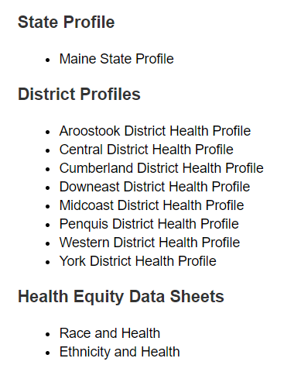
For More Data
www.mainechna.org
Notes:
The Maine Shared CHNA website contains health profiles for 3 of Maine’s largest cities, 16 counties, 5 public health districts, the state, as well as data provided by race, ethnicity, educational attainment, gender, sexual orientation, older adults, insurance status, income, and rurality.
IN addition, there is an interactive data portal where you can search by specific data points. All these breakdowns are then provided by data point.
REGARDING COVID-19 DATA
The Maine Shared CHNA data set does not include any data of COVID-19. This is largely due to the fact that there is a much more up-to-date and comprehensive Maine Data Dashboard continually being updated on the Maine CDC website.
Here you can find daily lab results, new case counts by date, trends, county breakdowns, data by race, and comparisons to other states and the nation.

Slide 19
Key Findings
Notes:
As we walk through the following data slides together, take notes. What surprises you? What stands out? What’s moving in the wrong direction?
Once the data presentation is over, you will be divided into breakout groups to discuss the data, share your top concerns, identify your top priorities, and share your knowledge about what’s working and what we need to work on to address those top concerns.
Ready? Here we go.

Slide 20
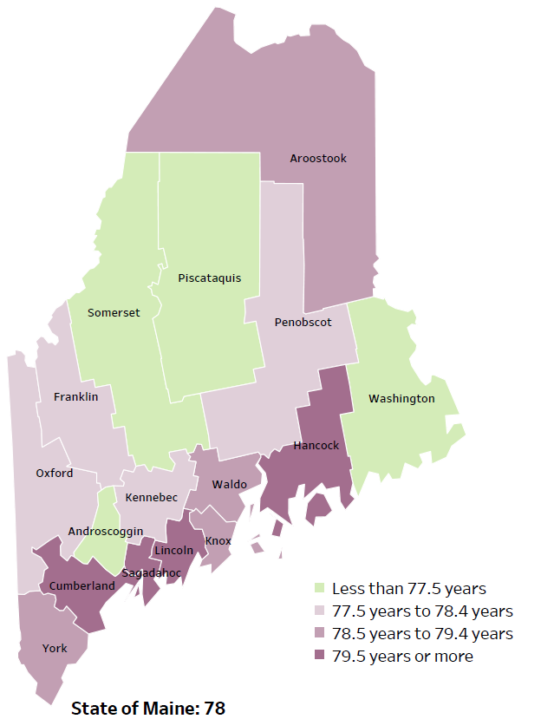
Demographics
Life Expectancy
2017-2019
National Center for Health Statistics,
CDC
RANK | MAINE | AROOSTOOK COUNTY
1 | Cancer | Cancer
2 | Heart Disease | Heart Disease
3 | Unintentional Injury | Chronic Lower Respiratory Disease
4 | Chronic Lower Respiratory Disease | Unintentional Injury
5 | Stroke | Alzheimer's Disease
Notes:
The life expectancy in Aroostook County is 78.6, which is very close to the state average of 78.7.
The table on the right side of the slides shows the five leading causes of death in Aroostook County. They are the leading causes of death for the whole state of Maine with the exception of Alzheimer’s Disease as the 5th leading cause of death in Aroostook.
Some highlights:
In Aroostook County and Maine overall, the leading cause of death is Cancer followed by Heart Disease. The opposite is true in the U.S. overall- Heart Disease is the leading cause of death, and cancer is the 2nd leading cause. As we will see later in the presentation, Aroostook has a high rate of colorectal cancer, which is reflected as the leading causes of death.
The 3rd leading cause of death- Unintentional Injury- includes a number of accidental causes: Three of the most common causes are i) Deaths due to motor vehicle crashes, ii) deaths due to accidental falls, iii) deaths due to poisonings that either were unintentional, or the intent was undetermined. Some Firearm deaths may also be classified as unintentional. Suicides, some Firearm deaths and some Poisoning deaths are classified as intentional injury.

Slide 21
Demographics
Age distribution for Aroostook County
AGE
AROOSTOOK COUNTY
POPULATION
67,809
STATE OF MAINE
POPULATION
1,362,359
Notes:
Aroostook County has the sixth largest population of any Maine County after Cumberland, York, Penobscot, Kennebec, and Androscoggin. The population is aging. There are fewer children and young adults and more adults over the age of 65, and fewer adults of the age where they might expect to have children.
Source: US Census Bureau, American Community Survey

Slide 22
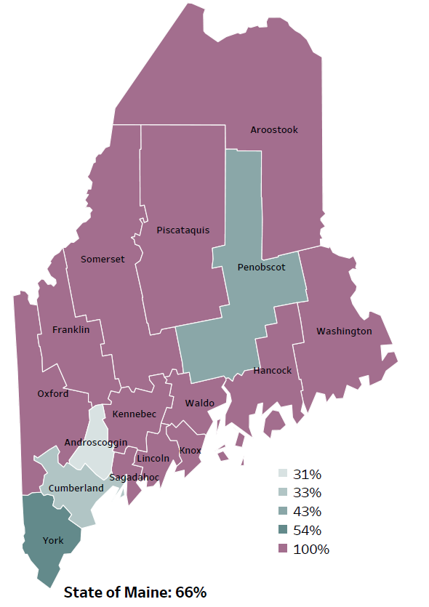
Demographics
Percentage of people living in
rural areas
2019
New England Round Table for Rural Health
Notes:
Aroostook County is one of 12 counties with no population in an urban area. These data are based on the most recent Census estimates at the Zip-code level, and calculated use rural Urban Commuting Area codes. The categories were established by the New England Rural Health Association. This data is NOT comparable to 2010 US Census data on populations living in rural areas, as that data uses a different definition for rural.
Source: Data, Research and Vital Statistics town-level population file

Slide 23
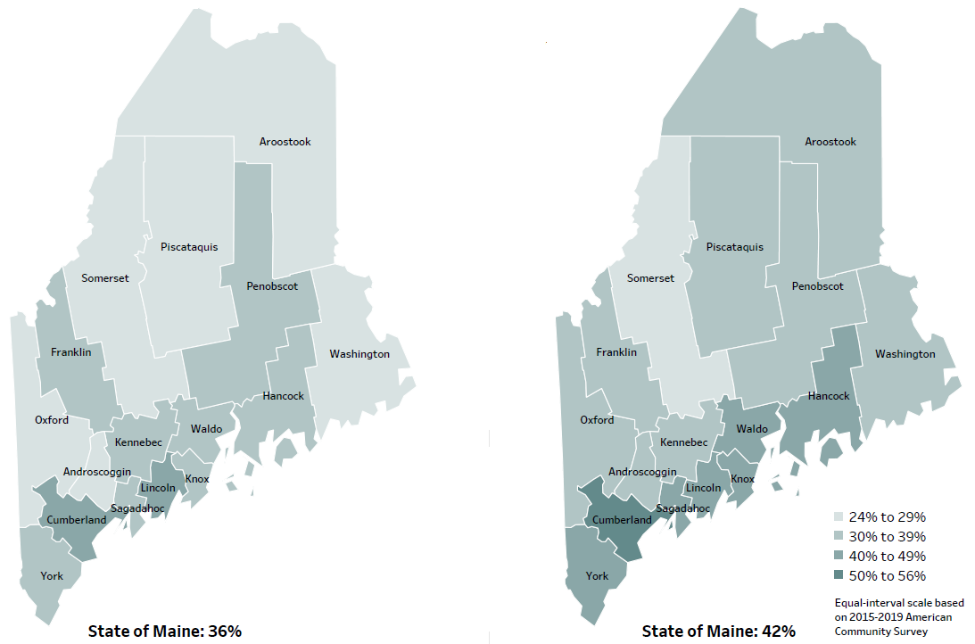
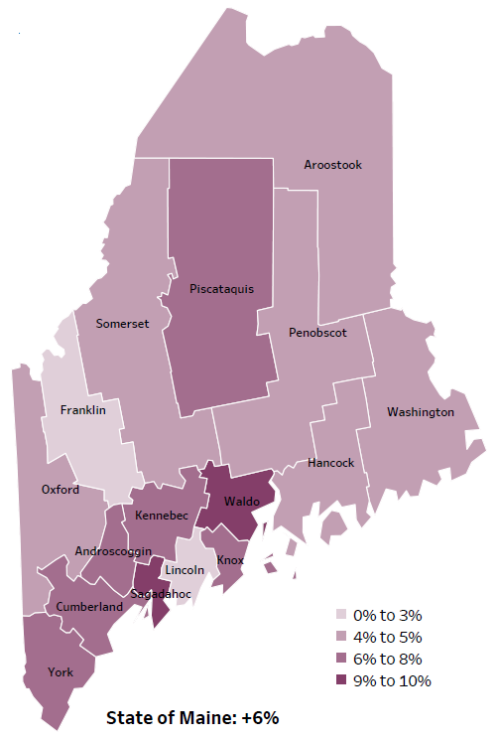
Demographics
Percent of population over age 25 with an associate’s degree or higher
2010
American Community
Survey
Change in percent of population over age 25 with an associate’s degree or higher
2010 to 2015-2019
2015-2019
American Community
Survey
Notes:
These maps show the educational attainment of adults over 25 for two different time periods. Aroostook County has had an increase in the rate of adults who have achieved an associate’s degree or higher degree of education. This is highlighted in the change over time map, which shows that this was a greater increase than 2 other counties and equal to 6 other counties.
Source: US Census Bureau, American Community Survey

Slide 24
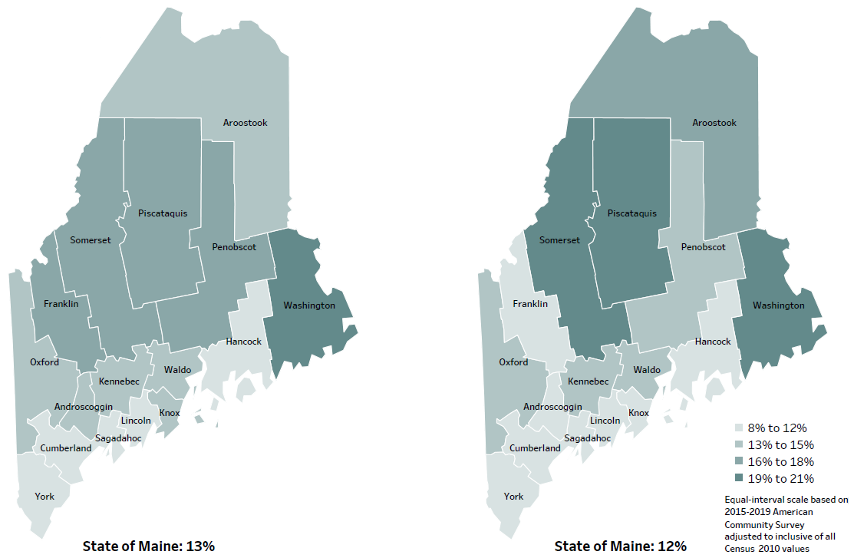
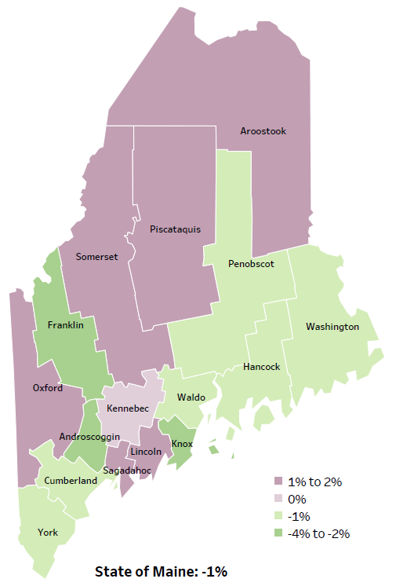
Demographics
Percent of population in poverty
2010
American Community
Survey
Change in percent of population in poverty
2010 to 2015-2019
2015-2019
American Community
Survey
Notes:
These maps show the rate of poverty for two different time periods. Aroostook County’s poverty rate has increased slightly over the time period, as shown in the change over time map, but other counties have higher levels of poverty in the state. During this period, poverty decreased in Maine overall.
Source: US Census Bureau, American Community Survey

Slide 25
Health Indicators
Notes:
Aroostook county residents are significantly more likely to rate their health as fair or poor when compared to the state overall. This is a self-rated measure meaning respondents subjectively rate their own health.
Data Source: Behavioral Risk Factor Surveillance System Read as needed - Definition: Percentage of adults who rate their health as fair or poor (vs. excellent, very good or good).

Slide 26
Health Indicators
Notes:
Ambulatory care sensitive conditions are ones for which good outpatient care can potentially prevent the need for hospitalization or early intervention can prevent the progression or severity of the disease. A few examples of this type of condition are asthma, atrial fibrillation, gastroenteritis and pneumonia. As this chart shows, residents in Aroostook county are significantly more likely to be hospitalized for these types of conditions when compared to the state overall.
Data Source: Maine Health Data Organization Hospital Inpatient Database
National Institute of Health https://www.ncbi.nlm.nih.gov/pmc/articles/PMC7429814/
Read as needed - Definition: Rate per 10,000 people of hospitalizations with a principal diagnosis of an ambulatory care-sensitive condition. ACSCs are conditions for which good outpatient care can potentially prevent the need for hospitalization, or for which early intervention can prevent complications or more severe disease.

Slide 27
Health Indicators
Notes:
Similar to the previous slide, this graph shows that the rate of Aroostook County residents seeking treatment for an ambulatory-care condition in emergency departments is significantly higher than the overall state rate. This indicates people are going to the emergency department for conditions that could be treated with outpatient care or would benefit from early intervention.
Data Source: Maine Health Data Organization Hospital Inpatient and Outpatient Databases
Read as needed - Definition: Rate per 10,000 people of emergency department discharges with a principal diagnosis of an ambulatory care-sensitive condition. ACSCs are conditions for which good outpatient care can potentially prevent the need for hospitalization, or for which early intervention can prevent complications or more severe disease.

Slide 28
Health Indicators
Notes:
The rate of new colorectal cancer diagnoses are higher than the state overall. Rates have risen within the county, but not to a significant degree. These data are age-adjusted, meaning that we have calculated the rates so that they can be compared to other parts of the state that might have a younger population. Older people tend to have higher rates of many diseases, including cancer. It’s important to adjust for age so that we don’t accidentally mistake a place with older people for a place with an unusual number of disease-related deaths.
Data Source: Maine Cancer Registry
Read as needed - Definition: Rate per 100,000 people of deaths from colon or rectum cancers.

Slide 29
Health Indicators
Notes:
Aroostook County residents are significantly more likely to be hospitalized due to a heart attack when compared to the state. The rate has decreased since 2016-2017, but not significantly.
Data Source: Maine Health Data Organization Hospital Inpatient Database
Read as needed - Definition: Rate per 100,000 people of deaths with heart attack as an underlying cause of death.

Slide 30
Health Indicators
Notes:
Aroostook County residents are more likely to be hospitalized due to high blood pressure than the State.
Data Source: Maine Health Data Organization Hospital Inpatient Database
Read as needed - Definition: Rate per 10,000 people of hospital discharges with a principal diagnosis of hypertension.

Slide 31
Health Indicators
Notes:
This chart shows the rate of hospitalizations due to stroke. As you can see, Aroostook County has a slightly higher rate of stroke hospitalizations when compared to the state.
Data Source: Maine Health Data Organization Hospital Inpatient Database
Read as needed - Definition: Rate per 10,000 people of hospital discharges with a principal diagnosis of stroke.

Slide 32
Health Indicators
Notes:
Chronic lower respiratory deaths within Aroostook County have increased since 2007-2011. While Aroostook County’s rate is higher than the State and the U.S., the difference is not considered significant.
Data Source: Maine CDC Vital Records and CDC WONDER Online Database
Read as needed - Definition: Rate per 100,000 people of deaths due to chronic lower respiratory disease.

Slide 33
Health Indicators
Notes:
Residents of Aroostook County are significantly more likely to require treatment in the emergency room for asthma when compared to the state overall.
Data Source: Maine Health Data Organization Hospital Inpatient and Outpatient Databases
Read as needed - Definition: Rate per 10,000 people of emergency department discharges with a principal diagnosis of asthma.

Slide 34
Health Indicators
Notes:
This slide shows the rate of hospitalizations from chronic obstructive pulmonary disease. As you can see, Aroostook County has a higher rate of hospitalization due to COPD when compared to the state. This difference is considered significant.
Data Source: Maine Health Data Organization Hospital Inpatient Database
Read as needed - Definition: Rate per 10,000 people of hospital discharges with a principal diagnosis of chronic obstructive pulmonary disease (COPD).

Slide 35
Health Indicators
Notes:
High school students in Aroostook are less likely to drink one or more, soda or sports drink than in previous years. The rate is significantly higher than the State overall. Data for this indicator is collected in odd numbered years.
Data Source: BRFSS
Read as needed - Definition: Percentage of high school students who drank at least one can, bottle, or glass of sugar-sweetened beverages per day during the past week. Data collected in odd numbered years.

Slide 36
Health Indicators
Notes:
This slide shows a significant decrease of teen births ages 15-19. While the County’s rate remains significantly higher than the State, this is a promising improvement.
Data Source: Maine Health Data Organization Hospital Inpatient and Outpatient Databases
Read as needed - Definition: Rate per 1,000 women, ages 15-19 years, who gave birth.

Slide 37
Health Indicators
Notes:
This slide shows the percentage of infants who have been breast fed within Aroostook County. Although there has been a slight increase over time, the County’s rate is significantly lower than the State.
Data Source: Maine CDC Vital Records
Read as needed - Definition: Percentage of babies who were ever fed breast milk.

Slide 38
Health Indicators
Notes:
Roughly one-third of Aroostook County residents have been diagnosed with arthritis, which is significantly higher than the state overall. As you can see, Aroostook’s rate has increased over the years.
Data Source: Behavioral Risk Factor Surveillance System
Read as needed - Definition: Percentage of adults who have been told by a healthcare provider that they have arthritis.

Slide 39
Health Indicators
Notes:
The percentage of residents who are having their private wells tested for arsenic has been increasing within Aroostook County. This is significantly lower than state testing levels but is trending in the right direction. This measure has been weighted, so it is representative of all households in the county.
Data Source: Behavioral Risk Factor Surveillance System
Read as needed - Definition: Percentage of households with a private well where the well water has been tested for arsenic. This data is weighted to be representative of all households in Maine.

Slide 40
Health Indicators
Notes:
This graph shows Aroostook County residence of those 65 or older that have received the pneumococcal vaccine. The County’s rate is significantly lower than the State’s. While Aroostook County’s rate is lower than the U.S., the data for significance testing was not present.
Data Source: Behavioral Risk Factor Surveillance System
Read as needed - Definition: Percentage of adults, ages 65 and older, who have ever had a pneumonia vaccine.

Slide 41
Health Indicators
Notes:
The rate of fall related deaths within Aroostook County have increased significantly since 2007-2011 but remain slightly below the state rate.
Data Source: Maine CDC Vital Records
Read as needed - Definition: Rate per 100,000 people of deaths due to unintentional falls.

Slide 42
Health Indicators
Notes:
Aroostook County has a significantly higher rate of ER discharges from an unintentional fall-related injury than the State.
Data Source: Maine Health Data Organization Hospital Inpatient and Outpatient Databases
Read as needed - Definition: Rate per 10,000 people of emergency department discharges with a diagnoses of a fall-related injury.

Slide 43
Health Indicators
Notes:
This chart shows the rate of Aroostook County’s 7th and 8th grade students who reported being bullied on school property. Although there’s been a decrease since 2017, the County’s rate is significantly higher than the State’s overall rate.
Data Source: Maine Integrated Youth Health Survey
Read as needed - Definition: Percentage of seventh- and eighth-grade students who have ever been bullied on school property. Data collected in odd numbered years.

Slide 44
Health Indicators
Notes:
The rate of Aroostook County residents being treated in the emergency room for a mental health condition is significantly higher than the state rate. This could be related to a lack of access to mental health professionals in the area.
Data Source: Maine Health Data Organization Hospital Inpatient and Outpatient Databases
Read as needed - Definition: Rate per 10,000 people of emergency department discharges with a principal diagnosis of mental health condition.

Slide 45
Health Indicators
Notes:
This measure shows the percentage of adults who have lost 6 or more teeth due to tooth decay or gum disease, As you can see, the percentage of adults in Aroostook county who have dealt with tooth loss is significantly higher than the overall state rate.
Data Source: Maine Health Data Organization Hospital Inpatient and Outpatient Databases
Read as needed - Definition: Percentage of adults who have lost six or more teeth due to tooth decay or gum disease. Data collected in even numbered years.

Slide 46
Health Indicators
Notes:
An ambulatory care condition is one that could be avoid with good preventative care or early intervention. This slide shows the rate of children within Aroostook who needed ambulatory care due to a dental emergency, which primarily includes untreated cavities. Aroostook’s rate is significantly greater than Maine’s overall rate.
Data Source: Maine Health Data Organization Hospital Inpatient and Outpatient Databases
Read as needed - Definition: Rate per 10,000 children with emergency department (ED) visits for dental-related reasons for which good regular dental care can potentially prevent the need for hospitalization, or for which early intervention can prevent complications or more severe disease. Note that included conditions for children are primarily for untreated cavities and are different for adults.

Slide 47
Health Indicators
Notes:
This slide shows the rate of infants who have been born addicted to a substance. This data is collected from healthcare providers who report there is a reasonable cause to suspect the baby has been affected by an illegal substance or is demonstrating withdrawal symptoms. The line graph shows the trend from 2011-2017. These single year data are not as reliable as the most recent two year, but still show a clear increase. The two-year rate of drug-affected infants born in Aroostook County is significantly higher than the State overall. The data shows the average annual rate for the two years, and therefore can be compared to the single year dat. There is a concern given the birth and health risk associated with drug exposure in utero.
Data Source: Maine CDC Vital Records
Read as needed - Definition: Rate per 1,000 births of infants for which a healthcare provider reported that there was reasonable cause to suspect the baby may be affected by illegal substance abuse or demonstrating withdrawal symptoms resulting from prenatal drug exposure or has a fetal alcohol spectrum disorder.

Slide 48
Health Indicators
Notes:
This slide shows the decreased rate of cardiovascular disease deaths within Aroostook County. There has been significant decline over time in Aroostook County. Although the County’s rate greater than the States overall, the difference would not be considered significant.
Data Source: Maine CDC Vital Records
Read as needed - Definition: Rate per 100,000 people of deaths with cardiovascular disease as an underlying cause of death.

Slide 49
Health Indicators
Notes:
This slide shows the decreased rate of prescription drug misuse among Aroostook County’s high school students. There has been a major, significant decline of prescription drug misuse since 2017. The difference between Aroostook County’s rate and the State’s overall rate is also considered significant.
Data Source: Maine Integrated Youth Health Survey
Read as needed - Definition: Percentage of high school students who used a prescription drug without a doctor's prescription at least one time in the last 30 days. Data collected in odd numbered years.

Slide 50
Breakout Discussions

Slide 51
Reconvene

Slide 52
Wrap up and Next Steps
Notes:
Jo introduces:
Dawn Roberts, Northern Light AR Gould Hospital

Slide 53
Contacts
Stacy Boucher, Aroostook District Public Health Liaison, stacy.boucher@maine.gov 207-493-4087
Dawn Roberts, Community Health & Volunteer Coordinator, Northern Light AR Gould Hospital, droberts@northernlight.org 207-768-4248
Maine Shared CHNA: info@mainechna.org

