Slide 1
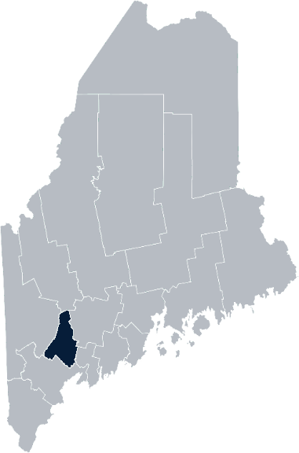
Maine Shared Community
Health Needs Assessment
Androscoggin County
2021

Slide 2





The Maine Shared CHNA is a collaboration between the Maine Center for Disease Control and Prevention (Maine CDC), Central Maine Healthcare, Northern Light Health, MaineGeneral Health, and MaineHealth.
Notes:
Local Planning Committee Member

Slide 3
Thank you, forum supporters!
Androscoggin Home Healthcare + Hospice | Sandcastle Clinical & Education Services
Central Maine Medical Center | St. Mary’s Regional Medical Center
City of Auburn Public Health | Sweetser
Community Concepts | Tri-County Mental Health Services
Healthy Androscoggin | Western Maine Community Action WIC
(members of the Androscoggin Community | Health Stakeholder Coalition)

Slide 4
Forum agenda
Time | Activity | Speaker/Facilitator
5:00-5:05 pm | Welcome and introductions | Holly Lasagna, Health Promotion Manager, Healthy Androscoggin, Central Maine Medical Center
5:05-5:10 pm | Zoom environment and CHNA background | Jo Morrissey, Program Manager, Maine Shared Community Health Needs Assessment
5:10-5:15 pm | Leadership remarks | Steve Jorgensen, President, St. Mary’s Regional Medical Center Hugh Jones, Vice President of Service Line Strategy, Central Maine Healthcare
5:15-5:25 pm | Review previous CHNA priorities and activities since last effort | Elizabeth Keene, VP, Mission Integration, St. Mary’s Regional Medical Center Holly Lasagna, Health Promotion Manager, Healthy Androscoggin, Central Maine Medical Center
5:25-5:50 pm | Presentation of key findings from the data | John Snow, Inc.
5:50-6:50 pm | Break-out session – facilitated discussion on data and health priority identification | John Snow, Inc. & Local Facilitator(s)
6:50-7:00 pm | Wrap up and next steps | Elizabeth Keene, VP, Mission Integration, St. Mary’s Regional Medical Center

Slide 5
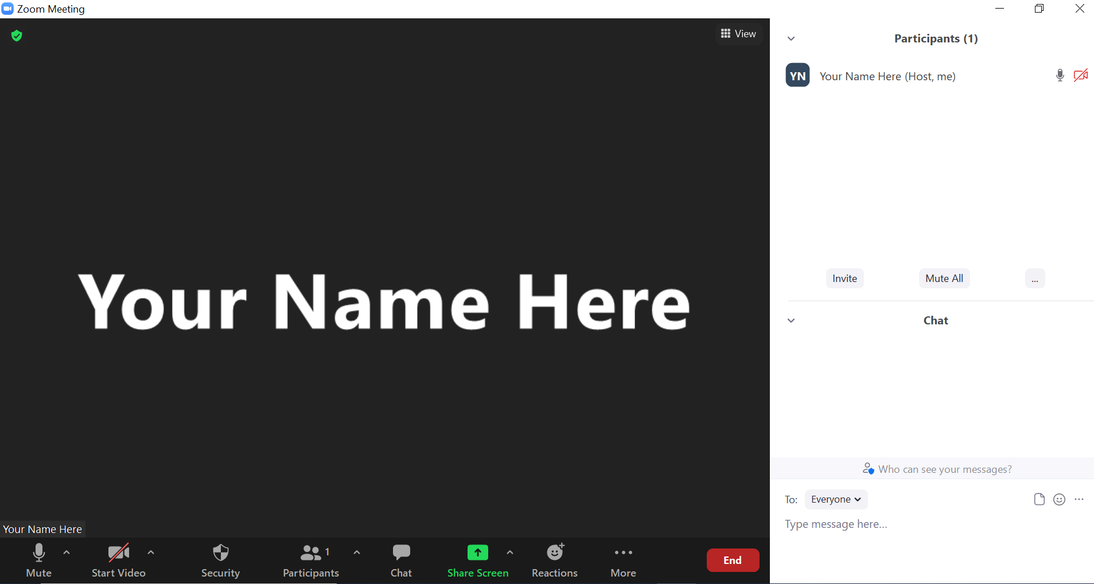
Share screen
Join Audio, Mute On/Off
Open/close participant list or chat
Turn Video On/Off
Reactions
Notes:
Jo or JSI

Slide 6


Matching Interests
Maine Shared
Community
Health Needs Assessment
Images of PHAB and IRS from the internet
Notes:
Jo or JSI

Slide 7
The Evolution of an Idea…
2010 OneMaine | 2015 SHNAPP | 2018 Maine Shared CHNA | 2021 Maine Shared CHNA
Forums Surveys | 16 Forums 1639 Surveys | 22 Mainstream Forums (live) 2 Immigrant Forums 45 Interviews | 16+ Mainstream Forums (virtual) 12+ Community Sponsored Events 2000+ Oral Surveys
Notes:
Jo or JSI

Slide 8
Inputs and Outcomes
Ways to Provide Input
Data Collected
Outcomes
District & County Reports DUE APRIL 2022
4 Health Priorities by county
Related indicators
Gaps/barriers and resources/assets
Notable comparisons between attendee input and the data.
Description of those who provided input
Methodology
Mainstream county forums
Number of attendees
Where attendees live (not CSE)
List of data identified Forums and CSE only)
Discussion notes (Forums and CSE only)
Chat box comments (Forums and CSE only)
Health Priorities
Gaps and Resources
Community sponsored events
State Report DUE APRIL 2022
4 Health Priorities by Community Event and immigrant population.
Related indicators
Gaps/barriers and resources/assets,
Notable comparisons to mainstream population.
Description of those who provided input
Methodology
Oral Survey
Forums, Events and Surveys conducted Fall 2021
Notes:
Steve Jorgensen, President, St. Mary’s Regional Medical Center
Steve Littleson, President and CEO, Central Maine Healthcare
Jo or JSI
Community Sponsored Event Partners include
Disability Rights Maine (2 events: people who are deaf or hard of hearing and people with other disabilities)
Maine Primary Care Association (People who are served by Maine’s Federally Qualified Health Centers
Maine Council on Aging (Older Adults 65+
Consumer Right Council of Maine (people with a mental health diagnosis)
Formerly Incarcerated (Maine Prisoner Re-Entry Network)
Maine Youth Action Network and Friends (Raising the voices of Maine’s diverse youth)
Green Memorial A.M.E. Zion Church (Black/African American)
Health Equity Alliance (LGBTQ+ community)
Portland Recovery Center (for people with a substance use disorder or in recovery)
ADD HOUSING INSECURE IF NEED BE
ADD VETERAN IF NEED BE
Oral Survey Partners include:
City of Portland’s Minority Health Program
New Mainer’s Public Health Initiative
Maine Immigrant Access Network
Gateway Community Services
Maine Immigrant and Refugee Services
Maine Community Integration
Mano en Mano
We are piloting these additional outreach methods with support from
State of Maine’s Preventative Health and Health Services Block Grant
Maine Health Access Foundation
Introduce leader for leadership remarks

Slide 9
Leadership remarks
Notes:
Leadership remarks
Leader to introduce the following who will provide comments on recent health improvement efforts
Steve Jorgensen, President, St. Mary’s Regional Medical Center
Hugh Jones, VP, Service Line Strategy, Central Maine Medical Center

Slide 10
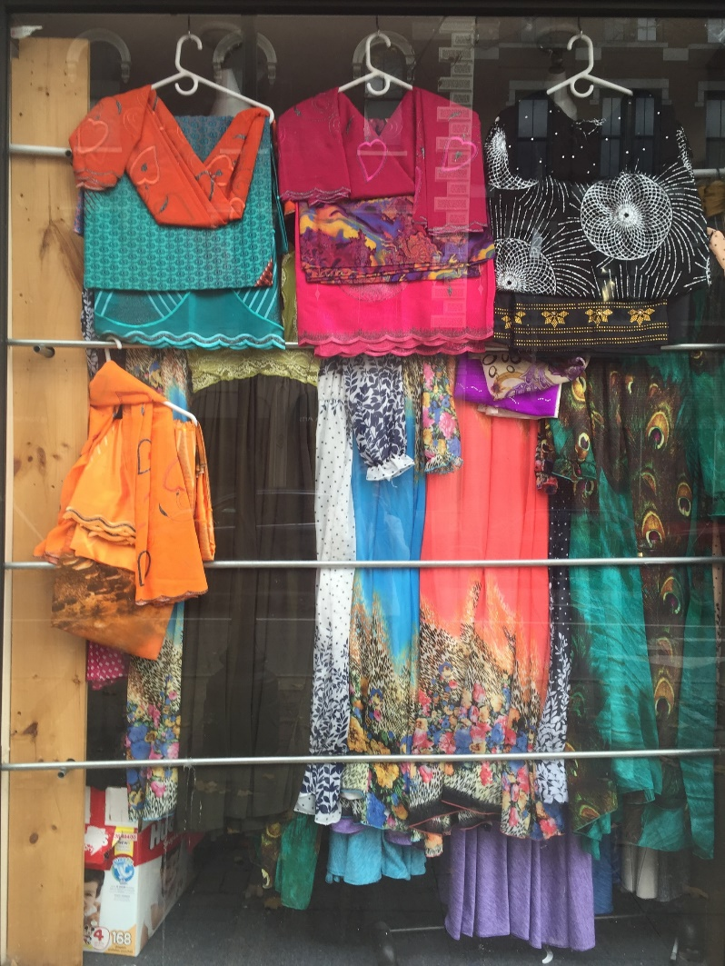
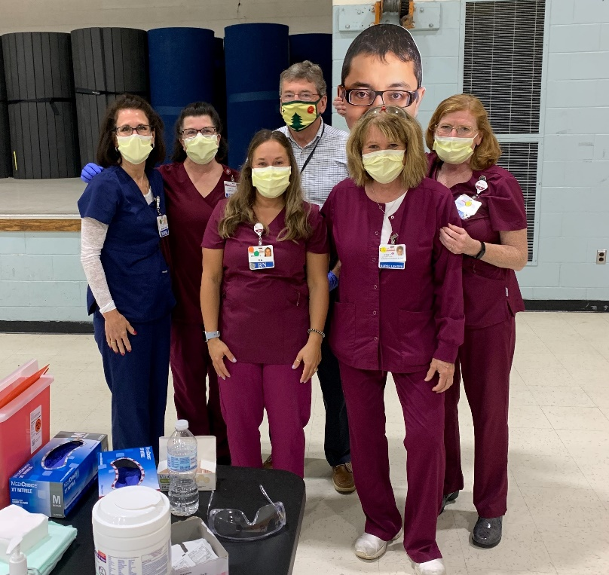

Local Activities and Accomplishments
Notes:
Elizabeth Keene, VP, Mission Integration, St. Mary’s Regional Medical Center
Holly Lasagna, Health Promotion Manager, Healthy Androscoggin, Central Maine Medical Center

Slide 11
Western Maine District– Androscoggin County
Hospital and District priority areas of work since the 2019 Shared CHNA
Social Determinants of Health
Adverse Childhood Experiences (ACEs): Androscoggin Community Health Stakeholder Coalition Food Security: Androscoggin Home Healthcare + Hospice St. Mary’s Regional Medical Center YMCA YWCA Housing: Androscoggin Home Healthcare + Hospice Recovery Connections Non-emergent Transportation: LAR Community Health Committee
Mental Health
Central Maine Medical Center Community Clinical Services Healthy Androscoggin Lewiston Police Department Recovery Connections St. Mary’s Regional Medical Center Sweetser Tri-County Mental Health Services
Substance Use
Central Maine Medical Center Community Clinical Services Healthy Androscoggin Lewiston Area Public Health Committee Lewiston Police Department Recovery Connections St. Mary’s Regional Medical Center Sweetser Tri-County Mental Health Services
COVID-19 Testing & Vaccines
Androscoggin Emergency Management Auburn Fire/Police Department Central Maine Medical Center City of Auburn Government City of Lewiston Government & Schools Community Clinical Services Healthy Androscoggin Lewiston Fire/Police Department St. Mary’s Regional Medical Center YMCA
Access to Care
Central Maine Medical Center Community Clinical Services Lewiston Police Department Recovery Connections St. Mary’s Regional Medical Center Tri-County Mental Health Services YMCA YWCA
Tobacco Use
Central Maine Medical Center Healthy Androscoggin St. Mary’s Regional Medical Center

Slide 12
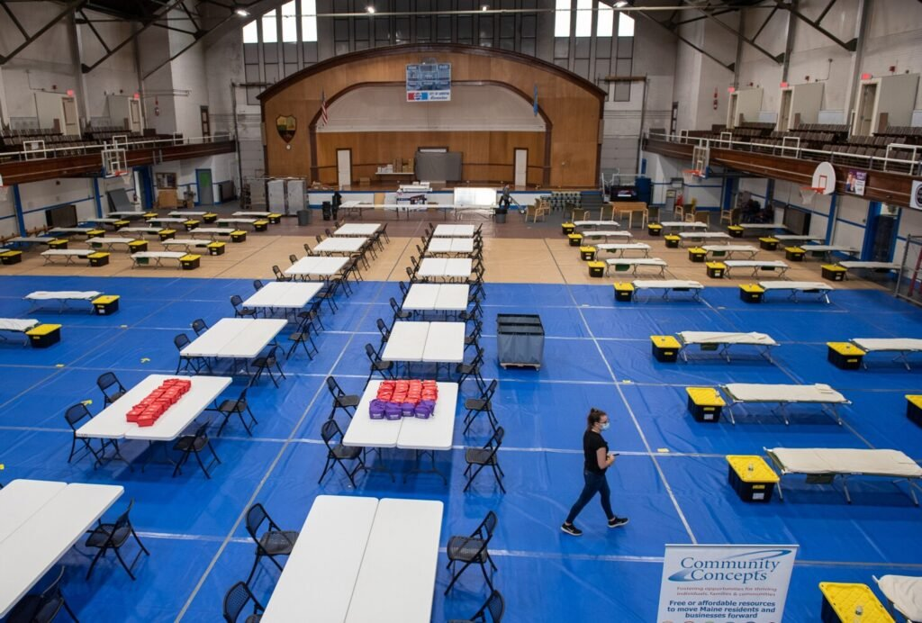


Accomplishments of Note
Social Determinants of Health:
Adverse Childhood Experiences (ACEs)
-Created resource list
-Trained health care and school employees
Food Security
-Added one new community garden & one school garden
-Established Local Foods, Local Places council and work plan
-Engaged community members as Community Food Champions
-Developing Community Food Center as part of Choice grant
Supportive Housing
-Emergency Wellness Shelter coordinated by Community Concepts
Mental Health:
-14 members of the Lewiston Youth Advisory Council
participated in a Photo Voice project for mental health support coordinated by Healthy Androscoggin
-St. Mary’s opened a new child/adolescent psychiatric unit and will open a new adult psychiatric unit this fall
-Tri-County Mental Health Services and Lewiston Police Department expanded the program for mental health support professionals to ride along with Lewiston police officers
Lewiston Youth Advisory Council Photo Voice Project

Slide 13
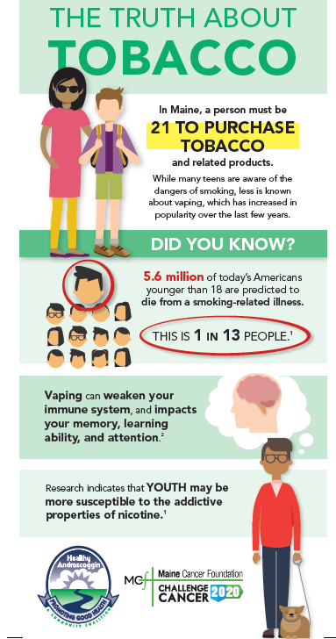
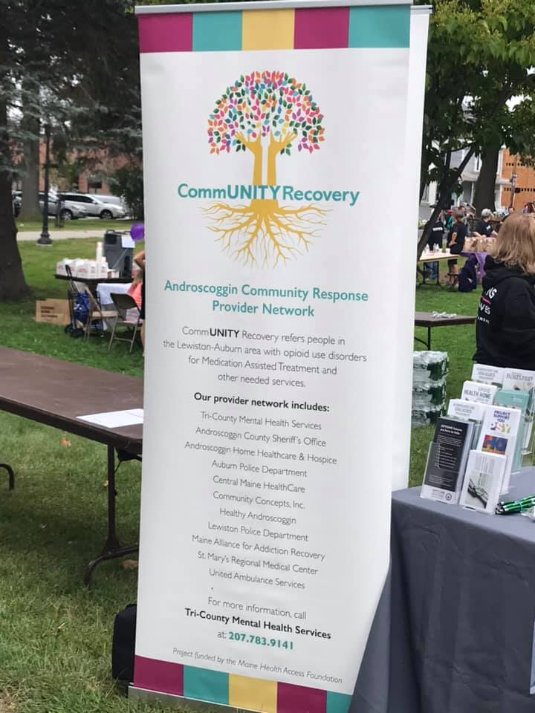
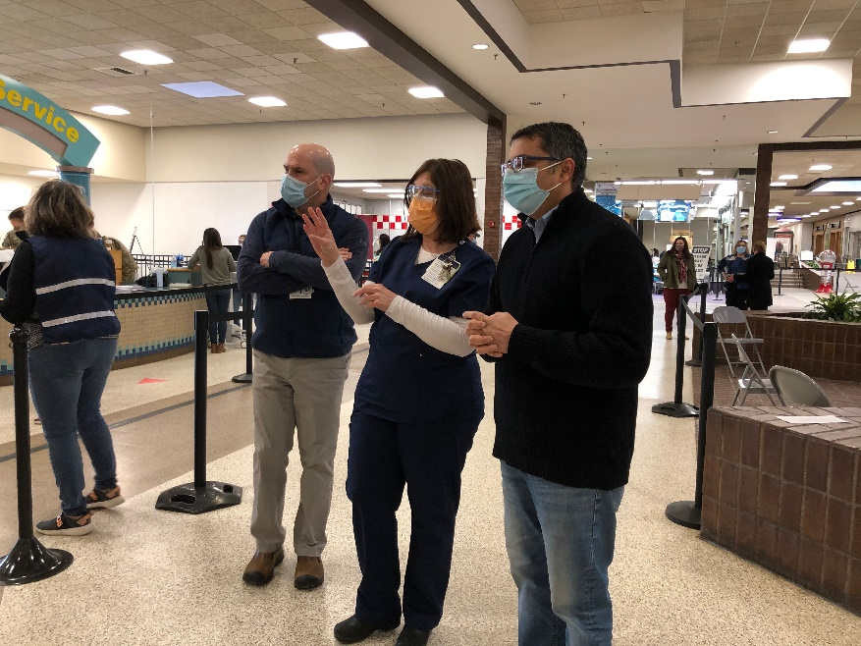


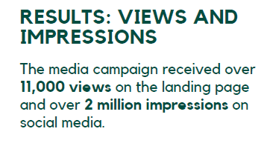
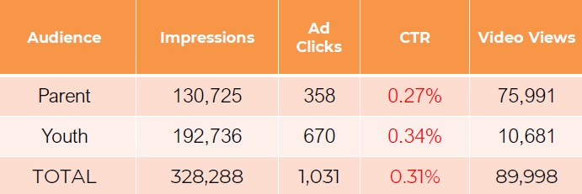
Accomplishments of Note
Substance Use:
-Tri-County CommUNITY Recovery Grant
-Over 250 people attended Rally for Recovery in Kennedy Park
Update on selected priorities and activities since the 2019 Shared CHNA
Access to Care:
-Auburn Mall high-volume vaccine clinic totals through 10/5/21
Tobacco Use:
-Youth Vaping Initiative
-T21
-Quit & Win Program
Notes:
Introduce Madison MacLean of John Snow, Inc. (JSI) who will now give a data presentation on the top indicators

Slide 14
How to Read the County Health Profiles and Health Equity Data Sheets
Notes:
JSI or other facilitator

Slide 15
How to Read County Health Profile
CHANGE shows statistically significant changes in the indicator over time, based on 95% confidence interval (see description on page 3).
ê | means the health issue or problem is getting better over time.
! | means the health issue or problem is getting worse over time.
○ | means the change was not statistically significant.
N/A | means there is not enough data to make a comparison.
BENCHMARK compares [COUNTY] data to state and national data, based on 95% confidence interval (see description on page 3).
ê | means [COUNTY] is doing significantly better than the state or national average.
! | means [COUNTY is doing significantly worse than the state or national average.
○ | means there is no statistically significant difference between the data points.
N/A | means there is not enough data to make a comparison.
ADDITIONAL SYMBOLS
* | means results may be statistically unreliable due to small numbers, use caution when interpreting.
— | means data is unavailable because of lack of data or suppressed data due to a small number of respondents.
EXAMPLE
Notes:
JSI or other facilitator
A star means that the health issue or problem is getting better over time or better in comparison to another place
A red exclamation point means that the health issue or problem is getting worse over time or worse in comparison to another place
A gray circle means that the dating hasn’t changed over time or isn’t much different in comparison to another place
N/A means that there was not enough data to be able to make a comparison
There are two additional symbols you might see:
A black dot means that you should use caution when interpreting the data – the results might be unreliable because of small numbers
A black dash means that data was unavailable, or that data was suppressed due to a small number of respondents
(Go to next slide and walk audience through an example)

Slide 16
How to Read County Health Profile
EXAMPLE
 | AROOSTOOK COUNTY |  |  | BENCHMARKS
INDICATOR | POINT 1 | POINT 2 | CHANGE | MAINE | +/- | U.S. | +/-
Individuals living in poverty | 2009-2011 15.6% | 2015-2019 16.1% | ¡ | 2015-2019 11.8% | ! | 2019 12.3% | N/A
Notes:
Here’s an example of how we’ve visualized the data in the County Health Profiles.
The charts in this presentation are all excerpts from the Data Health Profiles that were created by MaineHealth and the Maine CDC. They contain data pulled from publicly available sources that are designed to help people learn more about the health of their communities. Not all the data points are available for every measure, but we’ve included data wherever we can.
The green bars represent data from your community. The left most one represents a past data point, and the right bar represents the most recent data point available when the data was gathered. These are the same data points used in the Data Health Profiles.
The grey bars represent data for the state of Maine as a whole- on the left- and for the United States as a whole- on the right, when it is available.
We’ve also noted where differences in the data points are ‘statistically significant’. A difference between two measurements is significant when scientists can say, with a known degree of confidence, that the difference between them is large enough that the difference is most likely to be caused by an actual difference in the item being measured, and not caused by error associated taking the measurement. All of these tests are comparing the most recent data point for your community to other data points. A red exclamation mark indicates a difference that your community is significantly different in a less desirable direction compared to the data point with the symbol. A green star indicates that your community is significantly different in a more desirable direction. A grey circle indicates that there is no significant difference.
(keep in presentation – do not read for deaf/HOH event or people with disabilities). A difference between two measurements is significant when scientists can say, with a known degree of confidence, that the difference between them is large enough that the difference is most likely to be caused by an actual difference in the item being measured, and not caused by an error associated taking the measurement. All of these tests are comparing the most recent data point for your community to other data points.
For example, in this slide, we have two symbols. The grey circle next to the measurement for 2009-2011 Aroostook County means that there is no significantly different change in the rate of poverty in Aroostook County when comparing the data from 2009-2011 to the data from 2015-2019. The red exclamation mark next to the Maine data point says there is a significant difference between 2015-2019 Aroostook County and 2015-2019 Maine, and that it is less desirable that Aroostook County has a higher rate of individuals living in poverty. No comparison could be made to the data for the U.S. because the years of data collection were different.

Slide 17
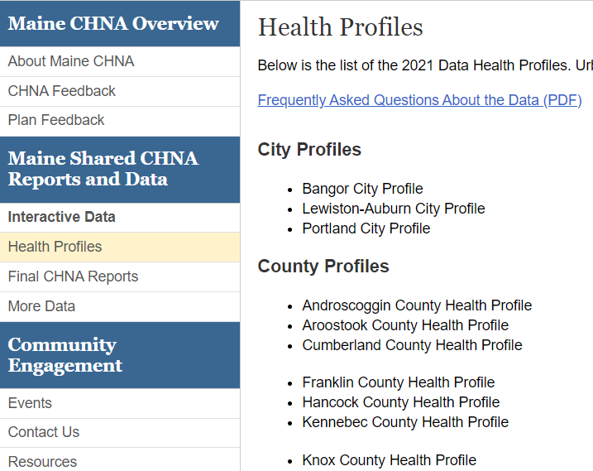
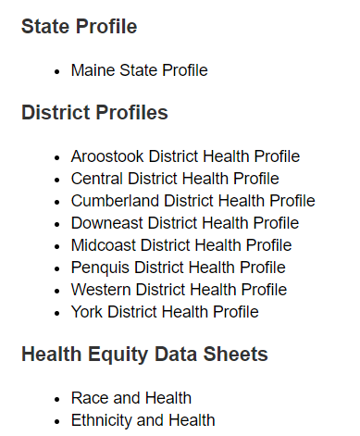
For More Data
www.mainechna.org
Notes:
The Maine Shared CHNA website contains health profiles for 3 of Maine’s largest cities, 16 counties, 5 public health districts, the state, as well as data provided by race, ethnicity, educational attainment, gender, sexual orientation, older adults, insurance status, income, and rurality.
IN addition, there is an interactive data portal where you can search by specific data points. All these breakdowns are then provided by data point.
REGARDING COVID-19 DATA
The Maine Shared CHNA data set does not include any data of COVID-19. This is largely due to the fact that there is a much more up-to-date and comprehensive Maine Data Dashboard continually being updated on the Maine CDC website.
Here you can find daily lab results, new case counts by date, trends, county breakdowns, data by race, and comparisons to other states and the nation.

Slide 18
Key Findings
Notes:
As we walk through the following data slides together, take notes. What surprises you? What stands out? What’s moving in the wrong direction?
Once the data presentation is over, you will be divided into breakout groups to discuss the data, share your top concerns, identify your top priorities, and share your knowledge about what’s working and what we need to work on to addres those top concerns.
Ready? Here we go.

Slide 19
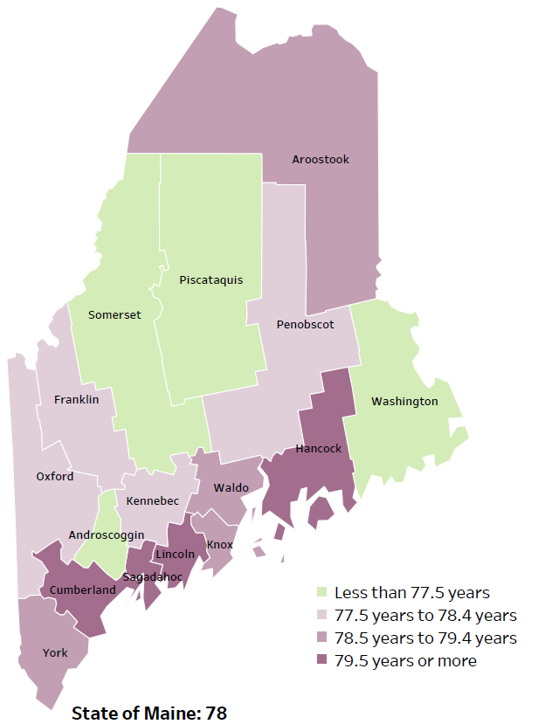
Demographics
Life Expectancy
2017-2019
National Center for Health Statistics,
CDC
RANK | MAINE | ANDROSCOGGIN COUNTY
1 | Cancer | Heart Disease
2 | Heart Disease | Cancer
3 | Unintentional Injury | Chronic Lower Respiratory Disease
4 | Chronic Lower Respiratory Disease | Unintentional Injury
5 | Stroke | Alzheimer's Disease
Notes:
The life expectancy in Androscoggin County is 77.1, which is slightly lower than the state average of 78. Androscoggin County has one of the lower life expectancy in the state. This is an indication that more people are dying at younger ages than residents in many other counties in Maine.
The table on the right side of the slides shows the five leading causes of death in Androscoggin County. They are also the leading causes of death for the whole state of Maine with the exception of Alzheimer's Disease, which is the 5th leading cause of death in the county.
The leading cause of death is Heart disease and cancer is second. The is true in the U.S. overall- Heart Disease is the leading cause of death, and cancer is the 2nd leading cause. However, the opposite is true for Maine- Cancer is the leading cause of death, followed by heart disease.
The 4th leading cause of death- Unintentional Injury- includes a number of accidental causes:
Three of the most common causes are i) Deaths due to motor vehicle crashes, ii) deaths due to accidental falls, iii) deaths due to poisonings that either were unintentional, or the intent was undetermined. Some Firearm deaths may also be classified as unintentional. Suicides, some Firearm deaths and some Poisoning deaths are classified as intentional injury

Slide 20
Demographics
Age distribution for Androscoggin County
AGE
ANDROSCOGGIN COUNTY
POPULATION
107,602
STATE OF MAINE
POPULATION
1,362,359
Notes:
Androscoggin County has the 5th largest population of any Maine County after Cumberland, York, Penobscot and Kennebec. The population is aging but doesn’t have the same age disparities seen in many other counties. There are more adults between 50 and 65, than other age groups.
Source: US Census Bureau, American Community Survey

Slide 21
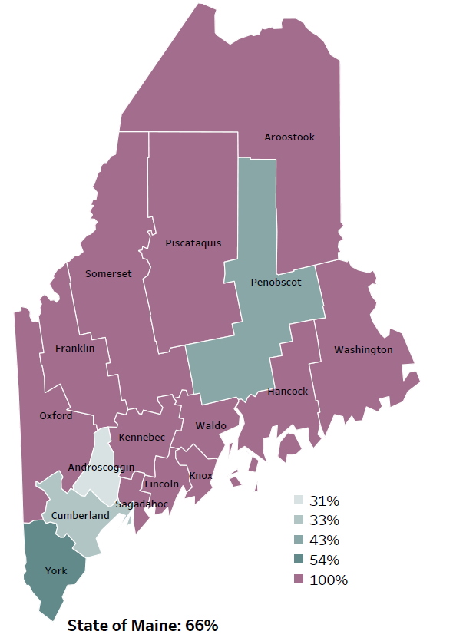
Demographics
Percentage of people living in
rural areas
2019
New England Round Table for Rural Health
Notes:
Androscoggin County is one of 4 counties with a population in an urban area. These data are based on the most recent Census estimates at the Zip-code level, and calculated use rural Urban Commuting Area codes. The categories were established by the New England Rural Health Association. This data is NOT comparable to 2010 US Census data on populations living in rural areas, as that data uses a different definition for rural]
Source: Data, Research and Vital Statistics town-level population file

Slide 22
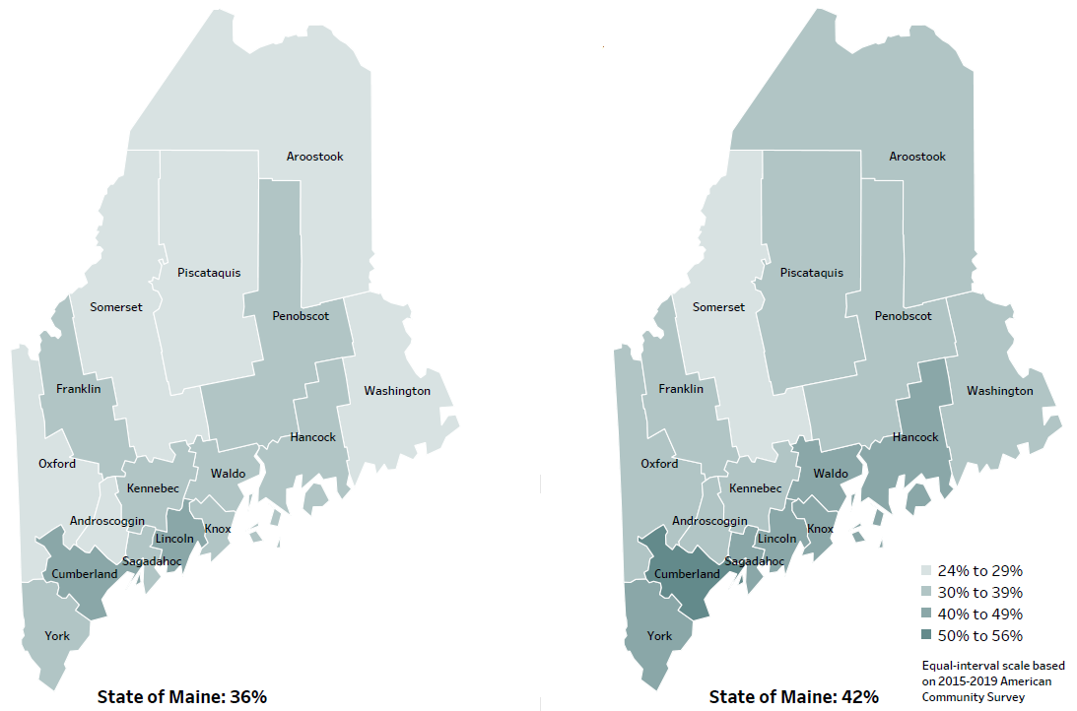
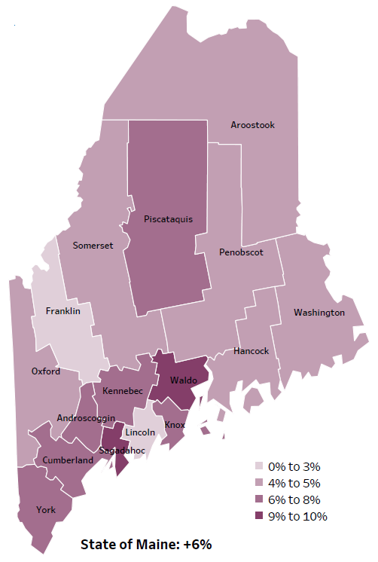
Demographics
Percent of population over age 25 with an associate’s degree or higher
2010
American Community
Survey
Change in percent of population over age 25 with an associate’s degree or higher
2010 to 2015-2019
2015-2019
American Community
Survey
Notes:
These maps show the educational attainment of adults over 25 for two different time periods. Androscoggin County has had an increase in the rate of adults who have achieved an associate’s degree or higher degree of education. This is highlighted in the change over time map, which shows that this was a greater increase than 8 other counties and equal to 6 other counties.
Source: US Census Bureau, American Community Survey

Slide 23
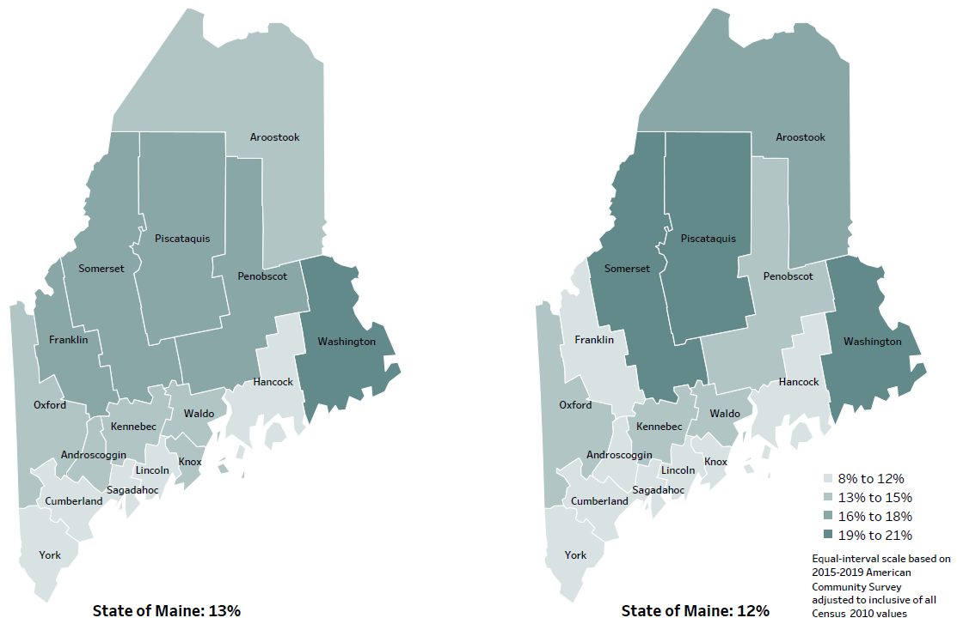
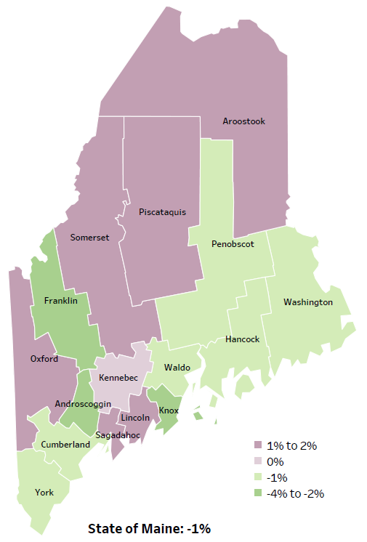
Demographics
Percent of population in poverty
2010
American Community
Survey
Change in percent of population in poverty
2010 to 2015-2019
2015-2019
American Community
Survey
Notes:
These maps show the rate of poverty for two different time periods. Androscoggin county’s poverty rate has decreased more than all but 2 other counties over the time period, as shown in the change over time map, and does have among the lowest levels of poverty in the state. During this period, poverty decreased in Maine overall.
Source: US Census Bureau, American Community Survey

Slide 24
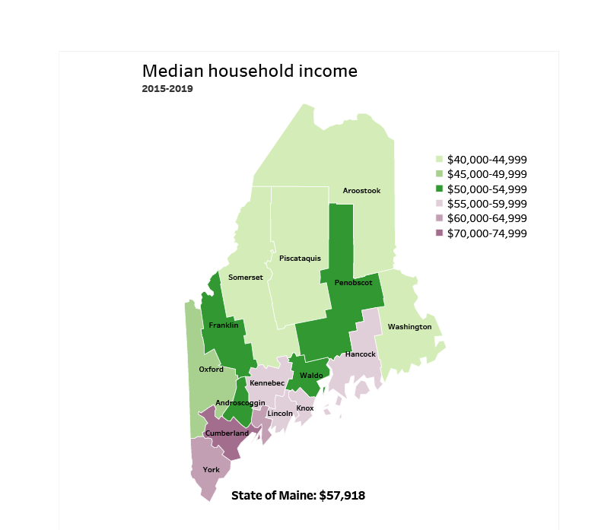
Demographics
Notes:
Androscoggin County has a median household income of $53,509. Half of the households in the county have an income higher than this amount and half have an income less that this amount. This is higher than 8 other counties and in the same range as 4 other counties. Androscoggin County has among a mid-range median income when looking at the state overall. This may be due to the mix of occupations among residents in the county, the employment outlook, educational attainment of residents in the county or other demographic, economic and social factors.
Source: American Community Survey

Slide 25
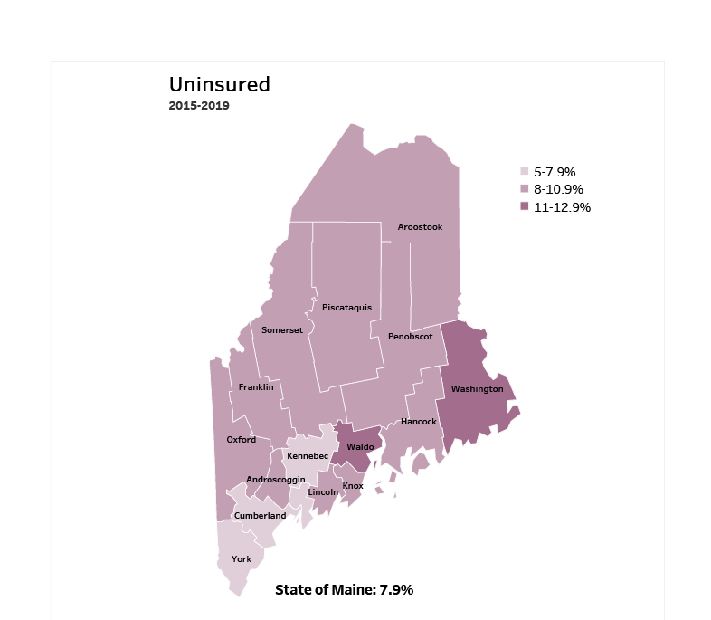
Demographics
Notes:
Androscoggin County has an uninsured rate of 8.0%, which is higher than four counties and about equal to nine counties. Lack of insurance can lead to delayed medical care, emergency room treatment and poorer health outcomes. This measure does not reflect “under-insurance” – people with high deductibles or other insurance that does not cover their health care costs well for which there is not good consistent data.
Source: American Community Survey

Slide 26
Health Indicators
Notes:
Androscoggin county residents are significantly more likely to rate their health as fair or poor when compared to the state overall. This is a self-rated measure meaning respondents subjectively rate their own health, rather than relying on some external measure like a diagnosis.
Data Source: Behavioral Risk Factor Surveillance System
To be read as needed. Definition: Percentage of adults who rate their health as fair or poor (vs. excellent, very good or good).

Slide 27
Health Indicators
Notes:
This graph shows the number of deaths per 100,000 within Androscoggin county. This rate has increased significantly within the county over time. It is also significantly higher than the state overall.
Data Source: Maine CDC Vital Records and National Center for Health Statistics, US CDC
To be read as needed. Definition: Rate per 100,000 people of deaths from any cause.

Slide 28
Health Indicators
Notes:
This slide shows the percentage of adults who have needed to see a provider but could not because of the cost. Delaying care can result in worsening conditions and poorer health outcomes. Androscoggin county residents are significantly more likely to have delayed care when compared to the state overall.
Data Source: Behavioral Risk Factor Surveillance System
To be read as needed. Definition: Percentage of adults reporting that there was a time during the last 12 months when they needed to see a doctor but could not because of the cost.

Slide 29
Health Indicators
Notes:
The rate of lung cancer diagnoses are decreasing within Androscoggin County but remains significantly higher when compared to the state. We have calculated the rates so that they can be compared to other parts of the state that might have a population with a different mix of ages. Older people tend to have higher rates of many diseases and health conditions. It’s important to adjust for age so that we don’t accidentally mistake a place with older people for a place with an unusual number of disease-related deaths.
Data Source: Maine CDC Vital Records
To be read as needed. Definition: Rate per 100,000 people of deaths from lung or bronchus cancers.

Slide 30
Health Indicators
Notes:
Cardiovascular disease deaths have remained relatively stable within the county over time, seeing only a slight increase. The State’s overall rate of deaths due to cardiovascular disease is significantly lower than Androscoggin County’s.
Data Source: Maine CDC Vital Records
To be read as needed. Definition: Rate per 100,000 people of deaths with cardiovascular disease as an underlying cause of death.
Age-Adjustment: We have calculated the rates so that they can be compared to other parts of the state that might have a population with a different mix of ages. Older people tend to have higher rates of many diseases and health conditions. It’s important to adjust for age so that we don’t accidentally mistake a place with older people for a place with an unusual number of disease-related deaths.

Slide 31
Health Indicators
Notes:
Stroke deaths have increased within Androscoggin County over time, but not to a significant degree. The rate of death due to stroke is significantly higher in Androscoggin County than in Maine overall.
Data Source: Maine CDC Vital Records
To be read as needed. Definition: Rate per 100,000 people of deaths with stroke as an underlying cause of death.
Age- Adjustment. We have calculated the rates so that they can be compared to other parts of the state that might have a population with a different mix of ages. Older people tend to have higher rates of many diseases and health conditions. It’s important to adjust for age so that we don’t accidentally mistake a place with older people for a place with an unusual number of disease-related deaths.

Slide 32
Health Indicators
Notes:
Rates of hospitalization due to diabetes are higher significantly higher in Androscoggin County than the State overall.
Data Source: Maine Health Data Organization Hospital Inpatient Database
To be read as needed. Definition: Rate per 10,000 people of hospital discharges with a principal diagnosis of diabetes.

Slide 33
Health Indicators
Notes:
Similar to the previous slide showing higher rates of diabetes-related hospitalizations, Androscoggin County residents are significantly more likely to be treated in the emergency department for diabetes.
Data Source: Maine Health Data Organization Hospital Inpatient and Outpatient Databases
To be read as needed. Definition: Rate per 10,000 people of emergency department discharges with a principal diagnosis of diabetes.

Slide 34
Health Indicators
Notes:
Injury-related deaths are the 4th leading cause of death in Androscoggin County. The rate has risen significantly within the county and is now roughly equal to the state rate of injury deaths.
Data Source: Maine CDC Vital Records
To be read as needed. To be read as needed. Definition: Rate per 100,000 people of deaths due to injuries.
Age Adjustment: We have calculated the rates so that they can be compared to other parts of the state that might have a population with a different mix of ages. Older people tend to have higher rates of many diseases and health conditions. It’s important to adjust for age so that we don’t accidentally mistake a place with older people for a place with an unusual number of disease-related deaths.

Slide 35
Health Indicators
Notes:
The rate of fall related deaths within Androscoggin County have increased significantly since 2007-2011 and is now slightly higher than the state rate.
Data Source: Maine CDC Vital Records
Read as needed - To be read as needed. Definition: Rate per 100,000 people of deaths due to unintentional falls.
Age Adjustment To be read as needed. Definition: We have calculated the rates so that they can be compared to other parts of the state that might have a population with a different mix of ages. Older people tend to have higher rates of many diseases and health conditions. It’s important to adjust for age so that we don’t accidentally mistake a place with older people for a place with an unusual number of disease-related deaths.

Slide 36
Health Indicators
Notes:
Androscoggin County has a significantly higher rate of ER discharges due to an unintentional fall-related injury than the State overall. This measure has been age-adjusted, so it cannot be attributed to Androscoggin county’s older residents.
Data Source: Maine Health Data Organization Hospital Inpatient and Outpatient Databases
To be read as needed. Definition: Rate per 10,000 people of emergency department discharges with a diagnoses of a fall-related injury.
Age Adjustment To be read as needed. Definition: We have calculated the rates so that they can be compared to other parts of the state that might have a population with a different mix of ages. Older people tend to have higher rates of many diseases and health conditions. It’s important to adjust for age so that we don’t accidentally mistake a place with older people for a place with an unusual number of disease-related deaths.

Slide 37
Health Indicators
Notes:
This indicator shows unintentional or undetermined poisoning, meaning these deaths are not due to suicide or other intentional injuries. As you can see the rate within Androscoggin County has increased. This increase is significant and is now slightly below the state rate.
Data Source: Maine CDC Vital Records
To be read as needed. Definition: Rate per 100,000 people of deaths due to poisonings of unintentional and undetermined intent.
Age Adjustment: We have calculated the rates so that they can be compared to other parts of the state that might have a population with a different mix of ages. Older people tend to have higher rates of many diseases and health conditions. It’s important to adjust for age so that we don’t accidentally mistake a place with older people for a place with an unusual number of disease-related deaths.

Slide 38
Health Indicators
Notes:
A violent crime is defined as a murder, rape, robbery or aggravated assault. This slide shows the rate is increasing within Androscoggin County, but the change is not significant. The rate is significantly higher than the state but remains significantly lower than the US rate overall.
Data Source: Maine Dept. of Public Safety
To be read as needed. Definition: Rate per 100,000 people of violent crime offenses. Violent crime is defined as a murder, rape, robbery or aggravated assault.

Slide 39
Health Indicators
Notes:
The rate of Androscoggin County residents being treated in the emergency room for a mental health condition is significantly higher than the state rate. This could be related to a lack of access to mental health professionals in the area.
Data Source: Maine Health Data Organization Hospital Inpatient and Outpatient Databases
To be read as needed. Definition: Rate per 10,000 people of emergency department discharges with a principal diagnosis of mental health condition.
We have calculated the rates so that they can be compared to other parts of the state that might have a population with a different mix of ages. Older people tend to have higher rates of many diseases and health conditions. It’s important to adjust for age so that we don’t accidentally mistake a place with older people for a place with an unusual number of disease-related deaths.

Slide 40
Health Indicators
Notes:
This slide shows the percentage of adults who have been diagnosed with anxiety by a healthcare provider. The rate within Androscoggin County is significantly higher than the state and has been rising within the county.
Data Source: Behavioral Risk Factor Surveillance System
To be read as needed. Definition: Percentage of adults who have ever been told by a healthcare provider that they have an anxiety disorder.

Slide 41
Health Indicators
Notes:
This slide shows Androscoggin County high school students who reported of feeling sad and hopeless for two weeks or more during the past 12 months and caused them to stop doing some of their usual activities. Depression in adolescence is linked with increased risks for negative effects on growth and development, school performance, and peer/family relationships in later adolescence. The precent has increased significantly in Androscoggin County between 2017 and 2019. Androscoggin County’s rate is higher than the overall State but the difference is not significant.
Data Source: Maine Integrated Youth Health Survey
Adolescent Mental Health Data.pdf (ucsf.edu)
Data Source: Maine Integrated Youth Health Survey
To be read as needed. Definition: Percentage of high school students who felt so sad or hopeless almost every day for two weeks or more in a row during the past 12 months that they stopped doing some usual activities. Data collected in odd numbered years.

Slide 42
Health Indicators
Notes:
Here we see the rate of deaths for which substance use was the underlying cause, including those attributable to acute poisoning by drugs and those from medical conditions resulting from chronic drug use. Deaths due to alcohol use are not included. The rate of drug-induced deaths among Androscoggin County residents is significantly higher within the county when compared to prior years and is now close to the state rate.
Data Source: Maine CDC Vital Records and CDC WONDER Online Database
To be read as needed. Definition: Rate per 100,000 people of deaths for which drugs are the underlying cause, including those attributable to acute poisoning by drugs and those from medical conditions resulting from chronic drug use. Deaths due to alcohol use are excluded.

Slide 43
Health Indicators
Notes:
This slide shows the deaths that are attributed to alcohol, including acute alcohol poisoning and from medical conditions resulting in long-term, chronic alcohol use, such as cirrhosis. The rate of alcohol related deaths has risen significantly within the county and has surpassed the state rate. The difference between county and state is not significant.
Data Source: Maine CDC Vital Records and CDC WONDER Online Database
To be read as needed. Definition: Rate per 100,000 people of deaths for which alcohol is the underlying cause, including those attributable to acute alcohol poisoning and those from medical conditions resulting from chronic alcohol use.

Slide 44
Health Indicators
Notes:
This slide shows the rate of infants who have been born addicted to a substance. This data is collected from healthcare providers who report there is a reasonable cause to suspect the baby has been affected by an illegal substance or is demonstrating withdrawal symptoms. The line graph shows the trend from 2011-2017. These single year data are not as reliable as the most recent two year, but still show a clear increase. The two-year rate of drug-affected infants born in Androscoggin County is significantly higher than the State overall. The data shows the average annual rate for the two years, and therefore can be compared to the single year data. There is a concern given the birth and health risk associated with drug exposure in utero.
Data Source: Maine Automated Child Welfare Information System (Maine Office of Child and Family Services)
To be read as needed. To be read as needed. Definition: Rate per 1,000 births of infants for which a healthcare provider reported that there was reasonable cause to suspect the baby may be affected by illegal substance abuse or demonstrating withdrawal symptoms resulting from prenatal drug exposure or has a fetal alcohol spectrum disorder.

Slide 45
Health Indicators
Notes:
This graph shows an increase over time in reported binge drinking among adults in Androscoggin County. Binge drinking is defined as consuming 5 or more alcoholic drinks on at least one day in the past 30 days. There was an increase between 2012-2014 and 2015-2017 and is now almost equal to the state percentage. However, none of these differences are significant.
Data Source: Behavioral Risk Factor Surveillance System
To be read as needed. Definition: Percentage of adults who had five or more drinks on at least one occasion for men or four or more drinks on at least one occasion for women in the past 30 days.

Slide 46
Health Indicators
Notes:
The rate of binge drinking among high school students has decreased within Androscoggin County and is below the state percentage of students who have reported binge drinking.
Data Source: Maine Integrated Youth Health Survey
To be read as needed. Definition: Percentage of high school students who had five or more alcoholic drinks on at least one day in the last 30 days. Data collected in odd numbered years.

Slide 47
Health Indicators
Notes:
This slide shows a decreasing rate of prescription drug misuse among Androscoggin County’s high school students. There has been a major, significant decline of prescription drug misuse since 2017. The difference between Androscoggin County’s rate and the State is minimal and is not significant.
Data Source: Maine Integrated Youth Health Survey
To be read as needed. Definition: Percentage of seventh- and eighth-grade students who used a prescription drug without a doctor's prescription at least one time in the last 30 days. Data collected in odd numbered years.

Slide 48
Health Indicators
Notes:
This slide shows the EMS response to overdoses from drugs, medications, alcohol and inhalants. The rate has risen in Androscoggin county and is now significantly higher than the state rate.
Data Source: Maine Emergency Medical Services
To be read as needed. Definition: Rate per 10,000 population of overdose emergency medical service responses, including overdoses from drugs, medications, alcohol, and inhalants.

Slide 49
Health Indicators
Notes:
This slide shows the percentage of Androscoggin County high school students who have used an e-cigarette at least once in the last 30 days. Data is collected in odd numbered years and, as you can see, use has increased between 2017 & 2019. This increase is significant.
Data Source: Maine Integrated Youth Health Survey
To be read as needed. Definition: Percentage of high school students who used an electronic vapor product at least one day in the last 30 days. Data collected in odd numbered years.

Slide 50
Breakout Discussions

Slide 51
Reconvene

Slide 52
Wrap up and Next Steps

Slide 53
Contacts
Holly Lasagna, Health Promotion Manager, Healthy Androscoggin
Central Maine Medical Center
holly.lasagna1@cmhc.org 207-795-5990
Elizabeth Keene, VP, Mission Integration
St. Mary’s Regional Medical Center
ekeene@stmarysmaine.com 207-777-8806
Jo Morrissey, Program Manager,
  Maine Shared CHNA
  info@mainechna.org

