Slide 1
Fight the Bite!
Maine Center for Disease Control and Prevention

Slide 2
…Mosquitoes
What do mosquitoes look like?
Where do mosquitoes live?
Can mosquitoes cause diseases?
What can happen if an infected mosquito bites me?
How can I prevent a mosquito from biting me?
Notes:
In this presentation, we will address:
What do mosquitoes look like?
Where do mosquitoes live?
Can mosquitoes cause diseases?
What can happen if an infected mosquito bites me?
How can I prevent a mosquito from biting me?

Slide 3
What do mosquitoes look like?
In Maine, there are many different kinds of mosquitoes
Notes:
There are 45 different species of mosquitoes found in Maine.
Mosquitoes have antennae, wings, legs, eyes, a proboscis, a head, a thorax, and an abdomen.
Only female mosquitoes have a proboscis for piercing skin, and only the females feed on blood. Male mosquitoes typically feed on plant nectar.
Vocabulary:
Antennae (antenna) – long, feathery sensory organs on the mosquito’s head, used to hear and smell
Proboscis – long, jagged mouth part on the mosquito’s head that is used to pierce the skin and suck out the blood
Thorax – the part of the mosquito between the head and the abdomen, where the wings and legs attach
Abdomen – part of the mosquito’s body that hangs from the thorax and serves as the mosquito’s stomach and lungs, holds the blood that the female takes in, as well as stores the female’s eggs

Slide 4
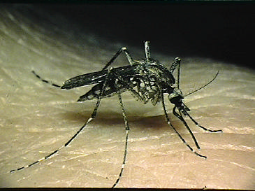
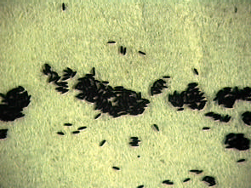
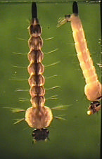
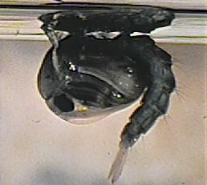
Mosquito Life Cycle
Adult
Egg
Larva
Pupa
Notes:
Mosquitoes grow from immature to adult in a process called metamorphosis (meta=change, morph=shape), just like a caterpillar turns into a moth. During their life cycle, the mosquito goes through four different stages: egg, larvae, pupae, and adult.
The egg, larval and pupal stages all require the mosquito to live in water.
Vocabulary:
Metamorphosis (“meta” = change; “morph” = shape) - the process of development from immature to adult
Eggs – the adult female mosquito lays between 50 – 300 eggs about every third day of her lifespan. The eggs can be laid as “rafts”, floating on the surface of standing water, or laid on an area of ground that floods on a regular basis. The egg stage lasts for 2 – 3 days.
Larvae (larva) – (also called wigglers or wrigglers) part of the mosquito lifecycle that comes after the eggs hatch. The larvae hang from the surface of water and breathe through tubes. The larval stage lasts for about 1 week.
Pupae (pupa) – (also called tumblers) part of the mosquito lifecycle that come after the larvae stage; pupae are partially encased in a cocoon. The pupa’ stage lasts for about 4 days before it becomes an adult mosquito. Adult – emerges from the pupa and rests on the surface of the water until it dries its wings and can fly away.

Slide 5
Where do mosquitoes live?
Some mosquitoes like bogs and swamps with:
Different kinds of plants
Clear or tea colored water
This is the favored habitat for mosquitoes carrying Eastern Equine Encephalitis (EEE) virus
Notes:
While all mosquitoes require water for their larvae to develop, different species like different types of water habitats. Generally, mosquitoes lay eggs in two types of habitats: permanent water and floodwater.
Some mosquitoes prefer to live in bogs with clear or tea colored water, and where there are different kinds of plants. This is the favored habitat for mosquitoes that can spread a virus that causes Eastern equine encephalitis (EEE).
Vocabulary:
Permanent water – water sources that are present for long periods of time and can support the growth of different types of plants
Floodwater – water sources that alternate between periods of dry and wet, such as when water overflows as a result of a flood or melting snow
Eastern equine encephalitis (EEE) virus – EEE is a virus that can be transmitted to humans by the bite of an infected mosquito

Slide 6
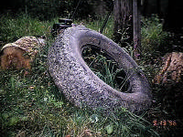
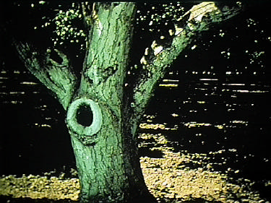
Other Mosquito Habitats
Some mosquitoes like:
Artificial containers
Catch basins
Flower pots
Discarded tires
The #1 mosquito breeding site is unmounted car tires
Stagnant (motionless)
temporary pools
Holes in trees
These are the favored habitats for mosquitoes carrying West Nile virus (WNV)
Notes:
Man-made containers are also important mosquito habitats. Mosquitoes can use buckets, cans, flower pots, or old tires to lay their eggs. Many of these man-made containers can be found around our houses and are important sources of mosquitoes near our homes.
The #1 mosquito breeding site around the home is unmounted car tires.
Some species live in natural containers, such as the spots between branches of trees, where water collects; some live in the holes formed in trees when branches break off. These are the favored habitats for mosquitoes that can carry West Nile virus.
Vocabulary:
Man-made containers – buckets, pails, flowerpots and other containers that can hold water and become part of mosquitoes’ habitat
Natural containers – containers found in nature that can hold water, such as the junction in between tree branches where water can collect
West Nile virus (WNV) – WNV is a virus that can be transmitted to humans by the bite of an infected mosquito

Slide 7
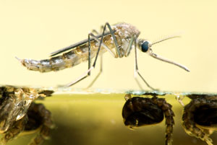
Mosquitos Need Water
Regardless of the type of mosquito…all mosquitos need water in order to reproduce
Notes:
Regardless of the type of mosquito, they all need water in order to reproduce!

Slide 8
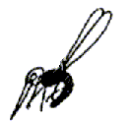
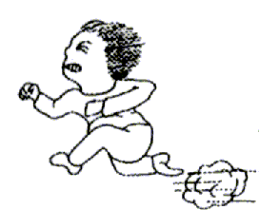
Mosquitoes and People
Far: Carbon Dioxide
Near: Heat, Moisture, Vision
Notes:
All humans and animals exhale carbon dioxide when they breathe, which attracts mosquitoes. When a female mosquito (remember, only the female mosquitoes bite humans and other animals) senses carbon dioxide, she flies toward it. As she gets closer, she is attracted by the heat and moisture your body gives off.
Vocabulary:
Carbon dioxide – the gas that all animals exhale that can attract mosquitoes from several hundred feet away

Slide 9
Can mosquitoes cause diseases?
YES. Two of the most common diseases in Maine are:
Eastern Equine Encephalitis (EEE) virus
One of the most serious mosquito-borne diseases in the United States
West Nile virus (WNV)
Occurs throughout the United States
Another disease sometimes found in Maine is:
Jamestown Canyon virus (JCV)
Occurs throughout the United States
Notes:
Mosquitoes can carry viruses that cause diseases and different mosquitoes can carry different viruses.
Mosquitoes can pick up viruses when they bite an animal or bird that carries the virus (also known as a host). They then spread the virus by biting another animal or human.
The most common diseases in Maine are: Eastern Equine Encephalitis (EEE) virus and West Nile virus (WNV).
Another virus that some mosquitoes in Maine carry is Jamestown Canyon virus (JCV).
Vocabulary:
Host - The animal in which the viruses live
Jamestown Canyon virus (JCV) – JCV is a virus that can be transmitted to humans by the bite of an infected mosquito

Slide 10
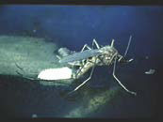
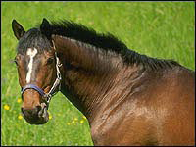
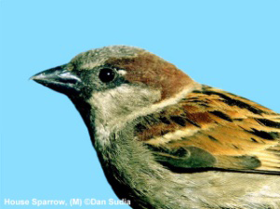
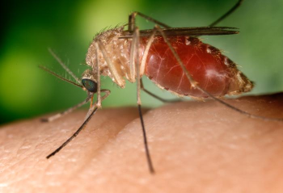
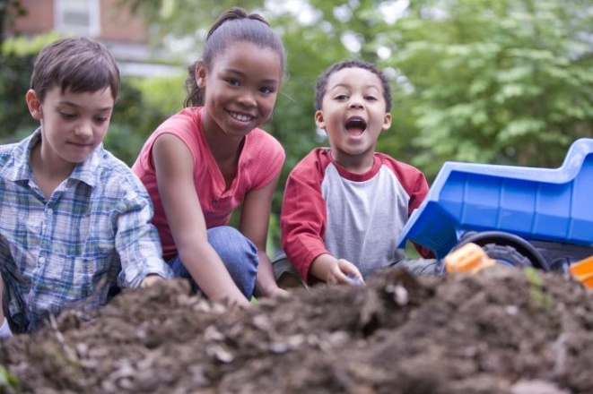
EEE and WNV Transmission Cycle
Bridge mosquito vectors
Amplification cycle
“Dead-end”
hosts
Notes:
The Transmission Cycle is the cycle in which some infected hosts can develop high levels of the virus in their bloodstream and mosquitoes can become infected by biting these infected hosts. The now infected mosquito then goes on to bite someone else.
Birds serve as reservoirs for EEE virus and WNV. Reservoirs are organisms that carry the germ but often will not get the disease itself (meaning reservoirs can carry the germ but not get sick from it).
Normally, what happens is:
The bird carries the virus; a mosquito feeds on the bird; then the mosquito feeds on another bird transmitting the virus to them to keep the cycle going and growing (also known as the amplification cycle).
Humans become infected when an infected mosquito bites them. Fortunately, humans can’t infect other mosquitoes, which make them “dead-end” hosts for the disease.
Vocabulary:
Transmission Cycle – the cycle in which some infected hosts can develop high levels of the virus in their bloodstream and mosquitoes can become infected by biting these infected hosts. Reservoirs – organisms that host a germ that is often not harmful to the host, but can cause illness in a different species
Amplification cycle – the process of replicating something and increasing its production
“Dead End” host- The virus cycle ends with this host. The host cannot transmit the virus to others.

Slide 11
What can happen if an infected mosquito bites me?
Symptoms can include: fever, head and body aches, lack of energy
MOST people infected with one of these viruses will not have any symptoms
Symptoms can be mild to severe
Appear 3-18 days after infection
Symptoms usually last 1-2 weeks: no treatment, only support
Notes:
WNV or EEE may start off with symptoms that look like the flu.
A person can get a headache and fever, may vomit, and may be very tired. In most cases, the infection doesn’t go beyond those symptoms.
In some people infected with WNV or EEE, more serious symptoms develop. These symptoms can include disorientation, seizures, paralysis, coma, or death.

Slide 12
Travel Related Mosquito-Borne Diseases
Chikungunya
Symptoms include fever, joint pain, headache, muscle pain, joint swelling, and rash.
Dengue Fever
Symptoms include high fever, severe headache, backache, joint pain, nausea and vomiting, eye pain, a “breaking bone feeling,” and rash.
Malaria
Symptoms may include high fevers, shaking chills, flu-like illness, headache, muscle aches, tiredness, nausea, vomiting, and diarrhea.
Zika
Symptoms include fever, rash, joint pain, and red eyes.
Mane Center for Disease Control and Prevention
Notes:
Chikungunya, dengue fever, malaria, and Zika are some of the most common mosquito-borne diseases acquired during international travel.
Local transmission in the United States is not common, but outbreaks of Chikungunya, Dengue, and Zika occasionally occur. Maine currently does not have the mosquitoes that carry chikungunya, dengue, malaria, or Zika.
It’s important to use the same prevention measures that are taken at home when traveling along with: staying indoors when mosquitoes are especially abundant, sleeping under a mosquito net when traveling to endemic areas, and taking preventative action, such as anti-malarial medications, before traveling to areas with a threat of disease.

Slide 13
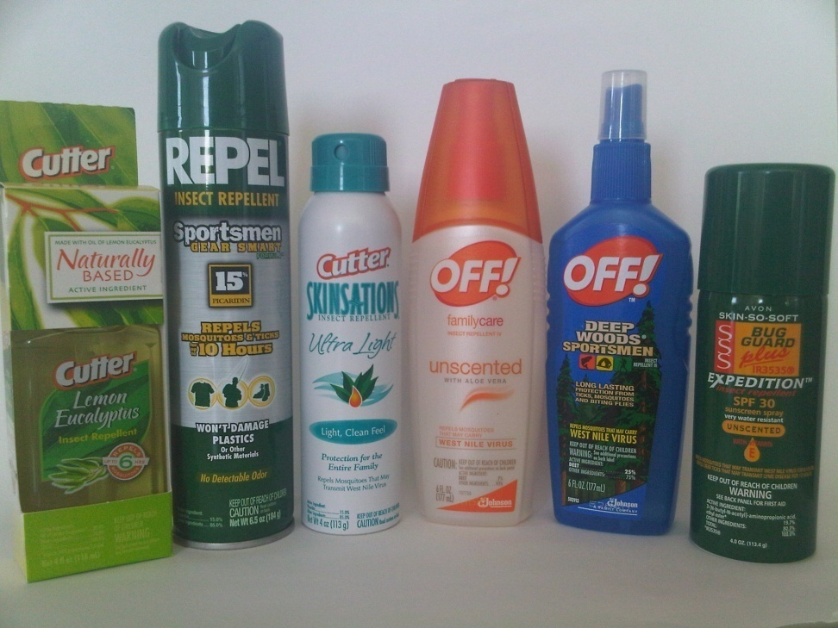
How can I protect myself?
Wear protective clothing
Wear long pants and long-sleeved
shirts
Use a repellent
Be extra careful from dusk until dawn
Mosquitoes that carry EEE and
WNV are most active in the
early morning and evening
Notes:
The best way to protect yourself from getting these diseases is by preventing getting bitten in the first place. Here are some tips to help you not get bit by mosquitoes:
Wear long pants and long-sleeved shirts to lessen the amount of uncovered skin
Use a repellent (also known as “spray”) that is approved by the EPA (Environmental Protection Agency) for repelling mosquitoes.
When using a repellent, follow the label instructions carefully. You can find the repellent that will work best for you here: http://cfpub.epa.gov/oppref/insect/
Try to minimize your time outside during early morning and early evening (this is when mosquitoes that transmit viruses in Maine are most active)
Vocabulary:
Repellent – a spray applied to skin to prevent insect bites
EPA (Environmental Protection Agency) – federal agency devoted to protecting human health and the environment

Slide 14
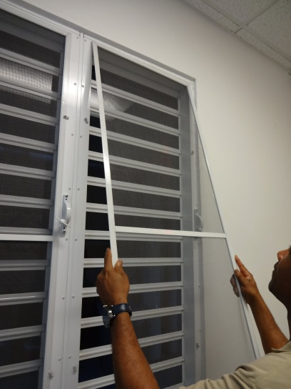
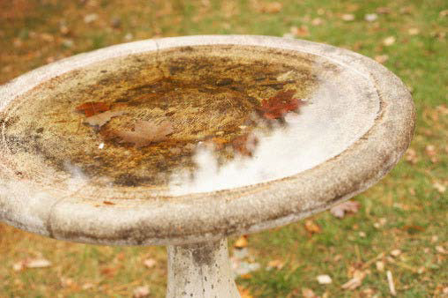
Make Your Yard Safer
*Check door and window screens to make sure there are no tears in them
*Dispose of old tires, cans, bottles and other containers left outside that hold water
*Drain water from gutters, flower pots, pet bowls and wading pools
Notes:
To protect yourself at home, check your doors and window screens to be sure there aren’t any tears or holes in them.
If you don’t have man-made containers around your home, the risk of being bitten decreases. Removing un-needed containers from around the home, or placing them so they will not hold water, is one way to reduce the number of mosquitoes. Throw-away or recycle old tires, cans, bottles or other containers left outside that might collect water and serve as a mosquito breeding ground.
If containers must be there, like bird baths or pet bowls, empty the water out of them once each week so that mosquito larvae in them won’t have time to complete their life cycle.

Slide 15
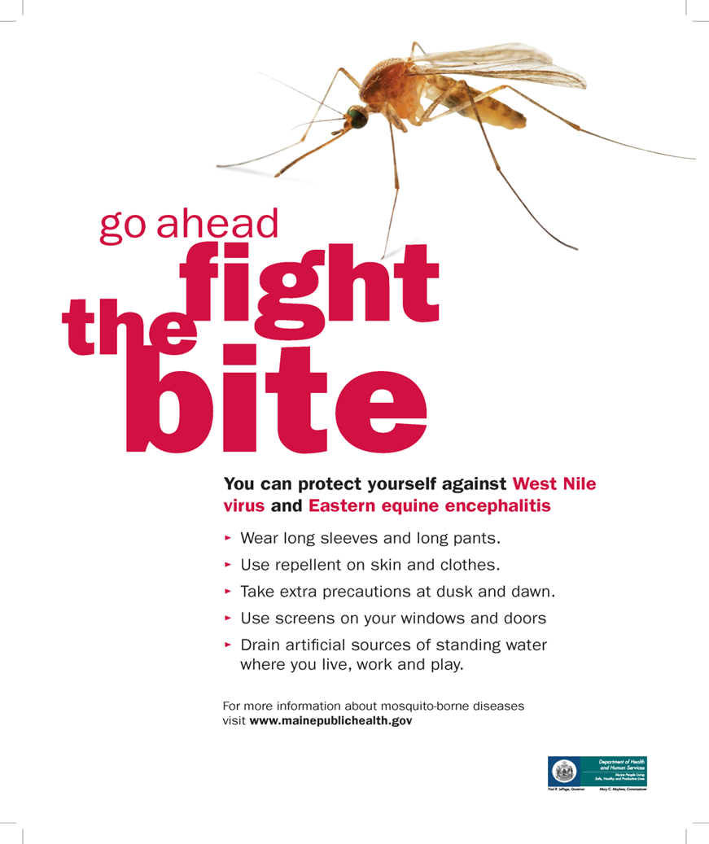

Slide 16
Questions?
* Maine CDC disease reporting and consultation line: 1-800-821-5821 Disease.reporting@maine.gov
* Maine CDC Vector-Borne Disease Website: www.maine.gov/dhhs/mecdc/infectious-disease/epi/vector-borne/index.shtml
* Maine Medical Center Research Institute – Vector-borne Disease Lab:
207-662-7142
Notes:
Please let us know if you have questions.

