Slide 1
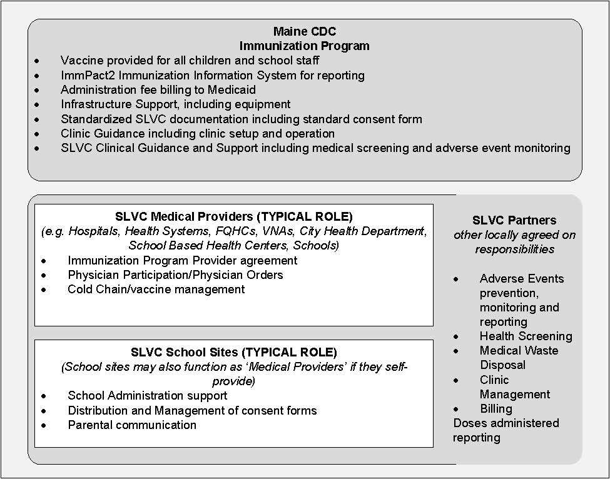
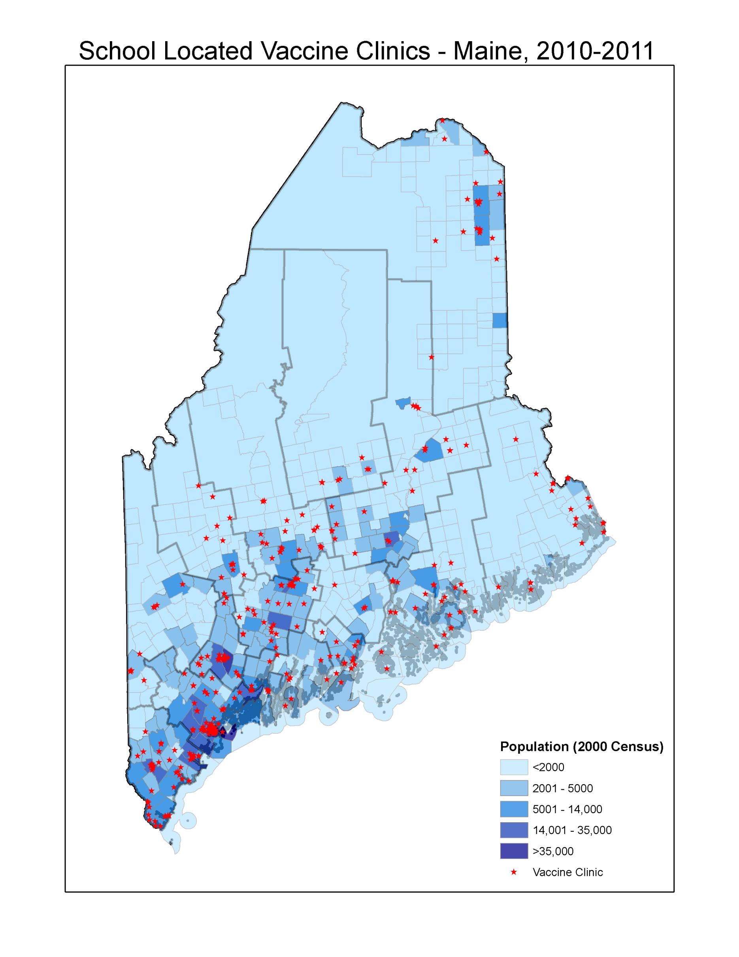
School Located Influenza Vaccine Clinics – Maine, 2010
Sara Robinson, MPH, Peter Smith, PhD, Maine Immunization Program
Maine Center for Disease Control and Prevention
WHAT IS AN SLVC?
WHY OFFER VACCINE IN SCHOOLS?
HOW ARE SLVC’S ACCOMPLISHED?
School Located Vaccine Clinics (SLVC)s can be defined as vaccination that is:
Administered on school grounds
Targets enrolled students and potentially others
Held before, during, and/or after school hours
Typically involves collaboration between public health departments and public and private schools/school districts.
Maine began using SLVC’s to distribute the pH1N1 vaccine in 2009, and continues to use this model for seasonal influenza vaccine distribution. All K – 12 schools are eligible to participate in SLVC’s.
Lessons learned from 2009 H1N1 vaccine clinics show that:
SLVC’s can help raise vaccination rates
SLVC’s can help reduce disparities among those vaccinated
SLVC’s are a collaborative effort between Maine’s Immunization Program, the school and medical providers.
H1N1 and seasonal vaccination rates among children 6 months – 17 years of age - Maine and the US, 2009-2010 (Source: National Surveys)
Vaccination by Percentage of School with Free/Reduced Lunch – Maine, 2009 -2010
Group 1 = <15% of school received reduced cost lunch
Group 2 = 15-30% of school received reduced cost lunch
Group 3 = 31-50% of school received reduced cost lunch
Group 4 = >50% of school received reduced cost lunch
WHO SUPPORTS SLVC’S?
Percent of Students by Vaccination Status
School located vaccine clinics require a medical provider , which may come from the school itself, or another partner in the community.
Influenza vaccination helps reduce absenteeism, even among those not vaccinated
FUTURE WORK
Maine CDC is continually working to enhance and improve the SLVC process
Maine CDC is conducting enhanced surveillance to look at the effectiveness and usefulness of SLVC’s
Maine CDC has an ongoing Influenza Vaccine Effectiveness Enhanced Surveillance (IVEES) project in Cumberland County that looks at vaccination in relation to PCR confirmed influenza
WHERE ARE SLVC’S IN MAINE?
In 2010 there were 347 clinics held statewide. All 16 counties had a least one clinic.
IVEES Preliminary Results – Maine 2010 -2011 Influenza Season
 |  | Vaccination Status |  |  | Total
 | Result | N | Y | U
 | A/Unsubtyped | 0 | 1 | 0 | 1
 | A/H3 | 18 | 6 | 2 | 26
 | A/pH1N1 | 20 | 11 | 0 | 31
 | B | 42 | 15 | 1 | 58
 | Negative | 42 | 24 | 0 | 66
 | Total | 122 | 57 | 3 | 182
In the two years that SLVC’s were available in Maine – the percentage of influenza vaccines received in the school setting increased from 0 to 30%
Offering vaccine in schools provides an opportunity for children that may not otherwise get vaccinated.
FOR MORE INFORMATION:
Maine CDC’s influenza website: www.maineflu.gov
Maine School-located Vaccine Clinic Toolkit: http://www.maine.gov/dhhs/boh/maineflu/h1n1/educators.shtml#schoolclinics

