Slide 1
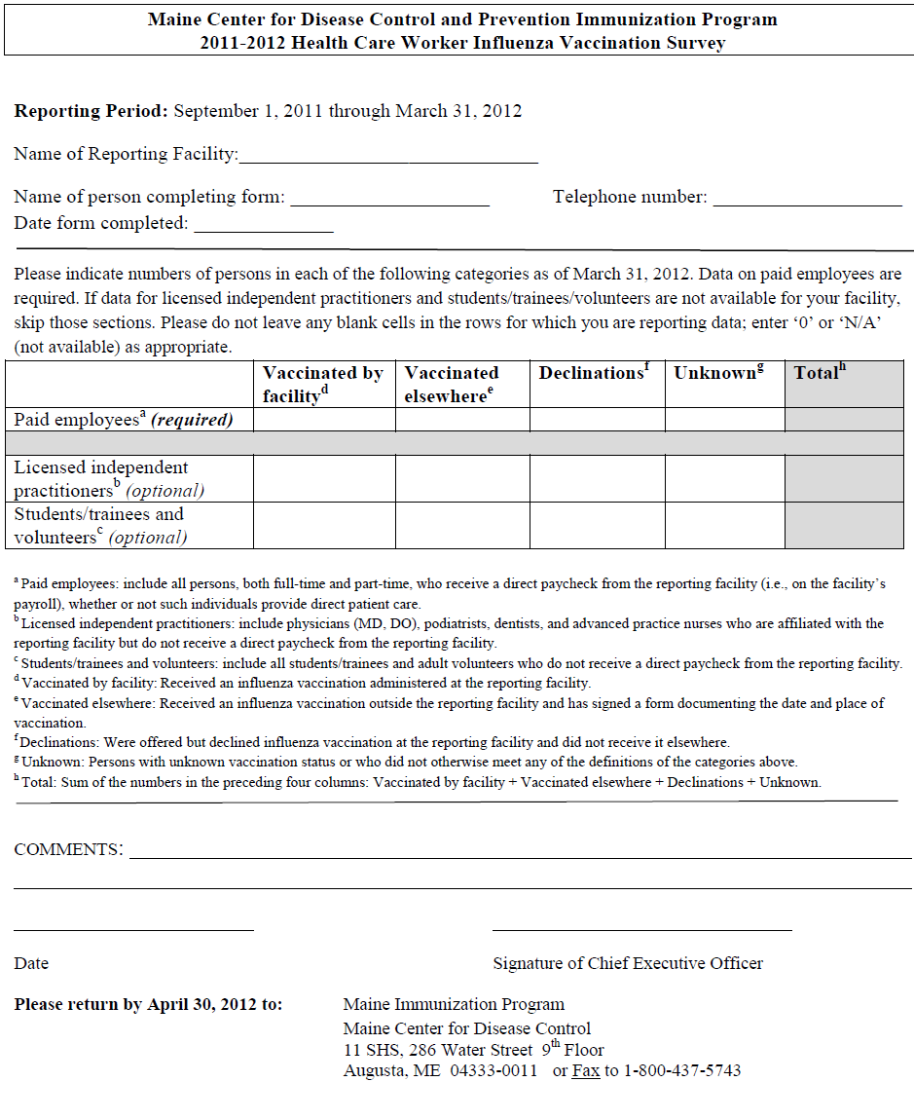
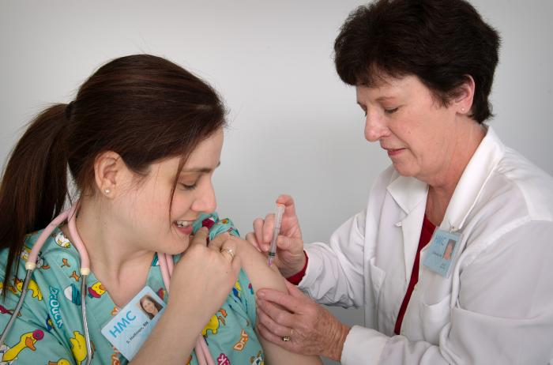
Influenza Vaccination Coverage Among Healthcare Workers – Maine, 2012
Susan E. Manning, MD, MPH, Sara Robinson, MPH, Stephen D. Sears, MD, MPH
Maine Center for Disease Control and Prevention
BACKGROUND
RESULTS
Influenza vaccination of healthcare workers (HCW) is a proven strategy to decrease spread of influenza virus to vulnerable patients
Increasing numbers of professional organizations have issued policy statements in favor of mandatory vaccination of HCW to promote patient safety, and many facilities have adopted such policies
Since 2002 Maine state law has required that healthcare facilities report data on seasonal HCW influenza vaccine coverage annually to the Maine Center for Disease Control and Prevention (Maine CDC)
Coverage data for paid employees were obtained from all 40 facilities surveyed
The statewide average HCW influenza vaccination coverage was 77.1%
The range of HCW influenza vaccination coverage was 50.0 – 97.5%
22 facilities had coverage levels greater than the state average, while 18 were below the state average
Percentage of Paid Employees Vaccinated Against Influenza, Maine Hospitals, 2011-2012
CONCLUSIONS
OBJECTIVE
Health care workers are the first line of defense in diagnosing, treating, and preventing further spread of the influenza virus
Six Maine hospitals met or exceeded the Healthy People 2020 (HP2020) objective of 90% HCW influenza vaccine coverage
Nine additional hospitals fell just short of the HP2020 goal, achieving vaccination coverage between 85-90%
Additional work is needed to ensure all Maine hospitals achieve the HP2020 objective
Tracking HCW influenza vaccination coverage can be an important component of a systematic approach to protecting patients and workers
Maine healthcare facilities are urged to use these results and the sharing of lessons learned from facilities with the highest coverage levels to inform their efforts to improve HCW influenza vaccination coverage for upcoming seasons
The objective of this project was to improve Maine CDC’s process for collecting influenza vaccination coverage data and reporting the information back to Maine hospitals
METHODS
Maine CDC collaborated with Maine Hospital Association and Maine Infection Prevention Collaborative to refine and standardize the process for collecting HCW influenza vaccination coverage data
Coverage levels were calculated as the number of employees vaccinated either at the facility or elsewhere divided by the total number of paid employees
All 37 acute care facilities, and 3 psychiatric facilities were included
Average Influenza Vaccination Coverage by Number of Paid Employees -- Maine Hospitals (N = 40), 2011-2012
NEXT STEPS
# of paid employees | # of facilities | Average vaccine coverage | Range
< 500 | 17 | 73.4% | 50.0-93.8%
500-1000 | 12 | 80.8% | 67.6-97.5%
>1000 | 11 | 78.6% | 60.2–90.4%
Maine CDC will continue to work with partner organizations and Maine hospitals to improve influenza vaccination of HCW
Maine CDC plans to focus on improving the reporting of influenza vaccination coverage for both employees and residents of long term care facilities throughout the state
ACKNOWLEDGEMENTS
The authors thank Sherry Hallett and Lori Wolanski (Maine CDC) and Sandra Parker (Maine Hospital Association).

