Slide 1
Start of the 2022-2023 Influenza Season
Maine’s Influenza Workgroup
9/28/2022

Slide 2
Welcome!
The 2022-2023 influenza surveillance season officially starts Sunday October 2, 2022

Slide 3
Influenza Activity Overview
International activity
The southern hemisphere is coming to the end of their flu season. Many countries saw an early peak this year. The dominate strain of virus differed between countries.
Globally, influenza activity remains low.
More information found at https://cdn.who.int/media/docs/default-source/influenza/influenza-updates/2022/2022_09_19_surveillance_update_428.pdf?sfvrsn=7a48d4f7_1&download=true

Slide 4
Influenza Activity Overview
US Activity
Though relatively mild, there was more activity than during the 2020-21 season and flu activity continued later than any season on record.
Currently, influenza activity remains low throughout the country.
All 4 influenza subtypes have recently been identified, with influenza A H1N1 and H3N2 being the most prevalent.

Slide 5
Influenza Activity Overview
Non-seasonal Influenza
Swine (variant) influenza
10 cases in humans identified during the 2021-22 season
9/10 had direct or indirect swine contact
Avian influenza (H5N1)
One human H5N1 case identified in the US
The Circulation of avian influenza continues in North American domestic and wild birds

Slide 6
Immunization
2022-2023 Influenza Vaccine Recommendations
Everyone six months of age and older should get a yearly flu vaccine.
Children 6 months through 8 years of age, receiving the flu shot for the first time or those who have only previously gotten one dose of vaccine in this age range, should get two doses of vaccine this season—spaced at least 4 weeks apart.
For the 2022-2023 flu season, there are three flu vaccines that are preferentially recommended for people 65 years and older.
Fluzone High-Dose Quadrivalent vaccine
Flublok Quadrivalent recombinant flu vaccine
Fluad Quadrivalent adjuvanted flu vaccine.
Both Influenza and COVID-19 vaccines can be given
at the same visit.
Notes:
Getting the influenza vaccine is especially important this year. While flu vaccine will not protect against COVID-19, getting vaccinated will protect you and your family from getting sick from the flu at the same time as COVID-19 is circulating and may also potentially save healthcare resources in a season that could be particularly taxing.
In situations where there is not high dose flu available for a patient 65 or older, regular dose flu vaccine should be used.

Slide 7
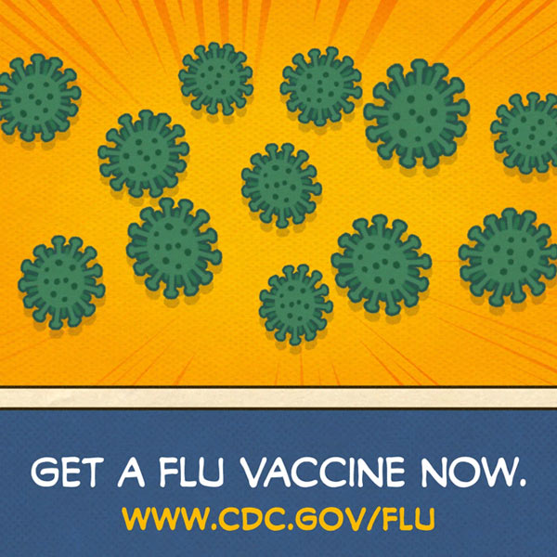
Immunization
Vaccine Compositions
All of the 2022-2023 egg-based influenza and LAIV4 vaccine are made to protect against the following four viruses:
A/Victoria/2570/2019/SWL1536/2019 (H1N1)pdm09-like virus (updated)
A/Darwin/9/2021 (H3N2)-like virus (updated)
B/Austria/1359417/2021-like virus (B/Victoria lineage) (updated)
B/Phuket/3073/2013 (B/Yamagata lineage)-like virus
For 2022-2023, cell- or recombinant-based vaccines contain:
A/Wisconsin/588/2019 (H1N1) pdm09-like virus
A/Darwin/6/2021 (H3N2)-like virus (updated)
B/Austria/1359417/2021-like virus (B/Victoria lineage) (updated)
B/Phuket/3073/2013-like virus (B/Yamagata lineage)
Live attenuated influenza vaccine (LAIV) – or the nasal spray vaccine – is available for use during the 2022-2023 flu season.
The LAIV nasal spray is a quadrivalent vaccine that can be administered to people between 2-49 years of age without contraindications to the nasal spray vaccine.

Slide 8
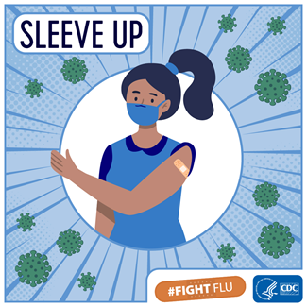
Immunization
Egg Allergies
People who have experienced only hives after exposure to egg can get any licensed flu vaccine that is otherwise appropriate for their age and health
People who have symptoms other than hives after exposure to eggs, such as angioedema, respiratory distress, lightheadedness, or recurrent emesis; or who have needed epinephrine or another emergency medical intervention, also can get any licensed flu vaccine that is otherwise appropriate for their age and health, but the vaccine should be given in a medical setting and be supervised by a health care provider who is able to recognize and manage severe allergic conditions.
Two completely egg-free (ovalbumin-free) flu vaccine options are
available: quadrivalent recombinant vaccine and
quadrivalent cell-based vaccine
Notes:
Recommendations for people with egg allergies are the same as the previous seasons:
People who have experienced only hives after exposure to egg can get any licensed flu vaccine that is otherwise appropriate for their age and health
People who have symptoms other than hives after exposure to eggs, such as angioedema, respiratory distress, lightheadedness, or recurrent emesis; or who have needed epinephrine or another emergency medical intervention, also can get any licensed flu vaccine that is otherwise appropriate for their age and health, but the vaccine should be given in a medical setting and be supervised by a health care provider who is able to recognize and manage severe allergic conditions.
Two completely egg-free (ovalbumin-free) flu vaccine options are available: quadrivalent recombinant vaccine and quadrivalent cell-based vaccine

Slide 9
Immunization
Healthcare Workers
The Centers for Disease Control and Prevention (CDC), the Advisory Committee on Immunization Practices (ACIP), and the Healthcare Infection Control Practices Advisory Committee (HICPAC) recommend that all U.S. health care workers (HCW) get vaccinated annually against influenza.
Since 2002, Maine state law requires that healthcare facilities report data on seasonal influenza vaccine coverage among healthcare workers in their facilities annually to the Maine Center for Disease Control and Prevention (Maine CDC).
As of 2021, healthcare workers employed by a licensed nursing facility, residential care facility, Intermediate Care Facility for Individuals with Intellectual Disabilities (ICF/IID), multi-level healthcare facility, hospital, or home health agency licensed by the State of Maine are required to show proof of seasonal influenza vaccination.
https://www.maine.gov/dhhs/mecdc/infectious-disease/immunization/providers/documents/Immunization%20Requirements%20for%20Healthcare%20Workers.pdf

Slide 10
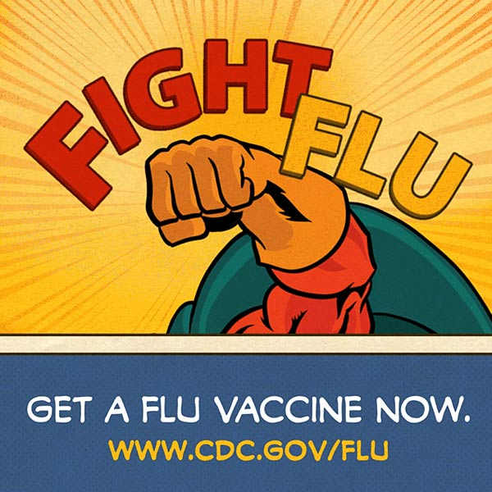
Immunization

Slide 11
Infection Control
US CDC offers guidelines and recommendations for seasonal influenza in healthcare settings.
Prevention strategies for season influenza in all healthcare settings:
https://www.cdc.gov/flu/professionals/infectioncontrol/healthcaresettings.htm
Outbreak management in long-term care and other post-acute settings:
https://www.cdc.gov/flu/professionals/infectioncontrol/ltc-facility-guidance.htm
Have specific questions?
For seasonal influenza infection prevention and control consultations, please reach out to Healthcare Epidemiology at MeCDC.HAI@maine.gov

Slide 12
Laboratory
Maine Health and Environmental Testing Laboratory (HETL)
The following specimens should be sent to HETL for confirmation or further analysis:
At least the first 10 positive specimens for each commercial laboratory or hospital
Any suspect novel influenza
Influenza results that can not be typed
Any samples from patients with swine or avian contact
Any suspected co-infections (positive for influenza A and B)
Consider sending samples for any hospitalized patient with clinically compatible illness and a negative rapid test

Slide 13
Laboratory
Influenza Laboratory Submission Information Sheet (LSIS)
https://www.maine.gov/dhhs/mecdc/public-health-systems/health-and-environmental-testing/micro/submitting-samples.shtml
Specimen Requisition Form
https://www.maine.gov/dhhs/mecdc/public-health-systems/health-and-environmental-testing/micro/download-forms.htm
Notes:
Include LSIS

Slide 14
Reporting Requirements
Influenza-like Illness (ILI) outbreaks
Pediatric influenza-associated deaths
Influenza-related hospitalizations
Novel influenza

Slide 15
Reporting Requirements
Influenza-like Illness (ILI) outbreaks
ILI = Fever (100°F or greater) and cough and/or sore throat in the absence of a known cause
Long-term care facilities
Two or more residents with respiratory illness when at least on has lab confirmation.
Acute care facility nosocomial outbreak
One or more patients with laboratory-confirmed influenza with symptom onset greater than or equal to 48 hours post-admission.
School or daycare
Greater than or equal to 15% absenteeism among students where the majority of those absent report respiratory symptoms.
Any sudden or unusual increase of ILI should be reported
Notes:
LTC- suspect an outbreak with one positive influenza result

Slide 16
Reporting Requirements
Pediatric influenza-associated deaths
A death in a person younger than 18 years old resulting from a clinically compatible illness that is confirmed by an appropriate laboratory test.
There should be no period of complete recovery between the illness and death.

Slide 17
Reporting Requirements
Influenza-related hospitalizations
A hospitalization (inpatient admission) due to influenza-related illness, that is laboratory confirmed.
Reporting options
REDCap survey
Faxed or emailed line list or individual report
Phone

Slide 18
Reporting Requirements
Novel influenza A
Novel influenza A viruses are viruses that do not normally circulate in humans
examples: avian influenza, swine influenzas
Most laboratory tests would identify this as influenza A but would be unable to subtype.
Send all unsubtypable specimens to HETL for further analysis
Novel Influenza A is immediately reportable by phone

Slide 19
Reporting Requirements
Maine CDC appreciates all reports of positive influenza test results
1-800-821-5821
(207) 287-8186 OR 207-287-6865
Influenza.DHHS@maine.gov
(no patient information)

Slide 20
Emergency Preparedness
Maine’s Public Health Emergency Preparedness (PHEP)
Statewide bed availability polls upon request. Contact:
Emergency Communication Systems Coordinator
Nate Riethmann nathaniel.riethmann@maine.gov / (207) 287-6551
Healthcare coalition Chapter coordinator
Maine CDC Pandemic Influenza Operations Plan can be accessed at www.maineflu.gov

Slide 21
Emergency Preparedness
To report any above-average antiviral shortages:
Contact the Northern New England Poison Center (NNEPC) at 1-800-222-1222
Regional Healthcare Coalition can provide logistical support during an influenza event, including:
Emergency communications, strategic national stockpile (SNS) resources such as medical countermeasures, medical volunteers, personal protective equipment (PPE), and supplies.

Slide 22
Communications
Weekly surveillance reports
www.maine.gov/dhhs/flu/weekly
https://public.govdelivery.com/accounts/MEHHS/subscriber/new?preferences=true (to subscribe)
Maine Health Alert Network System (HAN)
www.mainehan.org
Additional information
www.maineflu.gov
Influenza-specific questions
influenza.dhhs@maine.gov

Slide 23
Questions?
Influenza.DHHS@Maine.gov
1-800-821-5821

