Slide 1

2019 Novel Coronavirus Briefing for
Health Care Providers
Maine Center for Disease Control and Prevention
February 5, 2020, 1:00 P.M.

Slide 2
Agenda
Current Situation
Coronaviruses
Healthcare Preparedness
Early Identification
Infection Control
Clinical presentation and testing
Treatment
Nirav D. Shah, MD, JD
Director Maine CDC
Dr. Siiri Bennett
State Epidemiologist

Slide 3
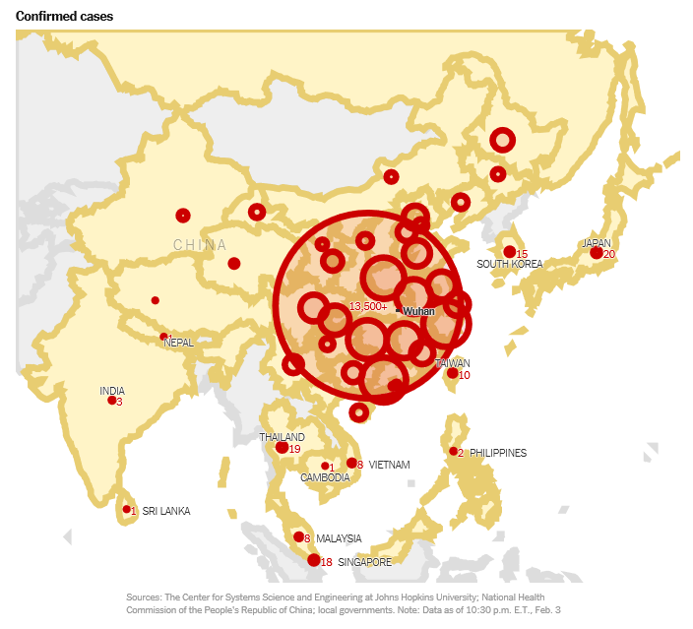
Current Situation: China
~24,400 cases in China, centered in Wuhan City, Hubei Province
Notes:
Cases in other countries not numerous and typically linked to travel to Hubei Province, China OR are a close contact of a case.

Slide 4
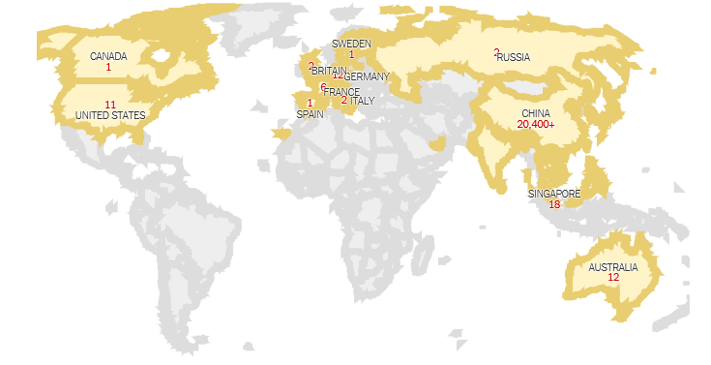
Current Situation: Global
24,562 confirmed cases in 28 countries
~490 deaths
199 cases outside of China
Limited person-to-person transmission
~1000 total recovered

Slide 5
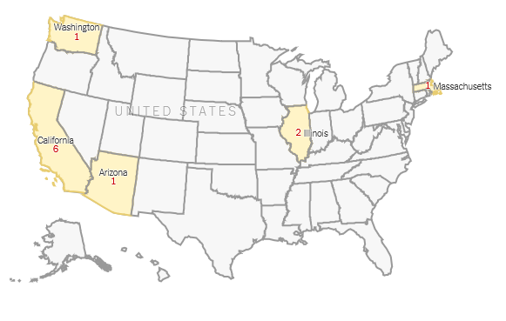
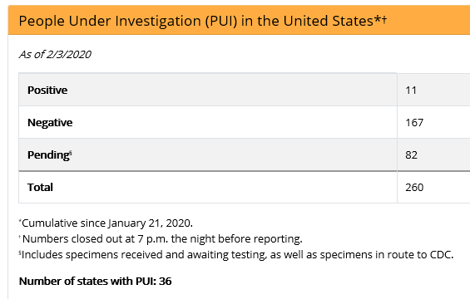
Current Situation: United States
Maine: (as of 02/05/2020)
Confirmed cases = 0
PUIs = 0
Immediate risk for U.S. remains LOW.

Slide 6
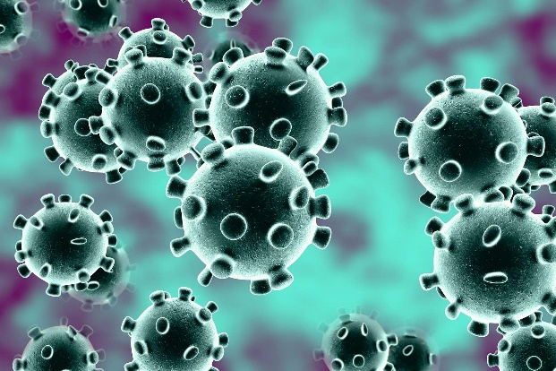
Coronaviruses
Enveloped virus
Spread by contact with infected secretions or by aerosol droplets
Survivability outside the body:
  1-2 days on nonporous surfaces (e.g. hard surfaces)
  8-12 hours on porous surfaces (e.g. soft goods)
https://www.webmd.com
Survivability dependent on temperature, humidity, inoculation size, etc.

Slide 7
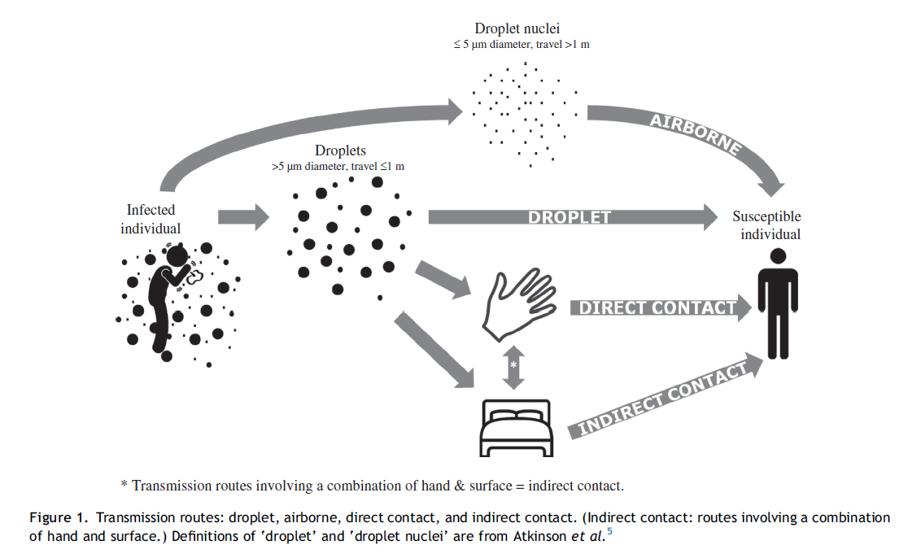
Airborne Transmission
https://www.journalofhospitalinfection.com/article/S0195-6701(15)00367-9/abstract
Notes:
Increasing evidence that a cough/sneeze generates droplet nuclei as well as larger droplets.
Time droplet nuclei stay in air dependent on cross currents in room ( e.g. opening/closing door, people/equipment movement in room)
How long does 2019-nCoV remain viable as an aerosol? We do not know. (MERS CoV is about 10 mins, Ebola is about 3 hours, HCoV-229E is 6 days)

Slide 8


Early Identification: Triage
Symptoms:
  Flu-like
    Fever and lower respiratory illness (e.g. cough, difficulty breathing)
    Runny nose
    Headache
    Sore throat
    Malaise
Ask About Travel:
  Have you been outside of Maine in the last 30 days?
  Have you been to China in the last 14 days?
https://www.chinahighlights.com/hubei/map.htm

Slide 9
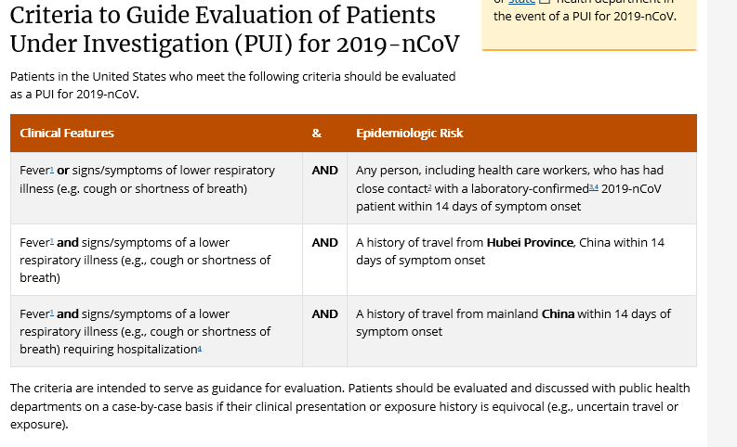
2019 nCoV Case Definition (subject to change)
January 31, 2020
https://www.cdc.gov/coronavirus/2019-nCoV/hcp/clinical-criteria.html
If you have a potential PUI…isolate IMMEDIATELY!!!
Notes:
Check for updates to case definition

Slide 10
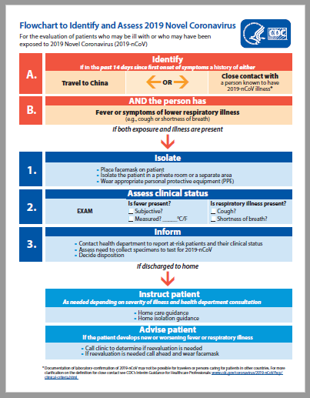

Slide 11
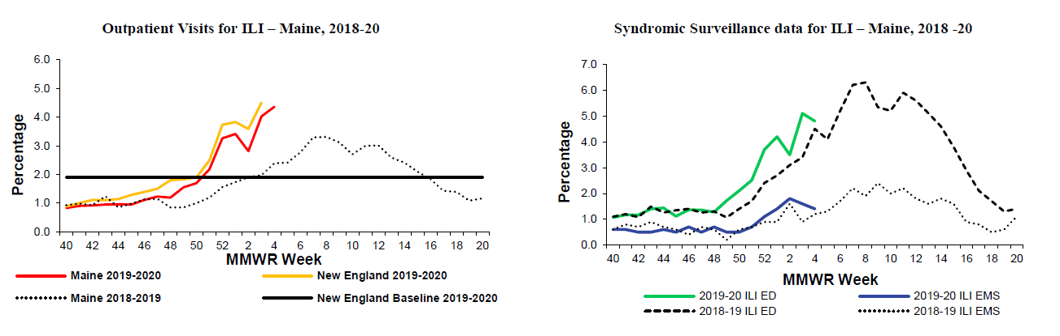
“Look-a-Like” Illness
MMWR Week 4 (ending 01/25/2020)
Maine ILI Report posted online weekly at: https://www.maine.gov/dhhs/mecdc/infectious-disease/epi/influenza/influenza-surveillance-weekly-updates.shtml
Notes:
Maine is in or entering “peak” ILI season.
If someone presents with flu-like symptoms and has not been to China or has had close contact with a PUI, have them don a mask and sit at least 3 ft away from others, if possible.

Slide 12
Infection Control
Additional Information:
Family & Visitors:
Restrict visitation.
Offer visitation by phone or video-call applications
Consider exceptions for end-of-life situations. Require PPE: mask, gown, gloves, eye
Duration of Precautions:
Consult with Maine CDC @ 800-821-5821 on a case-by-case basis
Environmental Disinfection:
Verify product is EPA-approved and has efficacy to enveloped viruses or emerging viral pathogen claims
CDC
Eye Protection
(Googles or Face Shield)
Contact
Precautions
(Gown, Gloves)
Standard
Precautions
(Hand Hygiene, Respiratory Etiquette, etc)
Airborne
Precautions
(AIIR, N95 or PAPR)
AIIR = Airborne Infectious Isolation Room
(a.k.a. Negative Pressure Room)
Notes:
Once in AIIR, patient facemask can be removed. If patient leaves AIIR, they must wear a mask.
HCW entering AIIR after patient leaves, but before time to clear aerosols has elapsed, must continue to following PPE recommendations.
We do not know how long 2019-nCoV remains infectious in the air – follow facility calculated time periods to clear aerosols from AIIRs.
All aerosol-generating procedures must be performed in an AIIR.

Slide 13
What if we do not have an AIIR?
CDC
Droplet
Precautions
(Respirator and Eye Protection)
Contact
Precautions
(Gown, Gloves)
Standard
Precautions
(Hand Hygiene, Respiratory Etiquette, etc)
(No AIIR)
Keep a mask on the Patient
What if staff are not fit-tested/trained to respirators? -- Use a mask!
Notes:
Short-term situations.

Slide 14
Transmission
Initially associated with exposure to a live animal market
No clear indication of any specific route of infection
Now confirmed person-to-person spread occurring
  Primarily among very close contacts and household members
  Does not appear to be through casual contact
  Suggestion of spread by asymptomatic individuals, though not confirmed
Risk factors for acquisition unknown and under investigation
Infectious period unknown at this time
  Detection of viral RNA does not necessarily mean detection of infectious virus
  Don’t know if more severe disease indicates prolonged infectious period

Slide 15
Epidemiology
Early information suggest incubation period of ~5 days (range 2-14 days)
Those at risk of severe illness
  Older age
  Presence of chronic medical conditions e.g. diabetes, CVD, chronic lung disease, chronic renal disease
  Immunocompromised

Slide 16
Clinical presentation
Wide clinical spectrum, from mildly ill to severe disease
  For mild illness, presentation may show as non-specific respiratory signs and symptoms usually seen in viral respiratory infections
  Usually fever, cough
  Less frequently myalgia or fatigue
  Some reports of sore throat, headache, hemoptysis, diarrhea
  Half report dyspnea and SOB
Radiologic findings
  CXR bilateral, sometimes unilateral infiltrates
  On chest CT, ground glass opacities with multiple areas of consolidation

Slide 17
Treatment
Supportive treatment as for patients with any viral pneumonia
  With addition of more strict IC precautions
  No specific treatment
  No known antiviral effectiveness
Follow clinical guidelines for management of community acquired pneumonia
Avoid corticosteroids
  May prolong viral replication in the respiratory tract and continuation of infection
  Use only if indicated for another reason, e.g. treatment of COPD
If patient stable and hospitalization is not clinically indicated, may be isolated at home if medically and socially stable
  No congregate settings
  Decision made in consultation with Maine CDC

Slide 18
Clinical course and complications
Fever may be prolonged
Potential for clinical deterioration in 2nd week in some patients
Complications
  ARDS in 17-20% of cases
  Secondary infection in up to 10% of cases
  ICU required for respiratory support in 25-33%
  Acute cardiac injury

Slide 19
Laboratory
Once identify a potential PUI:
  Maine CDC and HETL will coordinate nCoV testing with provider and federal CDC
  Call Maine CDC ASAP for guidance on specimen collection
    Will need 3 specimens: LRI (sputum, if possible), URI (NP and OP), Serum
  May take a couple days to receive results from federal CDC
    Testing not yet available to state laboratories
Always test for other possible causes of illness, e.g. influenza, RSV
  If positive, nCoV infection unlikely but always possible to have a simultaneous infection
Collect specimens ASAP and store per your institutional protocols
For transport of specimens to HETL, refer to institutional biosafety guidelines for transport of specimens related to infectious diseases
Laboratory test not available for hospitals or other primary care settings

Slide 20
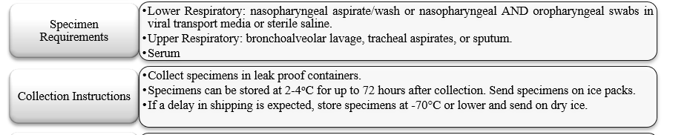

Laboratory Testing
Pre-approval from Maine CDC is needed for 2019-nCoV Laboratory Testing!
Call: 1-800-821-5821
Once approval is received, specimen should be sent to the Maine CDC laboratory
…if testing approved by Maine CDC!
https://www.maine.gov/dhhs/mecdc/public-health-systems/health-and-environmental-testing/micro/submitting-samples.shtml

Slide 21
Key Take-Aways…
Identify….Triage
  You must inquire about travel history --- START NOW!
    At reception AND
    During patient assessment
  Consider other common causes of respiratory infection, e.g. influenza, RSV, adenovirus
Isolate…IMMEDIATELY!
  If patient identified as a possible PUI, mask patient, immediately!
  HCW to don respirator and move patient to a isolation room, immediately!
  Post isolation signage
Inform…Communication
  Facility Infection Prevention and Control
  Facility Leadership/Team Lead
  It is a reportable condition; call Maine CDC @ 800-821-5821

Slide 22
Questions?
Contact Maine CDC at 800-821-5821

