Slide 1

Department of Health and Human Services
Transportation Services

Slide 2
Overview of the Project
DHHS Coordination of Transportation Service Contracts
In June 2019, the Department organized a workgroup of senior staff from the Office of MaineCare Services, Office of Child and Family Services, Office of Substance Abuse and Mental Health Services, Office of Aging and Disability Services, and DHHS Contract Management to conduct an assessment of Transportation Services, including evaluating the current service array and alignment of services.

Slide 3
Priorities of the Project
DHHS Coordination of Transportation Service Contracts
The workgroup determined three main priorities needed to be addressed:
  Alignment of Quality and Performance Measures
  Alignment of Safety Measures
  Evaluation of Transportation Services across DHHS

Slide 4
Priority 1: Alignment of Quality and Performance Measures
DHHS Coordination of Transportation Service Contracts
Conduct an assessment of quality and performance measures as required by each Office’s transportation contracts by reviewing the existing:
1) Contract Performance Standards
2) Deliverables
3) Accountability Measures

Slide 5
Priority 2: Alignment of Safety Measures
DHHS Coordination of Transportation Service Contracts
Review policies on safety standards to ensure alignment across DHHS by addressing:
1) Background Checks
2) Child and Waiver Member Transport
3) Other Safety Measures

Slide 6
Priority 3: Evaluation of Transportation Services
DHHS Coordination of Transportation Service Contracts
Evaluate the current service array for Medical and Non-Medical Transport to ascertain what is working and where improvements can be made across DHHS Offices
Consult with Department of Transportation (DOT) on performance and safety measures
Create a Communication Plan to disseminate findings, recommendations, and timeline for improvements

Slide 7
Assessment of Services
DHHS Coordination of Transportation Service Contracts
The Workgroup:
Conducted a detailed comparison of contract performance and safety requirements across offices
Developed a gap analysis
Negotiated and agreed on contract and policy change recommendations to align performance and safety measures

Slide 8
Assessment Results
DHHS Coordination of Transportation Service Contracts
Inconsistencies observed in contract performance and safety requirements
Challenges regarding:
    Ability to bill multiple funding streams
    Overlapping service populations
    Differences in eligibility requirements and payment methodologies across populations

Slide 9
DHHS Coordination of Transportation Service Contracts: Recommendations
Workgroup Recommendations:
1. Improve policy and contract language to better align services across DHHS.
Final contract standards should align performance and safety requirements above 95%
2. Communicate with providers, clients, and other stakeholders about the planned alignment and get feedback on the recommendations.
3. Implement this alignment in each program’s next transportation contract by July 1, 2020.
4. Procure an outside evaluation of Transportation Services.

Slide 10
Implementation of Safety Measure Recommendations
Align Safety Measures in all DHHS Transportation Contracts where appropriate. Measures include:
Mandatory background check requirements for all drivers, including language to exclude drivers with histories of crimes which were violent, drug related, or sexual in nature;
Requirements surrounding the transportation of child and waiver members to ensure the safety of those most vulnerable populations; and;
Mandatory minimum safety requirements for any vehicle being used to transport clients.

Slide 11
Implementation of Quality and Performance Measures
Align Quality and Performance Measures in all DHHS Transportation Contracts where appropriate. Alignment will include:
Contract performance: reliability, timeliness, and customer feedback standards;
Volunteer reimbursement rates;
Contract deliverables for reporting of outcome data; and
Accountability for not meeting performance requirements.

Slide 12
Procurement to Evaluate DHHS Transportation Services
Procure a vendor to perform an evaluation that includes gathering information from clients, transportation providers, brokers, and health care providers about the quality of transportation services and what they think would enhance quality of experience for beneficiaries.
The evaluation would also include best practices gathered from literature reviews and information from other states’ transportation programs.

Slide 13
Evaluation: Final Report
This evaluation will include a final report, which includes:
The perceived quality of transportation services provided to beneficiaries for each of the Department’s transportation programs;
Identification of barriers to client access to transportation services in each of Maine’s eight transit regions and between urban and rural areas;
Recommendations to improve quality and access to transportation services; and
Assessment of options including the implementation of one, single statewide transportation system through a request for proposals (RFP).

Slide 14
DHHS Transportation Services Initiative
Dashboard: October 23, 2019
 | TASKS | PRODUCTS (OWNER) | ETA
Priorities
Alignment of Quality and Performance Measures | Conduct an assessment of quality and performance measures as required by each Office’s transportation contracts by reviewing the existing: | Recommendations for Quality and Performance Measures Collaboration among DHHS Offices: OCFS OMS SAMHS OADS | Completed October 2019
 | 1) Contract Performance Standards 2) Deliverables 3) Accountability Measures
Alignment of Safety Measures | Review policies on standards of safety to ensure alignment across DHHS by addressing: 1) Background Checks 2) Child and Waiver Member Transport 3) Other Safety Measures | Recommendations for Safety Measures and Contract Standards Collaboration between DHHS Offices: OCFS OMS SAMHS OADS | Completed October 2019
Evaluation of Transportation Services | Evaluate the current service array for Medical and Non-Medical Transport to ascertain what is working and where improvements can be made across DHHS Offices. | DHHS will establish RFP for evaluation | To be published by Spring 2020 and completed by Fall 2020
 | Consult with DOT on performance and safety measures
 | Create a Communication Plan to disseminate findings, recommendations, and timeline for improvements.

Slide 15
DHHS Transportation Services Initiative
Dashboard: October 23, 2019
0 | TASKS | PRODUCTS (OWNER) | ETA
Implementation
Engaging Stakeholders | Communication/ Community meetings with providers and clients | All DHHS Offices will coordinate and invite Transportation Providers to participate in a meeting to review upcoming changes. DHHS will request feedback from providers on what could be reasonably implemented prior to the next renewal (7/1/2020). DHHS Offices will coordinate a second meeting to involve recipients of Transportation Services to obtain feedback on upcoming changes. | December 2019
Align Safety Measures in all DHHS Transportation Contracts | Mandatory background check requirements for all drivers, including language to exclude drivers with histories of crimes which were violent, drug related, or sexual in nature; Requirements surrounding the transportation of child and waiver members to ensure the safety of those most vulnerable populations; and Mandatory minimum safety requirements for any vehicle used to transport clients. | After receiving feedback from Stakeholders, all DHHS Offices involved with workgroup will determine whether to make changes through an amendment to the existing agreement or implement changes during next renewal on July 1, 2020. | Spring 2020 to July 1, 2020
Align Quality and Performance Measures in all DHHS Transportation Contracts where appropriate | Contract performance: reliability, timeliness, and customer feedback standards; Volunteer reimbursement rates; Contract deliverables for reporting of outcome data; and Accountability for not meeting performance requirements. | After receiving feedback from Stakeholders, all DHHS Offices involved with workgroup will determine whether to make changes through an amendment to the existing agreement or implement changes during next renewal on July 1, 2020. | Spring 2020 to July 1, 2020

Slide 16
DHHS Transportation Services
Appendix A
Agency Services Detail

Slide 17
DHHS Transportation Service
DHHS Transportation Services provide transportation to eligible clients to medical, educational, employment, social, and recreational appointments by means of private and/or public vehicles through multiple models across the state.
Summary of estimated impact:
2.5 million trips per year
55,000 unique individuals per year
$83 million per year ($30 million State General Fund)
95% MaineCare Funds

Slide 18
Office of MaineCare Services
This service provides transportation to medical services for eligible clients through a brokerage model. The program consists of three transportation brokers that have established call centers for members to call to schedule trips to covered Medicaid/MaineCare. Brokers then assign trips to sub-contracted companies and non-profits to provide the transportation.
Brokers are required to utilize the most cost-effective transportation available, meaning brokers start by assigning trips to the least expensive transporter. If the least expensive transporter cannot do the trip, brokers move to the next least expensive transporter and so on until they find a transporter to complete a trip.

Slide 19
Office of MaineCare Services
Populations Served | Full benefit regular MaineCare Members, Children, and Waiver Members, Sections 18, 19, 20, 21, and 29
Rides Per Year | Estimated 2.4 million Trips Per Year
Estimated Number of People Served | Estimated at 13% client utilization rate (50,000 unique individuals per fiscal year)
Vendors | There are three vendors (8 contracts) and hundred of subcontractors: Logisticare Penquis CAP, Inc. Waldo Community Action Partners Brokers utilize approximately 200 volunteers (combined) to supplement professional transporter capacity. Volunteers are paid a minimum of 41 cents per mile.
Costs | $78,716,503 Per Year
Funding Source | State funds and Medicaid funds at FFP rate

Slide 20
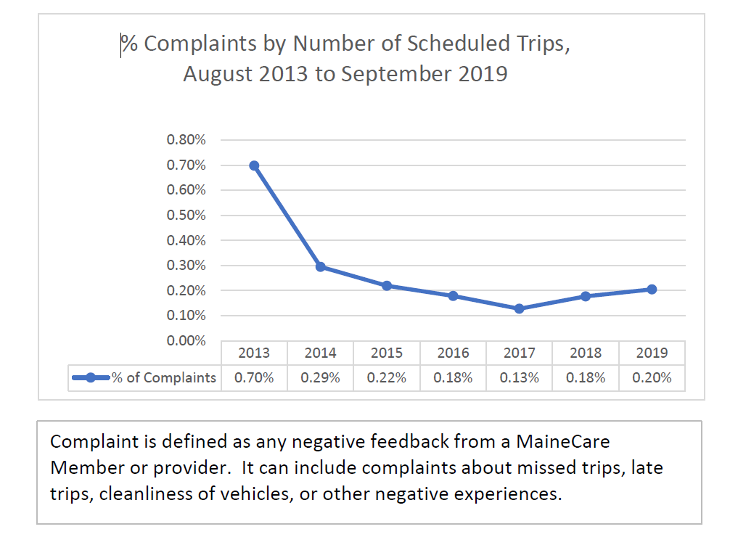
Office of MaineCare Services
NET Complaints Graph

Slide 21
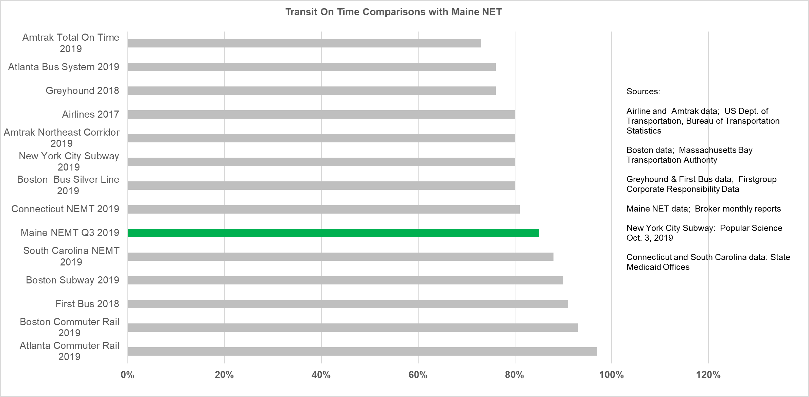
MaineCare Non-Emergency Transportation
Quarter 3 Performance Statistics-Year 2019

Slide 22
Office of Substance Abuse and
Mental Health Services
SAMHS contracts cover transportation services for Section 17 clients to educational, employment, social, and recreational appointments in the most rural areas of the state. Transportation must be initiated by either the client or their Section 17 Provider. Providers are also asked to provide annual outreach to regional mental health agencies and consumer education around which transportation options are the least expensive.
SAMHS contracts reimburse for travel to appointments, where either the client is not eligible for the MaineCare NET program or the purpose of the ride is not reimbursable by the MaineCare NET program.

Slide 23
Office of Substance Abuse and Mental Health
Services Client Transportation
Populations Served | Individuals who meet the Eligibility for Care requirements for Section 17: Community Support Services, as stated in 10-144 C.M.R. ch.101, ch. 2, § 17.02.
Rides Per Year | Estimated 4,968 trips Per Year
Estimated Number of People Served | Around 500 unique individuals per fiscal year
Vendors | There are four (4) vendors: Sweetser Penquis CAP, Inc. Aroostook Mental Health Services Downeast Community Partners
Costs | $147,154.00 Per Year
Funding Source | Three (3) funding sources: Mental Health State General Fund=$62,146.00 per fiscal year Social Services Block Grant=$58,030.00 per fiscal year Block Grants for Community Mental Health Services=$26,978.00 per fiscal year

Slide 24
Office of Child and Family Services
Child Welfare Transportation
The purpose of this service is to provide transportation to children and families involved in open Child Protective Services (CPS) cases to reach necessary destinations related to their case or care. Clients are transported for medical, court, educational, visitation and other purposes. The caseworker provides a prior authorization for all services.
The Provider coordinates pickups and drop-offs, and transports each eligible client utilizing private and/or public vehicles.

Slide 25
Office of Child and Family Services
Child Welfare Transportation
Populations Served | Children and families involved in open Child Protective Service Cases
Rides Per Year | Estimated 77,000 Trips Per Year
Estimated Number of People Served | Estimated 5,000 unique individuals per fiscal year
Vendors | There are nine (9) vendors covering the 16 counties Community Concepts Penquis CAP, Inc. Aroostook Regional Transportation Kennebec Valley CAP Downeast Community Partners York CAP Regional Transportation Provider Waldo Cap Western Maine Transportation Approximately 89% of trips are provided by volunteers ($ .44 per mile)
Costs | $3,100,00 Per Year
Funding Source | Two (2) funding sources: State General Funds =$2,200,00 per fiscal year TANF =$900,000 per fiscal year

Slide 26
Office of Child and Family Services
Transportation for Individuals with Low Income
Transportation services for eligible individuals and families (125% FPL) to provide access to medical, social and/or employment services by means of private and/or public vehicles.
Target populations are older people at risk of institutionalization or needing preventative services; people with physical handicaps; persons with developmental disabilities or mental health conditions living in the community, and low-income families with medical, social and or employment needs.
The Provider determines eligibility, purchases bus passes, coordinates pickups and drop-offs and transport for each eligible client utilizing private and/or public vehicles.

Slide 27
Office of Child and Family Services
Transportation for Individuals with Low Income
Populations Served | Individuals who meet the Eligibility for Care requirements
Rides Per Year | Estimated 62,000 Trips Per Year
Estimated Number of People Served | Around 11,000 unique individuals per fiscal year
Vendors | There are nine (9) vendors covering the 16 counties Community Concepts Penquis CAP, Inc. Aroostook Regional Transportation Kennebec Valley CAP Downeast Community Partners York CAP Regional Transportation Provider Waldo CAP Western Maine Transportation Approximately 60% of trips are provided by volunteers ($ .44 per mile)
Costs | $1,195,191.64 Per Year
Funding Source | Social Services Block Grant

Slide 28
Questions?
Workgroup Members
Bethany L. Hamm, Commissioner’s Office
Robert Blanchard, OCFS
Roger Bondeson, OMS
Derek Fales, OADS
Christie Goodman, SAMHS
Sheena Bunnell, Consultant
Jim Lopatosky, DCM
Mark Lutte, OADS
Molly Slotznick, OMS
Stephen Turner OMS

