Slide 1
Filter Sampling in Central Maine
Molly King
Division Director, Technical Services
Maine DEP, Bureau of Remediation and Waste Management

Slide 2
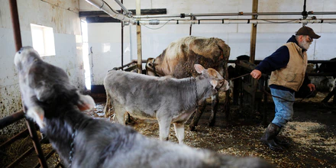
How we got here
Milk sampled by distributor
Not above threshold, but high enough to ask questions
Then individual farms
Based on licenses
Then soil
Finally, water
Notes:
Homeowners might needle them for information
Need to consider what information they give them

Slide 3
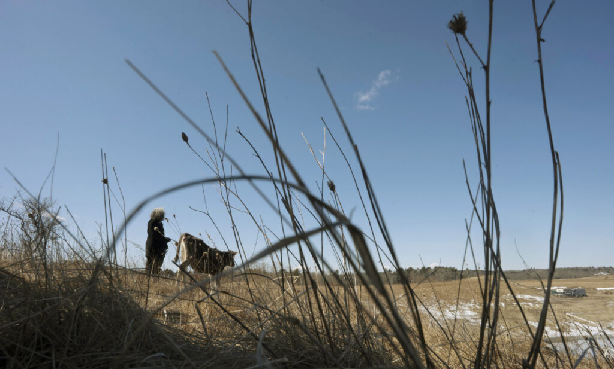
Fairfield
Started with one farm
Risk based decisions
Project grew quickly
Finally moving to other towns
Some families have been drinking it for 30 years or more

Slide 4
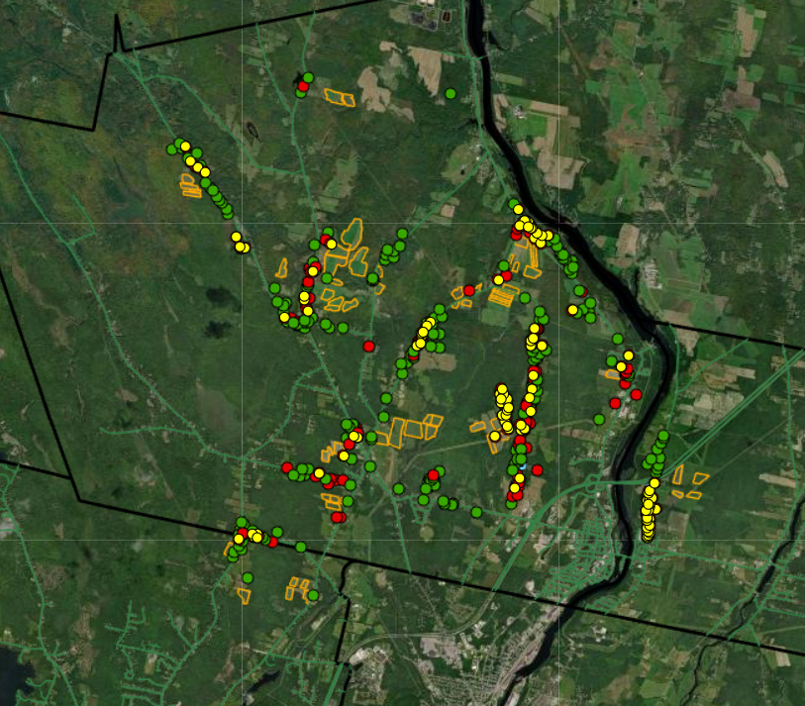
People are…
Frustrated
Scared
Ok
Angry
Grateful
Notes:
Blame the DEP

Slide 5
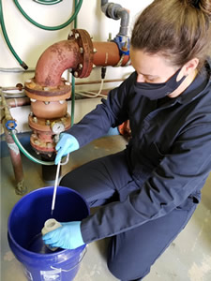
Day-Of Logistics
Two samplers
Carry gear
Field sheets
Communicate with homeowners
Purge from ports

Slide 6
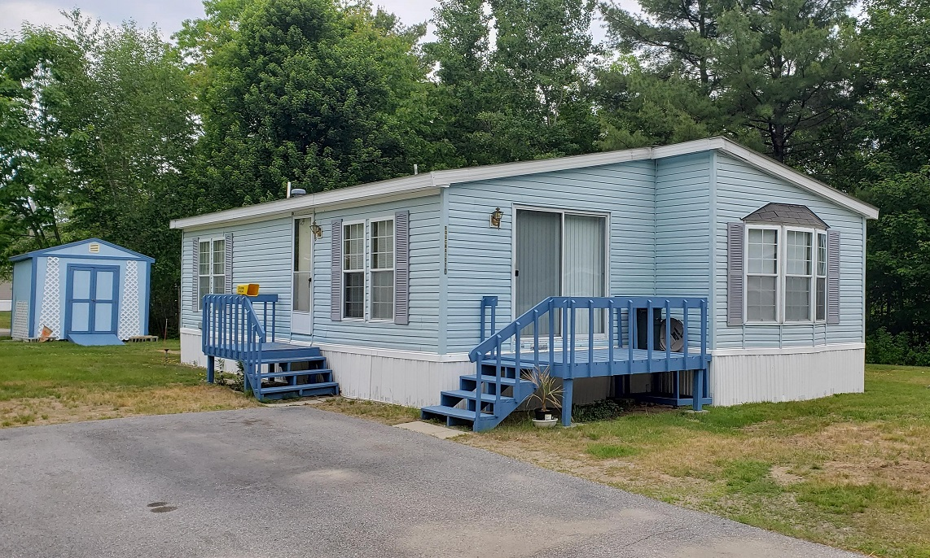
Respecting homeowners
Simple things
Ask about taking shoes off or entering through a basement door
Consider wearing a mask
Respect the homes and people
Carry in, carry out
Notes:
You should know:
Are they being sampled Monthly vs quarterly?
Will the sampler always be you or will it be another person in your company next time?

Slide 7
Who to direct Questions to?
Health – Center for Disease Control
Maintaining filters – Department of Environmental Protection
Manure or farm fields – Department of Agriculture
Someone will follow up with them

Slide 8
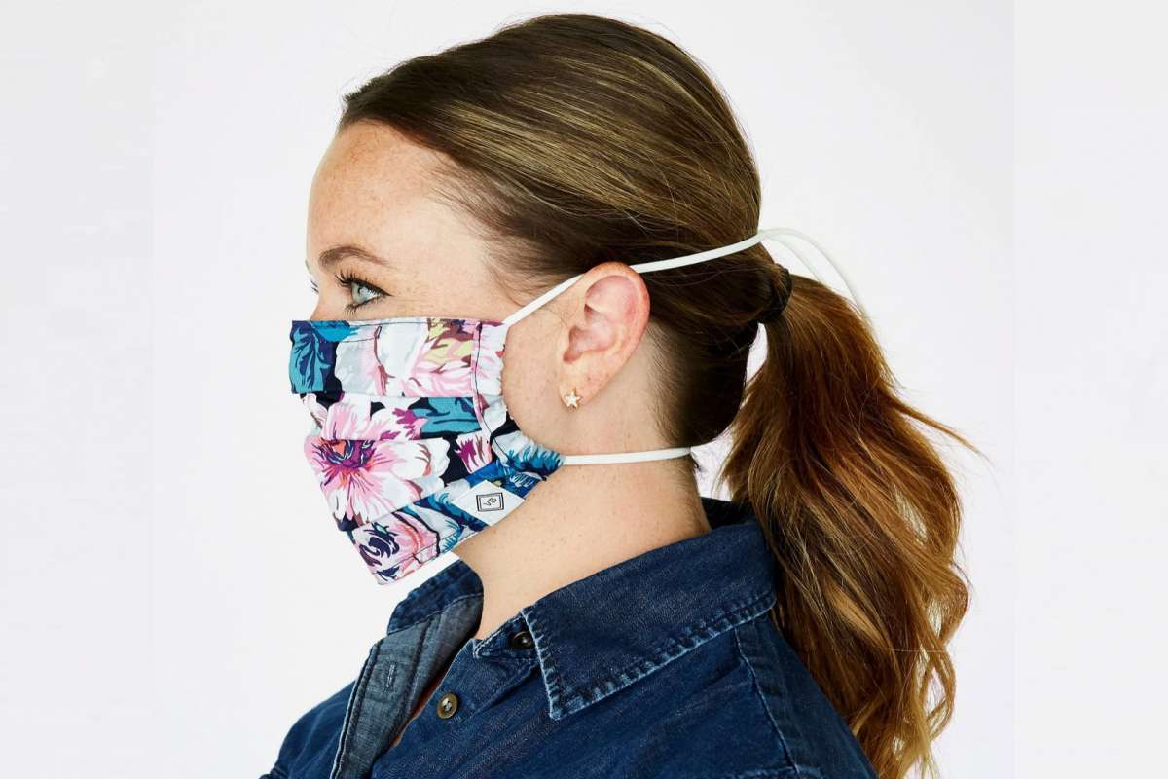
COVID-19
Some people are nervous, some aren’t
Ask about masks
Be safe

Slide 9
Molly King
Molly.King@Maine.gov

