Slide 1
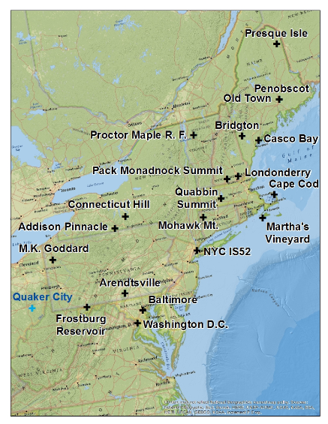

Slide 2
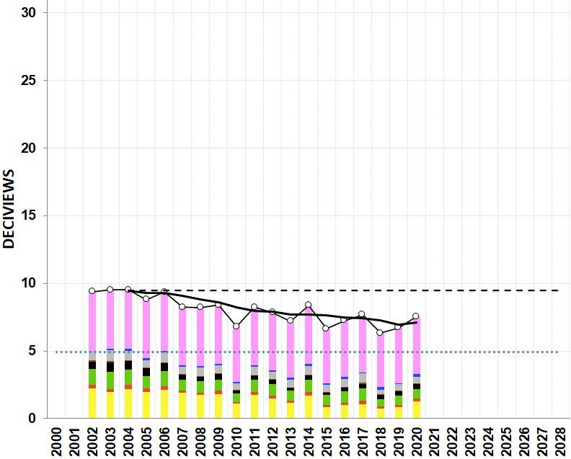
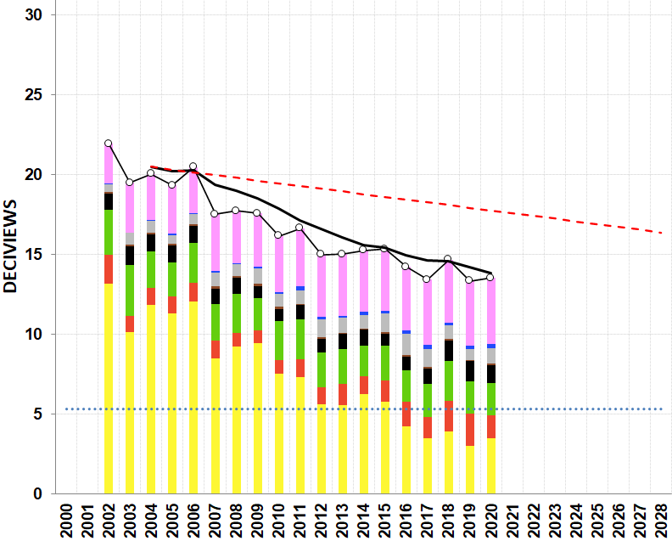
(a) 20% Clearest Days
(b) 20% Most Impaired Days
PAINT
5 – 8
872 x 643
SIZE – 5.1
Position – 0.1 / 6.45 Horizontal
- 0.1 / 0.1 Vertical
Presque Isle

Slide 3
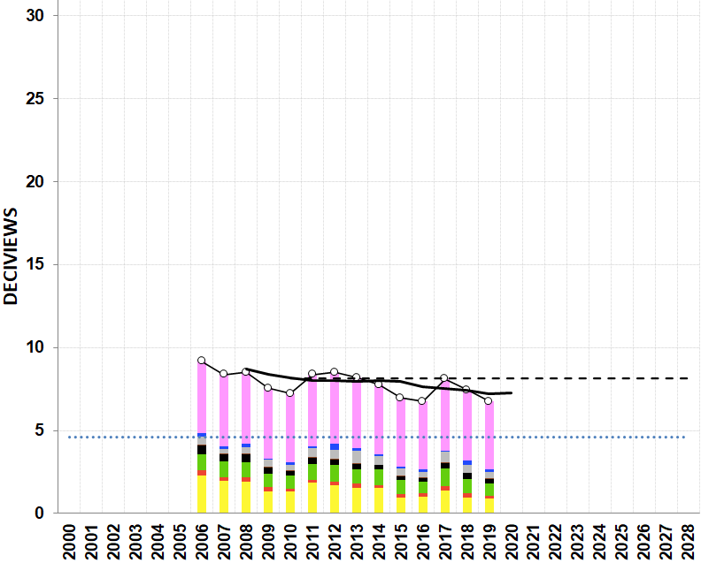
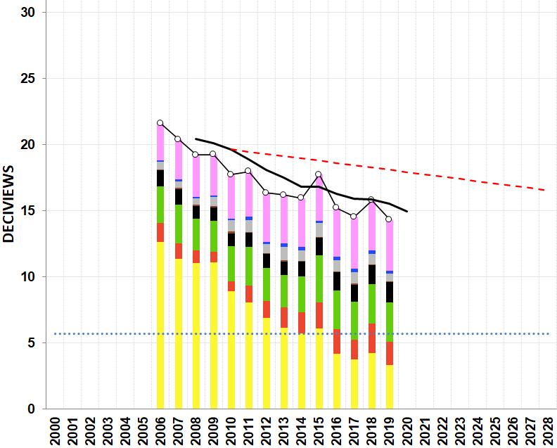
(a) 20% Clearest Days
(b) 20% Most Impaired Days
SIZE – 5.1
Position – 0.1 / 6.45 Horizontal
- 0.1 / 0.1 Vertical
Penobscot Nation

Slide 4
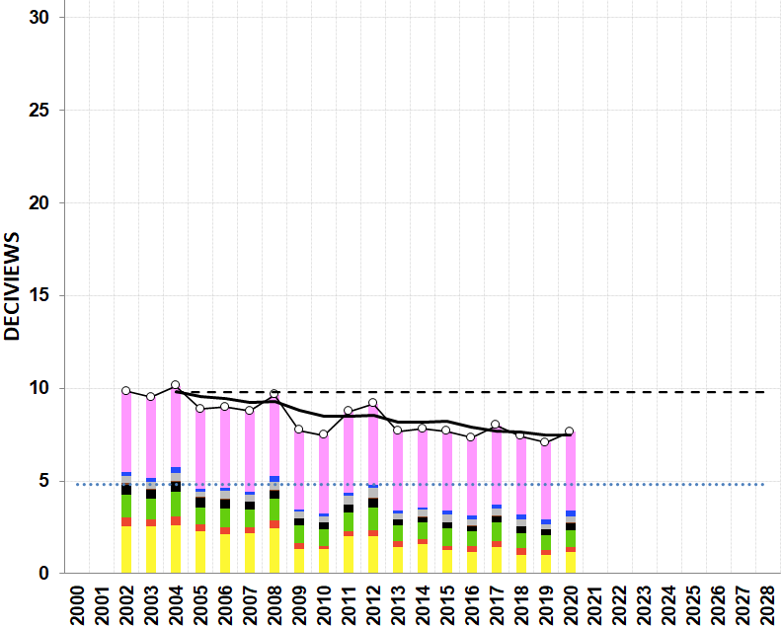
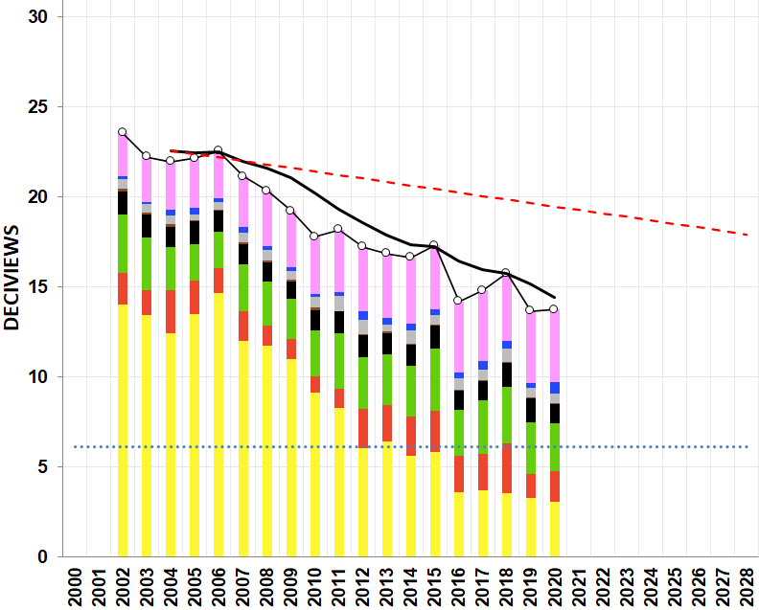
(a) 20% Clearest Days
(b) 20% Most Impaired Days
SIZE – 5.1
Position – 0.1 / 6.45 Horizontal
- 0.1 / 0.1 Vertical
Casco Bay

Slide 5
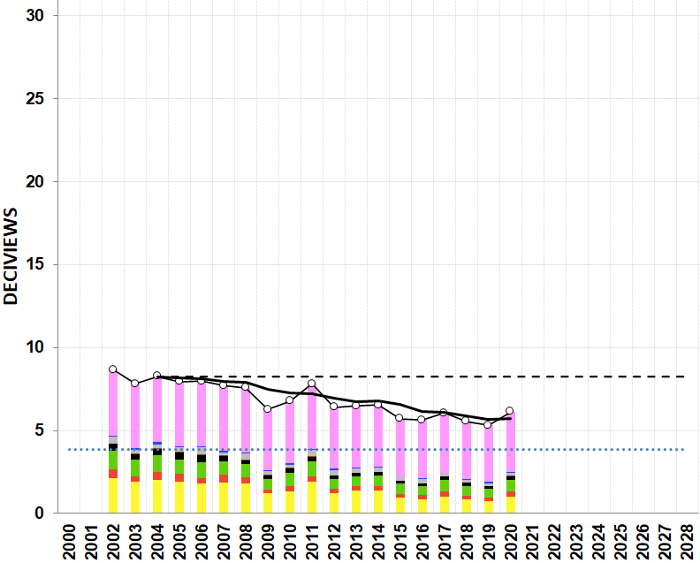
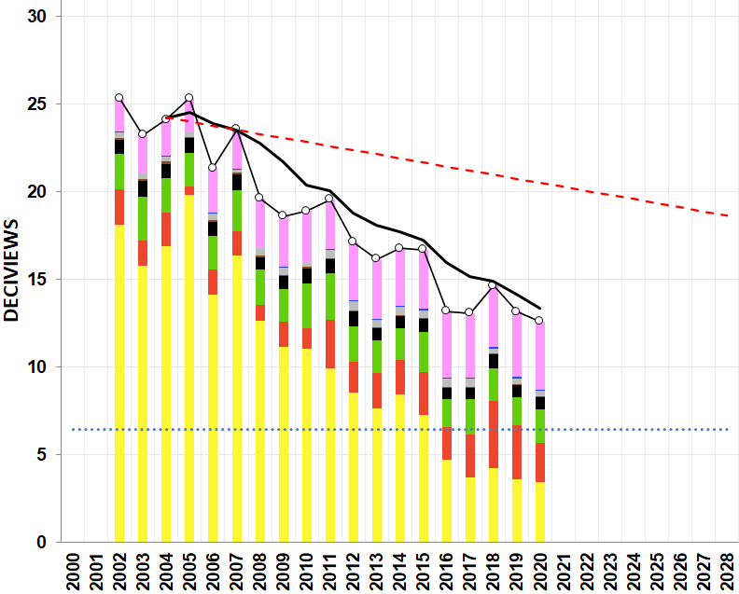
(a) 20% Clearest Days
(b) 20% Most Impaired Days
SIZE – 5.1
Position – 0.1 / 6.45 Horizontal
- 0.1 / 0.1 Vertical
Proctor Maple R.F.

Slide 6
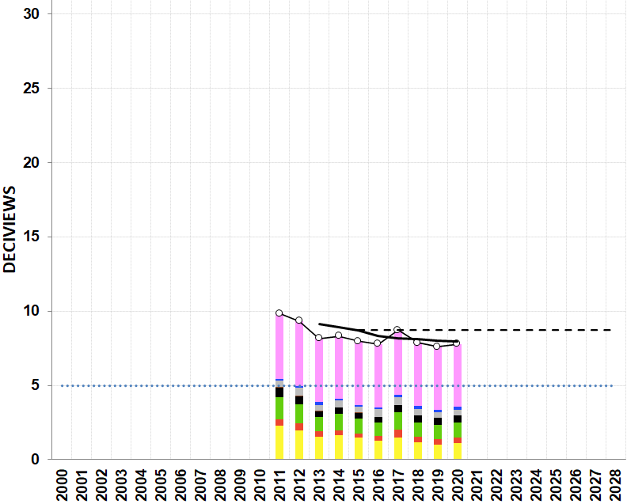
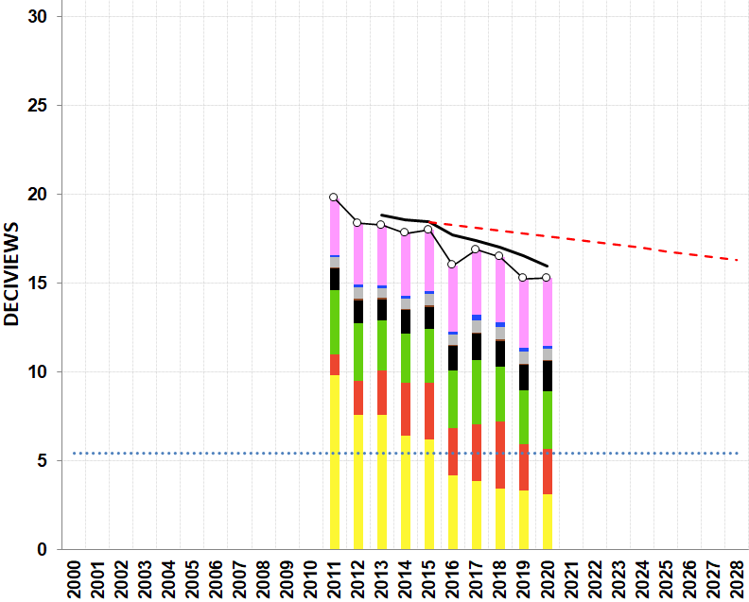
(a) 20% Clearest Days
(b) 20% Most Impaired Days
SIZE – 5.1
Position – 0.1 / 6.45 Horizontal
- 0.1 / 0.1 Vertical
Londonderry

Slide 7
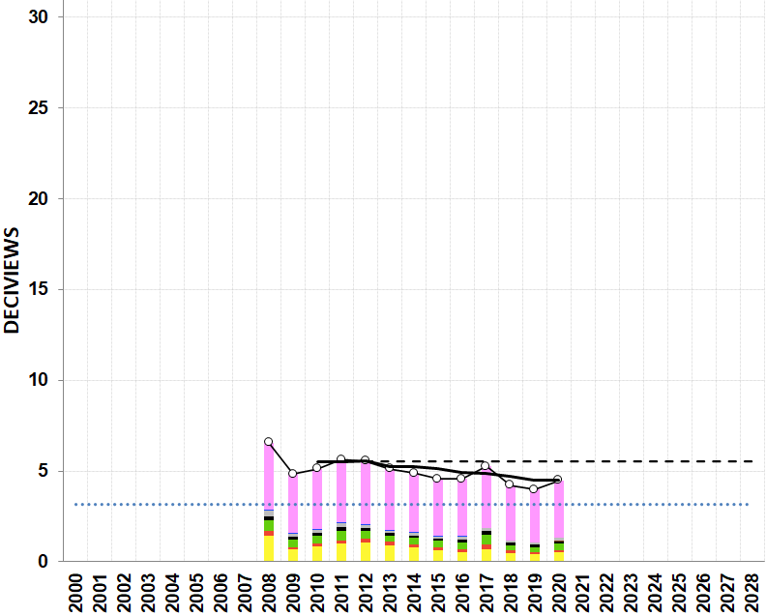
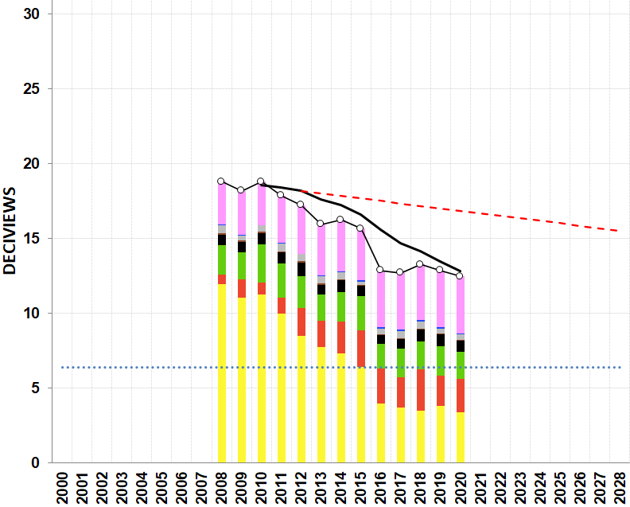
(a) 20% Clearest Days
(b) 20% Most Impaired Days
SIZE – 5.1
Position – 0.1 / 6.45 Horizontal
- 0.1 / 0.1 Vertical
Pack Monadnock Summit

Slide 8
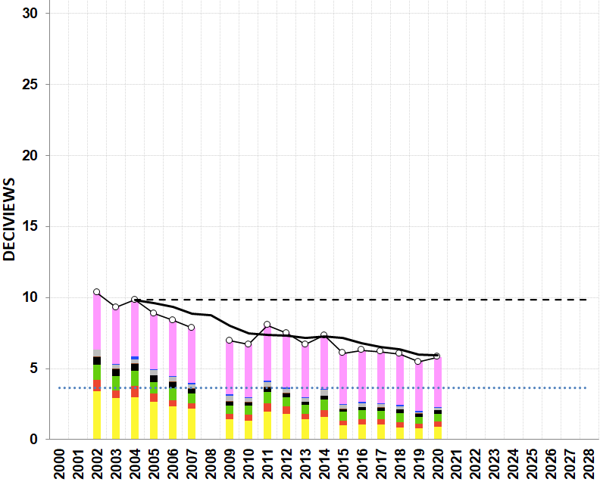
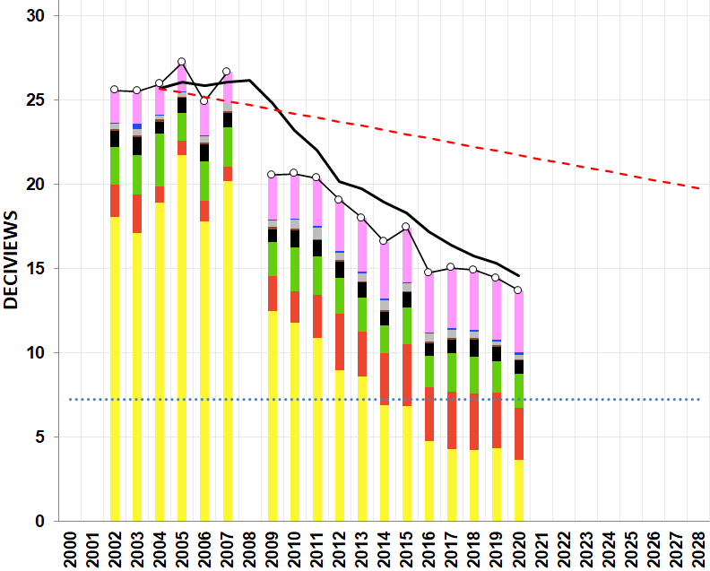
(a) 20% Clearest Days
(b) 20% Most Impaired Days
SIZE – 5.1
Position – 0.1 / 6.45 Horizontal
- 0.1 / 0.1 Vertical
Mohawk Mt.

Slide 9
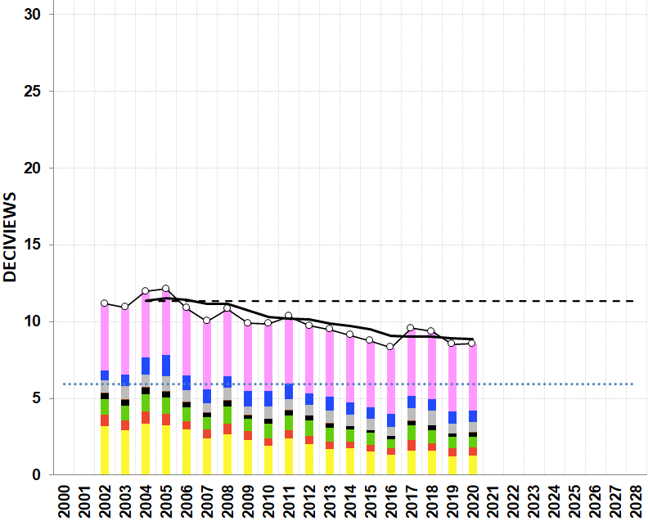
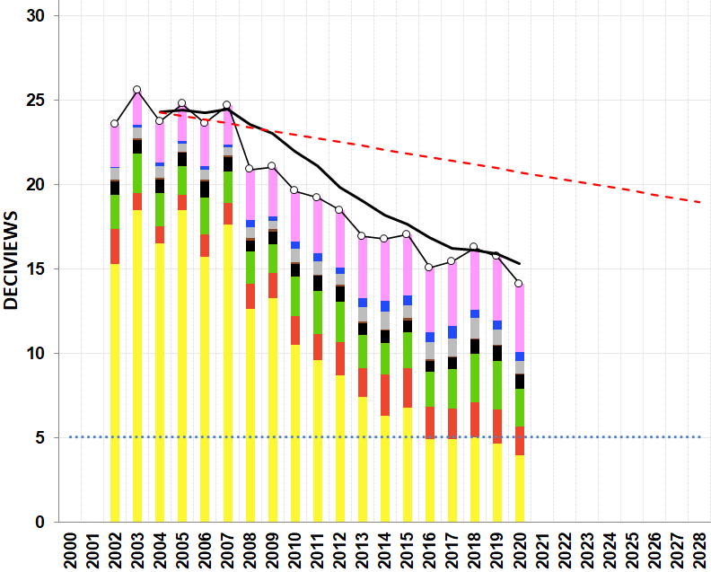
(a) 20% Clearest Days
(b) 20% Most Impaired Days
SIZE – 5.1
Position – 0.1 / 6.45 Horizontal
- 0.1 / 0.1 Vertical
Cape Cod

Slide 10
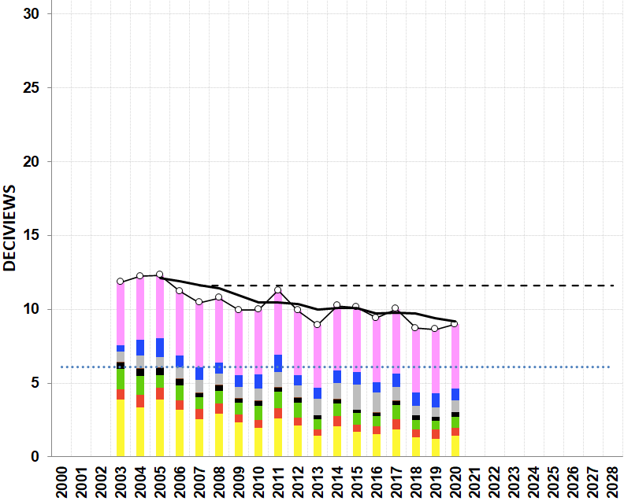
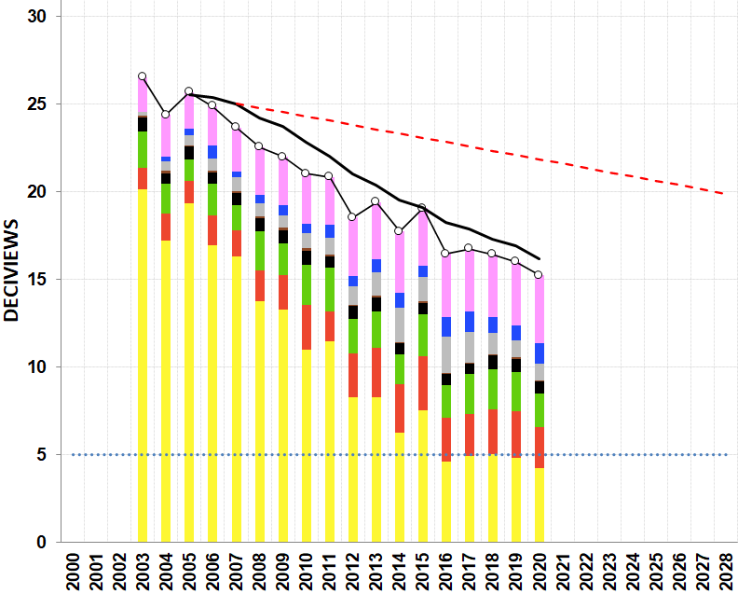
(a) 20% Clearest Days
(b) 20% Most Impaired Days
SIZE – 5.1
Position – 0.1 / 6.45 Horizontal
- 0.1 / 0.1 Vertical
Martha’s Vineyard

Slide 11
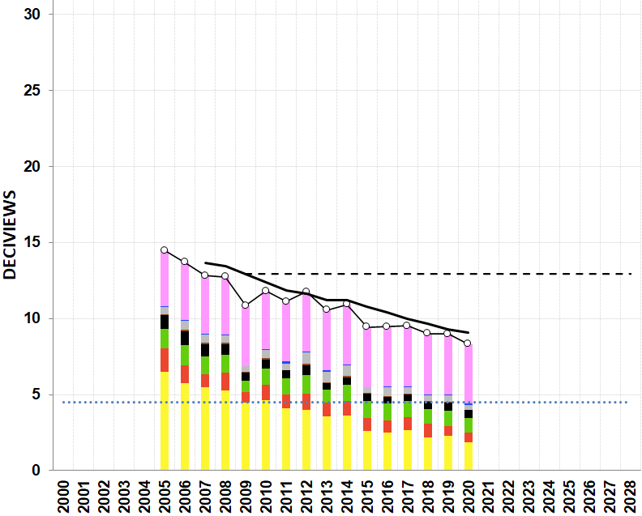
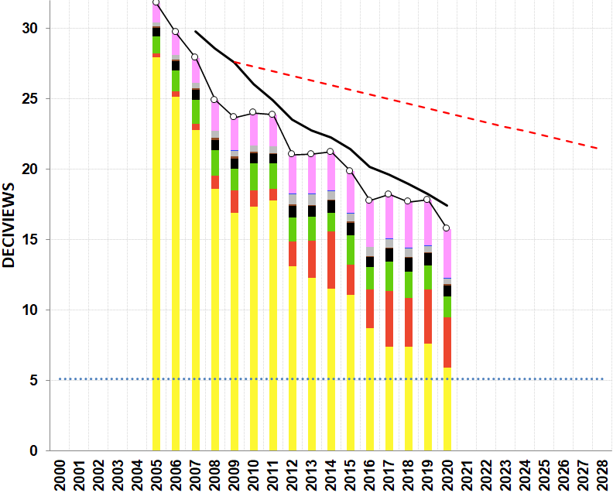
(a) 20% Clearest Days
(b) 20% Most Impaired Days
SIZE – 5.1
Position – 0.1 / 6.45 Horizontal
- 0.1 / 0.1 Vertical
Frostburg Reservoir

Slide 12
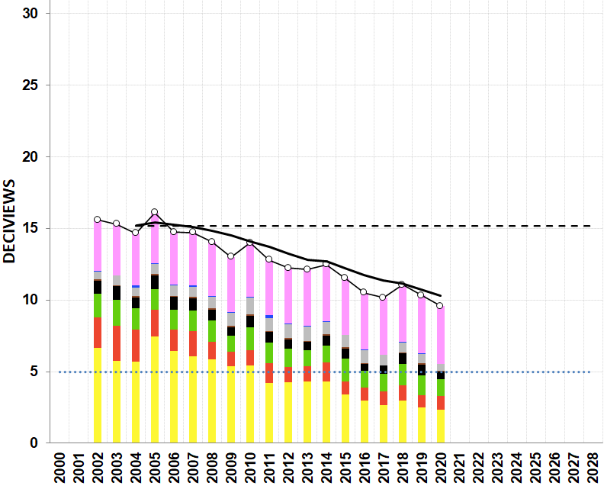
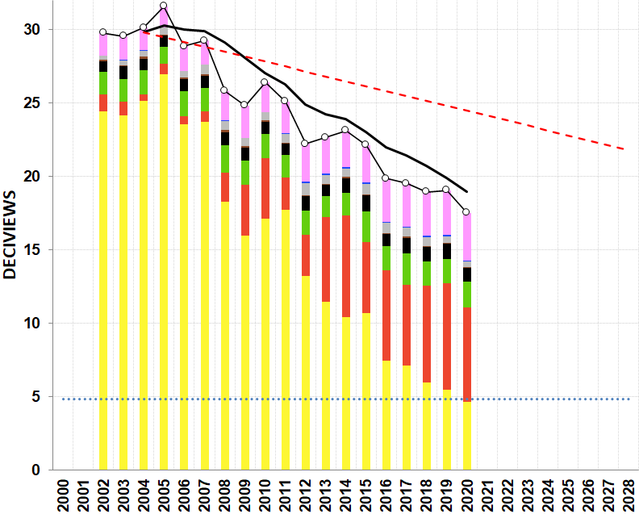
(a) 20% Clearest Days
(b) 20% Most Impaired Days
SIZE – 5.1
Position – 0.1 / 6.45 Horizontal
- 0.1 / 0.1 Vertical
Quaker City

Slide 13
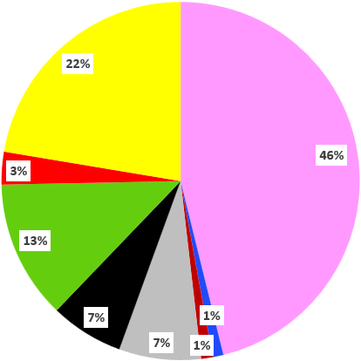
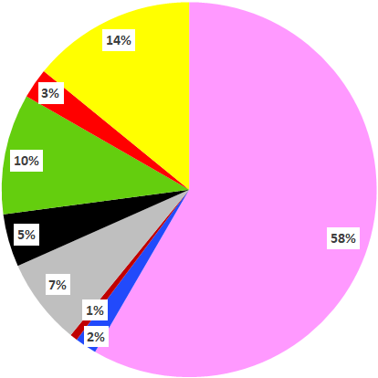
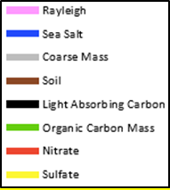
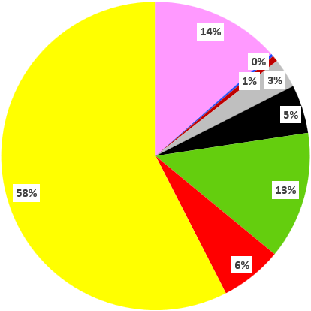
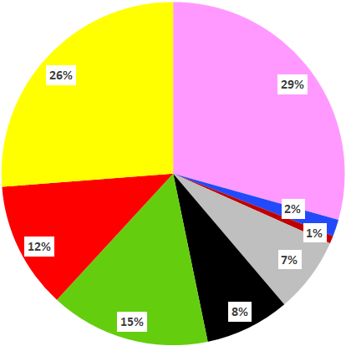
(a) 2002-04 20% Clearest Days
(b) 2016-20 20% Clearest Days
95 X 100 px
414 X 414 px
Presque Isle
(c) 2002-04 20% Most Impaired Days
(d) 2016-20 20% Most Impaired Days
SIZE
3.35
POSITIONS
0.3 - 0.45
6.1 - 0.45
0.3 - 4.1
6.1 - 4.1

Slide 14
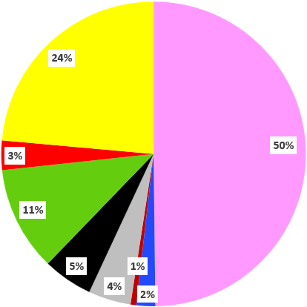
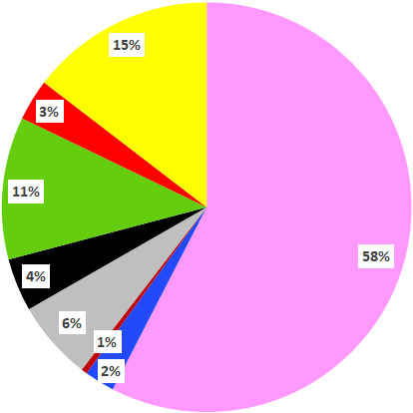
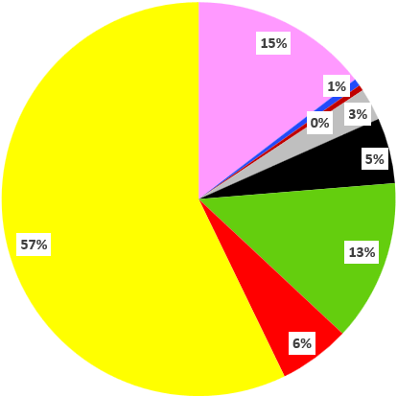
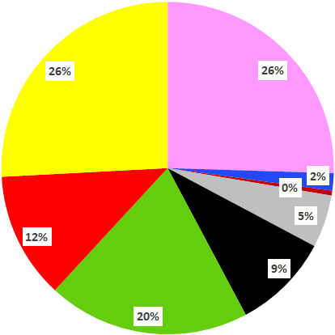
(a) 2006-08 20% Clearest Days
(b) 2016-20 20% Clearest Days
95 X 100 px
414 X 414 px
Penobscot Nation
(c) 2006-08 20% Most Impaired Days
(d) 2016-20 20% Most Impaired Days
SIZE
3.35
POSITIONS
0.3 - 0.45
6.1 - 0.45
0.3 - 4.1
6.1 - 4.1

Slide 15
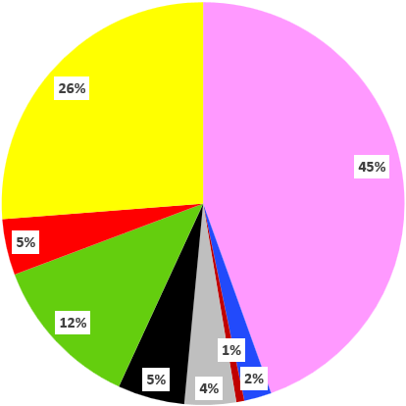
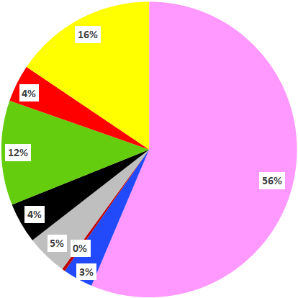
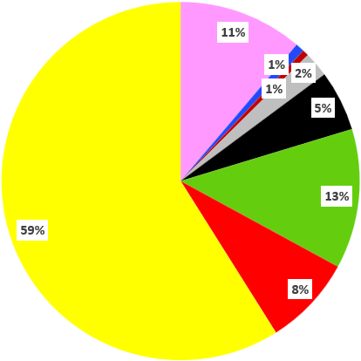
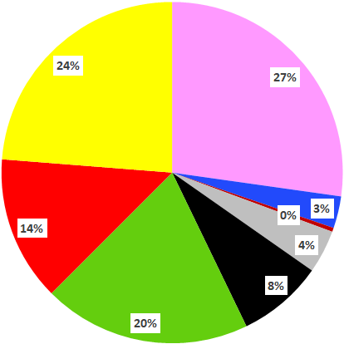
(a) 2002-04 20% Clearest Days
(b) 2016-20 20% Clearest Days
95 X 100 px
414 X 414 px
Casco Bay
(c) 2002-04 20% Most Impaired Days
(d) 2016-20 20% Most Impaired Days
SIZE
3.35
POSITIONS
0.3 - 0.45
6.1 - 0.45
0.3 - 4.1
6.1 - 4.1

Slide 16
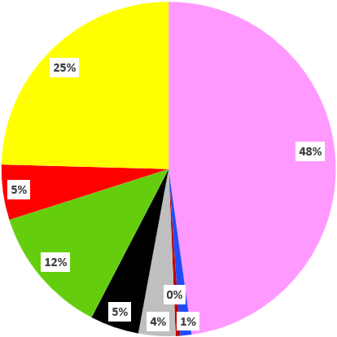
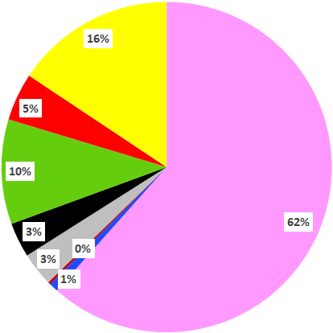
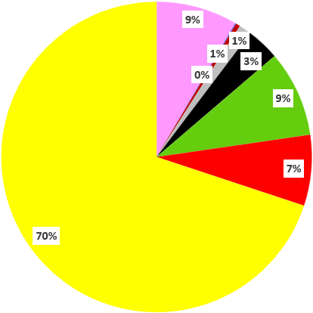
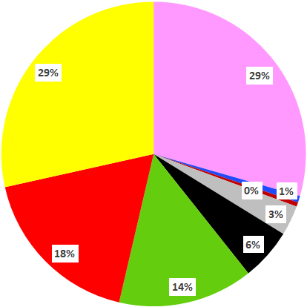
(a) 2002-04 20% Clearest Days
(b) 2016-20 20% Clearest Days
95 X 100 px
414 X 414 px
Proctor Maple R.F.
(c) 2002-04 20% Most Impaired Days
(d) 2016-20 20% Most Impaired Days
SIZE
3.35
POSITIONS
0.3 - 0.45
6.1 - 0.45
0.3 - 4.1
6.1 - 4.1

Slide 17
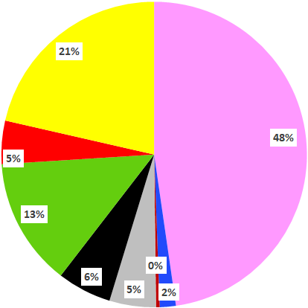
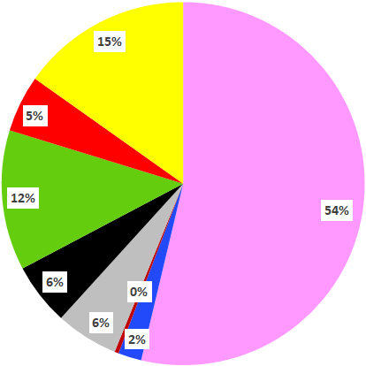
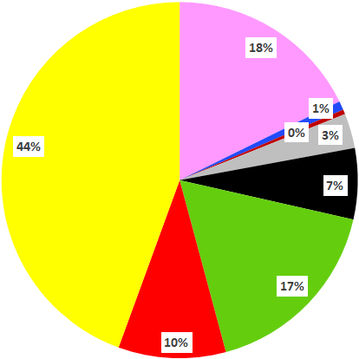
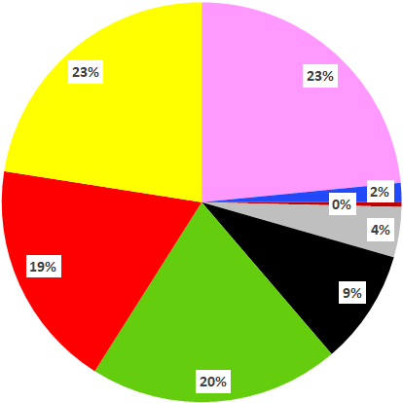
(a) 2011-13 20% Clearest Days
(b) 2016-20 20% Clearest Days
95 X 100 px
414 X 414 px
Londonderry
(c) 2011-13 20% Most Impaired Days
(d) 2016-20 20% Most Impaired Days
SIZE
3.35
POSITIONS
0.3 - 0.45
6.1 - 0.45
0.3 - 4.1
6.1 - 4.1

Slide 18
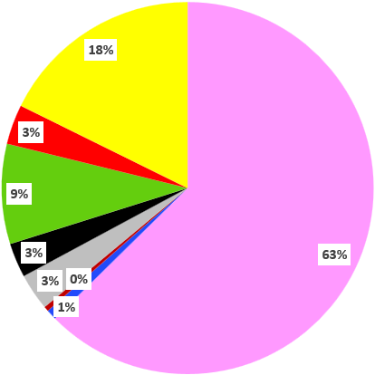
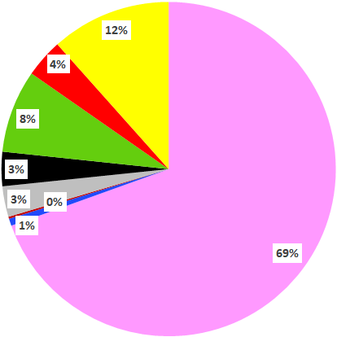
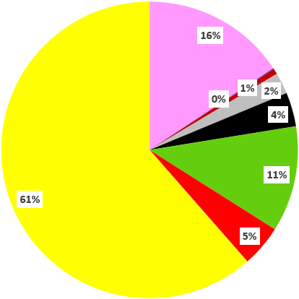
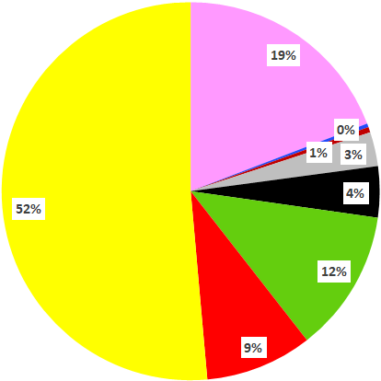
(a) 2008-10 20% Clearest Days
(b) 2016-20 20% Clearest Days
95 X 100 px
414 X 414 px
Pack Monadnock Summit
(c) 2008-10 20% Most Impaired Days
(d) 2016-20 20% Most Impaired Days
SIZE
3.35
POSITIONS
0.3 - 0.45
6.1 - 0.45
0.3 - 4.1
6.1 - 4.1

Slide 19
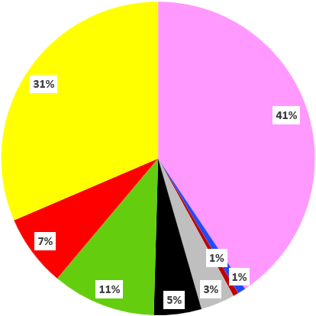
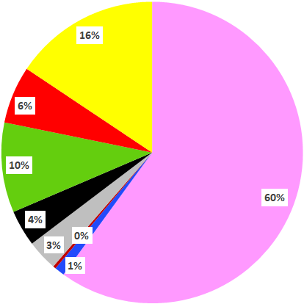
(a) 2002-04 20% Clearest Days
(b) 2016-20 20% Clearest Days
95 X 100 px
414 X 414 px
Mohawk Mt.
(c) 2002-04 20% Most Impaired Days
(d) 2016-20 20% Most Impaired Days
SIZE
3.35
POSITIONS
0.3 - 0.45
6.1 - 0.45
0.3 - 4.1
6.1 - 4.1

Slide 20
(a) 2002-04 20% Clearest Days
(b) 2016-20 20% Clearest Days
95 X 100 px
414 X 414 px
Cape Cod
(c) 2002-04 20% Most Impaired Days
(d) 2016-20 20% Most Impaired Days
SIZE
3.35
POSITIONS
0.3 - 0.45
6.1 - 0.45
0.3 - 4.1
6.1 - 4.1

Slide 21
(a) 2003-05 20% Clearest Days
(b) 2016-20 20% Clearest Days
95 X 100 px
414 X 414 px
Martha’s Vineyard
(c) 2003-05 20% Most Impaired Days
(d) 2016-20 20% Most Impaired Days
SIZE
3.35
POSITIONS
0.3 - 0.45
6.1 - 0.45
0.3 - 4.1
6.1 - 4.1

Slide 22
(a) 2005-07 20% Clearest Days
(b) 2016-20 20% Clearest Days
95 X 100 px
414 X 414 px
Frostburg Reservoir
(c) 2005-07 20% Most Impaired Days
(d) 2016-20 20% Most Impaired Days
SIZE
3.35
POSITIONS
0.3 - 0.45
6.1 - 0.45
0.3 - 4.1
6.1 - 4.1

Slide 23
(a) 2002-04 20% Clearest Days
(b) 2016-20 20% Clearest Days
95 X 100 px
414 X 414 px
Quaker City
(c) 2002-04 20% Most Impaired Days
(d) 2016-20 20% Most Impaired Days
SIZE
3.35
POSITIONS
0.3 - 0.45
6.1 - 0.45
0.3 - 4.1
6.1 - 4.1

Slide 24
a)
b)
3.7
0.1 0.05
5.55 0.05
0.1 3.77
5.55 3.77
c)
d)
Paint
14 – 44
xxx-500

Slide 25
a)
b)
3.7
0.1 0.05
5.55 0.05
0.1 3.77
5.55 3.77
c)
d)
Paint
14 – 44
xxx-500

Slide 26
a)
b)
3.7
0.1 0.05
5.55 0.05
0.1 3.77
5.55 3.77
c)
Paint
14 – 44
xxx-500

