Slide 1
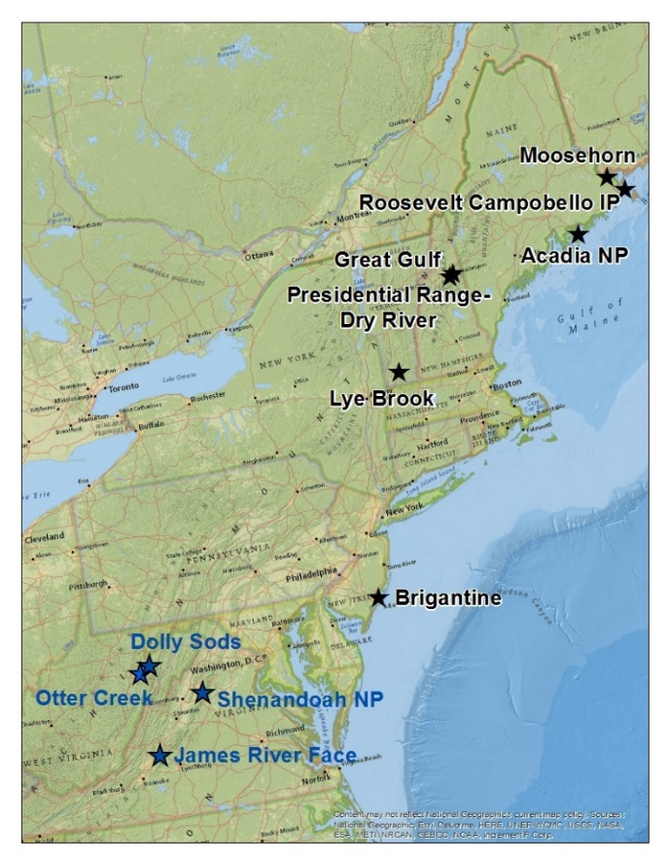
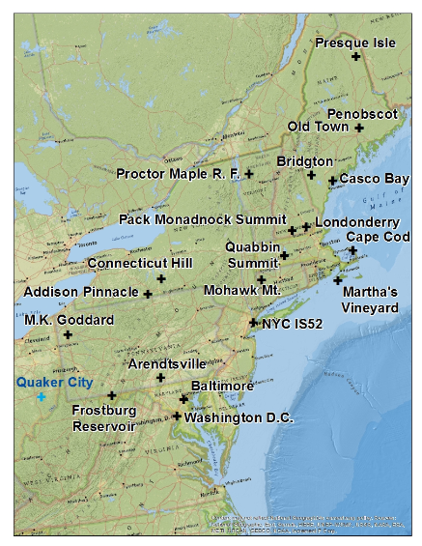

Slide 2
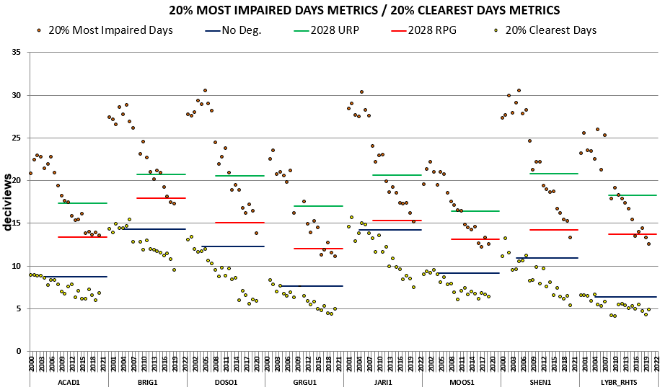

Slide 3
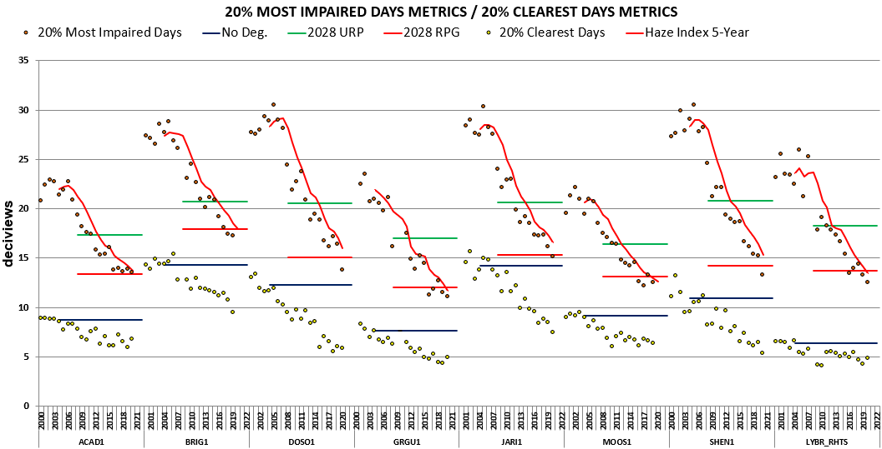

Slide 4
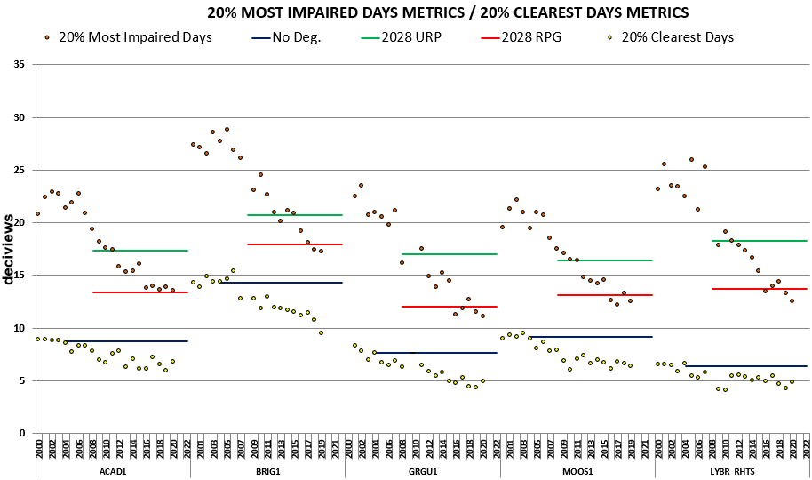

Slide 5
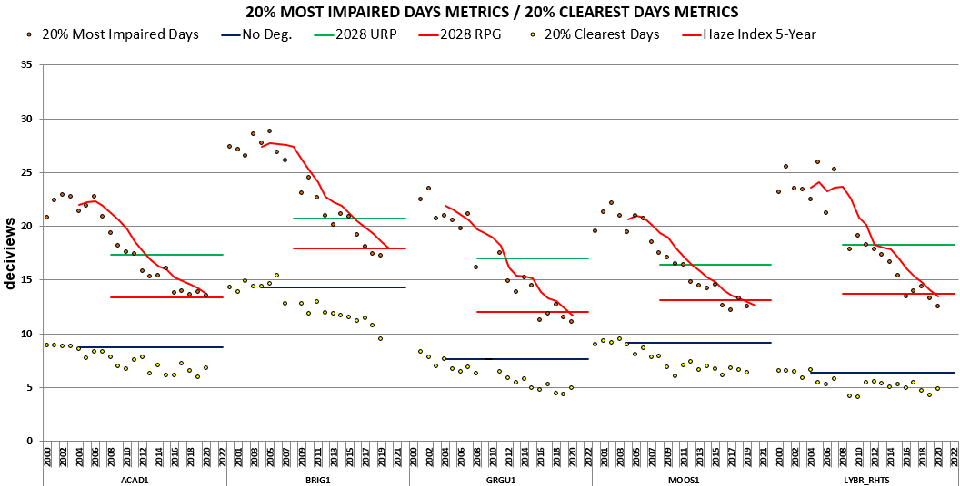

Slide 6
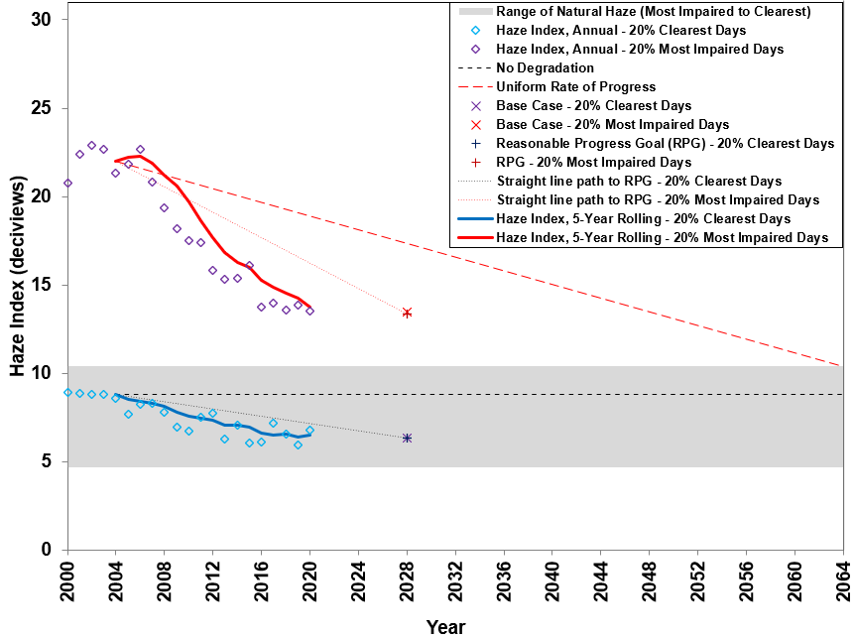
Acadia NP
Size – 7.4
Horiz – 2.0
Vert – 0.1

Slide 7
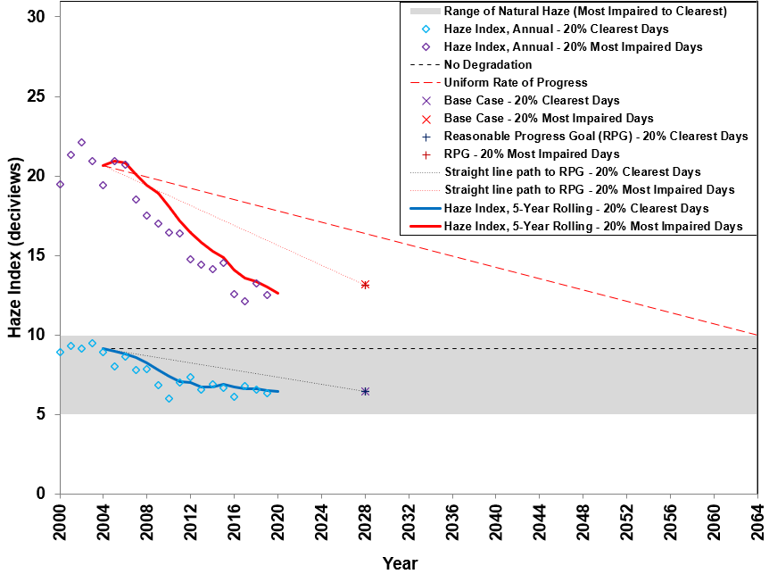
Moosehorn
Size – 7.4
Horiz – 2.0
Vert – 0.1

Slide 8
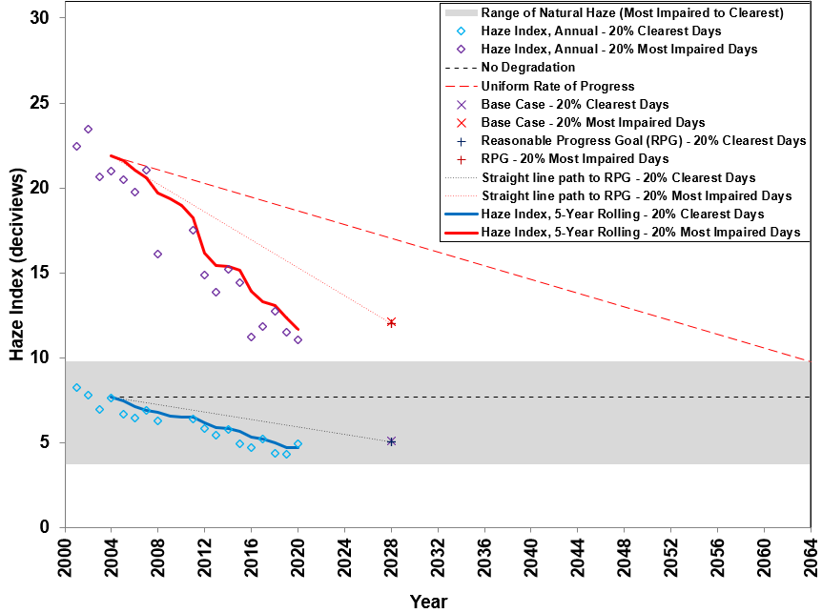
Great Gulf
Size – 7.4
Horiz – 2.0
Vert – 0.1

Slide 9
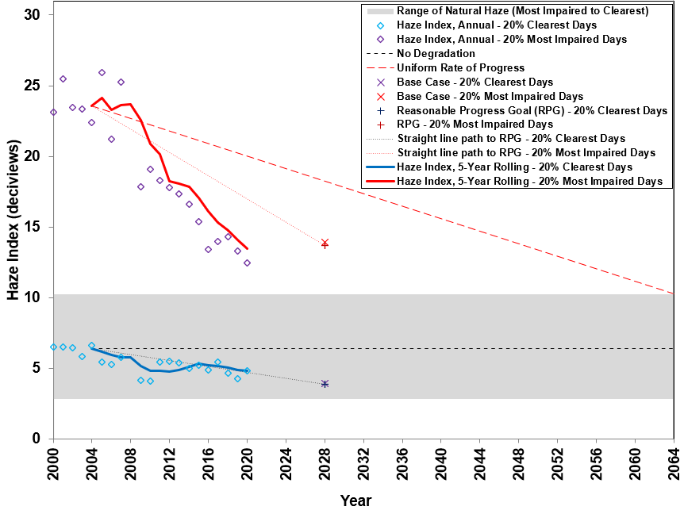
Lye Brook
Size – 7.4
Horiz – 2.0
Vert – 0.1

Slide 10
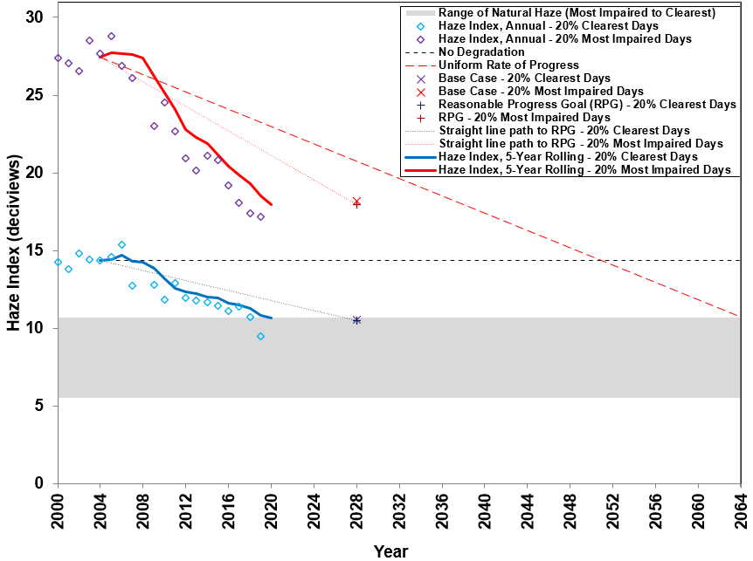
Brigantine
Size – 7.4
Horiz – 2.0
Vert – 0.1

Slide 11
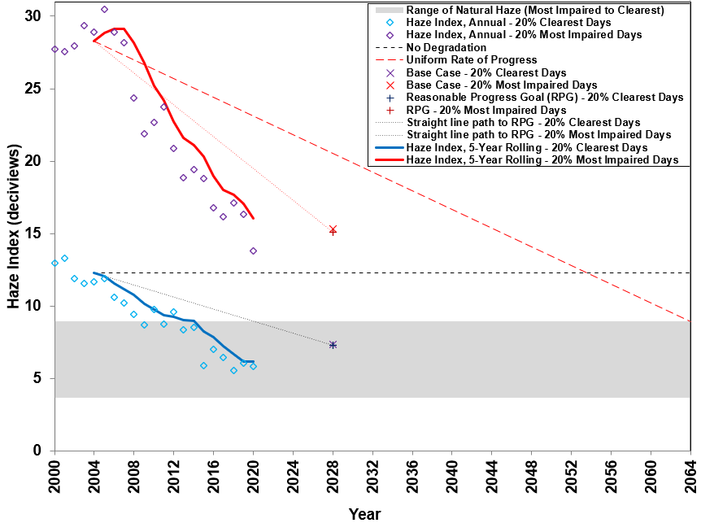
Dolly Sods
Size – 7.4
Horiz – 2.0
Vert – 0.1

Slide 12
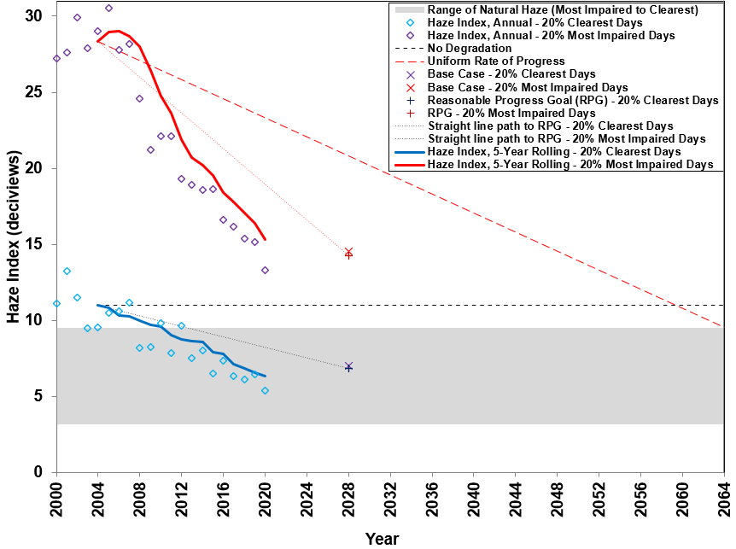
Shenandoah NP
Size – 7.4
Horiz – 2.0
Vert – 0.1

Slide 13
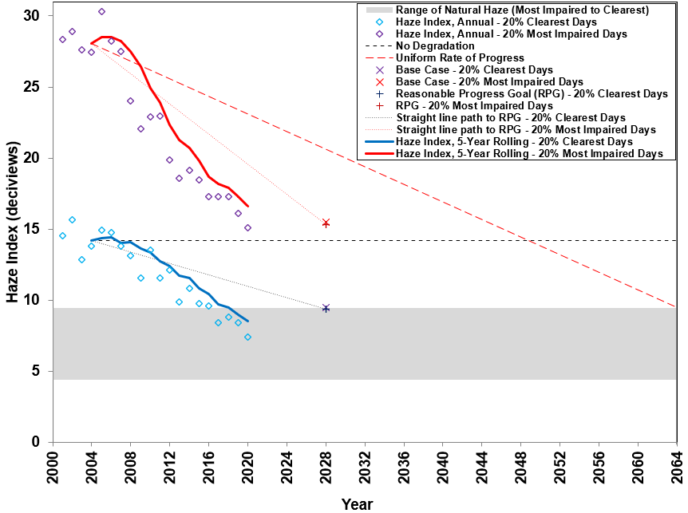
James River Face
Size – 7.4
Horiz – 2.0
Vert – 0.1

Slide 14
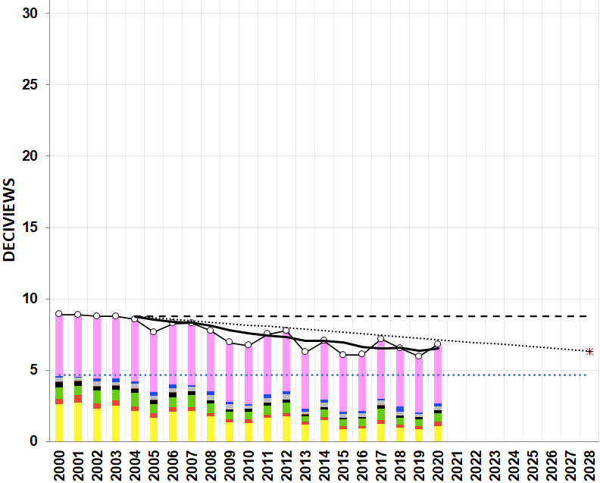
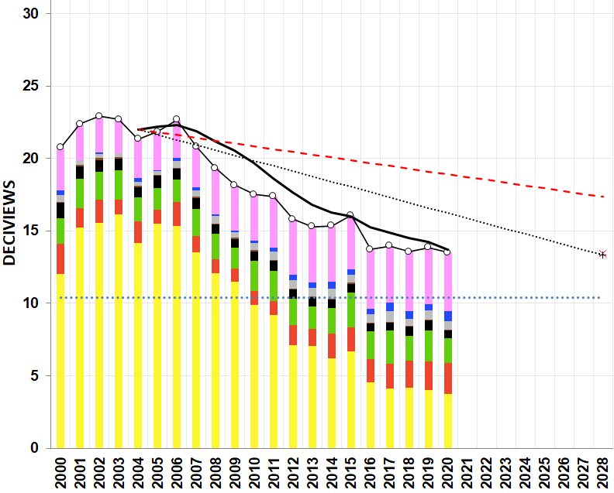
(a) 20% Clearest Days
(b) 20% Most Impaired Days
PAINT
21 , 18
792 x 637
SIZE – 5.1
Position – 0.1 / 6.45 Horizontal
- 0.1 / 0.1 Vertical
ACADIA NP

Slide 15
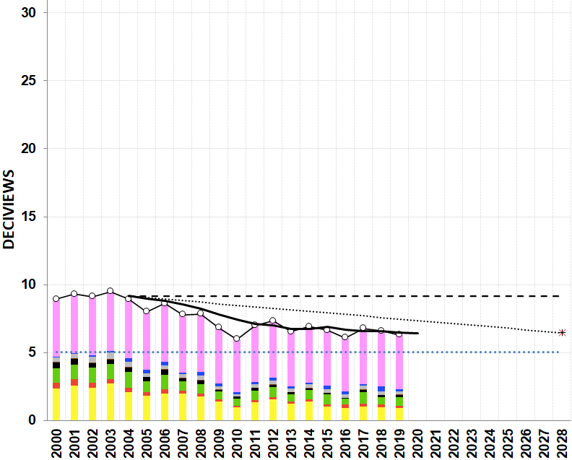
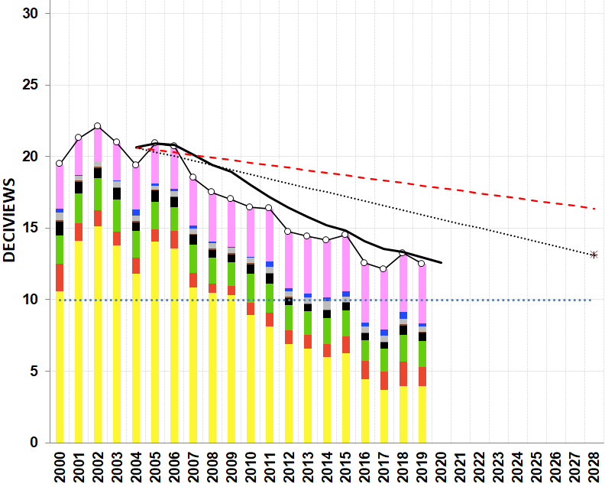
(a) 20% Clearest Days
(b) 20% Most Impaired Days
SIZE – 5.1
Position – 0.1 / 6.45 Horizontal
- 0.1 / 0.1 Vertical
MOOSEHORN

Slide 16
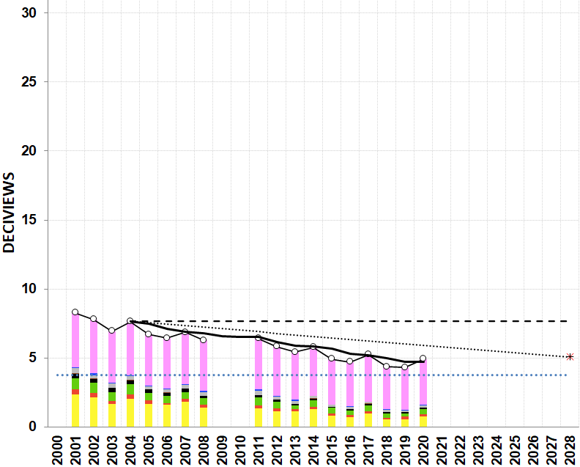
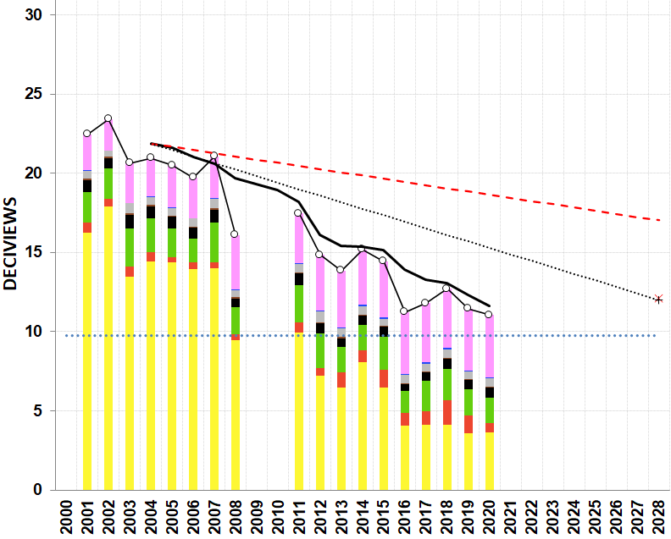
(a) 20% Clearest Days
(b) 20% Most Impaired Days
SIZE – 5.1
Position – 0.1 / 6.45 Horizontal
- 0.1 / 0.1 Vertical
GREAT GULF

Slide 17
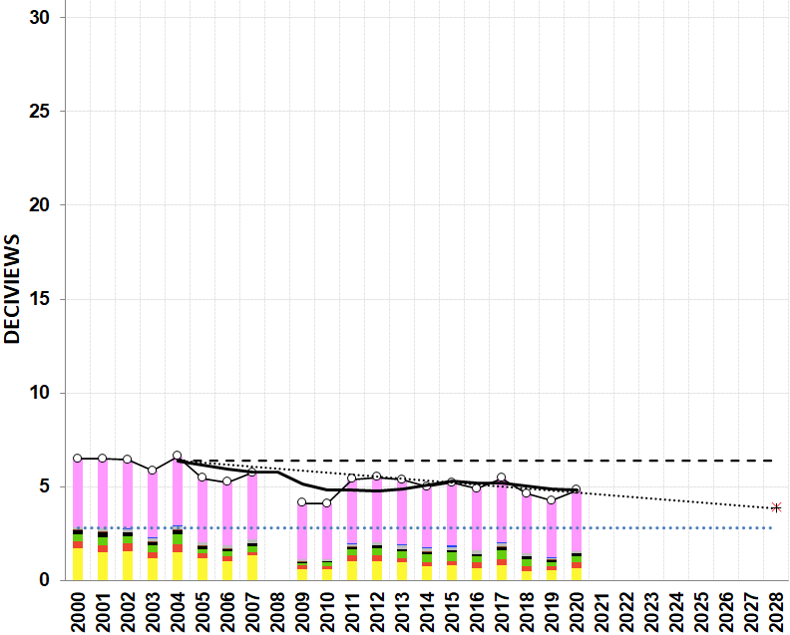
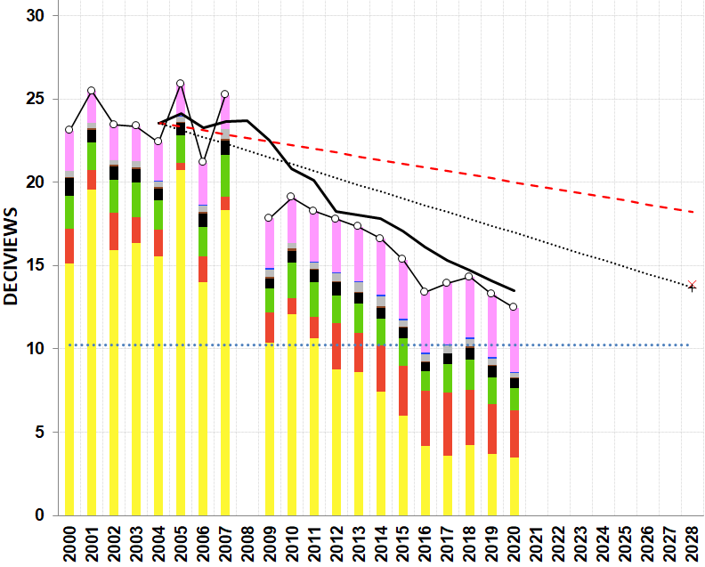
(a) 20% Clearest Days
(b) 20% Most Impaired Days
SIZE – 5.1
Position – 0.1 / 6.45 Horizontal
- 0.1 / 0.1 Vertical
LYE BROOK

Slide 18
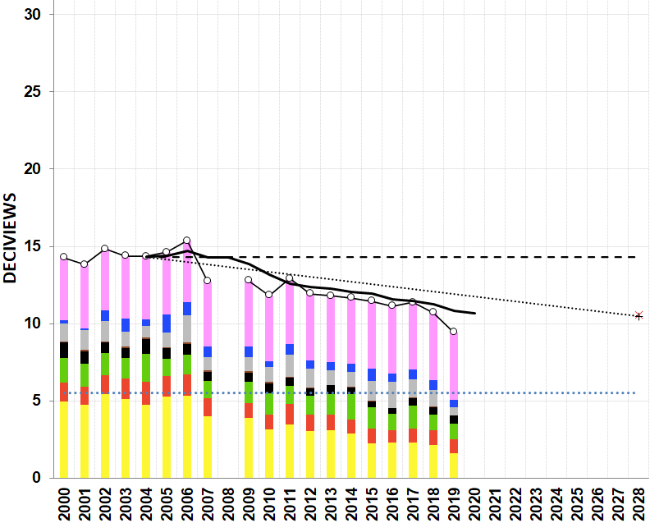
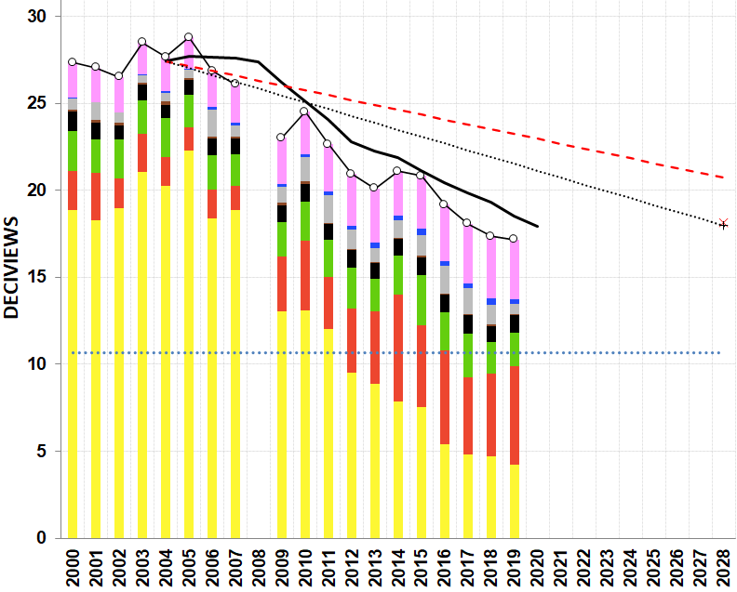
(a) 20% Clearest Days
(b) 20% Most Impaired Days
SIZE – 5.1
Position – 0.1 / 6.45 Horizontal
- 0.1 / 0.1 Vertical
BRIGANTINE

Slide 19
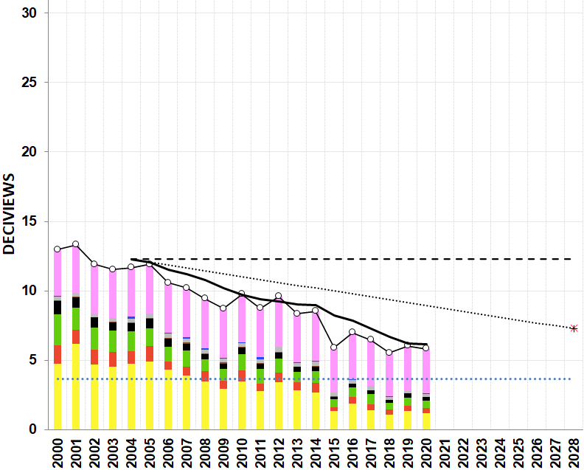
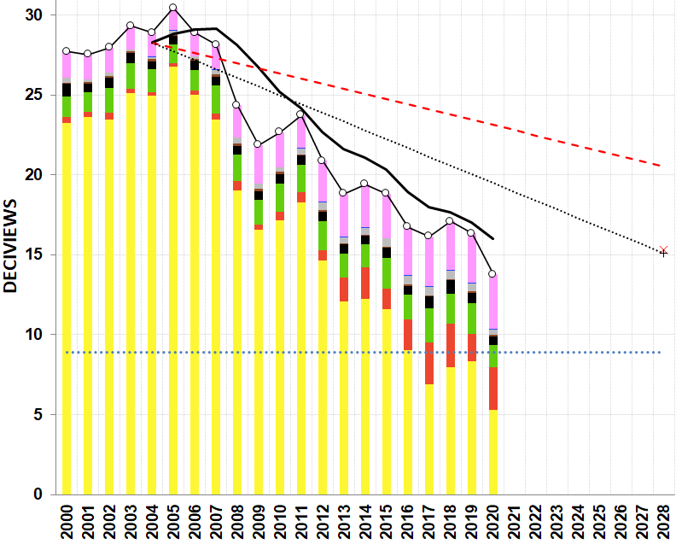
(a) 20% Clearest Days
(b) 20% Most Impaired Days
SIZE – 5.1
Position – 0.1 / 6.45 Horizontal
- 0.1 / 0.1 Vertical
DOLLY SODS

Slide 20
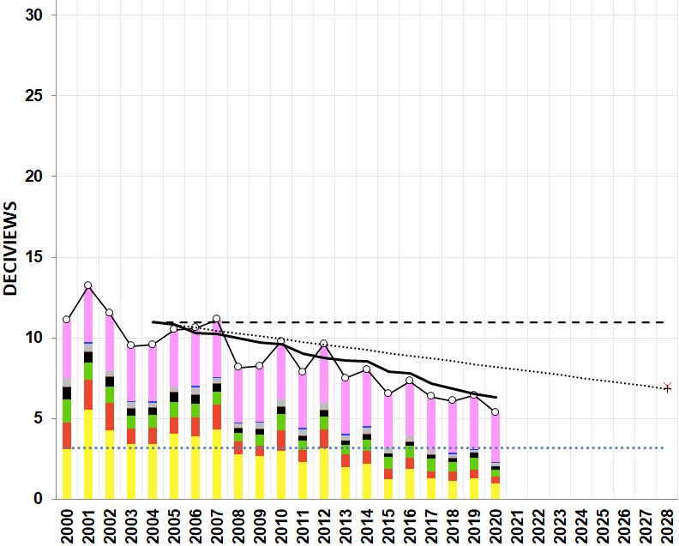
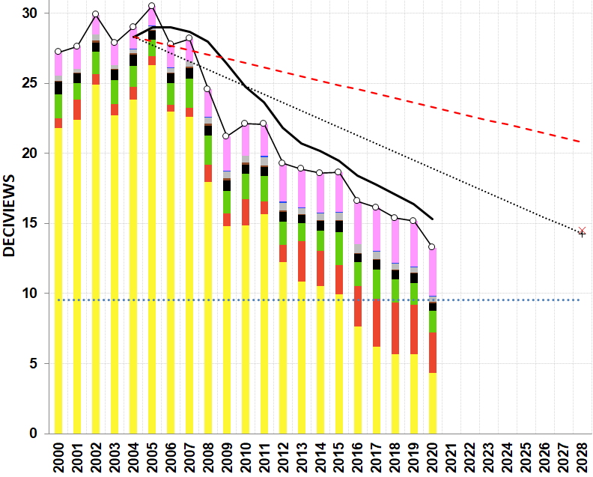
(a) 20% Clearest Days
(b) 20% Most Impaired Days
SIZE – 5.1
Position – 0.1 / 6.45 Horizontal
- 0.1 / 0.1 Vertical
SHENANDOAH

Slide 21
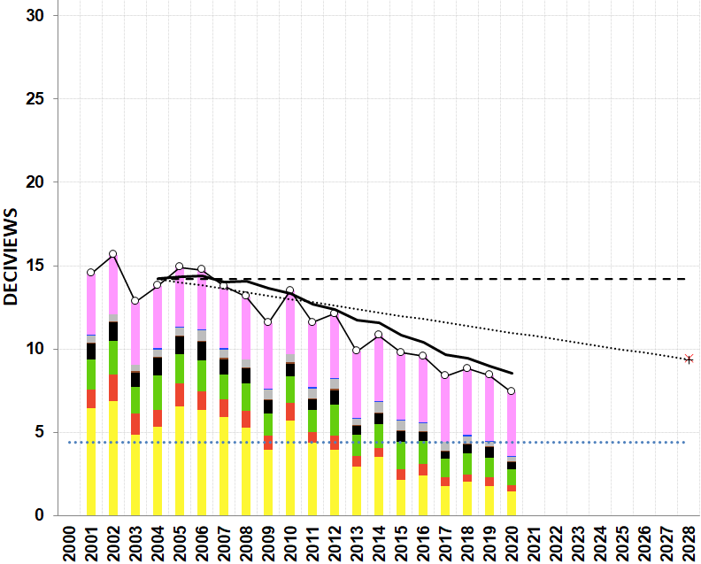
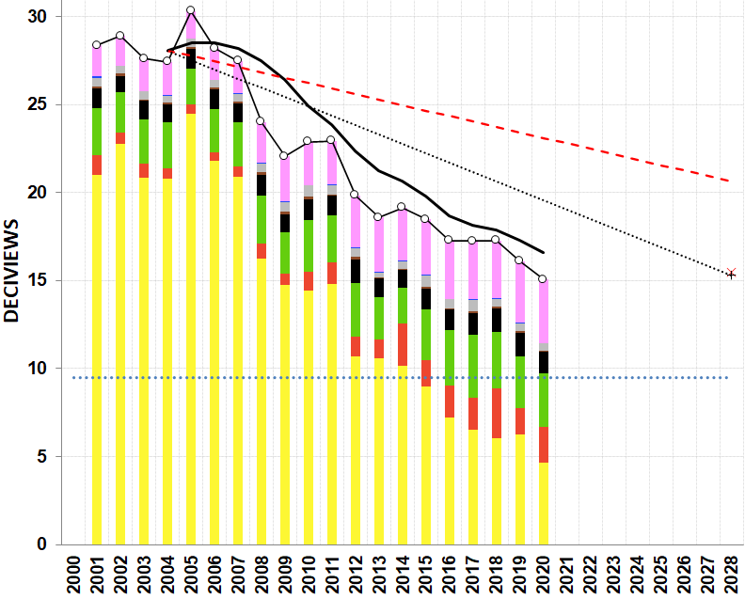
(a) 20% Clearest Days
(b) 20% Most Impaired Days
SIZE – 5.1
Position – 0.1 / 6.45 Horizontal
- 0.1 / 0.1 Vertical
JAMES RIVER

Slide 22
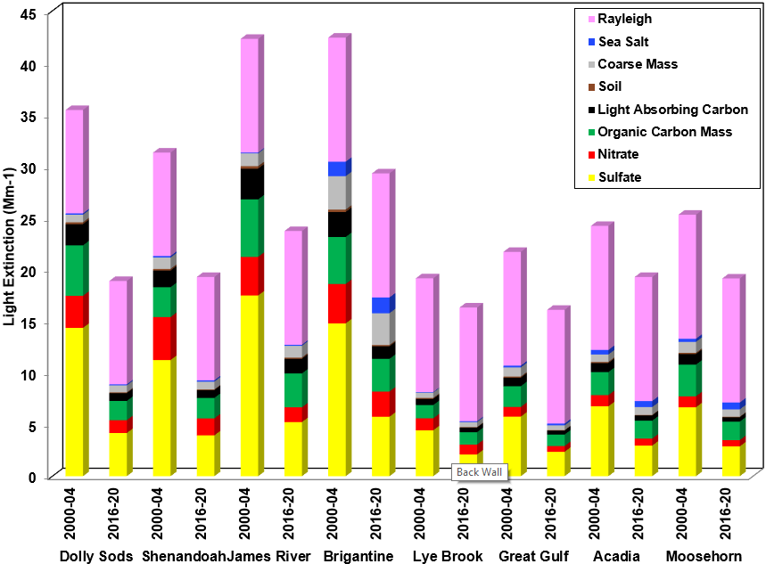
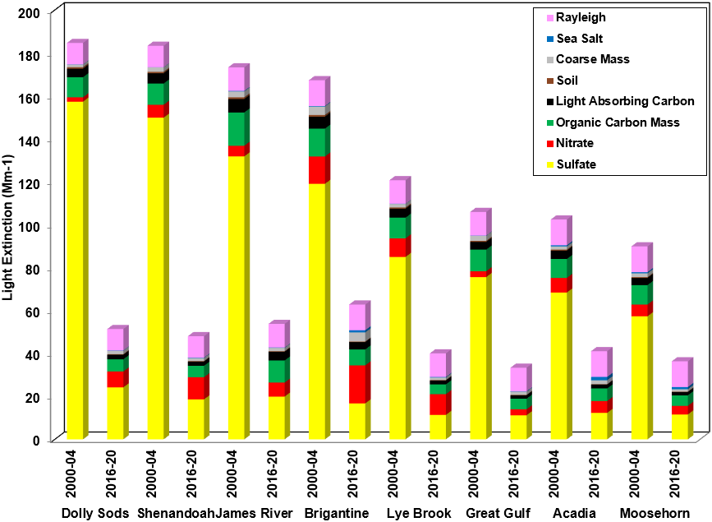
a) 20% Clearest Visibility Days
b) 20% Most Impaired Visibility Days
SIZE – 4.85
Position – 0.02 / 6.65 Horizontal
- 1.15 / 1.15 Vertical

Slide 23
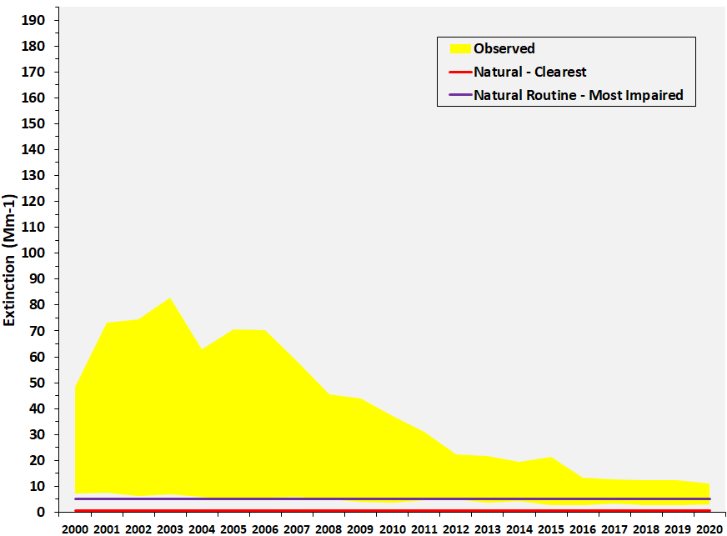
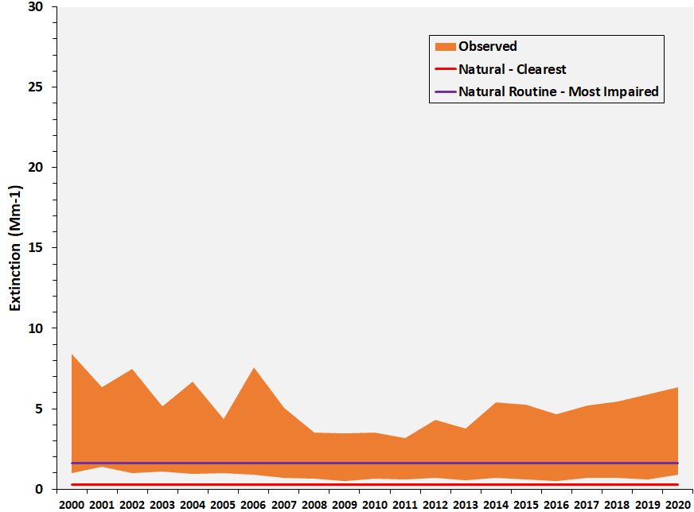
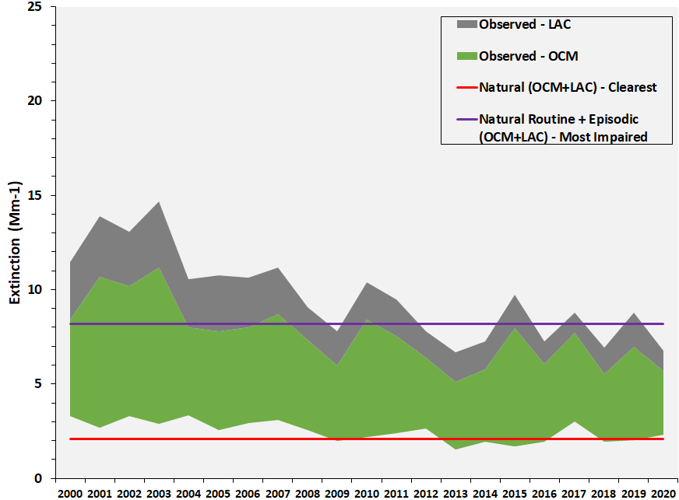
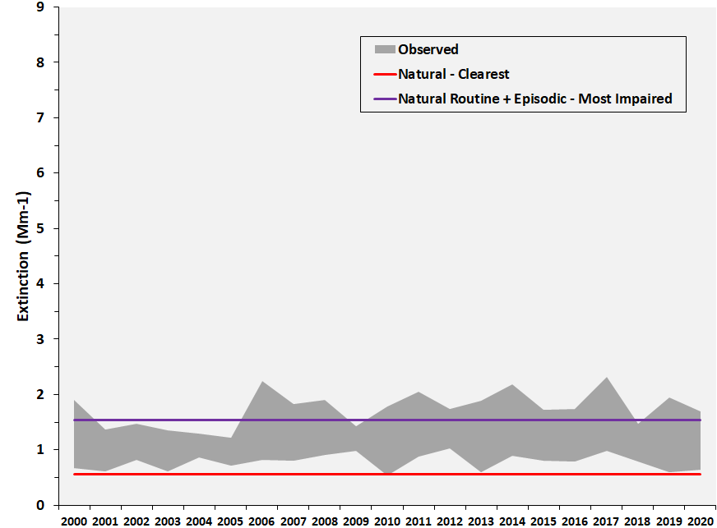
(a) Sulfate
(b) Nitrate
Acadia National Park
(c) Carbonaceous
Matter
(d) Coarse Mass
SIZE
3.7
POSITIONS
0.1 - 0.05
5.31 - 0.05
0.1 - 3.75
5.31 - 3.75

Slide 24
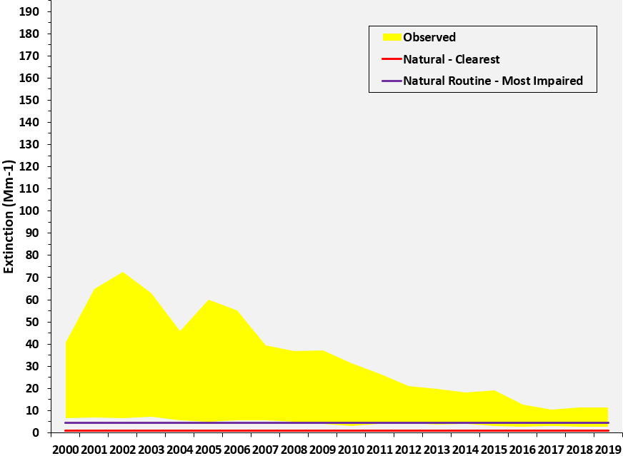
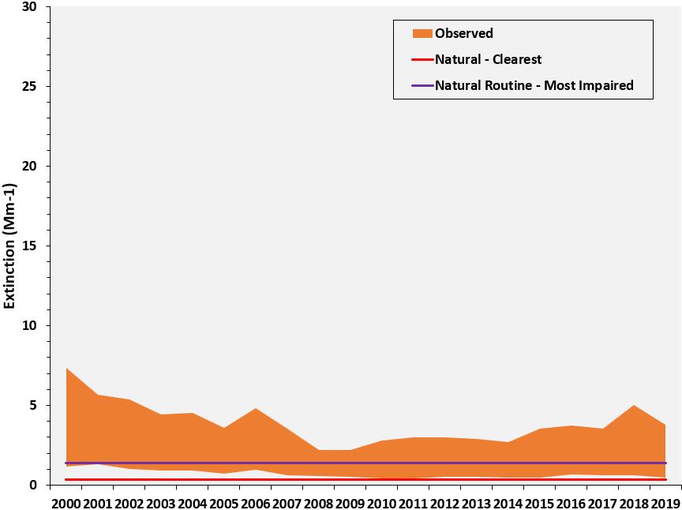
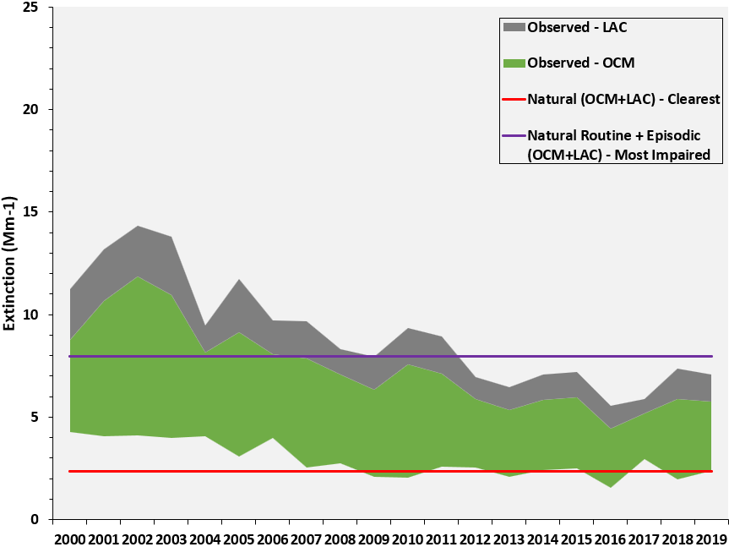
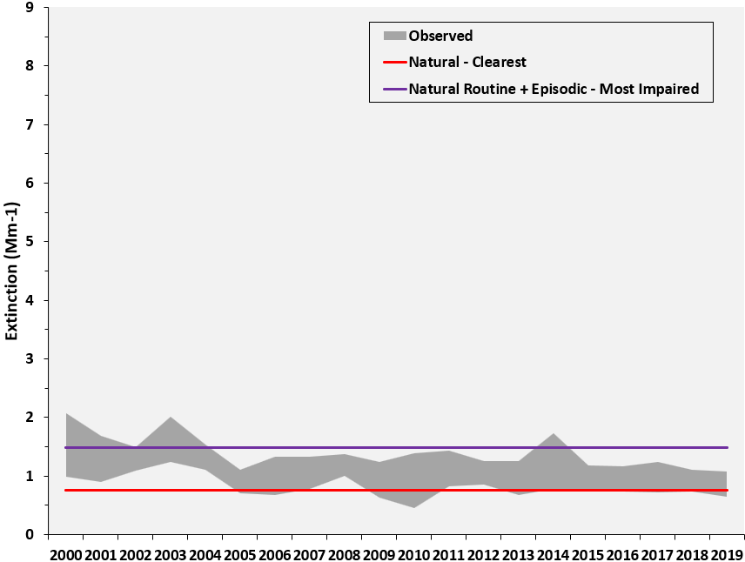
(a) Sulfate
(b) Nitrate
Moosehorn
(c) Carbonaceous
Matter
(d) Coarse Mass
SIZE
3.7
POSITIONS
0.1 - 0.05
5.31 - 0.05
0.1 - 3.75
5.31 - 3.75

Slide 25
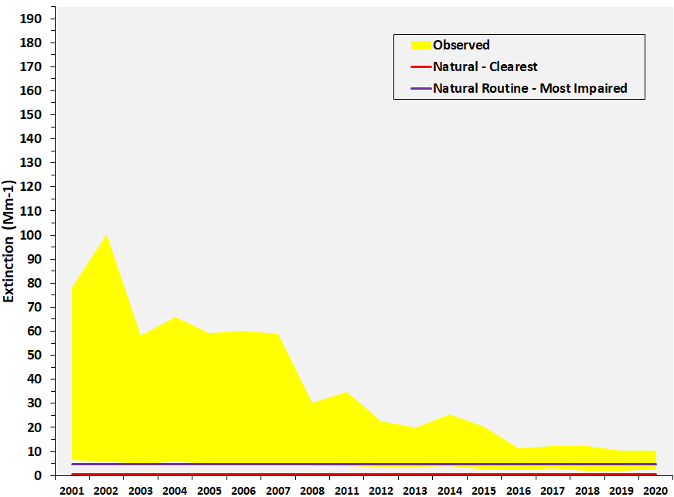
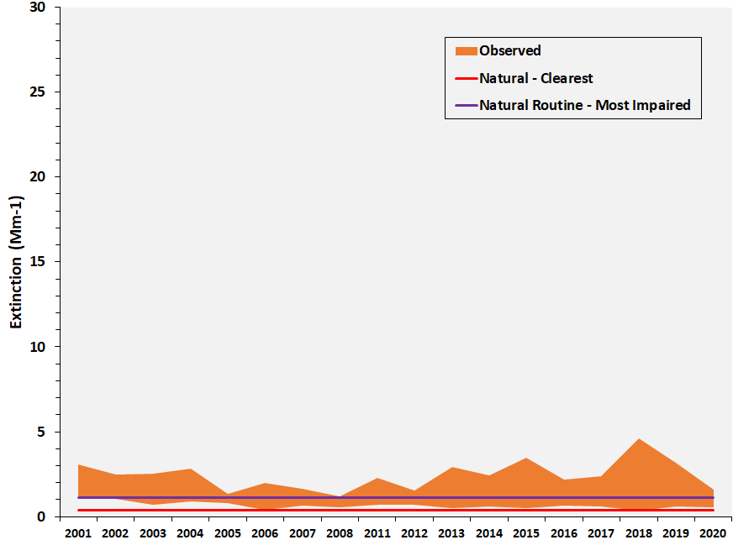
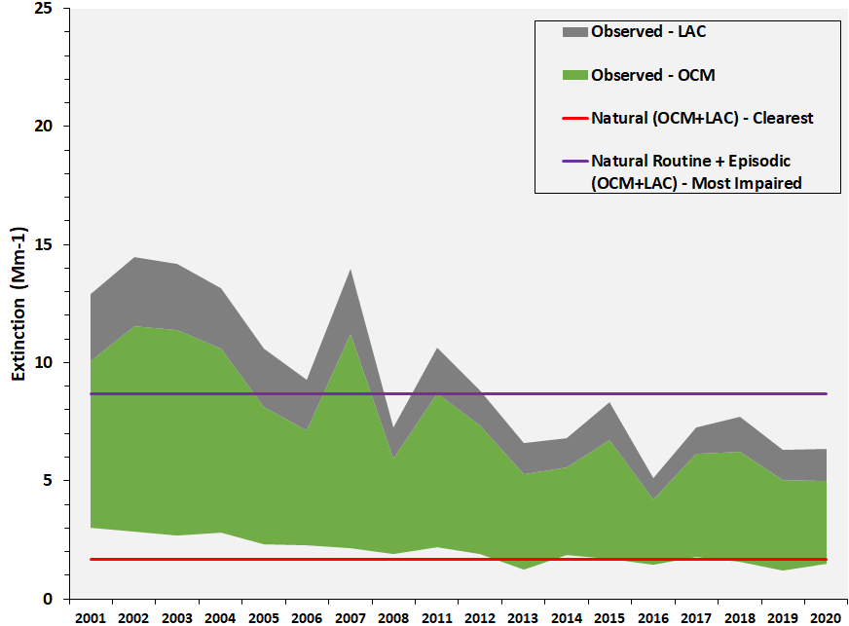
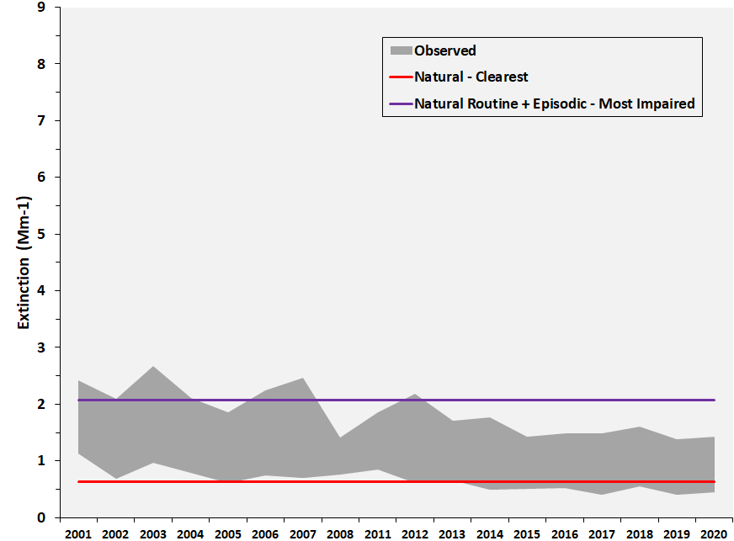
(a) Sulfate
(b) Nitrate
Great Gulf
(c) Carbonaceous
Matter
(d) Coarse Mass
SIZE
3.7
POSITIONS
0.1 - 0.05
5.31 - 0.05
0.1 - 3.75
5.31 - 3.75

Slide 26
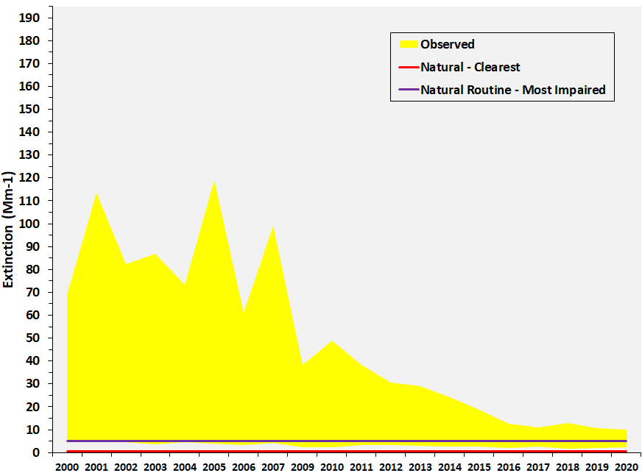
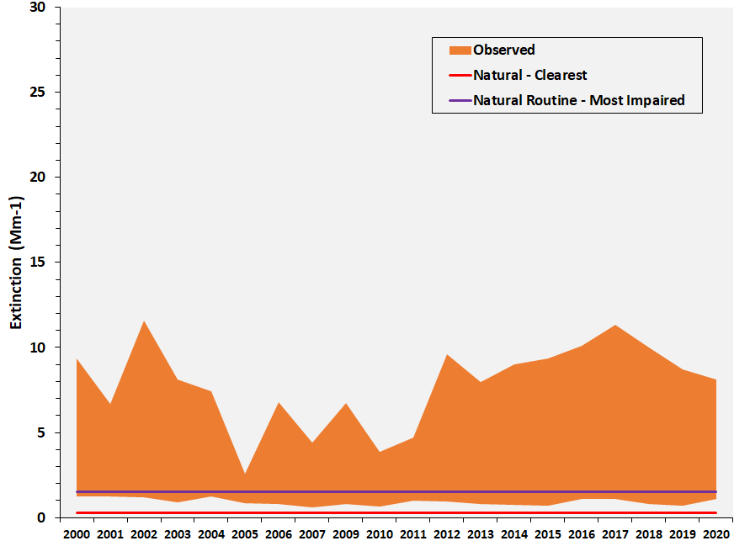
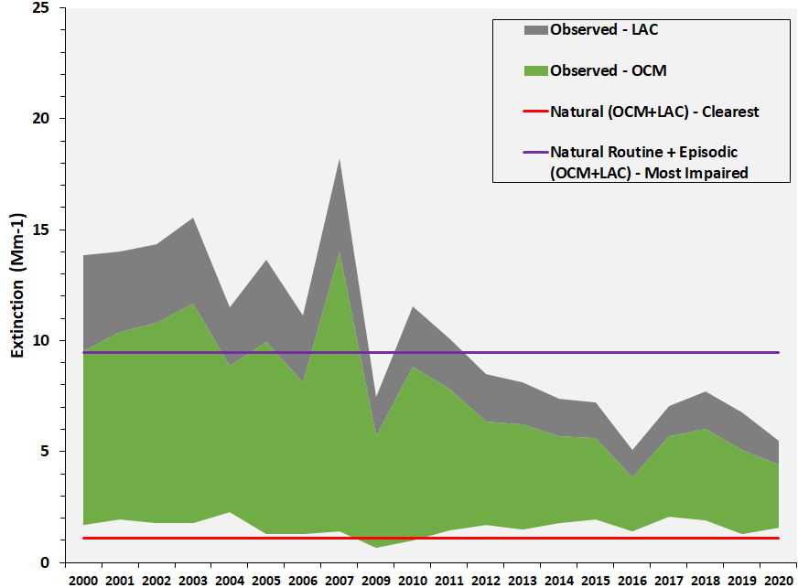
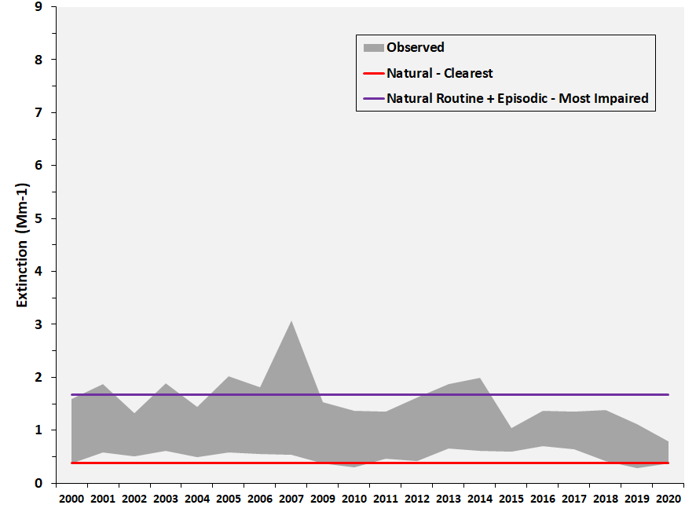
(a) Sulfate
(b) Nitrate
Lye Brook
(c) Carbonaceous
Matter
(d) Coarse Mass
SIZE
3.7
POSITIONS
0.1 - 0.05
5.31 - 0.05
0.1 - 3.75
5.31 - 3.75

Slide 27
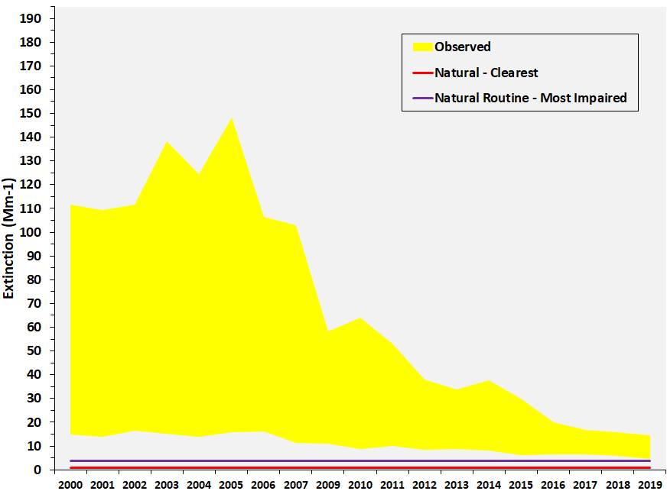
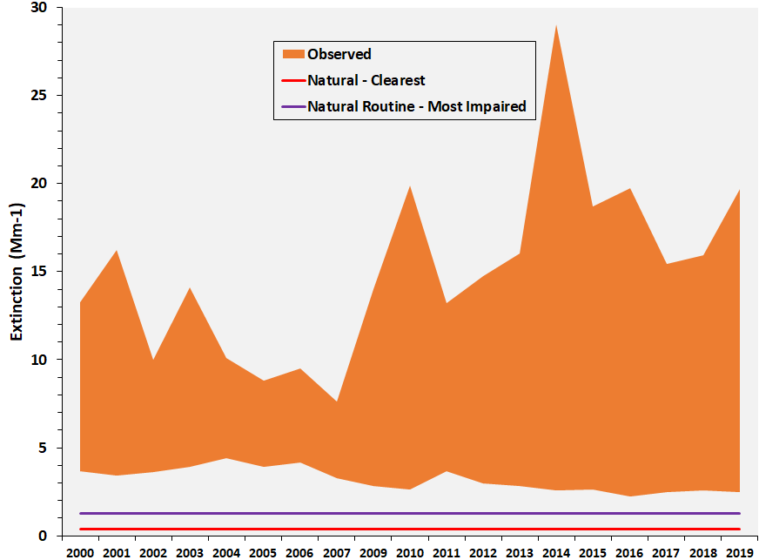
(a) Sulfate
(b) Nitrate
Brigantine
(c) Carbonaceous
Matter
(d) Coarse
Mass
SIZE
3.7
POSITIONS
0.1 - 0.05
5.31 - 0.05
0.1 - 3.75
5.31 - 3.75

Slide 28
(a) Sulfate
(b) Nitrate
Dolly Sods
(c) Carbonaceous
Matter
(d) Coarse Mass
SIZE
3.7
POSITIONS
0.1 - 0.05
5.31 - 0.05
0.1 - 3.75
5.31 - 3.75

Slide 29
(a) Sulfate
(b) Nitrate
Shenandoah NP
(c) Carbonaceous
Matter
(d) Coarse Mass
SIZE
3.7
POSITIONS
0.1 - 0.05
5.31 - 0.05
0.1 - 3.75
5.31 - 3.75

Slide 30
(a) Sulfate
(b) Nitrate
James River Face
(c) Carbonaceous Matter
(d) Coarse Mass
SIZE
3.7
POSITIONS
0.1 - 0.05
5.31 - 0.05
0.1 - 3.75
5.31 - 3.75

Slide 31
(a) 2000-04 20% Clearest Days
(b) 2016-20 20% Clearest Days
95 X 100 px
414 X 414 px
Acadia
(c) 2000-04 20% Most Impaired Days
(d) 2016-20 20% Most Impaired Days
SIZE
3.35
POSITIONS
0.3 - 0.45
6.1 - 0.45
0.3 - 4.1
6.1 - 4.1

Slide 32
(a) 2000-04 20% Clearest Days
(b) 2010-14 20% Clearest Days
95 X 100 px
414 X 414 px
Acadia
(c) 2016-20 20% Clearest Days
SIZE
3.35
POSITIONS
0.3 - 0.45
6.1 - 0.45
2.8 - 4.1

Slide 33
(a) 2000-04 20% Most Impaired Days
(b) 2010-14 20% Most Impaired Days
95 X 100 px
414 X 414 px
Acadia
(c) 2016-20 20% Most Impaired Days
SIZE
3.35
POSITIONS
0.3 - 0.45
6.1 - 0.45
2.8 - 4.1

Slide 34
(a) 2000-04 20% Clearest Days
(b) 2016-20 20% Clearest Days
95 X 100 px
414 X 414 px
Moosehorn
(c) 2000-04 20% Most Impaired Days
(d) 2016-20 20% Most Impaired Days
SIZE
3.35
POSITIONS
0.3 - 0.45
6.1 - 0.45
0.3 - 4.1
6.1 - 4.1

Slide 35
(a) 2000-04 20% Clearest Days
(b) 2010-14 20% Clearest Days
95 X 100 px
414 X 414 px
Moosehorn
(c) 2016-20 20% Clearest Days
SIZE
3.35
POSITIONS
0.3 - 0.45
6.1 - 0.45
2.8 - 4.1

Slide 36
(a) 2000-04 20% Most Impaired Days
(b) 2010-14 20% Most Impaired Days
95 X 100 px
414 X 414 px
Moosehorn
(c) 2016-20 20% Most Impaired Days
SIZE
3.35
POSITIONS
0.3 - 0.45
6.1 - 0.45
2.8 - 4.1

Slide 37
(a) 2000-04 20% Clearest Days
(b) 2016-20 20% Clearest Days
95 X 100 px
414 X 414 px
Great Gulf
(c) 2000-04 20% Most Impaired Days
(d) 2016-20 20% Most Impaired Days
SIZE
3.35
POSITIONS
0.3 - 0.45
6.1 - 0.45
0.3 - 4.1
6.1 - 4.1

Slide 38
(a) 2000-04 20% Clearest Days
(b) 2016-20 20% Clearest Days
95 X 100 px
414 X 414 px
Lye Brook
(c) 2000-04 20% Most Impaired Days
(d) 2016-20 20% Most Impaired Days
SIZE
3.35
POSITIONS
0.3 - 0.45
6.1 - 0.45
0.3 - 4.1
6.1 - 4.1

Slide 39
(a) 2000-04 20% Clearest Days
(b) 2016-20 20% Clearest Days
95 X 100 px
414 X 414 px
Brigantine
(c) 2000-04 20% Most Impaired Days
(d) 2016-20 20% Most Impaired Days
SIZE
3.35
POSITIONS
0.3 - 0.45
6.1 - 0.45
0.3 - 4.1
6.1 - 4.1

Slide 40
(a) 2000-04 20% Clearest Days
(b) 2016-20 20% Clearest Days
95 X 100 px
414 X 414 px
Dolly Sods
(c) 2000-04 20% Most Impaired Days
(d) 2016-20 20% Most Impaired Days
SIZE
3.35
POSITIONS
0.3 - 0.45
6.1 - 0.45
0.3 - 4.1
6.1 - 4.1

Slide 41
(a) 2000-04 20% Clearest Days
(b) 2016-20 20% Clearest Days
95 X 100 px
414 X 414 px
Shenandoah
(c) 2000-04 20% Most Impaired Days
(d) 2016-20 20% Most Impaired Days
SIZE
3.35
POSITIONS
0.3 - 0.45
6.1 - 0.45
0.3 - 4.1
6.1 - 4.1

Slide 42
(a) 2000-04 20% Clearest Days
(b) 2016-20 20% Clearest Days
95 X 100 px
414 X 414 px
James River
(c) 2000-04 20% Most Impaired Days
(d) 2016-20 20% Most Impaired Days
SIZE
3.35
POSITIONS
0.3 - 0.45
6.1 - 0.45
0.3 - 4.1
6.1 - 4.1

Slide 43
a)
b)
3.7
0.1 0.05
5.55 0.05
0.1 3.77
5.55 3.77
c)
d)
Paint
12 – 47
872-673

Slide 44
a)
b)
3.7
0.1 0.05
5.55 0.05
0.1 3.77
5.55 3.77
c)
d)

Slide 46
Baseline (2000-04)
Current (2016-20)
Natural (2064)
Current (2016-20)

