Slide 1
Particle Pollution
Martha Webster
Air Quality Meteorologist
Atmospheric Science and Analysis Section
Air Quality Assessment Division
Bureau of Air Quality

Slide 2
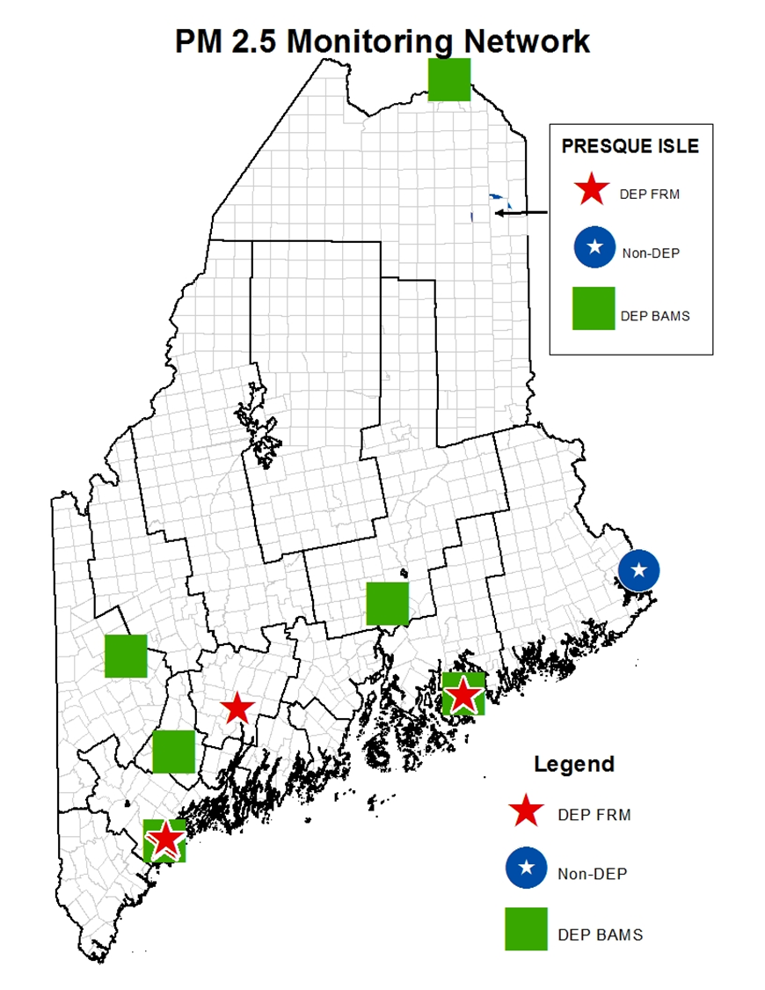
PM2.5 Trends compared to the Current NAAQS and possible 2022 NAAQS

Slide 3
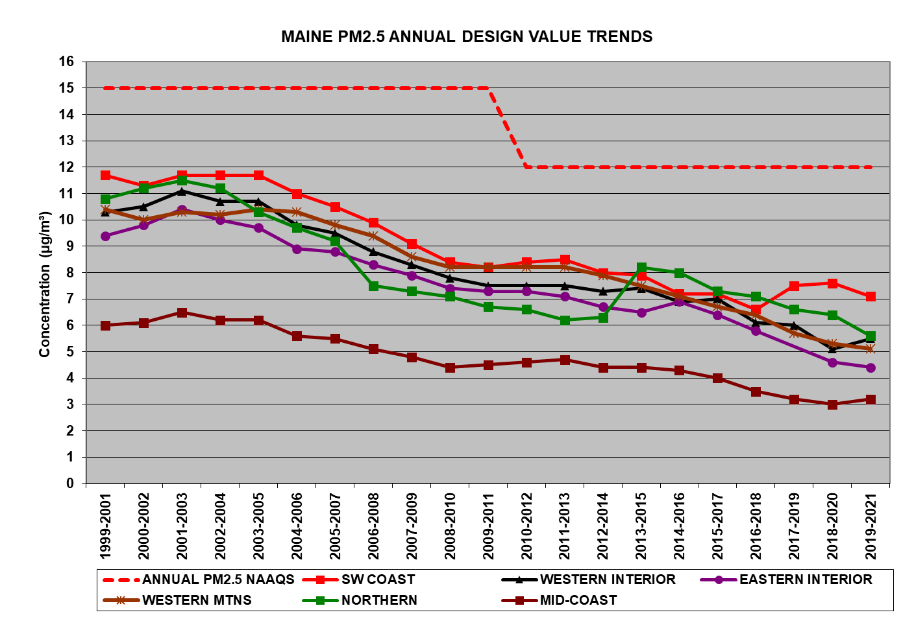
2021 filter data not available for the 4th quarter
Lowest potential Annual NAAQS

Slide 4
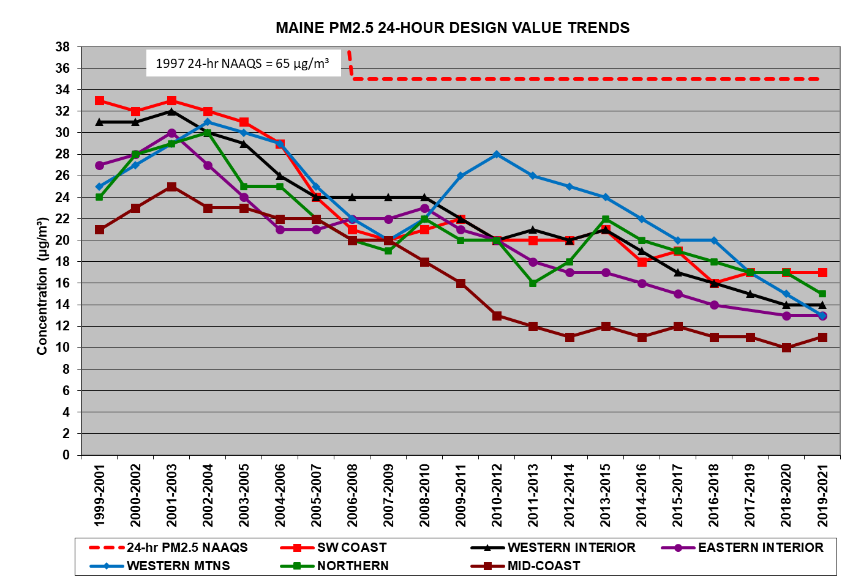

Slide 5
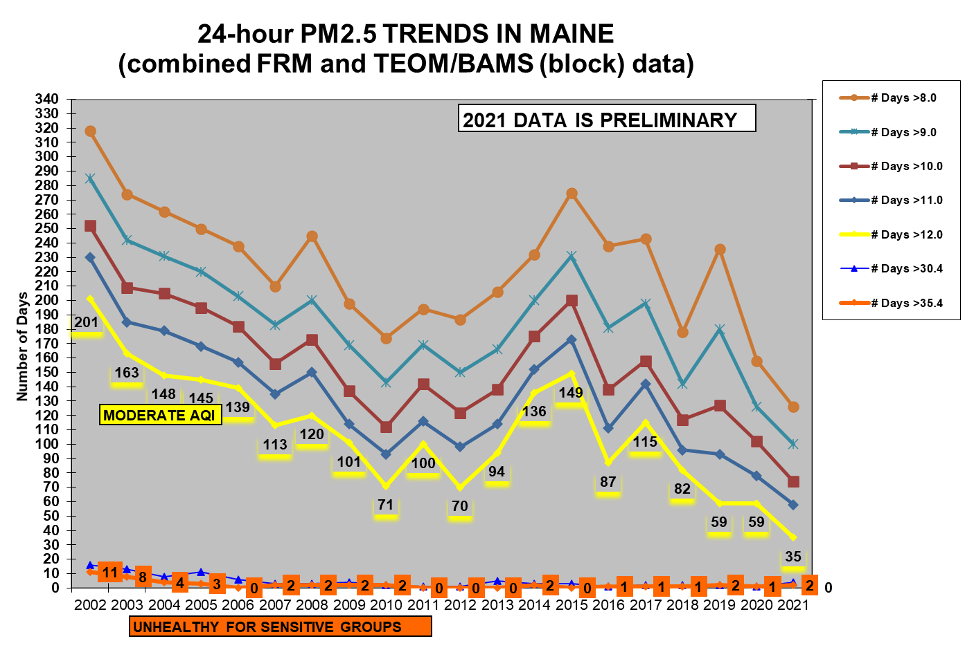
EPA often uses the annual NAAQS as the Good/Moderate breakpoint on the AQI.
If they follow that precedent, the numbers in the gray box to the right of the graph illustrate the number of days last year that would have been greater than good at a given potential breakpoint.
126 @ 8
100 @ 9
74 @ 10
58 @ 11
35 @ 12

Slide 6
Forecasting PM2.5: Running vs Block

Slide 7
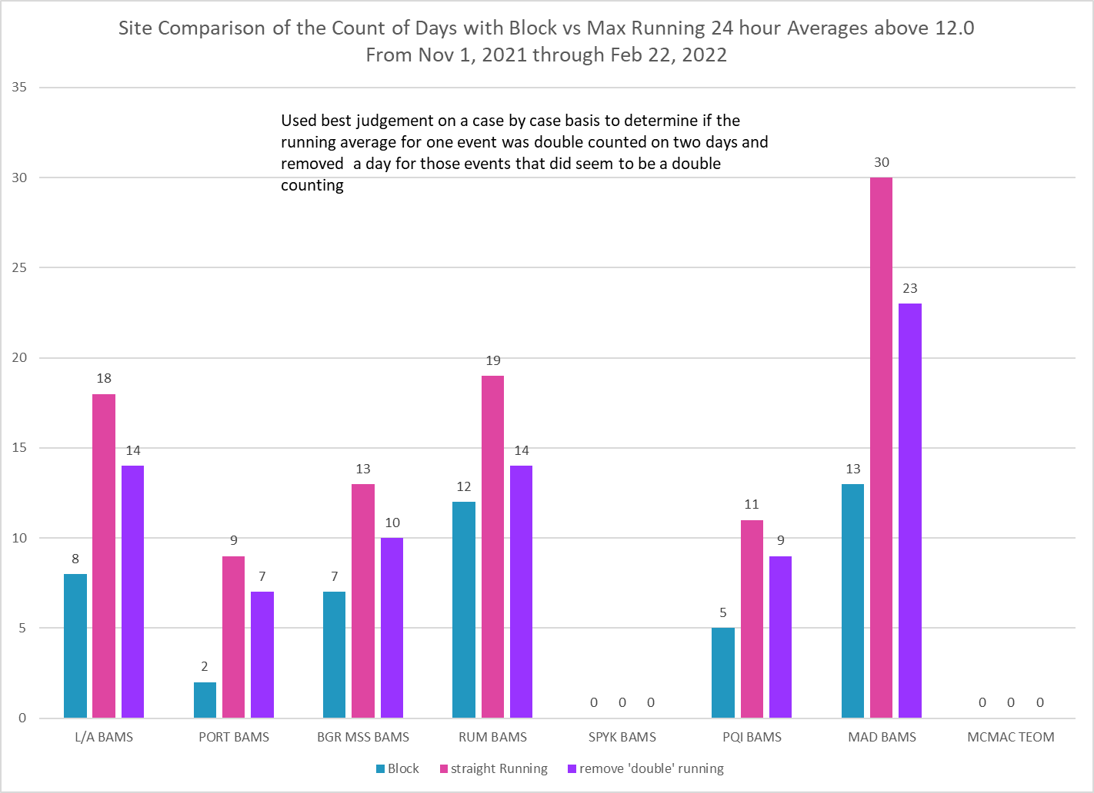

Slide 8
RITA

Slide 9
Rumford Intravalley Transport Analysis (RITA)
For years I’ve been wondering, in addition to inversion breakup, if there is ‘sloshing’ going on in the valley.

Slide 10
We’ve been collecting wind direction & speed from the RAP monitor site for several years. When the spikes occur in the morning, the main driver is inversion breakup where particle pollution from above is brought down to the surface. Along with that there was a usual scenario of very light winds and a wind shift from NNW to somewhere ENE to SE at the hour of the spike. With the wind shift being so noticeable maybe the additional PM2.5 isn’t all coming from above, maybe it is being brought back to the monitor from other areas in the valley. I asked for a sensor to be located further down river but still within that portion of the valley.
For the early part of the ‘winter’ the normal inversion break up signature didn’t happen often. It was the end of January and into February before we began to see the days with a ‘typical’ and near typical inversion break up signature.

Slide 11
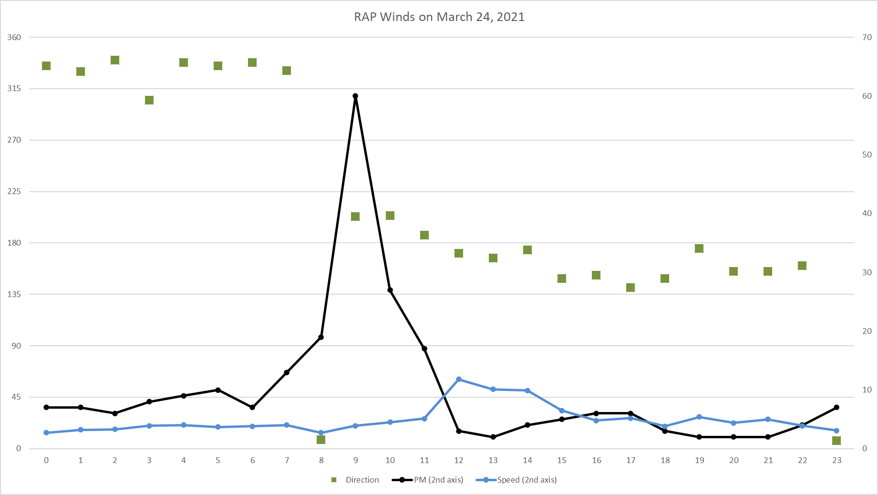
Fairly Typical Inversion Breakup Spike Scenario:
Wind Direction NW changing to E to SE or even S; wind speed light.

Slide 12
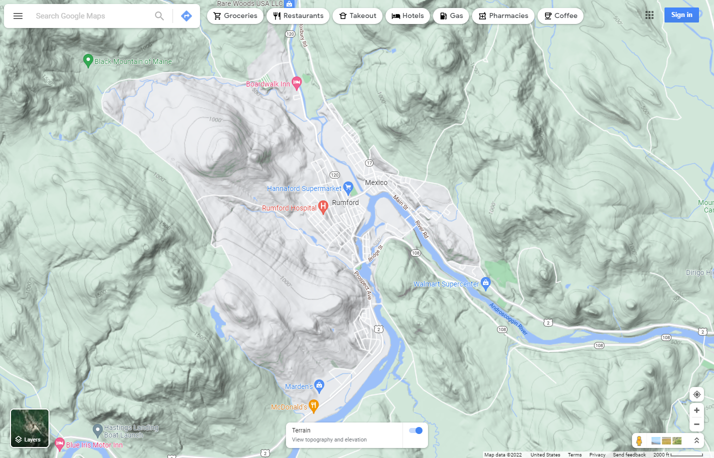

Slide 13
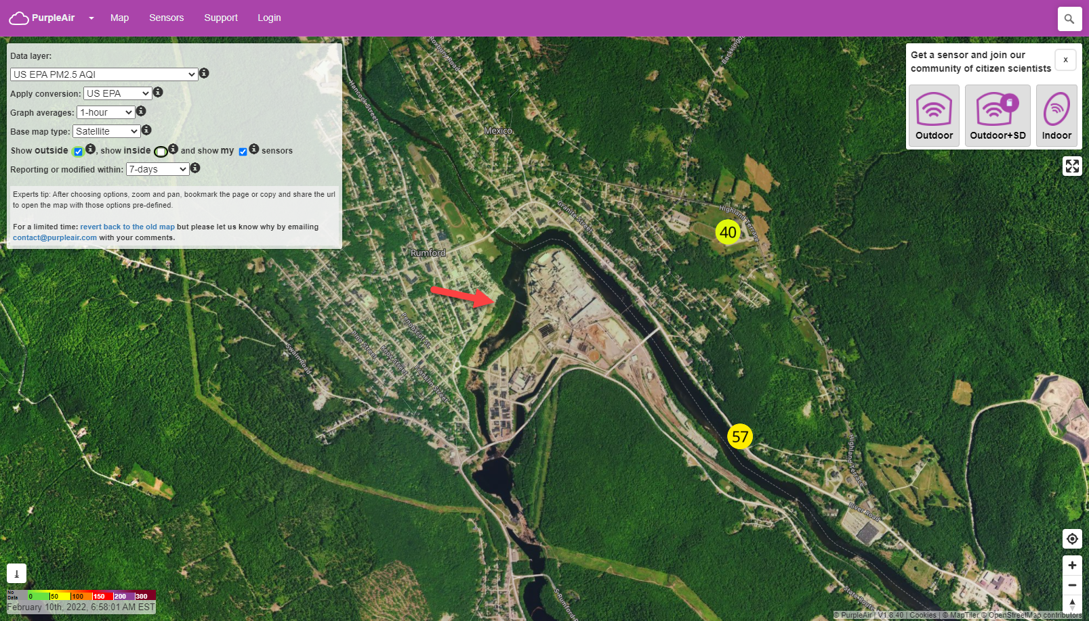

Slide 14
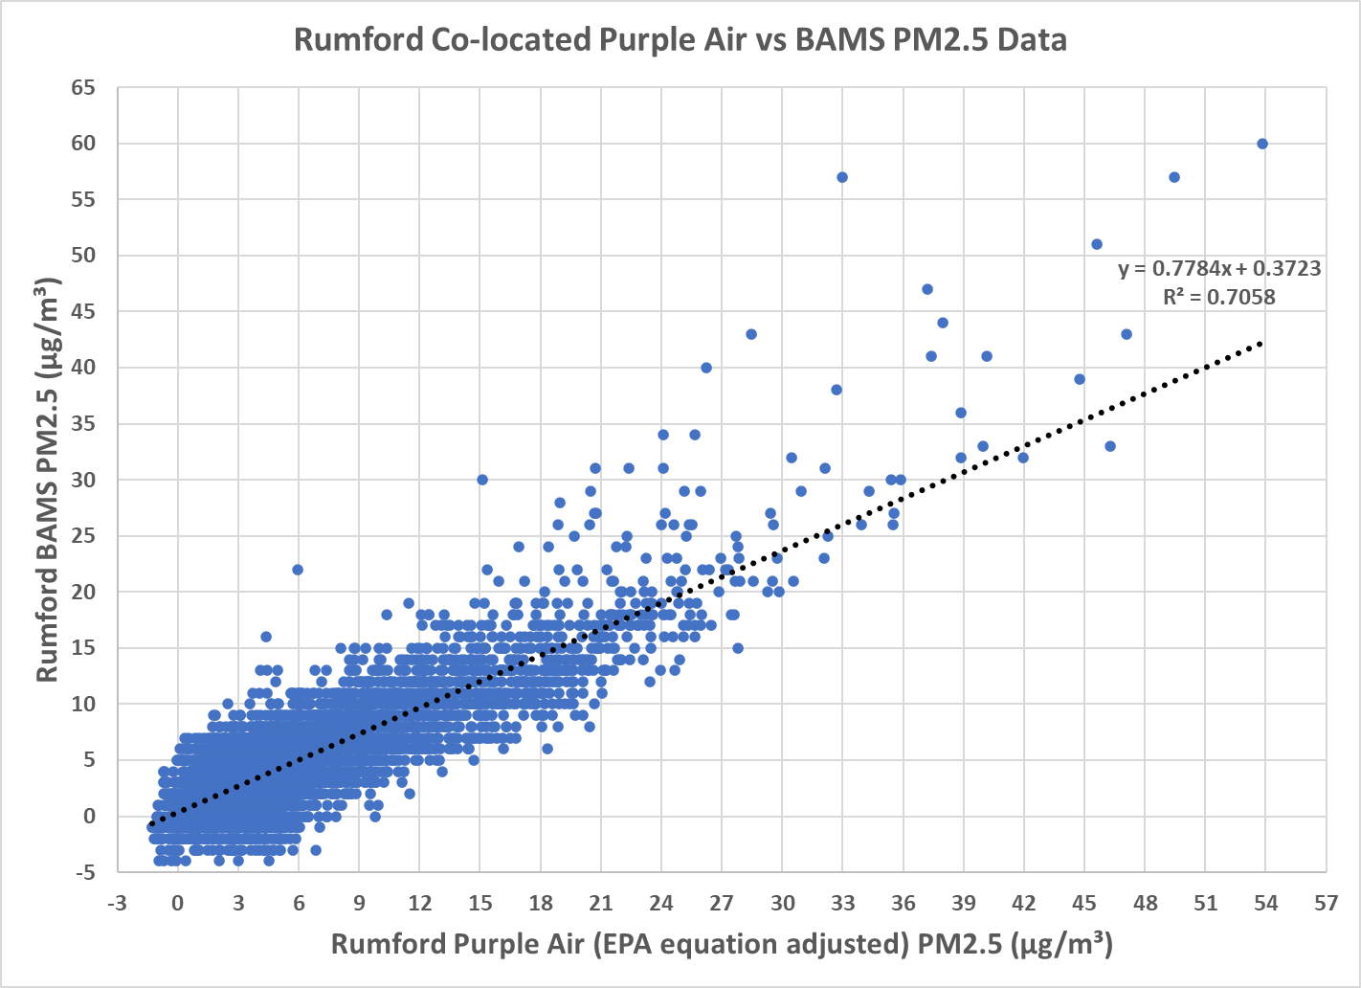
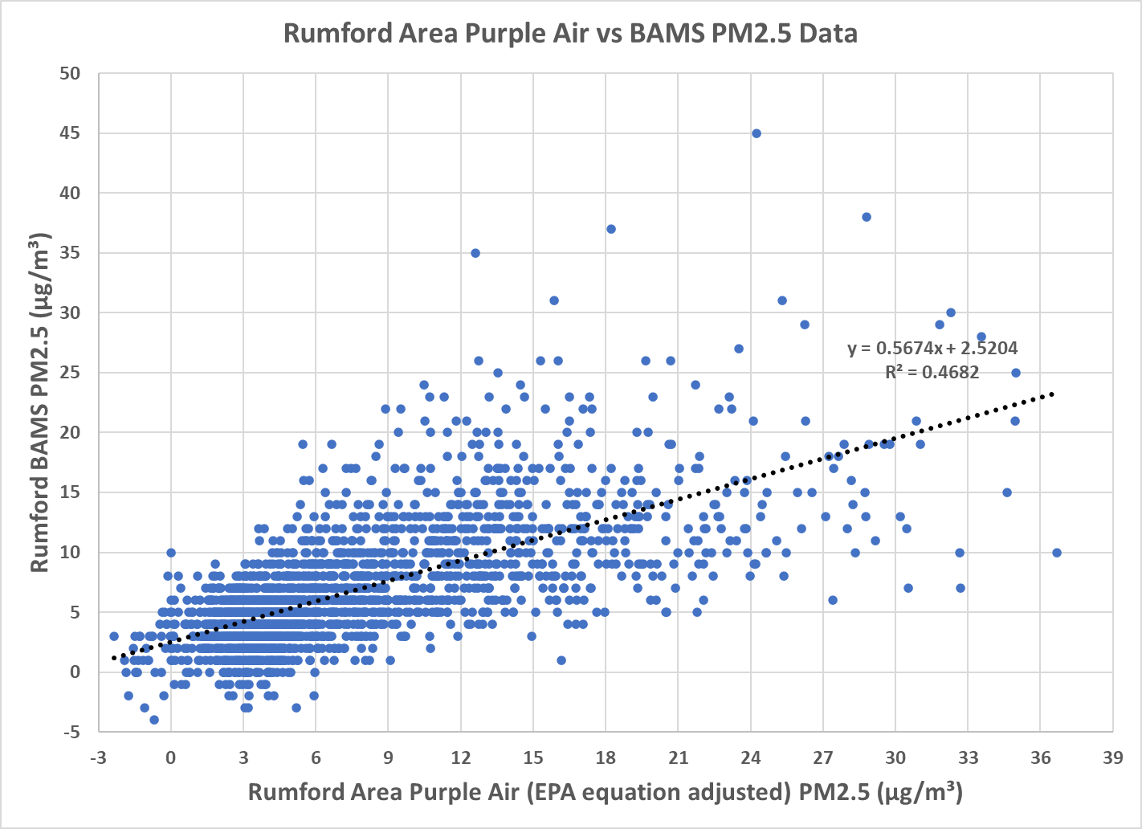

Slide 15
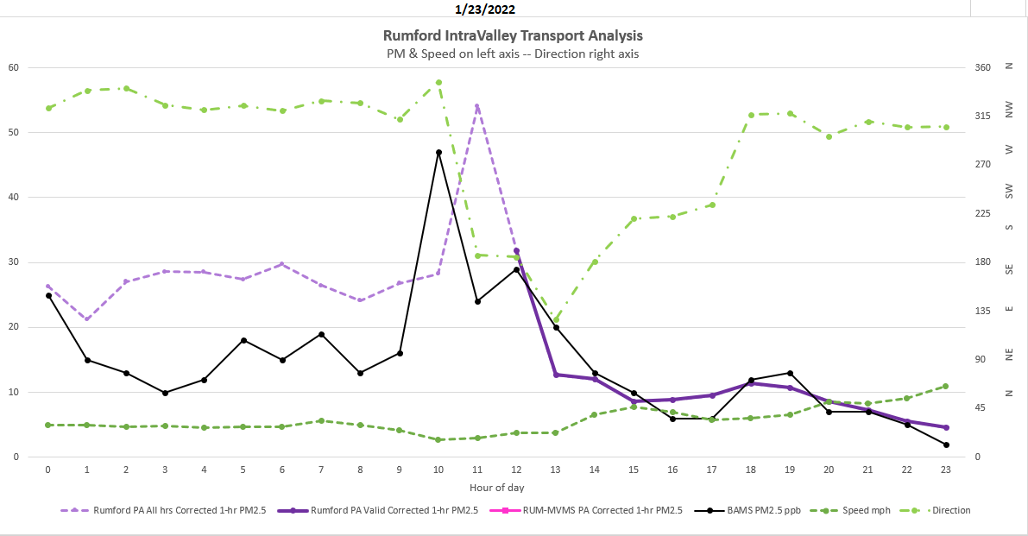
Jan 23, 2022: Interesting that the peak is the hour before the wind shift and the down valley site actually peaked after.

Slide 16
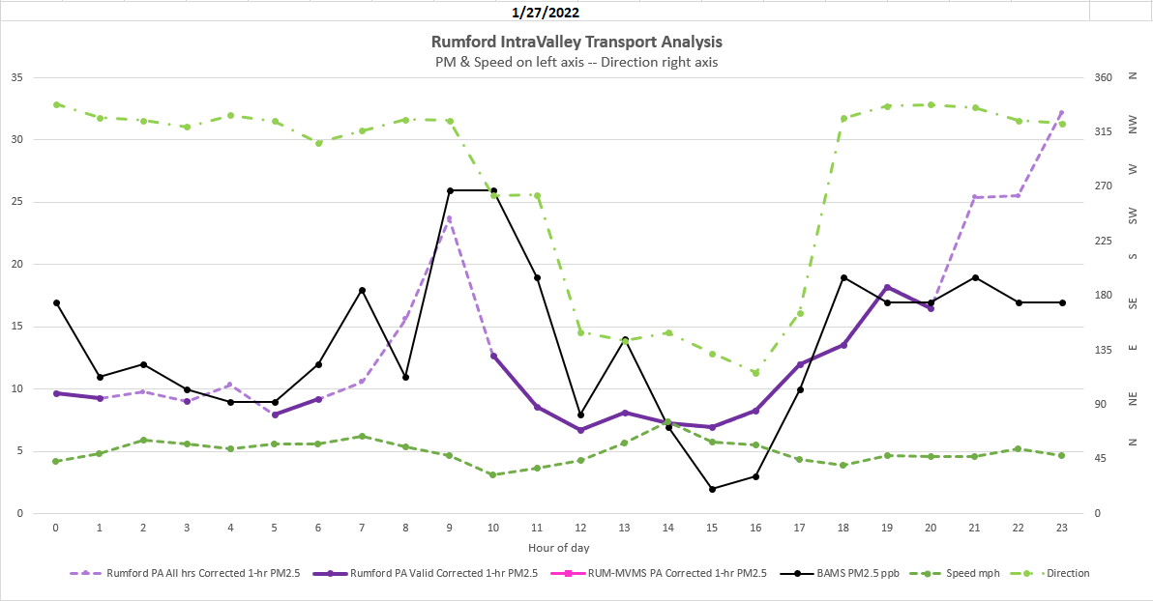
January 27, 2022: another day when RAP peaked before the wind shift this time both peaked same hour

Slide 17
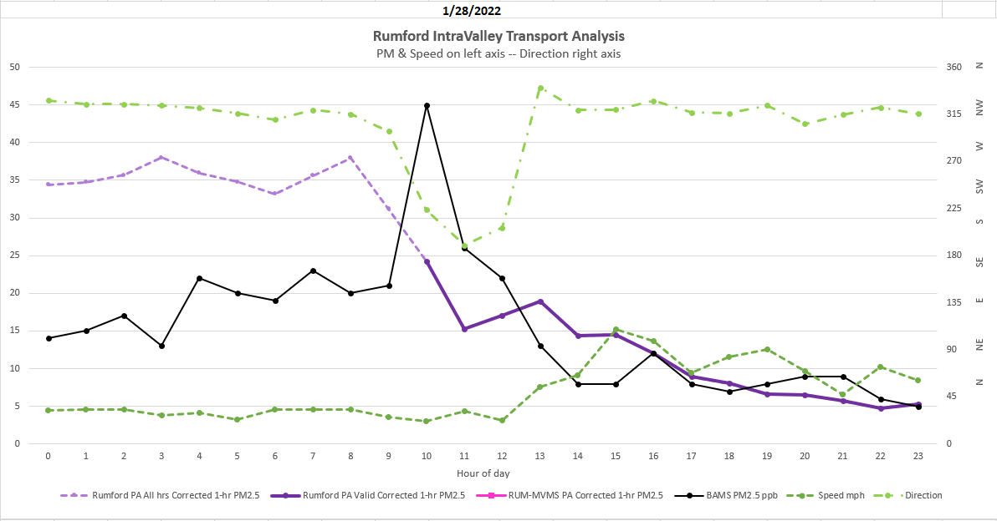
January 28, 2022: somewhat closer to the ‘typical’ inversion break up. Note that the down valley was high overnight and dropped as RAP was rising.

Slide 18
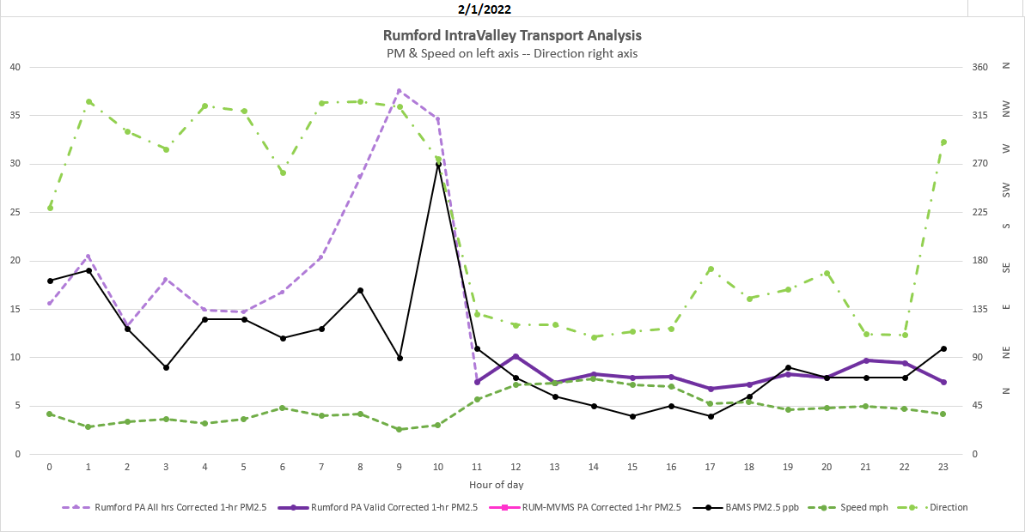
Feb 1, 2022: this day is much more in line with the ‘typical’ spike scenario. Note down river peaked prior to RAP.

Slide 19
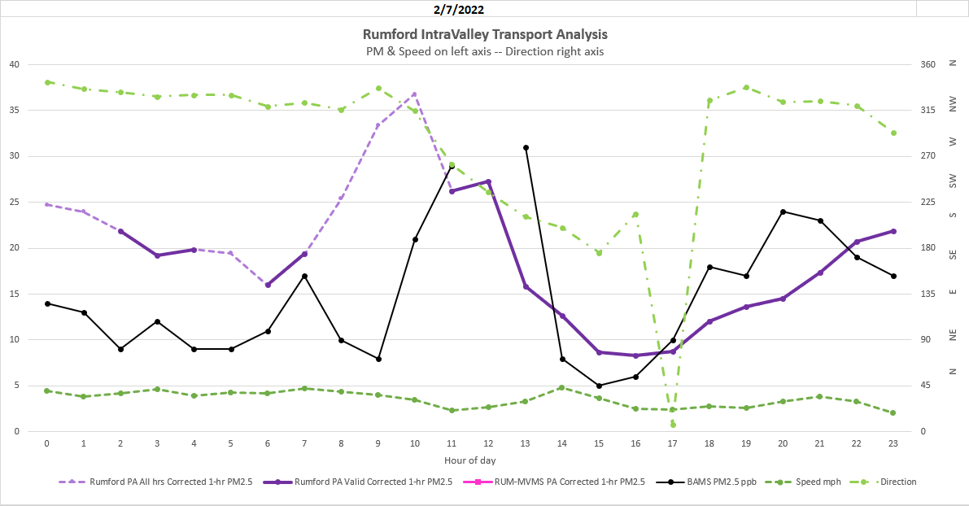
Feb 7, 2022: Wind shift not as typical but down valley peaked before RAP, and the spike was later at about Noon, so not really a typical event.

Slide 20
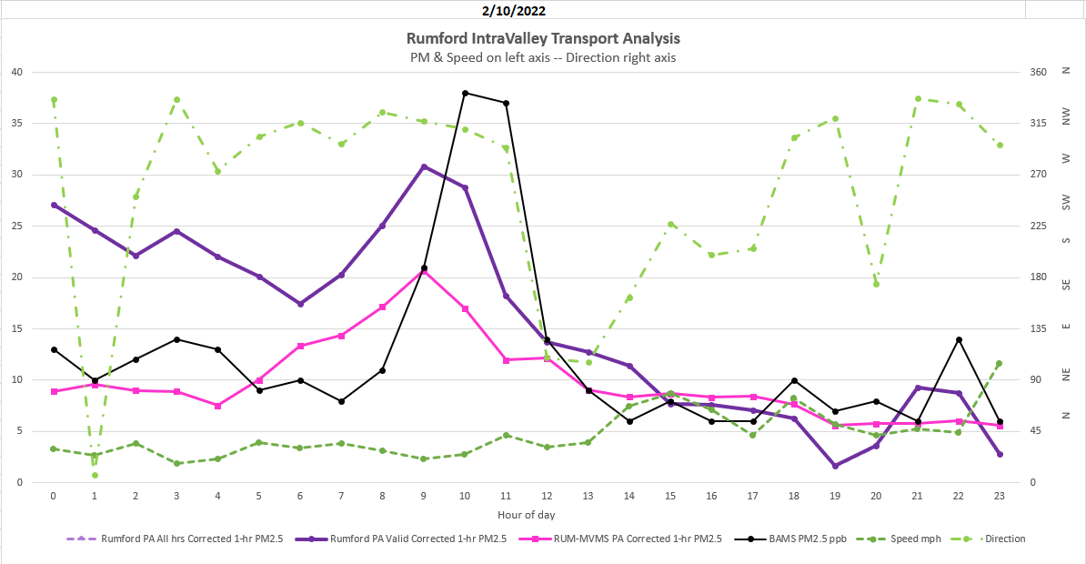
Feb 10, 2022: Two-hour spike that occurred before wind shift but timing is inversion break up and down wind PA’s spiked the hour before RAP.

Slide 21
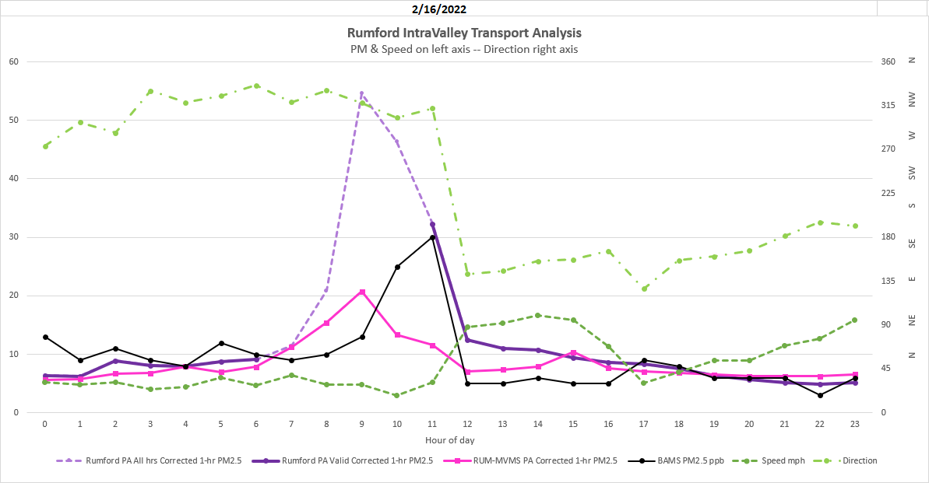
Feb 16, 2022: Downwind PA’s spiked prior to RAP again spike before wind shift

Slide 22
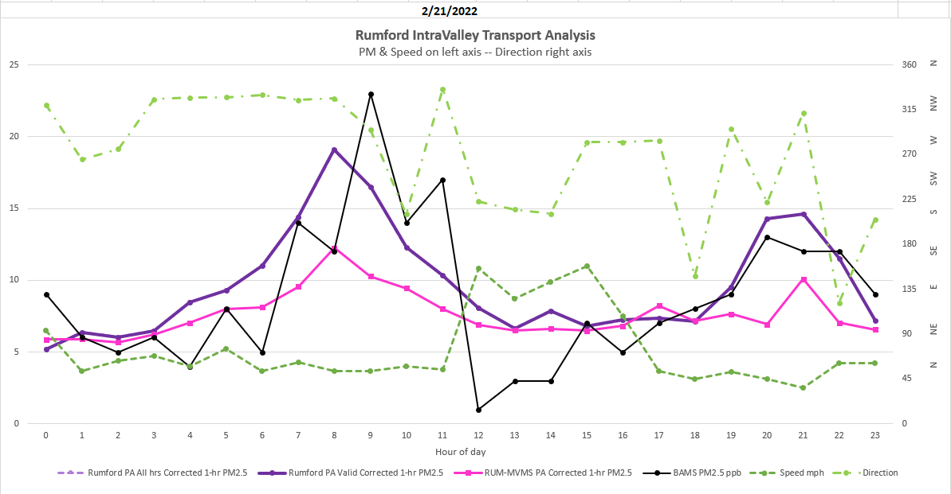
Feb 21, 2022: PA’s spike prior to RAP but again RAP spiked prior to wind shift.

Slide 23
Purple Air (PA) vs collocated or nearby BAMS or Sharp

Slide 24
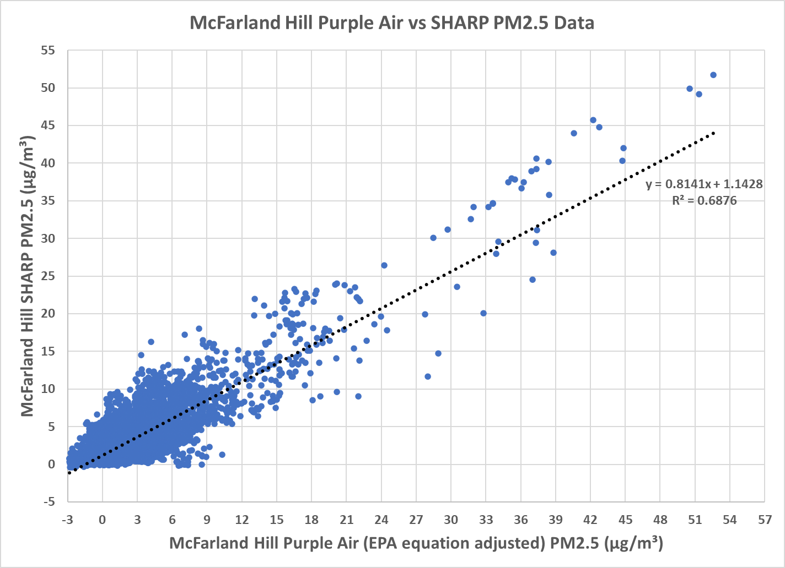

Slide 25
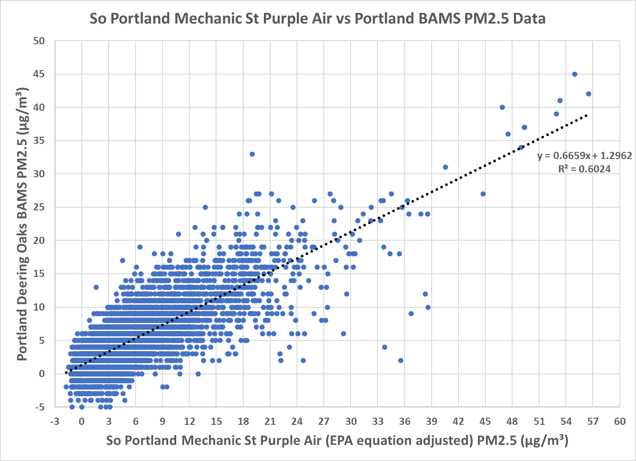

Slide 26
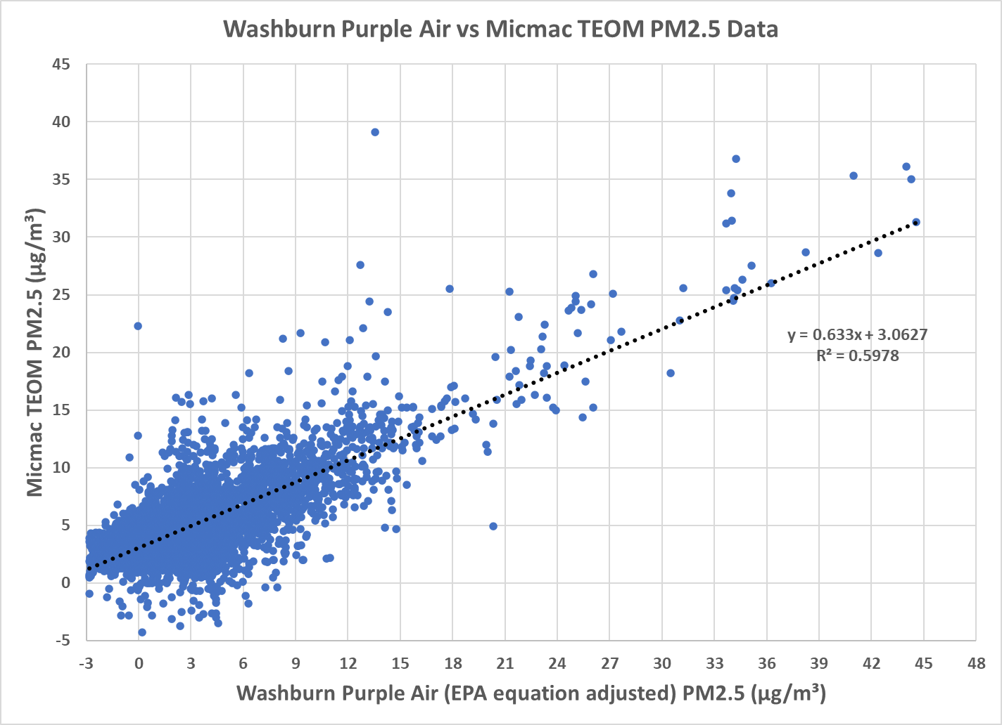
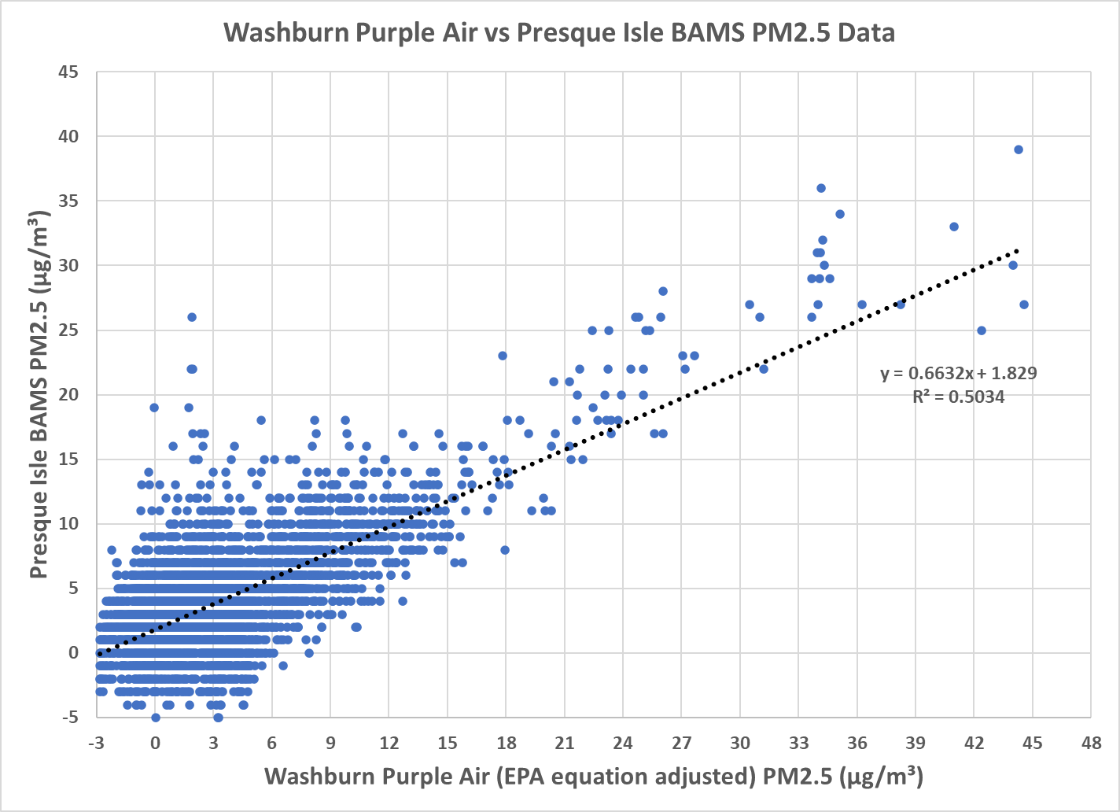

Slide 27
Martha Webster Air Quality Meteorologist martha.e.webster@maine.gov

