Slide 1
Comprehensive Planning and Land Use
Basic Training for Codes Enforcement Officers
April 2014

Slide 2
30-A M.R.S.A. §4451
Training and certification for code enforcement officers
A CEO is someone certified under this section and employed by a municipality to enforce all applicable laws and ordinances in the following areas:
Shoreland zoning
Comprehensive planning and land use
Internal plumbing
Subsurface wastewater disposal
Building standards
Today’s training covers Comprehensive Planning and Land Use
The CEO Certification Program offers other workshops covering the other topics.

Slide 3
What is Comprehensive Planning?
Comprehensive Planning is a process through which a community guides its future growth and development.
The guidance document that results from this process is the Comprehensive Plan.

Slide 4
What is Land Use?
The term Land Use refers to a system for describing and classifying the different ways that land is occupied or utilized (e.g. residential, commercial, industrial, agricultural, etc.).
The term is also commonly used as an adjective referring to the system of Federal, state and local laws that regulate the use of land
(e.g. land use attorney, land use decision, etc.)
The term Land Use Ordinance typically refers to any local land use regulation or ordinance (e.g. zoning, shoreland zoning, site plan review, minimum lot size and subdivision ordinances.

Slide 5
Origins of Land Use Regulation
Prior to local regulation of land use, an injured property owner needed to press his claim against an alleged perpetrator in a private civil suit.
With rising industrialization, the number of private claims grew to the point that, in the early 20th Century, governments chose to exercise their police powers rather than rely on individual private remedies.

Slide 6
Police Powers
The regulation of land use is an exercise of a municipality's "police powers" to protect the public health, safety, and welfare. These powers are granted to municipalities by the State as an extension of its powers. This is the same set of powers that allow government to set speed limits on highways and to require building and plumbing permits.

Slide 7
We the People of the United States, in Order to form a more perfect Union, establish Justice, insure domestic Tranquility, provide for the common defence, promote the general Welfare…
Preamble of the U.S. Constitution
The Congress shall have Power To lay and collect Taxes, Duties, Imposts, and Excises, to pay the Debts and provide for the common Defence and general Welfare of the United States…
Article I Section 8 of the U.S. Constitution
This is known as the Police Power

Slide 8
Ambler Realty v. Village of Euclid, 1926
"A nuisance may be merely a right thing in the wrong place, like a pig in the parlor instead of the barnyard."
Justice Sutherland's opinion in Euclid case
The purpose of zoning is to keep the pig in the barnyard, rather than to repair the china after its stroll through the parlor.
Only two years later, the Maine courts upheld the constitutionality of zoning in York Harbor v. Libby.

Slide 9
Wider Scope
Current concepts of “public nuisance” and “general health safety and welfare” encompass a variety of issues beyond those of the Euclid case. Today, ordinances are adopted to, for example:
protect water quality, wildlife habitat, important farmland, and other natural resources;
preserve historic sites or buildings;
minimize the fiscal impacts of development on municipal government;
control the appearance of certain neighborhoods

Slide 10
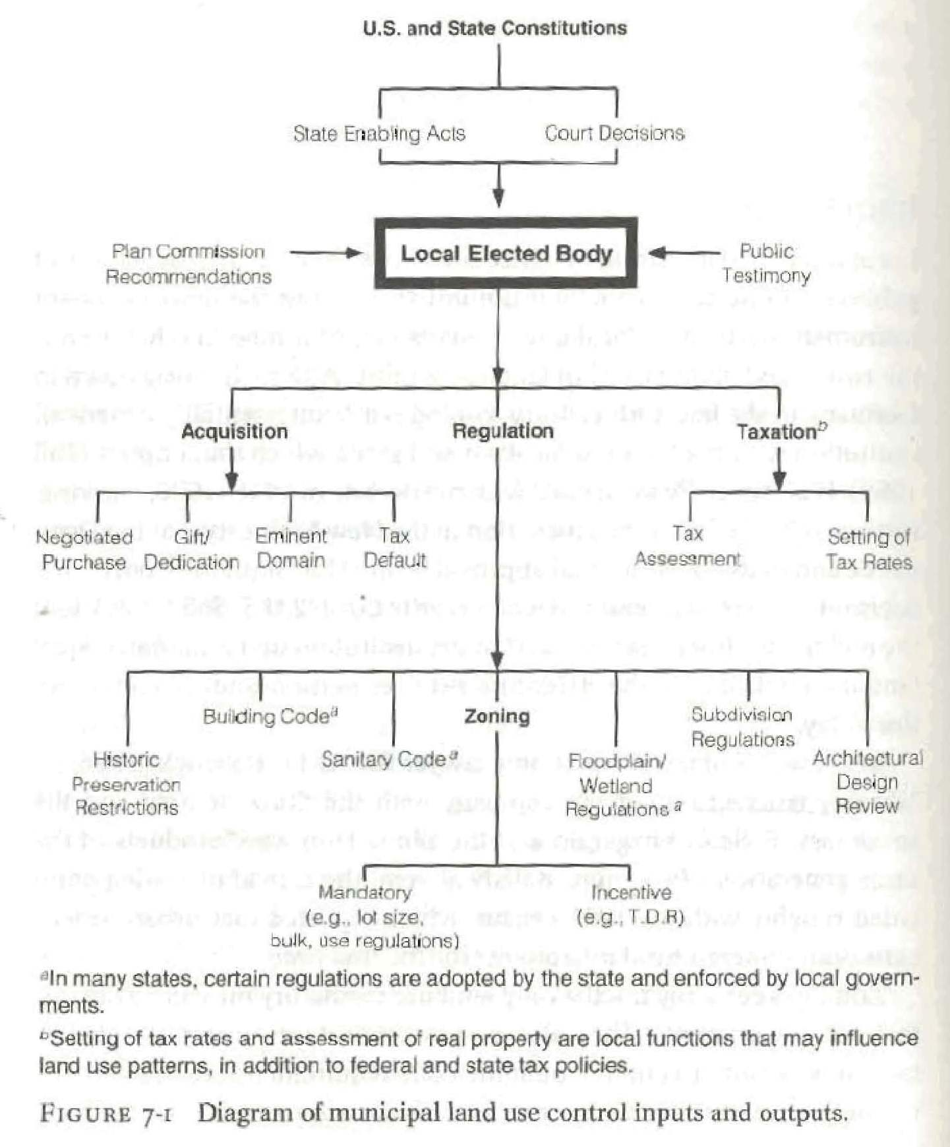
Platt: Land Use and Society, 1996 p.216
Plus state regulations such as shoreland zoning, informed growth act, floodplain management, etc.

Slide 11
What is the connection between Comprehensive Planning and Land Use?
30-A M.R.S.A. §4301
Land Use Planning and Regulation
commonly known as
The Growth Management Act
Passed in 1989

Slide 12
Growth Management Act
If a municipality chooses to adopt a zoning ordinance, an impact fee ordinance or a growth cap ordinance…
then it must adopt a comprehensive plans that is consistent with the provisions of the Act.
The local zoning, impact fee or growth cap ordinance must, in turn, be pursuant to and consistent with the local comprehensive plan.
The consistency of comprehensive plans and ordinances is determined by the Dept. of Agriculture, Conservation & Forestry
or by the Court.

Slide 13
No person shall be…deprived of life, liberty, or property without due process of law, nor shall private property be taken for public use without just compensation.
5th Amendment to the U.S. Constitution

Slide 14
Growth Management Act and
Private Property Rights and Zoning
By requiring linkage between the regulations in a town’s zoning ordinance and the policies in its comprehensive plan, the Legislature has taken a step to ensure that a community has considered and articulated its reasons before imposing restrictions on private property.

Slide 15
Zoning Outcomes
Here are a couple of illustrations of how zoning works, for better or worse.

Slide 16
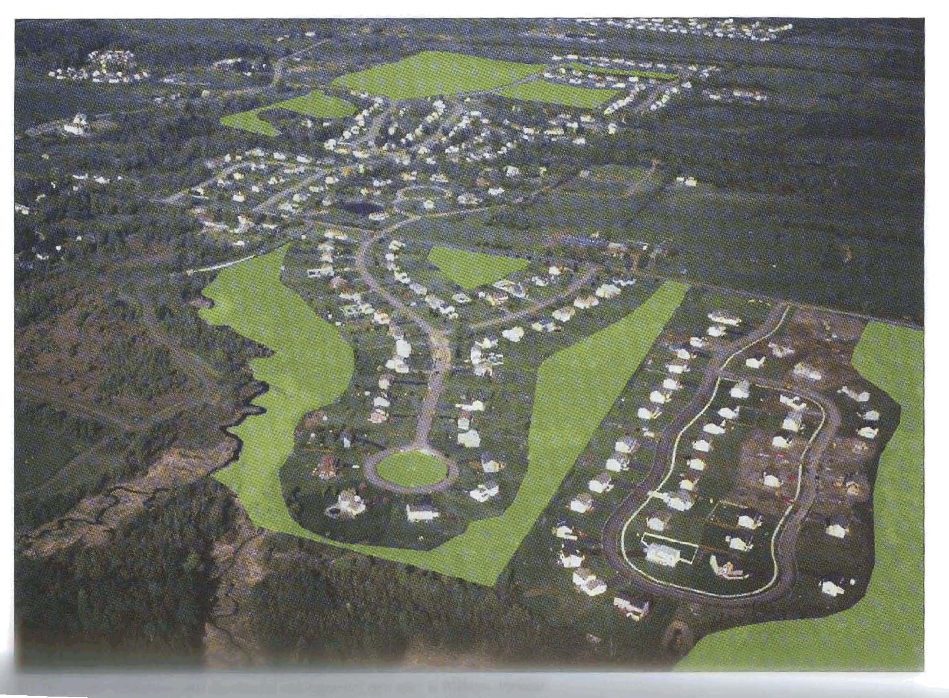
Campoli, Humstone, MacLean: Above and Beyond, 2002 p.75
Keeping records, and sharing records, is paramount
These three conservation subdivisions were developed at different times, and the open spaces have no connection to each other

Slide 17
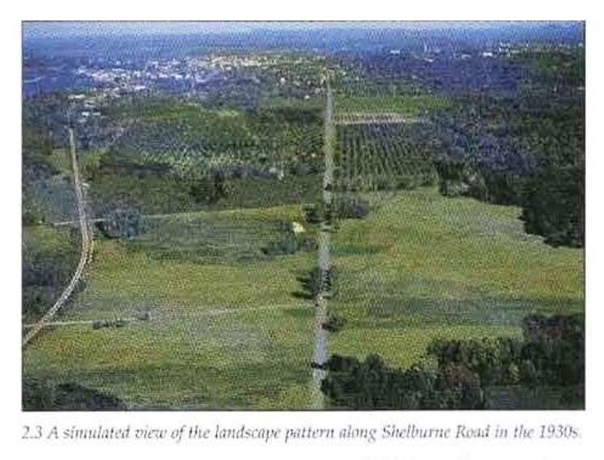
If you zone for strip commercial, that is what you will get

Slide 18
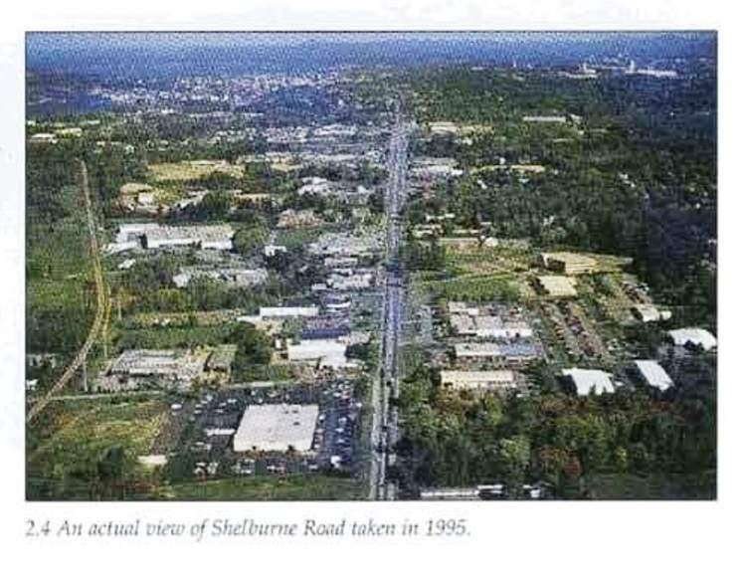
Campoli, Humstone, MacLean: Above and Beyond, 2002 p.20

Slide 19
The CEO’s role in comprehensive planning and land use
Administrator
Enforcer
Assistant or Staff to Town Boards
Educator and Public Relations Agent

Slide 20
Administrator
Assist applicants with understanding the application process and requirements
Review applications for completeness
Issue permits when authorized to do so
Ensure compliance during construction activities
Keep records of permits, inspections, violations, correspondence, etc.

Slide 21
Enforcer
Investigate complaints
Watch for possible violations
Take action, in court if necessary, to stop or prevent violations.

Slide 22
Rule 80K
Rule 80K refers to the land use enforcement system found within the Maine Rules of Civil Procedure
Before Rule 80K, prosecuting a land use or environmental violation required the services of a lawyer.
Under Rule 80K, a certified non-lawyer employee may represent municipalities, DEP, and LURC in District Court.

Slide 23
Assistant to Town Boards
Planning Board
Advise of problems with land use ordinances.
Review applications for compliance with objective standards (e.g. use, height, bulk, etc.)
Board of Appeals
Advise Board as to which ordinance provisions are pertinent to an appeal.
Provide Board with facts surrounding appeals case.

Slide 24
Advising the Planning Board
It is not a CEO's role to make policy or to approve or disapprove the content of an ordinance.
The CEO can, however, contribute a great deal toward the clarity and effectiveness of the ordinance. By understanding the intent of the Planning Board, the CEO should make the Board aware of ordinance language that could be improved, or issues that are not adequately addressed in the ordinance.
Working with the Planning Board to improve an ordinance will make administration and enforcement easier for all involved.

Slide 25
CEO as Staff to Town Boards
CEOs may serve as staff to the Planning Board, Board of Appeals or other Town bodies.
Responsible for writing and distributing meeting agenda, abutter notifications, etc.
Compile and distribute meeting packages to board members
Generate and distribute official correspondence with applicants and others

Slide 26
Public Relations Agent
CEO is often the primary contact person for members of the public that have dealings with the Planning Board and Appeals Board.
As such, the CEOs understanding of the application processes, the legal basis for the town’s land use policies, and sensitivity to the rights of private land owners is key to the smooth and effective administration of the land use regulations.

Slide 27
Phil Carey
Senior Planner
Municipal Planning Assistance Program
Department of Agriculture, Conservation & Forestry
287-3860
phil.carey@maine.gov
http://www.maine.gov/doc/commissioner/landuse/index.shtml

