Slide 1

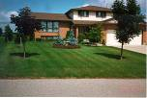
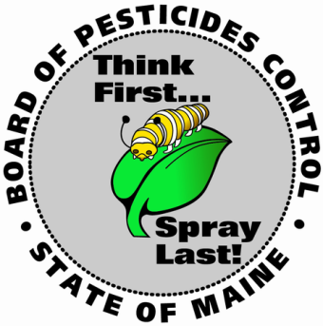
Home Pesticide Use
Risks & Benefits
Gary Fish
Maine Board of Pesticides Control
28 State House Station
Augusta ME 04333-0028
(207)287-2731
gary.fish@maine.gov

Slide 2
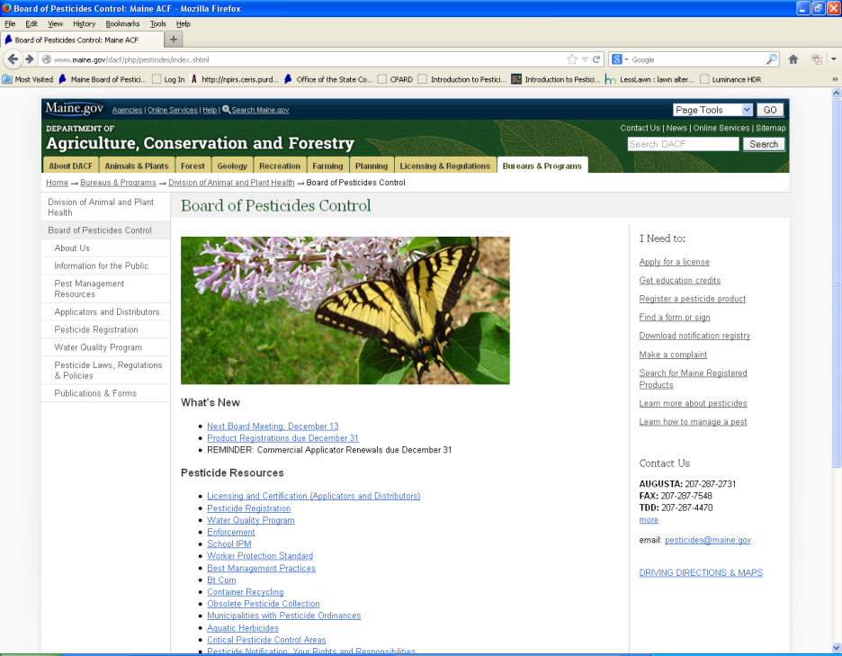
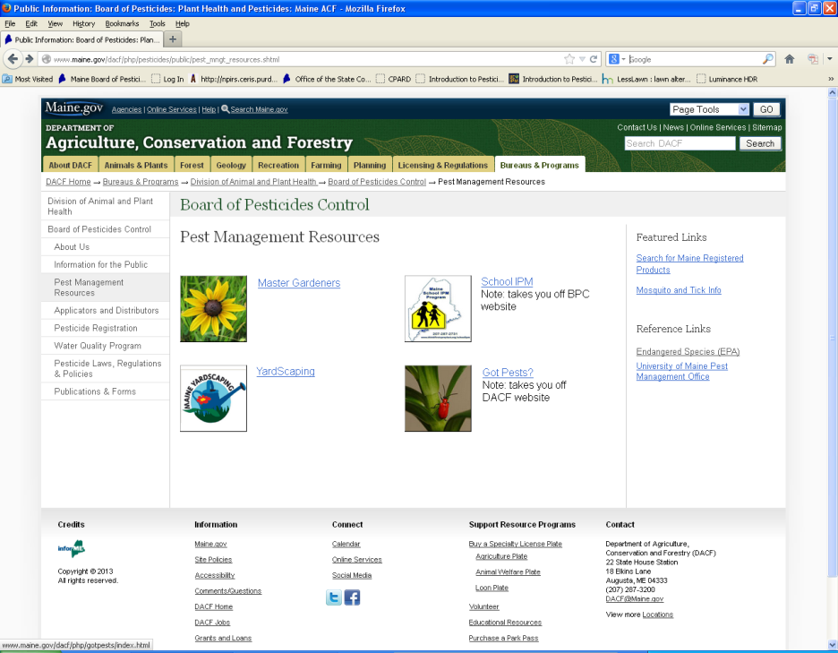
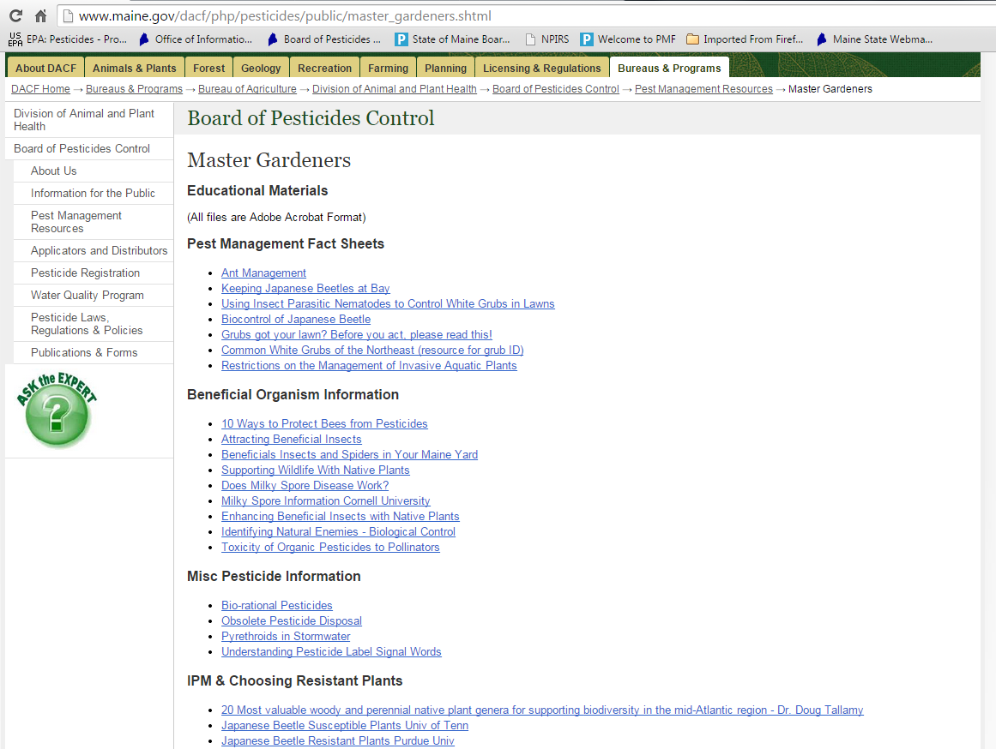
Handouts on-line

Slide 3
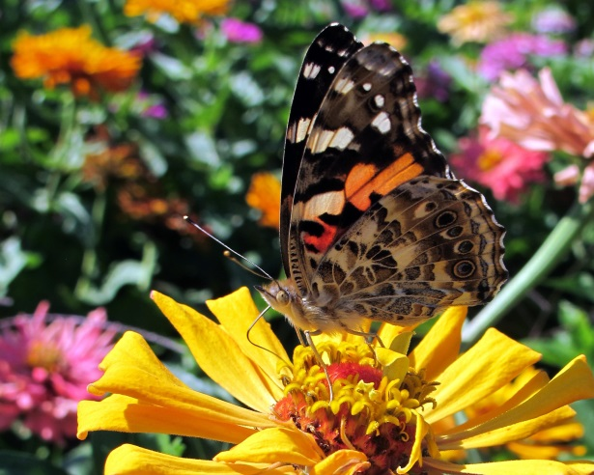
Which type of gardener are you?
Black thumb
Novice
Intermediate
Experienced
Greenest thumb

Slide 4
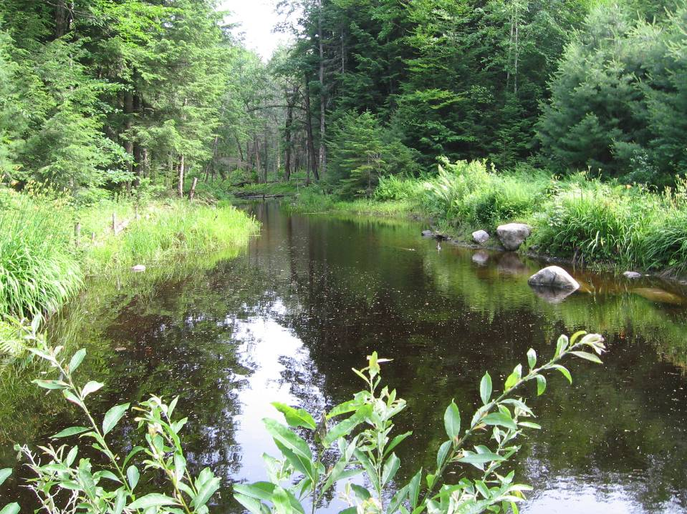

Have you ever heard of the Board of Pesticides Control (BPC)?
Yes
No

Slide 5
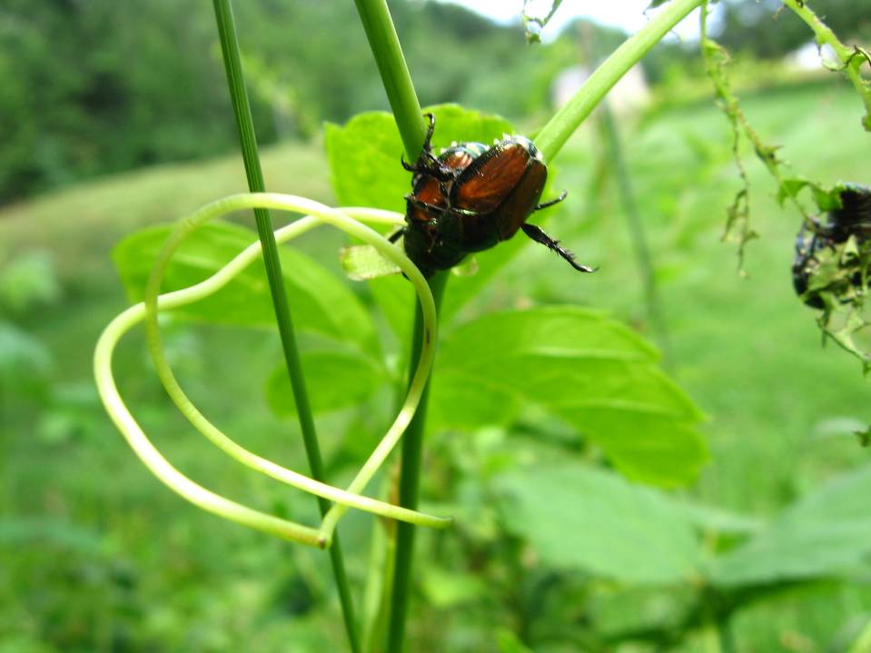
What is your opinion of the BPC?
Strongly favorable
Favorable
Neutral
Unfavorable
Strongly unfavorable

Slide 6
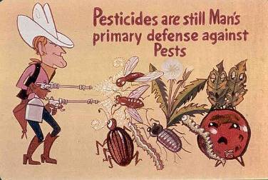
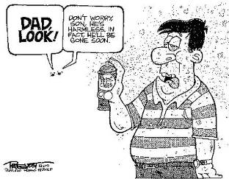
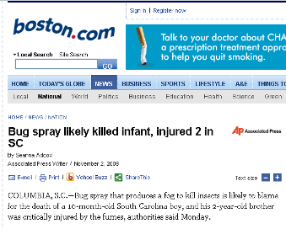
How we see ourselves using pesticides
Unfortunately, a not so uncommon result from our use of pesticides

Slide 7
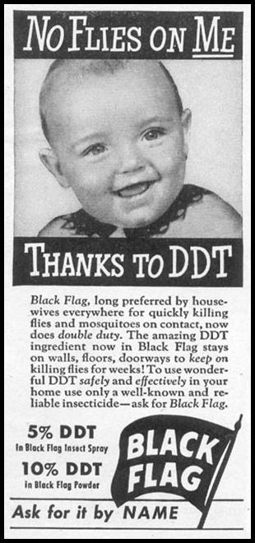
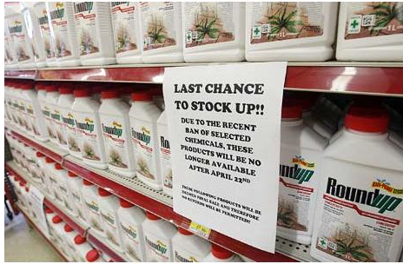
We’ve relied on pesticides in the past and still rely on them today

Slide 8
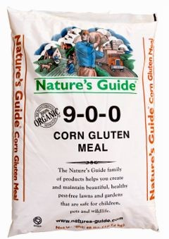
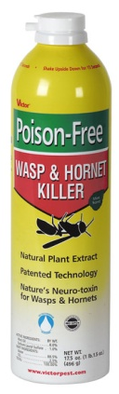

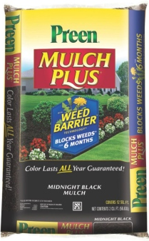
Which are pesticides?
A.
B.
C.
D.
No endorsement intended or implied

Slide 9

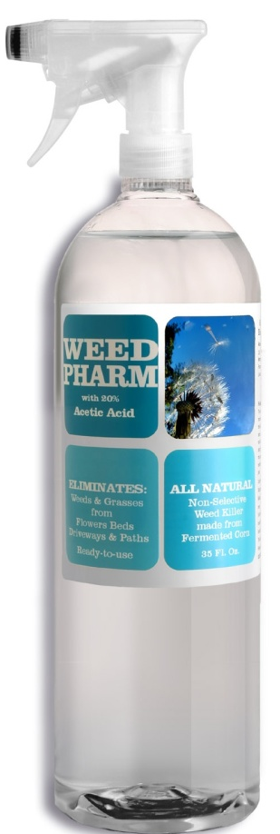
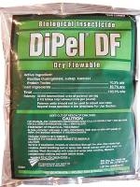
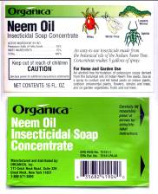

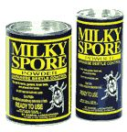
Maine pesticide use more common than perceived
No endorsement intended or implied

Slide 10
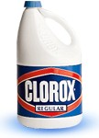
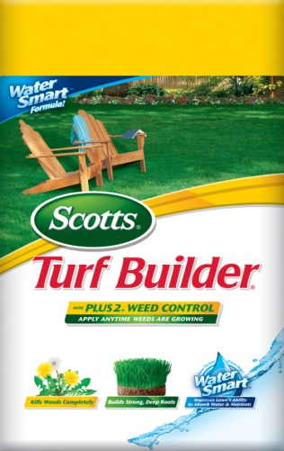
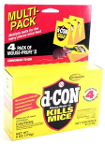
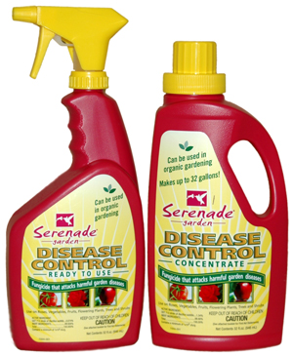
What are pesticides?
Bleaches, Lysol, pine oil
Weed & Feed, Roundup
Rat & mouse baits
Plant disease controls
No endorsement intended or implied

Slide 11
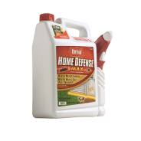
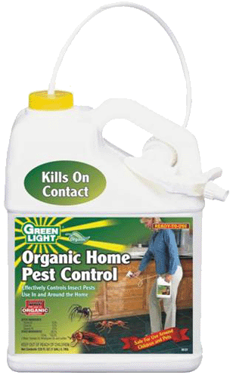

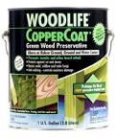
What are Pesticides?
Sevin, Pyrethroids, Raid
“Organics” like pyrethrum
Biological Controls
Wood preservatives
No endorsement intended or implied

Slide 12




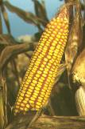












These are Pesticides?
Plant incorporated protectants
  Have the Bt. Crystalline protein engineered into them
No endorsement intended or implied

Slide 13
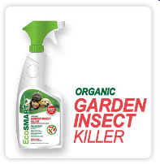
EPA exempt pesticides
Some pesticides have been deregulated by EPA
  Exempt from Federal registration
  Must be registered by State of Maine
  Exempt from toxicity testing
  NOT risk free
Ingredients in some of these products:
Rosemary oil
Peppermint oil
Thyme oil
Clove oil
Wintergreen oil
Cinnamon oil
No endorsement intended or implied

Slide 14
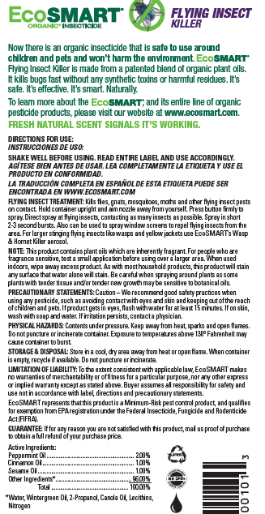
What are the risks?
Peppermint oil –
  highly toxic,
  use in infants or children is not recommended, when inhaled, due to the potential toxicity of the product
  doses of menthol over 1 g/Kg body weight may be deadly
  causes dermatitis,
Cinnamon oil –
  powerful irritant and
  even worse sensitizer
  cinnamon contains coumarin, the parent compound of warfarin, a medication used to keep blood from clotting
http://www.naha.org/ https://nccih.nih.gov/health/cinnamon
No endorsement intended or implied

Slide 15
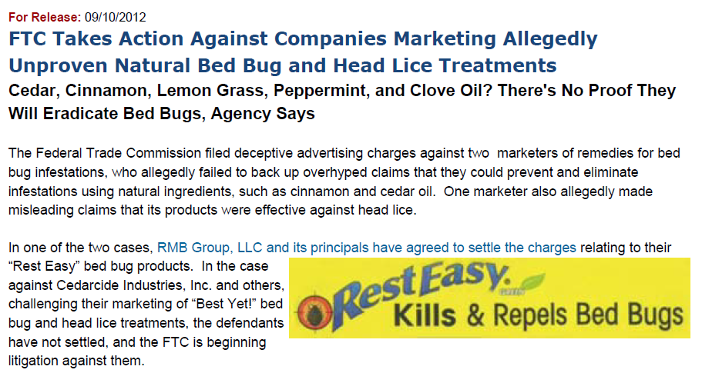
Caveat emptor!

Slide 16

What about home remedies
Home chemistry is not recommended by the BPC
Many of the materials used seem “safe” because we eat them or use them on our skin
Exposure routes may be different
What we eat may not be safe to breathe
Example
6. Eucalyptus oil
A great natural pesticide for flies, bees and wasps. Simply sprinkle a few drops of eucalyptus oil where the insects are found. They will all be gone before you know it

Slide 17
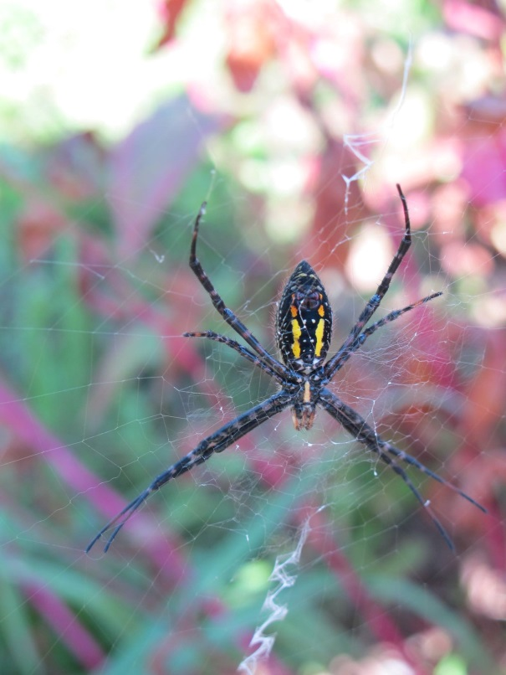
From Medline Plus – NLM NIH
http://www.nlm.nih.gov/medlineplus/druginfo/natural/700.html
Eucalyptus oil is POSSIBLY UNSAFE when applied directly to the skin without first being diluted. Eucalyptus oil is LIKELY UNSAFE when it is taken by mouth without first being diluted. Taking 3.5 mL of undiluted oil can be fatal. Signs of eucalyptus poisoning might include stomach pain and burning, dizziness, muscle weakness, small eye pupils, feelings of suffocation, and some others. Eucalyptus oil can also cause nausea, vomiting, and diarrhea.
Children: Eucalyptus oil is LIKELY UNSAFE for children. It should not be taken by mouth or applied to the skin. Not much is known about the safety of using eucalyptus leaves in children. It’s best to avoid use in amounts larger than food amounts.
Surgery: Since eucalyptus might affect blood sugar levels, there is concern that it might make blood sugar control difficult during and after surgery. Stop using eucalyptus at least 2 weeks before a scheduled surgery.

Slide 18
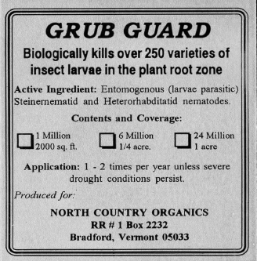
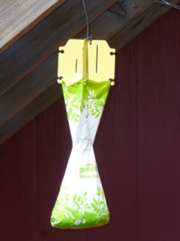

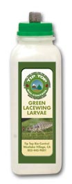
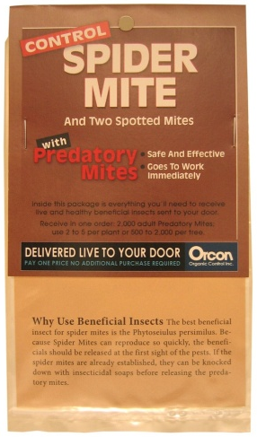
What products are NOT pesticides?
Insect parasitic nematodes
Rodent or insect traps
Beneficial insects or mites
No endorsement intended or implied

Slide 19


What does registration mean?
Not a safety guarantee
Reasonable certainty of no harm, but NOT risk free
Must read and follow the label to manage the risk

Slide 20
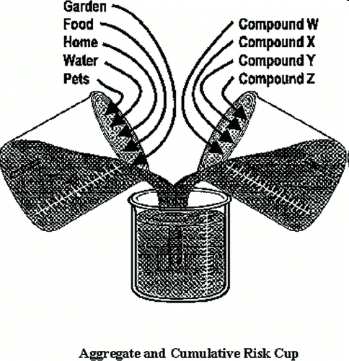
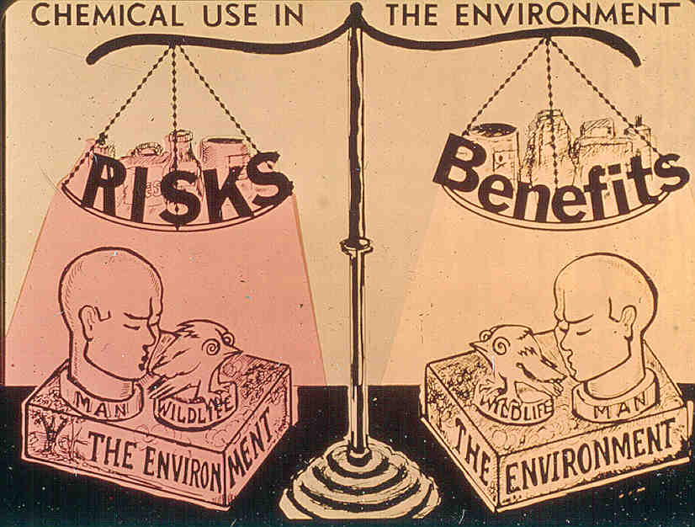
Risk assessment
Prior to 1996 FQPA
After 1996 FQPA

Slide 21

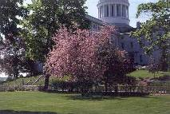
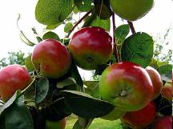
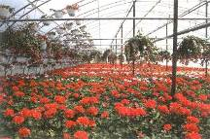
What are the benefits?
Aesthetics
Healthy saleable plants & produce

Slide 22
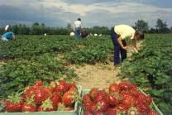
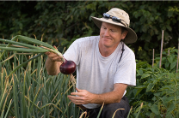
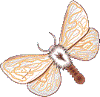

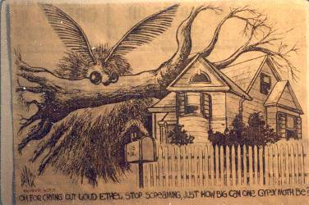
What are the benefits?
Bountiful harvest
BROWNTAIL MOTH
DEER TICK
Nuisance or public heath pest control
OH FOR CRYING OUT LOUD ETHEL, STOP SCREAMING, JUST HOW BIG CAN ONE GYPSY MOTH BE?

Slide 23
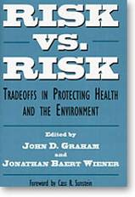
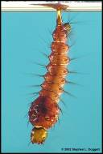
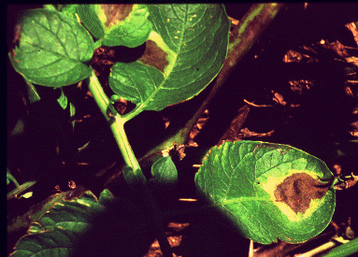
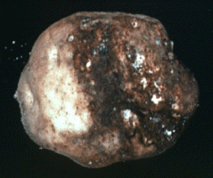
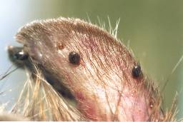

Risk vs. Risk
West Nile Virus & EEE
Malaria
Potato Late Blight Disease
Lyme Disease
deer tick larva
deer tick nymphs
Courtesy of Kevin Byron

Slide 24


What are the human risks?
Acute
  Rash
  Nausea
  Eye ticks
  Stomach cramps
  Death
Chronic
  Cancer
  Birth defects
  Allergies
  Organ damage
  Endocrine effects

Slide 25

How are the risks determined?
REMEMBER THE GOOD OLD DAYS WHEN WE ONLY HAD TO SMOKE A FEW CIGARETTES AND EAT SACCHARIN?

Slide 26





All pesticides have risks!!!
Organic ≠ Safe
Synthetic ≠ Highly toxic
Natural ≠ Safe
No endorsement intended or implied

Slide 27

Even natural or organic products are toxic!

Slide 28

“All substances are poisons; there is none which is not a poison. The right DOSE differentiates a poison from a remedy.”
–Paracelsus (1493-1541)
Even too much water can kill – over 1.5 liters/hour

Slide 29


Endocrine effects
EPA just finished the initial screening of 52 active ingredients.
  34 were not judged to be endocrine disruptors
  18 of 18 showed potential effects on the thyroid
  17 of 18 showed potential androgenic effects
  14 of 18 showed potential estrogenic effects
EPA will no require additional tests to determine if any of the 18 truly are endocrine disruptors
www2.epa.gov/ingredients-used-pesticide-products/endocrine-disruptor-screening-program-tier-1-assessments
Does the dose make the poison?? What about hormesis?
http://www.belleonline.com/index.htm

Slide 30



= X
No endorsement intended or implied

Slide 31




One way to quickly assess the risk?
Signal Words
Danger
Warning
Caution
No endorsement intended or implied

Slide 32

Please choose the two pesticide formulation types with the lowest exposure potential
Formulation Type
Percent Active Ingredient
Granular 3 - 15%
Ready to Use Baits, Gels or Liquids 1 - 15%
Dust 5 - 10%
Aerosol 1 - 5%
Wettable Powder 50 - 85%
Liquid Concentrate 40 - 90%

Slide 33
Reduce exposure by using targeted materials
Enclosed baits & gels
Spot treatments
Broadcast treatments
Best
Worst

Slide 34



Which product do you think is the better choice?
A
B
C
D
No endorsement intended or implied

Slide 35


How is risk reduced?- PPE

Slide 36

What are some “environmental” risks?
Wildlife effects
Residues on food

Slide 37


Remember “Silent Spring”
*Biomagnification of chlorinated hydrocarbons like DDT or Dieldrin was a problem in the 60’s & 70’s

Slide 38

Today’s wildlife concerns
Biomagnification is not a big issue any more
  the old extremely persistent products were cancelled
Pollinators are now a focus area
http://www.beeccdcap.uga.edu/index.html

Slide 39

Recent neonicotinoid research
The answers are only beginning to emerge, but current research has revealed some results
  Mites and viruses appear to be the main causes of hive failure along with the mite controls applied by beekeepers
    Fungicides may exacerbate Nosema disease
  Sub-lethal levels of some neonicotinoids effect wild bee density, nesting and colony growth
  Varroa mite levels have been found higher in honey bees hives exposed to sub-lethal levels of imidacloprid
  Neonicotinoids like this one can be expressed in ornamental plant pollen and nectar at levels much higher than in agricultural uses
    Mostly found at levels that are sub-lethal
Photo: Matthew Shepherd
No endorsement intended or implied
March 18, 2015 DOI: 10.1371/journal.pone.0118748
Nature 521, 77–80 (07 May 2015) doi:10.1038/nature14420

Slide 40

Toxicity of Common Organic-Approved Pesticides to Pollinators
Toxicity of Common Organic-Approved Pesticides to Pollinators
Soaps and Oils, only when directly sprayed upon the pollinator
Eric Mader – The Xerces Society for Invertebrate Conservation

Slide 41

Recent research on botanical pesticides
Acute Toxicity and Sublethal Effects to Honey Bees
  Andiroba oil, Garlic extract, Eucalyptus oil, Rotenone, Neem oil and Citronella oil applied to adults and fed to larvae
    All but Andiroba oil caused significant mortality to adult bees
    Andiroba, Garlic and Neem caused significant larval mortality
      These may work like insect growth regulators preventing ecdysis (moulting)
J. Insect Sci. (2015) 15(1): 137; DOI: 10.1093/jisesa/iev110

Slide 42


Pesticide residues are found on all types of food
Samples are randomly chosen near the point of consumption, and
reflect what is typically available to the consumer throughout the year
Samples are selected without regard to country of origin, variety, or organic labeling

Slide 43

2013 USDA-PDP Sampling
USDA – PDP 2013 sampling shows that 99.77% of all samples are well below the tolerances set by EPA
40% of samples had no detectable residues
301 (3.0%) of samples contained extremely low levels of pesticides for which there is no tolerance
“The data reported by PDP corroborate that residues found in fruits and vegetables are at levels that do not pose risk to consumers’ health”
http://www.ams.usda.gov/AMSv1.0/getfile?dDocName=STELPRDC5110007

Slide 44

PDP also detects pesticide residues on organic produce
According to the 2008 USDA Pesticide Data Program Report:
  43% of organic spinach samples were positive for spinosad
  (13 of 30 samples positive)
According to the 2010 and 2011 USDA Pesticide Data Program Report:
  52% of organic baby food pear samples were positive for spinosad
  (16 of 31 samples) 2010
  49% of organic baby food pear samples were positive for spinosad
  (33 of 67 samples) 2011
2013 USDA PDP report
  92% of organic nectarine samples were positive for spinosad
  (11 of 12 samples)
Spinosad is National Organic Program approved and is derived from a naturally occurring soil bacteria
No endorsement intended or implied

Slide 45


Other pesticide risks
Drift
Water contamination
Storage
Disposal

Slide 46




Drift
Check for sensitive areas first!
Watch the wind speed
Keep the spray low
Spray with the breeze
Don’t apply when over 85°F

Slide 47

Pesticides Can Leach Into Groundwater

Slide 48
Home pesticide use - Worst case
Groundwater monitoring results
Commodity Group
Number of Samples Collected
Number of Samples with Positive Detections
Percent of Samples with Positive Detections
Detections Above a Health Advisory
1994
1999
2005
1994
1999
2005
1994
1999
2005
1994
1999
2005
Potatoes
47
100
87
8
4
1
17%
4%
1%
None
None
None
Corn
49
51
28
7
0
4
14%
0%
14%
None
None
None
Blueberries
21
22
13
15
13
7
75%
59%
54%
None
None
None
Small Grains
3
9
17
0
0
1
0%
0%
6%
None
None
None
Orchards
1
5
3
1
0
0
100%
0%
0%
*
One
None
None
Christmas Trees
5
4
3
0
0
0
0%
0%
0%
None
None
None
Strawberries
None
3
6
---
0
0
---
0%
0%
---
None
None
Totals:
129
194
157
31
17
13
23.3%
9.0%
8.3%
---
---
---
*Homeowner application of diazinon to control ants – 10x over MCL

Slide 49


Groundwater monitoring results
We sampled wells near blueberry fields again in 2011 & 2013
  the number of wells with detections dropped to 38% in 2011, and
  dropped to 6% in 2013
We are still waiting for the 2015 sampling results

Slide 50

Pesticides Can Run-off Into Surface Waters

Slide 51

BayScaping Project
Friends Of Casco Bay did some detective work in 2001, 2002, 2003, 2005, 2006, 2008, 2009, (2014 and 2015 results not final yet)
Sampled runoff water from intensive lawn care areas in Cumberland, S Portland, Westbrook, Falmouth, Yarmouth, Brunswick, Freeport, Portland and Cape Elizabeth & Back Cove area

Slide 52

Surface Water/sediment Sampling – Home, Lawn & Garden Pesticides
  Pesticide residues detected in surface water
    Diazinon up to (2.6 ppb)**
    2,4-D up to (36.4 ppb)
    Dicamba up to (4.1 ppb)
    MCPP up to (26 ppb)
    MCPA up to (0.45 ppb)
    Clopyralid up to (0.91 ppb)
    Propiconazole up to (0.075 ppb)
    Chlorothalonil up to (0.22 ppb)
    Found Excess Nitrogen & Phosphorous in most samples
  Pesticide residues detected in sediments
    Bifenthrin up to (37 ppb)
    Permethrin up to (47 ppb)
    Cypermethrin up to (5 ppb)
**Values in red exceed Aquatic Life Criteria

Slide 53


USGS National Water Quality Assessment
Sampled urban streams
  Insecticides occurred more frequently in urban streams than they did in agricultural area streams
  Herbicides detected in 99% of Urban stream samples
  Phosphorous found at same levels as in agricultural streams
    70% of those samples exceeded the EPA desired goal for reducing nuisance plant growth (algae)

Slide 54

Prevent water contamination
Locate & stay away from wells
Stay away from ledge
Stay away from wetlands & water
Do not apply to slopes near water
Do not apply before heavy rains
Spot applications
Vegetative buffers

Slide 55



Storage
Buy only what you need
Keep them out of reach of children & lock them up
Keep in original containers
Never store in basement!

Slide 56

Disposal
Follow label
Rinse containers
Apply extra mix to labeled site
Call BPC about obsolete pesticides

Slide 57

Which product is most risky to handle?
A
B
C
No endorsement intended or implied

Slide 58

Think First…. Spray Last
“The quick fix is neither”!
Make the benefits
Outweigh the risks

Slide 59



1997 Legislative Mandate
It is the policy of the State to Minimize reliance on pesticides!

Slide 60


Look at the big picture
Make plans to manage specific problems

Slide 61



Do you need a pesticide?
First identify the pest
Is it really a problem
Try cultural or sanitary controls
Encourage the “Good bugs”
Replace with resistant varieties

Slide 62


Diagnosis murder??
Is it a pest problem?
  Often what’s normal for the plant is mistaken for a pest or disease
    Variegation
    Reproductive structures

Slide 63

Is this a disease?

Slide 64


Fruit Drop!

Slide 65


Who’s been chewing here?

Slide 66


They only come out at night!

Slide 67




“The gardener’s best buddies”

Slide 68



Japanese Beetle
Select non-preferred shrubs and trees (avoid linden, roses, crabapples, grapes, raspberries, cherries, etc.)
Cover susceptible plants with protective netting
Avoid traps
Use trap plants (Virginia creeper, zinnia, pole beans, etc.)
Kentucky wonder pole beans

Slide 69

Colorado potato beetle
Cultural controls
  Crop Rotation: Rotate potatoes or eggplant to a field that is at least 200 yards from the previous year's fields.
  Early planting: Green sprouting, prepares whole seed potatoes to emerge rapidly, gaining about 7-10 days to harvest.
  Late planting: CPB adults that do not find food leave the field in search of greener pastures. Plant after mid- June
  Straw mulch: When potato or eggplants are mulched with straw, fewer Colorado potato beetle adults will settle on the plants and fewer eggs will be laid.
  Biological control: There are numerous predators and parasitoids that attack CPB adults (a tachinid fly), larvae (12-spotted ladybeetle, spined soldier bug, ground beetles), and eggs. If sprays are needed, selective products will conserve beneficial.
King’s Plant Barn©

Slide 70


Cultural controls – Late Blight
Do not keep cull piles of potatoes
Do not save questionable potato seed
Do not compost diseased tubers, because parts of the compost pile may not be hot enough to kill the tubers, providing the pathogen with living tissue for overwintering
Buy seed from a good source
In the spring, scout, pull and destroy all volunteer potatoes

Slide 71



Look for varieties that are resistant to disease
Defender is the only U.S. commercial potato with late-blight-resistant leaves and tubers.
Photo by Peggy Bain
http://www.mofga.org/

Slide 72



Cultural controls
Landscape design
  replace “susceptible” or chronically pest-prone plants with resistant or non-susceptible plants
  increased plant diversity and habitat complexity can increase natural enemies present (Shrewsbury 1996)
Cranberry Viburnum
Siebold viburnum

Slide 73


Cultural controls
Fertilizer
  over fertilization can cause the “aphid effect”
  high nitrogen fertilizers may help the pest more than the plant
No endorsement intended or implied

Slide 74

Select slow release fertilizers
GUARANTEED ANALYSIS
Total Nitrogen (N)...…..................….8.00%
1.0 % Water Soluble Nitrogen
7.5 % Water Insoluble Nitrogen
Available Phosphate (P205)..........………….0.0 %
Soluble Potash (K20).....................…1.0 %
NON PLANT FOOD INGREDIENTS Bacillus subtilis, Bacillus licheniformis, Bacillus pumulis, Bacillus megaterium, Paenibacillus polymyxa, Paenibacillus durum each @ 275,000 CFU per gram of finished product
Derived from corn gluten, steamed bone meal & sulfate of potash
Look for Water Insoluble Nitogen (WIN)

Slide 75


Water management is crucial
  proper irrigation
    water deeply and infrequently
    only water the root system
    water early in the morning

Slide 76


Physical IPM Methods
Mulching
  can suppress weeds, conserve moisture, provide habitat for natural enemies
  pull mulch away from the trunk to decrease pest/ disease potential
  keep under 3 – 4 inches

Slide 77



Physical Methods
Exclusion by screens, barriers (example: bird netting, row covers)
Pruning infested/infected plants
Physical removal
  hand-pick,
  shake and capture
  rake or remove infested tissue

Slide 78


Slide 79


Slide 80

Welcome or Unwelcome?
Welcome
Unwelcome

Slide 81



Tachinid fly (the so-called “winsome fly”) laying an egg on a Japanese beetle adult
Istocheta (=Hyperecteina) aldrichi
Introduced into US from Japan in 1922
Adults emerge Late June/July, feed on honeydew, nectar
  Lay up 100 eggs in two weeks
  Eggs hatch 1 day later, dig into beetle
  Kills beetle in 5-6 days
  Just before death, beetle digs into ground where fly spend winter as pupa
Joshua P. Basham
T.S.U. Otis L. Floyd Nursery Research Center
McMinnville, TN 37110-1367
From Point Sebago Golf Course, Casco, Maine

Slide 82


We love the good “bugs!”
Photo Courtesy Vincent Hickey

Slide 83


Welcome or Unwelcome?
Welcome
Unwelcome

Slide 84

Good bug in action

Slide 85

Welcome or Unwelcome?
Welcome
Unwelcome

Slide 86

Flower fly larvae eat aphids!

Slide 87


Science fiction monster?

Slide 88


Delicate beauty

Slide 89




Spare the Sprays to Protect Beneficial Insects
Dragonflies
Spiders
Small parasitic wasps
Predatory mites
Syrphid flies
Ground beetles

Slide 90


Habitat enhancement for beneficials
Many beneficials, as adults, larvae, or both, require pollen and/or nectar as dietary supplements
Key is to provide a series of plants that, collectively, provide continuous
nectar/pollen supply
Many of the same plants that
provide food and habitat for
natural enemies also provide
resources for pollinators

Slide 91


Slide 92





Pretty ornamentals? Or Pests?

Slide 93

Birds can also be our allies
http://www.bringingnaturehome.net/

Slide 94
On average natives support 12x more lepidopteran species
70
N=69 for aliens
&
N=101 for natives
6
Aliens
Natives
Woody Ornamentals

Slide 95

Who you gonna call?

Slide 96


BPC Web Pages
www.thinkfirstspraylast.org
www.gotpests.org

Slide 97
Do you need a pesticide?
Is the pest in a susceptible stage?
Application timing is critical
Is the pest still present?

Slide 98



Is the pest protected?
Birch leafminer
Birch leafminer
Birch leafminer

Slide 99




Don’t apply when you can’t hit a susceptible target
Lace bugs
Colorado potato beetle

Slide 100



Timing is everything?

Slide 101




Nobody home!
Eriophyid gall mite
Oak apple gall wasp

Slide 102



What is the threshold for control!
Potato flea beetles
15 shot holes in a leaf
Must stop them early
Row covers can help

Slide 103
Nobody home!
Eriophyid gall mite
Oak apple gall wasp

Slide 104

The key to proper use
Read the label!

Slide 105
Colorado Potato Beetle Beater is a moderately hazardous pesticide.
True
False

Slide 106

False – Caution = slight hazard

Slide 107
Colorado Potato Beetle Beater should be applied before the pest is seen.
True
False

Slide 108

False
Page 4

Slide 109
Colorado Potato Beetle Beater is approved for organic production so it is not harmful to the environment.
True
False

Slide 110

False
Page 8

Slide 111
How many tablespoons of Colorado Potato Beetle Beater should you add to a 3 gallon sprayer?
2 Tbs
4 Tbs
6 Tbs
12 Tbs

Slide 112

12 Tbs for 3 gallons of spray
Page 3

Slide 113
Colorado Potato Beetle Beater is a good choice for treating asparagus spears for asparagus beetle damage
True
False

Slide 114
False – may only treat post harvest
Page 4

Slide 115
What protective equipment must be worn when mixing Colorado Potato Beetle Beater?
goggles
gloves
long pants & long sleeves
None of these

Slide 116

Nothing is required… But
Page 8

Slide 117
You must wait 10 days before re-applying Colorado Potato Beetle Beater to apples.
True
False

Slide 118
True
Page 4

Slide 119
It is appropriate to use Colorado Potato Beetle Beater if you will be selling your produce.
True
False

Slide 120


False
Pages 2 & 3

Slide 121
Colorado Potato Beetle Beater is best applied to apple trees just as they reach full bloom.
True
False

Slide 122
False
Page 8

Slide 123

The old days

Slide 124

Great directions!
“Bug Death is a patented non-poisonous powder, and is entirely different from anything that has ever been placed on the market, and overcomes all the objections to the deadly poisons that the farmers have been obliged to use in the past. It is just as effectual as Paris Green and other dangerous insect powders. It is sure death to the potato, squash and cucumber bugs, currant and tomato worms, also other plant and vine eating pests.
The deadly effect on bugs will not always be as quick, but it is just as sure. Contrary to the arsenic preparations, it is a benefit to the plant, and the more freely used the better the plant will thrive, and for potatoes when blight is prevalent, the extra yield will more than pay all expense of Bug Death.”
Contained 5% lead oxide & 47% zinc oxide

Slide 125

Today’s label
No endorsement intended or implied

Slide 126

Purchase wisely
Measure the area needing treatment
Only purchase what you need “right now”
Check the label for:
  re-entry
  site & pest
  days to harvest
  personal protective equipment needs

Slide 127


Prepare for the application
Read the label
Wear all PPE
Mix carefully
More is NOT better
Never use more than the label directs

Slide 128


Apply properly & be cautious
Only treat infested areas
Spot treatments conserve beneficial organisms
Avoid broadcast treatments
Keep the plant’s condition in mind
Check coverage & monitor control
Only repeat application if the label allows

Slide 129



Why treat the whole tree?
Dogwood borer on apple

Slide 130


Why treat the whole tree?
Eastern tent caterpillar

Slide 131




Broadcast applications
Broadcast applications of lawn herbicides can cause weird results
Broadcast applications of any pesticide are prohibited within 25 feet of any wetland or water body

Slide 132

If you must apply a pesticide
Wait long enough for the product to work
Examples
No endorsement intended or implied

Slide 133
If you must apply a pesticide
Keeps records of what was used and how well it worked
Review your records before treating again next season

Slide 134
If you must apply a pesticide
Clean yourself and you equipment
Apply rinse water to the application site
Wash contaminated clothing separately

Slide 135
YardScaping… for a healthy Maine

Slide 136

The YardScaping Partnership
The Partnership is very diverse!
Allen, Sterling & Lothrop
Bar Mills Ecological
Breakwater School
Carroll Associates, Landscape Architects
Casco Bay Estuary Partnership
City of Portland
Congress of Lake Associations
Friends of Casco Bay
Friends of Scarborough Marsh
Gnome Landscapes, Design & Masonry
Jacobs Edwards and Kelcey
Kennebunkport Conservation Commission
LakeSmart Program
Libby’s Landscaping and Greenhouse
Lisa Cowan, studioverde landscape architecture + design
Maine Board of Pesticides Control
Maine Department of Agriculture
Maine Department of Environmental Protection
Maine Landscape & Nursery Association
Maine Organic Farmers & Gardeners Association
Maine Soil & Water Conservation Districts
Maine State Planning Office
Maine Volunteer Lake Monitoring Program
Natural Resources Conservation Service
New England Organics
O'Donal's Nurseries
PJC & Company Ecological Land Care
Portland Trails
Shaw Brothers Construction
Skillin's Greenhouses
Southern Maine Community College
Think Blue Maine Program
Town of Brunswick
University of Maine Cooperative Extension

Slide 137


YardScaping
A new paradigm?
Some call it “Sustainable Landscaping” or “Ecological Landscaping”
We want to keep it simple
http://youtu.be/cwaSKjymQDc

Slide 138

YardScaping Mission
YardScaping hopes to inspire Maine people to create and maintain healthy landscapes through ecologically based practices that minimize reliance on water, fertilizer and pesticides.

Slide 139

The Ten-ets of YardScaping
Promote buffers
Promote appropriate plants - native plants and non-invasive alien plants
Reduce lawn area
Reduce runoff
Reduce reliance on pesticides, fertilizers and water
Promote low input lawns and landscapes
Promote YardScape diversity
Create wildlife habitats
Right plant, right place, right use
Commonsense pest management (IPM)

Slide 140



Use site appropriate, non-invasive plants
Native plants are often well adapted
  Fewer problems, less work, more rewards, but not all are problem free, e.g., viburnums
Invasive plants are easy to grow but crowd out native vegetation
  Our local forest habitats are changing rapidly
  Invasive plants can ruin wildlife habitat
  Invasive plants harbor more infected deer ticks
Wild Columbine
Viburnum Leaf Beetle
Oriental Bittersweet

Slide 141


Right plant, right place, right purpose
Choose plants based on the site conditions not just for their color
Select plants that thrive under existing conditions rather than trying to alter the conditions to meet the needs of a plant
Minimize disturbance of the existing landscape
Wild Cranberry Bog

Slide 142


Where to learn more
www.yardscaping.org/plants/index.htm

Slide 143

Use a diversity of plants & grasses
Less noticeable damage from pests and disease
Incorporate many layers of plant types
  Trees
  Shrubs
  Ground covers
  Perennials, and
  Lawns

Slide 144


Create wildlife habitats
Diversity and plant layers go hand in hand with habitat creation
Add nectar and fruit producing plants
Strive for continuous blooms
Add water, walls, feeders, woody debris

Slide 145


Reduce lawn area
Reduces
  Water & air pollution
  Water usage
  Maintenance
  Costs
Gives
  More free time
Mower exhaust = 11 cars’ exhaust
One hour of mowing = driving 400 miles
Mowers spew 87 lbs of greenhouse gases and 40 pounds of other pollutants annually

Slide 146



Use low input plant varieties
No-mow fescue vs Kentucky bluegrass
Pagoda dogwood vs flowering cherry
River birch vs paper birch

Slide 147




Protect lakes & streams with buffers
Preserve existing landscape
Winding paths
Don’t mow to the water’s edge
Leave the duff

Slide 148

Reduce runoff
Reduce amount of impervious (hard) surfaces
Create rain gardens or install rain barrels
Direct water into vegetated areas
Irrigate properly and only when needed

Slide 149


Reduce reliance on pesticides, fertilizers and water
Grow plants that are resistant to insects & diseases
Use plants that tolerate low fertility
Use drought resistant plants
White Fir
Sweet Fern

Slide 150

Use common sense pest management
Integrated pest management
  Know your pest
  Pick it, trap it or exclude it
  Know the good bugs
  Mow, prune or water
  Use pesticides as last resort

Slide 151
www.thinkfirstspraylast.org

Slide 152

www.yardscaping.org

Slide 153
Summary
Risk = Toxicity x Exposure
All pesticides have risks
Reduce risks - wear PPE
Make the benefits
outweigh the risks

Slide 154

Please rate this presentation
Wow
Helpful
Ho Hum
Crap
Bull Crap

