Slide 1
Opioid Settlements and the Maine Recovery Council
Office of the Maine Attorney General
Aaron M. Frey
November 22, 2022

Slide 2
Council Charge and Key Documents
LD 1722 – 5 M.R.S.A. s. 203-C
State-Subdivision Memorandum of Understanding
State-School Administrative Units’ Memorandum of Understanding
Settlement Agreements
Distributors (AmerisourceBergen, Cardinal, McKesson)
Johnson & Johnson (Janssen)
Mallinckrodt

Slide 3
Council Charge and Key Documents
LD 1722
“Whereas, addressing substance use disorder, overdoses and drug-related harms will require dedicating resources and directing opioid litigation proceeds to establish, sustain and expand substance use disorder abatement infrastructure, programs, services, supports and resources for prevention, treatment, recovery and harm reduction in Maine and represents a critically important step toward the work to be done; and”
“Whereas, experience with the 1990s tobacco settlements suggests that, without firm commitment and planning, the opioid litigation proceeds may not be directed toward preventing and addressing substance use disorder, overdoses and drug-related harms; and”
“Whereas, funds derived from settlement of or damages granted in these lawsuits are anticipated to begin being distributed this year, and the Maine Recovery Council should be formed and resources provided as soon as possible so that the money received by the State as a result of lawsuits related to manufacturers and distributors of prescription opioid analgesics, pharmacies that dispensed prescription opioid analgesics and related parties is able to immediately be put to use to help remediate and abate the substance use crisis; and”

Slide 4
Council Charge and Key Documents
LD 1722
5 M.R.S.A. § 203-C
“2. Maine Recovery Council established. The Maine Recovery Council, as established in section 12004-I, subsection 93 and referred to in this section as "the council,“ shall direct the disbursement of funds within the Maine Recovery Fund for approved uses.”
“1. Definitions….
A. "Approved uses" means the substance use disorder abatement purposes defined as "Approved Uses" in the memorandum of understanding.
B. "Maine Recovery Fund" means the fund described by the memorandum of understanding.
C. "Memorandum of understanding" means the Maine State Subdivision Memorandum of Understanding and Agreement Regarding Use of Settlement Funds, dated and signed on January 26, 2022, including Schedule A, Core Strategies and Schedule B, Approved Uses.

Slide 5
Council Charge and Key Documents
State-Subdivision Memorandum of Understanding Amended on June 13, 2022
II.B “Approved Uses. All Opioid Funds, regardless of allocation, shall be utilized for approved uses.”
II.C “Division of Funds. All Opioids Funds allocated to the State of Maine and the Subdivisions are to be distributed as follows: … 3. 50% to be placed in the Maine Recovery Fund which are to be spent on Approved Uses as directed by the Recovery Council.”
III “A Recovery Fund Council (the "Council") consisting of representatives appointed by the State and subdivisions, shall be created to direct the disbursement of recovery funds for recovery purposes on a statewide basis for the uses allowed by this MOU.”
III “Duties: The Recovery Council is primarily responsible for ensuring that the distribution of Recovery Funds complies with the terms of the MOU and the Agreement entitled “Maine School Administrative Units’ Inclusion in Maine’s Recovery Fund”.. It shall meet at least twice within each calendar year either in person or via a remote meeting method as allowed by Maine law.

Slide 6
Council Charge and Key Documents
State-Subdivision Memorandum of Understanding Amended on June 13, 2022
III “Collaboration: The Recovery Council shall facilitate collaboration among the State, subdivisions, Regional Councils and other stakeholders for the purposes of sharing data, outcomes, strategies and other relevant information related to abating the opioid crisis in Maine.”

Slide 7
Council Charge and Key Documents
State-School Administrative Units Memorandum of Understanding
“The Maine Memorandum of Understanding (the “MOU”) regarding the Distributor Settlement Agreement and Janssen Settlement Agreement (collectively, the “Agreements”) will include:
1. Maine’s Litigating School Administrate Units as defined in the Agreements will sign the participation agreement.
2. Three percent (03%) of Maine’s Recovery Fund shall be earmarked for Maine School Administrative Units’ for special education purposes. “

Slide 8
Council Charge and Key Documents
State-School Administrative Units Memorandum of Understanding
“Maine’s Recovery Council shall notify all Maine school administrative units of the grant process and will invite proposals for projects to provide abatement through the school administrative units. Maine’s Recovery Council will select grant recipients from among the proposals received. The Recovery Council shall ensure that funds to Maine’s schools administrative units will supplement not supplant other school funding. Grant money must be spent on abatement. “

Slide 9
Council Core Functions
Needs Assessment, Planning, and Expenditures/Outcomes Data
Facilitate collaboration among State, Subdivisions, Stakeholders
Distribution Statewide of Maine Recovery Funds
Distribution Statewide of Maine Recovery Funds for Abatement-Related Special Education Programs and Services

Slide 10
Opioid Litigation and Settlements
Distributors and Johnson & Johnson (Janssen)
Purdue Pharma and the Sackler family
Mallinckrodt
Endo
Future Settlements:
Teva
Pharmacies: CVS, Walgreens, Walmart

Slide 11
Payments www.maine.gov/ag/opioids/settlement-payments
Distributors | 18 years
J&J (Janssen) | 9 years
Mallinckrodt | 9 years
Walmart | 3 years
Purdue
Teva
CVS
Walgreens

Slide 12
Payments www.maine.gov/ag/opioids/settlement-payments *Estimates subject to increases or decreases
* Estimates | Total | Recovery Council (50%) | Attorney General (20%) | Subdivisions (30%) | Attorney Fee Backstop (-7% from Subdivisions)
Distributors & J&J | $131M | $65.7M | $26.3M | $39.4M | ($2.8M)
Mallinckrodt* | $5.8M | $2.9M | $1.2M | $1.7M
Walmart * | $12M
Purdue
Teva
CVS
Walgreens

Slide 13
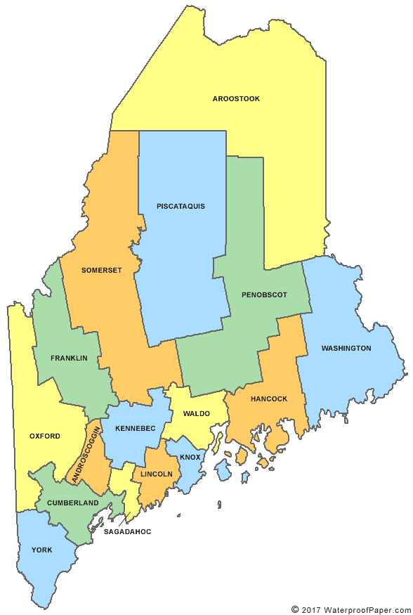
$38,209.28
Payments to Counties, Cities, and Towns.
As of 11/15/2022
Total: $2,994,257.47
$121,378.56
$110,719.25
$59,039.49
$343,955.22
$365,114.01
$105,899.77
$115,142.43
$115,261.97
$259,104.70
74,029.80
$43,235.90
$625,043.52
$64,741.02
$456,179.05
$59,011.27

Slide 14
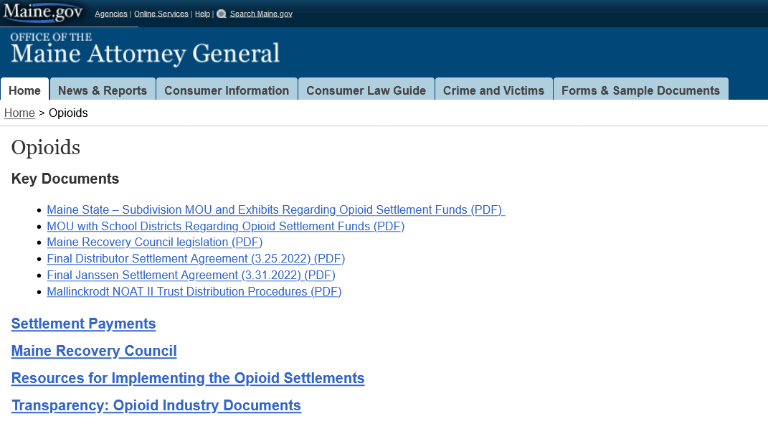

Slide 15
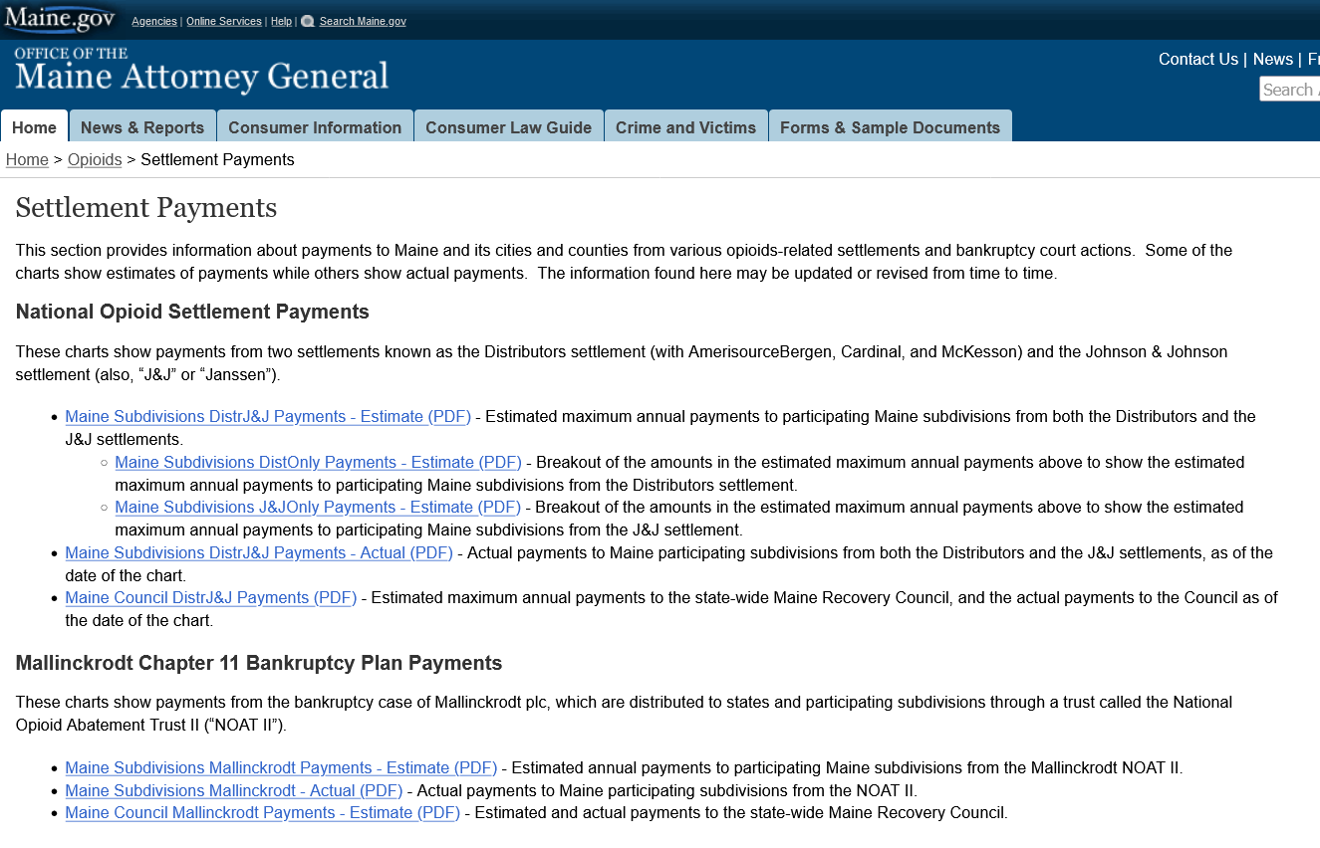

Slide 16
www.maine.gov/ag/recovery-council
info.recoverycouncil@maine.gov
www.maine.gov/ag/opioids

Slide 17
Freedom of Access Act
Brenda Kielty, AAG – Public Access Ombudsman
Brenda.Kielty@maine.gov
FOAA website – FAQs
https://www.maine.gov/foaa/faq

