Slide 1
Maine Recovery Council September Council Meeting 9.12.2024

Slide 2
Agenda
Welcome & Introduction
June / July / August Minutes
LOI Review Process
Contract Updates
Coordinator Report – Grant Application Discussion
Catherine Cutler Presentation
Finance Report -- Contractor RFP
External Evaluator Discussion

Slide 3
Coordinator LOI Review Process
Exported Raw Data to Excel
480 total responses recorded
Removed submissions not completed or submitted
Removed submissions “Finished” column = FALSE
Removed test submissions
Ran filter “Primary Organization IS NOT”: x, stet, n, TEST, etc..
Removed incomplete submissions*
Any submission with 3 or more missing fields was removed
Submissions left blank could have been submitted
Removed submissions requested by applicant
Any submission requested to be removed by organization in advance of submission deadline
Formatted responses for ease of viewing and comparison
Replaced “Other” responses with written answer / information provided
Removed misc. columns included in raw data (not part of application)
If funding request was a range, higher value was included
MRC Website Language
Applicants MUST submit a Letter of Intent to be considered for the grant application. The Council will review completed Letter of Intent submissions and selected applicants will be invited to apply for grant funding.
All Letter of Intent submissions must be completed by June 28th, 2024, at 4:59pm (EST). The Council will not review or consider submissions received after this deadline.
Notes:
Quality check, identified 4* submissions that marginal cases, which were excluded and perhaps should be reviewed – included substantive information for fields that were completed. After review, clear the submissions were intended to be submitted. Those submissions, once completed, will follow the same process and eligibility to submit full grant proposal will depend upon average LOI evaluation score.

Slide 4
Grant Application: Timeline Overview
Grant Application Published | By September 20, 2024*
Grant Application Due Date | October 18, 2024 @ 4:59pm (EST)*
Allows invited applicants 4 weeks to complete application

Slide 5
Grant Application: Timeline Overview
Grant Application Published | By September 20, 2024*
Grant Application Due Date | October 18, 2024 @ 4:59pm (EST)*
Allows invited applicants 4 weeks to complete application
By late October / early November…
Evaluation Committee convenes, holds first meeting (training, scoring review)
Receives grant assignments, begins grant review process
Goal: Provide grant award recommendation to full Council on November 14th (November Council Mtg.)

Slide 6
Grant Application
Grant Award Numbers:
Does the Council want to create any benchmarks for approximate # of grant awards?

Slide 8
Grant Application: Discussion
Coordinator Questions
Will the Council consider awarding grant funding to applicants currently receiving (or anticipate receiving) opioid settlement funds?
→ Recommendation: require applicants disclose total funding amount + source in application (project budget)
Does the Council wish to define any restrictions on MRC grant funding?
Does the Council wish to adopt the Finance Committee’s recommendation to cap grant administrative costs at 10%?
How does the Council wish to define “Indirect Rate Charges” for the grant application?
Will the Council require Letters of Support? If so, how many and for all application tiers?
Council Questions?

Slide 9
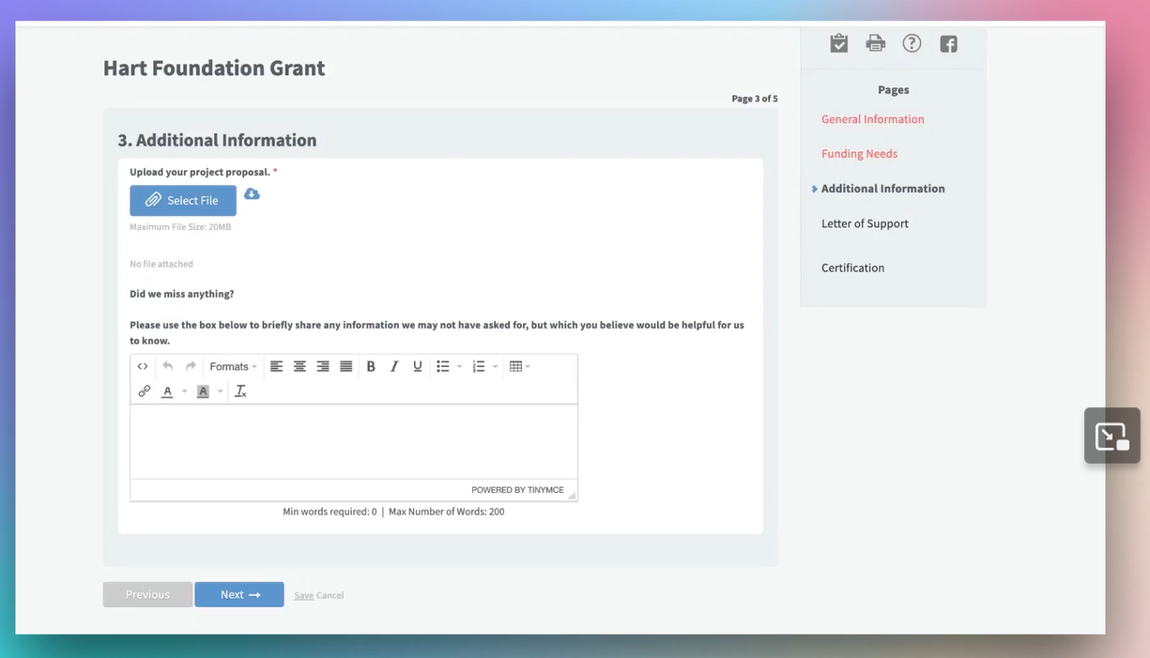
Grant Application: Submission Process
Submission Process Recommendation:
Use online grant management tool, SmartSelect, for this first round of grant applications (tutorial)
Platform provides user-friendly portal for both applicants and reviewers to access grant application
Applicants can save/track progress, upload documents, review checklists, etc..
Subscription can be upgraded or terminated within a year, and includes survey feature
Re-assess Council’s grant management system needs after full application cycle is complete. Intended for only this first grant

Slide 10

Grant Support Discussion

Slide 11
Grant Support: RFP Recommendation
Contract Management & Grant Support
Contract Management:
Assist in development of MRC contracts and provide oversight of financial reporting
Manage and oversee new and existing MRC contracts, including stakeholder communications
Ensure all contracts follow MRC policies and adhere to program expectations
Manage lifecycle of contracts, including renewal and amendments, and assist in resolving contract disputes
Grant Support:
Support and assist MRC with grant oversight and management
Collect project data, oversee grantee reporting requirements, provide ongoing evaluation monitoring
Review budgets, invoices, and financial reports; track invoices and program reports
Provide technical assistance and coordination support to grant stakeholders
Work collaboratively with Council, Coordinator, OAG, grantees and other stakeholders
Provide electronic tool for grant management and tracking of required documents and reports
Recommend including grant management system / tool as part of RFP deliverables
Discussion Questions
RFP Budget
Number of Contracts
Contract Duration
Scope of Services

Slide 12
Grant Evaluation: External Reviewers
Process Overview & Recommendation
Council members reach out to colleagues, friends, and professional networks to spread the word about Council review process and begin recruiting interested volunteers to support grant review process
Individuals who are interested in supporting the grant review process will be directed to contact the Coordinator to learn more about the review process
Coordinator will send a short survey to learn more about interested reviewers. Survey will include questions such as:
Name, current job title, organization
Preferred contact method (email, phone number)
Professional/work experience, as it relates to public health and substance use & writing, developing and/or reviewing grant proposal
Availability in October/November and time commitment expectations
Coordinator will share list of prospective reviewers with Council at October mtg.
Council will determine which individuals will be invited to participate in the grant review process & join Ad-Hoc Evaluation Committee to provide grant award recommendations to the full Council

Slide 13
Grant Evaluation: External Reviewers
Questions
Will the Council provide compensation to external reviewers? If so, at what rate?
Does the Council wish to prioritize reviewers with certain experiences and/or qualifications?
Are there members of the Council who are interested in participating in the grant review/evaluation process?

