Slide 1
Maine Prevention Inventory
Substance Use Prevention Assessment
June 2024

Slide 2
Background
The Ask
The New England PTTC contracted Public Consulting Group (PCG) to draft an assessment/inventory of recent and ongoing substance use prevention (SUP) efforts in Maine to share with the Prevention Workgroup.
Methods
PCG utilized a state-wide needs assessment and evaluation report produced in 2022 for the Maine Center for Disease Control and Prevention (Maine CDC) SUP Program to highlight funding sources, implementation, outcomes, and persistent gaps and challenges. Additionally, recent grant-specific evaluation reports and a conversation with the SUP Program Manager were used to inform the inventory.
Please note, this inventory does not include prevention initiatives outside of Maine CDC, such as Drug Free Communities or Community-level Partnerships for Success grants.

Slide 3
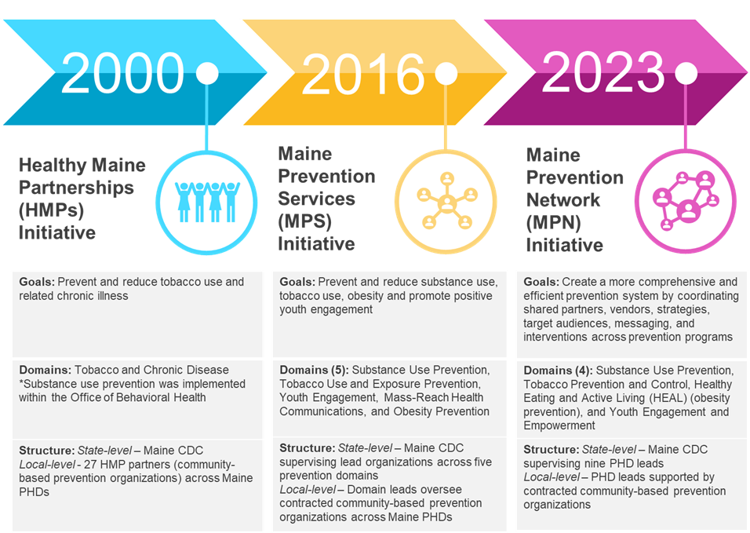
Substance Use Prevention in Maine: History

Slide 4
SUP Funding Sources (2023 and 2024)
 | SUPTRS (F)* | SOR III (F) | PFS 2022 (F) | SPF Rx 2021 (F) | ARPA (F) | CRRSAA (F) | OPTF (S) | FHM (S)
Awardee | OBH | OBH | SUP | SUP | State | State | SUP | SUP
Years Awarded** | 2023-2025 | 2022-2024 | 2022-2027 | 2021-2026 | 2021-2025 | 2021-2024 | 2023-2024 | 2023-2024
Total Amount | FY2023: $7,590,672 FY2024: $7,590,672 | 2022-23: $6,325,323 2023-24: $6,547,645 | FY2023: $1.25M FY2024: $1.25M | FY2023: $384,000 FY2024: $384,000 | $5,640,385 | $6,530,972 | N/A | Unknown
Percentage/ Amount dedicated to primary prevention | FY2023: 22% FY2024: 22% | 2022-23: 15% 2023-24: 8% | FY2023: 100% FY2024: 100% | FY2023: 100% FY2024: 100% | 38% | 20% | $1.25M | FY2023: $777,504 FY2024: $777,504
Focus | Alcohol, Cannabis, Prescription drugs | Opioids and Stimulants | Alcohol and Cannabis | Prescription Drugs | Alcohol and Cannabis, some secondary prevention | Opioids/ Prescription Drugs | Opioids | All
Population | General Population | General Population 12+ | 12–25-year-olds | General Population 12+ | General Population | General Population | Middle School Youth | General Population
Sustainab-ility | Annual, non-competitive | Two Year Award (moving to three), non-competitive | Five Year Award, competitive | Five Year Award, competitive | One-Time | One-Time | State Fund | Annual
Federal (F); State (S)

Slide 5
Maine Prevention Network
Funds Public Health District (PHD) partners to implement SUP programming in their communities targeting a variety of substances (e.g., opioids, cannabis, alcohol) and diverse populations. Interventions include, but are not limited to:
Information dissemination (e.g., health fairs, flyer distribution, media campaigns)
Policy development and implementation
Safe storage of substances
Drug take back
Educational programming
Multiagency collaboration and coordination

Slide 6
Additional SUP Programming
Maine Youth and Young Adult Screening, Brief Intervention and Referral to Treatment (MY-SBIRT) – a clinically effective public health approach for identifying individuals who engage in high-risk substance use behaviors and intervening to prevent more severe consequences
Student Intervention Reintegration Program (SIRP) – a SUP program targeting high-risk adolescents that opens the discussion with youth about substance use choices and associated risks in a non-judgmental way
Sources of Strength – a suicide prevention program that promotes protective factors and connects youth to each other and community resources
Enforcing Underage Drinking Laws – funds partners across the state to conduct compliance checks to ensure drinking laws are being upheld
Statewide media campaigns targeting various substances
Strategic Prevention Framework for Prescription Drugs (SPF Rx) Community Grants Program – allows for the implementation of prescription drug misuse prevention efforts in diverse, and often high-need, communities
Gateway to Opportunity (G2O) – a paid summer workforce program connecting youth in Maine to local organizations and businesses

Slide 7
Outcome Data
A number of outcome indicators from a variety of data sources (e.g., MIYHS, NSDUH, OCME) were reviewed as a part of the assessment.
Data from the two or three most recent data collection periods (2019 through 2023) were reviewed to assess change over time.
Indicators included, but were not limited to:
Risk and protective factors (e.g., ACEs, youth mattering)
Consumption of substances (e.g., past month use of substances)
Consequences of substance use (e.g., drug-related overdose rates)

Slide 8
Persistent Gaps and Challenges
Visibility and representation of Certified Substance Use Prevention Specialists in communities as leaders in the substance use prevention field is lacking.
Turnover among the substance use prevention workforce is frequent.
Long-term substance use primary prevention funding sources are lacking, which leads to challenges sustaining substance use prevention efforts and retaining staff at both community and state levels.
Highly prescriptive funding restrictions challenge prevention professionals’ ability to be adaptive and flexible in reaching targeted populations.
Emphasis on initiatives and programs that work towards systems change, building protective factors, social emotional learning and coping skills, and mitigating risk factors among youth in Maine is necessary.
There should be a greater focus on community-specific risk and protective factors and implementation of community-led prevention efforts to address these factors.

Slide 9
Persistent Gaps and Challenges (continued)
Increased multiple substance and cross-purpose programming (and funding sources) are crucial, especially for alcohol and cannabis as both are legal and widely used among youth and young adults. Programs should address shared risk and protective factors.
Community partners need increased support to implement local policy efforts through the development of a policy development and implementation toolkit.
The impact of retail cannabis access on cannabis use across the lifespan (especially in Maine) needs to be better understood to determine evidence-based and innovative strategies to combat the consequences of increased access, availability, and use.
Additional investment is needed to support streamlined data collection and reporting to allow community partners to better utilize funding and reduce the administration and reporting burden.
Improved engagement of a diverse group of stakeholders in substance use prevention efforts is needed, in addition to improved coordination and collaboration of such efforts.

Slide 10
Persistent Gaps and Challenges (continued)
There is a knowledge gap among partners and the general public regarding what primary prevention entails and the trained and certified primary prevention workforce who are equipped to implement evidence-based/informed strategies.
Knowledge and understanding can be bolstered among partners and the general public of how the social determinants of health impact substance use behaviors, mental health struggles of young people, especially with regard to the risks of cannabis and alcohol.
Knowledge and understanding of impactful environmental strategies and how to engage diverse populations among substance use prevention staff who are new to the field is lacking.
Prevention efforts for alcohol use among youth and the culture surrounding it are not prioritized, compared to the focus on preventing the use of other substances (e.g., opioids, cannabis).
Robust data to effectively understand trends and themes in youth at the local or school level are lacking or challenging to access.

