Slide 1
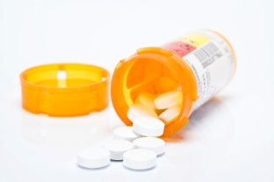
Prescription Drug Abuse in Maine:
The Federal Judicial Perspective
Chief Judge John A. Woodcock, Jr.
United States District Court
District of Maine

Slide 2
“A Cure with a Curse”
Today in Maine
Pharmaceutical overdose deaths outnumber motor vehicle deaths
23.6% of high school seniors have used someone else’s prescription drugs
Over 500 babies suffer opiate withdrawal after birth

Slide 3
Federal Criminal Law
Federal Sentences
Type of Offense | Incarceration | Maximum Fine | Supervised Release
First Offense | Up to 20 years | $1,000,000 | 3 years to life
Second Offense | Up to 30 years | $2,000,000 | 6 years to life
Death or Serious Bodily Injury | 20 years to life
Death or Serious Bodily Injury (if prior felony drug offense) | Mandatory life sentence

Slide 4
Federal Criminal Law

Slide 5
Federal Criminal Law

Slide 6
Federal Criminal Law
Maine Federal Drug Prosecutions

Slide 7
Federal Criminal Law
Percentage of Drug Trafficking Defendants Cooperating with Law Enforcement

Slide 8
Federal Criminal Law
Defendants by Gender, Nationally
Powder Cocaine
Meth & Other Drugs

Slide 9
Federal Sentencing in Maine
Southern Maine v. Northern Maine
Defendants Sentenced in 2010 for Prescription Drug Crimes

Slide 10
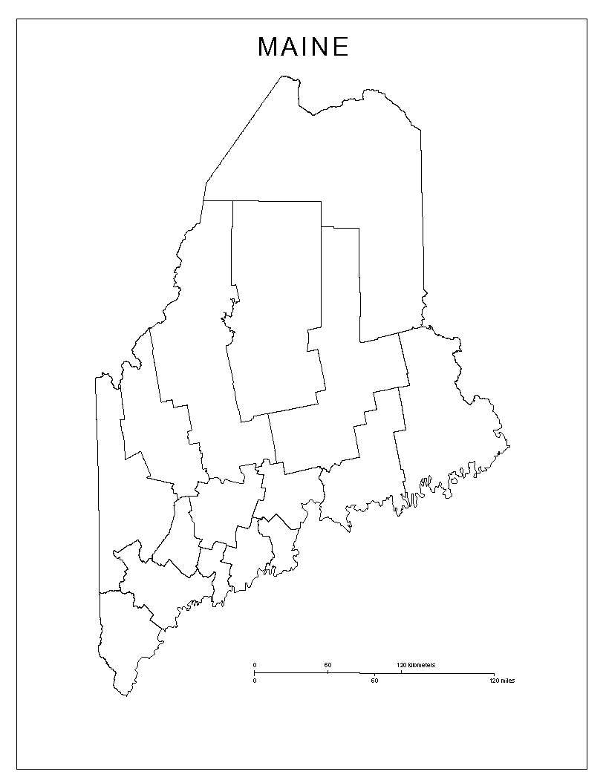
Federal Sentencing in Maine
Southern Maine v. Northern Maine
Drug trafficking prosecutions for prescription drugs ONLY:
Aroostook
Hancock
Kennebec
Piscataquis
Washington

Slide 11
Federal Sentencing in Maine
Crack Cocaine Prosecutions
August 2009 – September 2011
Southern Maine
= 46

Slide 12
Federal Sentencing in Maine
Crack Cocaine Prosecutions
August 2009 – September 2011
Southern Maine
= 46
Northern Maine
= 1

Slide 13
Federal Sentencing in Maine
Violations of Supervised Release for Prescription Drug Abuse
38.2%
20.6%

Slide 14
Why & How?

Slide 15
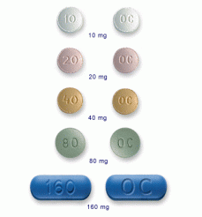
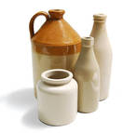
Why & How?
Age-old human desire to get high…

Slide 16
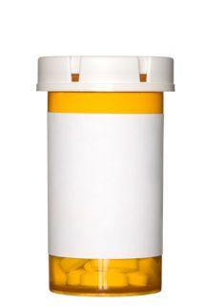
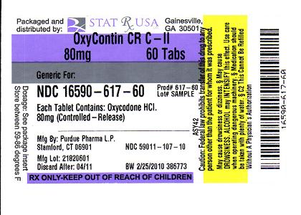
Why & How?
Age-old human desire to get high
Efficacy of opioid agonists…

Slide 17
Why & How?
Age-old human desire to get high
Efficacy of opiod agonists
Legal substance…

Slide 18
Why & How?
Age-old human desire to get high
Efficacy of opiod agonists
Legal substance
Legitimate source…

Slide 19
Why & How?
Age-old human desire to get high
Efficacy of opiod agonists
Legal substance
Legitimate source
Money…

Slide 20
Why & How?
Age-old human desire to get high
Efficacy of opiod agonists
Legal substance
Legitimate source
Money
Out-of-state sources…

Slide 21
Responses

Slide 22
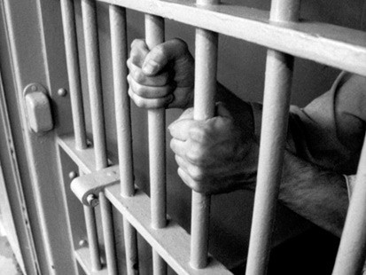
Responses
Criminalization…

Slide 23
Responses
Criminalization
Treatment…

Slide 24
Responses
Criminalization
Treatment
Drug Court…

Slide 25
Solutions

Slide 26
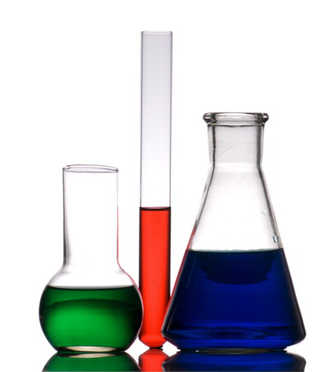
Solutions
Changes in the formula…

Slide 27
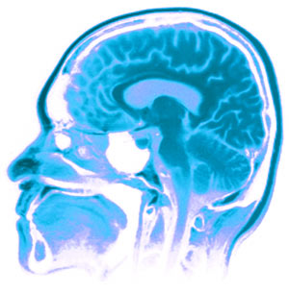
Solutions
Changes in the formula
Advances in neurobiology…

Slide 28
Solutions
Changes in the formula
Advances in neurobiology
While we wait…

Slide 29
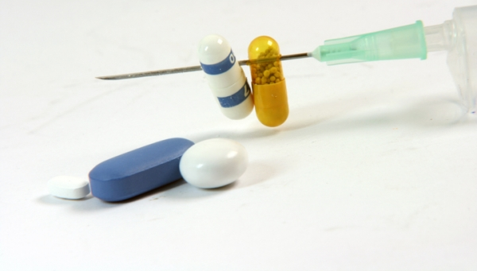
Solutions
Changes in the formula
Advances in neurobiology
While we wait:
State and federal cooperation…

Slide 30
Solutions
Changes in the formula
Advances in neurobiology
While we wait:
State and federal cooperation
Education…

Slide 31
Solutions
Changes in the formula
Advances in neurobiology
While we wait:
State and federal cooperation
Education
Women and drugs…

Slide 32
Solutions
Changes in the formula
Advances in neurobiology
While we wait:
State and federal cooperation
Education
Women and drugs
Users and dealers…

Slide 33
Solutions
Changes in the formula
Advances in neurobiology
While we wait:
State and federal cooperation
Education
Women and drugs
Users and dealers
Other tools…

Slide 34
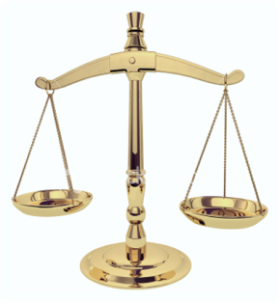
Federal Criminal Law
Sentencing in Maine
Balancing individual fairness with societal justice
Crime meets punishment
Far-reaching impact
Defendants often speak
Reasons to hope…

