Slide 1

Prescription Drug Abuse
National Perspective
Gil Kerlikowske,
Director
White House Office of National Drug Control Policy

Slide 2
ONDCP’s Authority
Established by the Anti-Drug Abuse Act of 1988
Principal purpose: Establish policies, priorities, and objectives for the nation's drug control program
Goals: Reduce illicit drug use, manufacturing, and trafficking, drug-related crime and violence, and drug-related health consequences
2
Notes:
2
2
2

Slide 3
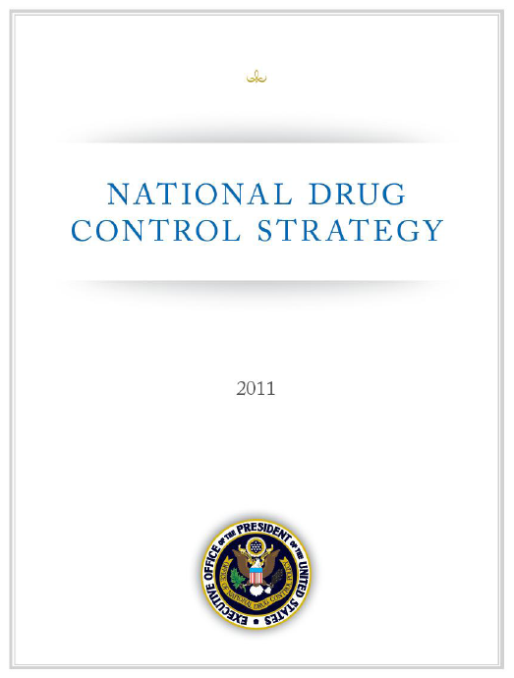
National Drug Control Strategy
Science-based, public health approach to drug policy
Coordinated federal effort on 115 action items
  Special emphasis on active duty, veterans, and military families; women and girls; individuals in the criminal justice system; and college students
Signature initiatives
  Prescription Drug Abuse
  Prevention
  Drugged Driving

Slide 4
The Prescription Drug Abuse Problem
478 million prescriptions for controlled-substances dispensed in U.S. in 2010
7 million Americans reported current non-medical use of prescription drugs in 20010
1 in 4 people using drugs for first time in 2010 began by using a prescription drug non-medically
6 of top 10 abused substances among high school seniors are prescription drugs
28,000 unintentional overdose deaths in 2007 – driven by prescription opioids

Slide 5
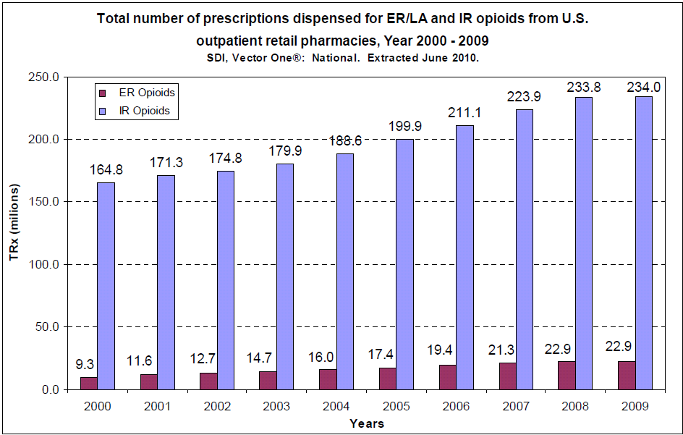
Pain Reliever Prescriptions: 2000-2009
ER – Extended Release, LA – Long-Acting, IR – Immediate Release
Source: SDI, Vector One: National. Extracted June 2010.

Slide 6
Prescriptions Dispensed for select opioids in U.S. Outpatient Retail Pharmacies, 2000-2009
Number of Prescriptions
Source: SDI, Vector One: National. Extracted June 2010.

Slide 7
New Users in the Past Year of Specific Illicit Drugs
among Persons Aged 12 or Older, 2010
Note: The specific drug refers to the drug that was used for the first time in the past year, regardless of whether it was the first drug ever used or not.
*Includes pain relievers, tranquilizers, stimulants, and sedatives
Source: SAMHSA, 2009 National Survey on Drug Use and Health (September 2010).

Slide 8
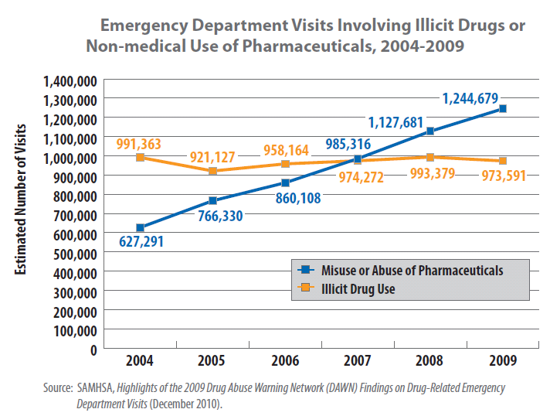
Emergency Department Visits

Slide 9
Persons Classified with Substance Abuse/Dependence on Psychotherapeutics
Results from the 2010 National Survey on Drug Use and Health (NSDUH): National Findings, SAMHSA (2011).
http://www.oas.samhsa.gov/nsduhLatest.htm.
*Number in 2010 is statistically significantly higher than in 2005.

Slide 10
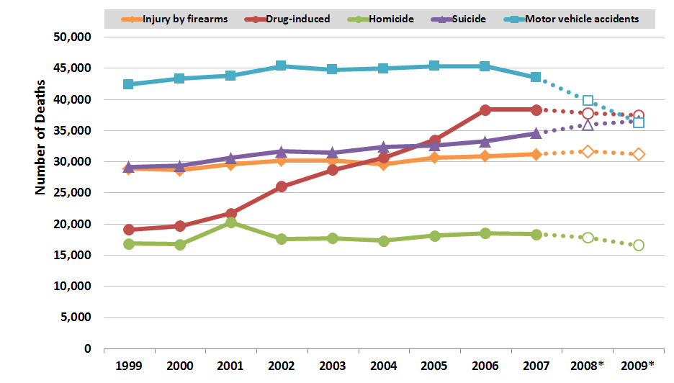
Drug-Induced Deaths vs. Other Injury Deaths, 1999–2009*
*Data for 2008 and 2009 are provisional and subject to change.
Causes of death attributable to drugs include accidental or intentional poisonings by drugs and deaths from medical conditions resulting from chronic drug use. Drug-induced causes exclude accidents, homicides, and other causes indirectly related to drug use. Not all injury cause categories are mutually exclusive.
Source: National Center for Health Statistics, Centers for Disease Control and Prevention. National Vital Statistics Reports Deaths: Final Data for the years 1999 to 2007 (2001 to 2009); Deaths: Preliminary Data for the years 2008 and 2009 (2010 and 2011).
9/2011

Slide 11
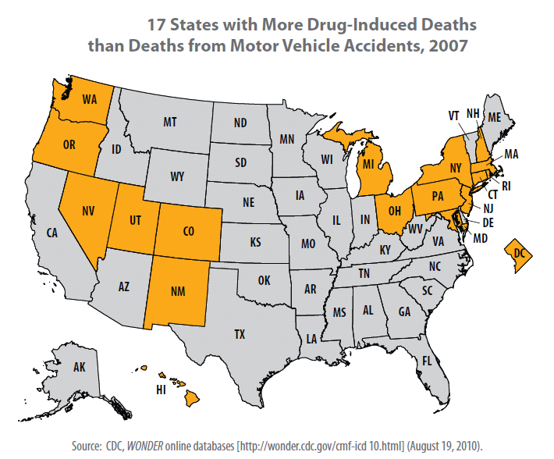

Slide 12
Unintentional Drug Overdose Deaths
United States, 1970–2007
27,658 unintentional drug overdose deaths
Cocaine
Heroin
Year
National Vital Statistics System, http://wonder.cdc.gov

Slide 13
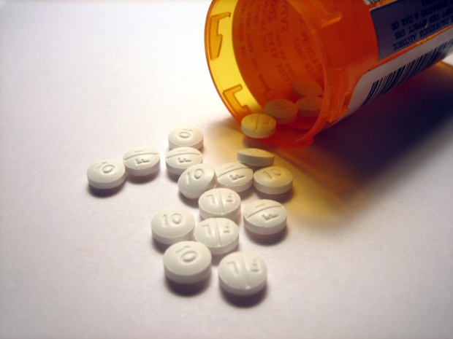
Public Health Impact of Opioid Analgesic Use
For every 1 overdose death in 2007, there were
Mortality figure is for unintentional overdose deaths due to opioid analgesics in 2007, from CDC
Treatment admissions are for with a primary cause of synthetic opioid abuse in 2007, from TEDS
Emergency department (ED) visits related to opioid analgesics in 2007, from DAWN
Abuse/dependence and nonmedical use of pain relievers in the past month are from the 2008 National Survey on Drug Use and Health
Notes:
Corrected data (Oct 2011)
Number Ratio people using pain relievers non-medically in the past month in 2007. 5,174,000 450
people with abuse or dependence on pain relievers in 2007 1,707,000 148
ED visits related to opioid analgesics in 2007 328,182 29
treatment admissions with a primary cause of synthetic opioid abuse in 2007 85,422 7
unintentional overdose deaths due to opioid analgesics in 2007; 11,499

Slide 14
Economic Costs
Illicit drug use in the United States is estimated to have cost the U.S. economy more than $193 billion in 2007¹
$55.7 billion in costs for prescription drug abuse in 2007²
  $24.7 billion in direct healthcare costs
Opioid abusers generate, on average, annual direct health care costs 8.7 times higher than nonabusers³
National Drug Intelligence Center. The Economic Impact of Illicit Drug Use on American Society. 2010. http://www.justice.gov/ndic/pubs44/44731/44731p.pdf
Birnbaum HG, White, AG, Schiller M, Waldman T, et al. Societal Costs of Prescription Opioid Abuse, Dependence, and Misuse in the United States. Pain Medicine. 2011;12:657-667.
White AG, Birnbaum, HG, Mareva MN, et al. Direct Costs of Opioid Abuse in an Insured Population in the United States. J Manag Care Pharm. 11(6):469-479. 2005

Slide 15
Unique Aspects of Prescription Drugs
Perceived Risk
Accessibility and Supply

Slide 16
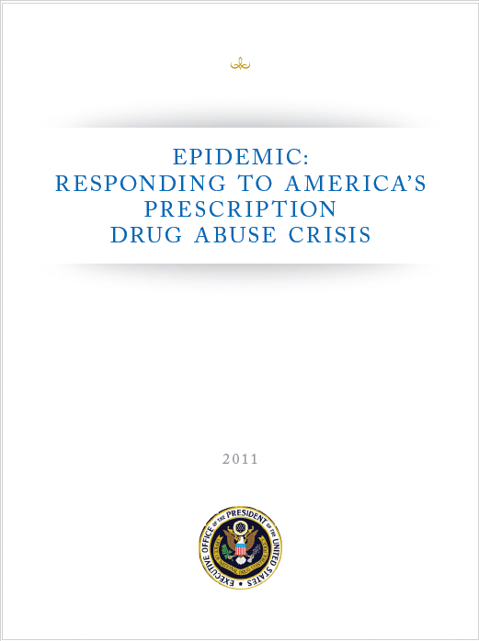
Prescription Drug Abuse Prevention Plan
Coordinated effort across the Federal government
4 focus areas
  Education
  Prescription Drug Monitoring Programs
  Proper Medication Disposal
  Enforcement

Slide 17
Education
Education Goals for parents and patients
  Increase awareness about prescription drug abuse
  Patients and parents understand how to use medications safely, and how to store and dispose them properly
Main Actions
  Evidence-based public education campaign partnering with local anti-drug coalitions, and other organizations (chain pharmacies, community pharmacies, boards of pharmacies, boards of medicine)

Slide 18
Education
Education Goals for healthcare providers
  Knowledge on appropriate prescribing
  Effectively identifying those at risk for abuse
  PDMP use in everyday clinical practice
  Screening, intervention, and referral for those misusing or abusing prescription drugs
Main Actions
  Legislation requiring mandatory education for all clinicians who prescribe controlled substances
  Increase substance abuse education in health profession schools, residency programs, and continuing education
  Work with the American College of Emergency Physicians to develop evidence-based clinical guidelines that establish best practices for opioid prescribing in the Emergency Department
  Expediting research on the development of abuse deterrent formulations

Slide 19
Top 10 prescribing specialties immediate-release opioids, 2009
SDI, Vector One: National, 2009. Extracted June 2010.
http://www.fda.gov/downloads/AdvisoryCommittees/CommitteesMeetingMaterials/Drugs/AnestheticAndLifeSupportDrugsAdvisoryCommittee/UCM217510.pdf
Notes:
An 'immediate release' liquid or tablet that you take every 2 to 4 hours

Slide 20
Top 10 prescribing specialties
extended-release/long acting opioids, 2009
SDI, Vector One: National. Years 2009. Extracted June 2010.
http://www.fda.gov/downloads/AdvisoryCommittees/CommitteesMeetingMaterials/Drugs/AnestheticAndLifeSupportDrugsAdvisoryCommittee/UCM217510.pdf
Notes:
'Slow release' tablets, capsules or powders that you take every 12 or 24 hours

Slide 21
Education Gaps
Physicians
  2000 survey: 56 % of residency programs required substance use disorder training, median number of curricular hours ranged from 3 to 12 hours¹
  2008 follow-up: “Although the education of physicians on substance use disorders has gained increased attention, and progress has been made to improve medical school, residency, and postresidency substance abuse education since 2000, these efforts have not been uniformly applied.”²
Pharmacists³
  67.5% report receiving two hours or less of addiction or substance abuse education in pharmacy school
  29.2% reported receiving no addiction education
  Pharmacists with greater amounts of addiction-specific education:
    Higher likelihood of correctly answering questions relating to the science of addiction and substance abuse counseling
    Counseled patients more frequently and felt more confident about counseling
1. Isaacson JH, Fleming M, Kraus M, Kahn R, Mundt M. A National Survey of Training in Substance Use Disorders in Residency Programs. J Stud Alcohol. 61(6):912-915. 2000.
2. Polydorou S, Gunderson EW, Levin FR. Training Physicians to Treat Substance Use Disorders. Curr Psychiatry Rep. 10(5):399-404. 2008.
3. Lafferty L. Hunter TS, Marsh WA. Knowledge, attitudes and practices of pharmacists concerning prescription drug abuse. J Psychoactive Drugs. 2006 Sep:38(3):229-232.

Slide 22
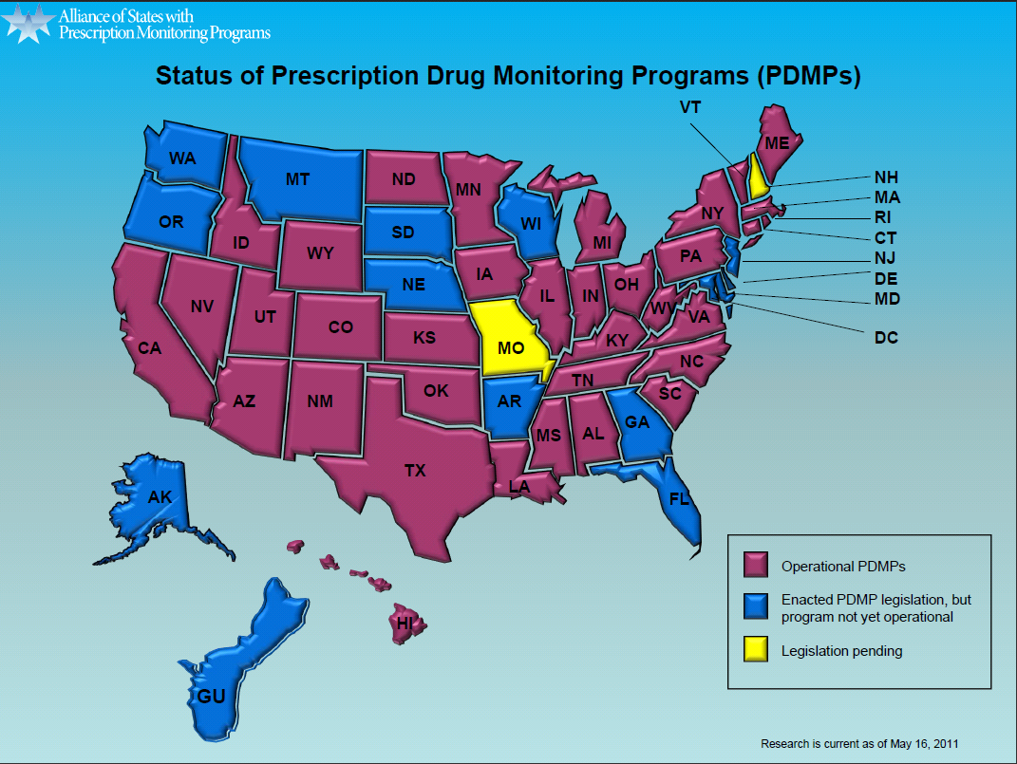
Prescription Drug Monitoring Programs
http://www.pmpalliance.org/pdf/pmpstatusmap2010.pdf

Slide 23

Proper Medication Disposal
Goals:
  Easily accessible, environmentally friendly method of drug disposal that reduces the amount of prescription drugs available for diversion and abuse
Main Actions
  Publish and implement regulations allowing patients and caregivers to easily dispose of controlled substance medications
  DEA will continue holding a take-back day at least every 6 months until a Final Rule is implemented
  Once regulations are in place, partner with stakeholders to promote proper medication disposal programs

Slide 24
Enforcement
Goals:
  Assist states in addressing “pill mills” and doctor shopping
Main Actions
  Provide technical assistance to states on model regulations/laws for pain clinics
  Encourage High-Intensity Drug Trafficking Areas (HIDTAs) to work on prescription drug abuse issues
  Support prescription drug abuse-related training programs for law enforcement

Slide 25
Conclusions
Prescription drug abuse and its consequences are the fastest growing drug problem in the U.S.
No single solution
We all have a role to play
Success will come from coordination and collaboration at the Federal, state, local, and tribal levels

Slide 26
http://www.whitehouse.gov/ondcp

