Slide 1

Electronic Real Estate Transfer Tax and
Electronic Turn Around Document
2017 September
https://www1.maine.gov/cgi-bin/online/mrs/rettd/index.pl
Link is on Property Tax Transfer Tax webpage

Slide 2
Value to towns
Town may access turn around document online at any time.
You may access all RETTs reporting property in your town.
Town may update turn around document (TAD) electronically, as time and information allows.
Data entered electronically will be saved to the database and loaded to the paper/excel spreadsheet mailed to you.

Slide 3
Corrections to Turn Around
Any necessary edits to the turn around must be completed by MRS once you have processed the TAD transaction electronically
You will be able to complete edits if you entered data electronically earlier in the year. Each town will still be mailed their TAD after June sales are keyed into our system (mid-August at the earliest) and you may still request the spreadsheet in excel. The TAD will reflect the data you entered when you electronically processed the transaction; edits may be made to the paper copy or the excel version.

Slide 4
To create municipal account
Municipalities must contact Property Tax Division to set up municipal account. We will need the following information to create an account:
  Name
  Town
  Town address
  Telephone number
  Email address – must be unique for each account. If you have multiple towns, you must use different email for each town. Multiple accounts can be created for each town.
  Account number and password will be provided. We encourage you to change the password. You may request your password when the account is created.
  Account information is not shared or publicly displayed; it is only required to create the account and provide Property Tax with contact information.
  There are 324 active municipal accounts as of September 1, 2017; municipalities may have more than 1 account.
  Deb Maringola 624-5606 Monday – Thursday
  Laurie Thomas 624-5602 Monday - Friday

Slide 5
Additional benefits
Municipal staff may print a copy of any declaration reporting property in their town.
  A copy of a paper filed return is available. DLN starts with 001 (located on left side of Turn Around Document)
  A PDF copy of an electronically filed return is available. DLN starts with 100
  Declarations recorded after 2011 are available on the website. RETTs dating back to 2005 should be available on the municipal website soon.

Slide 6
Searching for a declaration
Best search method is using book and page.
Other search options include:
  Search by DLN number
  Search by Transfer Date
  Search by minimum and maximum sale price
  Name search is not the best search method.

Slide 7
Declaration processing comparisons
Paper Processing by MRS
Electronic Processing by MRS
Declarations filed at Registry – May 1 - May 31
Received by MRS – June 10
Available on website July 10th( approximate)
Mailed to municipalities by July 20
Filed by originator – May 2
Processed by registry – May 3
Approved by MRS – May 4 or 5
Available to municipalities on website – May 5 or 6

Slide 8
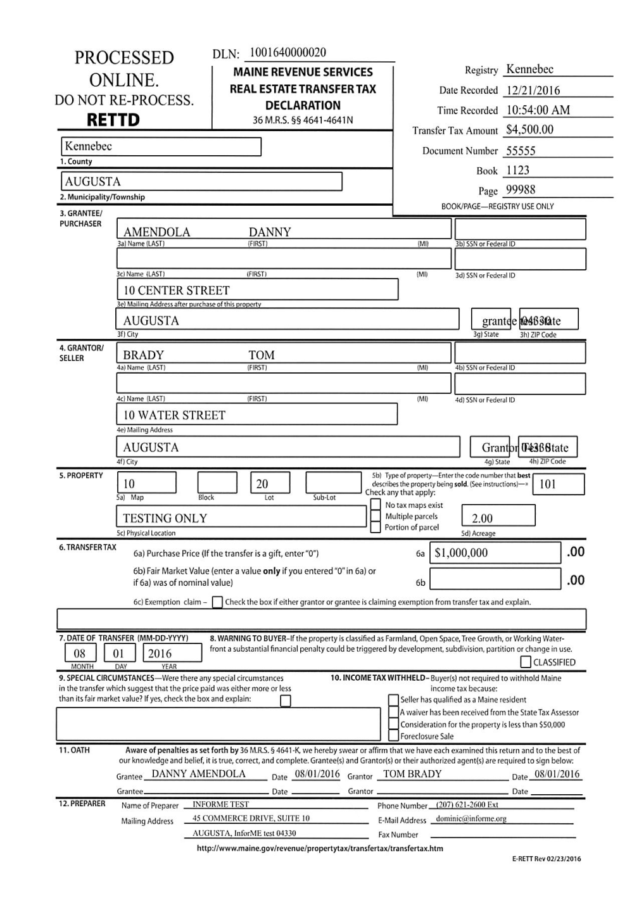
PDF copy of electronically filed declaration

Slide 9
MRS proceeding with mandate to file RETTs electronically
Rule 104-Filing of Maine Tax Returns has been amended.
Amendment includes a mandate to file RETTds electronically:
  Preparers submitting 200 or more RETTds during 2017 will be mandated to file electronic RETTds in 2018
  Preparers submitting 100 or more RETTds during 2018 will be mandated to file electronic RETTds in 2019
  Preparers submitting 50 or more RETTds during 2019 will be mandated to file electronic RETTds in 2020
  Preparers submitting 10 or more RETTds during 2020 or any subsequent year will be mandated to file electronic RETTds in 2021 or subsequent years
  Waivers to preparers will be granted if mandate causes undue hardship.

Slide 10
Looking to the future…...
Preliminary internal discussions about tying turn around document into Vision and TRIO.
We are in discussions to develop a database for filing MVRs. All MVR data will be searchable for you on this website.

