Slide 1
How to use the Footprints Executive Dashboard

Slide 2
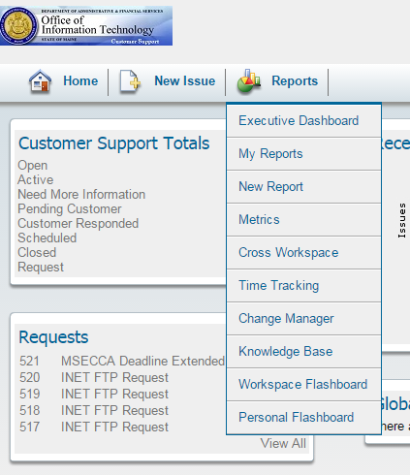
Reports Dropdown
After logging in to FootPrints,
click on “Reports” and select
“Executive Dashboard”

Slide 3
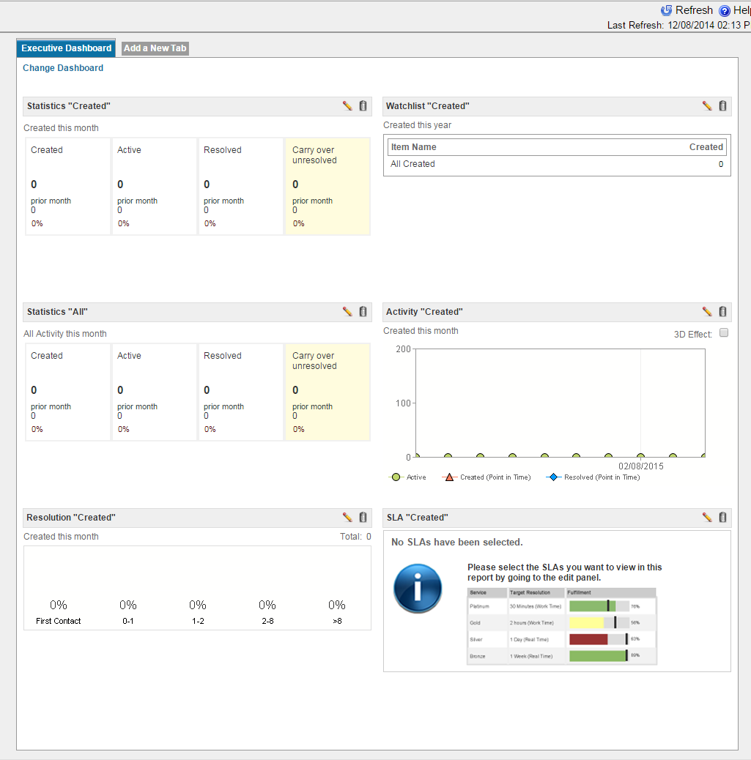
Executive Dashboard
This will bring up a screen with
some canned reports.
These can be edited to suit your
needs by clicking the pencil icon
or removed if not needed by
clicking the trash can icon.

Slide 4
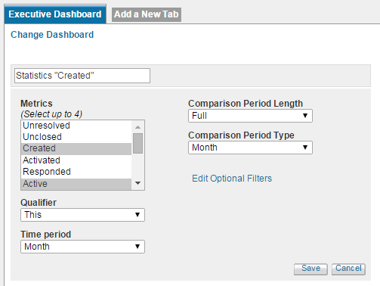
Statistics Style Report
After clicking the pencil icon to
edit, you will see this screen for
selecting your metrics for the
Statistics style report.
If you wish to filter your results,
click “Edit Optional Filters”

Slide 5
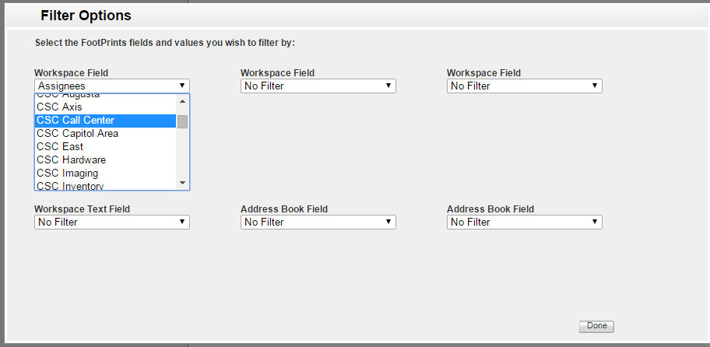
Filter Options for all Styles
These are the Filter Options available for each type of report.
After selecting your filters (or none) click “done”

Slide 6
Saving Report
After you make your changes,
click “Save”.

Slide 7
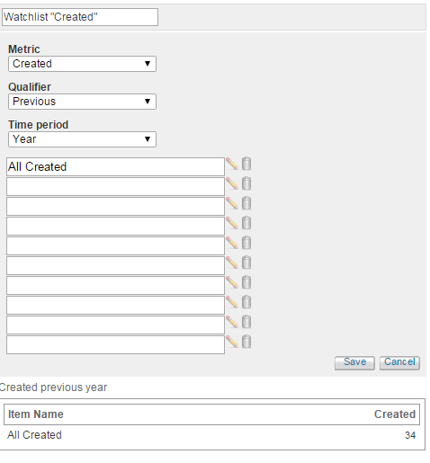
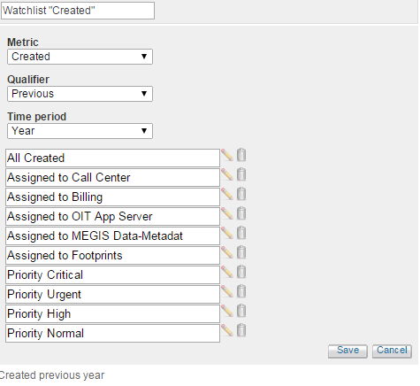
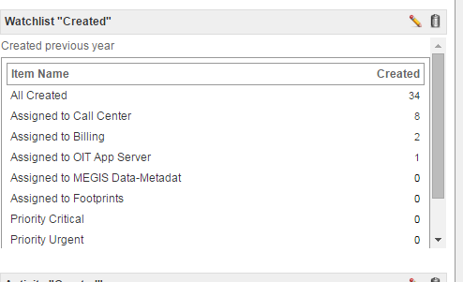
Watchlist Style Report
This is the edit screen for the
Watchlist style component.
You can add up to ten configurations.

Slide 8
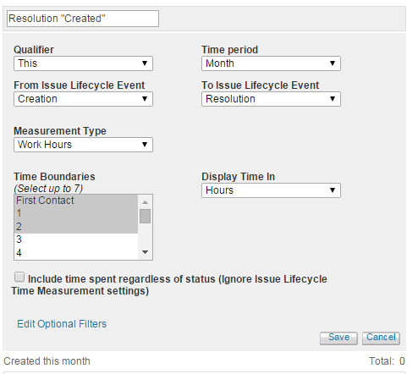
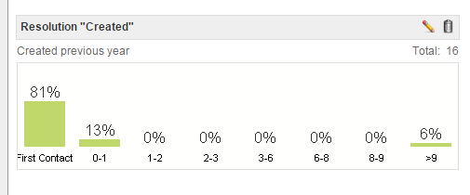
Resolution Style Report
The edit screen in the Resolution
style component.
The resulting bar graph:

Slide 9
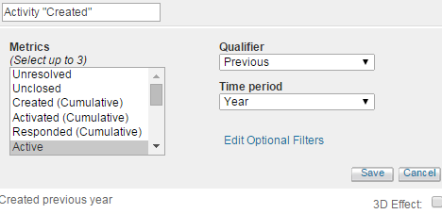
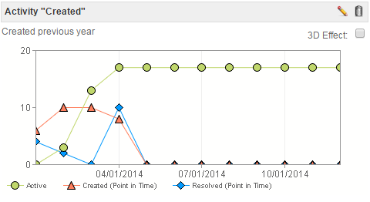
Activity Style Report
The edit screen in the Activity
style component.
Resulting Graph:

Slide 10
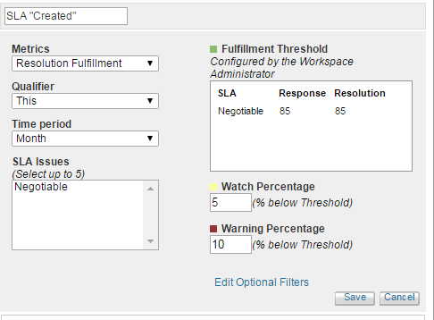
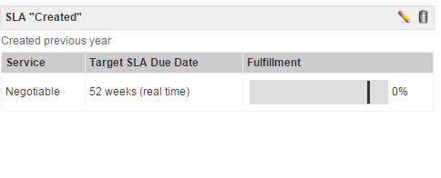
SLA Style Report
The edit screen in the SLA
style component.
Table Result:

Slide 11
New Tab
If you want to add another
dashboard, click “Add a New Tab” at the top.

Slide 12
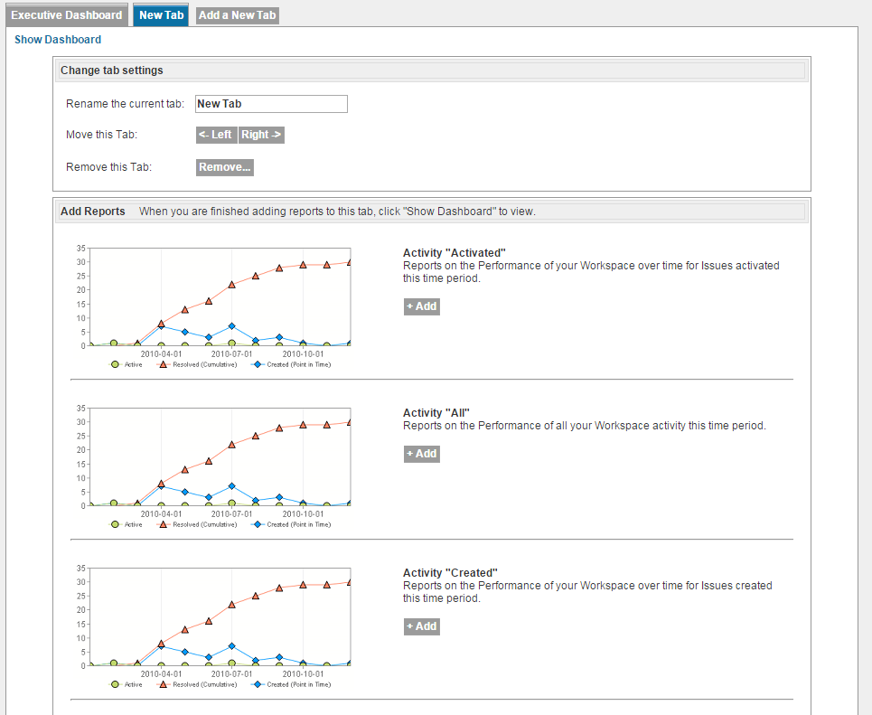
New Tab Selection Options (Activity)
On the new tab, you have
the option to change the
tab settings.
There are 3 selections
for each report style.
Activated
All
Created

Slide 13
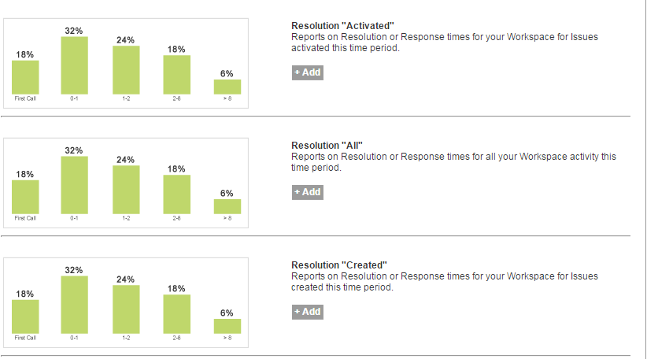
Resolution Options
Resolution:

Slide 14
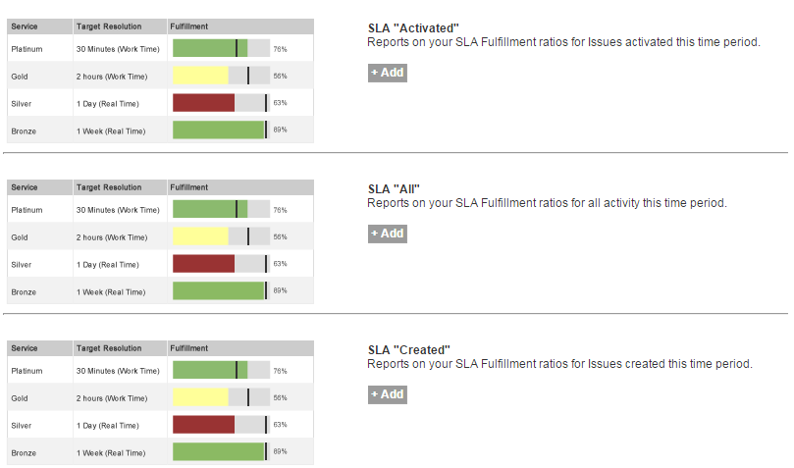
SLA Options
SLA’s (as defined in Footprints)

Slide 15
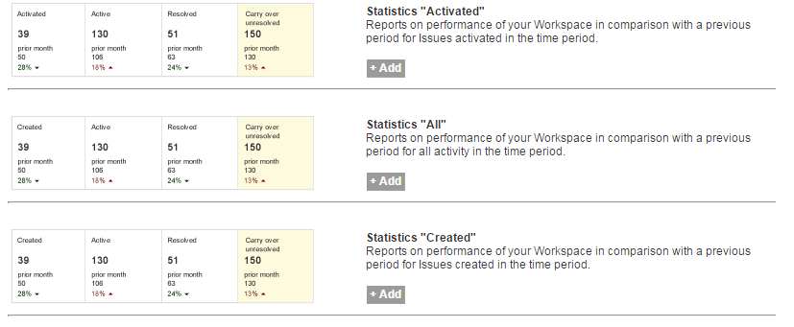
Statistic Options
Statistics:

Slide 16
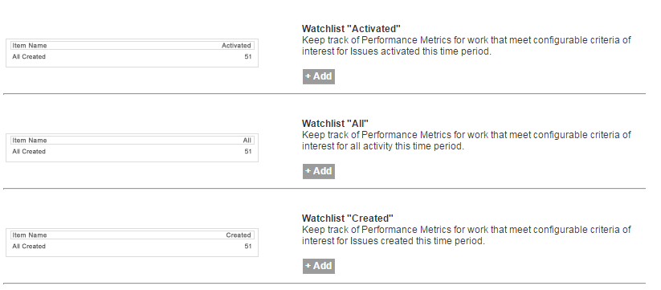
Watchlist Options
Watchlists:
You would click the +Add to include your selection on the new tab.

Slide 17
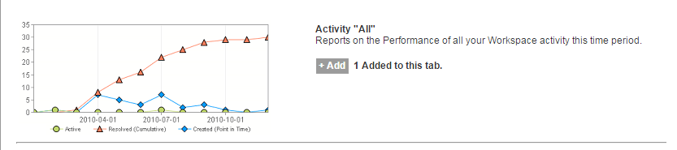
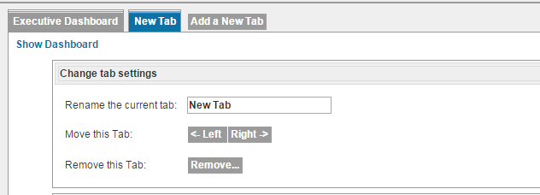
Adding Options to New Tab
Once you click +Add, it will show “1 Added to this tab” beside your selection.
After making your
selections, click
“Show Dashboard”

Slide 18
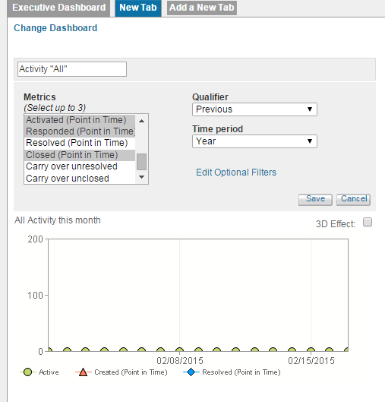
Saving components
You would then click the
pencil icon to edit the settings,
click “Save” when you are done.

Slide 19
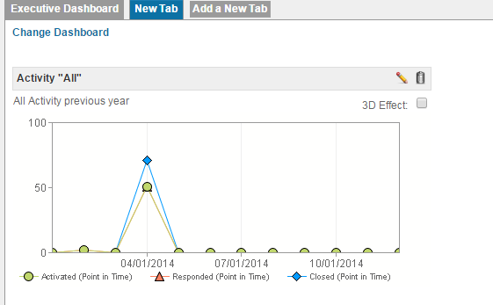
New Tab results
The results will be shown on the dashboard.
To make changes to the components shown, click “Change Dashboard”

Slide 20
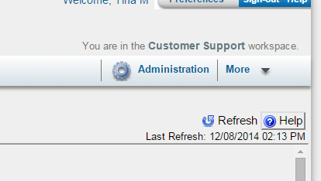
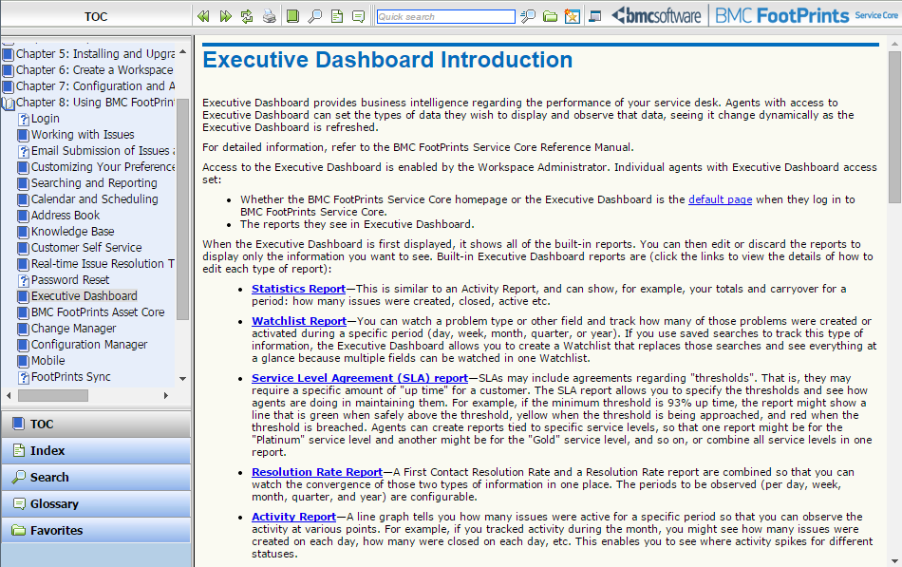
How to get Help
If you need help, you can click the “Help” icon in the upper right hand corner
of the screen for context sensitive information.

Slide 21
Contact Information
If you have any questions about the Executive Dashboard,
please send them to support.footprints@maine.gov

