Slide 1

Automation Basics for the Small Public Library

Slide 2
Why automate?
Automation makes a library’s collection available online not only to local patrons but to library patrons statewide. Resource sharing is important to small libraries with limited budgets. Small libraries need to automate to bring them up to today’s standards so that they can be viable in their communities and in the larger library world.

Slide 3
We will review the following during this course
First steps
  Weeding
  Learning vocabulary and acronyms
  Planning
Retrospective Conversion/Data Conversion
Selecting an Automation Software (ILS/LMS)

Slide 4
Weeding
Weeding your collection is one of the first and most important steps in the automation process.
You don’t want to spend money and time creating computer records for books that haven’t circulated in years, are old and out-dated, and have no value to your library.
An excellent weeding process, CREW, has been developed by the Texas State Library and Archives Commission.

Slide 5
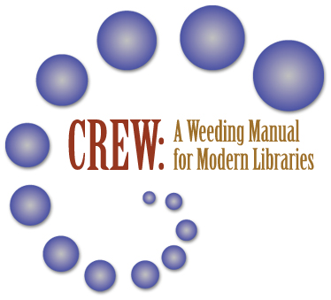
CREW
Download the PDF of CREW: A Weeding Manual for Modern Libraries

Slide 6
Weeding
  The Crew (Continuous Review, Evaluation, and Weeding) Guidelines, developed by the Texas State Library and Archives Commission is a system that has worked for libraries nationwide for over 30 years.
  It is a library’s responsibility to maintain a collection that is free from outdated, obsolete, shabby, or no longer useful items. You can read through the CREW Manual and use it as a guideline to develop your own policy for weeding your collection for your automation project and weeding after automation.

Slide 7
Weeding using CREW
The system uses a numbering system that consists of:
Copyright date (the age of material in the book.)
The last time the book was used or checked out
Negative factors, called MUSTIE factors are also used to evaluate whether an item should be weeded. If the book is:
  Misleading, Ugly, Superseded, Trivial, Irrelevant, or available Elsewhere through interlibrary loan or reciprocal borrowing.

Slide 8
Weeding
A rule of thumb held by many library professionals is that about 5% of the collection be weeded every year
The justification for weeding is to maintain a collection that is vital, relevant, and useful.
The criteria for weeding a library is based upon physical condition, relevance of the subject, and currency of the information.
Libraries are experiencing increasing scrutiny from the public and funding sources, so by establishing a policy based on a national standard allows a library to justify their discard practices.

Slide 9

Learning vocabulary and acronyms
ILS/LMS
MARC
Z39.50
Retrospective/data conversion
Copy Cataloging
OPAC
Barcode symbology

Slide 10
ILS or LMS
An Integrated Library System (ILS) or a Library Management System (LMS) is software used by a library to track books, patrons, overdues, inventory, etc.
An ILS/LMS is usually built on a database.
Each patron and item has a unique ID in the database that allows the ILS to track its activity.

Slide 11
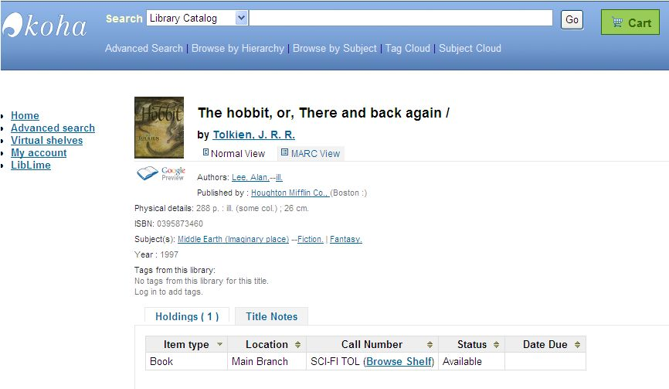
ILS or LMS Interfaces
Staff and patrons interact with that database through two graphical user interfaces (GUIs).
This means the screens that patrons and staff see are different and have different purposes.

Slide 12
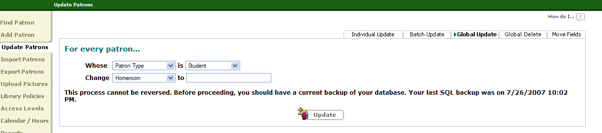
ILS or LMS
Most ILS/LMS separate software functions into modules.
Each module performs a different function and has a different user interface.
Examples of modules might include: circulation, cataloging, inventory, reports, etc.

Slide 13
MARC Records
MARC -MAchine-Readable Cataloging - MARC was developed by the Library of Congress.
It is a standard way of putting the description of a book or other item (audiocassette, DVD, etc.) into a machine readable (computer) record to permit sharing with another machine (computer).

Slide 14
MARC Records
A MARC record is a precise description of an item, which makes it very useful in automated systems and shared catalog systems.
MARC allows any system to use the same record--whatever automated system you choose, the MARC record can be read by the system, and it will know exactly how and where to find the author and the title, etc.

Slide 15
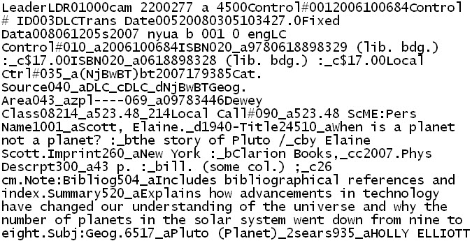
What does a MARC record look like?

Slide 16
The MARC record looks like this in an online catalog…
J
523.48 Scott, Elaine. 1940-
When is a planet not a planet? : the story of
Pluto / by Elaine Scott. - New York : Clarion
Books, c2007.
43 p. : ill. (some col.) ; 26 cm.
Explains how advancements in technology have
changed our understanding of the universe and why
the number of planets in the solar system went down
from nine to eight.
Includes bibliographical references and index.
ISBN 9780618898329 (lib. bdg.) : ISBN 0618898328
(lib. bdg.) : $17.00
1. Pluto (Planet)
523.48
2006100684 DLC

Slide 17
MARC Records
MARC records play an important part in a library’s ability to share its collection with other libraries. It is one of the ways that all the different ILS/LMS automation software can have a common way to represent a library’s collection in a computerized format.
MARC allows the records of many different libraries to come together in a union catalog. At the same time that it provides standard format, it allows for flexibility for individual libraries--you can add your own holdings information, call number, notations, etc.

Slide 18
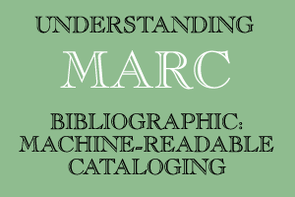
MARC Records
For more information about MARC records see Understanding MARC Bibliographic: Machine-Readable Cataloging at the Library of Congress website: http://www.loc.gov/marc/umb/

Slide 19
What is Z39.50 and what does it do?
Z39.50 is a standard that defines how computers search in library catalogs. The Library of Congress is the Maintenance Agency and Registration Authority for this standard.
Z39.50 is designed to enable communication between computer systems such as those used to manage library catalogs.
It is a set of rules and standards that allow searching and retrieving information between different computer systems.
You’ll see “Z39.50 compliant” listed in automation software brochures.

Slide 20
Z39.50 – Clients and Servers
Z39.50 is a client/server based service and protocol for information retrieval. It is used to retrieve database records, and perform related information retrieval functions for interlibrary loan, MARC retrieval, etc.
An ILS or LMS may have a Z39.50 client that can communicate with a Z39.50 server to download MARC records.

Slide 21
Retrospective Conversion/Data Conversion
The process of converting information from a traditional card catalog to an electronic format is often called retrospective conversion.
You use the paper records that you have (a shelf list, card catalog, or the books themselves) to create the computerized record (MARC).
This process is time consuming when the library uses staff or volunteers for this portion of the automation process.
This process is expensive when you pay the ILS/LMS software company or another third party company to do this for your library.

Slide 22
Copy Cataloging
These days converting your library’s collection is easier than in the past because most ILS/LMS either offer the service (for a price) or offer access to databases where you can “copy” and download a MARC record for a book in your collection.
This is called Copy Cataloging.

Slide 23
Copy Cataloging part two
Copy Cataloging is the process of building upon someone else’s original cataloging.
A library staff person or volunteer can be trained to match the library’s item, catalog card or shelf list record to one that can be downloaded via the Internet and uploaded into your automation program.
The Library of Congress as well as many other state systems allow you to access their catalogs and “copy” the record and add it to your collection.

Slide 24
Copy Cataloging part three
Many ILS/LMS software provide access to Z39.50 compliant catalogs from which you can download MARC records.
Most cataloging in small libraries today use this method rather than create an original cataloging record for every item in the library’s collection.
Vendors offer copy cataloging resources for a price if it is not included in your ILS/LMS.

Slide 25
OPAC - Online Public Access Catalog
The OPAC replaces your card catalog.
An Online Public Access Catalog is an electronic "card catalog" with access through a computer.
OPACs allow searches by author, title, subject heading and keyword.
The keyword search is a powerful tool for the user to find books when they may not know the title or appropriate subject heading.
The subject heading “cookery” isn’t as user friendly as the term “cookbook”. Keyword searching provides library users with a more flexible way to search library catalogs.

Slide 26
More Definition Resources
  The Information Professional's Glossary http://www.sir.arizona.edu/resources/glossary.html
  Online Dictionary for Library and Information Science
  http://www.abc-clio.com/ODLIS/odlis_A.aspx

Slide 27
Planning for the Automation Process
Pre-planning should include discussions among staff, trustees and others
  Why do you want to automate?
  What will you try to accomplish in what time frame?
  What will your budget be?
  How much staff time can you dedicate?

Slide 28
Planning for the Automation Process
Establish a Timetable
Make sure to allow some flexibility
Set realistic goals and milestones
Your timetable will be determined by budget, staff and volunteer time.

Slide 29
Planning: Discussions
Discuss the automation project with staff and board/trustees, town manager.
Make sure everyone understands the work involved and money needed for success.
Discuss what kind of staff time and budget money you can free up for this process.
Consider writing a grant to cover all or some costs.
Although automation saves some time when checking out books and cataloging, many of those tasks are replaced by other work required by the software.
Automating your library will provide your patrons better access, provide accurate statistics and allow sharing your resources with other libraries.

Slide 30
Some other considerations
How many items do you have in your collection? Often the cost of an ILS/LMS is dependent on collection size. (Remember the importance of weeding!)
Research ILS/LMS software
  Use the web to do research
  Visit vendors at state or national conferences
  Visit other libraries in your area to see how systems work.

Slide 31
Beginning the Retrospective Conversion/Data Conversion
What resources do you have to begin the automation process?
  Do you have “printed” a card catalog?
  Do you have a Shelf list?
  Will you use the actual book or item to locate a computerized MARC record?

Slide 32
Paying for Conversion
Will you pay a vendor for the conversion or do it yourself?
  If you choose your software vendor or a third party vendor to do the conversion it will be quicker but will cost $.40 - $1.50 per book/item.
  A collection of 5,000 books can cost between $2,000 - $7500. 20,000 books? $8,000 - $30,000.
  AV material records usually have higher conversion costs.

Slide 33
Paying for Conversion Continued
Paying a vendor to convert your shelf list or card catalog is a more straightforward process.
Many companies that sell ILS/LMS software also offer conversion services.
This may or may not be a cost effective solution for your library.
Make sure you compare third party conversion vendor quotes to those of the ILS/LMS software company. You may be able to negotiate a lower cost.

Slide 34
Third Party Vendors for Retrospective Conversion
Brodart:
http://www.books.brodart.com/
Backstage:
http://www.bslw.com/retro/
Marcive:
http://home.marcive.com/
There are many other vendors that provide this service. Check with your State Library for more resources that may be available to you.

Slide 35
Alternatives to Paying for Conversion:
Do it yourself ? – this is very labor intensive; volunteers and or staff must be trained; it can take multiple years.
What is your time table?

Slide 36
Getting a Head Start with Conversion
You can start your automation project now with new book purchases. Purchase MARC records from your book vendor. For example: Baker and Taylor supplies MARC records for an additional fee.
  See: http://www.btol.com/ps_details.cfm?id=340
Check with your book supplier about obtaining MARC records for the books you purchase. You will then have a MARC records for every new book that comes into your library.

Slide 37
Reducing Conversion Costs
Can the costs of conversion be reduced? Yes, first by weeding your collection. Libraries hate to throw away books but during an automation project every book kept in the collection represents a cost.
What is the “cost” to keep, shelve and create a MARC record for a book that hasn’t left the library in 5-20 years?
Notes:
An \

Slide 38
Money in Weeded Books
Books sales! The amount of money you get for each book sold could cover the cost of a MARC record for a book kept in the collection.
Paperback swaps (online and locally)
Sell weeded books online. See this document - Innovative Ways Of Getting Rid Of Books created by a Maine librarian. http://www.maine.gov/msl/libs/tech/automation/ridbks.doc

Slide 39
Catalog on the Go
Cataloging “as you go” or on the fly is an option that you can incorporate that works well to get books that circulate converted sooner.
As you methodically go through your collection to create records you also make sure that every book that is returned to the library after being checked out is immediately converted before it goes back on the shelf.

Slide 40
Selecting Automation Software
You should know what you need and want based on your planning process and discussions
Basics – Circulation and Catalog
Beyond basics – Reports, serials, Internet access to your catalog via the web, …

Slide 41
Additional Considerations for School Libraries
School libraries – what systems do other schools in the district use? Other schools like you? Schools in neighboring districts?
Make sure that the OPAC offers a Visual Search component for younger children in elementary schools.
Look for an ILS/LMS that has specific functions or modules for schools that compliment learning and school management.

Slide 42
Selecting Software: What to Look for
Real MARC record creation
Access to MARC records to match, download, and import
Catalog (online and web-based)
Circulation – ease of use
Can you download a trial? Watch a web demonstration?
Do you want an Inventory feature (and need hardware to do that?)

Slide 43
More to Look for
Reports (for statistical purposes, over due books, etc.)
Do you want to print your own barcodes
Backups – is this built in? How is it done? How you backup all your data is very IMPORTANT!!
Tech Support
  Annual fees for support/software updates – it is very important to budget for annual support.
Other modules (Serials management, etc.)

Slide 44
Key Factors in Selection
Select automation software that creates real MARC records.
It is also important that the software you select can export your collection in MARC format.
Some smaller and inexpensive “automation” and “catalog card creation” software don’t use true MARC format.
If you are going to automate your library ensure that your efforts are not wasted by creating records that aren’t compatible and can’t be exported into another system.
It is an important consideration for the future if your library ‘s collection will be added to a regional or state catalog.

Slide 45
Other Purchases?
If you purchase an ILS/LMS that is not remotely hosted you will need a server.
  Server and server software (client/server)
  Server – up-front high costs, maintenance and tech expertise needed locally; client licenses needed?
  Do you have the expertise on your staff to manage a server?
  Do you have funds to pay for a technology company to provide support?

Slide 46
More Purchases ?
Do you need hardware for public access catalogs?
Do you have a website for an online catalog?
Will you need to upgrade staff computers to handle the new software?
Do you have a computer you can dedicate to circulation?

Slide 47
Remote Hosting (Off-site)
Some ILS/LMS are hosted by the vendor and all systems work through a web-based interface.
This interface communicates over the Internet to the server for every circulation transaction, catalog search, etc.
With remote hosting you have higher yearly costs for subscription but no costs to purchase a server.
The backups and installation are done by vendor
All browser based; platform independent (PC or Mac)

Slide 48
Pros and Cons of Remote Hosting
No investment in a server
No “super techie” expertise needed at the local level
Higher per year costs to host
Lower initial costs
Lower staff costs
Lower local tech support costs
But…if the Internet connection is lost you have to have a plan to circulate manually…

Slide 49
In-House Server software
Most ILS systems require server software.
They won’t run on XP/Vista/Windows 7 computers.
You will need to purchase server software for an ILS/LMS that you are running on-site in your library.
Costs for server software can exceed $600 (for Microsoft server products).
Look for Microsoft server software at a discount from Tech Soup Stock- $31. http://www.techsoup.org/stock/

Slide 50
Linux versus Windows
Linux is an alternative to Windows
Local expertise needed for installation
Lower software costs
Still need local technology support after installation
Staff must learn enough about the new operating system to navigate.
Open source ILS like Evergreen and Koha can run on Linux.

Slide 51
Open Source
What is Open Source software?
The software is free to use and alter.
Support is via the web (wikis, discussion boards, web sites)
Is an Open Source ILS a good idea for your library?
Some libraries use an Open Source ILS but pay a company for tech support, installation, service, etc.
Notes:
Ome

Slide 52

Open Source ILS
Evergreen
Koha
OPALS
OpenBiblio

Slide 53
Prices and Software Information
These cost under $600 and just offer a very basic, no frills solution
Library World - $425.00 (2012) per year (includes online support)-web-based; no server; patrons access to catalog via the Internet. http://www.libraryworld.com
ResourceMate – initial cost $395-$595 (multi-user); yearly fee of $90. No web access for patrons. http://www.resourcemate.com/

Slide 54
More Sophisticated Software
Costs vary and depend on collection size, support selected, etc.
Mandarin M3 (public and school libraries)
http://www.mlasolutions.com/index.php
Apollo (Small and medium public libraries)
http://www.biblionix.com/products/apollo/
OPALS (School library focus)
http://www.mediaflex.net/
Koha (LibLime)
http://www.liblime.com/liblimekoha

Slide 55
Higher Cost Software
Most of the software listed below are used by both public and school libraries or have a version for public libraries and a different version for school libraries. They have more bells and whistles.
Destiny - Follett http://www.follettsoftware.com/
Concourse, Atriuum - Book Systems http://www.atriuum.net/
Alexandria - COMPanion Corporation http://www.goalexandria.com/
Surpass – Surpass Software http://www.surpasssoftware.com/
Liberty3/Oliver- Softlink http://www2.softlinkint.com

Slide 56
Comprehensive Lists of ILS or LMS Software
You can check these other resources:
Library Technology Guides:
http://www.librarytechnology.org/
Comparison Chart
http://www.maine.gov/msl/libs/tech/automation/compare.shtml

Slide 57
Further Evaluation of ILS/LMS
Free downloads, trials
Online demos and webinars
Scheduled online demonstrations by vendors
Conferences
Visits to libraries running the software

Slide 58
After you select your software
Please read the manual…
Install the software (not needed if you are using a web-based product)
Configure your software
Order barcodes, scanners, etc.
Add patrons
Purchase and barcode library cards
Begin adding MARC records

Slide 59
Reading the manual
The manual won’t answer all your questions but it will be a great help as you go through the process of setting up your software.
If the manual is online you may want to print sections for staff and volunteers.
It is worthwhile reading and/or scanning the manual before making final configuration decisions.

Slide 60
Installing software
Web-based products that use a remote web host won’t require any installation but will have to be configured.
Other products will have to be installed.
Unless you are confident working with servers and installations you may want to hire someone to do the installation.
Remember that installing the software and configuring the software are two different processes

Slide 61
Configuring software
Configuring the software involves a variety of steps and decisions. Each software will handle this differently but you will have to set up the software to reflect your library’s policies and practices.
It is good practice to record the username and passwords for the software and file in a safe place. Many ILS programs have different usernames and passwords for different functions.

Slide 62
Configuration Steps
Set up Barcode ranges
Set Circulation policies and practices
Create Patron types
Set up Item types/Material types
Set up Printers, scanners, etc.
Notes:
Set Set up

Slide 63
Barcodes
Barcodes may look similar but have different “symbologies”.
The most common barcode symbologies used in libraries are Codabar (or Code-A-Bar) and Code 39 (or Code 3 of 9). These look different from UPC barcodes that you see on store items.
Before you order barcodes, find out what symbology works with your software.

Slide 64
Barcodes
You will need to purchase pre-printed barcodes or decide whether you will print your own barcodes.
Pre-printed barcodes are more durable although the cost is higher.
You can purchase barcodes from library supply companies like Brodart and Demco. You can also find good deals on the web from discounters such as Bar Code Discount Warehouse.
Library items should not be barcoded before the library has chosen its ILS/LMS!

Slide 65
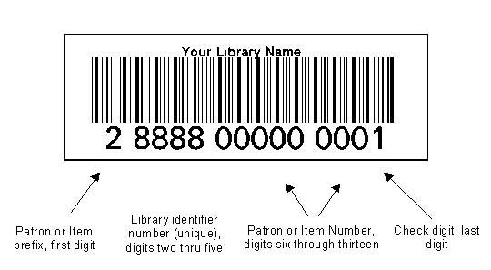
“Decoding” a Barcode
Codabar library barcodes consist of a string of 14 digits:
You can learn more about barcodes
at All About Library Barcodes:
http://www.barcodediscount.com/solutions/library-labeling.htm

Slide 66
Barcode Application
Barcode labels can be placed on the inside or outside of the item. There are advantages and disadvantages to where the label is placed on the item.
Inside or Outside ?
  Placing the barcode label on the outside of the cover is useful for inventory purposes and fast check-out without having to open the book.
  Placing the barcode label on the inside back cover endpaper protects the barcode. If your library uses date due slips or date stamps this may increase check-out efficiency.

Slide 67
Circulation Policies
Below is a list of items that will probably have to be configured in the circulation area:
Loan length for different material types (example: videos versus books)
Number of renewals allowed
Fines

Slide 68
Circulation Policies (cont.)
Below is a list of items that will probably have to be configured in the circulation area:
Staff privileges for access to different parts of the software
Can the patron request a hold or renewal via the web catalog if that is available? What email will that request go to? Will you have to set up a new email account that various staff can log into for these requests?

Slide 69
Decide on Patron Types
Do you want to set up different patron types?
Think about gathering statistics before setting up patron types.
  Adult
  Young Adult
  Juvenile
  Non-resident
  Staff
  Other ?

Slide 70
Item/Material Types
Item or material types are the "categories" into which your library items are divided.
Give this some thought. Circulation rules, statistics, catalog searches, and other software functions are based on these categories once they are set up.

Slide 71
Item/Material Types (cont.)
Do you want categories for DVDs, videocassettes, audio books?
For ease in gathering of statistics for federal annual report do you want material types for Children, Young Adult, Magazines, etc.?

Slide 72
Printers, Scanners, etc.
There will also be a place to set up printers, bar code scanners, wands, etc, that can be used for the software.
Before purchasing a scanner make sure it can be configured to read the barcode symbology supported by your software.

Slide 73
Add Patrons
Begin entering your patrons into the software so you can create their barcoded library card.
Do not automatically assign a barcode to every patron you currently have listed. Some of your patrons may have moved or are no longer living.
Clean up your patron records and get current address and phone number information for your currently active patrons.
Be sure to collect your patron’s email address! Most ILS software allows you to email overdue notices and other news.

Slide 74
Cataloging and Adding Records
The steps for this process will vary a bit from software to software.
Most ILS software has a built in cataloging module that allows you to easily download free MARC records.
Usually you can scan the ISBN/EAN barcode from the back of the book to search a Z39.50 catalog, match the item and download the MARC record.
Once downloaded you will need to enter your “local information” like the Dewey Call number.
Remember that some of the best sources for MARC records on the Internet are free.

Slide 75
Adding Items/Books
You can import the files from the third party vendor who did your conversion.
If you are doing the conversion yourself or adding new books begin by scanning the ISBN number. Find the matching MARC record, save or download and then import into your ILS/LMS. Some systems allow you to create batches of MARC records to upload. Others require you load one at a time.
You will have to add your local Call Number information in the MARC tag required by your software.
Notes:
Ome systems

Slide 76
To sum up..
The process to automate a small library is the same as automating a large library.
Although the scope is smaller it library to dedicate the time and resources needed is still a challenging endeavor for any small.
But in today’s technologically sophisticated world a library that is not yet automated, or has decided not to automate, is simply a reading room. Today, people’s expectations of what can be done online is very high. Without an automation system a library can’t even begin travelling down the path to meet those expectations.

Slide 77
Good luck with your automation project!
This short course doesn’t cover every step and consideration but will hopefully provide enough information to give your library a solid foundation
on which to build your automation project.

