Slide 1
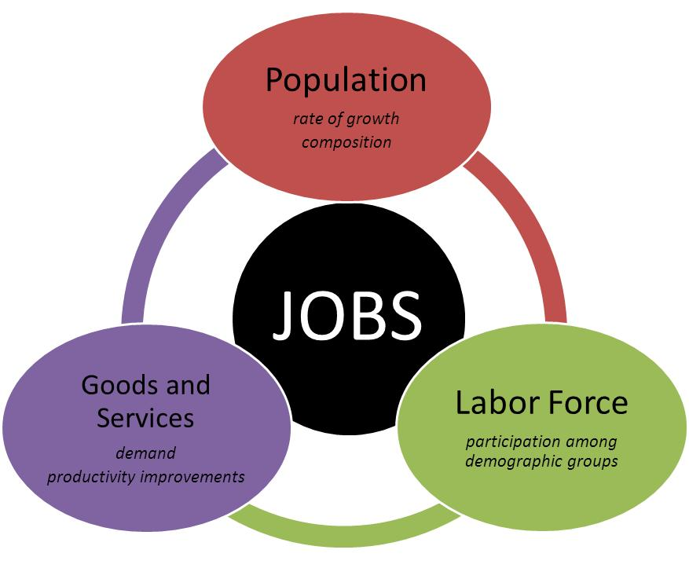
Maine Workforce & STEM Occupations Outlook
2014 to 2024
Glenn Mills
Chief Economist
Center for Workforce Research
Maine Dept. of Labor
www.maine.gov/labor/cwri
207-621-5192

Slide 2
Labor Force
Trends & Outlook

Slide 3
The number of births has declined precipitously
Natural population change–the difference between births and deaths–has been slightly negative since 2011, a pattern that is expected to continue over the next decade. Net migration–the difference between the number moving into and out of the state–was positive most years from the 1970s to early 2000s, but has only been just enough to offset the natural decline since 2007.

Slide 4
The decline in births caused an imbalance in our population structure. Maine has a very high share of people in their 50s and 60s headed toward retirement and low share of kids to replace them in the labor force.
The large gap between the number of people who will retire and the number of young people who will enter the workforce will put significant downward pressure on the size labor force over the next two decades.

Slide 5
The total population has been nearly unchanged since 2008 due to the combination of no natural increase and very little net migration
From the 1970s to early 2000s, the combination of natural increase and positive net migration– the difference between those moving into and out of the state–caused consistent population growth. Since 2007, net migration has been just enough to offset the small natural decline. If net migration does not pick up, the total population is likely to gradually decline.

Slide 6
The senior population is expected to rise sharply as the number of prime-age workers declines nearly as much
Changes in the size of the labor force are driven not only by changes in the size of the population, but also its composition. A rising share of the population is advancing beyond their peak years of labor force attachment.

Slide 7
The senior population is expected to rise sharply as the number of prime-age workers declines nearly as much
Changes in the size of the labor force are driven not only by changes in the size of the population, but also its composition. Labor force participation rates are expected to rise in all age groups, but the total participation rate will decline because a rising share of population is advancing to retirement.

Slide 8
The labor force is expected to decline through 2024 as a result of these population trends
Rapid labor force growth from the mid 1960s through 1980s was driven by thousands of baby boomers going to work. Over the next two decades more baby boomers are expected to leave the labor force than the number of young people who will begin working, causing the size of the labor force to decline.

Slide 9
Industry Job
Trends & Outlook

Slide 10
Employment has long been shifting from businesses that produce goods to those that provide services

Slide 11
Three-quarters of jobs are in healthcare, government, retail, professional services, hospitality, or manufacturing
With 101,100 jobs, healthcare and social assistance was the largest sector in Maine in 2014. Government (federal, state, and local, including public schools, community college, and university systems) was second with 95,500 jobs. Retail trade (81,700 jobs), professional and business services (63,500), leisure and hospitality (63,200), and manufacturing (50,200) were the next largest.

Slide 12
Job gains are expected to be substantial in three sectors, with large losses in two, and little change in others
The shifting age structure of the population is a primary factor driving job gains in healthcare and losses in government, mostly in public education. Professional services and hospitality are expected to continue to add jobs and the long-term downward job trend in manufacturing and information is also expected to persist.

Slide 13
Occupational Job
Trends & Outlook

Slide 14
The occupational structure of employment has shifted away from blue-collar jobs

Slide 15
STEM Occupations Job
Trends & Outlook

Slide 16
Two approaches to defining STEM
By academic course of study or degree
By occupation of work
Some who have an academic background in a STEM field do not work in an associated field
Some working in a STEM occupation do not have an academic background in that discipline
We use the occupation of work approach to look at the number of jobs and the outlook for growth

Slide 17
STEM occupations
The U.S. Bureau of Labor Statistics designates 184 occupations as STEM
The O*Net Consortium designates 167 occupations as STEM
We use a combined list, totaling 197 occupations

Slide 18
Jobs in STEM occupations are expected to increase by about 5,400 to 115,900 in 2024
Of 197 STEM occupations, jobs in 120 are expected increase at a faster rate than the average, but jobs in 77 occupations are projected to increase at or below the average or lose jobs.

Slide 19
In contrast, the number of jobs in non-STEM occupations is not expected to change much

Slide 20
And the share of jobs in STEM occupations is only expected to rise slightly (from 16.7% to 17.4% of all jobs)

Slide 21
Growth is the source of only 12% of job openings. Most openings are to replace those who leave the labor force. About 17% of openings are expected in STEM occupations.
In STEM occupations, about 22% of openings will be due to growth; in non-STEM occupations, just 9% of openings will be due to growth.

Slide 22
STEM jobs are found in 15 of 22 broad occupational groups. The largest share are healthcare practitioners & technicians.

Slide 23
39% of STEM jobs are in health practitioner/technician, 12% in management, 10% in computer/mathematics,
9% in business/finance, and 9% in architecture/engineering occupations
STEM occupations are not a homogeneous group; education and skill requirements, wage levels, and job outlook differ greatly

Slide 24
There is a wide range of education requirements among STEM occupations, though 75% require an associate’s degree or higher

Slide 25
About half of jobs in STEM occupations require a Bachelor’s degree, 15% require an advanced degree, and nearly 1/3 do not require a degree

Slide 26
The average hourly wage of jobs in STEM occupations is 84% higher than for jobs in non-STEM occupations…
The average is skewed by high wages of Physicians and other health practitioners, which comprise the 10 highest paying STEM occupations. Average wages for 28 STEM occupations are below the average for all occupations.

Slide 27
The highest average wages are in healthcare occupations

Slide 28
Within occupational groups, average wages are similar for STEM and non-STEM jobs…with some exceptions

Slide 29
STEM jobs offer higher average wages no matter what the education requirement for the occupation. Differentials generally are larger at higher levels of required education

Slide 30
Not all occupations expected to increase rapidly will have many openings
(20 STEM occupations with fastest rate of growth)

Slide 31
Not all occupations with large numbers of expected openings are growing
(20 STEM occupations with largest number of openings)

