Slide 1
Six Green
and
Speckled Frogs

Slide 2
Six green and speckled frogs,
Sat on a speckled log,
Eating some most delicious bugs.
Yum! Yum!

Slide 3
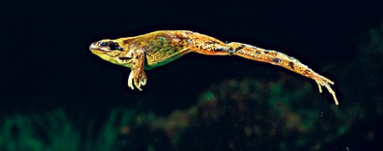
One jumped into the pool,
Where it was nice and cool.
Now there are five green speckled frogs.
Glub! Glub!

Slide 4
One jumped into the pool,
Where it was nice and cool.
Now there are four green speckled frogs.
Glub! Glub!

Slide 5
One jumped into the pool,
Where it was nice and cool.
Now there are three green speckled frogs.
Glub! Glub!

Slide 6
One jumped into the pool,
Where it was nice and cool.
Now there are two green speckled frogs.
Glub! Glub!

Slide 7
One jumped into the pool,
Where it was nice and cool.
Now there is one green speckled frog.
Glub! Glub!

