Slide 1
Who Fed the Chickens?
Modified from the song by Ella Jenkins

Slide 2
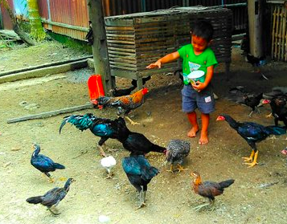
Who fed the chickens?
I did!
Who stacked the hay?
I did!
Who milked the cow?
I did!
On this fine day.

Slide 3
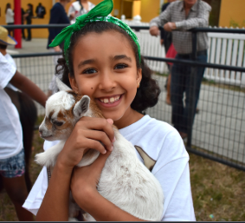
Who fed the chickens?
We did!
Who pet the kid?
We did!
Who brushed the llama?
We did!
On this fine day.

