Slide 1
Sleeping Outdoors
By Marchette Chute

Slide 2
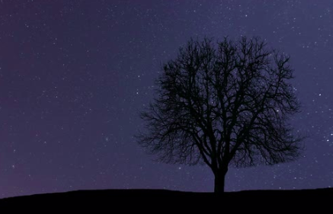
Under the dark is a star,
Under the star is a tree,
Under the tree is a blanket,
And under the blanket is me.

