Slide 1
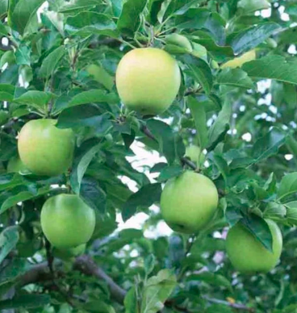
Five Green Apples

Slide 2
Farmer Gladys had 5 green apples
hanging on a tree,
Farmer Gladys had 5 green apples
hanging on a tree.
Then she grabbed one apple
and she gulped it hungrily!
Leaving 4 green apples
hanging on a tree.

Slide 3
Farmer _____ had 4 green apples
hanging on a tree,
Farmer _____ had 4 green apples
hanging on a tree,
Then s/he grabbed one apple
and s/he gulped it hungrily!
Leaving 3 green apples
hanging on a tree.

Slide 4
Farmer _____ had 3 green apples
hanging on a tree,
Farmer _____ had 3 green apples
hanging on a tree,
Then s/he grabbed one apple
and s/he gulped it hungrily!
Leaving 2 green apples
hanging on a tree.

Slide 5
Farmer _____ had 2 green apples hanging on a tree,
Farmer _____ had 2 green apples hanging on a tree,
Then s/he grabbed one apple
and s/he gulped it hungrily!
Leaving 1 green apple
hanging on a tree.

Slide 6
Farmer _____ had 1 green apple hanging on a tree,
Farmer _____ had 1 green apple hanging on a tree,
Then s/he grabbed that apple
and s/he gulped it hungrily!
Leaving no green apples
hanging on a tree!

