Slide 1
Student Learning and Growth: Approaches to Measuring Teacher Effectiveness

Slide 2
Introduction
This slide presentation introduces emergent thinking on a method of rating teachers on the student learning and growth component of a performance evaluation and professional growth (PEPG) system. The "Performance-Gap-Reduction" (PGR) method presents both a unique approach to targeting and measuring student growth and to rating teacher impact on that growth. This resource supports districts in understanding both the PGR method and the more commonly used method. The Maine DOE welcomes input and feedback from districts who decide to use either of the methods described in this presentation.
HOME

Slide 3
Overview of Presentation
The primary purpose of this presentation is to provide an analysis of two methods of measuring and rating teachers on student learning and growth. We call these two methods the "Percent-Met" method and the "Performance-Gap- Reduction" method. The presentation includes:
An overview of requirements related to measures of student learning and growth
Sample methods of combining measures to arrive at a summative rating
A review of the components of the SLO
A comparison between the SLO and state requirements for student learning and growth
An analysis of the two rating methods.
FAQs on the Performance Gap Reduction method
HOME

Slide 4
Overview of Requirements Related to Measures of Student Learning And Growth

Slide 5
Local Decisions Related to the Student Learning and Growth Factor and Rating
*The method of determining a teacher's rating on measures of Student Learning and Growth
*Procedures for setting growth targets for students
Requirements for attribution of student growth to teachers (Teacher(s) of Record; collective attribution)
Criteria for size of instructional cohort
Criteria for length of instructional interval of time
Requirements for number of growth targets per year/summative rating
Local requirements for use and development of assessments
*Method of recording and monitoring elements of the growth measure, e.g, the Student Learning Objective (SLO)
The method of combining student learning and growth with other factors to arrive at a summative rating.
*Primary focus of this slide presentation
HOME

Slide 6
General Requirements and Concepts

Slide 7
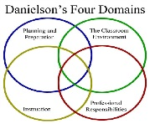
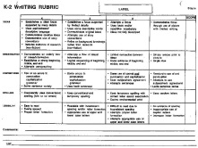
Required Measures of Educator Effectiveness
Professional Practice
Student Learning and Growth
A district may choose to include other measures of effectiveness , such as professional growth or surveys.
Multiple Measures

Slide 8
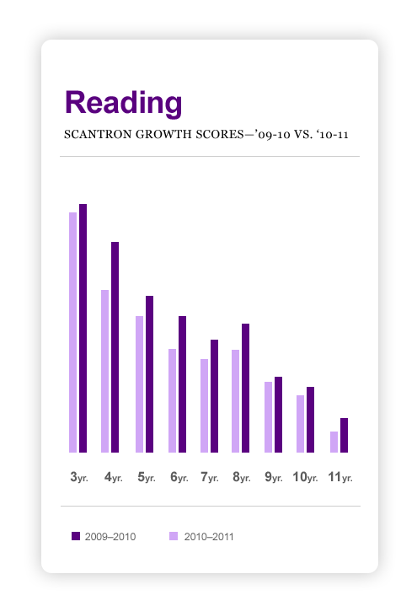
Defining 'Student Learning and Growth'
As a factor in the summative effectiveness rating of a teacher or principal, 'Student Learning and Growth' is based on data that measures a change in an *instructional cohort's academic knowledge and skills between two points of time.
*The student or group of students whose
academic growth will be attributed to a
teacher or principal.

Slide 9
Learning and Growth Measure: The Basics
Growth Measure
Based on Content Standards
Requires Pre and post assessment
* Attributed to individual or multiple teachers of record
Based on an assessment that meets criteria for "permissible measures" in Rule Chapter 180
*May be applied outside TOR under certain conditions
HOME

Slide 10
Student Learning and Growth as a "Significant Factor"
Local Decision: The percentage of an overall summative rating that student learning and growth will comprise is a local decision subject to Maine DOE approval.
Maine DOE Parameters: The Educator Effectiveness law requires that in an educator's summative effectiveness rating Student Learning and Growth must be a "significant factor." "To be considered “significant,” the rating on student learning and growth must have a discernible impact on an educator’s summative effectiveness rating" (Rule Chapter 180).
Default Percentage: If by June 1, 2015 the local development committee cannot by consensus reach agreement on the percentage that Student learning and Growth will comprise, the default percentage will be 20% in a numeric scale.

Slide 11
Methods of Combining Multiple Measures
The next three slides illustrate two different methods of combining measures to arrive at a summative rating. The method used is a local decision.

Slide 12
Method 1: Numeric Values and Weights
SAMPLE Summative Evaluation Score Table
Measure of Effectiveness | Results |  | Weight |  | Weighted Results
Professional Practice | 3.5 | X | .60 | = | 2.1
 |  |  |  |  | +
Professional Growth | 3 | X | .10 | = | .3
 |  |  |  |  | +
Student Learning and Growth | 3 | X | .30 |  | .9
 |  |  |  |  | =
 | Final Summative Score |  |  |  | 3.30
Final Score | Summative Effectiveness Rating
3.4 or higher | Distinguished
2.5-3.4 | Effective
1.5-2.4 | Developing
Less than 1.5 | Ineffective

Slide 13
Method 2: Criterion-Based Ratings Plotted on Pre-set Matrix
See detailed instructions in the Maine DOE T-PEPG Handbook
Notes:
5. intention is to ensure equity, fairness, validity and reliability, rigor, integrity

Slide 14
Different Approaches, Same Process
Rate Individual Indicators
Combine Individual Ratings into Composite Performance Measure Ratings
Combine Performance Measure Ratings
Rate individual indicators of professional practice
Rate individual measures of student growth (e.g., results of individual SLOs)
Rate individual factors of any other performance categories, e.g., professional growth
Combine ratings on individual indicators of professional practice into a composite professional practice rating (PP Rating)
Combine ratings on individual measures of student growth into a composite student learning and growth rating (SG Rating)
Combine ratings on individual factors related to any other measures of performance categories into composite rating (e.g., PG Rating)
Summative Effectiveness Rating
1
2
3

Slide 15
The Student Learning Objective (SLO) Framework
This purpose of this section is to provide perspective on the role of the Student Learning Objective (SLO) framework in measuring student learning and growth. We include this section because our analysis of the two rating methods has implications for the SLO process.

Slide 16
The Benefits of the SLO Process in a Performance Evaluation and Professional Growth System
Performance Evaluation | Professional Growth
Links student outcomes to individual teachers | “Adds value and improves practice,” as reported by Maine teachers
Contains important data, such as roster and teacher(s) of record. | Focuses and aligns student needs, learning objectives, instruction and assessment
Reduces risk of inaccuracies in roster verification | Provides context for important professional conversations and collaboration
Allows for flexible grouping and attribution of teachers in a student-centered system | Connects to additional readily available resources across the nation

Slide 17
The Components of the SLO Document
As commonly understood, the SLO is a locally designed document framework that:
Always includes | Includes depending on method used | Optionally includes
Roster of instructional cohort and names of teacher(s) of record |  | Identification of students' needs or readiness to meet the standards, based on available data
Interval of instructional time
Expected learning outcomes and range of possible growth | Teacher-developed growth target(S) The Performance Gap Reduction method of measuring growth and rating teachers does not necessitate a teacher-developed growth target, but it does necessitate knowledge of the individual and mean performance gaps as determined by pre and post assessments.
Identification of content standards that will be taught and assessed |  | Explicit alignment of content standards to assessment items
Identification of pre- and post-assessments |  | Key Instructional Strategies and formative assessment processes
Baseline performance on a pre-assessment
Post-assessment results

Slide 18
Elements of the SLO Required or implicated by Law (The SLO framework itself is not a requirement of the law)

Slide 19
SLO Sections | Required | Description of information Typically Entered on SLO Document
Teacher of Record Demographics | YES | States the number of students included in the SLO
 |  | Provides relevant and complete information about student characteristics
 |  | Includes start and end dates of interval of instructional time
Baseline data and Student Needs | LOCAL Decision | Identifies area(s) of need
 |  | Identifies available data used to determine areas of strength and need
 |  | Includes analysis of available data for areas of strength and need
Content Standards | YES (de facto) | Includes standards that align to the area of need and to the assessments Rule Chapter 180 requires that an assessments "Be able to measure growth in identified and intended learning outcomes."
 | LOCAL Decision | Includes both application/process and content standards
 | YES (de facto) | Includes standards that are rigorous but focused enough to be measured using an appropriate assessment Rule Chapter 180 requires that an assessments "Be able to measure growth in identified and intended learning outcomes."
Box 10 Pre and Summative Assessment | YES | Identifies an assessment that aligns with the identified content and process standards.
 | YES | Identifies an assessment that meets all criteria in Rule Chapter 180 (Table 5 of SLO Handbook)
 | LOCAL Decision | Describes the format and structure of the assessment
 | YES (de facto) | Lists modifications or accommodations that will be necessary for students with IEPs or 504 plans and/or ELL students, and explains how the modifications or accommodations will be provided. Rule Chapter 180 requires that an Assessment Be able to measure growth in identified and intended learning outcomes

Slide 20
SLO Sections | Required | Description of information Typically Entered on SLO Document
Box 11 Growth Targets | LOCAL Decision | Numerical growth targets for all students on the roster
 | LOCAL Decision | Includes targets that are rigorous, attainable, and developmentally appropriate
 | LOCAL Decision | Includes a rationale for the targets that explains how the growth targets were determined
Box 12 Instructional Strategies | LOCAL Decision | Lists two or three key strategies that the teacher will use to support students.
 | LOCAL Decision | Identifies multiple ways the teacher will monitor student progress throughout the interval of instruction.
 | LOCAL Decision | Explains how progress monitoring data will drive instructional plans.
Box 13 Formative Assessment | LOCAL Decision | Describes strategies that will be used to assess learning at anticipated check points and the adjustments to instruction or interventions that might be taken based on results of formative assessment (not all formative assessments and adjustments can be anticipated, but the teacher should have preplanned some formative processes).
Pre-Approval by Peer(s) | LOCAL Decision
Final Approval Signature | LOCAL Decision

Slide 21
Guidance Provided in The Maine DOE SLO Handbook
Table 1—Teacher(s) of record and Instructional Cohort
Table 2—Student Demographics and Baseline Data
Table 3—Interval of Instructional Time
Table 4—Curricular Standards
Table 5—Assessments
Table 6—Growth Targets
Table 7—Key Instructional Strategies
Table 8—Formative Assessment Processes
Table 9—The Approval Process
Table 10—Modifications to an SLO
Table 11—Implementing the SLO
Table 12—Rating the SLO

Slide 22
Method of Scoring Student Learning and Growth Measures to Determine Teacher Rating
The following slides compare two different methods of measuring student growth and determining a teacher's impact on that growth :
The Percent-Met Method
The Performance-Gap-Reduction Method

Slide 23
Percent-Met Method Rating Scale*
Based on number of students who meet a growth target, which is typically set by the teacher.
Percentage Ranges of Students Who Met Their Growth Targets | Teacher Impact
85–100% | High
71–84% | Moderate
41–70% | Low
0–40% | Negligible
Total of the % of all growth targets met ÷ number of SLOs = Average % of students who met the growth target | Impact on Student Learning and Growth Rating
*This Impact scale is used in the Maine DOE Teacher Performance Evaluation and Professional Growth Model, which also uses an SLO frame. The design of the scale represents the widely used method of measuring student growth and rating teacher impact on that growth. In some instances of the use of this method, the rating categories are numeric (e.g. 85-100% = 3.51-4.00 Points).

Slide 24
Steps in the Percent-Met Method
Step 1: Pre-assess; score
Step 2: Teacher sets a growth target for the cohort, using one of multiple approaches (see slide 34)
Step 3: Post-assess; score
Step 4: Determine how many students met the growth target set for the cohort
Step 5: Determine the teacher's impact rating on the % Met Impact Scale

Slide 25
Step 1: Pre-Assessment
Student | Mastery Score | Pre-Assessment Score
A | 250 | 95
B | 250 | 86
C | 250 | 222
D | 250 | 37
E | 250 | 103
F | 250 | 214
G | 250 | 230
H | 250 | 78
I | 250 | 87
J | 250 | 200
Assessment: The comprehensive assessment in our sample has a total possible points of 250.
Notes:
Slide is animated; Click after comapring scales

Slide 26
Step 2: Teacher Sets Growth Target for the Cohort
Target-Setting Guidelines
Baseline and pretest data inform developmentally appropriate expectations for students on the summative assessment.
Growth targets are informed by knowledge of students, content, and assessments.
State and district guidelines help ensure that SLO growth targets are rigorous, attainable, and developmentally appropriate.
All students regardless of pre-assessment scores are expected to demonstrate significant and appropriate growth.
Student growth targets may be formatted in a variety of ways. Districts may set additional guidelines or requirements related to the formatting of growth targets. The following slide shows sample formats, but not the only formats, for growth targets.
Maine DOE and MSFE Guidelines
Notes:
Slide is animated; Click after comapring scales

Slide 27
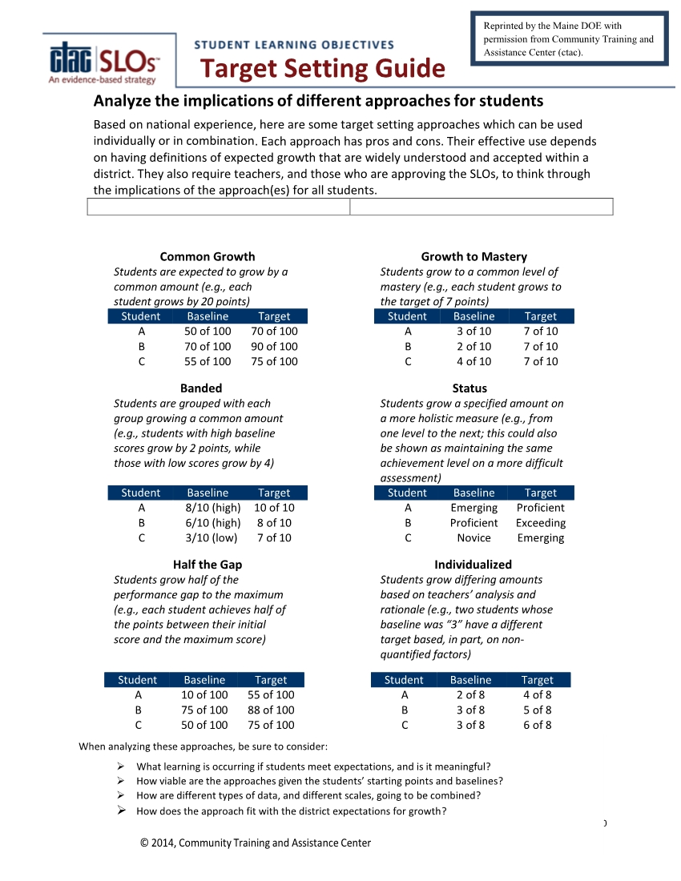
This guide can be found in the Maine DOE Student Learning Objective Handbook

Slide 28
Step 2: Continued
Growth Target Format: Half-the-Gap
Example: All students will increase their scores by one half the difference between 250 and their pre-assessment score; a student who scored 50 on the pre-assessment would be expected to score a 150 on the post-assessment.
Notes:
Slide is animated; Click after comapring scales

Slide 29
Step 2: Continued
Growth Target Format: Half-the-Gap
All students will increase their scores by one half the difference between 250 and their
pre-assessment score; a student who scored 50 on the pre-assessment
would be expected to score a 150 on the post-assessment.
Student | Max Score Possible | Pre-Assessment Score | Performance Gap | ½ the gap growth target
A | 250 | 95 | 155 | 72.5
B | 250 | 86 | 164 | 82
C | 250 | 222 | 28 | 14
D | 250 | 37 | 213 | 106.5
E | 250 | 103 | 147 | 73.5
F | 250 | 214 | 36 | 18
G | 250 | 230 | 20 | 10
H | 250 | 78 | 172 | 86
I | 250 | 87 | 163 | 81.5
J | 250 | 200 | 50 | 25
Notes:
Slide is animated; Click after comapring scales

Slide 30
Step 3: Post-assess
Student | Max Score Possible | Pre-Assessment Score | Performance Gap | ½ the gap growth target | Post assessment score
A | 250 | 95 | 155 | 72.5 | 194
B | 250 | 86 | 164 | 82 | 167
C | 250 | 222 | 28 | 14 | 236
D | 250 | 37 | 213 | 106.5 | 135
E | 250 | 103 | 147 | 73.5 | 171
F | 250 | 214 | 36 | 18 | 231
G | 250 | 230 | 20 | 10 | 240
H | 250 | 78 | 172 | 86 | 162
I | 250 | 87 | 163 | 81.5 | 193
J | 250 | 200 | 50 | 25 | 229
Notes:
Slide is animated; Click after comapring scales

Slide 31
Step 4: Determine Number of Students who Meet Growth Target
Student | Max Score Possible | Pre-Assessment Score | Performance Gap | ½ the gap growth target | Post assessment score | Growth gain | Met target Yes/no
A | 250 | 95 | 155 | 72.5 | 194 | 99 | Y
B | 250 | 86 | 164 | 82 | 167 | 81 | N
C | 250 | 222 | 28 | 14 | 236 | 14 | Y
D | 250 | 37 | 213 | 106.5 | 135 | 98 | N
E | 250 | 103 | 147 | 73.5 | 171 | 68 | N
F | 250 | 214 | 36 | 18 | 231 | 17 | N
G | 250 | 230 | 20 | 10 | 240 | 10 | Y
H | 250 | 78 | 172 | 86 | 162 | 84 | N
I | 250 | 87 | 163 | 81.5 | 193 | 106 | Y
J | 250 | 200 | 50 | 25 | 229 | 29 | Y
 |  |  |  |  |  |  | 5/10
 |  | 50% of students met growth target
Notes:
Slide is animated; Click after comapring scales

Slide 32
Step 5: Determine the Teacher's Impact Rating on the Percent-Met Scale
Percentage Ranges of Students Who Met Their Growth Targets | Teacher Impact
85–100% | High
71–84% | Moderate
41–70% | Low
0–40% | Negligible
Total of the % of all growth targets met÷ number of SLOs = Average % of students who met the growth target | Impact on Student Learning and Growth Rating
Notes:
Slide is animated; Click after comapring scales

Slide 33
Some Implications of Setting Growth Targets
The SLO typically includes a teacher-developed growth target. The growth target element of the SLO process requires:
The need for training in setting of growth targets
A mechanism for ensuring comparability, fairness, and accuracy
A mechanism for safeguarding against conflicts of interest
An approval agent well-versed in growth targets

Slide 34
A Closer Look at the Percent-Met Method
The following slides illustrate possible outcomes of the Percent-Met method.

Slide 35
Comparing Percent Targets Met in Two Like Cohorts
Teacher 1 Growth Teacher 2 Growth
A 150 /157 y 7 A 150/162 y 12
B 170/176 y 6 B 170/189 y 19
C 175/163 n -12 C 175/180 n 5
D 180/187 y 7 D 180/194 y 14
E 190/186 n -4 E 190/193 n 3
F 195/203 y 8 F 195/213 y 18
% Met Growth
Target 4 of 6 ≈ 66%..................................................................................................4 of 6 ≈ 66%
Two like teachers
Illustration based on use of individual growth targets (GTs) converted to mean GT of 6
Same number of students meet the growth target

Slide 36
Percent-met Rating Scale
Percentage Ranges of Students Who Met Their Growth Targets
85–100% | High
71–84% | Moderate
41–70% | Low
0–40% | Negligible
Total of the % of all growth targets met÷ number of SLOs = Average % of students who met the growth target | Impact on Student Learning and Growth Rating
Teacher 1 and Teacher 2
Same rating on Percent-Met Scale
Notes:
Slide is animated; Click after comapring scales

Slide 37
Comparing Actual Growth
Teacher 1 Growth Teacher 2 Growth
A 150 /157 y 7 A 150/162 y 12
B 170/176 y 6 B 170/189 y 19
C 175/163 n -12 C 175/180 n 5
D 180/187 y 7 D 180/194 y 14
E 190/186 n -4 E 190/193 n 3
F 195/203 y 8 F 195/213 y 18
4 12 4 71
% Met Growth
Target 4 of 6 ≈ 66%..................................................................................................4 of 6 ≈ 66%
Mean Growth 12÷6 = 2.00 ………………………………………………………………..71÷6 =11.83
Different amount of actual growth occurs.

Slide 38
Comparing Percent-met with Actual Growth
Teacher 1 Growth Teacher 2 Growth
A 150 /157 y 7 A 150/164 y 14
B 170/176 y 6 B 170/189 y 19
C 175/163 n -12 C 175/180 n 5
D 180/187 y 7 D 180/194 y 14
E 190/196 y 6 E 190/195 n 5
F 195/203 y 8 F 195/213 y 18
5 22 4 75
% Met Growth
Target 5 of 6 ≈ 83%..................................................................................................4 of 6 ≈ 66%
Mean Growth 22÷6 = 3.66 ………………………………………………………………..75÷6 =12.50
Different amount of actual growth occurs.

Slide 39
Percent-Met Rating Scale
Percentage Ranges of Students Who Met Their Growth Targets
85–100% | High
71–84% | Moderate
41–70% | Low
0–40% | Negligible
Total of the % of all growth targets met÷ number of SLOs = Average % of students who met the growth target | Impact on Student Learning and Growth Rating
Teacher 1
Teacher 2
Teacher 1 is rated as having greater growth impact than Teacher 2 even though teacher 2’s instructional cohort has more than three times the mean growth as Teacher 1’s instructional cohort.
Notes:
Slide is animated; Click after comapring scales

Slide 40
Summary of A Closer Look at the Percent-Met Method
The percent-met method of arriving at a teacher's Student Learning and Growth uses a binary, yes or no, target that does not account for all of the growth attained (or not attained) by students in a cohort.
When all factors are made equal, the Percent-Met method cannot distinguish between two teachers with significantly different actual growth.
When all factors are made equal, the Percent-Met method could result in teachers whose instructional cohorts show lower actual growth being rated higher than teachers whose cohorts show higher actual growth.
Notes:
Slide is animated; Click after comapring scales

Slide 41
Performance-Gap-Reduction (PGR) Method

Slide 42
Steps in the PGR Method
Step 1: Pre-assess; score
NOTE: The PGR method does not require teachers to set a growth target for a cohort.
Step 2: Calculate the mean performance gap among students
Step 3: Post-assess; score
Step 4: Calculate the mean growth among students
Step 5: Calculate % Mean Performance Gap Reduction
Step 6: Determine the teacher's impact rating on the RPG Impact Scale
Notes:
Slide is animated; Click after comapring scales

Slide 43
Step 1: Pre-Assessment
Student | Max Score Possible | Pre-Assessment Score
A | 250 | 95
B | 250 | 86
C | 250 | 222
D | 250 | 37
E | 250 | 103
F | 250 | 214
G | 250 | 230
H | 250 | 78
I | 250 | 87
J | 250 | 200
Assessment: The comprehensive assessment in our sample has a total possible points of 250.
Notes:
Slide is animated; Click after comapring scales

Slide 44
Step 2: Calculate Mean Performance Gap
Student | Max Score Possible | Pre-Assessment Score | Performance Gap
A | 250 | 95 | 155
B | 250 | 86 | 164
C | 250 | 222 | 28
D | 250 | 37 | 213
E | 250 | 103 | 147
F | 250 | 214 | 36
G | 250 | 230 | 20
H | 250 | 78 | 172
I | 250 | 87 | 163
J | 250 | 200 | 50
 |  |  | Mean Performance Gap 1,148 ÷ 10 ≈ 114.8
Notes:
Slide is animated; Click after comapring scales

Slide 45
Step 3: Post-assess
Student | Max Score Possible | Pre-Assessment Score | Performance Gap | Post-Assessment Score
A | 250 | 95 | 155 | 194
B | 250 | 86 | 164 | 167
C | 250 | 222 | 28 | 236
D | 250 | 37 | 213 | 135
E | 250 | 103 | 14 | 171
F | 250 | 214 | 36 | 231
G | 250 | 230 | 20 | 240
H | 250 | 78 | 172 | 162
I | 250 | 87 | 163 | 193
J | 250 | 200 | 50 | 229
 |  |  | Mean Performance Gap 1,148 ÷ 10 ≈ 114.8
Notes:
Slide is animated; Click after comapring scales

Slide 46
Step 4: Calculate Mean Growth
Student | Max Score Possible | Pre-Assessment Score | Performance Gap | Post-Assessment Score | Mean Growth Gain
A | 250 | 95 | 155 | 194 | 99
B | 250 | 86 | 164 | 167 | 81
C | 250 | 222 | 28 | 236 | 14
D | 250 | 37 | 213 | 135 | 98
E | 250 | 103 | 147 | 171 | 68
F | 250 | 214 | 36 | 231 | 17
G | 250 | 230 | 20 | 240 | 10
H | 250 | 78 | 172 | 162 | 84
I | 250 | 87 | 163 | 193 | 106
J | 250 | 200 | 50 | 229 | 29
 |  |  | Mean Performance Gap 1,148 ÷ 10 ≈ 114.8 |  | 606 ÷ 10 ≈ Mean Growth 60.6
Notes:
Slide is animated; Click after comapring scales

Slide 47
Step 5: Calculate Percent Performance Gap Reduction (PGR)
Student | Max Score Possible | Pre-Assessment Score | Performance Gap | Post-Assessment Score | Mean Growth Gain
A | 250 | 95 | 155 | 194 | 99
B | 250 | 86 | 164 | 167 | 81
C | 250 | 222 | 28 | 236 | 114
D | 250 | 37 | 213 | 135 | 98
E | 250 | 103 | 147 | 171 | 68
F | 250 | 214 | 36 | 231 | 17
G | 250 | 230 | 20 | 240 | 10
H | 250 | 78 | 172 | 162 | 84
I | 250 | 87 | 163 | 193 | 106
J | 250 | 200 | 50 | 229 | 29
 |  |  | Mean Performance Gap 1,148 ÷ 10 ≈ 114.8 |  | 606 ÷ 10 ≈ Mean Growth 60.6
 |  | % Performance Gap Reduction—60.6/114.8 ≈ 53 %
Notes:
Slide is animated; Click after comapring scales

Slide 48
Step 6: Determine Rating on PGR Impact Scale
PGR Impact Scale
Mean growth index reduces mean performance gap by at least 75% | High
Mean growth index reduces mean performance gap by at least 50% | Moderate
Mean growth index reduces mean performance gap by at least 25% | Low
Mean growth index reduces mean performance gap by less than 25% | Negligible
Multiple measures of Student Learning Growth may be combined through equal or weighted values, but collective measures may not be weighted more than 25% of the total. | Impact on Student Learning and Growth Rating

Slide 49
Summary of the PGR Scale Analysis
Using a Performance Gap Reduction scale…
Uses all of the growth demonstrated by students in a cohort
Eliminates the variability in quality and rigor of growth targets set by individual teachers
Makes room for a greater focus, in training programs, on the quality of content standards, instruction, and assessments
Preserves data on individual students by using growth gains to arrive at the performance gap reduction
Provides for equity and comparability in establishing teacher impact rating for instructional cohorts with low, high or widely varying pre-assessment scores
Notes:
Slide is animated; Click after comapring scales

Slide 50
Frequently Asked Questions about the PGR Scale

Slide 51
FAQ 1
Question: We are intuitively uncomfortable with eliminating student growth targets. Can we use the PGR Rating scale along with student growth targets?
Answer: The PGR method does not eliminate student growth targets. It rather sets a continuum of growth ranging from 0 growth for 0 students to 100% of students achieving maximum attainable growth. Within that continuum, teachers should base their instruction on identified needs of students and articulated learning goals for improvement. This goal-oriented focus of instruction is clearly called for in the standards of every instructional practice framework approved by the Maine DOE for PEPG systems, and it is integral to the SLO process (for districts who choose to use SLOs).
Notes:
Slide is animated; Click after comapring scales

Slide 52
FAQ 2
Question: Is the maximum performance score that provides the performance-gap range based on the assessment or on something else?
Answer: The maximum performance must be defined by the assessment, but the assessment itself should be based on the appropriate developmental level of proficiency (learning goals) expected of the students at the end of the instructional period.
Notes:
Slide is animated; Click after comapring scales

Slide 53
FAQ 3
Question: Does the PGR method require that the pre and post assessments have the same number of questions or rubric criteria?
Answer: While it is possible to account for differences in the number of assessment items or * rubric criteria, it is not advisable with any method to have different numbers of pre and post assessment items. Statistically speaking, differences in the number of items reduces the assessment's accuracy in measuring growth gains by students. Especially when using data to measure educator effectiveness, the comparability of pre and post assessments is of highest priority.
*As a reminder, standards-based rubrics can be applied to different tasks while keeping the number of criteria stable.
Notes:
Slide is animated; Click after comapring scales

Slide 54
FAQ 4
Question: Isn't it possible to arrive at the mean PGR by simply comparing the pre and post mean performance gaps? Why is the column for mean growth included?
Answer: Yes, it is possible, but arriving at the mean performance gap on the post-assessment requires first knowing the growth gain each student makes. We feel it is important to make both that step and the growth gains visible.
Notes:
Slide is animated; Click after comapring scales

Slide 55
FAQ 5
Question: Can the PGR scale be used with the NWEA?
Answer: The NWEA Conditional Growth Index Calculator provides for a mean growth target for a cohort. The mean growth result is expressed as a mean 'Z' Score (CGI). The NWEA CGI scores can easily be converted to a rating on the PGR Scale.
A video explaining the calculation of the CGI score can be viewed here:
https://nwea.adobeconnect.com/_a203290506/cgicalculator/
A modified PGR impact scale with CGI Scores is shown on the next slide.
Notes:
Slide is animated; Click after comapring scales

Slide 56
PGR Impact Scale With NWEA CGI Results
PGR Impact Scale
Mean growth index reduces mean performance gap by at least 75% | High
NWEA mean Conditional Growth index of at least 0.5 (69th growth percentile)
Mean growth index reduces mean performance gap by at least 50% | Moderate
NWEA mean Conditional Growth index of at least 0.0 (50th growth percentile)
Mean growth index reduces mean performance gap by at least 25% | Low
NWEA mean Conditional Growth index of at least -0.5 (31st Growth percentile)
Mean growth index reduces mean performance gap by less than 25% | Negligible
NWEA mean Conditional Growth index of at least -1.0 (16th Growth Percentile)
Multiple measures of Student Learning Growth may be combined through equal or weighted values, but collective measures may not be weighted more than 25% of the total. | Impact on Student Learning and Growth Rating

Slide 57
FAQ 6
Question: Does the PGR approach advantage teachers of "zero-knowledge" courses, e.g., foreign language, in that the teachers will appear to influence more growth in students? Similarly, does the PGR approach disadvantage teachers with a preponderance of high achievers?
Answer: No. The problem of equal opportunity to impact student growth is not caused by any one scale, nor should the problem be addressed by adjusting growth targets. Rather it is a problem solved by selecting appropriate curriculum and assessments.
Notes:
Slide is animated; Click after comapring scales

Slide 58
FAQ 7
Question: How can we apply the PGR Rating for teachers to a principal's Student Learning and Growth rating?
Answer: One method is to plot the aggregate of all PGR ratings for teachers on the same scale.
PGR Impact Scale
Aggregate Reduction in mean performance gaps is at least 75% | High
Aggregate Reduction in mean performance gaps is at least 50% | Moderate
Aggregate Reduction in mean performance gaps is at least 25% | Low
Aggregate Reduction in mean performance gaps is less than 25% | Negligible
Notes:
Slide is animated; Click after comapring scales

Slide 59
FAQ 8
Question: What are the implications of the PGR method for the (SLO) process?
Answer: The PGR method provides a uniquely stable standardization of growth targets across teachers and contents. This allows for greater attention to the selection and approval of the content standards, the assessments, and the instructional plan articulated in the SLO.
Notes:
Slide is animated; Click after comapring scales

Slide 60
FAQ 9
Question: How did you come up with the cut scores on the PGR Scale?
Answer: The cut scores are based on a local district's answer to the question “How good is good enough?" The greater the percentage-gap reduction assigned to the lower impact rating levels (e.g., increasing negligible to 0-35% and Low to 35-70%) increases the growth expectation. On the other hand, reducing the percentage gap reduction assigned to these rating levels lowers the growth expectation. This same phenomena applies to the CGI criteria in establishing cut scores based on NWEA.
In our sample, an equal distribution of gap-reduction across the four ratings has been used for simplicity of illustration.
Notes:
Slide is animated; Click after comapring scales

Slide 61
FAQ 10
Question: In order to align with a 4-point proficiency scale, we convert all of our assessments to a 4-point scale. Can we still do this using the PGR scale?
Answer: Yes. In fact, the conversion of all assessments to a universal scale is helpful when it is necessary to combine results from multiple assessments either for one cohort or for multiple cohorts in determining a teacher's overall impact on student learning and growth.
In making the conversion, certain criteria must be met:
If a 1-4 scale is used for assessments, 1 must be equal to the lowest score in the performance range on the assessment. In our example 1 on the 1-4 scale is equal to 0). Therefore a value of 1 must be added to all converted scores.
In making the conversion the results from both the pre assessment and the post assessment must be converted to the universal scale.
The universal scale must use a non-truncated decimal place value (i.e., 1.00…1.35...2.15…3.00… 3.25...4.00)
See Example on the next slide.
Notes:
Slide is animated; Click after comapring scales

Slide 62
Example:
Note: If a "4-point scale" has a range of 1 to 4, it only has 3 levels of performance (1-2; 2-3; 3-4).
To convert our sample assessment to a 1-4-point scale:
Find the value of each point on the 250 point assessment: 3/ 250= .012; Each point on the 0-250 scale is equal to .012. score on the assessment of 125 would be equal to 2.50 on the 1-4 scale.
Pre-assessment: 100 points: 2.2 on the 1-4 scale (.012 X 100 = 1.2 +1)
The student's performance gap on the assessment scale is 100 pts.
On the 1-4 scale,100 equals 1.20 (.012 X 100 = 1.2 )
Post-assessment: 200 pts., on the1-4 scale, 3.4 (.012 X 200 = 2.40 +1)
Post-assessment performance gap: 50;
On the 1-4 scale, 50 equals .60 (.012 x 50 = .06)
Performance gap Reduction 50/100 = 50% or .06/1.2 = 50%
Notes:
Slide is animated; Click after comapring scales

Slide 63
Example:
Step in Process | Expanded Assessment Scale | Conversion | 1-4 Scale 3 levels (1-2; 2-3; 3-4)
Find point value of assessment items | 0-250 Pt. Assessment | 3÷250 = | .012
Pre-assessment | 100 | 100 X .012 = 1.2 + 1 | 2.2
Pre-assessment Performance Gap | 150 pts | 100 X .012 = 1.8 | 1.8
Post-assessment | 200 | 200 X .012 = 2.4 + 1 | 3.4
Growth | 100 pts | 100 X .012 = 1.2 | 1.2
Performance Gap Reduction | Growth divided by performance gap (100 ÷ 150) 66% | 1.2 ÷ 1.8 | 66%
Notes:
Slide is animated; Click after comapring scales

Slide 64
Contributors
Maine Department of Education—Mary Paine, Educator Effectiveness Coordinator; Anita Bernhardt, Director, Standards and Instructional Supports
RSU 74— Ken Coville, Superintendent
Maine Schools for Excellence—Scott Harrison, TIF 3 and TIF 4 Project Director; Sue Williams, TIF 3 Professional Development Coordinator; Jane Blais, TIF 4, Professional Development Coordinator; Deb Lajoie, TIF 3 and TIF 4 Project Coordinator A special thanks to the following for contributing technical expertise. BST Educational Consulting—Paul Stautinger, Consultant Community Training and Assistance Center—Scott Reynolds, Senior Associate, National School Reform
American Institutes for Research—Mariann Lemke, Managing Researcher
Notes:
Slide is animated; Click after comapring scales

