Slide 1
SAT Suite Question Bank
April 2020
10/02/18

Slide 2
Overview of the SAT Suite Question Bank

Slide 3
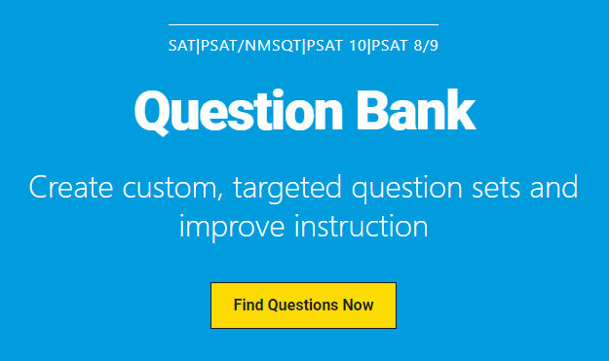
SAT Suite Question Bank
New resource to help educators understand the SAT Suite and make connections to classroom instruction.
Contains over 3,500 actual test questions from the SAT, PSAT/NMSQT (PSAT10), and PSAT 8/9.
Enables educators to find questions by:
Assessment
Test
Cross-Test and/or Sub-score
Level of Difficulty
Passage Text Complexity Level
Calculator/No-Calculator
Primary Dimension

Slide 4
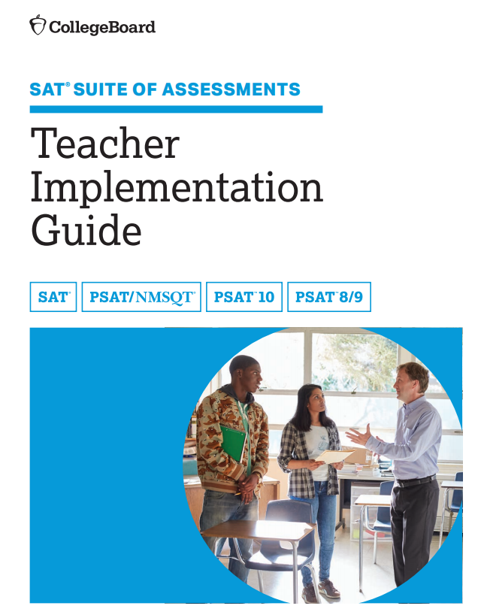
Primary, Secondary & Tertiary Dimensions The primary dimension is the skills and knowledge measured by each test are divided into broad categories called primary dimensions. Secondary dimensions are the subcategories of each primary dimension. Tertiary dimensions are the subcategories of each secondary dimension. The Teacher Implementation Guide (TIG) provides additional information on these dimensions.

Slide 5
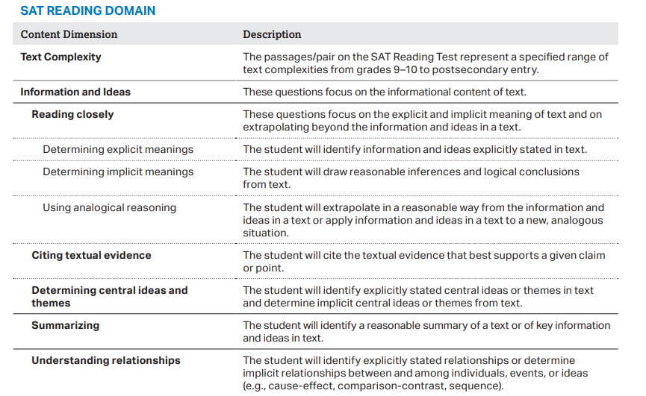
Where to Find Content Dimensions in TIG
Reading Test
Begins on page 16
Writing & Language Test
Begins on Page 28
Math Test
Begins on page 49
https://collegereadiness.collegeboard.org/pdf/redesigned-sat-k12-teacher-implementation-guide.pdf

Slide 6
SAT Suite Question Bank
The SSQB is publicly available.
A College Board account/username/password is not needed to access the SSQB.
K12 Educators
https://collegereadiness.collegeboard.org/educators/k-12
SAT Suite Question Bank Ideas
https://collegereadiness.collegeboard.org/educators/k-12/sat-suite-question-bank
SAT Suite Question Bank
https://satsuitequestionbank.collegeboard.org/

