Slide 1
Reading in high school
Helping all students engage with complex texts
Notes:
Redefine text as “source” instead of just text.

Slide 2
Goals for Series
Understand the similarities and differences of reading instruction in high school and in the lower grades
Learn strategies to help students engage with complex texts in any context
Develop instructional plans to address a variety of student needs
Notes:
Many strategies for teaching reading are developed for the lower grades. It is essential to help students engage with complex texts and not to replace complex texts with simplified versions. Most important is the need to develop consistent, unified plans to address needs in each content area.

Slide 3
Topics in Session 3
Asking the right questions
Key strategies inspired by wida

Slide 4
All students will be able to read, comprehend, and use information from complex texts that meet their personal and professional needs
COMMON PURPOSE
Notes:
In the larger sense, we want to set an overall purpose for reading instruction. We also need to be clear about the purpose of any task. What is it we want the student to learn and to know as a result of the task?

Slide 5
Agreements About Reading in the 21st Century
Reading is a social process.
We must expand our “definition” of reading to include viewing and listening.
We must expand our concept of text to include any source that helps students learn.
Notes:
Our shared vision of reading literacy: all students will be able to read, comprehend, and use information from complex texts that meet their personal and professional needs.

Slide 6
Direct Instruction of Reading Skills in High School
What does the text say?
How does the text work?
What does the text mean?
Notes:
These are three of the concepts found in Text Dependent Questions by Fisher, Frey, et.al.

Slide 7
The most important of these is:
What does the text say?
How does the text work?
What does the text mean?
Notes:
Which of these approaches to text will provide the greatest growth and protentional for learning transfer?

Slide 8
Creating the path for learning transfer
Notes:
Creating the path to learning transfer requires intentional instruction of universal elements and constructs. Understanding how a text works is the most significant element of reading transfer and is also the least taught.

Slide 9
The most important of these is:
How does the text work?

Slide 10
How Does the Text Work?
Text type – what is unique about the type of text?
How do headings and footers help with navigation?
What function do sidebars and pullout boxes serve?
Typography – what do different type styles mean?
Does color convey meaning in the text?
What is the purpose of symbols and icons?
What information is shared through images and graphs?

Slide 11
MS Physical Science
What do you notice?
How does this text differ from a literary text?
What features does a textbook usually have?
Notes:
What is the relationship between and among the various features on these pages?

Slide 13
SAT Evidence-Based Reading
Actual examples of related items.

Slide 14
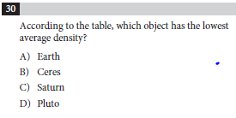
Determine Explicit Meaning
Notes:
Analysis in science: 88% correct

Slide 15
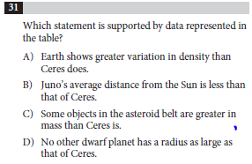
Determine Implicit Meaning
Notes:
Command of evidence/analysis in science: 54% (drawn to A: 27%)

Slide 16
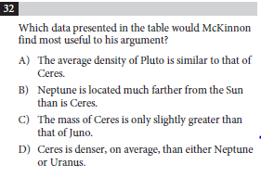
Analogical Reasoning
Notes:
Command of evidence/analysis in science: 45% (B: 14, C:11, D:29)

Slide 17
SAT ERW: ANALYSIS IN THE CONTENT AREA
NOT
aligned to content standards

Slide 18
How Does the Text Work?
Things you can do to determine whether students understand how the text works:
Students create an outline before reading – does the student understand the navigation and how to use text features?
Students write questions to be explored while reading by using the text features before reading to inspire curiosity and connect to prior learning.
Students create a visual representation of the information in the text. How do all the pieces fit together? Which visual representations are the students most comfortable with?

Slide 19
Middle School Science
Text
not
Textbooks
https://newsela.com/
http://www.dogonews.com/
http://tweentribune.com/
https://school.bighistoryproject.com/
https://student.societyforscience.org/sciencenews-students
http://teachkidsnews.com/
http://www.need.org/curriculum
19
Notes:
19

Slide 20
Breakout 5 minutes
What are you thinking and feeling about what you have learned thus far?

Slide 21
Reading Strategies in Practice
Our sample text:
Harvard Medical School: “Becoming a vegetarian”
On your text, write a five-word summary of the article.
Waterfall:
What do you estimate to be the reading level of this text?
Notes:
https://docs.google.com/document/d/1FineE1J5_xrEZT-wJJxwEdKO7071SNiAN4c0q6c_wfs/copy

Slide 22
Reading Strategies in Practice
Our sample text:
Harvard Medical School: “Becoming a vegetarian”
5-word summary protocol
Discussion:
Highlight elements of the text that may challenge students.
What is one strategy you would typically do to prepare students to engage with a text like this?
Breakout 10 – 15 minutes
Notes:
https://docs.google.com/document/d/1FineE1J5_xrEZT-wJJxwEdKO7071SNiAN4c0q6c_wfs/copy

Slide 23
Strategies for Multilingual Learners*
Integrate the WIDA English Language Development Standards into your daily instructional practice.
Focus on vocabulary.
Leverage background knowledge.
Approach reading as a social process.
*formerly referred to as English learners

Slide 24
WIDA English Language Development Standards
Language for Language Arts: Grades 9-12
Key Language Use | Interpretive | Expressive
Inform | MLs will interpret informational texts in language arts by: Identifying or summarizing central ideas Analyzing descriptions and inferences in textual evidence for key attributes, qualities, characteristics, activities, and conceptual relationships Evaluating cumulative impact and refinement of author’s key word choices over the course of text | MLs will construct informational texts in language arts that: Introduce and define topic and/or entity for audience Establish an objective or neutral stance Add precision, details, and clarity about complex attributes, qualities, characteristics, activities, and conceptual relationships Develop coherence and cohesion throughout text
Notes:
Emphasize interpretive vs expressive and the inclusivity involved – comprehension precedes production
Interpretive language expectations: Align with the three text questions (say, work, and mean)
These are the standards that come into play when reading, viewing, or listening to expository sources in language arts. Identify the primary language expectation that students need to work with and focus instruction on supporting students in meeting that language expectation. The depth/complexity at which students will engage with each language expectation depends on their level of English proficiency.

Slide 25
Strategy 1: Integrate WIDA ELD Standards
Maine Learning Results for ELA
R.5 Provide an accurate summary of various texts; determine the central idea(s) or theme(s) and analyze its development throughout each text.
WIDA ELD Standards
ELD-LA.9-12.Inform.Interpretive
Multilingual learners will interpret informational texts in language arts by identifying and/or summarizing central ideas.
WIDA ELD Standards Manual
Notes:
https://wida.wisc.edu/teach/standards/eld/2020

Slide 26
Strategy 2: Focus on vocabulary.
Harvard Medical School: “Becoming a vegetarian”
Working backwards:
Identify the central idea of the text. What question does the text seek to answer and what answer does it assert?
Determine which words are essential to students as they attempt to understand the central idea. Note 1-2 sentences where the central idea is captured most clearly.
Among those essential words, which ones are likely to be new/unfamiliar to students? (And how do you know?)
Notes:
Have teachers do this in pairs or triads with the sample text.
https://docs.google.com/document/d/1FineE1J5_xrEZT-wJJxwEdKO7071SNiAN4c0q6c_wfs/copy
In session 4, we’ll talk more about what it means for a student to know a word and how to support vocabulary acquisition.

Slide 27
Strategy 3: Leverage background knowledge.
Before engaging in reading:
Find out what students already know about the topic.
Provide opportunities to share cultural perspectives. What are some dietary practices related to belief systems?
Draw linguistic comparisons/contrasts when possible.
Vegetarians live longer.
Where I grew up, a lot of people are vegetarian for religious reasons.
Notes:
Have pairs/triads discuss how they might do this in practice, using the sample text
Note that many cognates exist between English and romance languages in advanced/scientific vocabulary.
Do students’ languages have separate words for vegetarian and vegan? Do the words have connotations of what a person does/does not eat (such as dairy/eggs/chicken/fish)?

Slide 28
Strategy 4: Approach reading as a social process.
In its 2019 position statement on the Act of Reading, NCTE asserts:
“Reading is a sociocultural activity in which readers construct meaning from text through the lenses of culture and personal experience.”
Key practices:
Acknowledge and discuss the lenses we all bring to reading.
Structure learning opportunities in which students make meaning of texts together, deepening and enriching each other’s understanding.
Leverage students’ motivation to learn for a genuine social purpose.

Slide 29
Accountable Talk
Productive talk moves will help each learner clarify their understanding and build on each other’s ideas.
Accountable talk must include:
Explicit logic
Evidence-based responses
Precise word choice
Acknowledgement of the socio-cultural lens
Accountable talk structures measurable outcomes

Slide 31
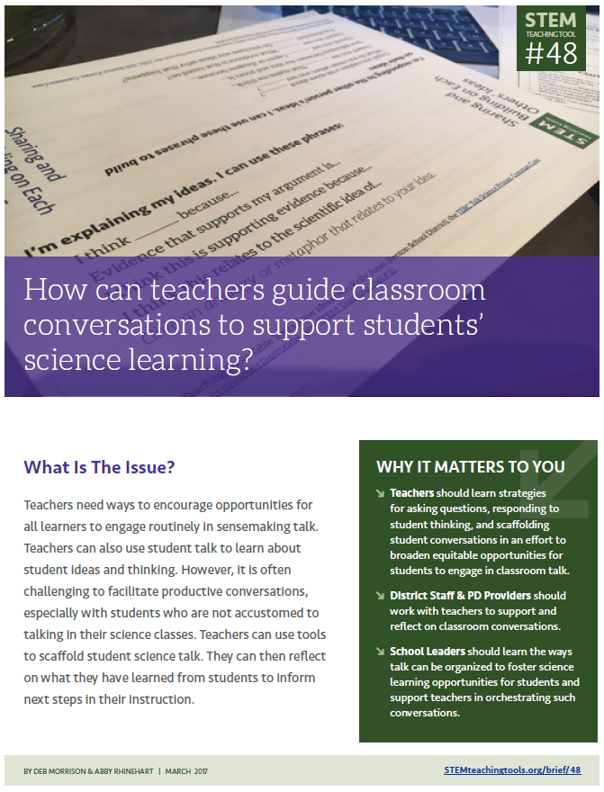
STEM Teaching Tool 48
Notes:
Shari
https://stemteachingtools.org/brief/48

Slide 32
“Center your instruction around the idea that the person doing the talking is the person doing the learning.”

Slide 33
Discussion Checklist
Goal One: Help Individual students share, expand and clarify their own thinking
Goal Two: Help Students listen carefully to one another
Goal Three: Help Students deepen their reasoning
Goal Four: Help Students think with others
Notes:
Shari
https://inquiryproject.terc.edu/prof_dev/Goals_and_Moves.cfm.html

Slide 34
Notes:
https://www.edutopia.org/video/encouraging-academic-conversations-talk-moves

Slide 35
Breakout groups
What does a student gain from moving from a social to a more professional/academic type of discussion?
How do Talk Moves help Multilingual Learners?
React to the following quote from the video:
“Everything about activating a child’s cognitive skills begins with activating their social connectedness. Verbalizing and using language and working with peers creates that kind of social stimulus that drives the development of the brain.”
Dr. Pamela Cantor

Slide 36
Looking Ahead to Next Session
Focus: Meeting the needs of every learner in any context
Who is a “struggling” reader?
What is the role of conceptual/background knowledge in literacy instruction?
What are some common misconceptions about vocabulary acquisition?
How can we differentiate for various kinds of learners?

Slide 37
Feedback for contact hours
We will trade feedback for your contact hours. Please complete this form and download the certificate you receive after.
Notes:
Feedback https://forms.office.com/g/uLWH2LfkW3

