Slide 1
Reading, Writing, Listening, & Speaking in Social Studies
Kristy A. Brugar, PhD
Associate Professor, Social Studies Education
University of Oklahoma

Slide 2
Introduction
Social studies is a multi-disciplinary subject area that benefits greatly from multimodal sources and experiences for students. Literacy – reading, writing, listening, and speaking - allow teachers and students to best engage in multimodal sources.
Question (respond in the chat): For what purpose(s) do you use literacy practices in social studies?

Slide 3
Literacy in Social Studies With a Purpose
engaging with sources
exploring new information
comprehension
pre-reading
demonstrating new knowledge
setting goals and a purpose for reading
activating prior knowledge
asking and generating questions
making predictions
re-reading
summarizing
making inferences

Slide 4
Beginning, Middle, End: Close reading and Organizing Time
You have been given 9 events associated with the American Revolution.
In your groups (and without other resources), organize the events in three groups:
Beginning (3 events)
Middle (3 events)
End (3 events)
Identify the words or phrases that helped you decide beginning, middle, or end.
Add identifiers (e.g., Sugar Act, Boston Massacre)
Go to another source (e.g., book, website) to identify the dates of these events.
Organize chronologically!

Slide 5
Writing – 4-Square Paragraph
Why the Great Molasses Flood Was So Deadly by EMILY SOHN
The Boston Globe/Getty Images
It was like a perfect—if bizarre, terrifying and very sticky—storm.
Around lunchtime on the afternoon of January 15, 1919, a giant tank of molasses burst open in Boston’s North End. More than two million gallons of thick liquid poured out like a tsunami wave, reaching speeds of up to 35 miles per hour. The molasses flooded streets, crushed buildings and trapped horses in an event that ultimately killed 21 people and injured 150 more. The smell of molasses lingered for decades.
One hundred years later, analyses have pinpointed a handful of factors that combined to make the disaster so disastrous. Among them: flawed steel, safety oversights, fluctuating air temperatures and the principles of fluid dynamics.
Results were devastating.
“First you kind of laugh at it, then you read about it, and it was just horrible,” says Mark Rossow, a civil engineer and professor emeritus at Southern Illinois University in Edwardsville, who has written about the molasses flood.
In the immediate aftermath, news coverage included speculation about fermentation that produced too much pressure inside the tank. Some blamed anarchists for setting off a bomb. “Explosion Theory Favored by Expert,” reported the Boston Evening Globe. The trial that ensued lasted for years and gathered input from thousands of expert witnesses, producing 20,000 pages of conflicting testimony.
Ultimately, U.S. Industrial Alcohol, the company that owned the tank, was found liable, even as many questions remained about what had actually happened.

Slide 6
1
2
Write down the three (3) most striking or most important things about your text.
Write 2-3 sentences for each item you chose in part one (1). Explain/Elaborate
3
4
Write a conclusion about the text and the three (3) items you chose in part one (1).
What do the three (3) items in part one (1) have in common?
Notes:
SUMMARIZE

Slide 7
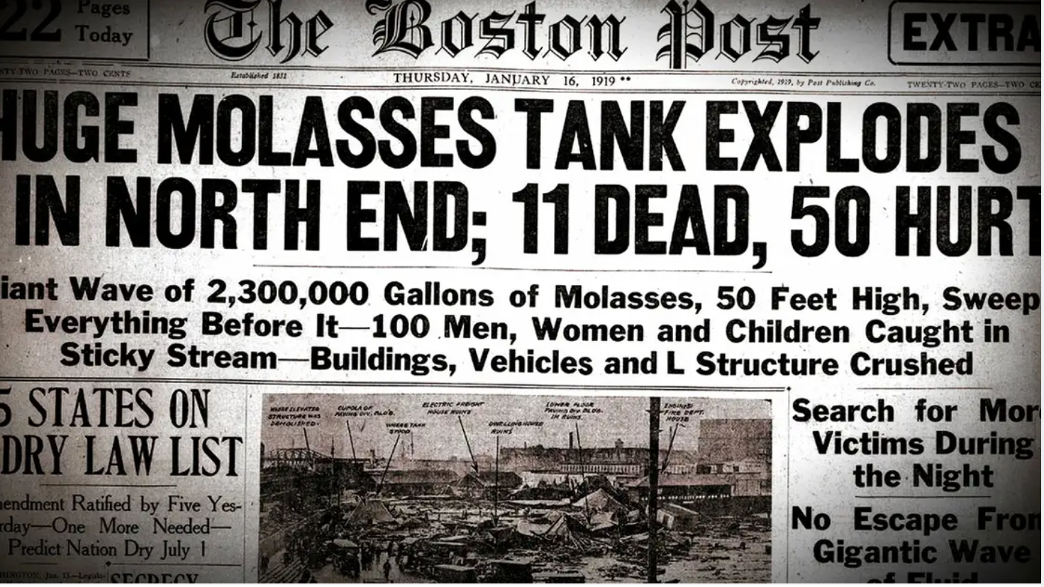
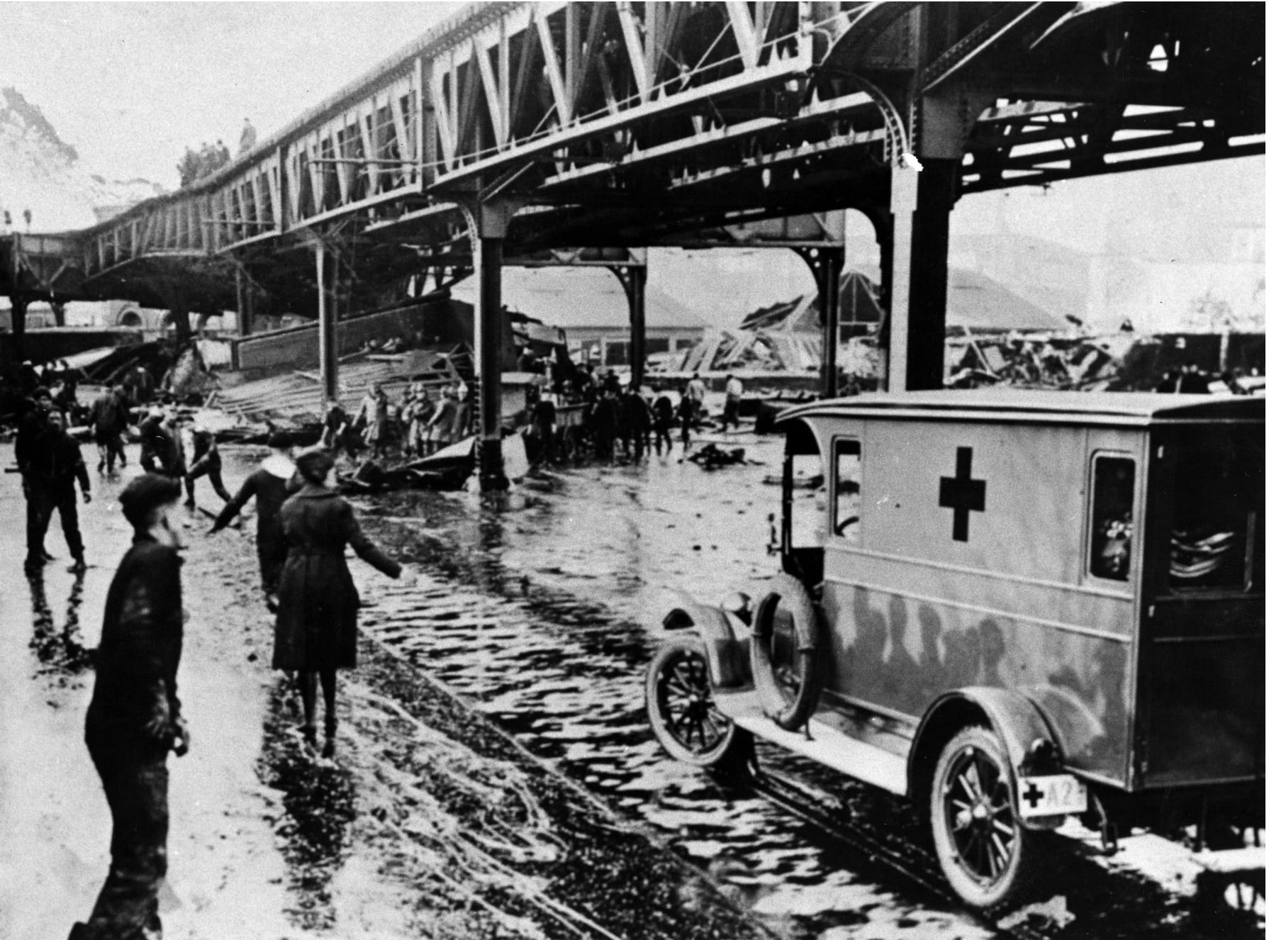
Putting it Together
Part 4 becomes the first sentence in a paragraph about the text – it is the “thesis” of the paragraph.
Part 2 becomes the three development points – sentences 2-4
Part 3 becomes the conclusion – sentence 5
EXAMPLE
Over the last 100 years, historians are learning more about the Great Molasses Flood of 1919. (PART 4) In 1919, a molasses tank exploded in Boston. The explosion and the aftermath caused injury to 150 people and killed 21 others. There were several hypothesis about the cause of the explosion. (PART 2) Historians and scientists have worked together to understand more about this event. (PART 3)

Slide 8
Judging a Book by the Cover (speaking & listening)
In order to activate prior knowledge, anticipate content for the lesson, or reflect son information presented students respond to a prompt or “quick write” about an image.
Feel
Think
Know

Slide 9
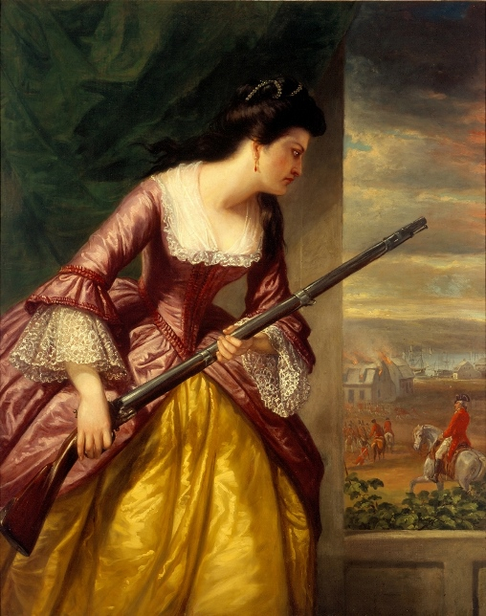
Judging a Book by the Cover
Feel – How do you feel as you look at this painting?
Think - What do you think as you look at this painting ?
Know – What do you know about this painting (i.e., people, events, etc.)? What would you like to know about this painting?
Notes:
Daniel Huntington (1816-1906), Abigail Hinman
According to the Lyman Allyn Museum: Hinman was an American patriot and New London native who is best remembered for her decision to remain at her home while the British burned the city in September of 1781. Her husband, Captain Elisha Hinman, was away at sea when New London was attacked by British commander and New Haven traitor, Benedict Arnold. As recounted by Abigail to her chldren and grandchildren, she stood by her window watching the British when she identified Arnold and seized a musket to take aim. Upon pulling the trigger, she found the gun was not loaded.

Slide 10
Questions
Feel free to contact me:
Kristy Brugar
kristy.a.brugar@ou.edu

